Slide 1
AIO Tools
Presented
by
Tushar Jaryal Aadarsh Sharma Amit Kumar Verma
2210987036 2210987001 2210987004
Under the Supervision
of
Dr. Rajwinder Kaur
Dr. Rupinder Singh
Department of Computer Applications
Chitkara University, Punjab

Slide 2
Problem statement and objectives of the project
Problem Statement:
The increasing burden on small and medium scale vendors for investing a large amount of sum
for keeping track of sales and employees. Sometimes even using Files method to track everything
or keeping multiple software for any specific amount.

Slide 3
Functionality
^{Store –}
^{1. Sells different goods.}
2. Tracks Products available and their popularity
Customer - 1. Buys Goods and products available
^{2. Register for benefits}
^{Functions..}
1 – Transaction of the customer would be recorded in the Database with following details
2 – Store Manager can keep a track of the daily sales and increase in customers.
3 – He can also look at the performance of the employees
4 – He can keep track of the employees attendance
5 – He can keep track of the products.
^{Finance -}
1. Keeping a record of admins on the dashboard
2. Keeping a record of performance of employees
^{Store Manager -}
^{1.Monitors sales of store.}
2. Tracking of popular items and products
3. Tracking of geographical locations of orders
^{USERS}
^{Name}
^{Email}
^{City}
^{State}
^{Country}
^{Occupation}
^{Phone Number}

Slide 4
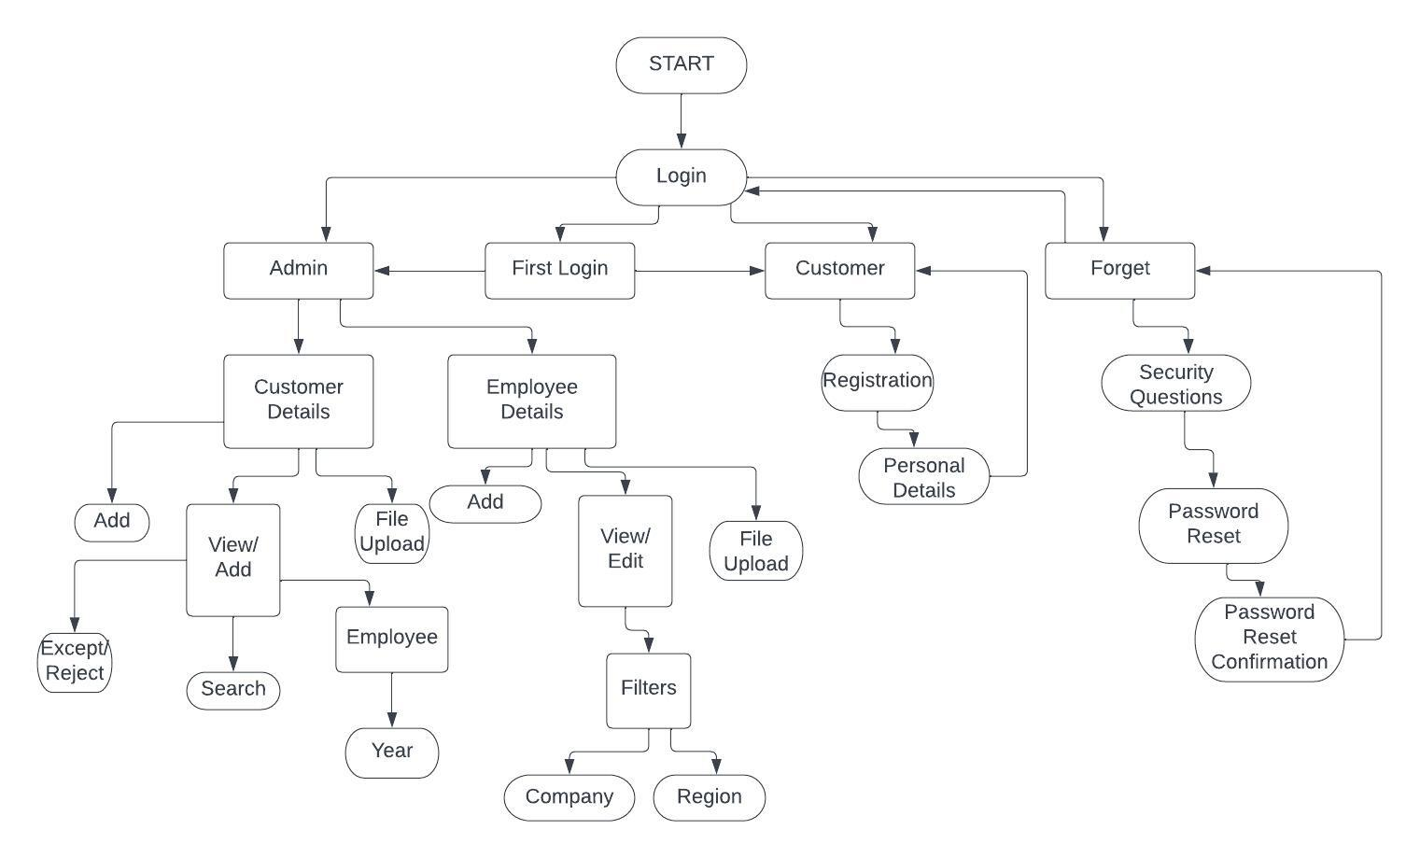
Architecture

Slide 5
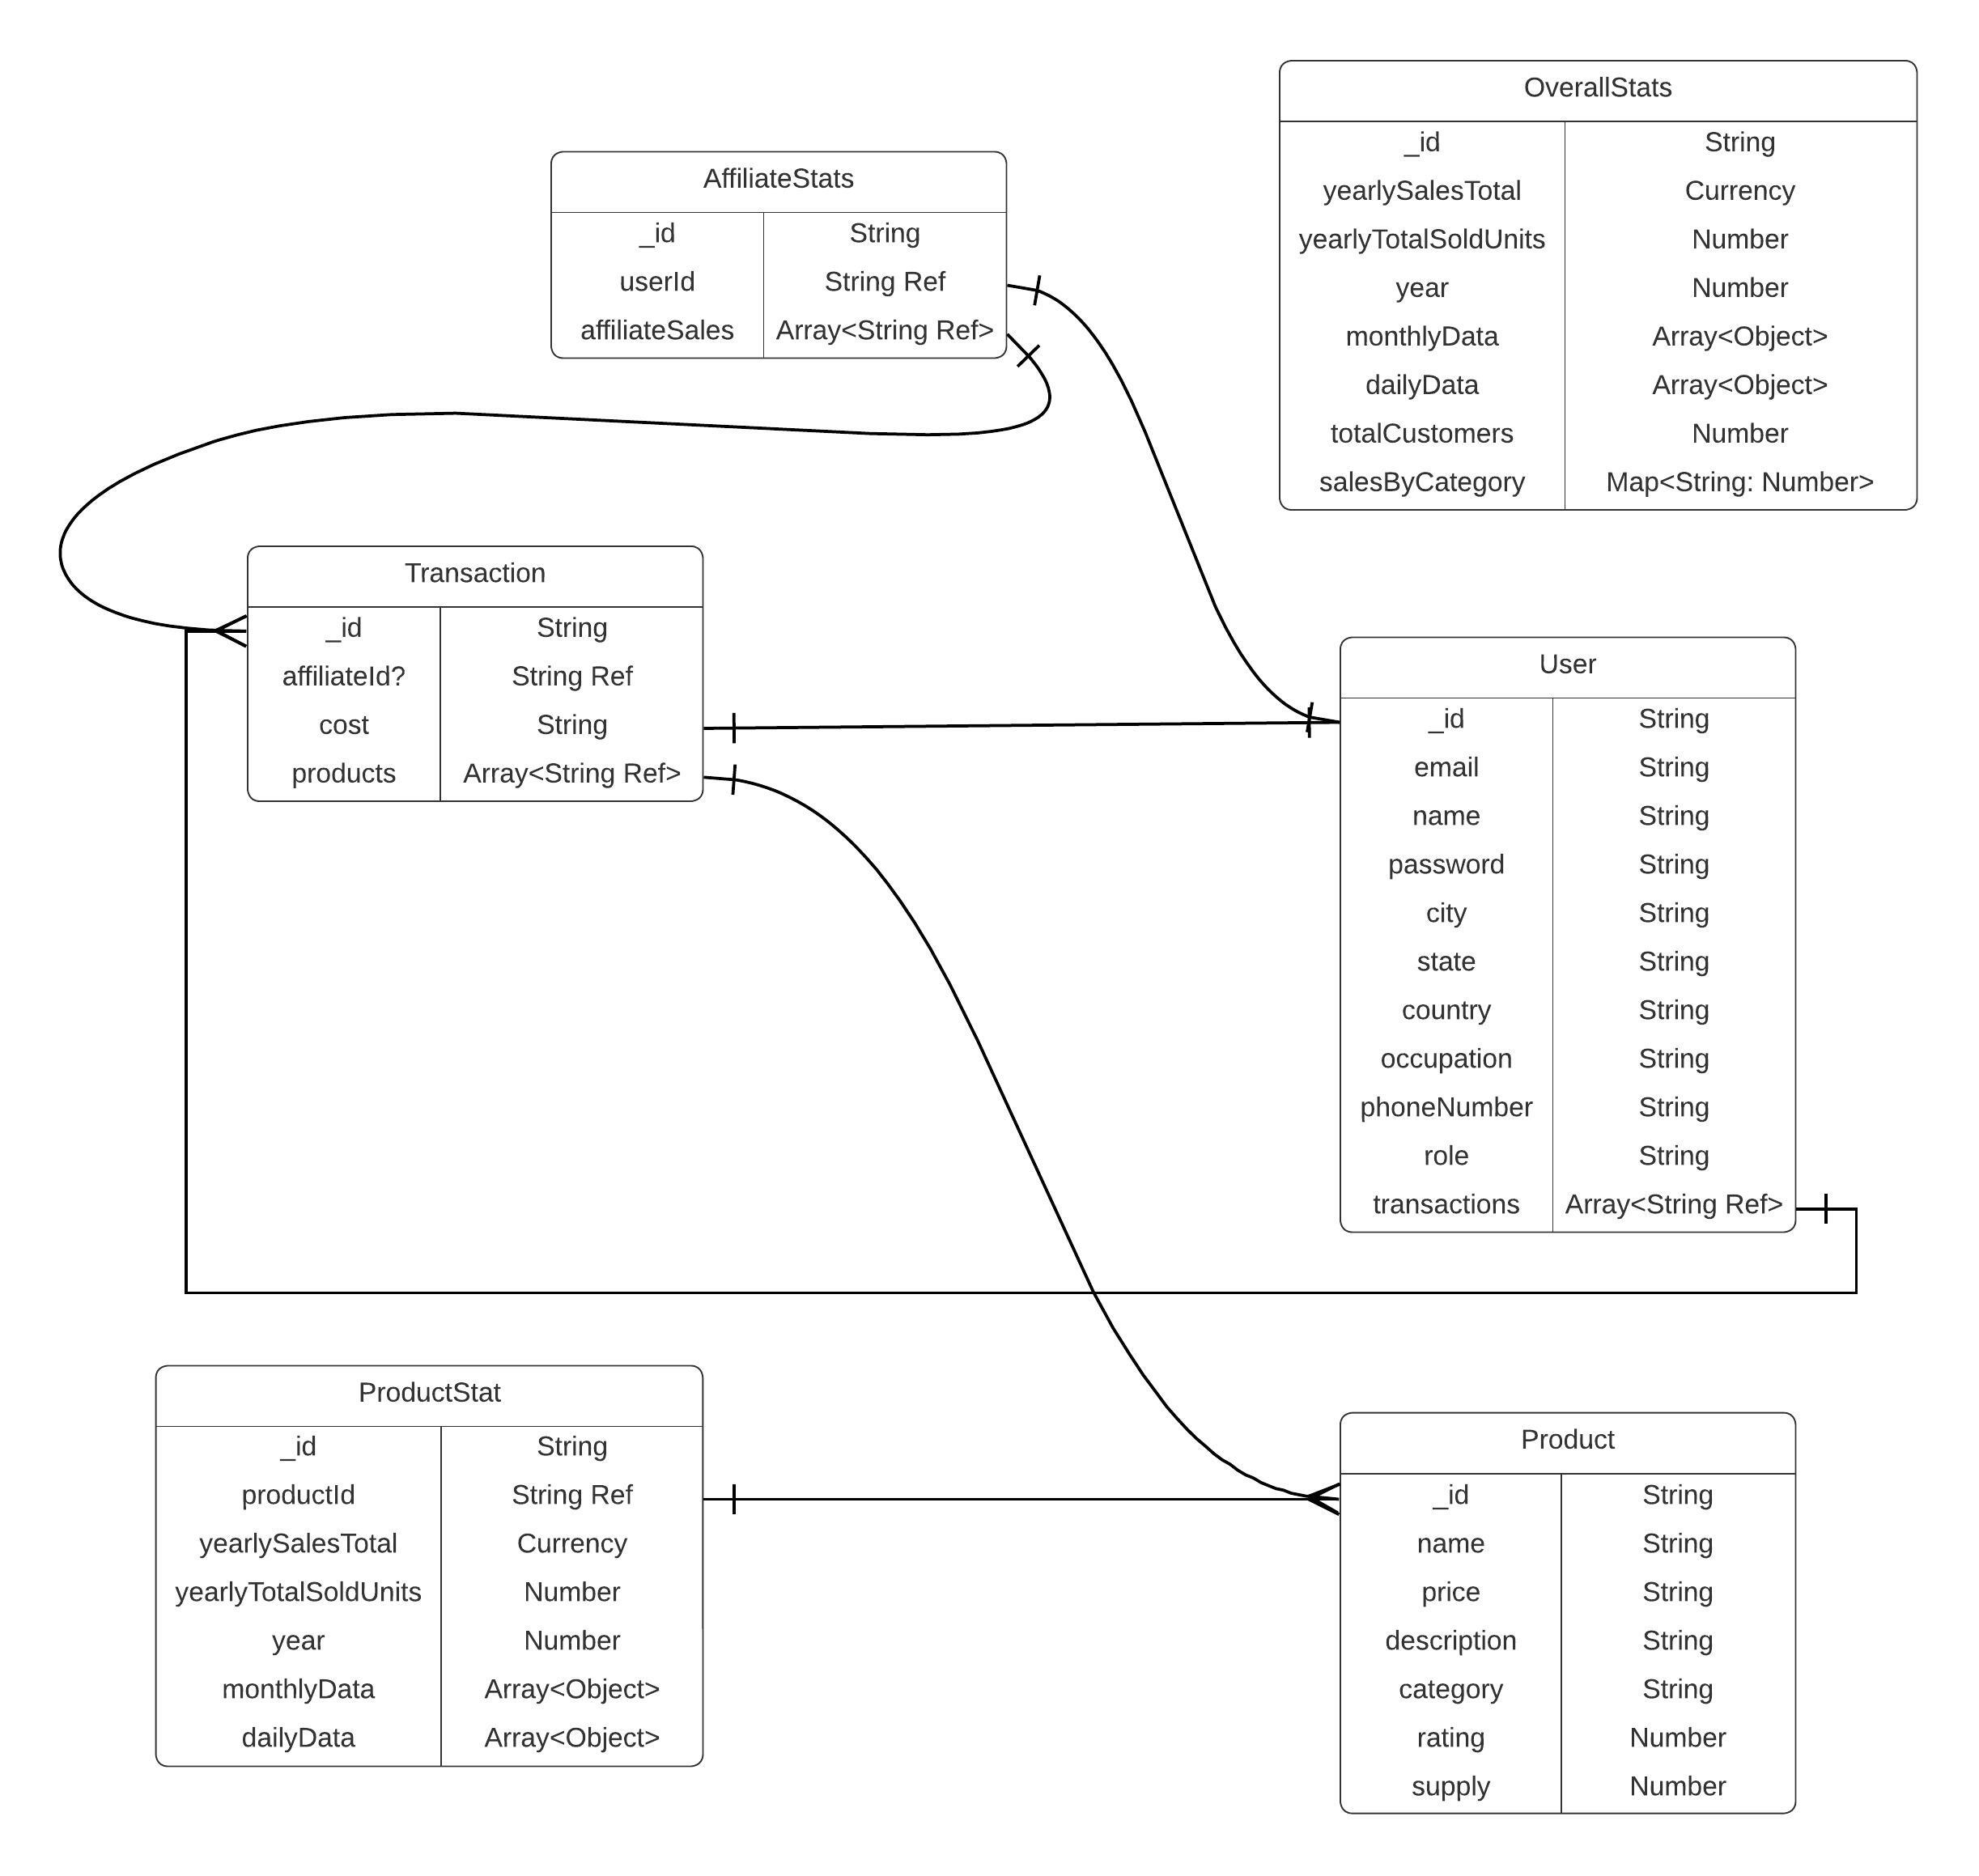
Database design

Slide 6
Roll of each team member (in case of more than one member)
Tushar Jaryal (2210987036) - Implementation of Dashboard and connection with the backend server and database.
2. Aadarsh Sharma (2210987001) - Implementation of certain Dashboard elements and functions.
3. Amit Kumar Verma (2210987004) - Database creation and implementation of queries and connection with the database.

Slide 7
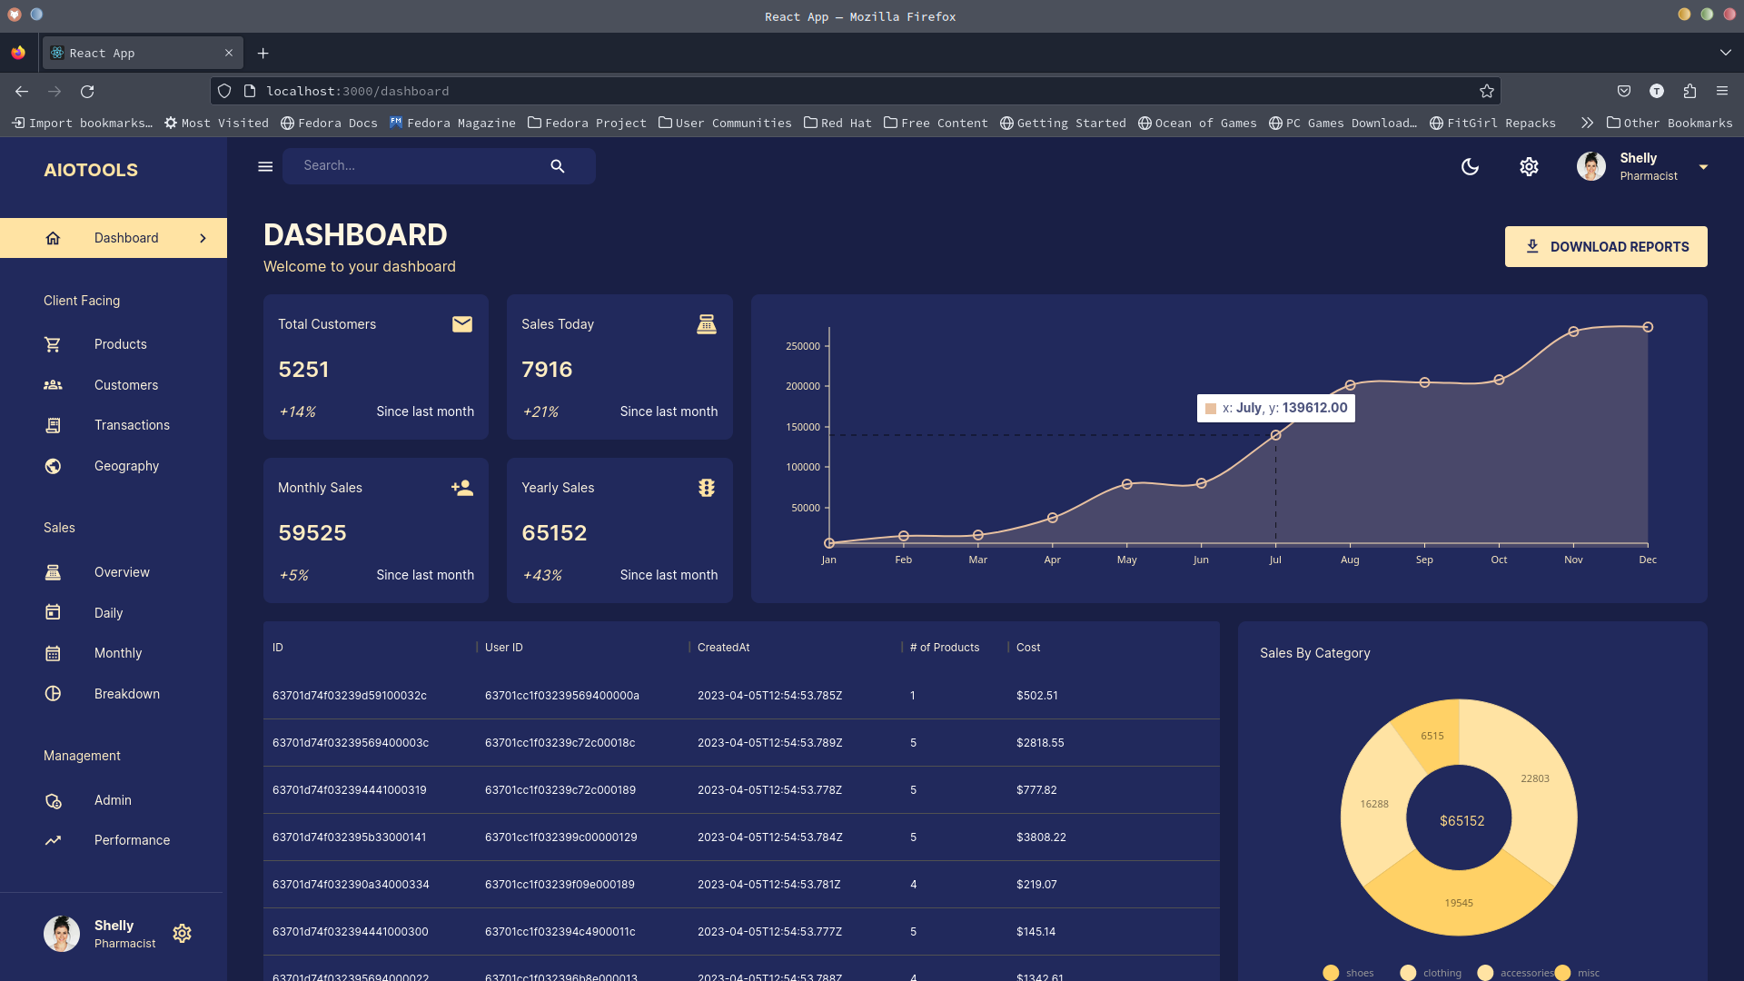
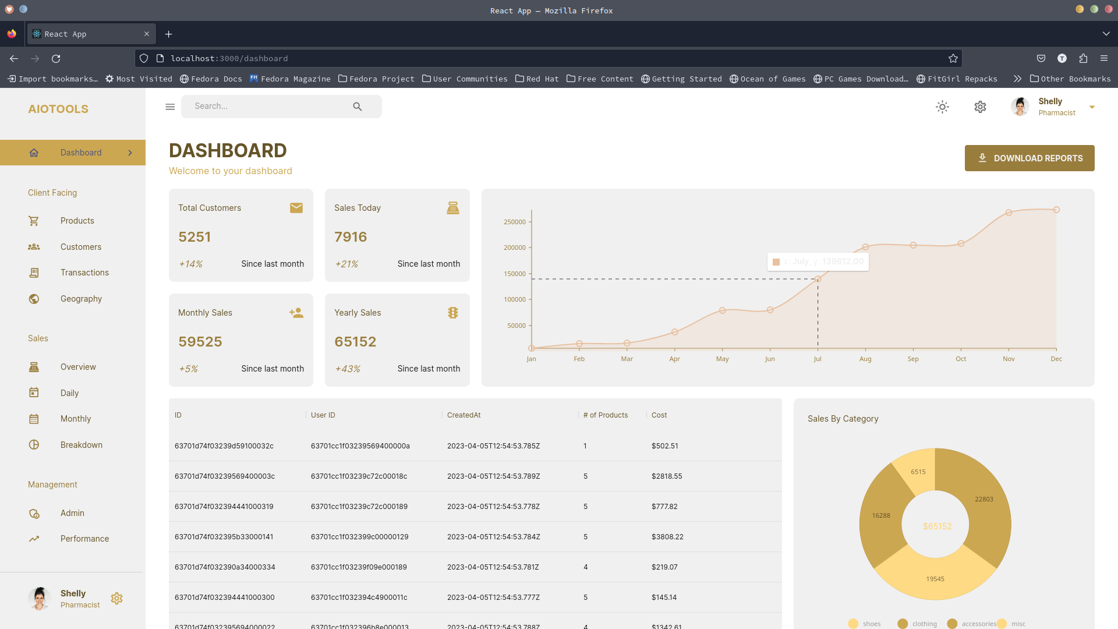
Execution of the project
Screen shots

Slide 8
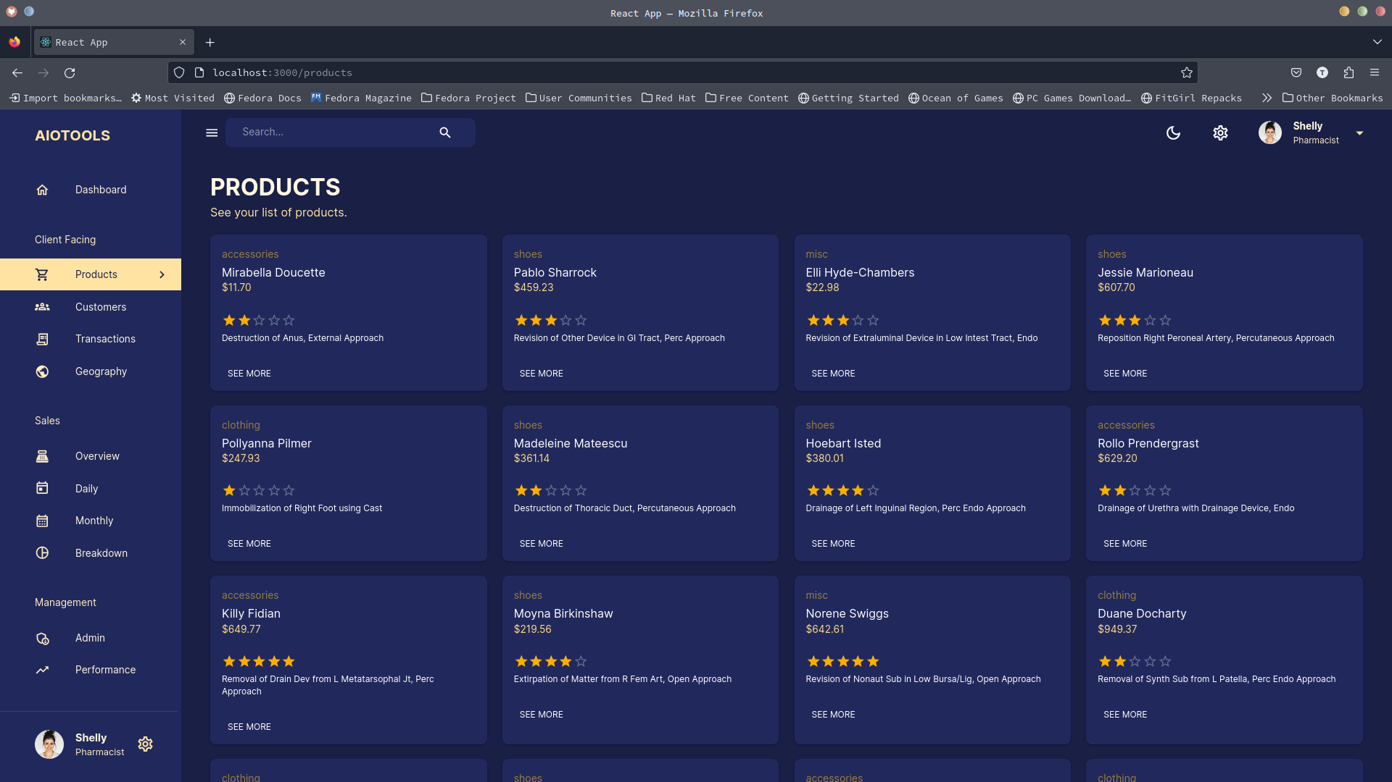
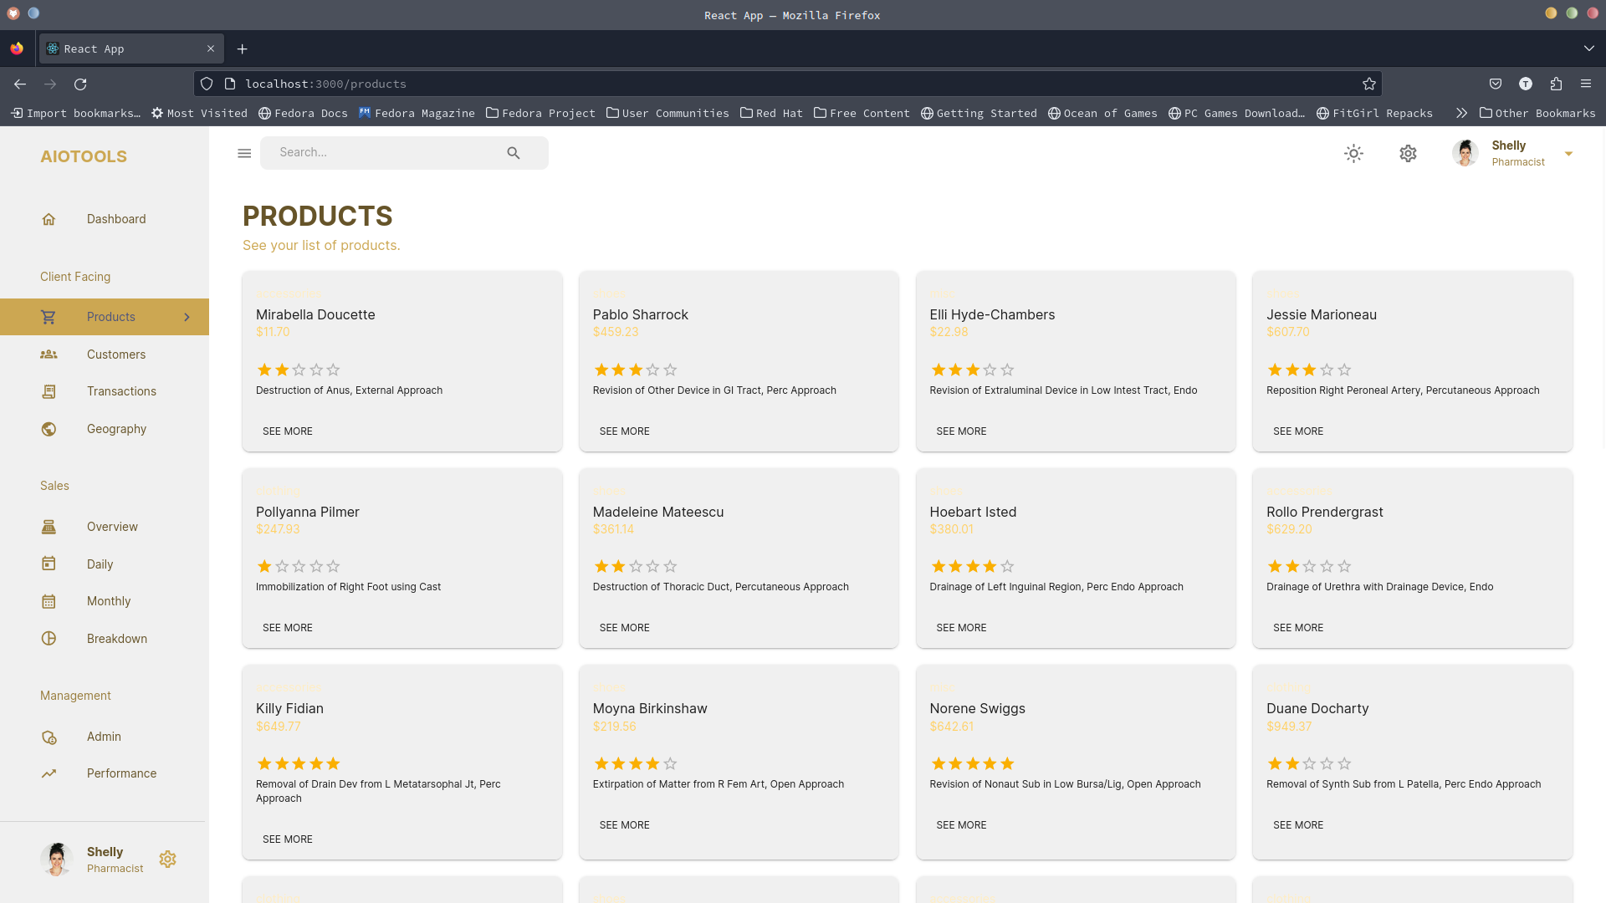
Execution of the project
Screen shots

Slide 9
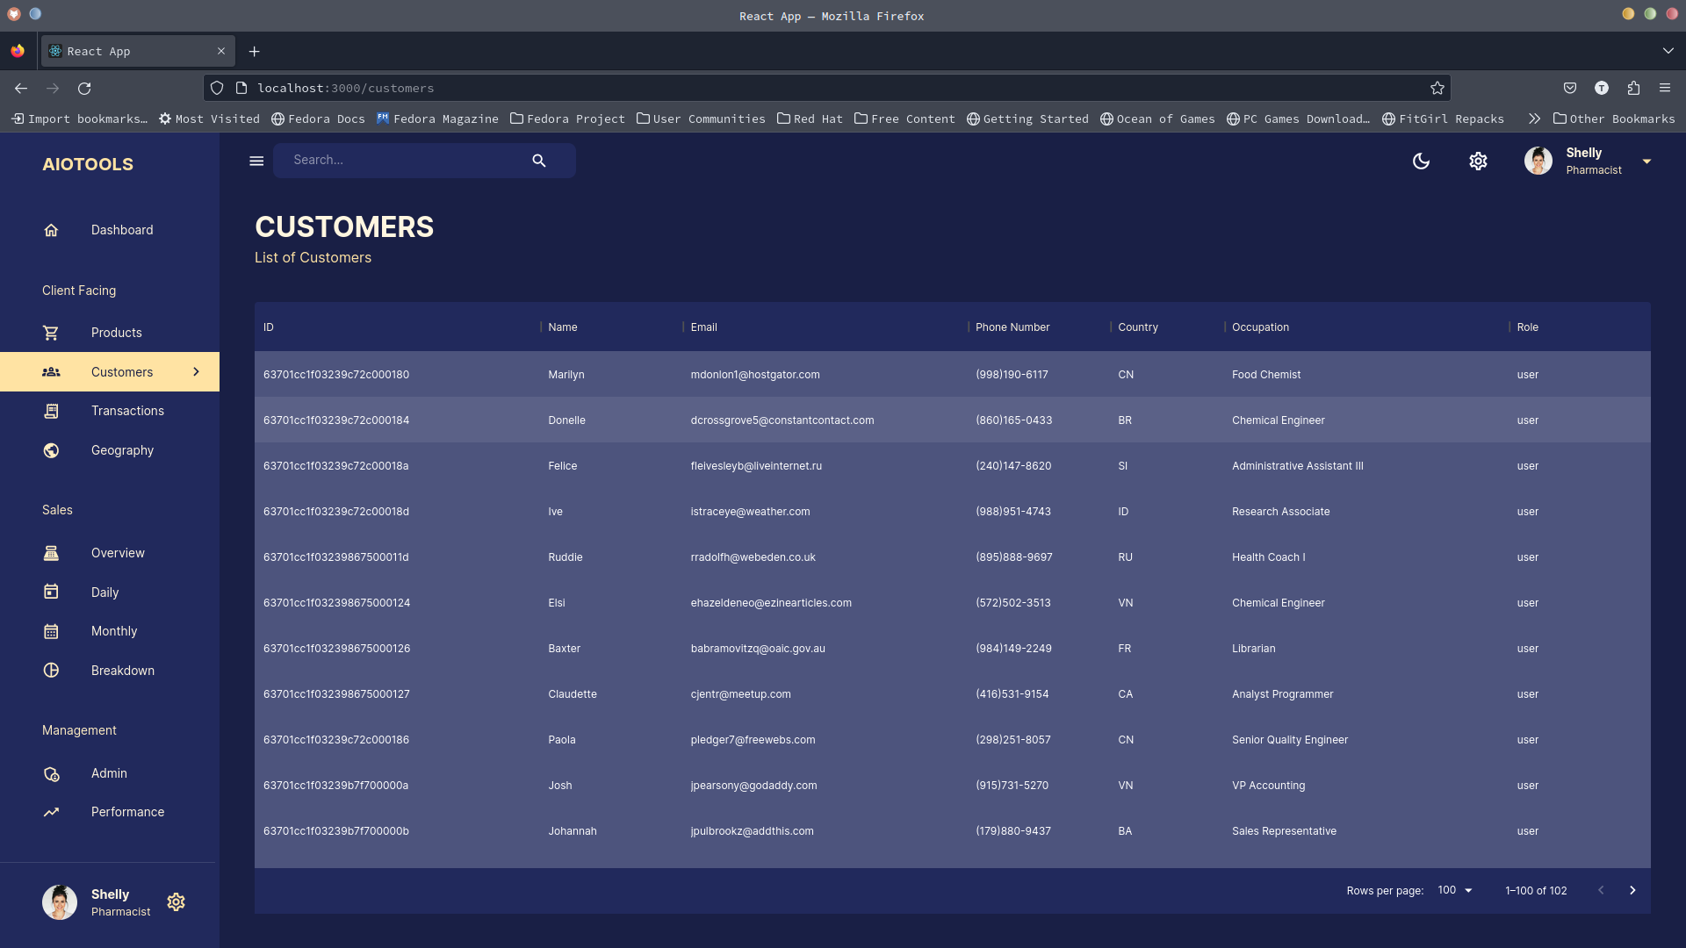
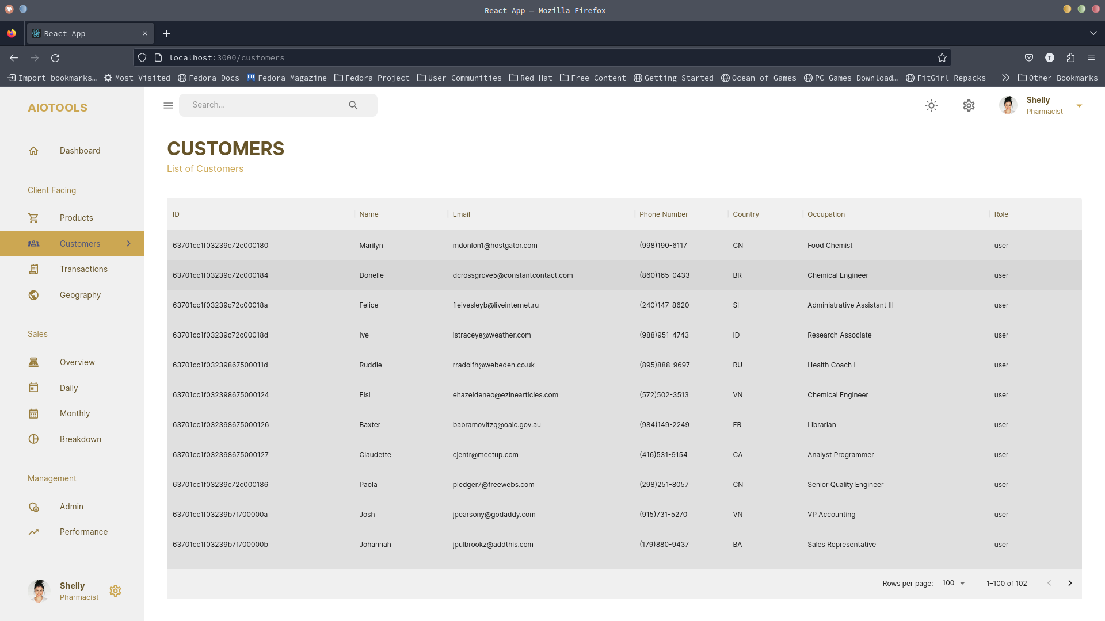
Execution of the project
Screen shots

Slide 10
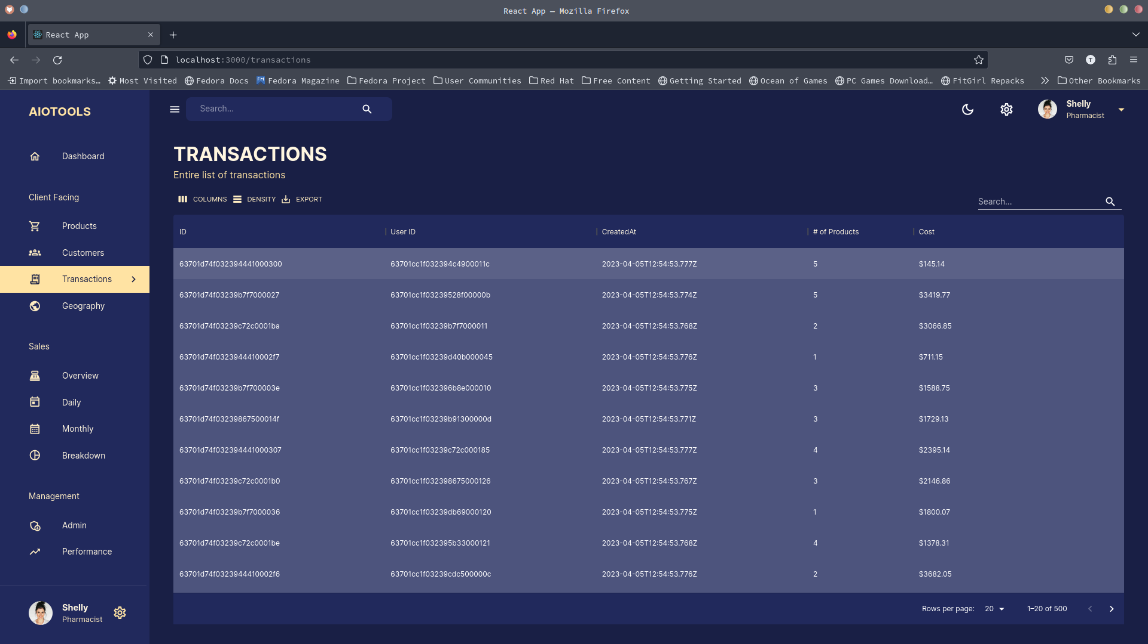
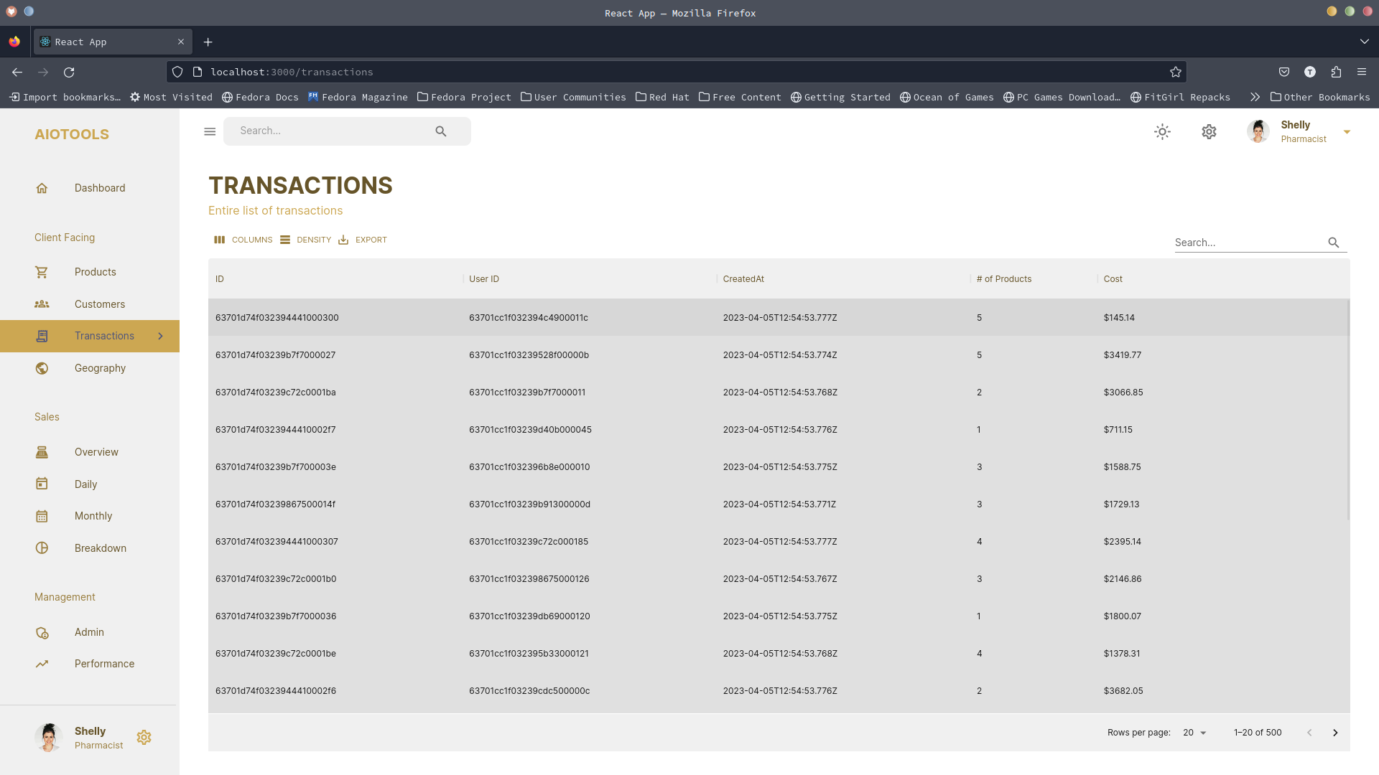
Execution of the project
Screen shots

Slide 11
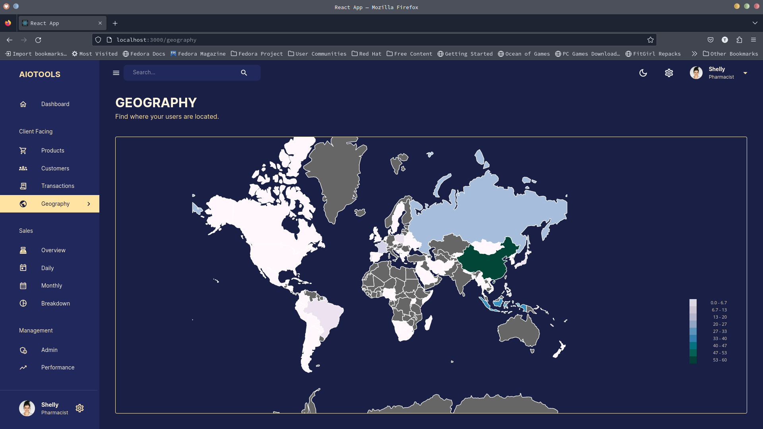
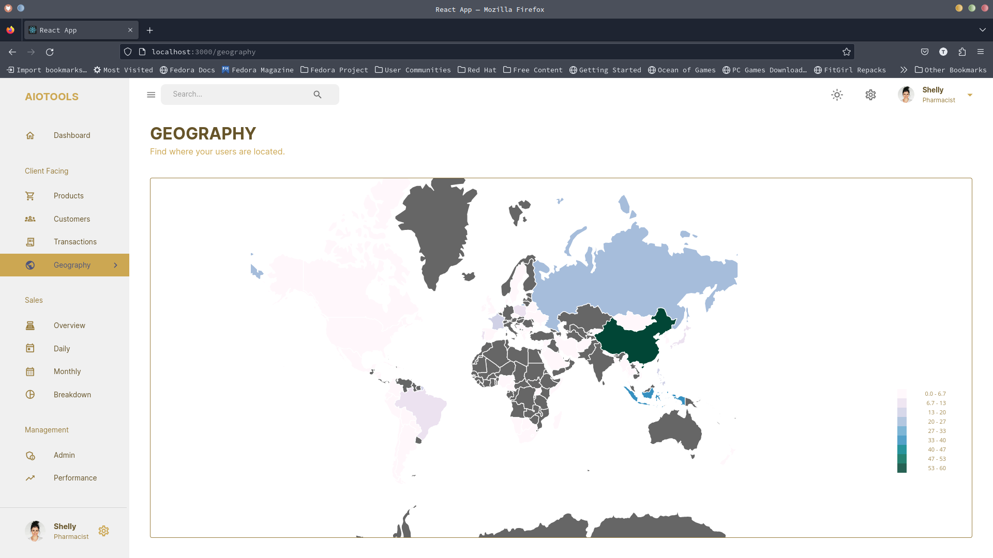
Execution of the project
Screen shots

Slide 12
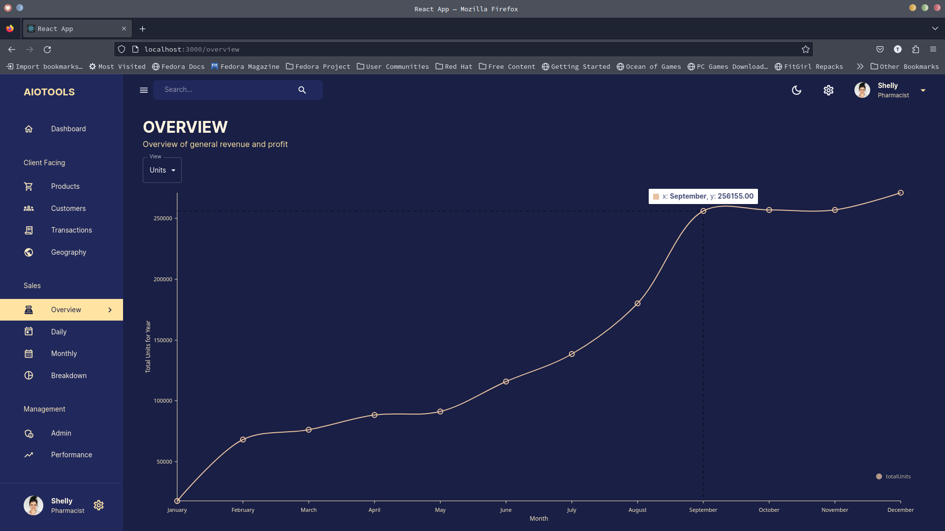
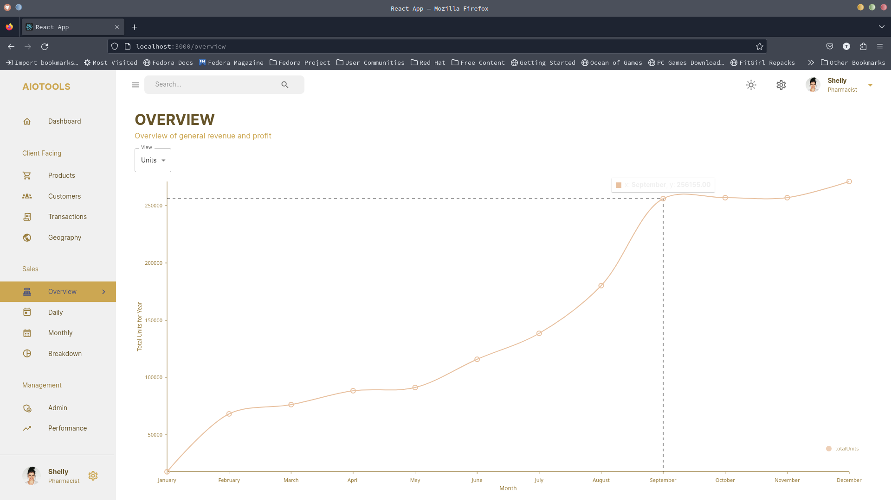
Execution of the project
Screen shots

Slide 13
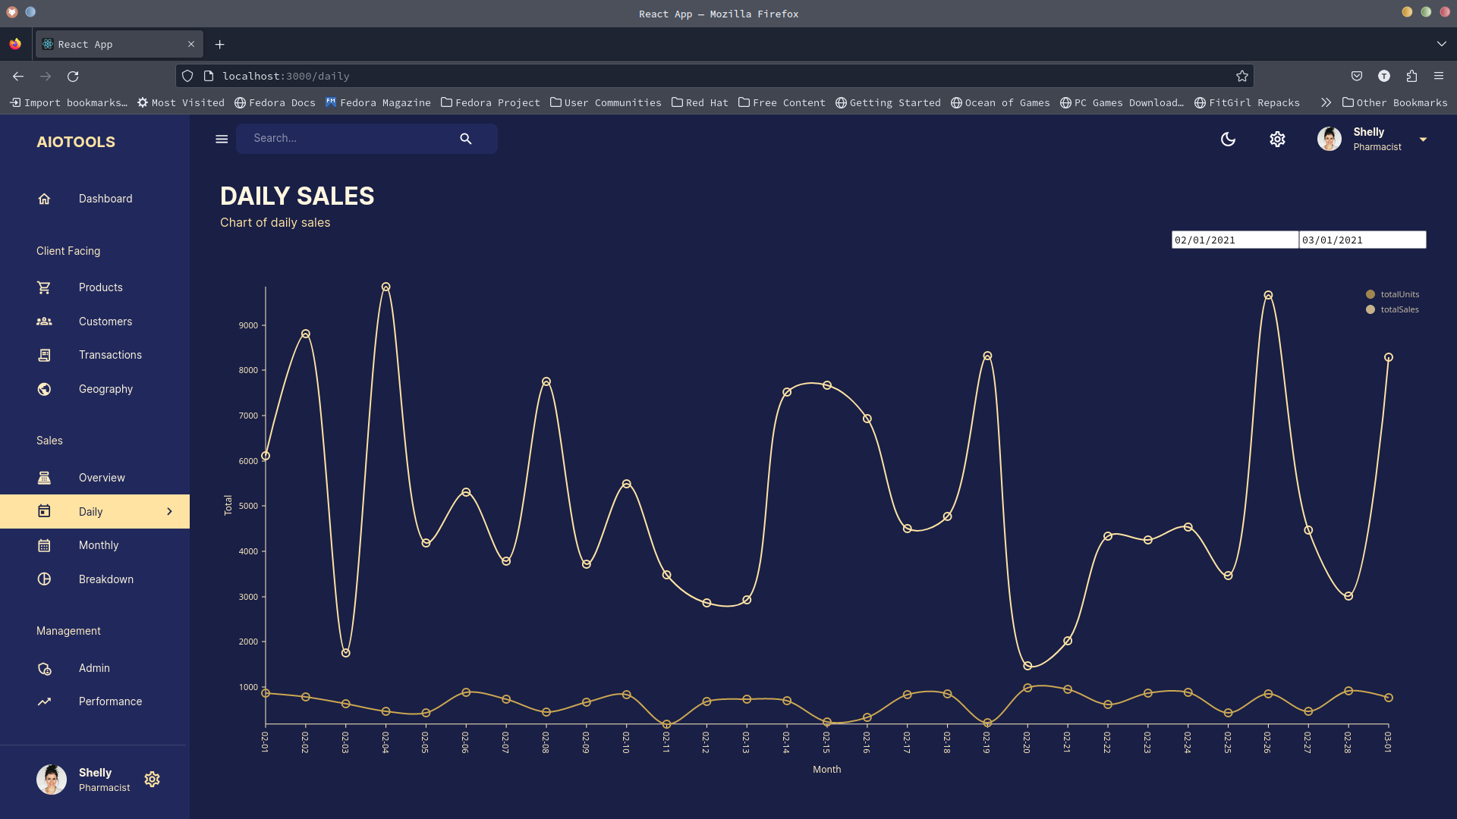
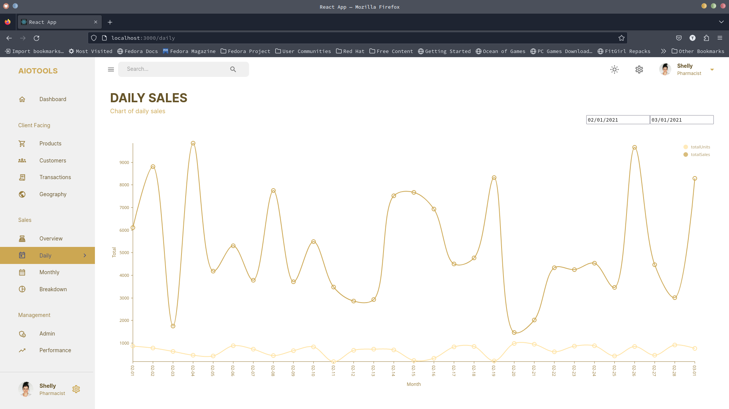
Execution of the project
Screen shots

Slide 14
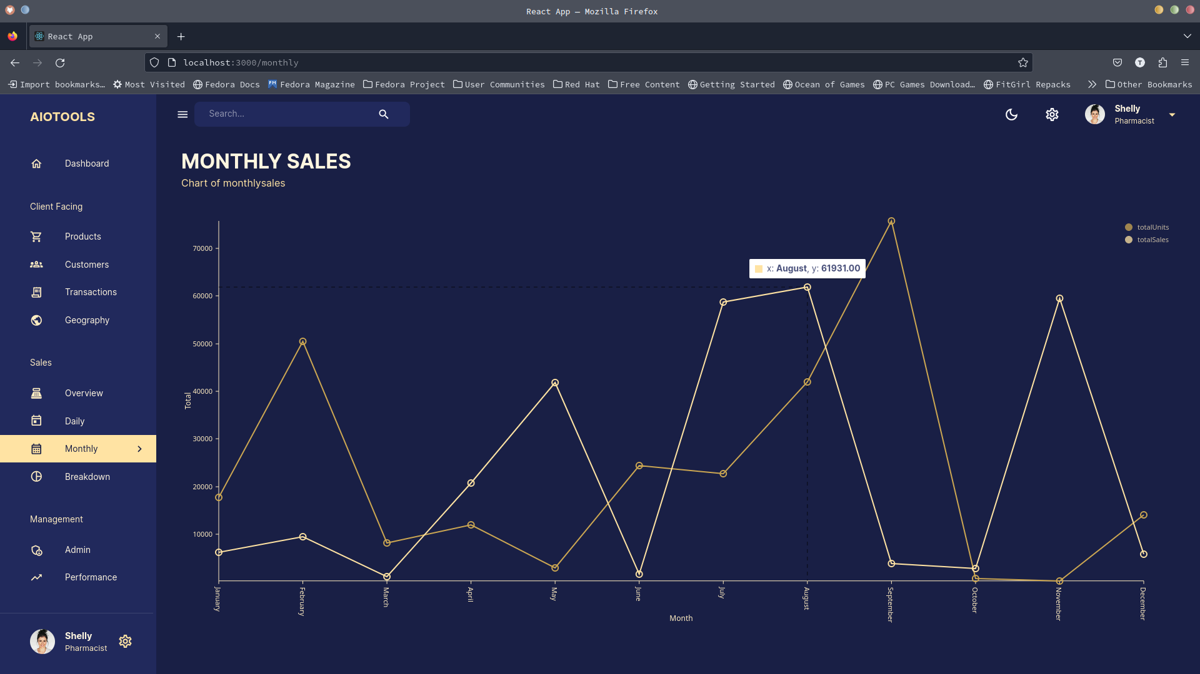
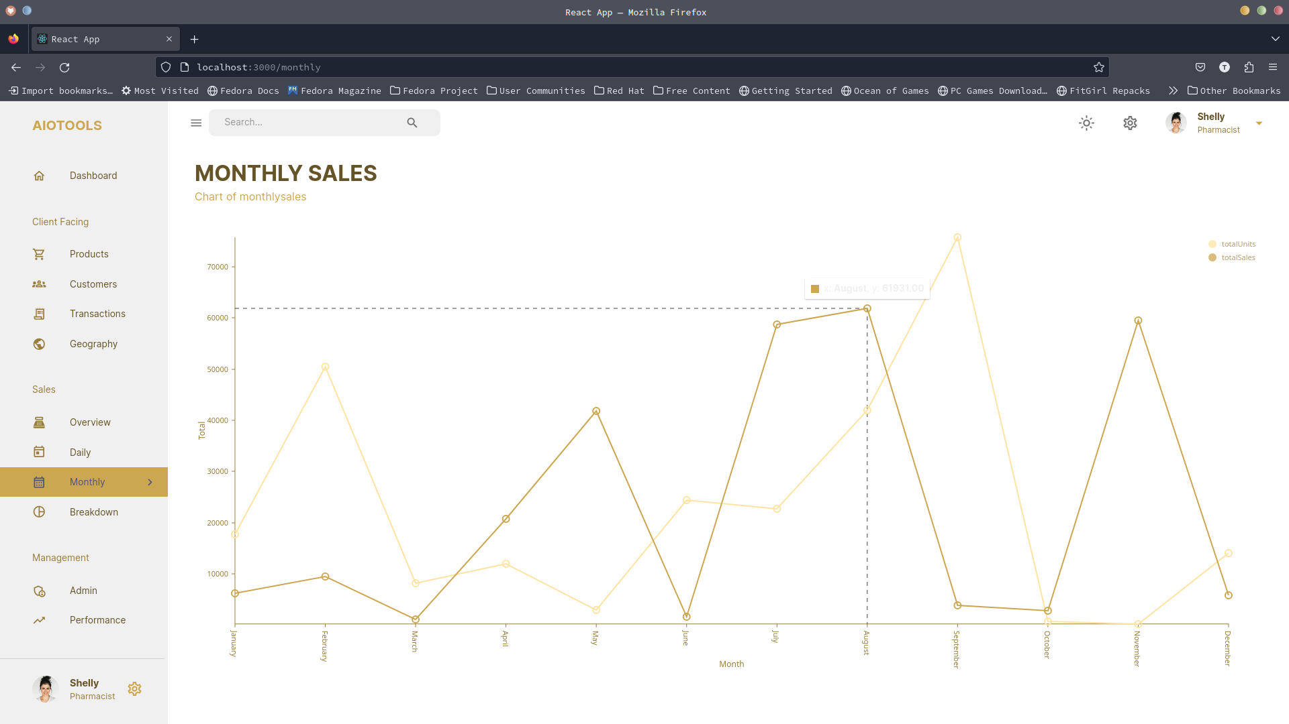
Execution of the project
Screen shots

Slide 15
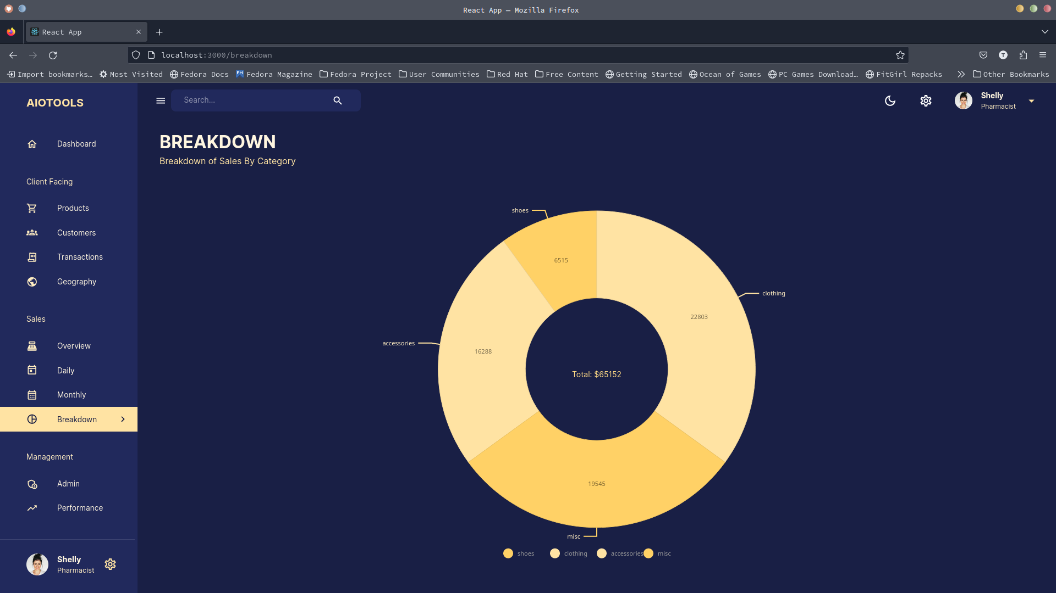
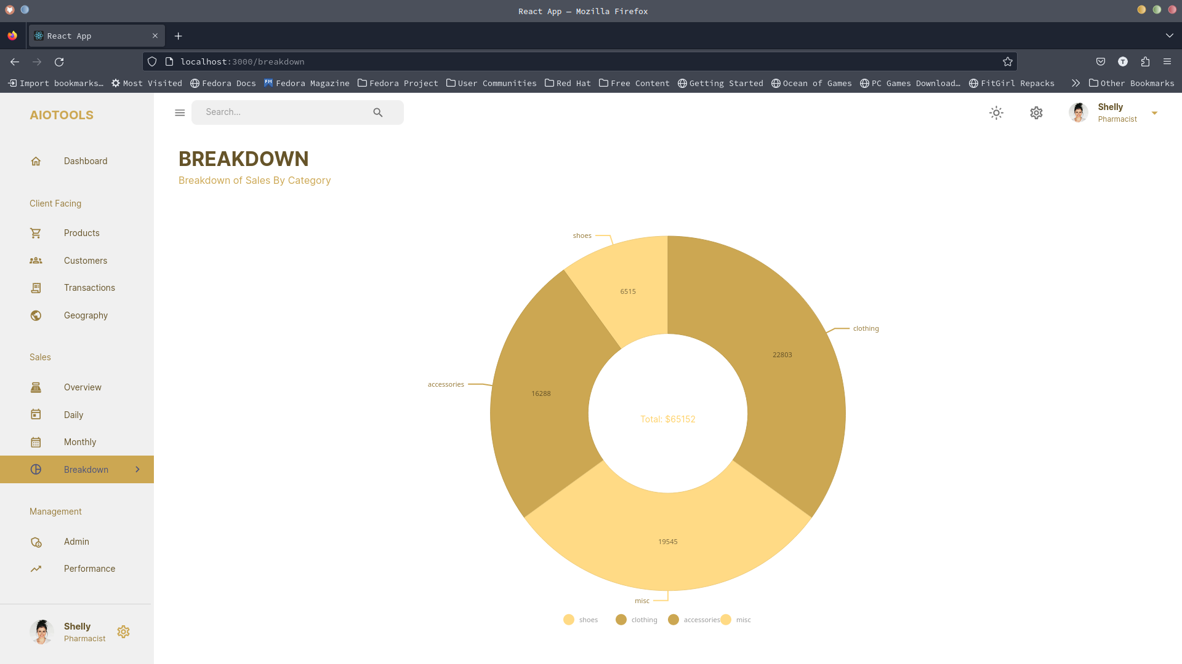
Execution of the project
Screen shots

Slide 16
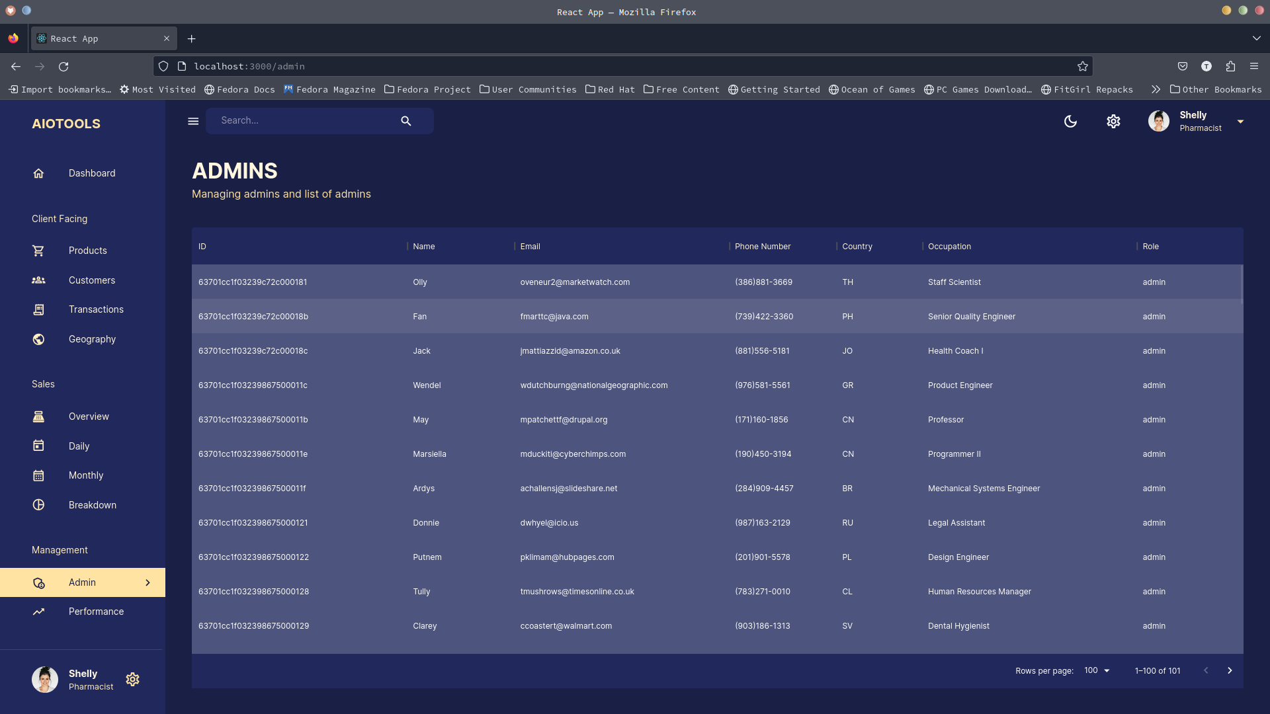
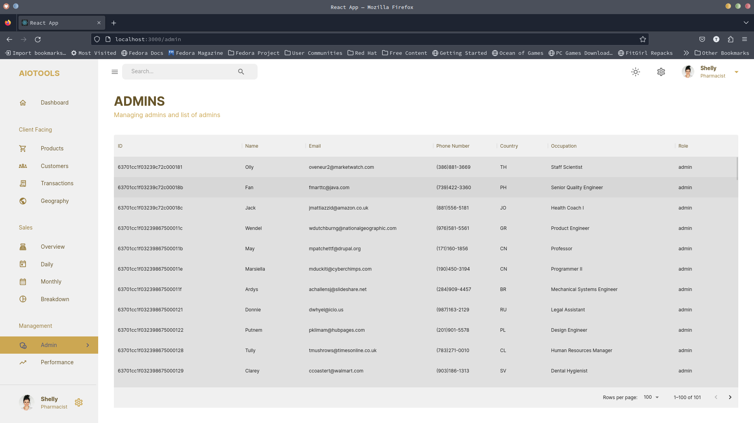
Execution of the project
Screen shots

Slide 17
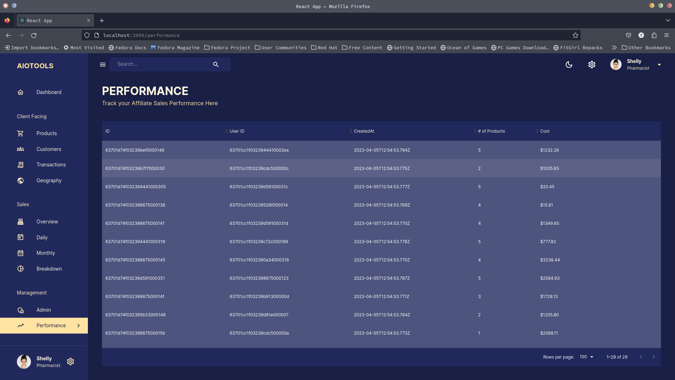
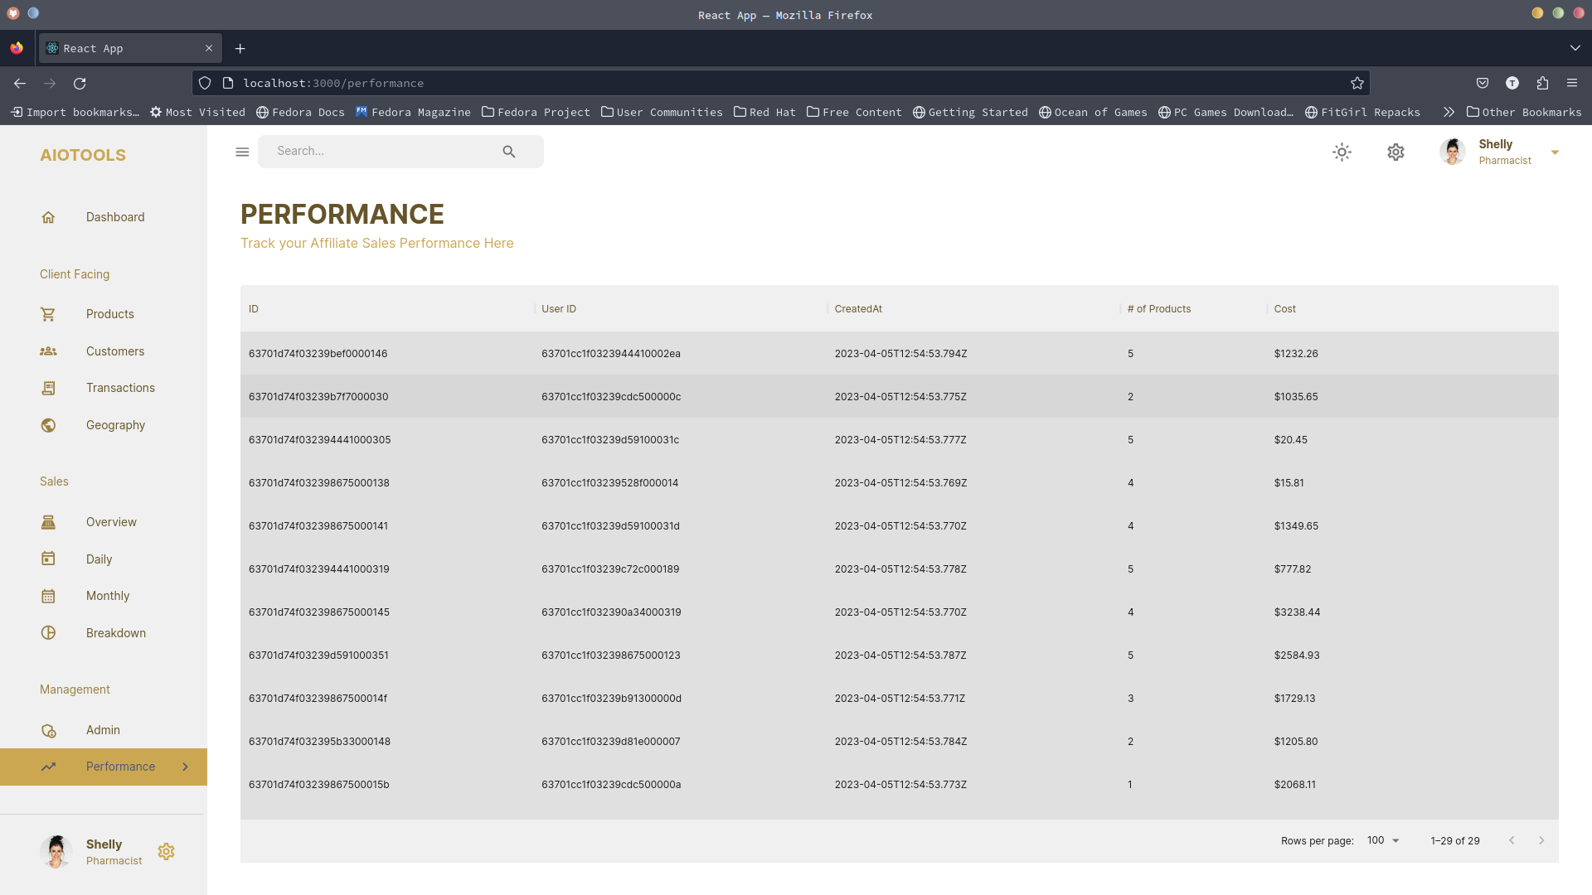
Execution of the project
Screen shots

