Slide 1
AIO Tools Presented
by Tushar Jaryal
2210987036
Aadarsh Sharma Amit Kumar Verma
2210987001 2210987004
Under the Supervision of Dr. Rajwinder Kaur
Dr. Rupinder Singh
Department of Computer Applications
Chitkara University, Punjab

Slide 2
Problem statement and objectives of the project
Problem Statement:
The increasing burden on small and medium scale vendors for investing a large amount of sum
for keeping track of sales and employees. Sometimes even using Files method to track everything
or keeping multiple software for any specific amount.

Slide 3
Functionality
Store – 1. Sells different goods.
2. Tracks Products available and their popularity
Customer - 1. Buys Goods and products available
^{2. Register for benefits}
Store Manager -1.Monitors sales of store.
2. Tracking of popular items and products
3. Tracking of geographical locations of orders
Finance - 1. Keeping a record of admins on the dashboard
2. Keeping a record of performance of employees
^{Functions..}
1 – Transaction of the customer would be recorded in the Database with following details
^{Name}
^{Delivery Address}
^{Product}
^{Phone no.}
^{Email id}
2 – Store Manager can keep a track of the daily sales and increase in customers.
3 – He can also look at the performance of the employees
4 – He can keep track of the employees attendance
5 – He can keep track of the products.

Slide 4
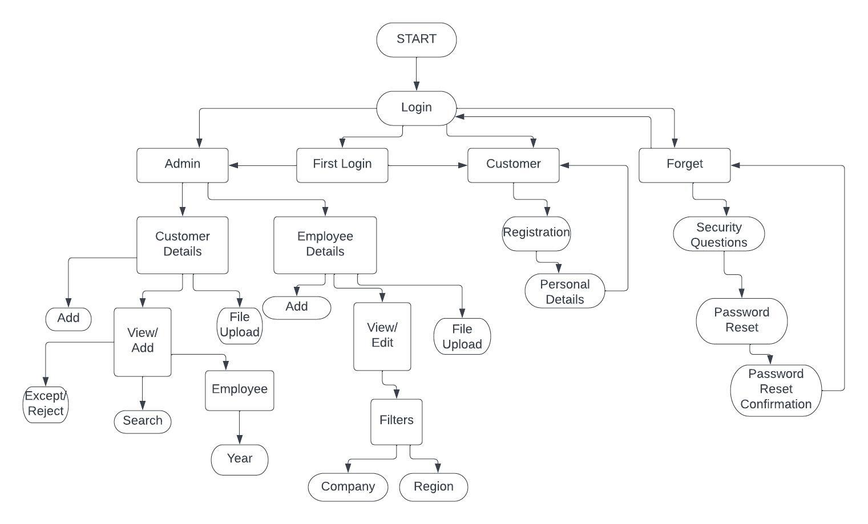
Architecture

Slide 5
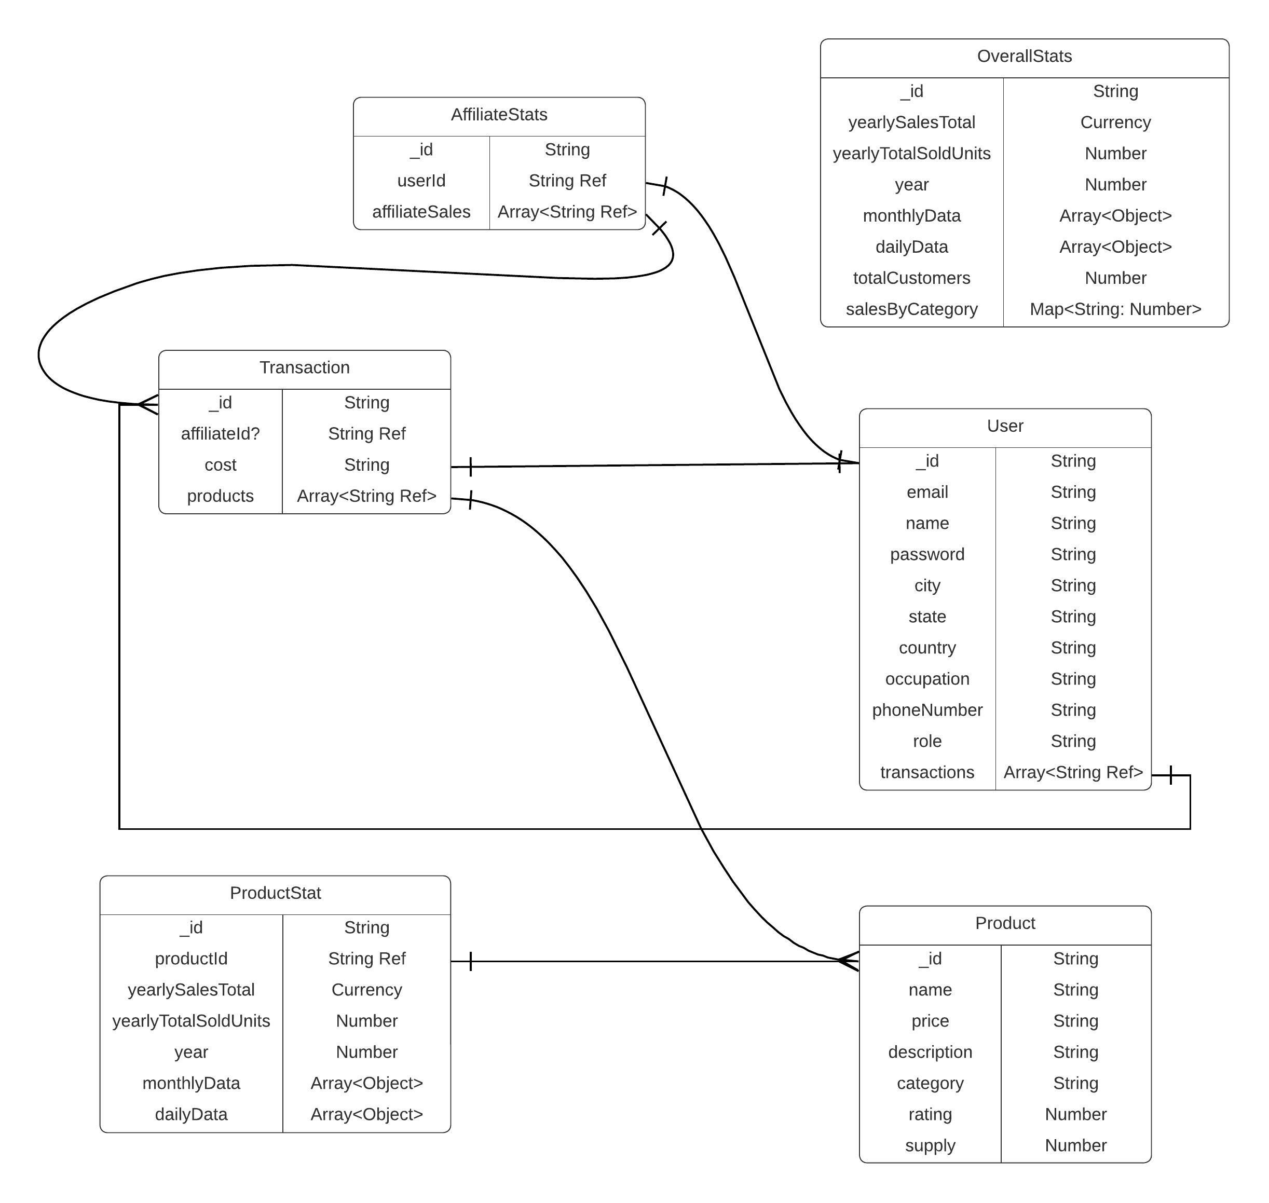
Database design

Slide 6
Roll of each team member (in case of more than one member)
Tushar Jaryal (2210987036) - Implementation of Dashboard and connection
with the backend server and database.
2. Aadarsh Sharma (2210987001) - Implementation of certain Dashboard elements and functions.
3. Amit Kumar Verma (2210987004) - Database creation and implementation of queries and
connection with the database.

Slide 7
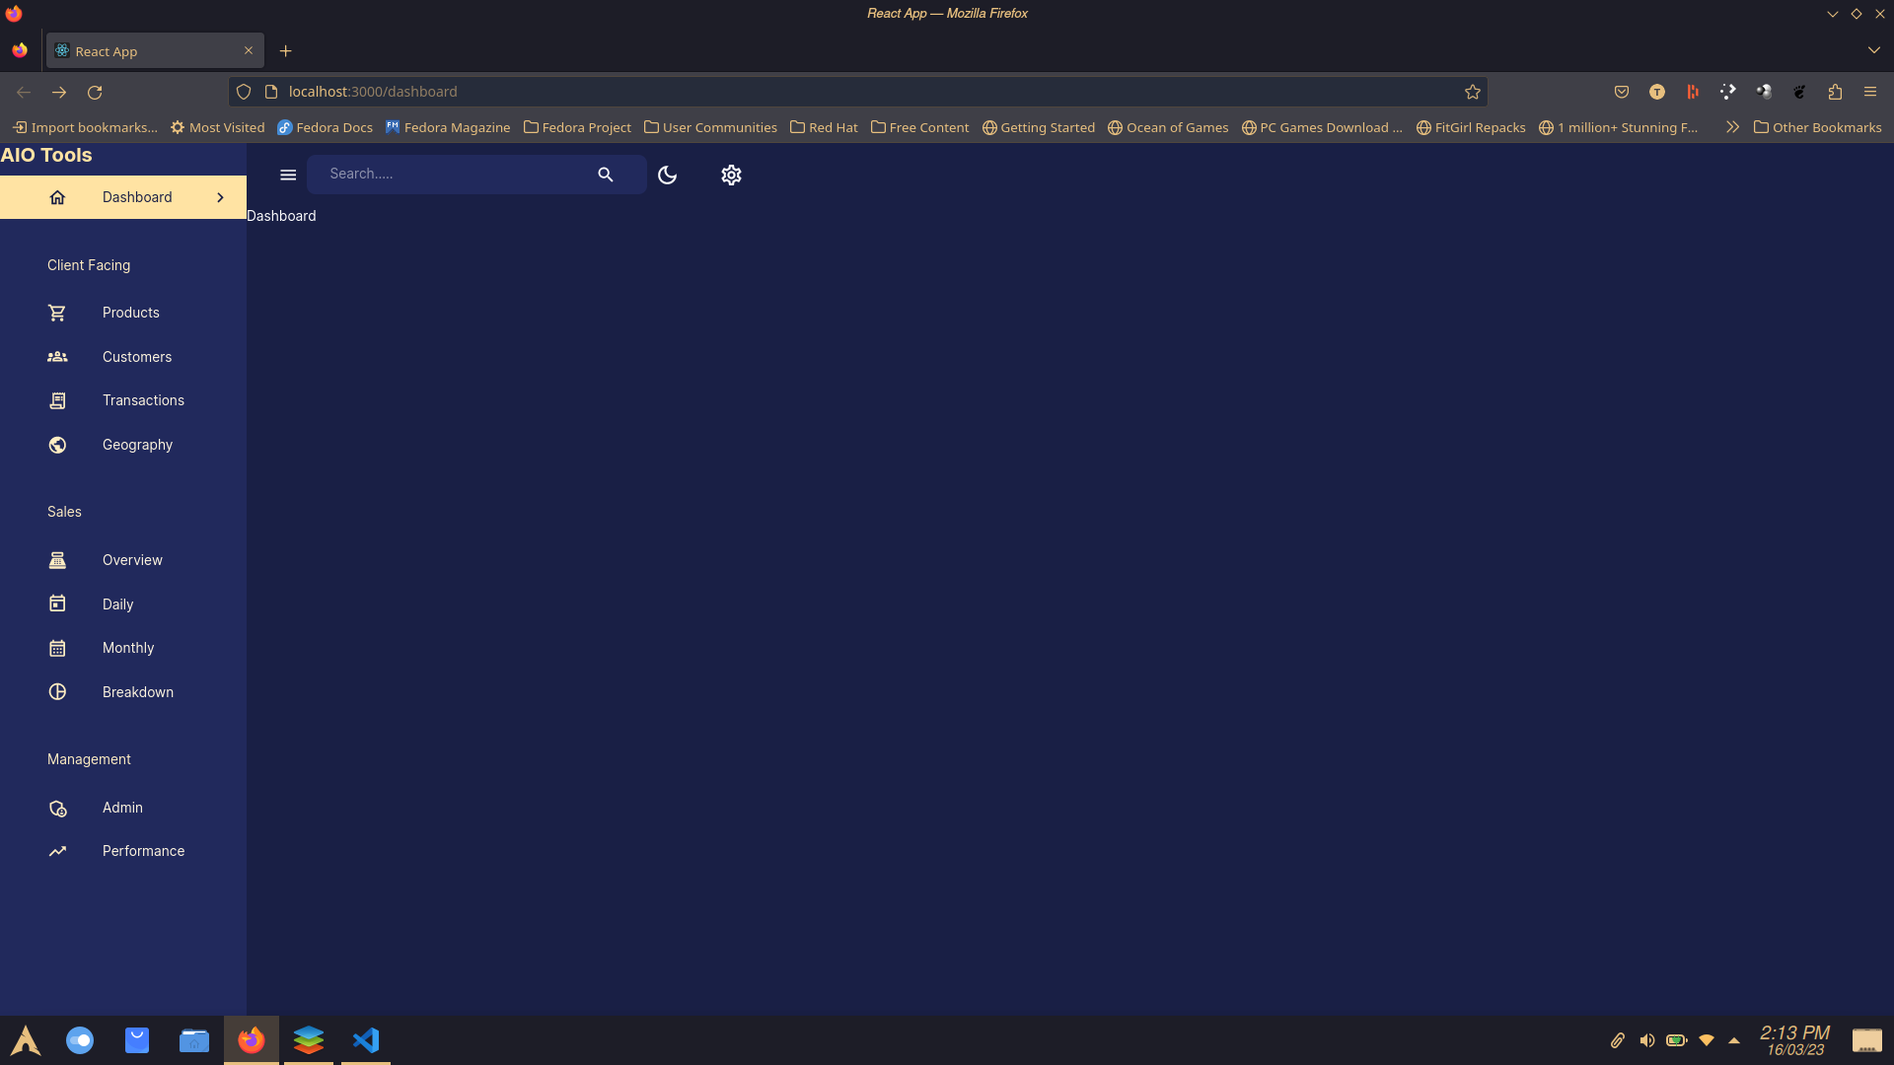
Execution of the project
Screen shots

Slide 8
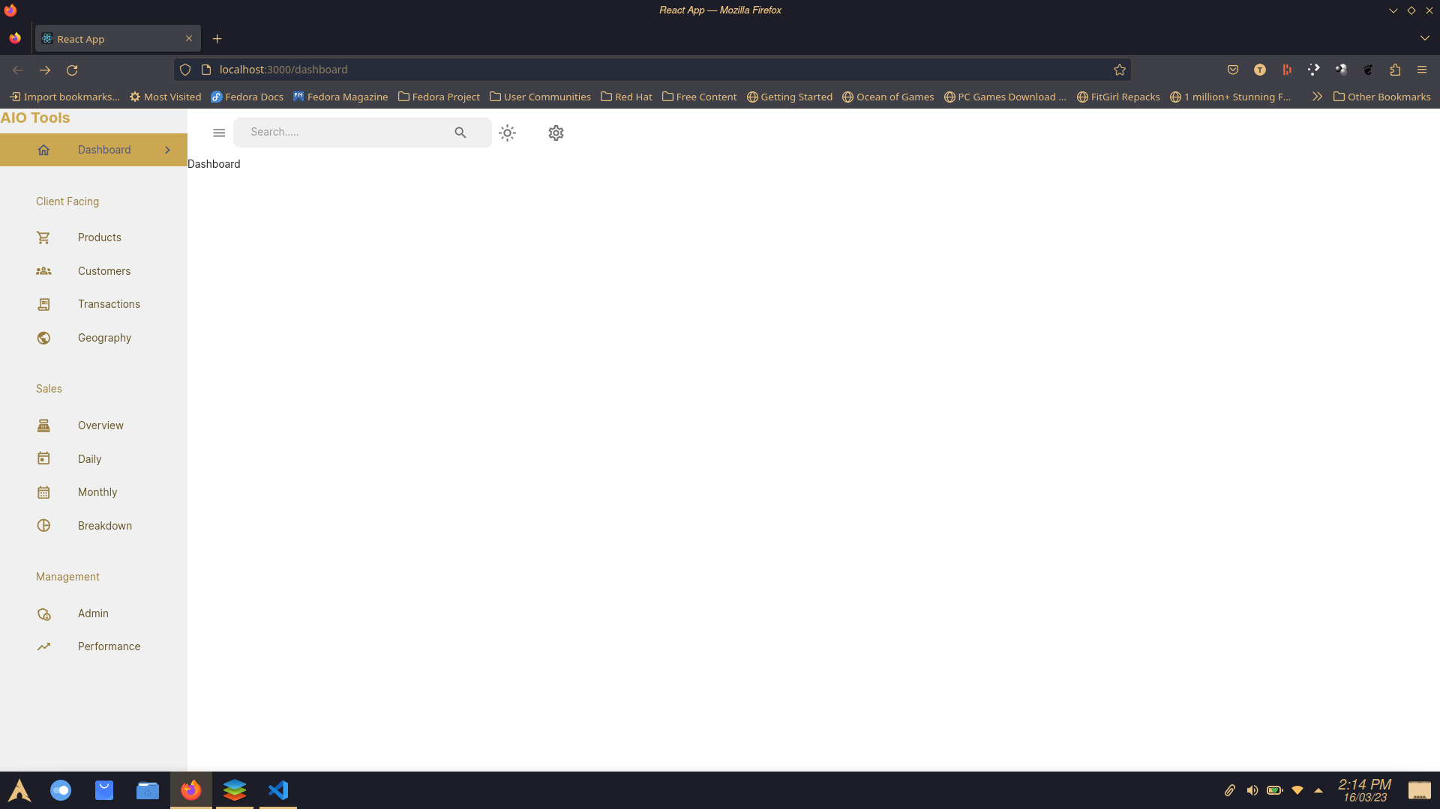
Execution of the project
Screen shots

Slide 9
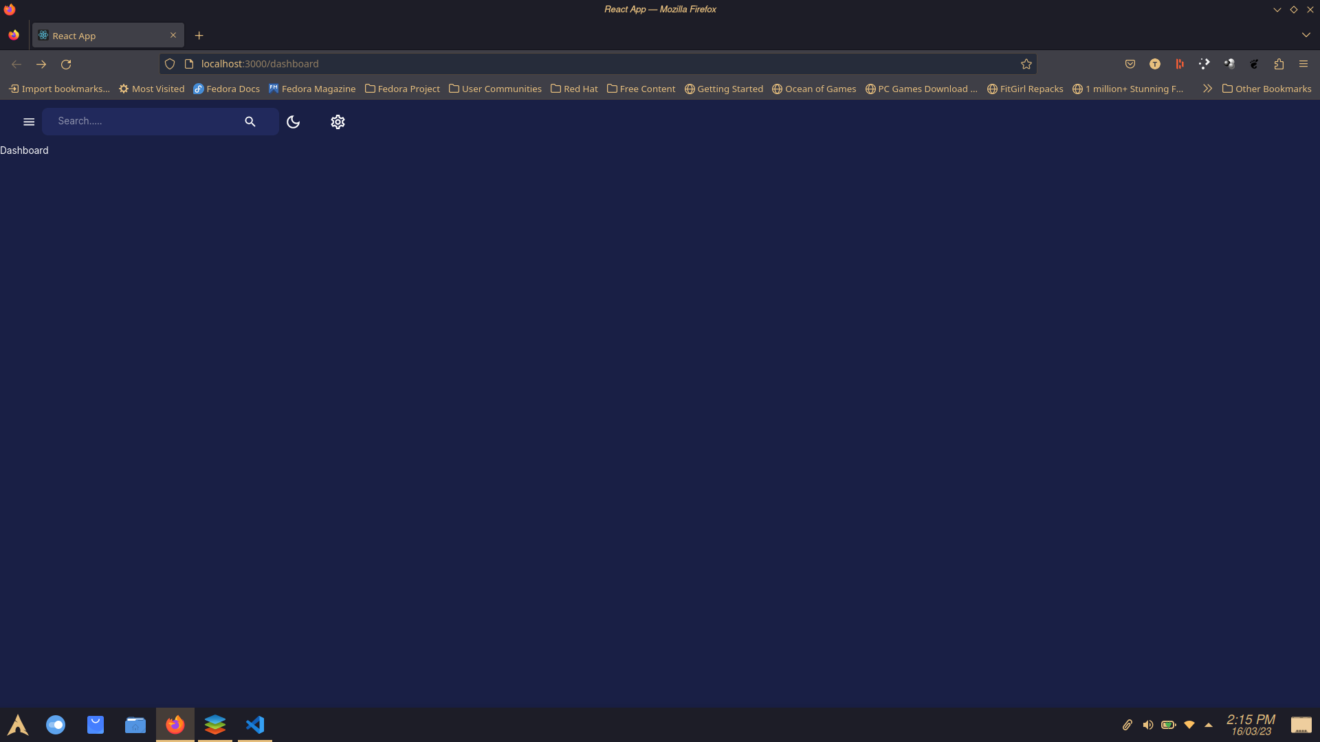
Execution of the project
Screen shots

