Slide 1
Week-04 File Handling and basic projects structuring
Engr. Tushar Kanjwani

Slide 2
File Handling in Python
File handling refers to the process of performing operations on a file through a programming interface, such as
Create()
Open()
Read()
Write()
Close()
It involves managing the data flow between the program and the file system on the storage device, ensuring that data is handled safely and efficiently.

Slide 3
Why do we need File Handling
To store data permanently.
To access external files like .txt, .csv, .json, etc.
To process large files efficiently without using much memory.
To automate tasks like reading or saving outputs.

Slide 4
open() function
The open() function takes two parameters; filename, and mode.
There are four different methods (modes) for opening a file:
"r" - Read - Default value. Opens a file for reading, error if the file does not exist
"a" - Append - Opens a file for appending, creates the file if it does not exist
"w" - Write - Opens a file for writing, creates the file if it does not exist
"x" - Create - Creates the specified file, returns an error if the file exists
In addition, you can specify if the file should be handled as binary or text mode
"t" - Text - Default value. Text mode
"b" - Binary - Binary mode (e.g. images)

Slide 5
open() function - Syntax
To open a file for reading it is enough to specify the name of the file:
f = open("demofile.txt", "r")
Note: If you don’t specify the mode, Python uses 'r' (read mode) by default.

Slide 6
close() function - Syntax
It is a good practice to always close the file when you are done with it.
If you are not using the with statement, you must write a close statement in order to close the file:
Close the file when you are finished with it:
f = open("demofile.txt", "r") f.close()

Slide 7
read() function - Syntax
Reading a file can be achieved by file.read() which reads the entire content of the file. After reading, it’s good practice to close the file to free up system resources.
If the file is located in a different location, you will have to specify the file path, like this:
f = open("D:\\myfiles\welcome.txt", "r") print(f.read())
f.close()
You can also use the with statement when opening a file:
with open("demofile.txt""r") as f: print(f.read())
f.close()
Then you do not have to worry about closing your files, the with statement takes care of that.

Slide 8
Reading from a File
Write a program that reads the contents of a text file and prints them.

Slide 9
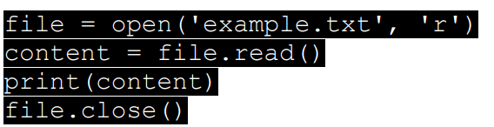
Reading from a File
Write a program that reads the contents of a text file and prints them.

Slide 10
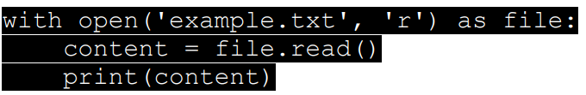
Using `with` Statement
Write a program to open a file using the `with` statement to ensure the file is properly closed.

Slide 11
Read Only Parts of the File
By default the read() method returns the whole text, but you can also specify how many characters you want to return:
Example: Return the 5 first characters of the file:
with open("demofile.txt“,"r") as f: print(f.read(5))

Slide 12
Read Lines
You can return one line by using the readline() method:
Example: Read one line of the file:
with open("demofile.txt") as f: print(f.readline())
Example: Read two lines of the file:
with open("demofile.txt") as f: print(f.readline()) print(f.readline())
Example: Loop through the file line by line:
with open("demofile.txt") as f: for x in f: print(x)

Slide 13
Reading File Line by Line
Write a program that reads a file line by line and prints each line.

Slide 14


Reading File Line by Line
Write a program that reads a file line by line and prints each line.

Slide 15
Checking File Properties
Once the file is open, we can check some of its properties:
f = open("geek.txt", "r")
print("Filename:", f.name)
print("Mode:", f.mode)
print("Is Closed?", f.closed)
f.close()
print("Is Closed?", f.closed)
Explanation:
f.name: Returns the name of the file that was opened (in this case, "geek.txt").
f.mode: Tells us the mode in which the file was opened. Here, it’s 'r' which means read mode.
f.closed: Returns a boolean value- False when file is currently open otherwise True

Slide 16
Writing a File
In Python, writing to a file is done using the mode "w". This creates a new file if it doesn’t exist, or overwrites the existing file if it does. The write() method is used to add content. After writing, make sure to close the file.
Example: Writing to a file (overwrites if file exists)
with open("geek.txt", "w") as file:
file.write("Hello, Python!\n")
file.write("File handling is easy with Python.")
print("File written successfully")
with open("demofile.txt") as f: print(f.read())

Slide 17
Writing Multiple Lines to a File
Write a program that writes multiple lines to a file using `writelines()`.

Slide 18
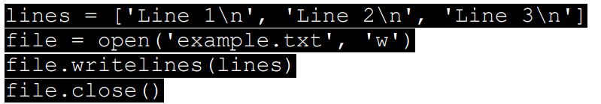
Writing Multiple Lines to a File
Write a program that writes multiple lines to a file using `writelines()`.

Slide 19
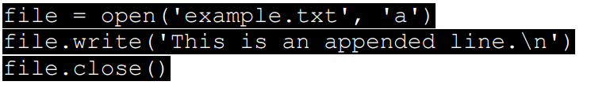
Appending to a File
Write a Python program that appends data to an existing file.

Slide 20
Writing Numbers to a File
Write a program that writes numbers 1 to 5 into a file, each on a new line.

Slide 21
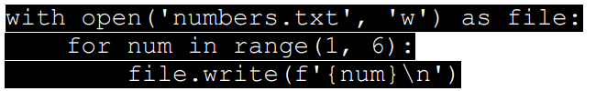
Writing Numbers to a File
Write a program that writes numbers 1 to 5 into a file, each on a new line.

Slide 22
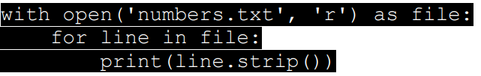
Reading Numbers from a File
Write a program that reads the numbers from `numbers.txt` and prints them.

Slide 23
Create a New File
o create a new file in Python, use the open() method, with one of the following parameters:
"x" - Create - will create a file, returns an error if the file exists
"a" - Append - will create a file if the specified file does not exists
"w" - Write - will create a file if the specified file does not exists
Example: Create a new file called "myfile.txt":
f = open("myfile.txt", "x")
Note: If the file already exist, an error will be raised.

Slide 24
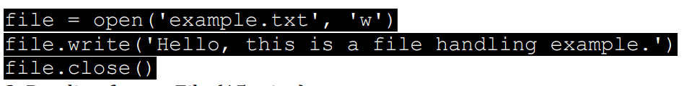
Creating and Writing to a File
Write a Python program that creates a text file and writes a simple message into it.
Notes:
DYS

Slide 25
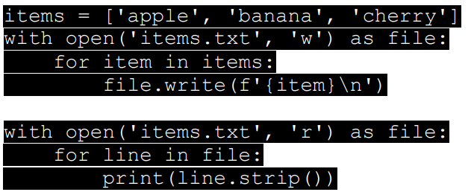
Writing and Reading Lists to a File
Write a program that writes a list of strings to a file and then reads them back.

Slide 26
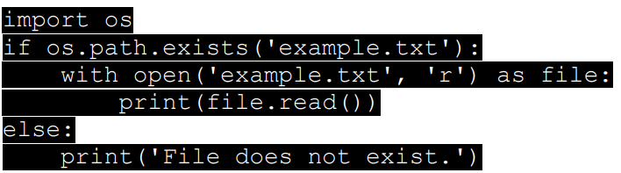
Checking if a File Exists
Write a program that checks if a file exists before trying to open it.

Slide 27
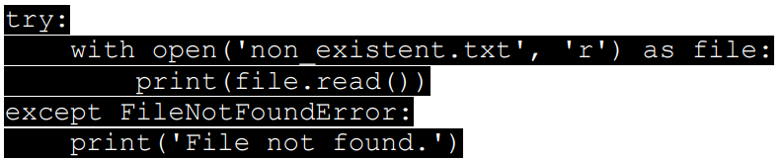
Handling FileNotFoundError
Write a program that handles the `FileNotFoundError` when trying to open a non-existent file

Slide 28
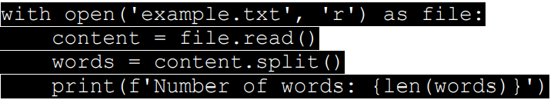
Counting Words in a File
Write a program that reads a text file and counts the number of words in it.

Slide 29
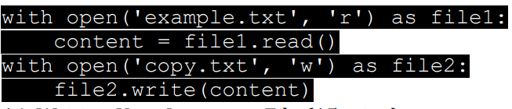
Copying the Contents of a File
Write a program that copies the contents of one file to another.

Slide 30
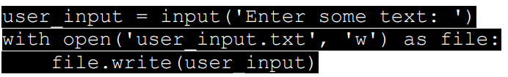
Writing User Input to a File
Write a program that takes user input and writes it to a file.

Slide 31
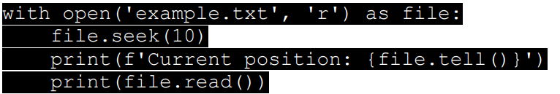
File Seek and Tell
Write a program that demonstrates the use of `seek()` and `tell()` methods while working with a file.

Slide 32
Assignment Task:
Simple Text Editor
Write a Python program that simulates a simple text editor with the following functionalities:
1. Create a new text file.
2. Append text to an existing file.
3. Display the contents of a file.
4. Exit the program.
Notes:
def text_editor(): while True: print("\nOptions:") print("1. Create a new file") print("2. Append to an existing file") print("3. Display file contents") print("4. Exit") choice = input("Choose an option: ") if choice == "1": filename = input("Enter the filename: ") content = input("Enter text to write: ") with open(filename, 'w') as file: file.write(content) print(f"File '{filename}' created.") elif choice == "2": filename = input("Enter the filename: ") content = input("Enter text to append: ") with open(filename, 'a') as file: file.write(content) print(f"Text appended to '{filename}'.") elif choice == "3": filename = input("Enter the filename: ") try: with open(filename, 'r') as file: print(file.read()) except FileNotFoundError: print(f"File '{filename}' not found.") elif choice == "4": break else: print("Invalid choice") text_editor()

Slide 33
Week-04 File Handling and basic projects structuring
Working with Files

Slide 34

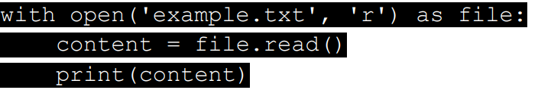
Appending Data to a File & Reading After Appending
Write a Python program that appends a new line of text to an existing file and read the contents of a file after appending data to it.

Slide 35
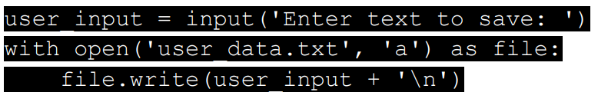
Writing and Appending User Input
Write a Python program that asks the user for input and writes it to a file. If the file exists, append to it; otherwise, create a new file.

Slide 36
Delete a File
To delete a file, you must import the OS module and run its os.remove() function:
Example: Remove the file "demofile.txt":
import os os.remove("demofile.txt")

Slide 37
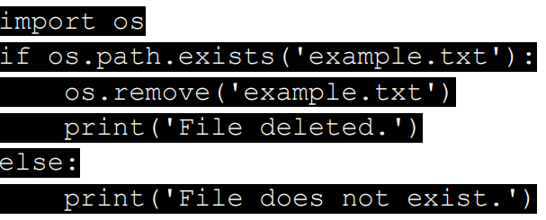
Delete a File
Check if File exist:
To avoid getting an error, you might want to check if the file exists before you try to delete it:
Example: Write a program that deletes a file if it exists

Slide 38
Delete Folder
To delete an entire folder, use the os.rmdir() method:
Example: Remove the folder "myfolder":
import os os.rmdir("myfolder")
Note: You can only remove empty folders.

Slide 39

Writing User Data to a File
Write a program that asks the user for their name and age, then saves this information to a file.

Slide 40
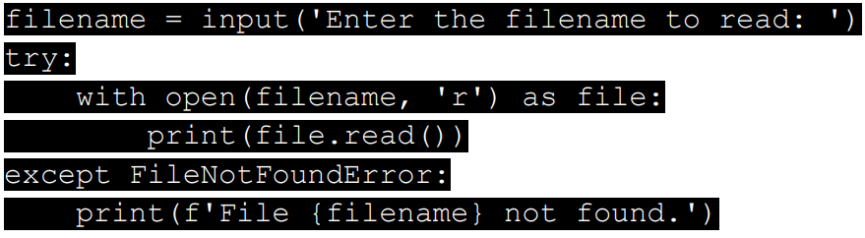
Handling File Input Errors
Write a program that asks for a filename to read and handles the `FileNotFoundError` if the file doesn't exist.

Slide 41
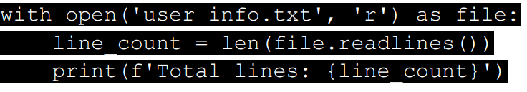
File Line Count
Write a program that counts the number of lines in a text file

Slide 42
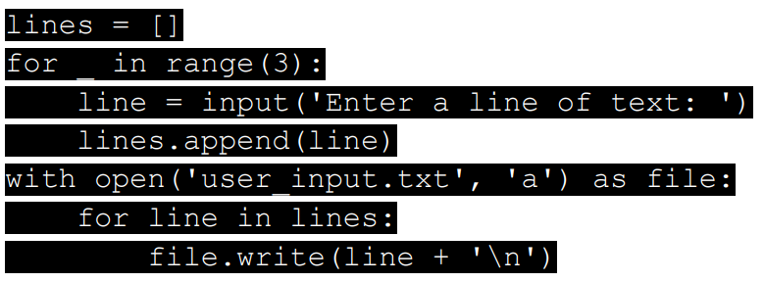
Appending Multiple Lines of Input
Write a program that asks the user for multiple lines (Example=3 lines) of input and appends each line to a file.

Slide 43
Assignment Task
User Data Storage System
Write a Python program that simulates a basic user data storage system. The program should allow the user to:
1. Add new user data (name, age, and email).
2. View all stored user data.
3. Append new data to an existing user entry.
4. Handle errors if the file does not exist.
Notes:
def user_data_storage(): while True: print("\nOptions:") print("1. Add new user data") print("2. View all user data") print("3. Append to existing user data") print("4. Exit") choice = input("Choose an option: ") if choice == "1": name = input("Enter name: ") age = input("Enter age: ") email = input("Enter email: ") with open('user_data.txt', 'a') as file: file.write(f'Name: {name}, Age: {age}, Email: {email}\n') print("User data saved.") elif choice == "2": try: with open('user_data.txt', 'r') as file: print(file.read())
except FileNotFoundError: print("No user data found.") elif choice == "3": name = input("Enter name: ") data = input("Enter data to append (age or email): ") try: with open('user_data.txt', 'a') as file: file.write(f'Updated data for {name}: {data}\n') print(f"Data for {name} updated.") except FileNotFoundError: print(f"No data found for {name}.") elif choice == "4": break else: print("Invalid option.") user_data_storage()

Slide 44
Week-04 File Handling and basic projects structuring
Structuring a Python Project

Slide 45
Learning Outcomes
Learn how to structure a Python project with modules and functions.
Organize code into reusable components.
Explore how to import code from other files and create basic Python packages

Slide 46
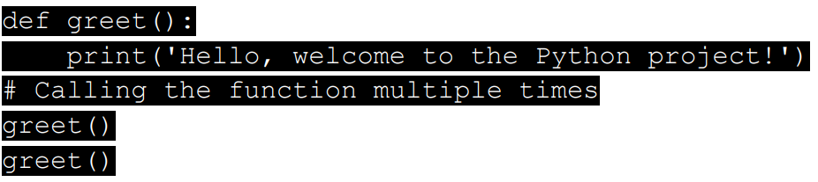
Organizing Code into Functions
Write a Python function `greet()` that prints a greeting message. Call the function multiple times in the script.

Slide 47
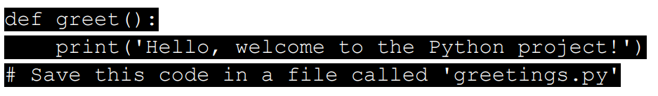
Saving Functions in a Separate File
Save the `greet()` function from Task 1 in a file named `greetings.py`

Slide 48

Importing a Function from Another File
Write a new Python script that imports the `greet()` function from `greetings.py` and calls it

Slide 49
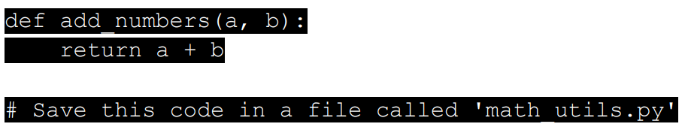
Creating a Function to Add Numbers
Write a Python function `add_numbers(a, b)` that takes two numbers as input and returns their sum. Save this function in `math_utils.py`.

Slide 50
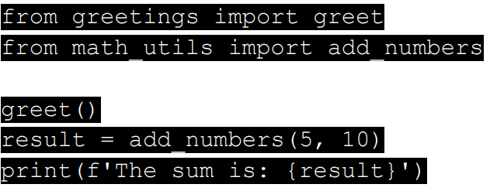
Importing Functions from Multiple Files
Write a script that imports `greet()` from `greetings.py` and `add_numbers()` from `math_utils.py`.

Slide 51
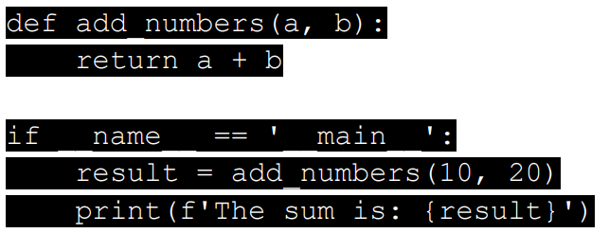
Using ‘if __name__ == '__main__'’
Modify the `add_numbers()` function in `math_utils.py` so that it only runs when the file is executed directly.

Slide 52
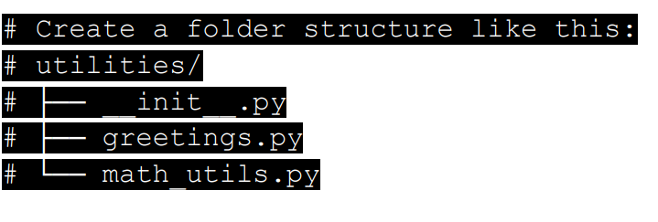
Creating a Python Package
Create a folder named `utilities`, and place `greetings.py` and `math_utils.py` inside it. Create an empty `__init__.py` file inside the folder to make it a package.

Slide 53
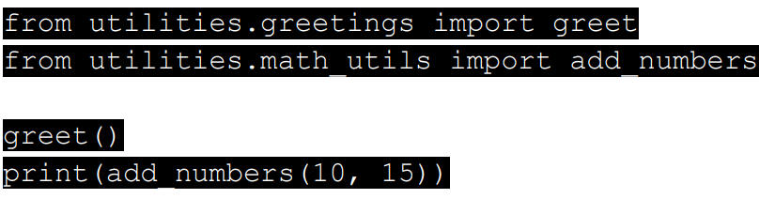
Importing from a Python Package
Write a script that imports the functions `greet()` and `add_numbers()` from the `utilities` package.

Slide 54
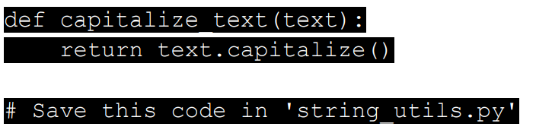
Creating a Module for String Operations
Create a file `string_utils.py` and write a function `capitalize_text(text)` that capitalizes a given string.

Slide 55
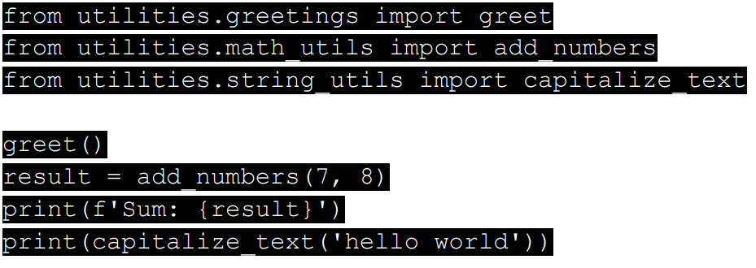
Importing from Multiple Modules
Write a script that imports functions from `greetings.py`, `math_utils.py`, and `string_utils.py` and calls them.

Slide 56
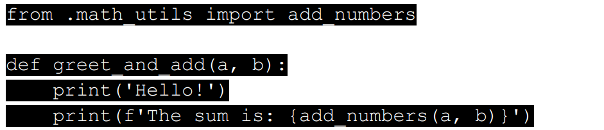
Using Relative Imports
Modify your package to use relative imports for importing `add_numbers()` inside the `greetings.py` file.

Slide 57
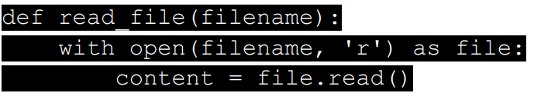
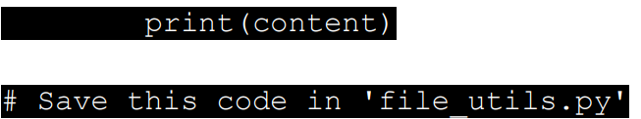
Writing a Module for File Operations
Create a new file `file_utils.py` that contains a function `read_file(filename)` to read and print the contents of a file.

Slide 58
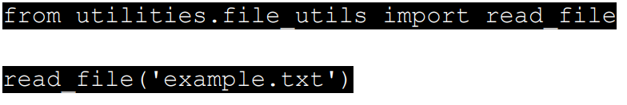
Importing and Using File Operations
Write a script that imports `read_file()` from `file_utils.py` and reads the contents of a file.

Slide 59
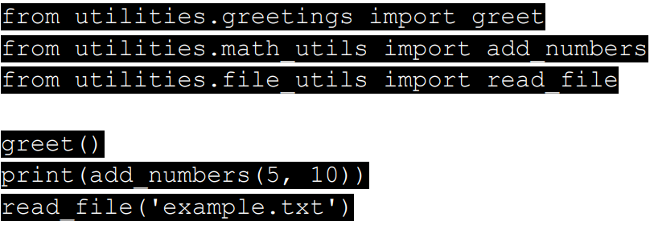
Combining Functions in a Project
Write a Python script that combines the functions from all the modules created so far into a single script that performs a greeting, a calculation, and a file read.

Slide 60
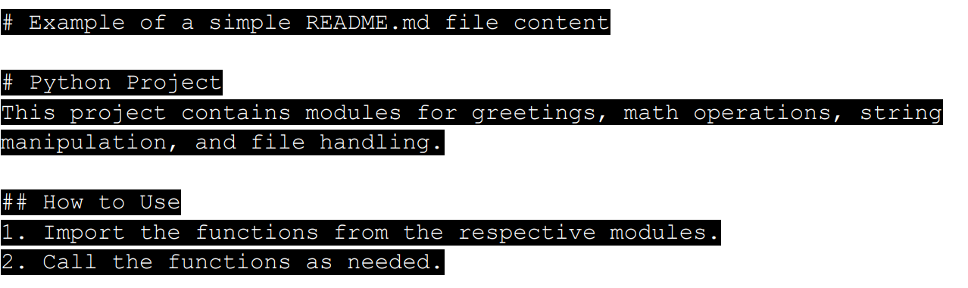
Documenting a Python Project
Write a `README.md` file for the Python project you have created, explaining how to use each module and function.

Slide 61
Assignment Task
Modularized To-Do List Application
Write a Python program to modularize the To-Do List application. The application should allow the user to:
1. Add a new task to the list.
2. View all tasks.
3. Delete a task from the list.
The program should be divided into multiple files: one for handling tasks, one for file operations (saving/loading tasks), and one for the main logi
Notes:
# tasks.py tasks = [] def add_task(task): tasks.append(task) def view_tasks(): for i, task in enumerate(tasks, 1): print(f'{i}. {task}') def delete_task(task_number): if 0 < task_number <= len(tasks): tasks.pop(task_number - 1) # file_utils.py def save_tasks(filename): with open(filename, 'w') as file: for task in tasks: file.write(task + '\n') def load_tasks(filename): with open(filename, 'r') as file: global tasks tasks = file.read().splitlines() # main.py from tasks import add_task, view_tasks, delete_task from file_utils import save_tasks, load_tasks while True: print("\n1. Add Task") print("2. View Tasks") print("3. Delete Task") print("4. Save Tasks") print("5. Load Tasks") print("6. Exit") choice = input("Choose an option: ") if choice == "1": task = input("Enter a task: “
add_task(task) elif choice == "2": view_tasks() elif choice == "3": task_number = int(input("Enter task number to delete: ")) delete_task(task_number) elif choice == "4": save_tasks('tasks.txt') print("Tasks saved.") elif choice == "5": load_tasks('tasks.txt') print("Tasks loaded.") elif choice == "6": break else: print("Invalid choice")

Slide 62
Week-04 File Handling and basic projects structuring
Project Day Preparation

Slide 63
Reviewing File Handling Basics
Write a simple program that creates a text file and writes a message into it.

Slide 64

Reviewing File Handling Basics
Write a simple program that creates a text file and writes a message into it.

Slide 65
Reading from a File
Write a Python program to read the contents of a file and print them to the console.

Slide 66

Reading from a File
Write a Python program to read the contents of a file and print them to the console.

Slide 67
Appending Data to a File
Write a program to append new data to an existing file.

Slide 68

Appending Data to a File
Write a program to append new data to an existing file.

Slide 69
Organizing Code into Functions
Write a Python function `save_to_file(filename, data)` that saves data to a file

Slide 70
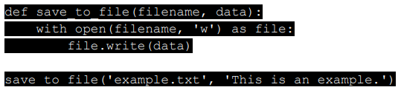
Organizing Code into Functions
Write a Python function `save_to_file(filename, data)` that saves data to a file

Slide 71
Reading and Processing File Data
Write a function `read_file(filename)` that reads the file and returns the content.

Slide 72


Reading and Processing File Data
Write a function `read_file(filename)` that reads the file and returns the content.

Slide 73
Creating a Project Folder
Create a folder named `todo_project` and move your Python files into it for better organization

Slide 74

Creating a Project Folder
Create a folder named `todo_project`

Slide 75
Saving Task Data to a File
Write a function `save_tasks(tasks)` that saves a list of tasks to a file.

Slide 76
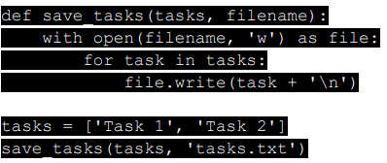
Saving Task Data to a File
Write a function `save_tasks(tasks)` that saves a list of tasks to a file.

Slide 77
Loading Task Data from a File
Write a function `load_tasks(filename)` that loads tasks from a file and returns them as a list.

Slide 78
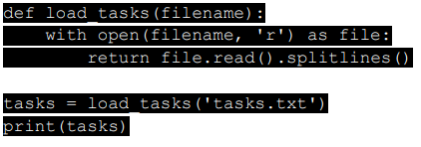
Loading Task Data from a File
Write a function `load_tasks(filename)` that loads tasks from a file and returns them as a list.

Slide 79
Refactoring Code into Modules
Move your task-saving and loading functions into a separate file called `file_utils.py`.

Slide 80
Refactoring Code into Modules
Move your task-saving and loading functions into a separate file called `file_utils.py`.

Slide 81
Importing Functions from a Module
Write a new script that imports the `save_tasks` and `load_tasks` functions from `file_utils.py` and uses them.

Slide 82
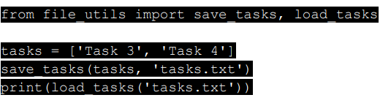
Importing Functions from a Module
Write a new script that imports the `save_tasks` and `load_tasks` functions from `file_utils.py` and uses them.

Slide 83
Handling File Errors
Write a program that handles `FileNotFoundError` when trying to load tasks from a nonexistent file.

Slide 84
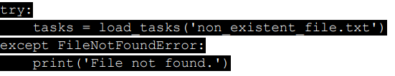
Handling File Errors
Write a program that handles `FileNotFoundError` when trying to load tasks from a nonexistent file.

Slide 85
Reviewing Modularization Concepts
Refactor your to-do list project by separating file handling, task management, and main logic into separate files.

Slide 86
Reviewing Modularization Concepts
Refactor your to-do list project by separating file handling, task management, and main logic into separate files.

Slide 87

Using `if __name__ == '__main__'`
Ensure your scripts only execute when run directly, not when imported as modules.

Slide 88
Debugging with Print Statements
Add print statements to your project to trace the flow of data between modules.

Slide 89
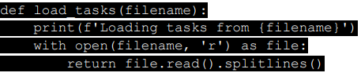
Debugging with Print Statements
Add print statements to your project to trace the flow of data between modules.

Slide 90
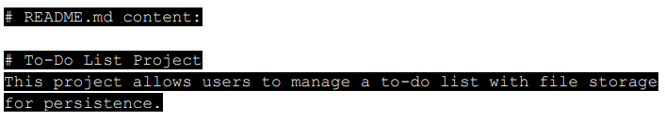
Documenting the Refactored Project
Write a `README.md` file explaining how the project is structured and how to use it

