Slide 1
Control Flow & Looping
Engr. Tushar Kanjwani

Slide 2
Learning Outcomes
By the end of this lab, students will be able to:
Understand what loops are in programming
Use while loops correctly in Python
Apply break and continue statements
Create nested loops
Build interactive programs using loops

Slide 3
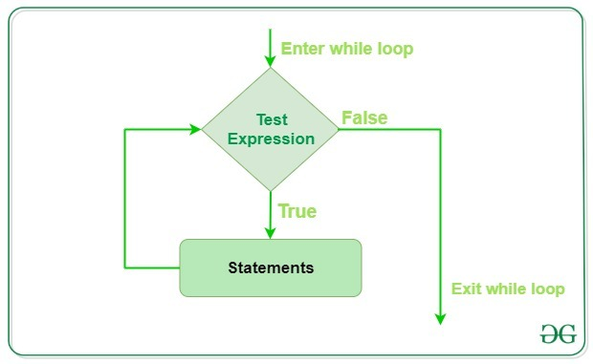
What is a Loop?
A loop is a programming construct that allows a block of code to be executed repeatedly until a condition is met.
Why use loops?
Avoid repetitive code
Improve readability
Automate repeated tasks

Slide 4
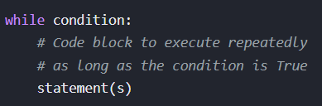
Types of Loops in Python
while loop
With the while loop we can execute a set of statements as long as a condition is true.

Slide 5
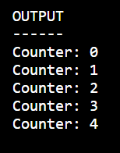
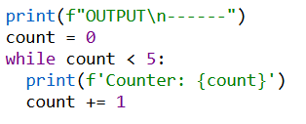
Task 1
Write a program to print numbers 0 to 4 using while loop.

Slide 6
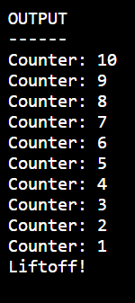
Task 2
Write a countdown program from 10 to 0 and print 'Liftoff!'

Slide 7
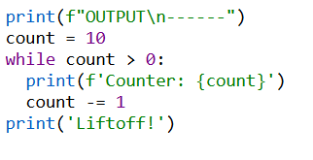
Task 2
Write a countdown program from 10 to 0 and print 'Liftoff!'

Slide 8
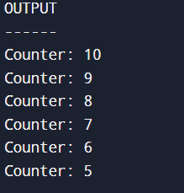
Task 3
Modify the countdown when number becomes less than 5. (Hint: Using ‘break’)

Slide 9
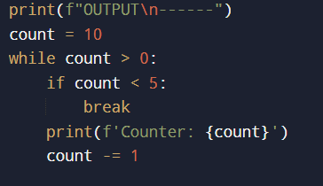
Task 3
Modify the countdown when number becomes less than 5. (Hint: Using ‘break’)

Slide 10
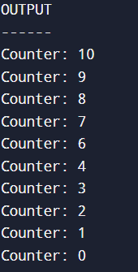
Task 4
Skip printing number 5 in countdown.
(Hint: Using `continue)

Slide 11
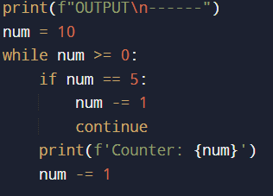
Task 4
Skip printing number 5 in countdown.
(Hint: Using `continue)

Slide 12
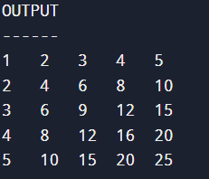
Task 5
Create a nested ‘while’ loop to print a simple multiplication table (from 1 to 5).

Slide 13
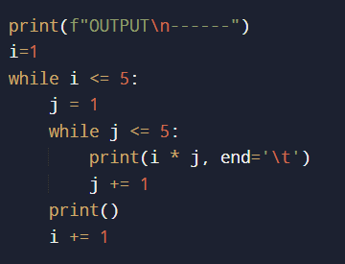
Task 5
Create a nested ‘while’ loop to print a simple multiplication table (from 1 to 5).

Slide 14
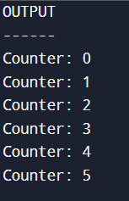
Task 6
Write a simple program that creates an infinite loop and then modify it to break after a certain condition is met.

Slide 15
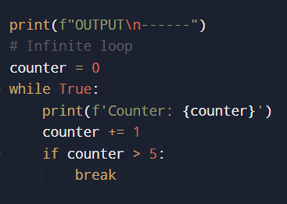
Task 6
Write a simple program that creates an infinite loop and then modify it to break after a certain condition is met.

Slide 16
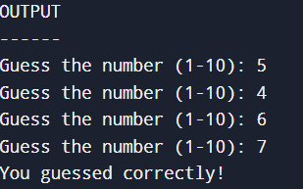
Task 7
Create a `while` loop that asks the user to guess a number until they guess it correctly

Slide 17
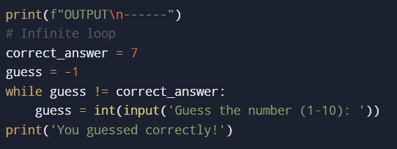
Task 7
Create a `while` loop that asks the user to guess a number until they guess it correctly

Slide 18
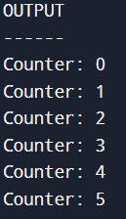
Task 8
Write a Python program that uses a flag variable to terminate the loop.

Slide 19
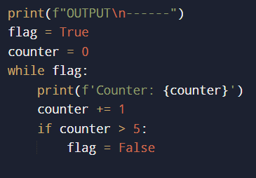
Task 8
Write a Python program that uses a flag variable to terminate the loop.

Slide 20
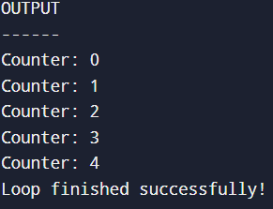
Task 9
Write a Python program that uses the `else` block with a `while` loop to display a message after the loop completes.

Slide 21
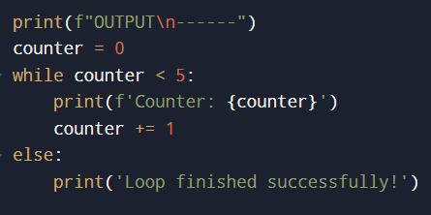
Task 9
Write a Python program that uses the `else` block with a `while` loop to display a message after the loop completes.

Slide 22
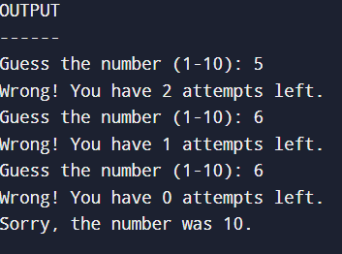
Task 10
Create a number-guessing game where the user has a limited number of attempts to guess a random number

Slide 23
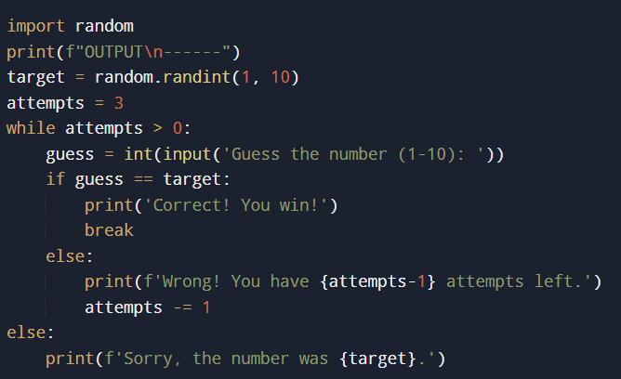
Task 10
Create a number-guessing game where the user has a limited number of attempts to guess a random number

Slide 24
Assignment Task:
Building a Countdown Timer with Custom Features:
Extend the countdown timer by adding these features:
Allow the user to input the starting number for the countdown.
Allow the user to decide whether to include numbers divisible by 3.
Allow the user to terminate the countdown at any point by pressing a specific key (e.g., 'q’).

Slide 25
Control Flow & Looping
For Loop

Slide 26

Types of Loops in Python
For Loop
A for loop is used for iterating over a sequence (that is either a list, a tuple, a dictionary, a set, or a string).

Slide 27
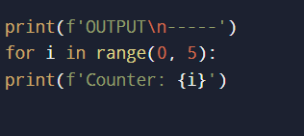
Task 1
Write a program to print numbers 0 to 4 using while loop.

Slide 28

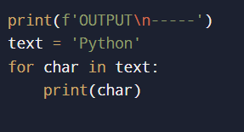
Task 2
Write a Python program that uses a `for` loop to iterate over each character of a string.
Notes:
print(f'OUTPUT\n-----')
text = 'Python'
i = 0
while i < len(text):
print(text[i])
i += 1

Slide 29
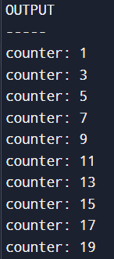
Task 3
Use the `range()` function to print every second number between 1 and 20.

Slide 30
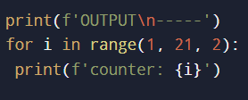
Task 3
Use the `range()` function to print every second number between 1 and 20.

Slide 31
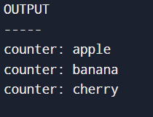
Task 4
Create a list of fruits and use a `for` loop to print each fruit.

Slide 32
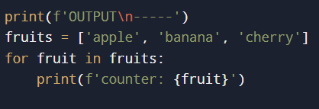
Task 4
Create a list of fruits and use a `for` loop to print each fruit.

Slide 33
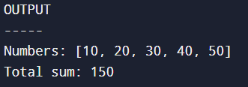
Task 5
Write a Python program that calculates the sum of all numbers in a list using a `for` loop.

Slide 34
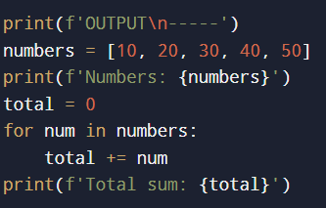
Task 5
Write a Python program that calculates the sum of all numbers in a list using a `for` loop.

Slide 35
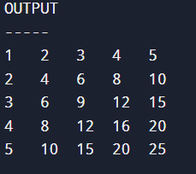
Task 6
Use nested `for` loops to print a multiplication table (1 to 5).

Slide 36
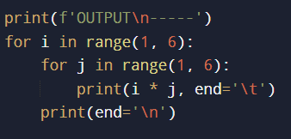
Task 6
Use nested `for` loops to print a multiplication table (1 to 5).

Slide 37
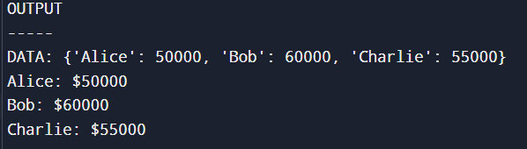
Task 7
Create a dictionary of employee names and their salaries. Use a `for` loop to print each key value pair

Slide 38
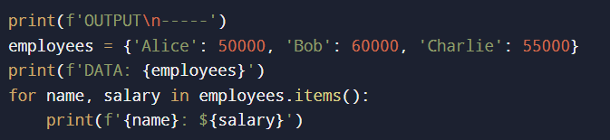
Task 7
Create a dictionary of employee names and their salaries. Use a `for` loop to print each key value pair

Slide 39
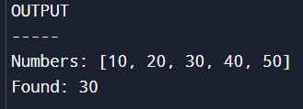
Task 8
Write a Python program that searches for a specific item in a list and breaks the loop when it is found.

Slide 40
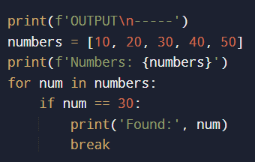
Task 8
Write a Python program that searches for a specific item in a list and breaks the loop when it is found.

Slide 41

Task 9
Write a Python program that skips printing the number 3 from a range of 1 to 5.

Slide 42
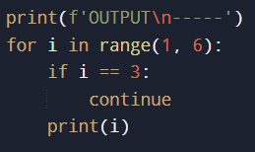
Task 9
Write a Python program that skips printing the number 3 from a range of 1 to 5.

Slide 43
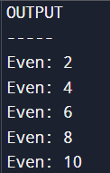
Task 10
Create a list of numbers and print only the even numbers using a `for` loop and `if` condition

Slide 44
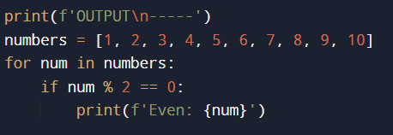
Task 10
Create a list of numbers and print only the even numbers using a `for` loop and `if` condition

Slide 45
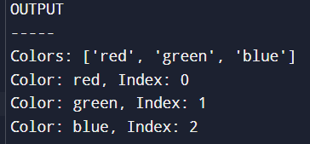
Task 11
Use the `enumerate()` function in a `for` loop to print the index and value of each item in a list.

Slide 46
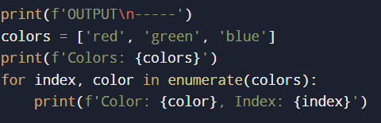
Task 11
Use the `enumerate()` function in a `for` loop to print the index and value of each item in a list.

Slide 47

Task 12
Use a `for` loop to print numbers from 5 down to 1.

Slide 48
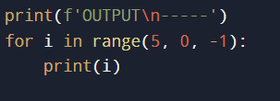
Task 12
Use a `for` loop to print numbers from 5 down to 1.

Slide 49
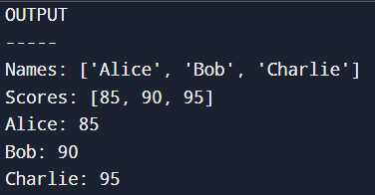
Task 13
Use the `zip()` function to loop over two lists and print corresponding items

Slide 50
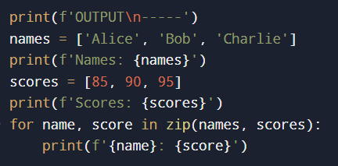
Task 13
Use the `zip()` function to loop over two lists and print corresponding items

Slide 51
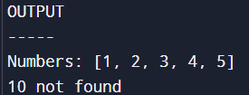
Task 14
Write a `for` loop that searches for a number in a list, and prints a message if the number is not found

Slide 52
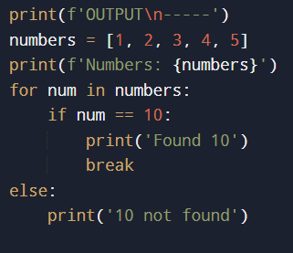
Task 14
Write a `for` loop that searches for a number in a list, and prints a message if the number is not found

Slide 53

Task 15
Use list comprehension to create a list of squares of numbers from 1 to 5.

Slide 54

Task 15
Use list comprehension to create a list of squares of numbers from 1 to 5.

Slide 55
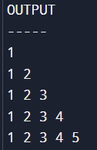
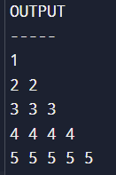
Assignment Task:
Creating a Number Pattern Printer:
Write a Python program that uses `for` loops to print the following pattern:

Slide 56
Lecture 3

Slide 57
Lists – Introduction and Basic Operations
Learning Outcomes:
Understand how to use lists in Python.
Learn basic list operations such as adding and removing items.
Apply loops to iterate over lists and perform common tasks

Slide 58
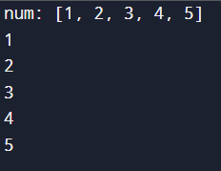
Task 1
Create a list of 5 numbers and print each number using a `for` loop.

Slide 59
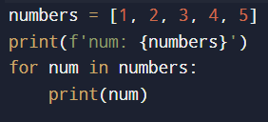
Task 1
Create a list of 5 numbers and print each number using a `for` loop.

Slide 60

Task 2
Create an empty list and use a loop to append numbers 1 through 5 to the list

Slide 61

Task 2
Create an empty list and use a loop to append numbers 1 through 5 to the list

Slide 62
Task 3
Create a list of 5 fruits, and then remove 'apple' from the list

Slide 63

Task 3
Create a list of 5 fruits, and then remove 'apple' from the list

Slide 64

Task 4
Create a list of 5 items and print the first and last items using list indexing

Slide 65

Task 4
Create a list of 5 items and print the first and last items using list indexing

Slide 66

Task 5
Write a Python program that creates a list of numbers 1 to 10 and prints the first 5 numbers using list slicing.

Slide 67

Task 5
Write a Python program that creates a list of numbers 1 to 10 and prints the first 5 numbers using list slicing.

Slide 68

Task 6
Create a list of student names and print each name using a `for` loop

Slide 69

Task 6
Create a list of student names and print each name using a `for` loop

Slide 70

Task 7
Write a Python program that checks if 'apple' is in the list of fruits.

Slide 71

Task 7
Write a Python program that checks if 'apple' is in the list of fruits.

Slide 72

Task 8
Create a list of numbers and sort them in ascending order.

Slide 73

Task 8
Create a list of numbers and sort them in ascending order.

Slide 74

Task 9
Create a list of numbers and reverse the order of the list.

Slide 75

Task 9
Create a list of numbers and reverse the order of the list.

Slide 76

Task 10
Use list comprehension to create a list of squares of numbers from 1 to 5.

Slide 77

Task 10
Use list comprehension to create a list of squares of numbers from 1 to 5.

Slide 78

Task 11
Create two lists of fruits and concatenate them into one list..

Slide 79

Task 11
Create two lists of fruits and concatenate them into one list..

Slide 80
Task 12
Create a list of 5 items and print the length of the list.

Slide 81

Task 12
Create a list of 5 items and print the length of the list.

Slide 82

Task 13
Create a list of numbers and use `max()` and `min()` functions to find the largest and smallest number

Slide 83

Task 13
Create a list of numbers and use `max()` and `min()` functions to find the largest and smallest number

Slide 84

Task 14
Create a list with repeated items and count how many times a specific item appears in the list

Slide 85

Task 14
Create a list with repeated items and count how many times a specific item appears in the list

Slide 86

Task 15
Create a nested list (a list of lists) and use a loop to print each sublist.

Slide 87

Task 15
Create a nested list (a list of lists) and use a loop to print each sublist.

Slide 88
Assignment Task
To-Do List Program with Multiple Tasks
Write a Python program that allows the user to create a to-do list with multiple tasks. The program should allow the user to:
Add tasks to the list.
View all tasks.
Mark tasks as completed.
Remove completed tasks from the list.

Slide 89
Mega Task 1
Building a Multi-List To-Do Application
Write a Python program that allows the user to create multiple to-do lists (e.g., work tasks, personal tasks) and manage tasks for each list

Slide 90
Mega Task 2
Prime Number Checker with Range
Write a Python program that allows the user to input a range of numbers and checks which numbers are prime within that range.

Slide 91
Mega Task 3
Multi-Dimensional List Operations
Write a Python program that creates a 2D list (a list of lists) and performs the following operations:
Print the 2D list.
Find the sum of elements in each row.
Find the sum of elements in each column.

Slide 92
Mega Task 4
Enhanced Guessing Game with Score System
Extend the number-guessing game by adding a score system that tracks how many tries the player needed and calculates a score based on their performance.

Slide 93
Mega Task 5
Continue building the to-do list project by adding the following features:
Allow the user to mark tasks as completed and view only completed or pending tasks.
Add a feature to delete a to-do list entirely.

