Slide 1
Introduction to Object-Oriented Programming (OOP)
Week-05
Engr. Tushar Kanjwani

Slide 2
What is OOP?
Python is an object-oriented language, allowing you to structure your code using classes and objects for better organization and reusability.
Python supports the core principles of object-oriented programming, which are the building blocks for designing robust and reusable software.

Slide 3
Advantages of OOP
Provides a clear structure to programs
Makes code easier to maintain, reuse, and debug
Helps keep your code DRY (Don't Repeat Yourself)
Allows you to build reusable applications with less code
Tip: The DRY principle means you should avoid writing the same code more than once. Move repeated code into functions or classes and reuse it.

Slide 4
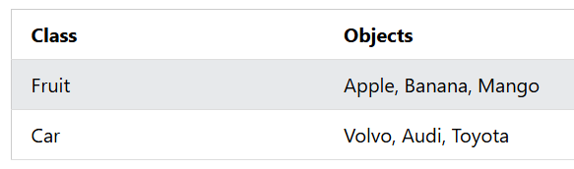
What are Classes and Objects?
Classes and objects are the two core concepts in object-oriented programming.
A class defines what an object should look like, and an object is created based on that class.
When you create an object from a class, it inherits all the variables and functions defined inside that class.

Slide 5


Syntax:
Create a Class:
Create a class named MyClass, with a property named x:
Create Object
Now we can use the class named MyClass to create objects:

Slide 6
__init__() Method
All classes have a built-in method called __init__(), which is always executed when the class is being initiated.
The __init__() method is used to assign values to object properties, or to perform operations that are necessary when the object is being created.

Slide 7
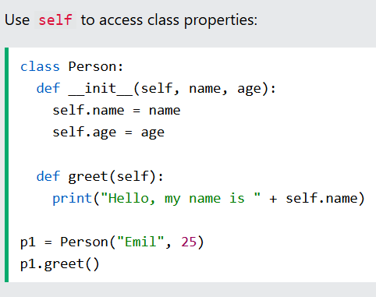
The self Parameter
It is used to access properties and methods that belong to the class.
Use self to access class properties
self → refers to the current object
name → value passed when creating the object
age → value passed when creating the object

Slide 8
Defining a Simple Class
Write a Python class `Car` with two attributes: `brand` and `model`. Then create an object of the class
class Car:
def __init__(self, brand, model):
self.brand = brand
self.model = model
# Create an object
my_car = Car('Toyota', 'Corolla')
print(f'My car is a {my_car.brand} {my_car.model}')

Slide 9
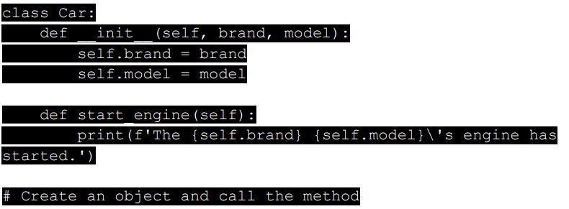

Car Class
Create a car class(self, brand, model) and Add a method `start_engine()` to the `Car` class that prints a message when called.

Slide 10
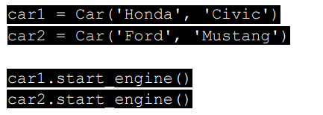
Creating Multiple Objects
Create multiple objects of the `Car` class with different attributes and call their methods

Slide 11
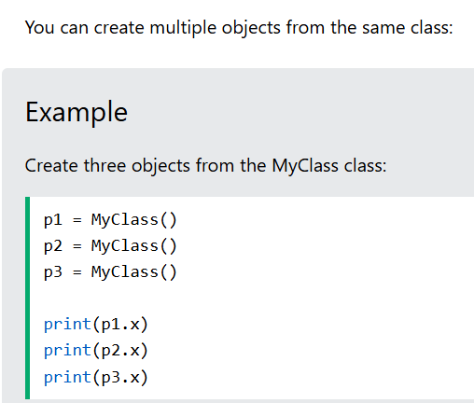
Multiple Objects
Note: Each object is independent and has its own copy of the class properties.

Slide 12
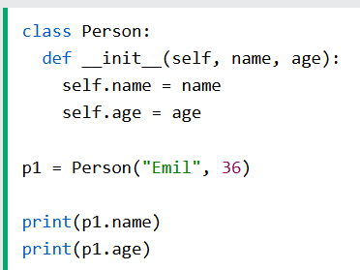
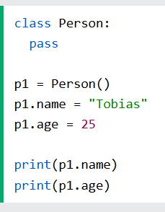
__init__() Method
with __init__() Method
without __init__() Method

Slide 13
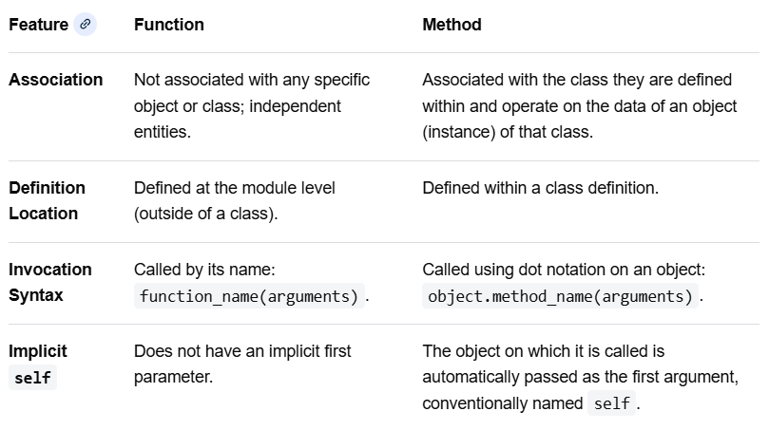
Function Vs Method

Slide 14
Using Object Attributes
Write a class `Student` with attributes `name` and `age`. Add a method `introduce()` that prints a message with the student's name and age.

Slide 15
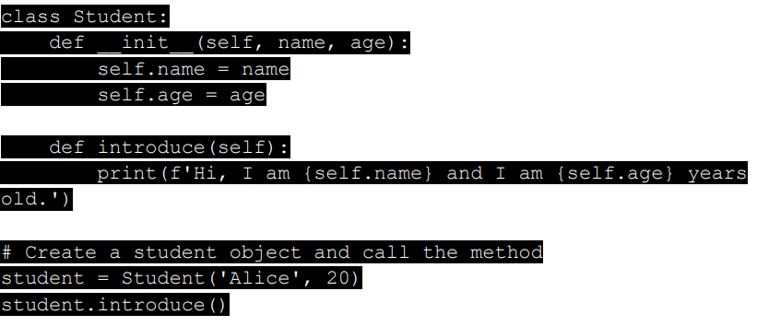
Using Object Attributes
Write a class `Student` with attributes `name` and `age`. Add a method `introduce()` that prints a message with the student's name and age.

Slide 16
Using Object Attributes
Write a class `Student` with attributes `name` and `age`. Add a method `introduce()` that prints a message with the student's name and age.

Slide 17

Modifying Object Attributes
Modify the attributes of the `Student` object after its creation.

Slide 18
Defining a Simple Class for To-Do List
Define a class `Task` with attributes `title` and `completed`. Add a method `mark_complete()` to mark the task as completed.

Slide 19
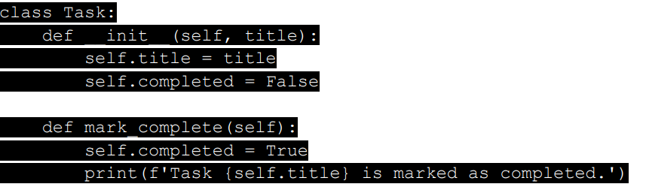

Defining a Simple Class for To-Do List
Define a class `Task` with attributes `title` and `completed`. Add a method `mark_complete()` to mark the task as completed.

Slide 20
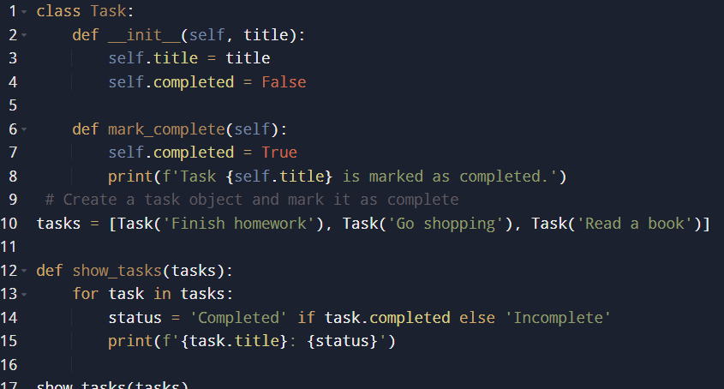
Creating and Managing Multiple Task Objects
Create multiple `Task` objects and store them in a list. Write a function to display all tasks and their statuses.

Slide 21
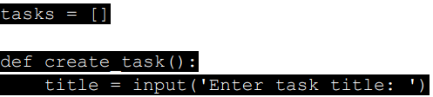
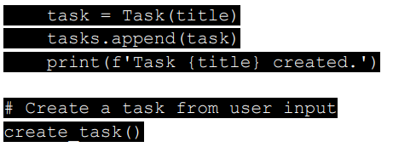
Adding User Input to Create Tasks
Write a Python program that allows users to create `Task` objects by providing a title via user input. Store the tasks in a list.

Slide 22
Assignment Task
Simple Task Management System
Write a Python program that simulates a simple task management system using OOP. The program should allow the user to:
1. Add a new task (title only)
2. View all tasks
3. Mark a task as completed
4. Exit the program

Slide 23
Introduction to Object-Oriented Programming (OOP)
Week-05
More on Classes and Methods

Slide 24
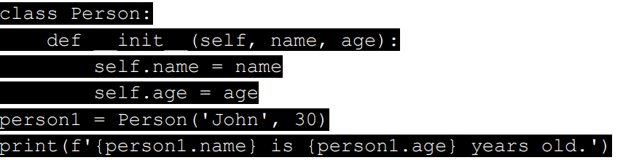
Defining a Constructor Method (__init__)
Define a class Person with attributes name and age. Initialize these attributes using a constructor method.

Slide 25
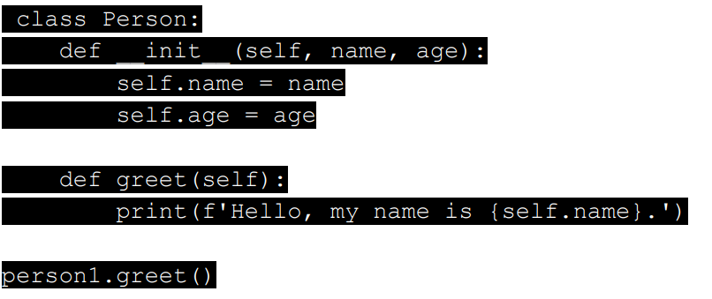
Adding Methods to a Class
Add a method greet() to the Person class that prints a greeting

Slide 26
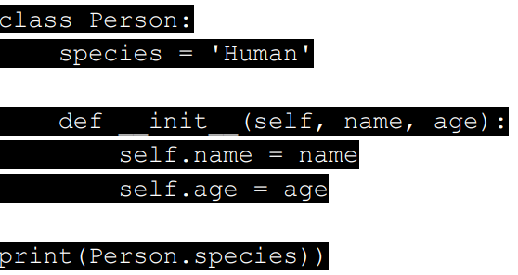
Using Class Attributes
Modify the countdown timer to break the loop if the number goes below 5.

Slide 27
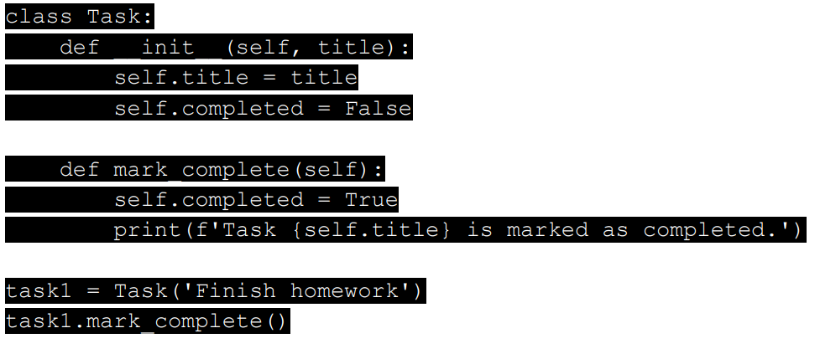
Creating a Task Class for To-Do List
Create a Task class with attributes title and completed. Add a method mark_complete().

Slide 28
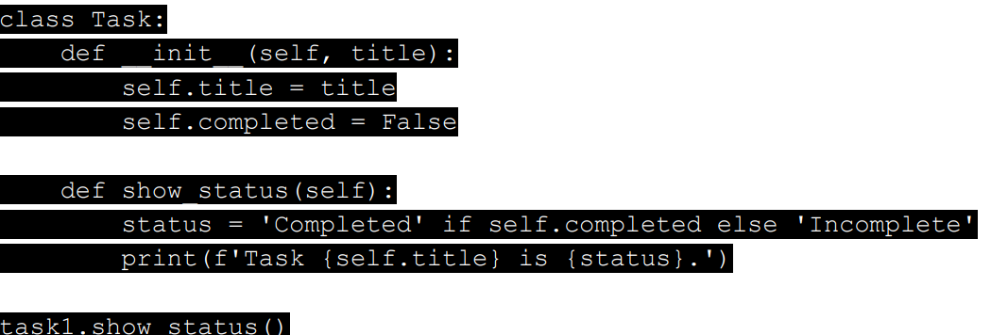
Adding a Method to Display Task Status
Add a method show_status() to the Task class that prints whether the task is completed.

Slide 29
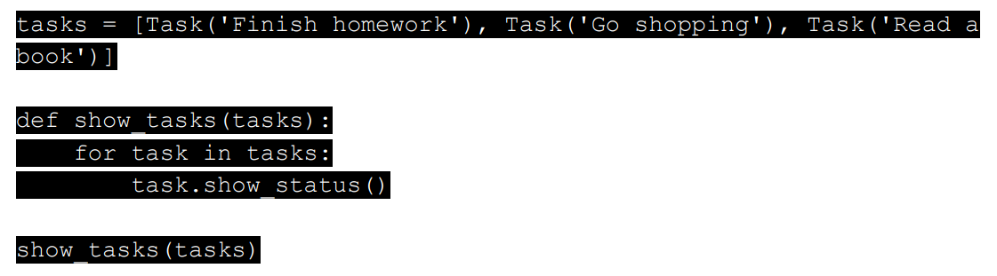
Creating Multiple Task Objects
Create multiple Task objects and store them in a list. Write a function to display all tasks and their status.

Slide 30
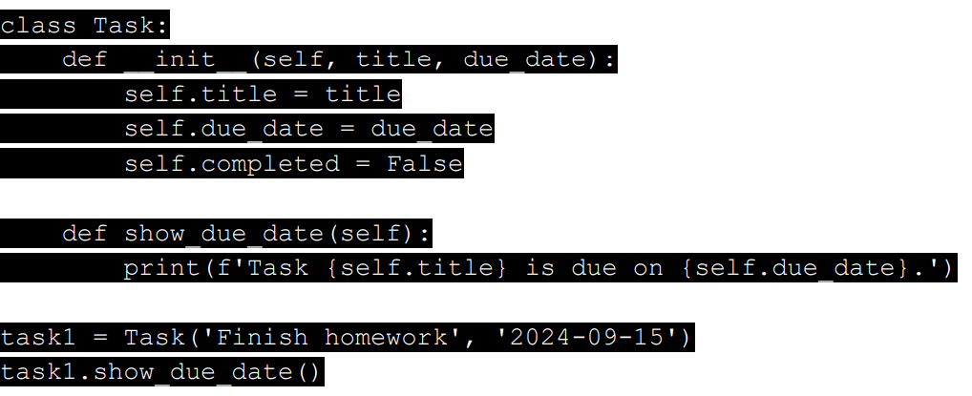
Creating a Task with Due Date
Modify the Task class to include a due date (due_date attribute) and display it.

Slide 31
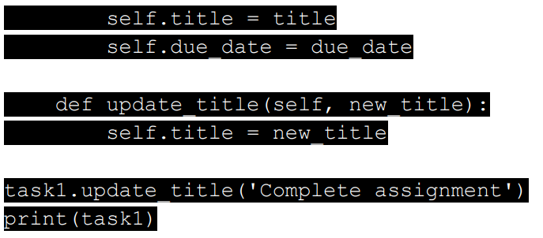
Updating Task Title
Add a method update_title(new_title) to change the title of a task

Slide 32
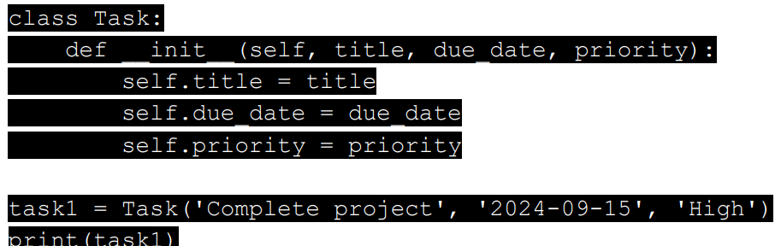
Adding Task Priority
Add a priority attribute (Low, Medium, High) to the Task class and display it.

Slide 33
Marking Task Completion from User Input
Extend the program to allow users to mark tasks as completed by entering the task number.

Slide 34
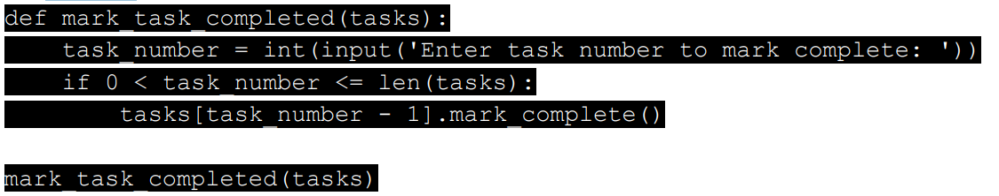
Marking Task Completion from User Input
Extend the program to allow users to mark tasks as completed by entering the task number.

Slide 35
Viewing All Tasks
Write a program that displays the status and due date of all tasks.

Slide 36
Adding Task Priority
Add a priority attribute (Low, Medium, High) to the Task class and display it.

Slide 37
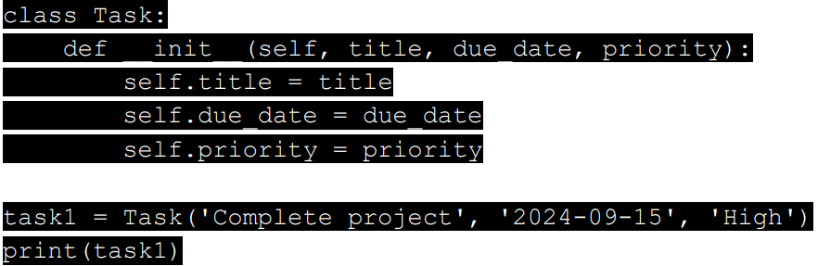
Adding Task Priority
Add a priority attribute (Low, Medium, High) to the Task class and display it.

Slide 38
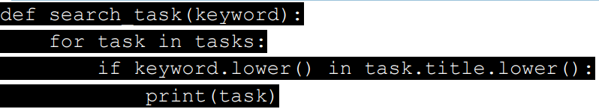
Task Search by Keyword
Add a search function that allows users to search for tasks by keyword.

Slide 39
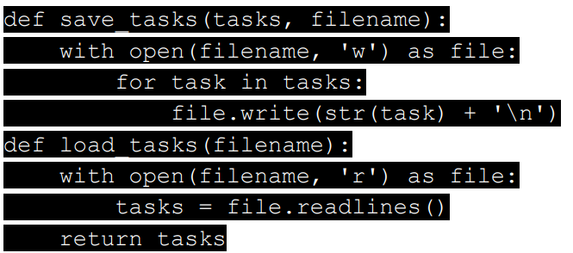
Saving and Loading Tasks
Write functions to save tasks to a file and load them back into the program.

Slide 40
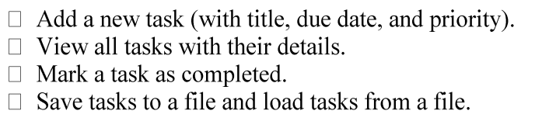
Assignment Task
Task Management System (45 mins):- Extend the countdown timer by adding these features:

Slide 41
Introduction to Object-Oriented Programming (OOP)
Week-05
Inheritance and Polymorphism

Slide 42
Python Inheritance
Inheritance allows us to define a class that inherits the methods and properties from another class.
Parent class is the class being inherited from, also called base class.
Child class is the class that inherits from another class, also called derived class.

Slide 43
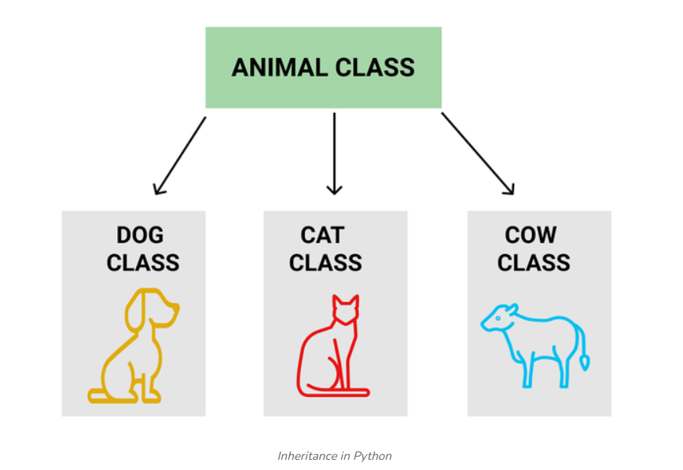
Python Inheritance

Slide 44
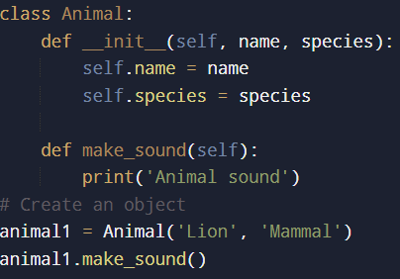
Creating a Parent Class (Base Class)
Create a class `Animal` with attributes `name` and `species`. Add a method `make_sound()`.

Slide 45
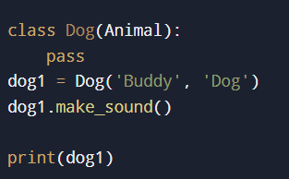
Creating a Child Class (derived class)
Create a class `Dog` that inherits from `Animal.

Slide 46
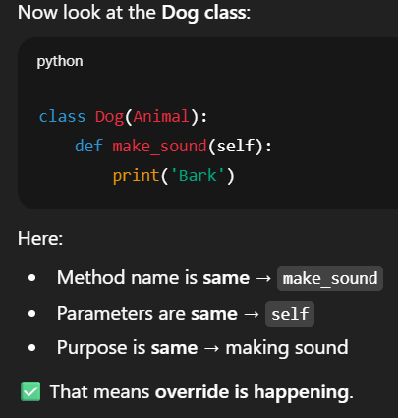
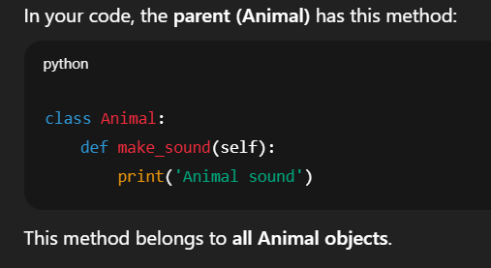
What is Method Overriding?
When a child class defines a method with the SAME NAME and SAME PURPOSE as a method in the parent class, the child’s version replaces the parent’s version for child objects.

Slide 47
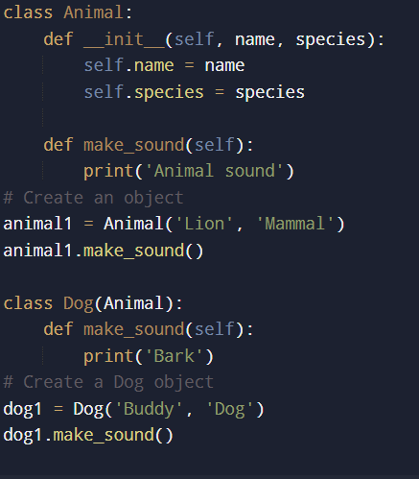
Add properties of child:
class `Dog` that inherits from `Animal` and overrides `make_sound()`.

Slide 48
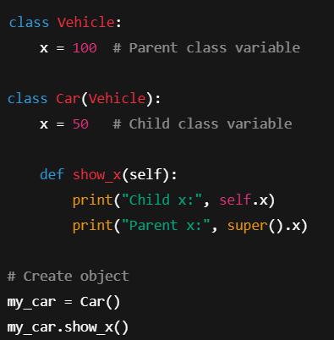
Using `super()` in Child Class
Use the `super()` function to access the parent class's constructor and methods.

Slide 49
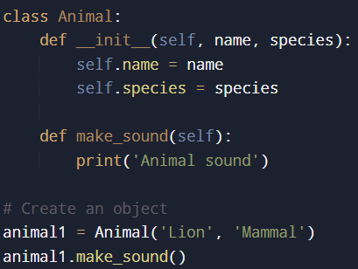
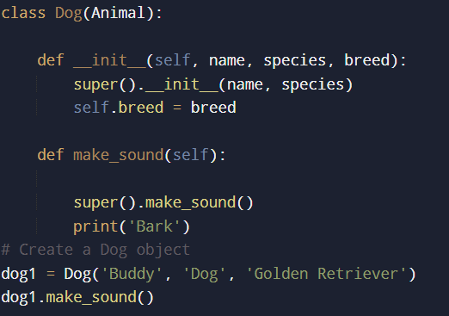
Using `super()` in Child Class

Slide 50
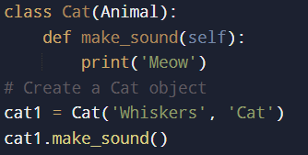
Creating Another Child Class
Create a class `Cat` that also inherits from `Animal` and has its own `make_sound()`.

Slide 51
Adding New Methods in Child Class
Add a method `play()` to the `Dog` class that prints a message. For example( “DOG_NAME” is playing)

Slide 52
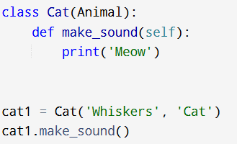
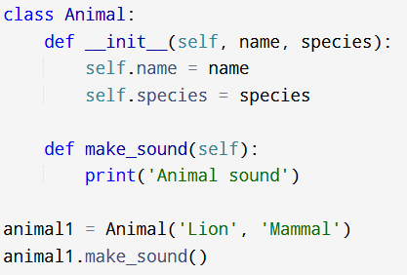
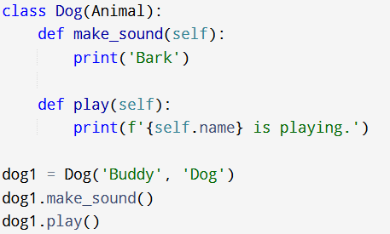


Adding New Methods in Child Class

Slide 53
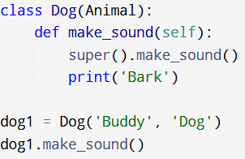

call the parent class method using `super()`

Slide 54
Adding Attributes to Child Class
Add a new attribute `age` to the `Dog` class and initialize it using `__init__()`.

Slide 55
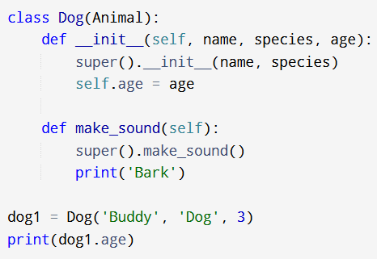


Add a new attribute `age` to the `Dog` class and initialize it using `__init__()`

Slide 56
Inheritance with Multiple Levels
Create another class `Puppy` that inherits from `Dog` and adds a method `train()`.

Slide 57
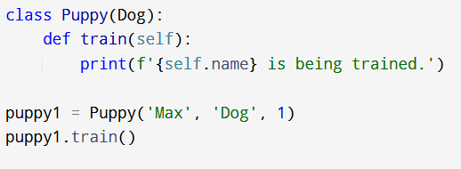
Create another class `Puppy` that inherits from `Dog` and adds a method `train()`

Slide 58
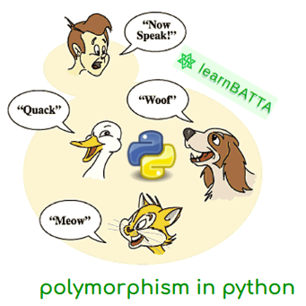
Python Polymorphism
The word "polymorphism" means "many forms", and in programming it refers to methods/functions/operators with the same name that can be executed on many objects or classes.
The same method name behaves differently depending on the object that calls it.

Slide 59
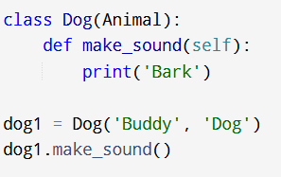
Polymorphism Example

Slide 60
Creating a Vehicle Base Class
Create a class `Vehicle` with attributes `make`, `model`, and a method `start_engine()`.

Slide 61
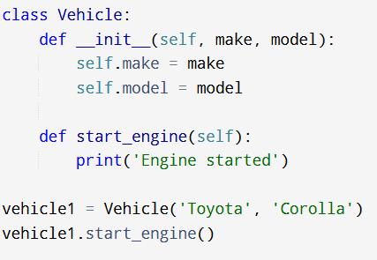
Create a class `Vehicle` with attributes `make`, `model`, and a method `start_engine()`.

Slide 62
Inheriting from `Vehicle`
Create a class `Car` that inherits from `Vehicle` and adds an attribute `brand, model, year`.

Slide 63
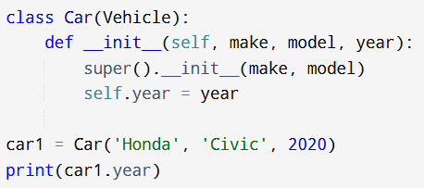
Create a class `Car` that inherits from `Vehicle` and adds an attribute `year`.

Slide 64
Overriding a Method in Child Class.
Override the `start_engine()` method in the `Car` class.

Slide 65
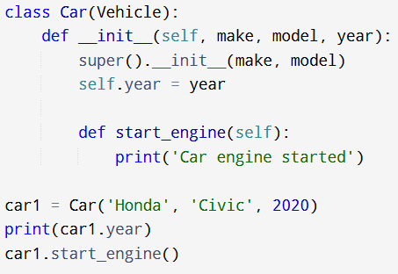


Create a class `Car` that inherits from `Vehicle` and adds an attribute `year`.

Slide 66
Adding Methods to `Car` Class
Add a method `drive()` to the `Car` class that prints (“{brand} and {model} is driving”)

Slide 67
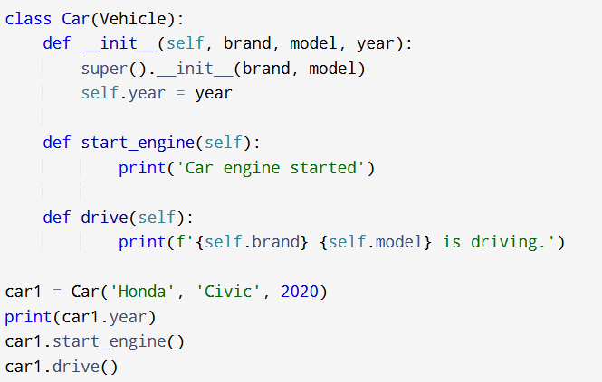
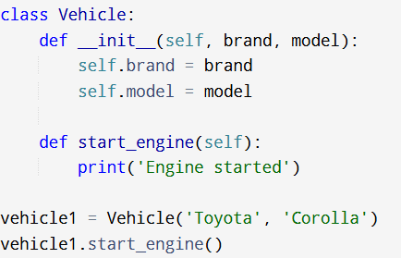


Add a method `drive()` to the `Car` class that prints brand name and model

Slide 68
Multiple Inheritance
Create a class `ElectricCar` that inherits from both `Car` and another class `ElectricVehicle`(create method “charge_battery that prints “battery is charging”)

Slide 69


Add a method `drive()` to the `Car` class that prints brand name and model

Slide 70
Python Encapsulation
Encapsulation means hiding internal details of a class and only exposing what’s necessary. It helps to protect important data from being changed directly and keeps the code secure and organized.
Why do we need Encapsulation?
Protects data from unauthorized access.
Controls data updates.
Enhances Security by hiding internal implementation details.
Example: Restricting direct access to a bank account balance.

Slide 71

Access Specifiers
Access specifiers define how class members (variables and methods) can be accessed from outside the class.
They help in implementing encapsulation by controlling the visibility of data. There are three types of access specifiers:

Slide 72


Example:

Slide 73
Assignment Task
Task Management System with Inheritance
Extend the Task Management System with the following:
Create a base class `Task` with attributes `title`, `due_date`, and `priority`
Create a child class `ProjectTask` that inherits from `Task` and adds an attribute `project_name`.
Override the method to display task details in the `ProjectTask` class to include the project name.
Write a function that accepts both `Task` and `ProjectTask` objects and displays their details.

Slide 74
Introduction to Object-Oriented Programming (OOP)
Week-05
Working with Objects in the Project

Slide 75
Create A Class “TASK”
Create a class “Task” with attributes (title, due_date, priority).

Slide 76

Create a class ‘Task’ with attributes (title, due_date, priority).

Slide 77
Adding a `mark_complete` Method
Add a method `mark_complete()` to the `Task` class that marks the task as completed.

Slide 78
Add a method `mark_complete()` to the `Task` class that marks the task as completed.

Slide 79
Displaying Task Status
Add a method `show_status()` that displays title, Due_date and task status.

Slide 80

Add a method `show_status()` that displays title, Due_date and task status.

Slide 81
Adding a Task to a List
Write a function that allows users to create a new task and add it to a list of tasks.

Slide 82


Write a function that allows users to create a new task and add it to a list of tasks.

Slide 83
Viewing All Tasks
Write a function `view_tasks()` to display all tasks in the list, including their completion status

Slide 84
Write a function `view_tasks()` to display all tasks in the list, including their completion status

Slide 85
Marking a Task as Completed
Extend your program to allow users to mark a task as completed by selecting it from the list using function “mark_task_completed”.

Slide 86


Extend your program to allow users to mark a task as completed by selecting it from the list using function “mark_task_completed”.

Slide 87
Removing a Task
Add a function “remove_task()” that allows users to delete a task from the list. (Hint : use pop())

Slide 88

Add a function “remove_task()” that allows users to delete a task from the list. (Hint : use pop())

Slide 89
Searching for a Task by Title
Write a function that searches for a task by its title and displays its details.

Slide 90

Write a function that searches for a task by its title and displays its details.

Slide 91
Updating a Task
Write a function `update_task()` to allow users to change the title or due date of a task.

Slide 92

Write a function `update_task()` to allow users to change the title or due date of a task.

Slide 93
Saving Tasks to a File
Add function “save_tasks_to_file(filename)” to save the list of tasks to a file.

Slide 94

Add function “save_tasks_to_file(filename)” to save the list of tasks to a file.

Slide 95
Loading Tasks from a File
Write a function “load_tasks_from_file(filename)” to load tasks from a file and repopulate the task list.

Slide 96

Write a function “load_tasks_from_file(filename)” to load tasks from a file and repopulate the task list.

Slide 97
Displaying Completed Tasks Only
Write a fuction “show_completed_tasks()” to display only tasks that are marked as completed.

Slide 98

Write a fuction “show_completed_tasks()” to display only tasks that are marked as completed.

Slide 99
Displaying Incomplete Tasks Only
Write a function “show_incomplete_tasks()” to display only tasks that are marked as Incompleted.

Slide 100

Write a function “show_incomplete_tasks()” to display only tasks that are marked as Incompleted.

Slide 101
Create Menu Function:
Write a function “Menu” which ask user that which Task Manager service you want?

Slide 102




Write a function “Menu” which ask user that which Task Manager service you want?

Slide 103
Task
Init(title, due_date, priority) , variable complete
Make_complete()
Show_status()
add_task()
View_task()
mark_task_completed()
Remove_task(title)
Search_task() → # pop function
Update_ task(task_number)
Save_task_to_file(filename= ‘Task.txt’)
load_task_from_file(filename= ‘Task.txt’)
Show_completed_task()
Show_incomplete_task()

