Slide 1
Introduction to Programming and Python Basics
Introduction to Programming Concepts
Week 1
Engr. Tushar Kanjwani

Slide 2
Course Outline
Introduction to Programming and Python Basics
Control Flow and Looping
Functions and More Data Structures
File Handling and Basic Project Structuring
Introduction to Object-Oriented Programming (OOP)
Introduction to APIs and External Libraries
Advanced Python Concepts and Data Visualization
Project Finalization and Deployment

Slide 3
Learning Outcomes:
Install Python and set up an Integrated Development Environment (IDE).
Understand basic programming concepts.
Write and execute your first Python program.
Work with basic data types (strings, integers).
Understand how to declare and use variables.

Slide 4
Programming Languages
A programming language is how we write code, what keywords we use, to tell the computer what to do.
Why Programming is Used
Programming is used to create:
Websites
Mobile apps
Games
Software
Artificial Intelligence
Very Simple Example (Real Life)
Think of programming like a recipe for cooking 🍳. You write step-by-step instructions, and the computer follows them exactly

Slide 5
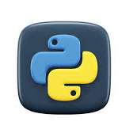
What is Python?
Python is a popular programming language.
It is used for:
web development (server-side)
software development
Mathematics
Game development

Slide 6
What can Python do?
Python can be used on a server to create web applications.
Python can connect to database systems.
Python can be used to handle big data and perform complex mathematics.
Python can be used for rapid prototyping, or for production-ready software development.

Slide 7
Install Python and IDE Setup
Python Installation:
Visit https://www.python.org/downloads/
Download the latest version of Python
Install an IDE like Visual Studio Code or PyCharm.

Slide 8

Your First Python Program

Slide 9
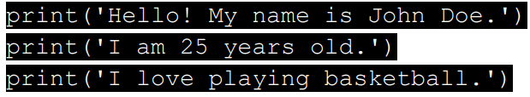

Write a Python program
OUTPUT:

Slide 10
Variables
A variable is a container used to store data in a program. The value stored in a variable can change during program execution.
name = "Ali"
age = 20

Slide 11
Variable naming rules
Same rules like in other programming language.
Each variable should be start with upper or lower or underscore signe.
Each variable can contain upper or lower or undersocre or number or any other symbols.
Variable name cannot start with space.

Slide 12
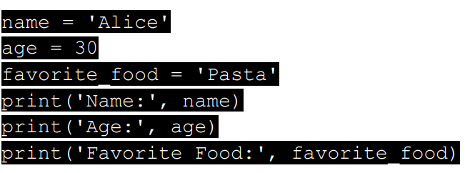

Introduction to Variables
Understand variables and how they store data.
Assign values to variables and display them using `print()`.

Slide 13
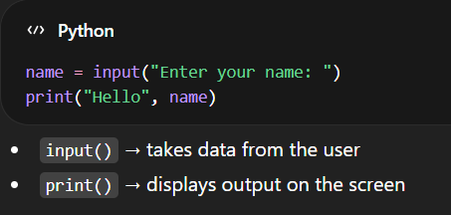
Input / Output (I/O)
Input means getting data from the user.
Output means displaying results to the user.

Slide 14

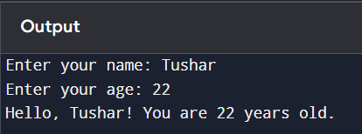
User Input and String Concatenation
Learn how to use the `input()` function to get user input.
Write a program that asks the user for their name and age:

Slide 15
Combining Strings and Numbers
Learn how to concatenate numbers and strings in the same output.
Write a program that asks the user for their name and age, then prints a personalized message that includes arithmetic operations:

Slide 16
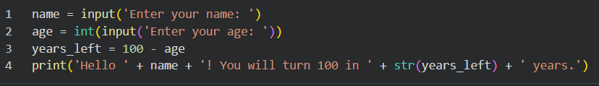
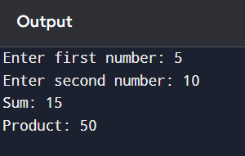
Combining Strings and Numbers

Slide 17
Assignment
Write a detailed Python program that asks the user for the following details:
Full name
Age
Favorite hobby
Year of birth
Based on the inputs, the program should:
1. Greet the user with their full name.
2. Calculate the number of years remaining until they turn 100 years old. 3. Display their age in dog years (1 human year = 7 dog years).
4. Print a personalized message mentioning their hobby and what year they were born in.

Slide 18
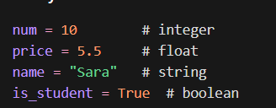
Data Types
Data types define the type of data a variable can store.
Common data types include:
Integer (int): whole numbers Example: 10, 25
Float: decimal numbers Example: 3.14, 10.5
String (str): text or characters Example: "Hello", "Python"
Boolean (bool): true or false values Example: True, False

Slide 19
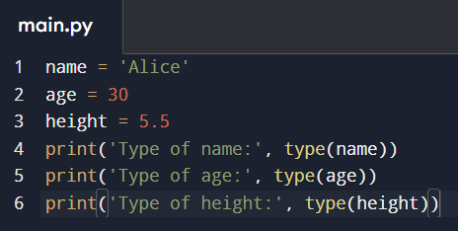
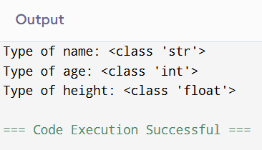
Checking Data Types
Write a Python program that creates a string, integer, and float variable, then prints their data types:

Slide 20
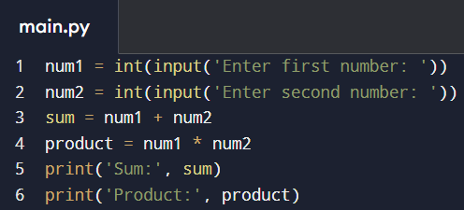
Simple Arithmetic Operation
Learn how to use basic arithmetic operations (addition, multiplication).
Write a program that asks the user for two numbers and performs arithmetic operations:

Slide 21
Performing Arithmetic Operations
Learn how to use basic arithmetic operations (addition, subtraction, multiplication, division).
Write a program that asks the user for two numbers and performs arithmetic operations:

Slide 22
Working with Floats and Integers
Understand the difference between integers and floats.
Perform operations with both integer and float data types.

Slide 23
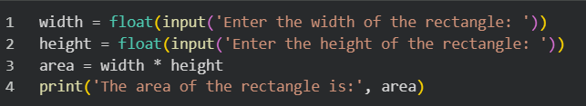

Working with Floats and Integers

Slide 24
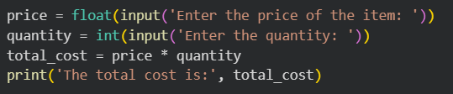

Combining User Input and Calculations
Write programs that ask the user for inputs (like cost, and quantity) and perform calculations using these inputs and save output in total_cost.

Slide 25
Handling Division and Float Precision
Explore how Python handles division and float precision.
Write a program that divides two numbers and limits the result to two decimal places.
Start teaching them built-in functions, e.g., round().

Slide 26
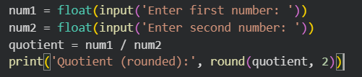

Handling Division and Float Precision

Slide 27

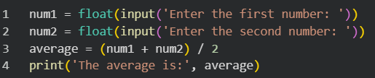
Calculating Averages
Write a program that asks the user for two numbers and calculates the average.

Slide 28

Advanced Input and Output
Use formatted strings to display results with clarity.
Write a Python program that takes multiple inputs from the user and displays them in a well-formatted output.x

Slide 29
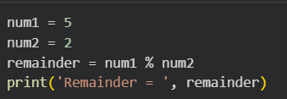
Using the Modulus Operator
Learn how to use the modulus operator `%` to find remainders in division.
Write a program that checks if a number is even or odd using the modulus operator.

Slide 30
Assignment
Write a Python program that asks the user for the radius of a circle and calculates the area
Formula: Area = π * (radius)^2

Slide 31
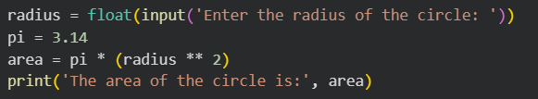

Solution

Slide 32
Correct Variable Naming in Python
Variable names must start with a letter or an underscore (_), but not a number.
Variable names can only contain alphanumeric characters (A-Z, a-z, 0-9) and underscores (_).
Variable names are case-sensitive (e.g., age and Age are different variables).
Variable names should be descriptive and concise, avoiding abbreviations where clarity might be lost.
Avoid using Python keywords like if, else, for, class, etc., as variable names.
1) 1st_variable = “Hello World"
2) @name = "John"
3) my variable = "This is wrong"
4) user-age = 25
5) total$amount = 1000

Slide 33


String Concatenation
Practice combining strings using concatenation.
Write a Python program that accepts a favorite color and food from the user and combines them in a sentence.

Slide 34
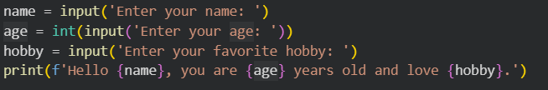
String Formatting Using f-Strings
Learn how to format strings using f-strings for cleaner code and output.
Write a Python program that accepts name, age, and hobby, and formats them in a message using f-strings

Slide 35
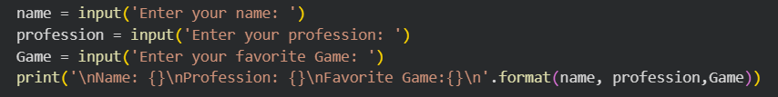
String Formatting with the ‘format()’ Method
Write a program that asks for the user's favorite movie and city, then prints a formatted message using `format()`

Slide 36
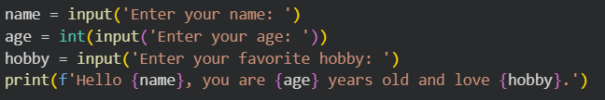
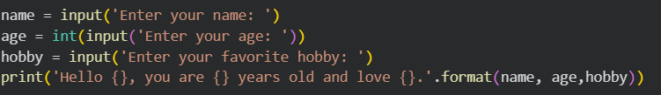
Different between f-string & format()

Slide 37
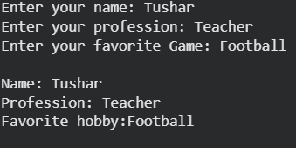
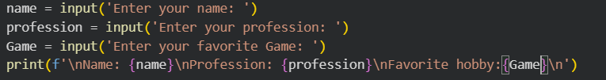
Advanced Input and Output
Write a program that asks for the user's name, profession, and a fun fact, then prints them in a multi-line format. (hint = ‘\n’)

Slide 38
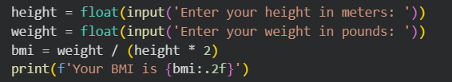

Handling Different Data Types in Input
Write a program that asks for a person's height (float) and weight (float) and calculates their Body Mass Index (BMI).
(Hint=1pound = 2.2kg and 1meter = 3.28)

