Slide 1
Application Programming Interface (APIs)
Week-06
Engr. Tushar Kanjwani

Slide 2
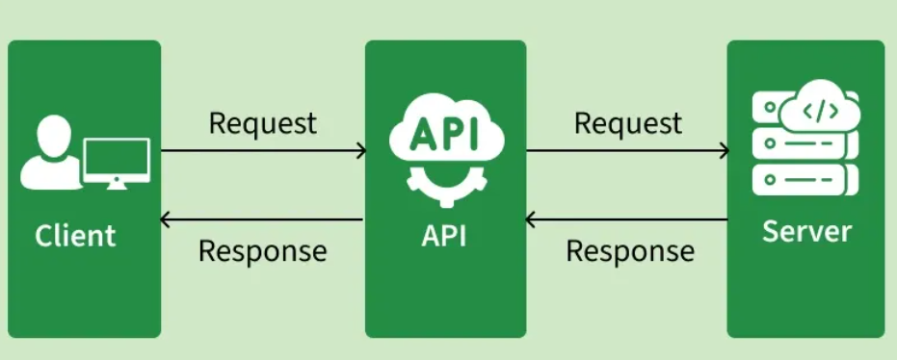
What is an API
APIs are the invisible backbone of modern software development. They enable applications and systems to communicate and share data efficiently.

Slide 3
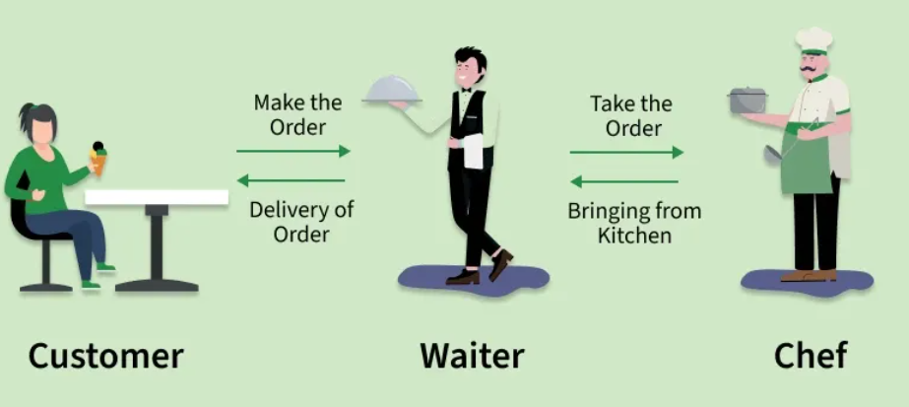
Example:

Slide 4
Why Do We Need APIs?
Reusability: (e.g., Google Maps API, Stripe Payments API).
Efficiency: Save development time.
Integration: Connect multiple platforms web, mobile, IoT.
Automation: machines to machines communication
Scalability

Slide 5
Python Requests
Python Requests Library is a simple and powerful tool to send HTTP requests and interact with web resources.
It allows to easily send requests to web servers and handle responses using:
GET
POST
PUT
DELETE
PATCH
HEAD

Slide 6
How to Install Request Library
Use `pip` to install the `requests` library.
pip install requests

Slide 7

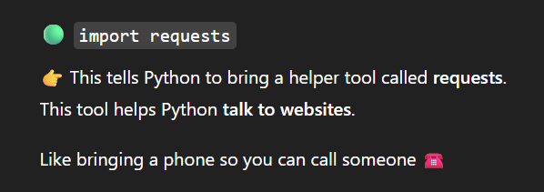
Making a Simple HTTP GET Request
Write Python code to make an HTTP GET request to an API endpoint using the `requests` library

Slide 8
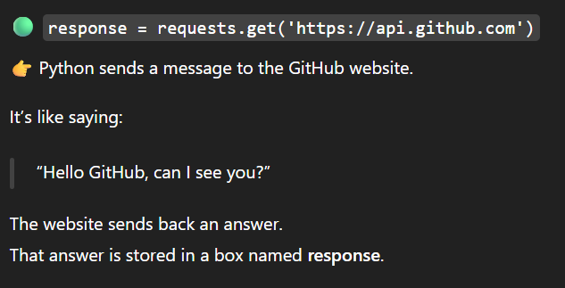
Making a Simple HTTP GET Request
Write Python code to make an HTTP GET request to an API endpoint using the `requests` library

Slide 9
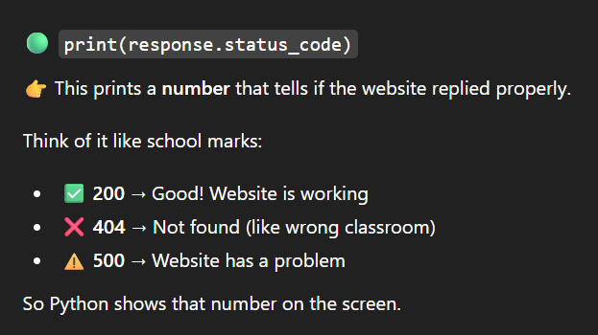
Making a Simple HTTP GET Request
Write Python code to make an HTTP GET request to an API endpoint using the `requests` library

Slide 10
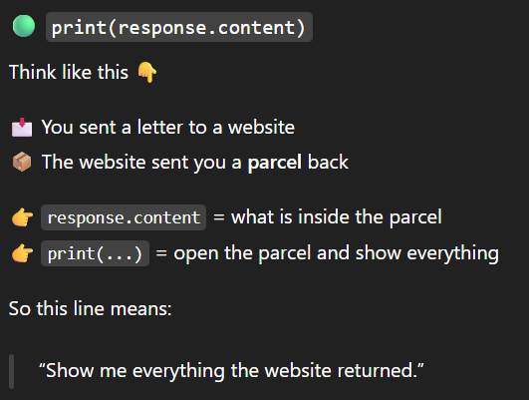
Accessing the Response Content
Access and print the content returned by the API request.

Slide 11
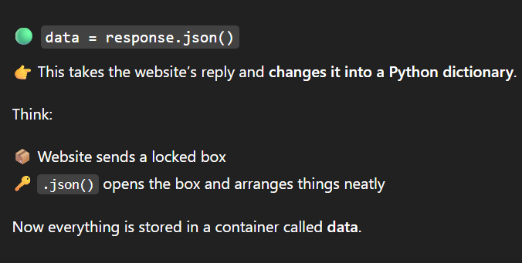

Accessing JSON Data
Convert the API response content to JSON and print it.

Slide 12
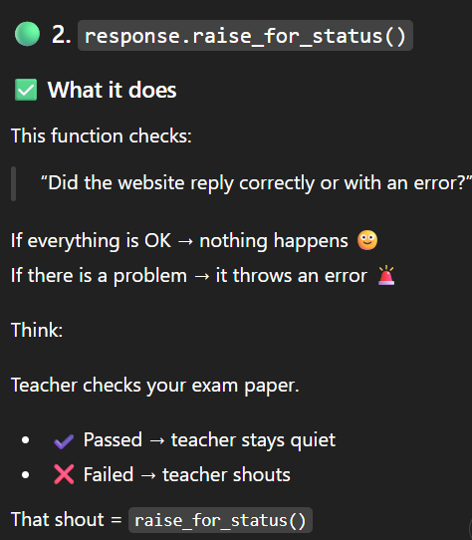
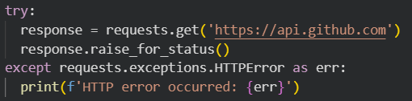
Fetching Specific Data from JSON
Extract specific information from the JSON response. (e.g., Extract the 'current_user_url' from GitHub API response).

Slide 13
Using API Parameters
Make an API request with query parameters. (e.g., Search for a user on GitHub).

Slide 14
Listing Installed Packages
Write a Python script to list all installed packages using `pip`
!pip list

Slide 15
Installing a Specific Version of a Package
Install a specific version of a package using `pip` (e.g., install version 2.26.0 of `requests`)
pip install requests==2.26.0

Slide 16
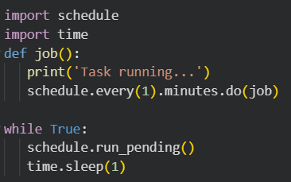
Using `schedule` Library to Schedule a Task
Install and use the `schedule` library to schedule a task that prints a message every minute

Slide 17
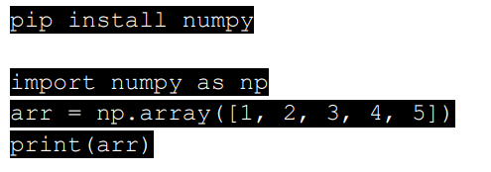
Installing `numpy` for Mathematical Operations
Install `numpy` and use it to create and manipulate arrays.

Slide 18

Making an API Request
Make an HTTP GET request to the chosen API using `requests` and print the response status code from “https://catfact.ninja/fact”

Slide 19

Parsing API Response
- Convert the API response content to JSON and print the data.

Slide 20

Extracting Data from the API
Extract specific information from the JSON response. For example, extract a Fact from a cat fact API

Slide 21
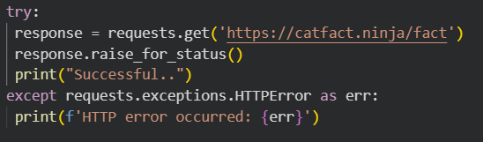
Handling API Errors
- Handle errors that may occur during the API request using `try-except`.

Slide 22
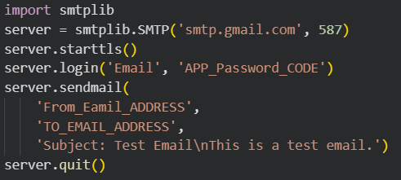
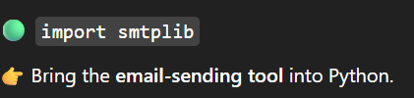
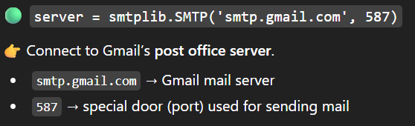

Sending Emails with `smtplib`
Use the `smtplib` library to send an email programmatically.x

Slide 23
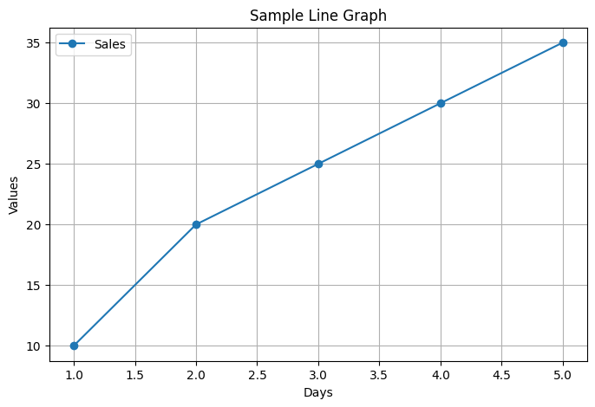
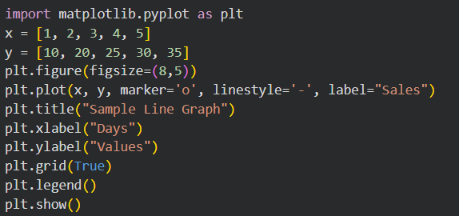
sing `matplotlib` for Plotting
Install `matplotlib` and use it to create a simple line plot.

Slide 24
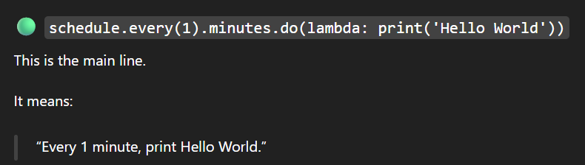
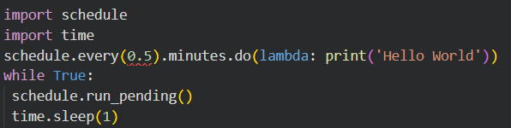
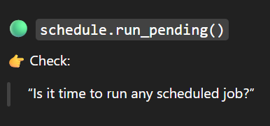

Scheduling a Simple Task
Write a Python script to schedule a task that prints 'Hello World' every minute.

Slide 25
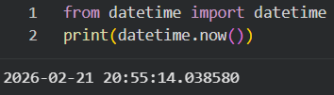
Working with Dates and Time using `datetime
Use the `datetime` library to print the current date and time.

Slide 26
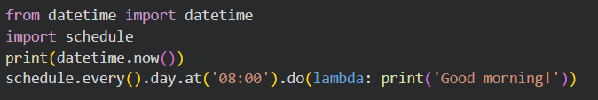
Working with Dates and Time using `datetime
Use `schedule` to schedule a task at a specific time (e.g., every day at 8:00 AM)

Slide 27
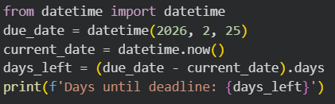
Adding a Deadline to a Task
Use `datetime` to add a deadline to a task and print how many days remain until the deadline.

