Slide 1
Line Search

Slide 2
Line Search
Line search techniques are in essence optimization algorithms for one-dimensional minimization problems.
They are often regarded as the backbones of nonlinear optimization algorithms.
Typically, these techniques search a bracketed interval.
Often, unimodality is assumed.
a
x*
b
Exhaustive search requires N = (b-a)/ε + 1 calculations to search the above interval, where ε is the resolution.

Slide 3
Basic bracketing algorithm
ε
a
x1
x2
b
Two point search (dichotomous search) for finding the solution to minimizing ƒ(x):
0) assume an interval [a,b]
1) Find x1 = a + (b-a)/2 - ε/2 and x2 = a+(b-a)/2 + ε/2 where ε is the resolution.
2) Compare ƒ(x1) and ƒ(x2)
3) If ƒ(x1) < ƒ(x2) then eliminate x > x2 and set b = x2
If ƒ(x1) > ƒ(x2) then eliminate x < x1 and set a = x1
If ƒ(x1) = ƒ(x2) then pick another pair of points
4) Continue placing point pairs until interval < 2 ε

Slide 4
Fibonacci Search
Fibonacci numbers are:
1,1,2,3,5,8,13,21,34,.. that is , the sum of the last 2 numbers
F_{n} = F_{n-1} + F_{n-2}
L2
L3
ε
a
x1
x2
b
L2
L1
L1 = L2 + L3
It can be derived that
L_{n} = (L1 + F_{n-2} ε) / F_{n}

Slide 5
Golden Section
b
a
a - b
Discard
a
b
In Golden Section, you try to have b/(a-b) = a/b
which implies b*b = a*a - ab
Solving this gives a = (b ± b* sqrt(5)) / 2
a/b = -0.618 or 1.618 (Golden Section ratio)
See also 36 in your book for the derivation.
Note that 1/1.618 = 0.618

Slide 6
Bracketing a Minimum using Golden Section
Initialize:
x1 = a + (b-a)*0.382
x2 = a + (b-a)*0.618
f1 = ƒ(x1)
f2 = ƒ(x2)
Loop:
if f1 > f2 then
a = x1; x1 = x2; f1 = f2
x2 = a + (b-a)*0.618
f2 = ƒ(x2)
else
b = x2; x2 = x1; f2 = f1
x1 = a + (b-a)*0.382
f1 = ƒ(x1)
endif
a
x1
x2
b

Slide 7
Newton's Methods
If your function is differentiable, then you do not need to evaluate two points to determine the region to be discarded. Get the slope and the sign indicates which region to discard.
Basic premise in Newton-Raphson method:
Root finding of first derivative is equivalent to finding optimum
  (if function is differentiable).
Method is sometimes referred to as a line search by curve fit because it approximates the real (unknown) objective function to be minimized.

Slide 8
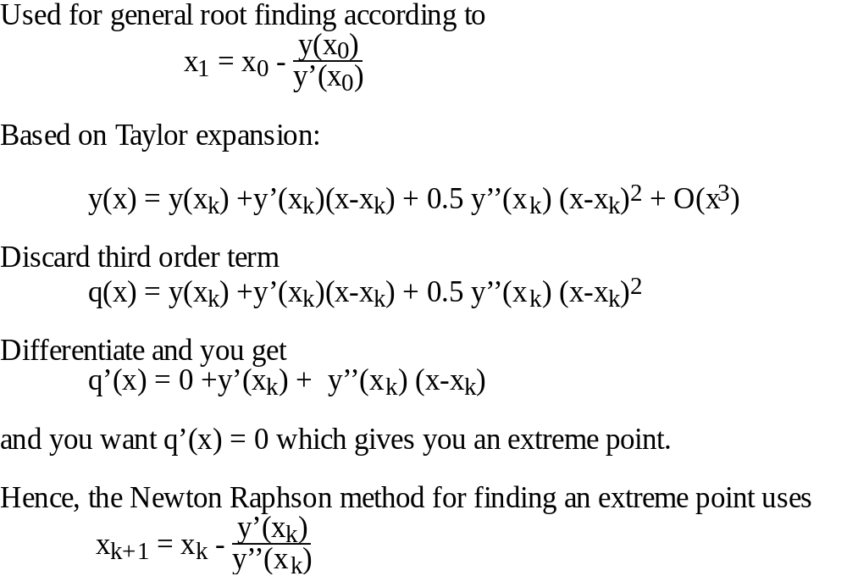
Newton-Raphson Method
Question: How many iterations are necessary to solve an optimization problem with a quadratic objective function ?

Slide 9
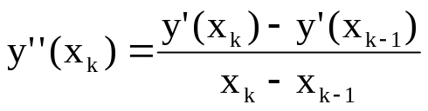
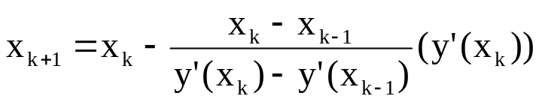
False Position Method or Secant Method
Second order information is expensive to calculate (for multi-variable problems).
Thus, try to approximate second order derivative.\
Replace y''(x_{k}) in Newton Raphson with
Hence, Newton Raphson becomes
Main advantage is no second derivative requirement
Question: Why is this an advantage ?

