Slide 1
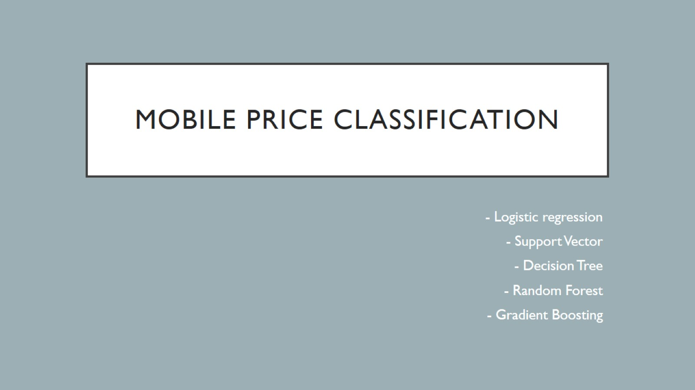
Mobile Price Classification

Slide 2


Slide 3
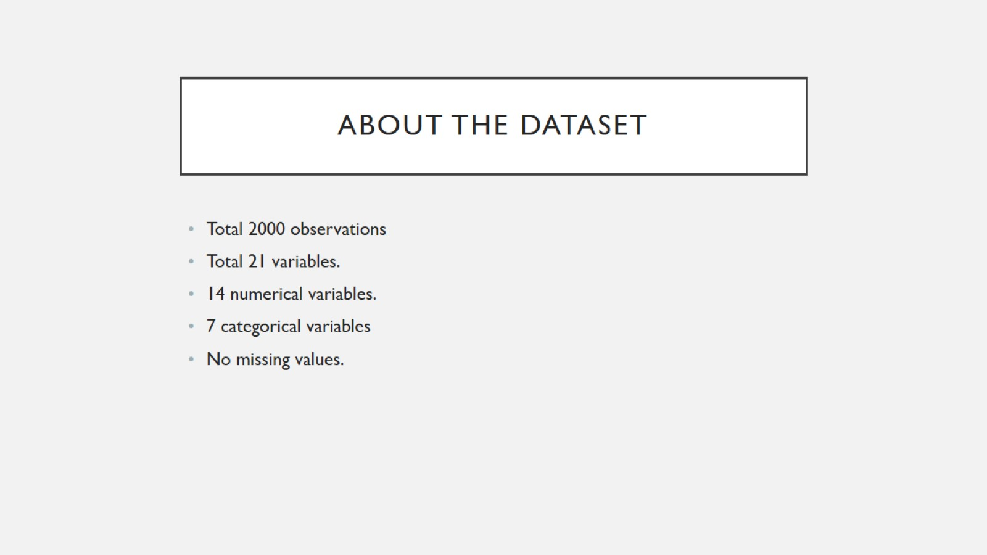
About the Dataset

Slide 4
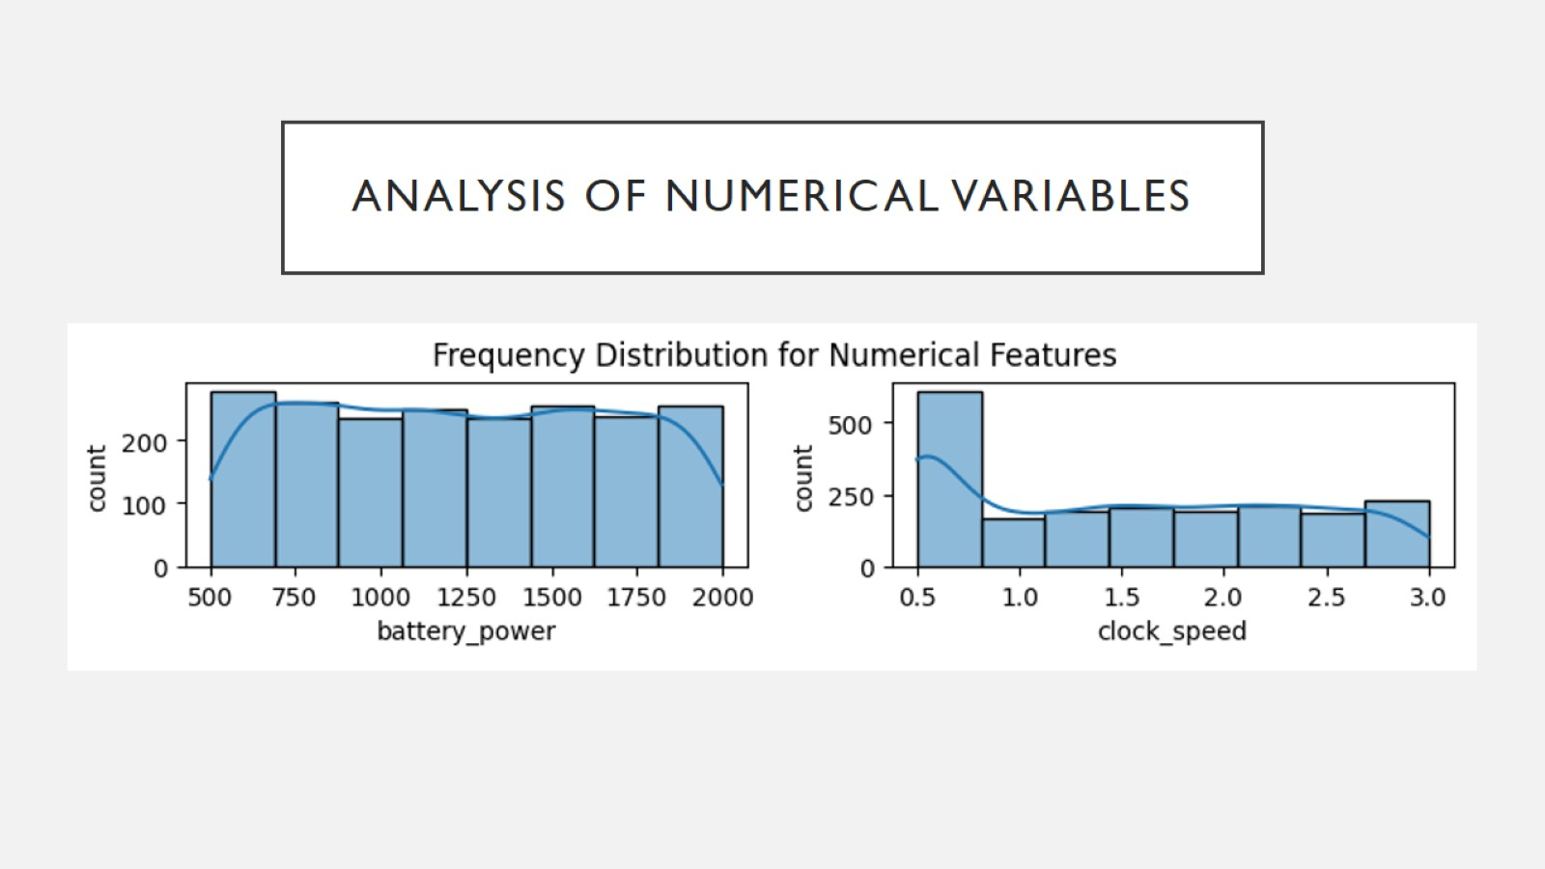
Analysis of Numerical Variables

Slide 5
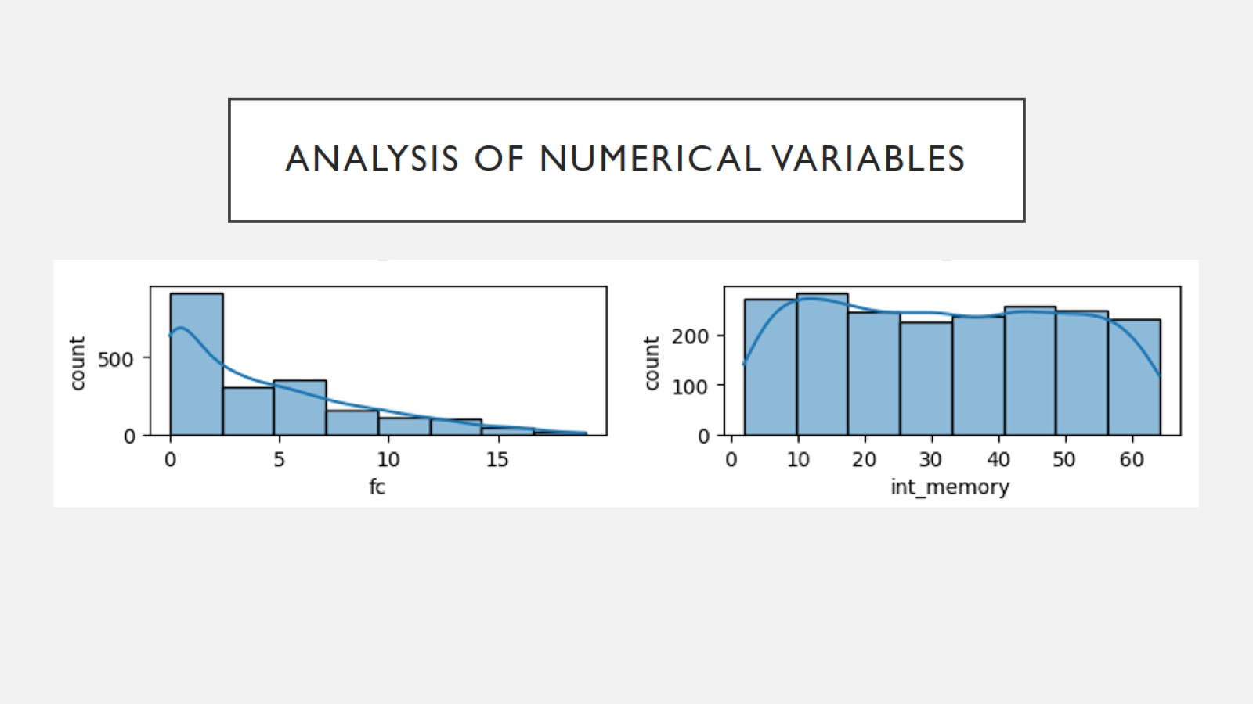
Analysis of Numerical Variables

Slide 6
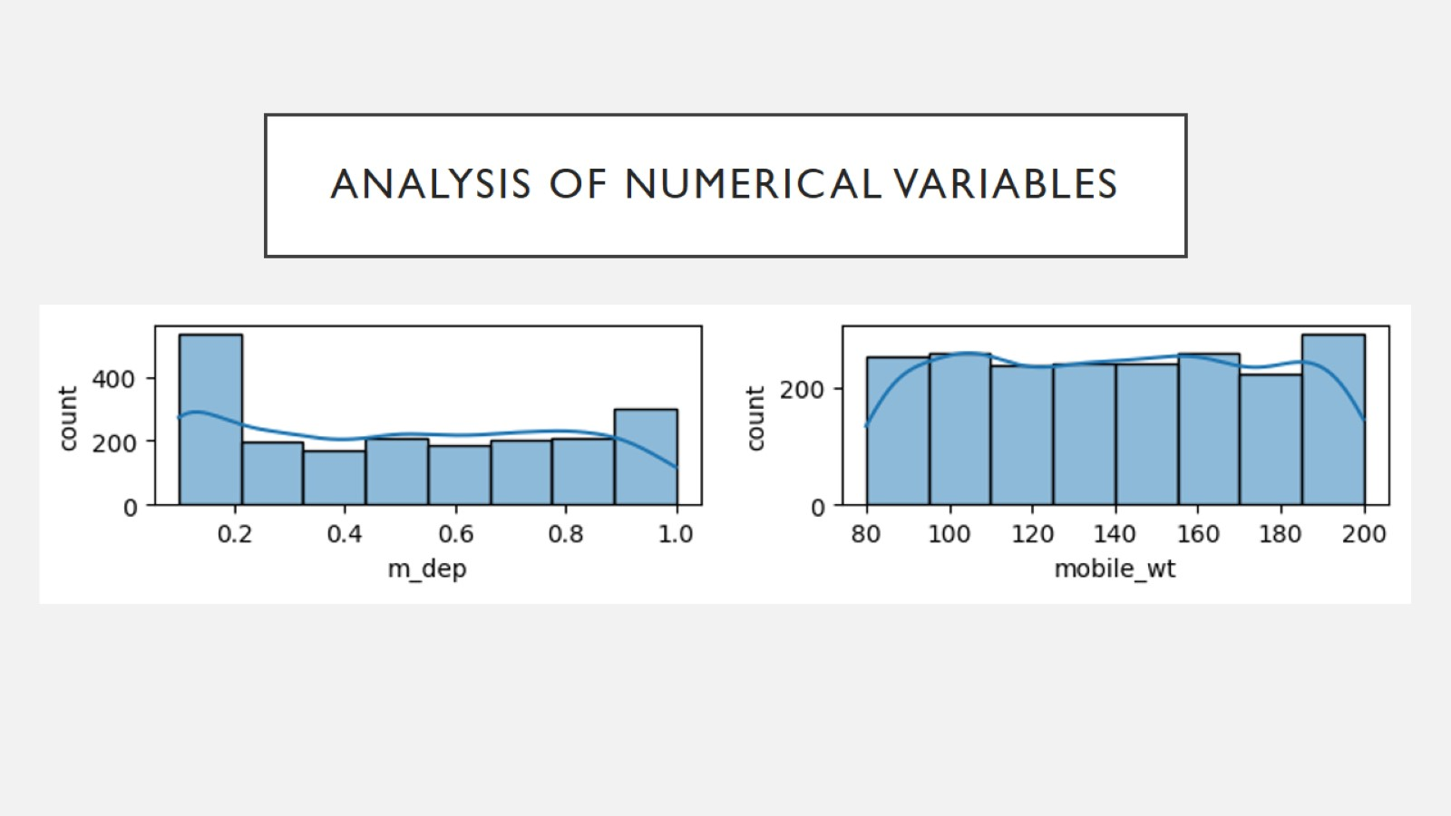
Analysis of Numerical Variables

Slide 7
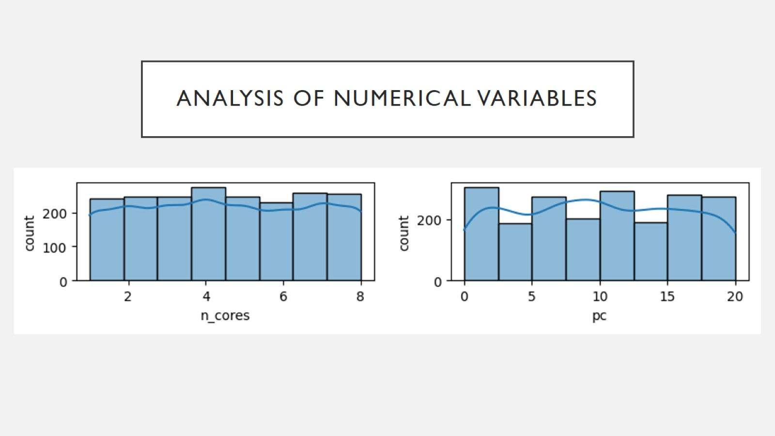
Analysis of Numerical Variables

Slide 8
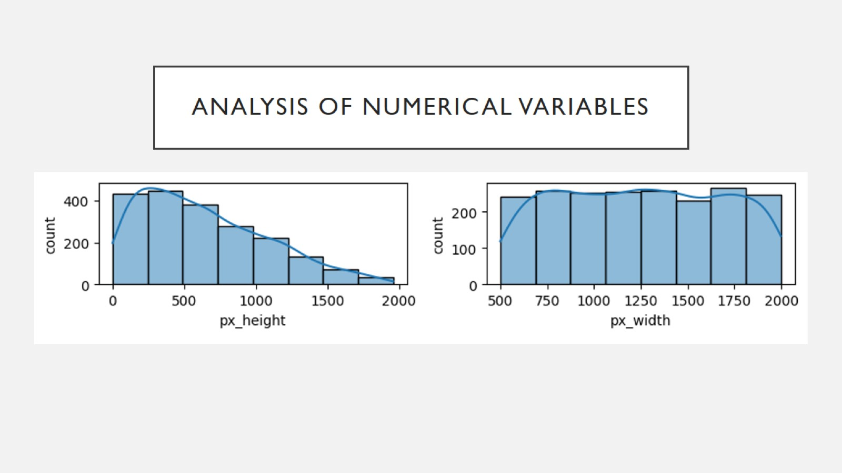
Analysis of Numerical Variables

Slide 9
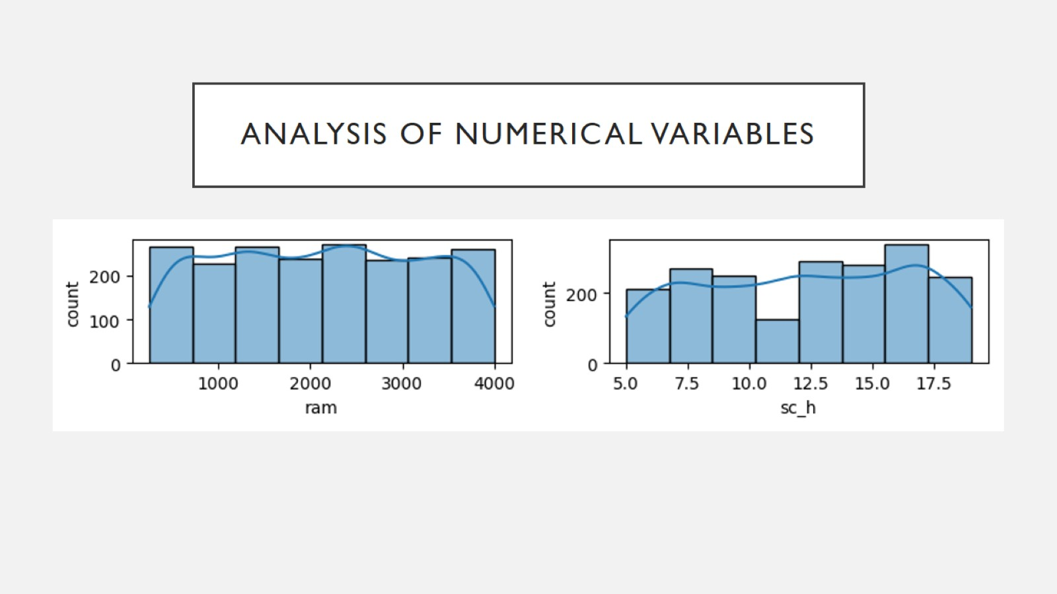
Analysis of Numerical Variables

Slide 10
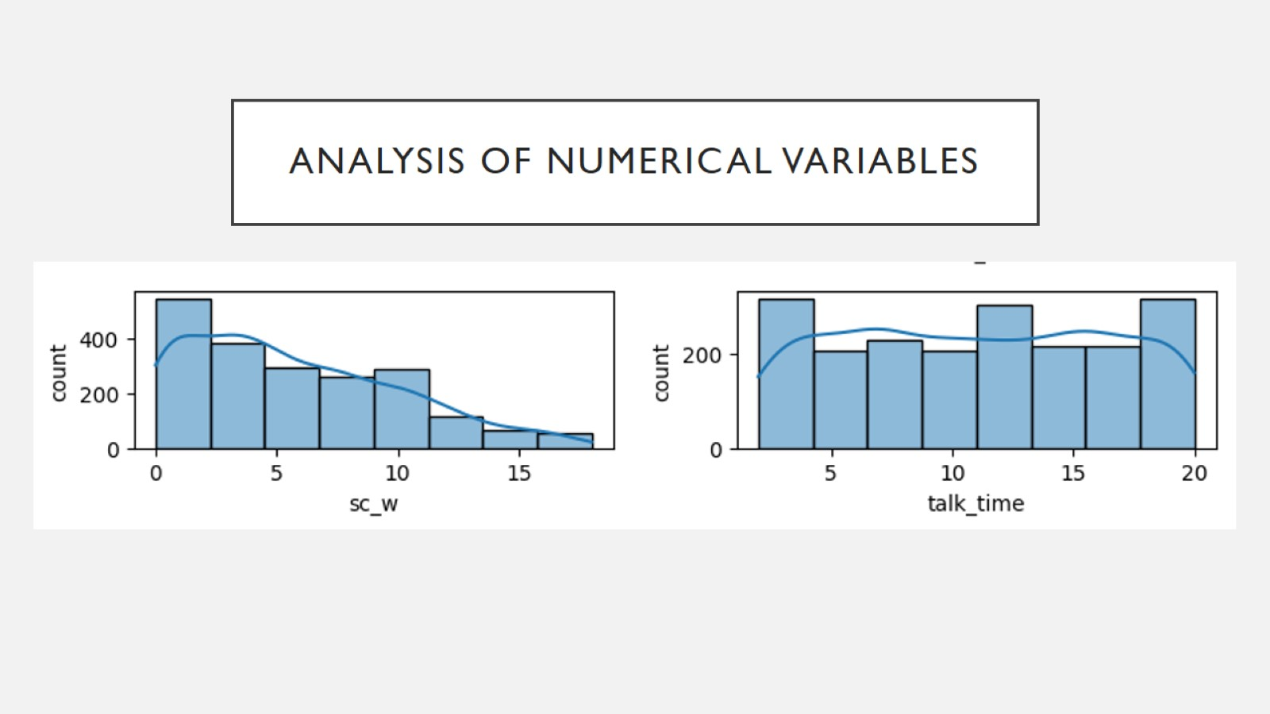
Analysis of Numerical Variables

Slide 11
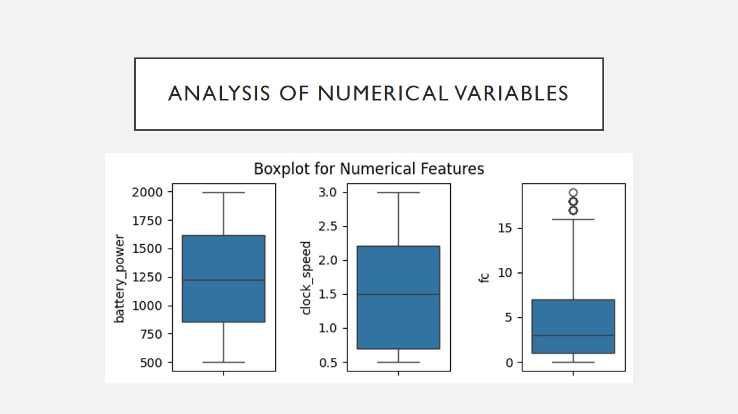
Analysis of Numerical Variables

Slide 12
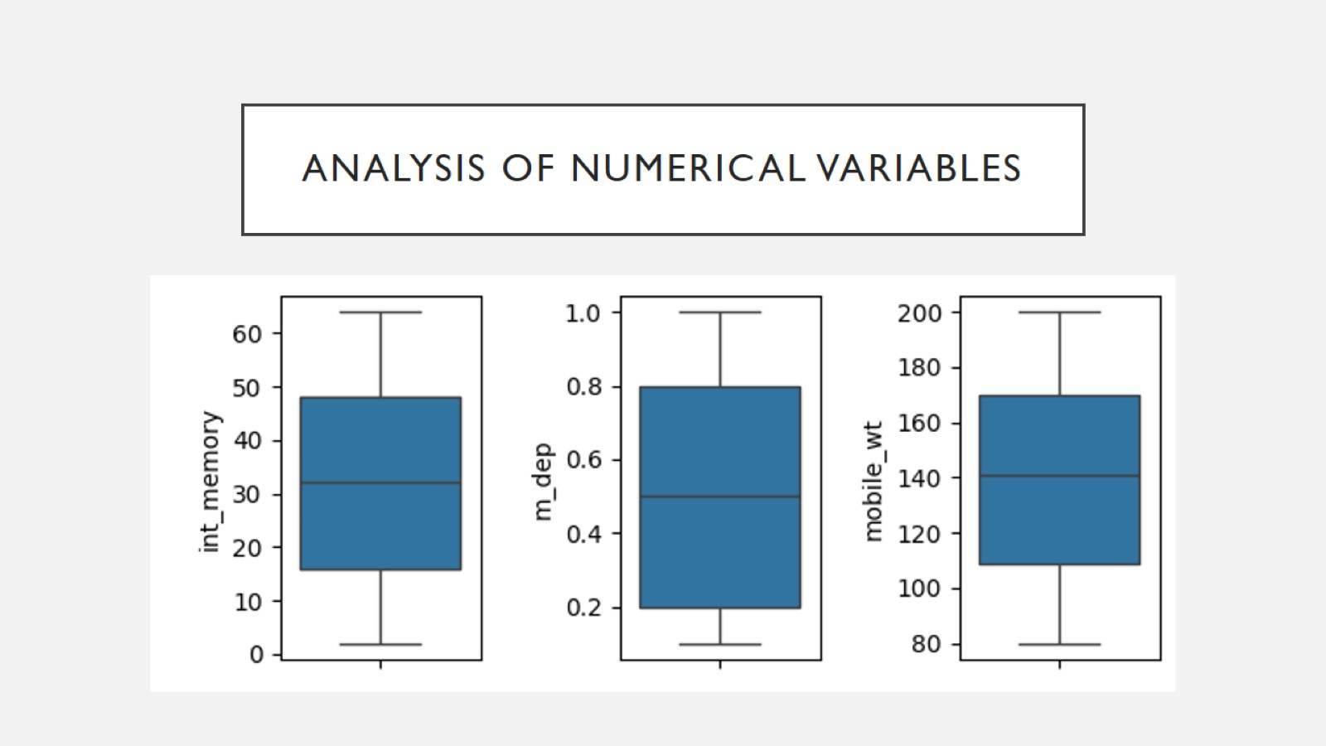
Analysis of Numerical Variables

Slide 13
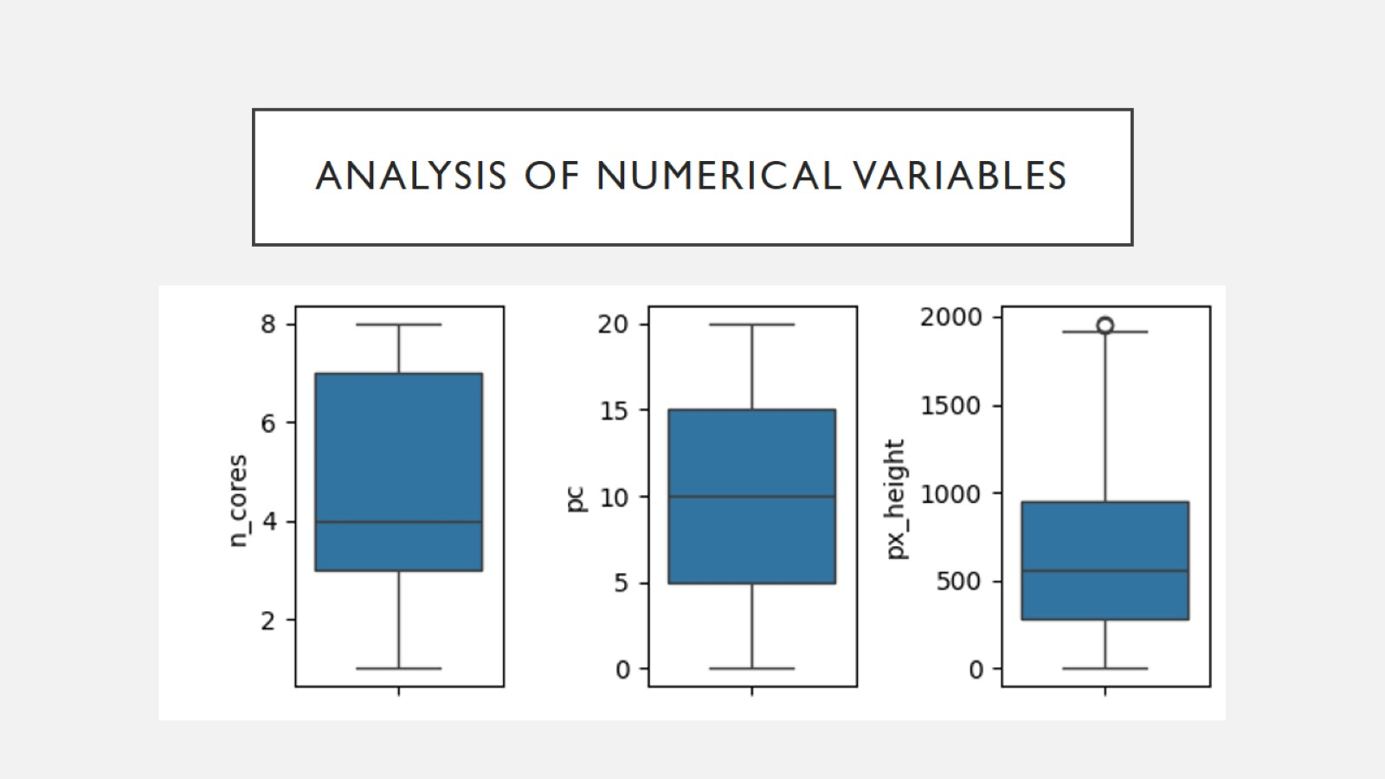
Analysis of Numerical Variables

Slide 14
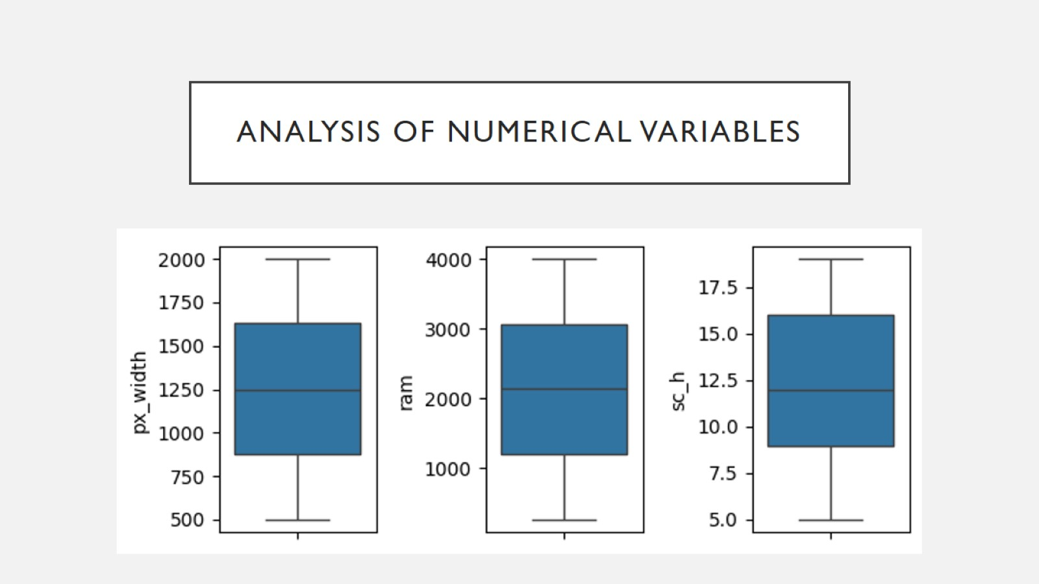
Analysis of Numerical Variables

Slide 15
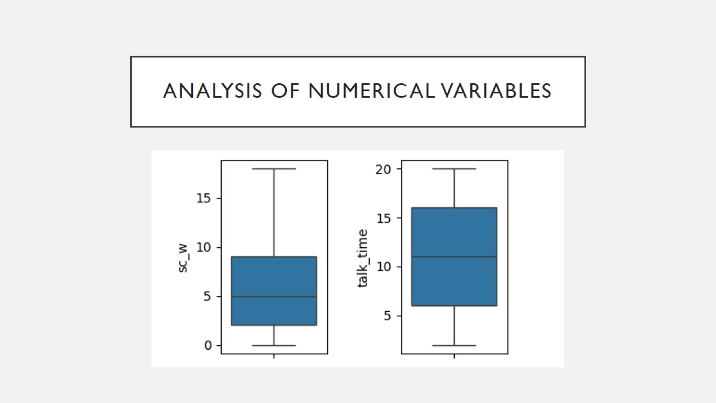
Analysis of Numerical Variables

Slide 16
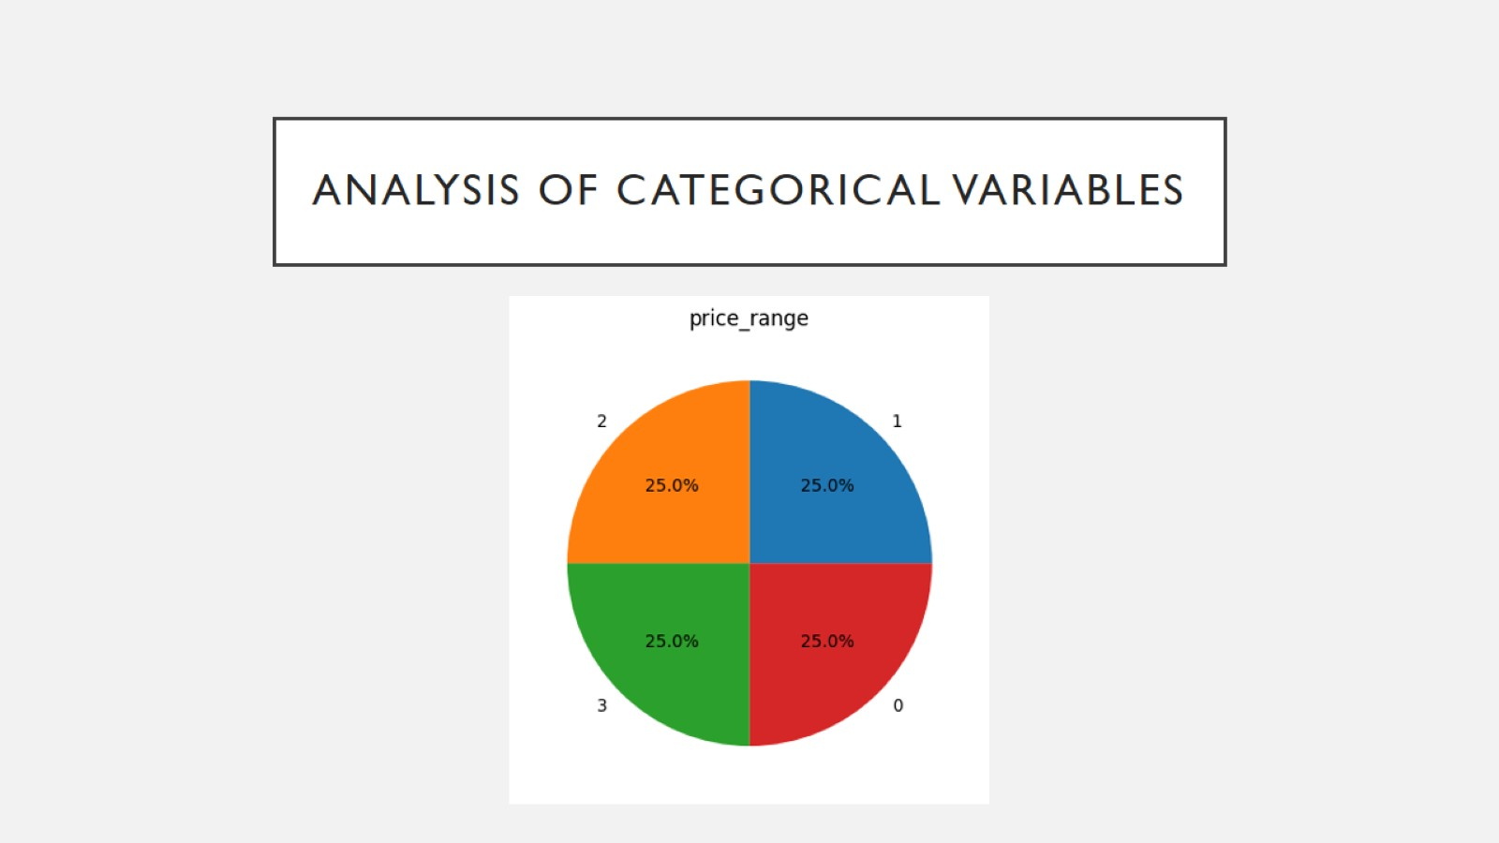
Analysis of Categorical Variables

Slide 17
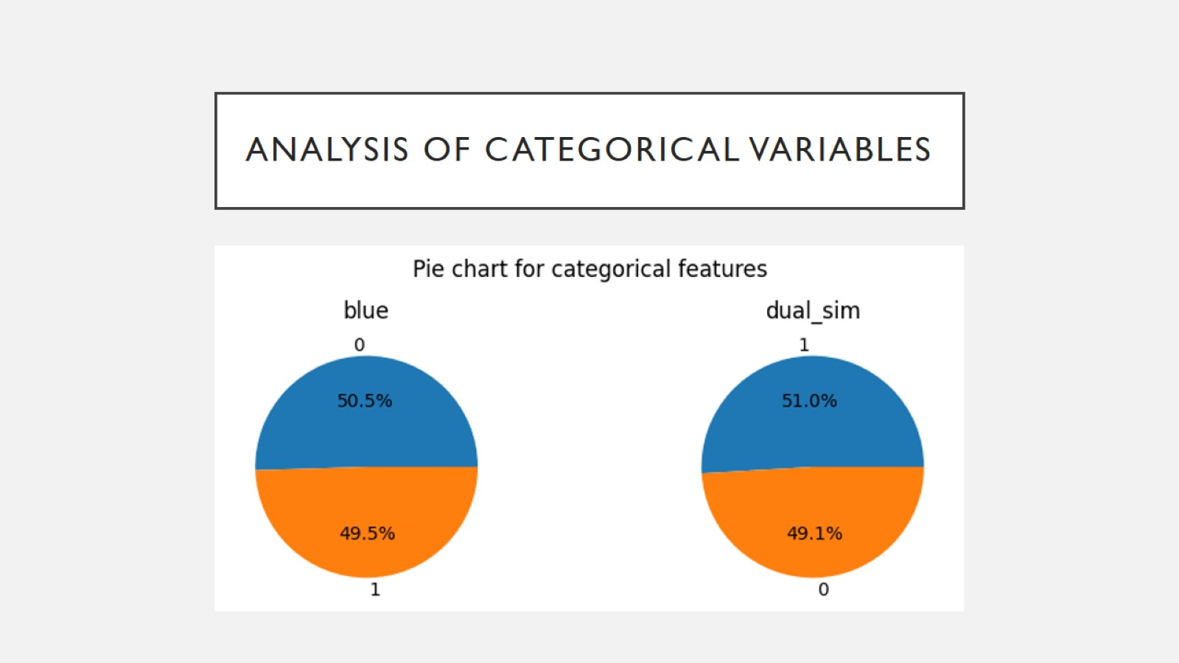
Analysis of Categorical Variables

Slide 18
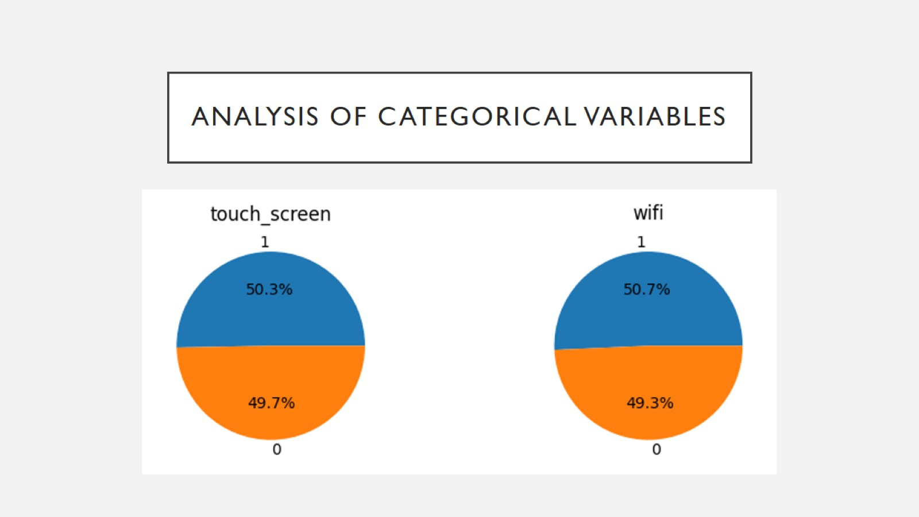
Analysis of Categorical Variables

Slide 19
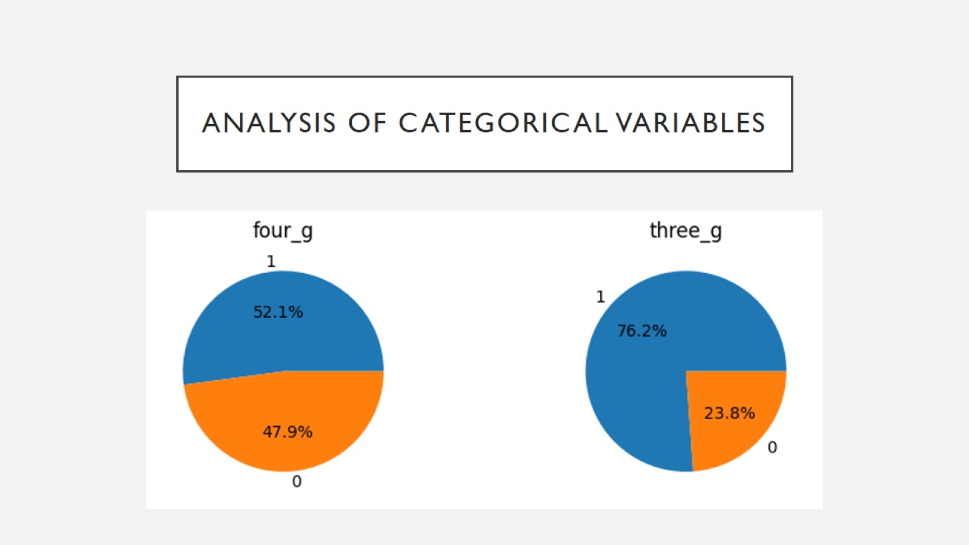
Analysis of Categorical Variables

Slide 20
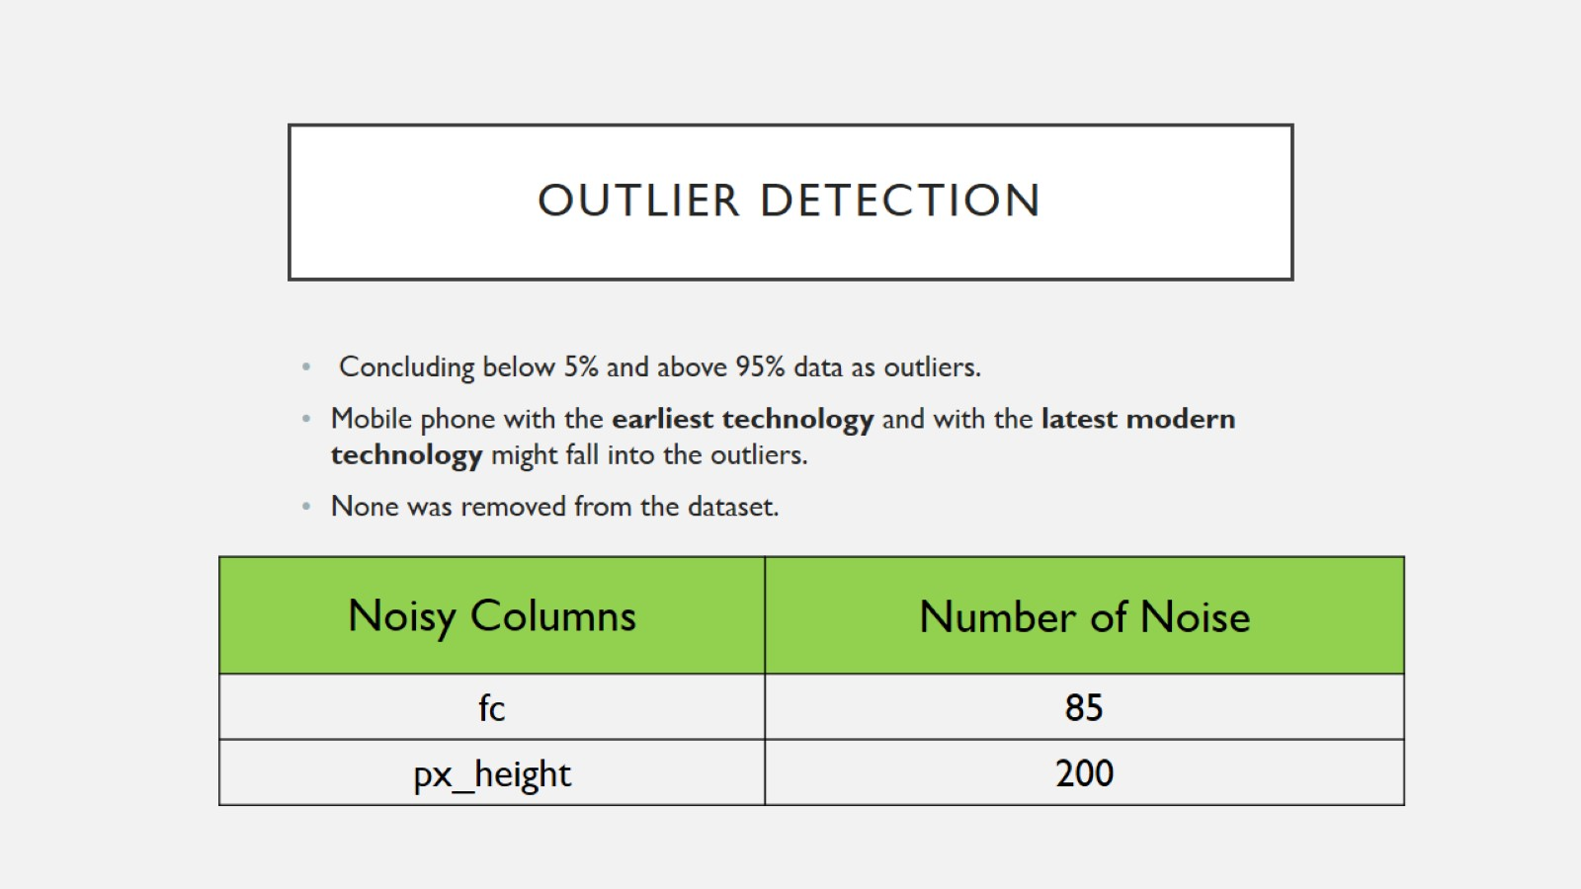
Outlier Detection

Slide 21
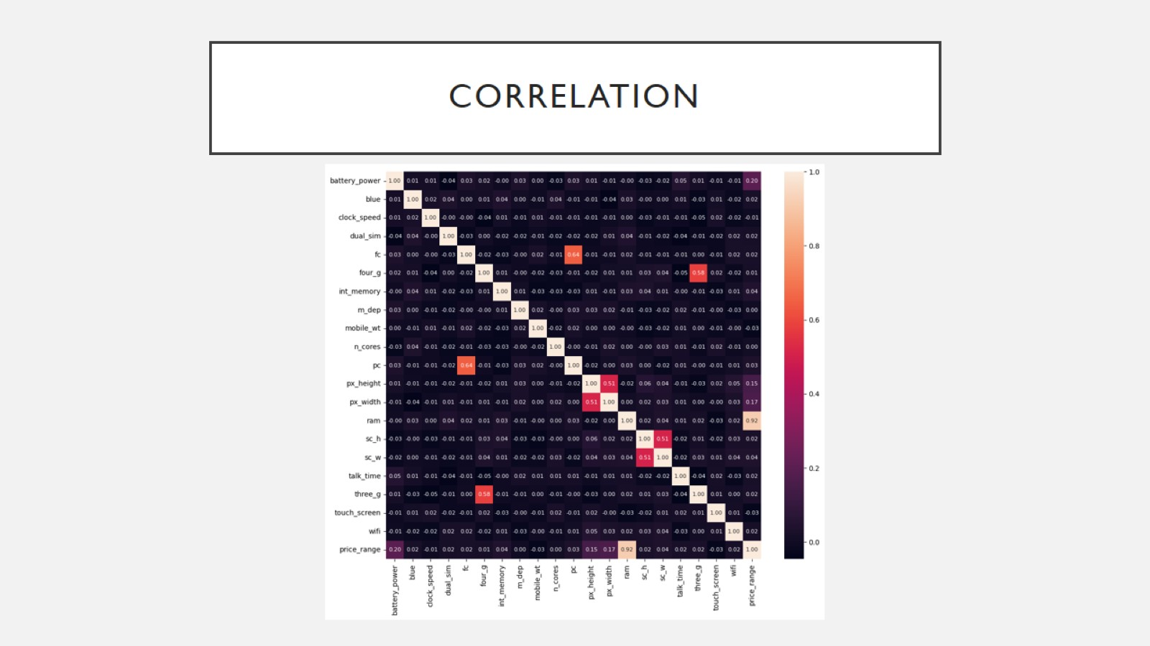
Correlation

Slide 22
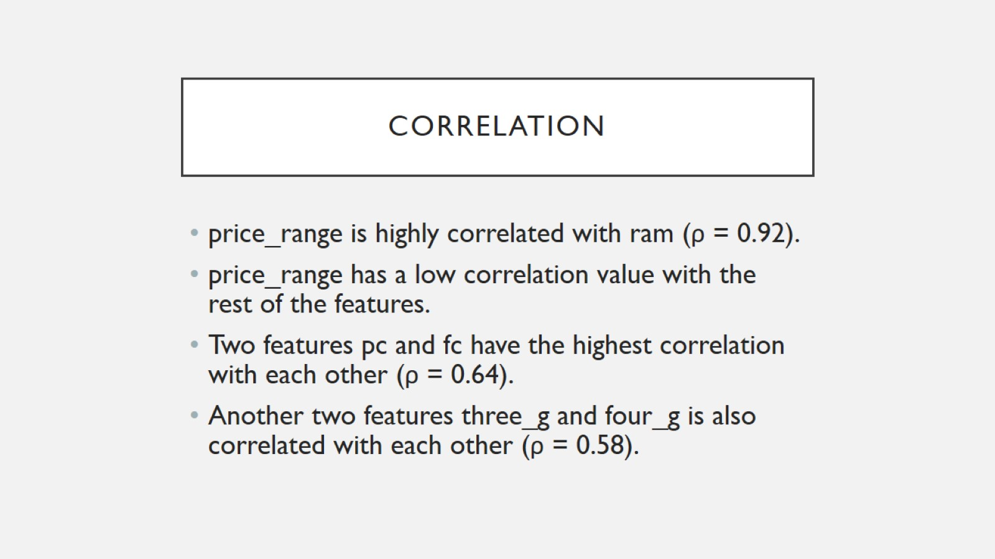
Correlation

Slide 23
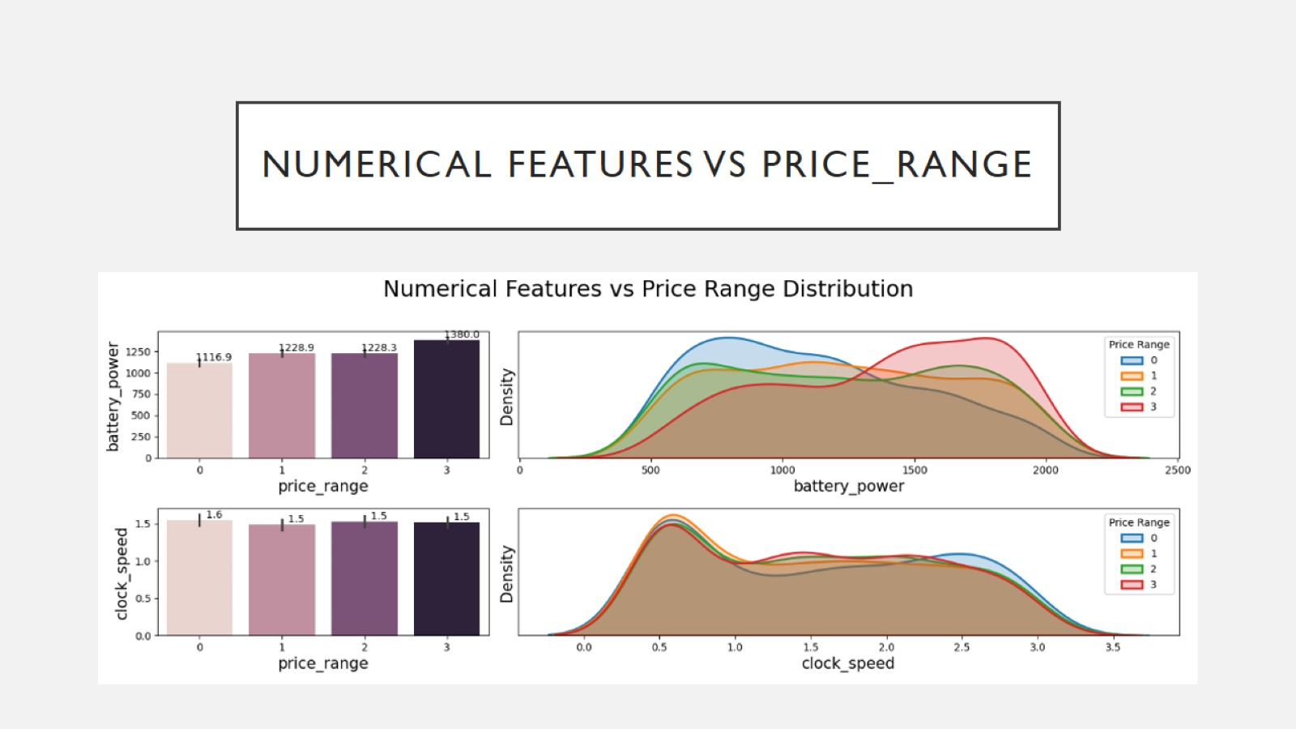
Numerical Features vs price_range

Slide 24
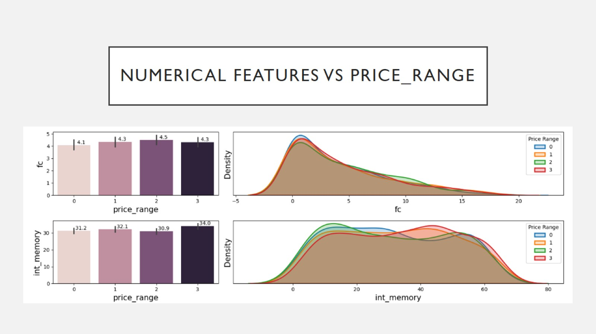
Numerical Features vs price_range

Slide 25
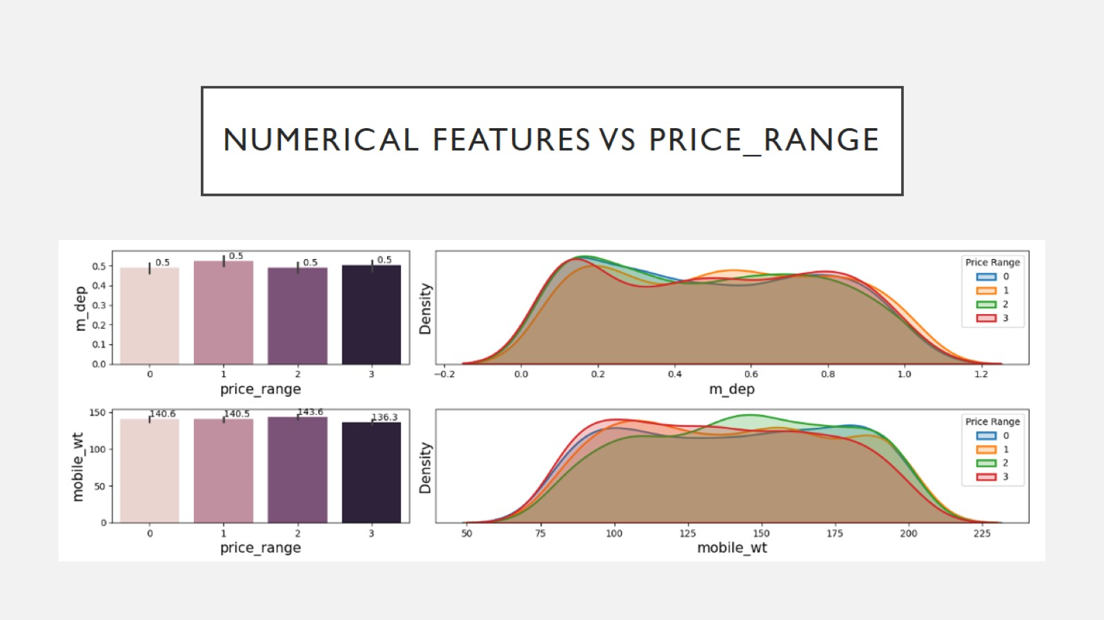
Numerical Features vs price_range

Slide 26
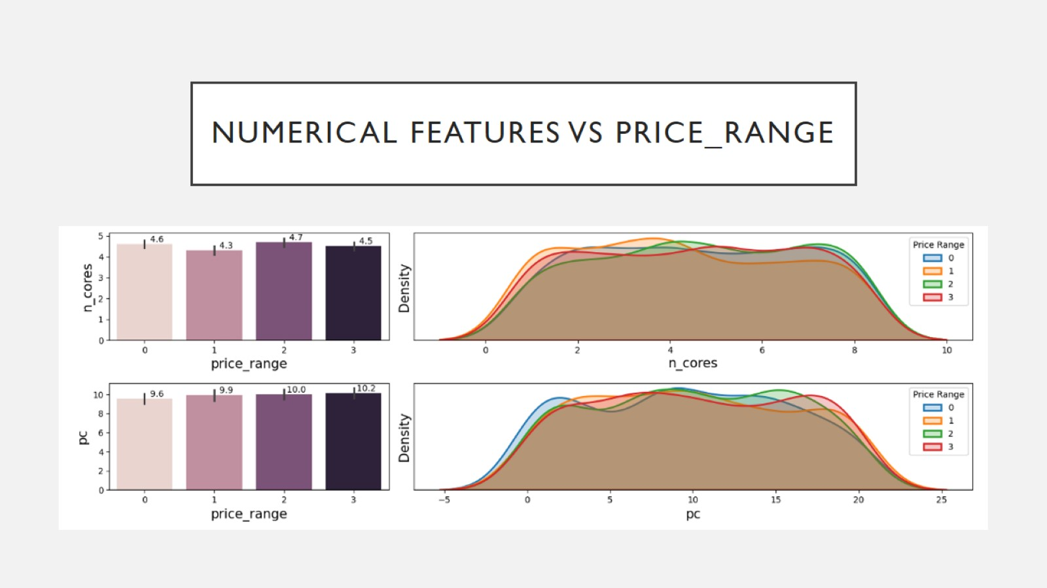
Numerical Features vs price_range

Slide 27
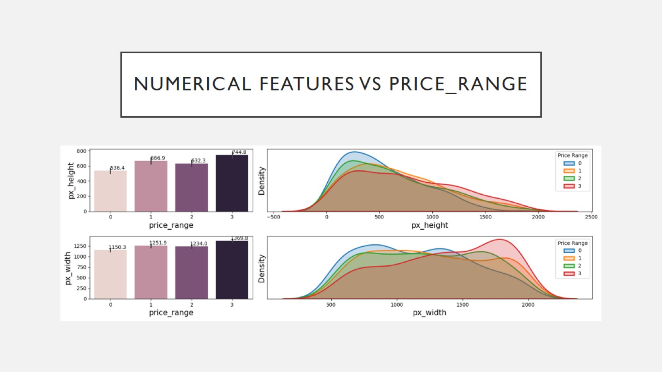
Numerical Features vs price_range

Slide 28
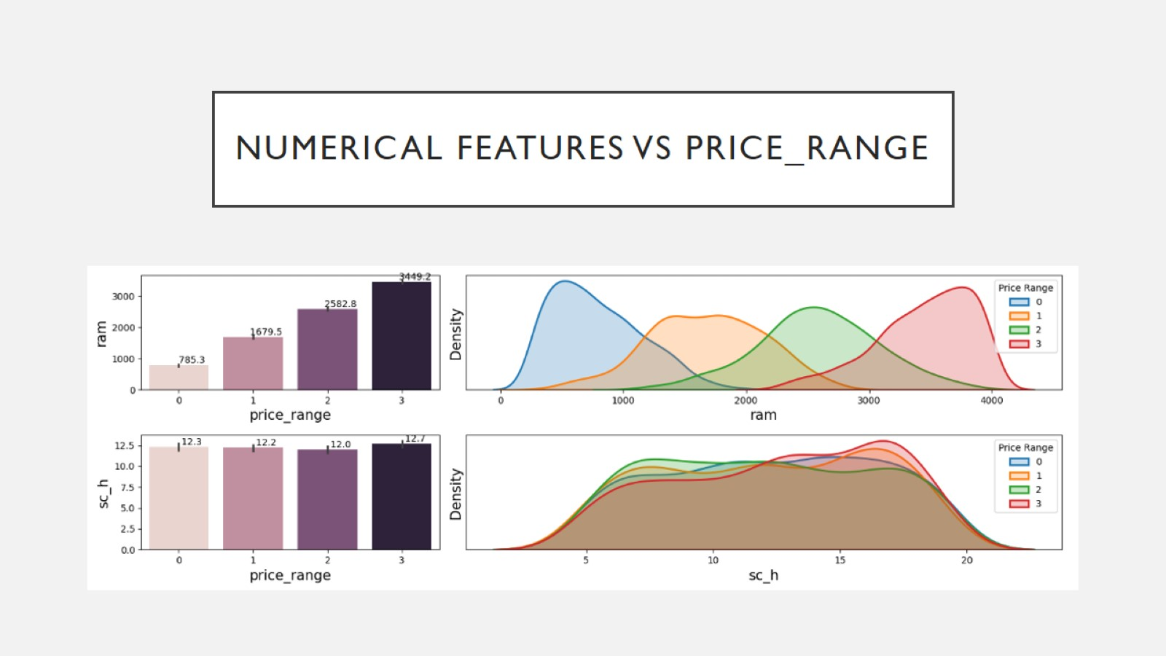
Numerical Features vs price_range

Slide 29
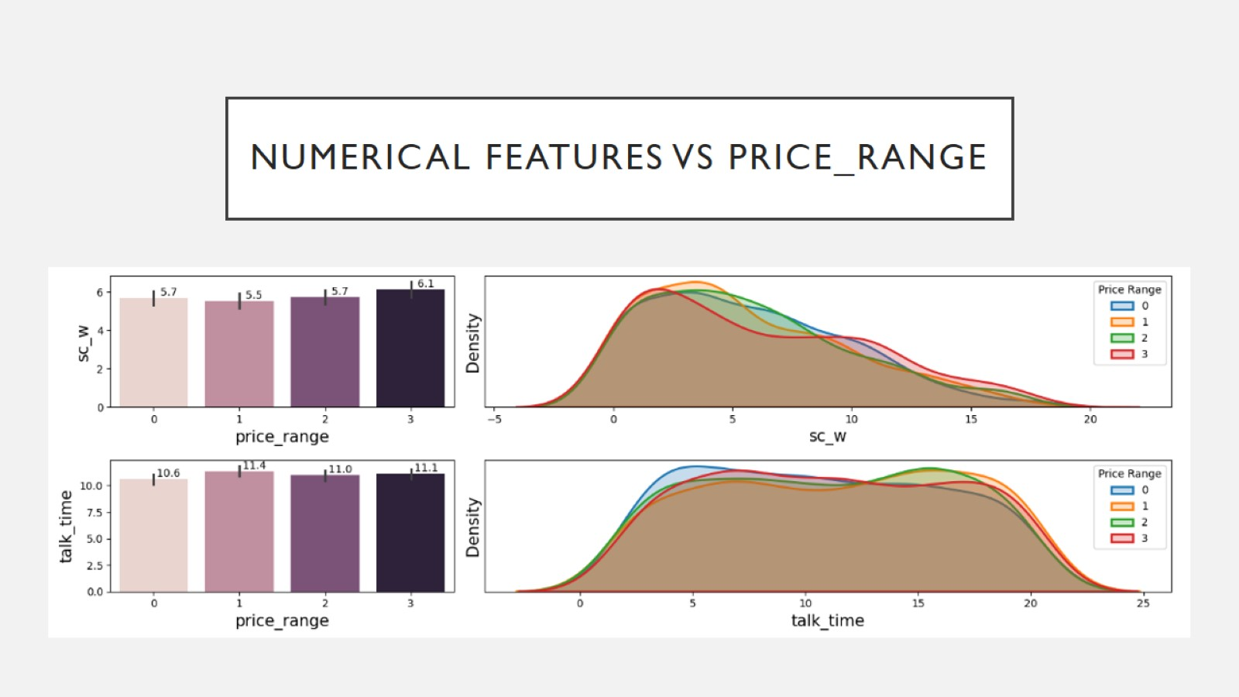
Numerical Features vs price_range

Slide 30
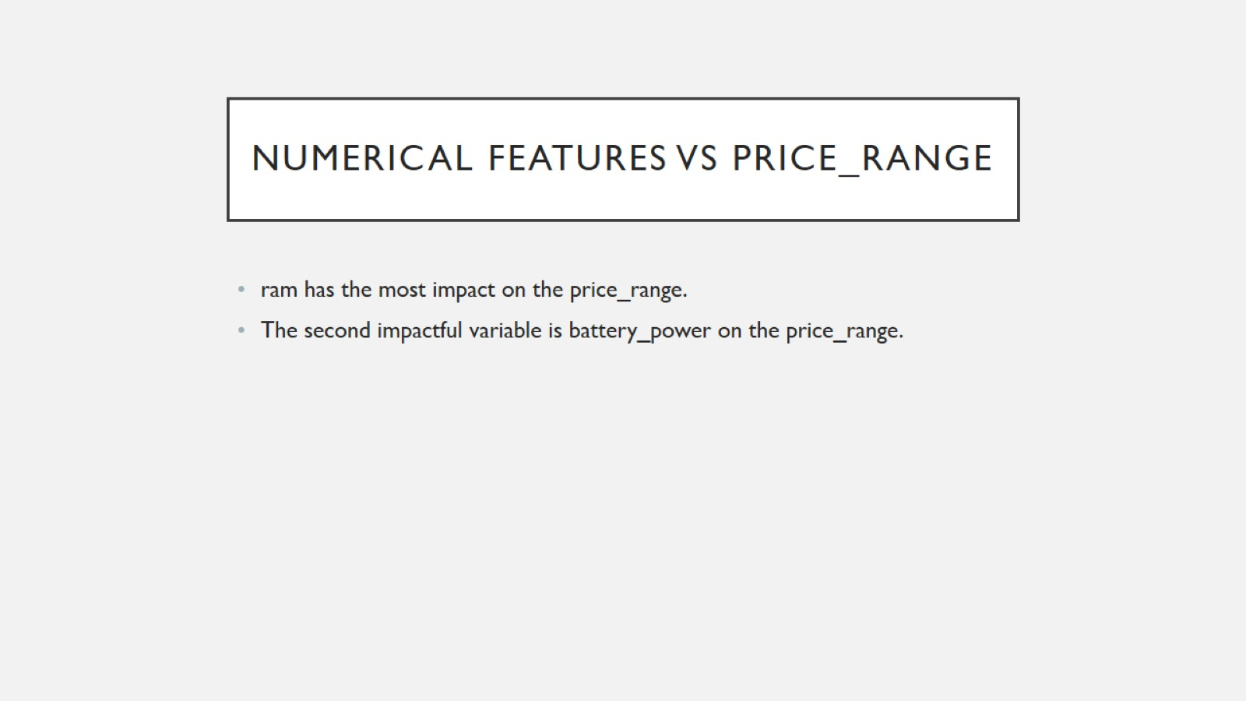
Numerical Features vs price_range

Slide 31
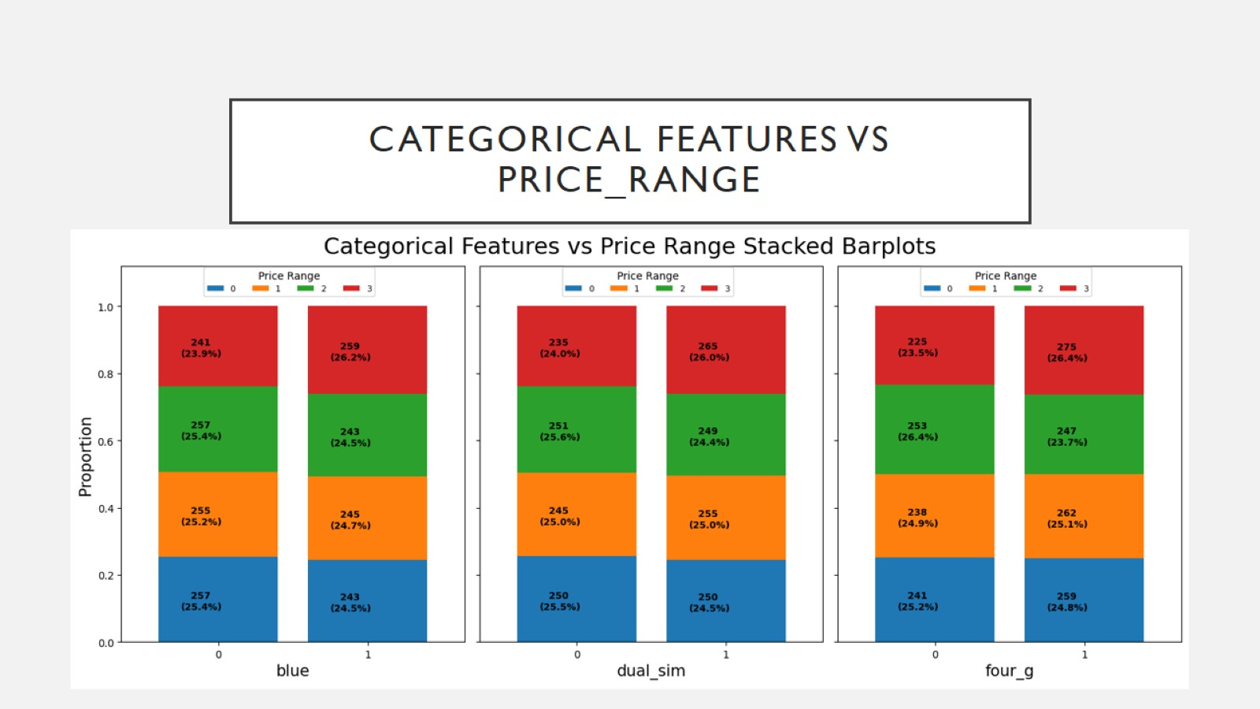
Categorical Features vs price_range

Slide 32
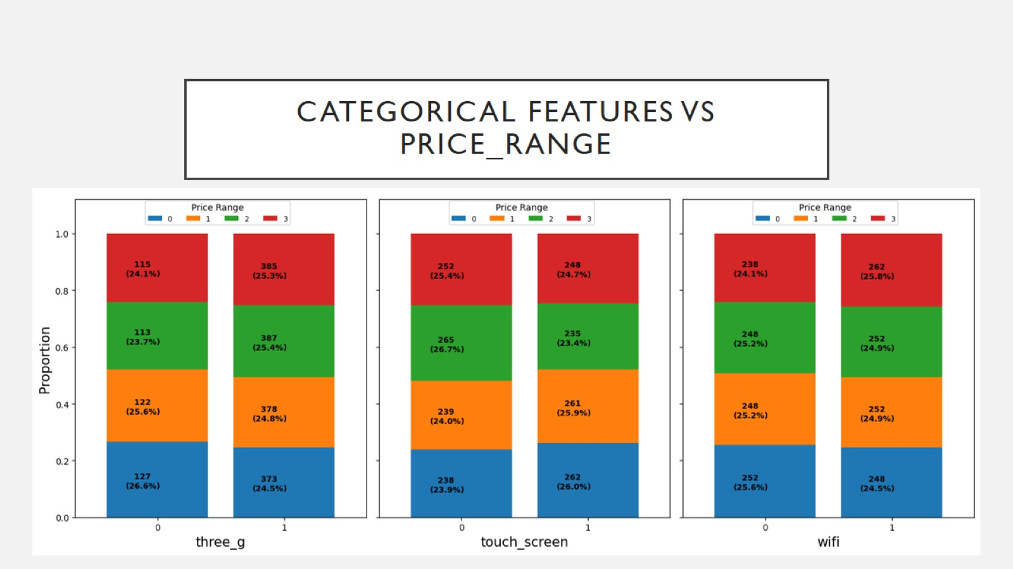
Categorical Features vs price_range

Slide 33
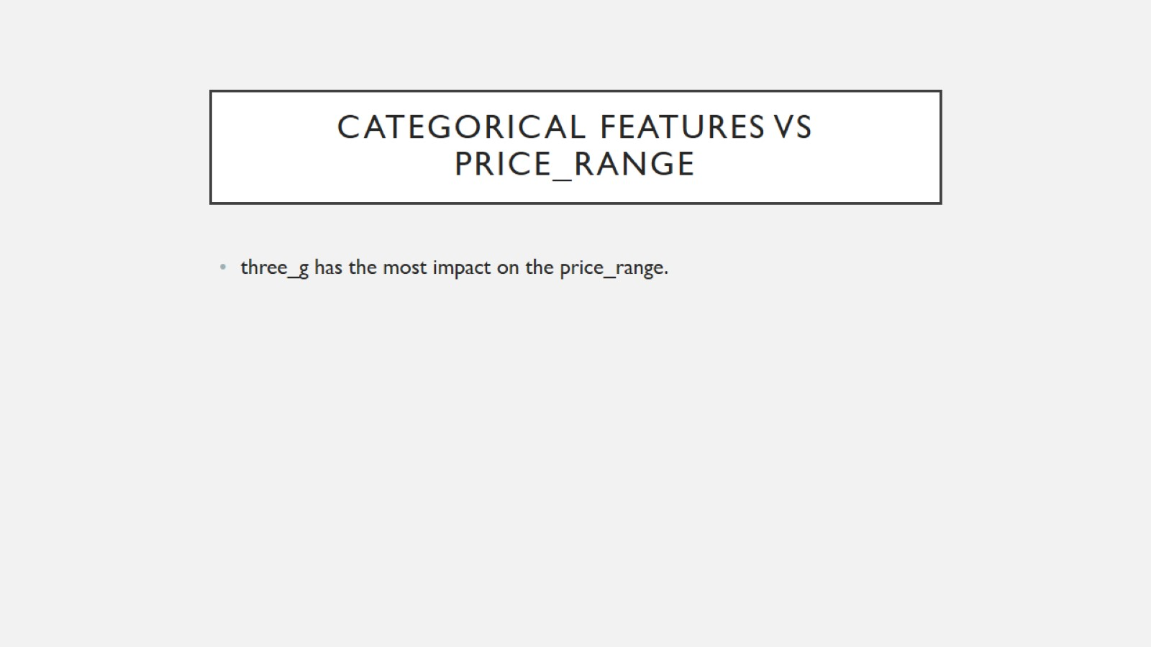
Categorical Features vs price_range

Slide 34
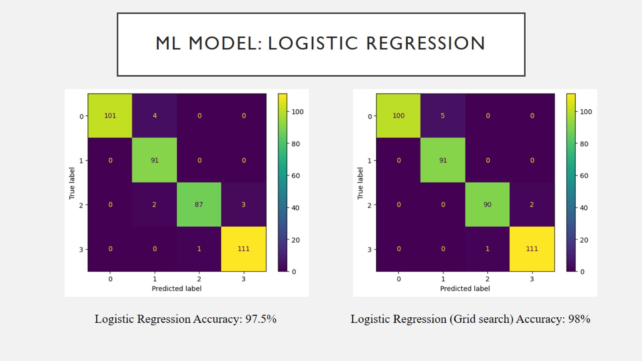
ML Model: Logistic Regression

Slide 35
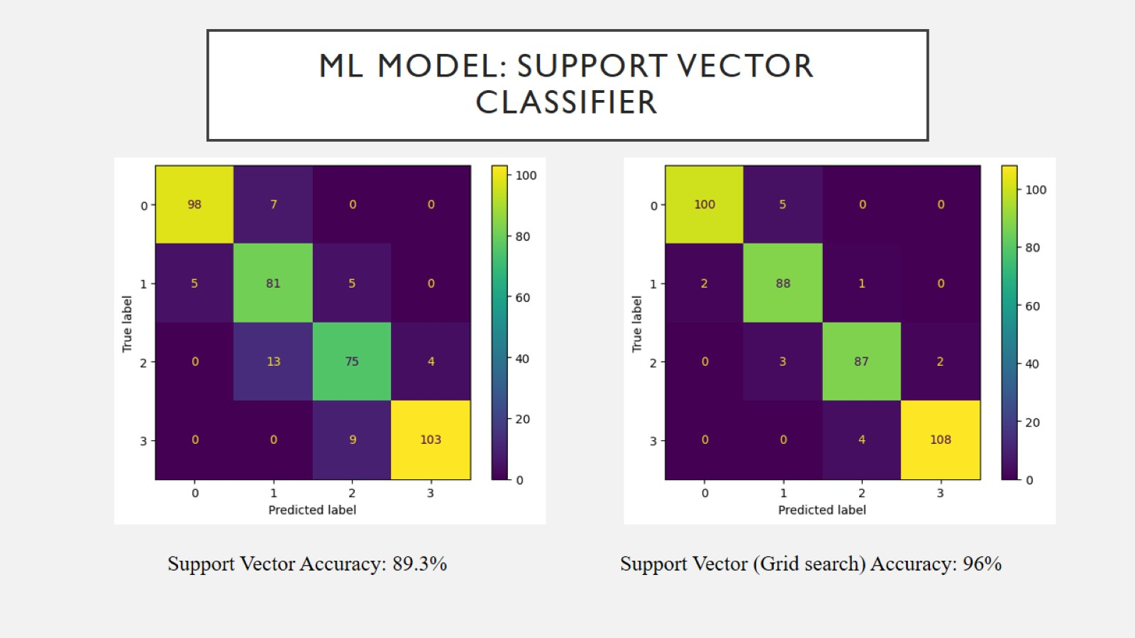
ML Model: Support Vector Classifier

Slide 36
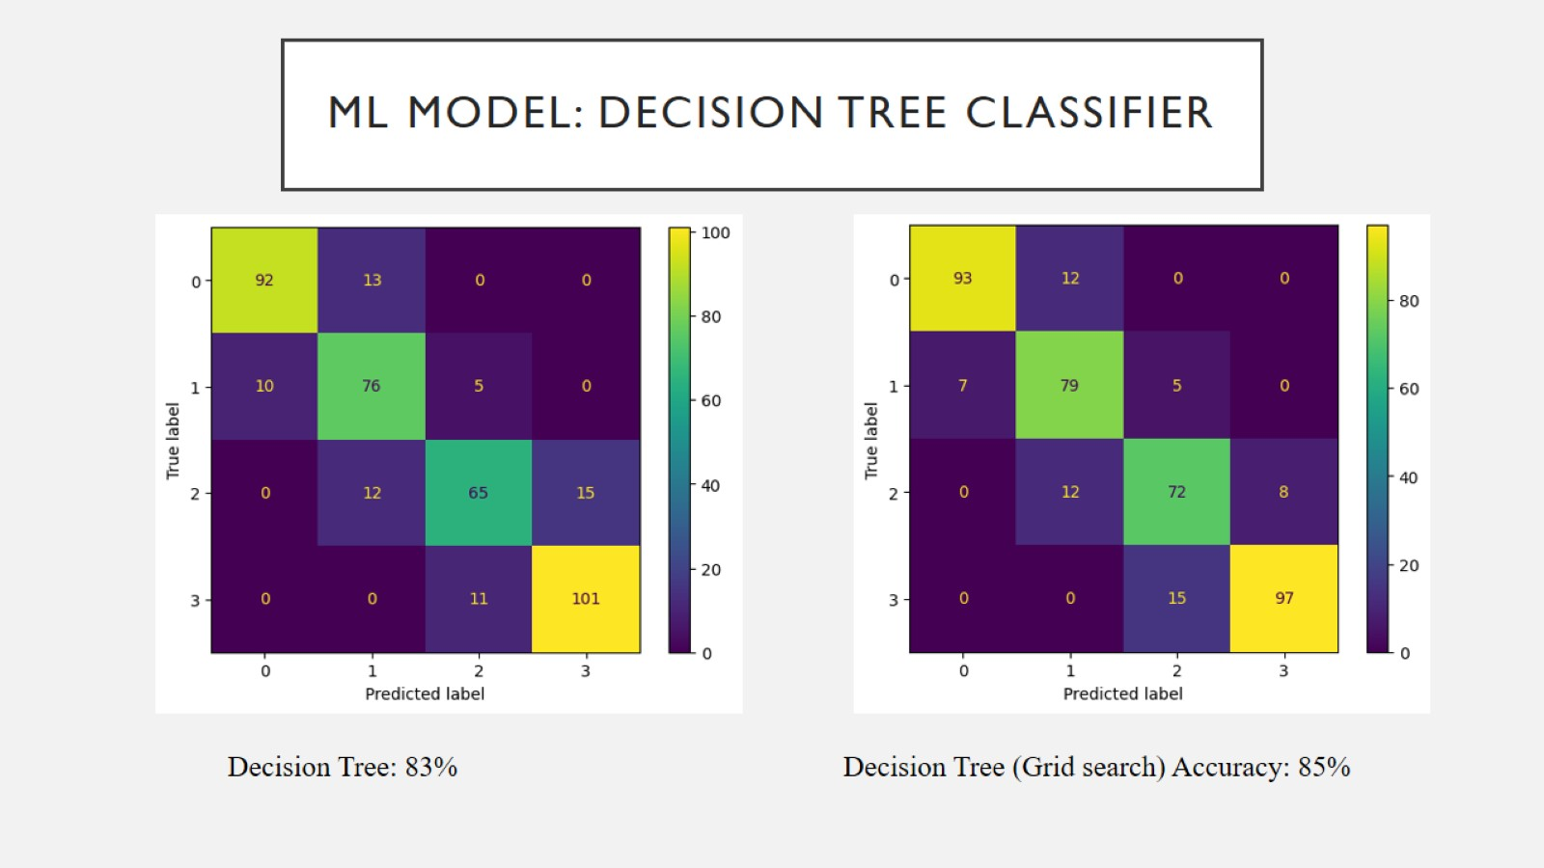
ML Model: Decision Tree Classifier

Slide 37
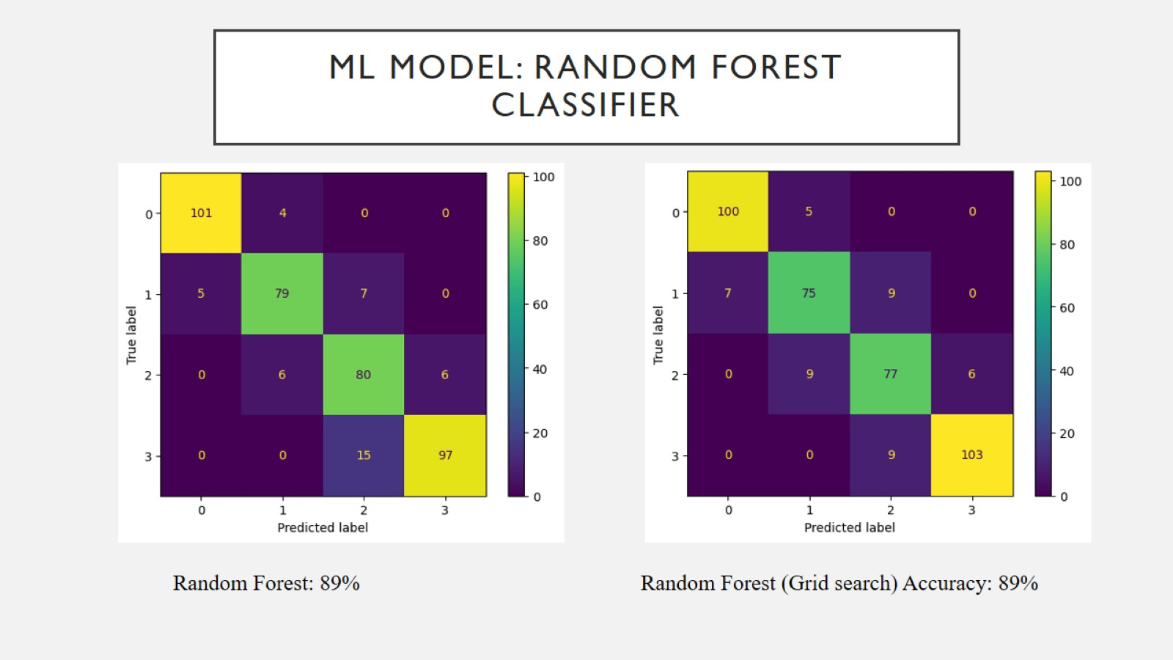
ML Model: Random Forest Classifier

Slide 38
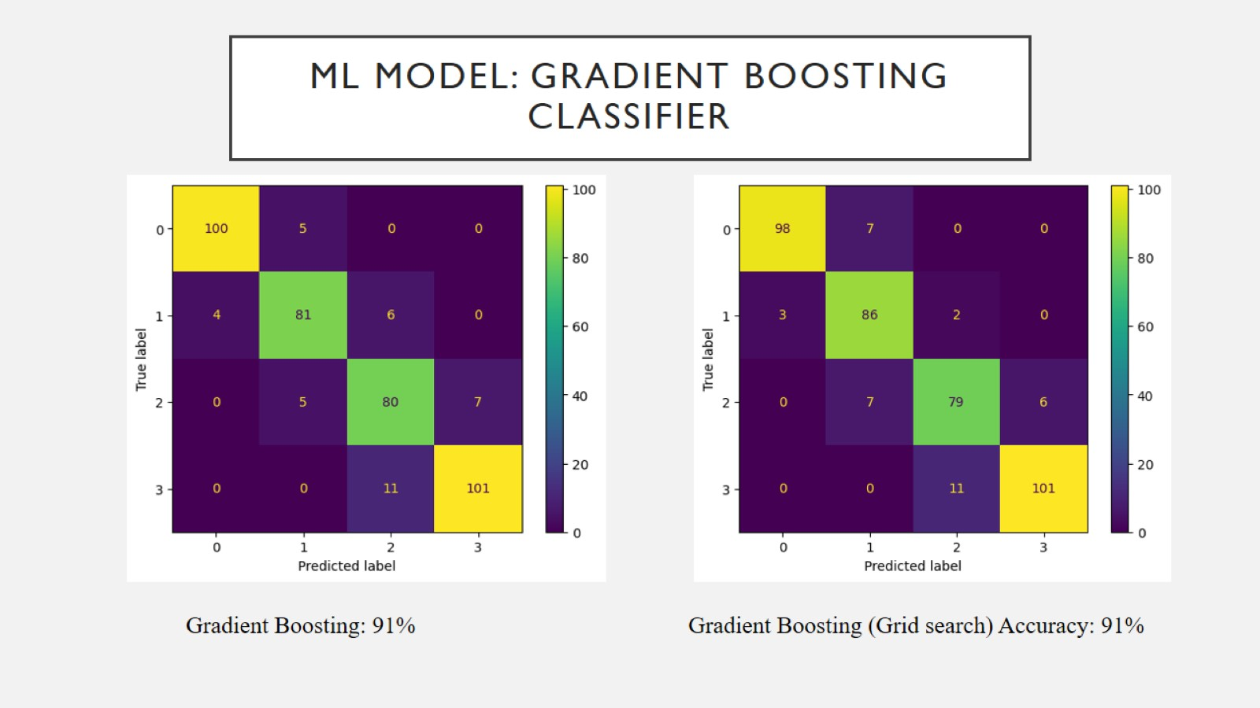
ML Model: Gradient Boosting Classifier

Slide 39
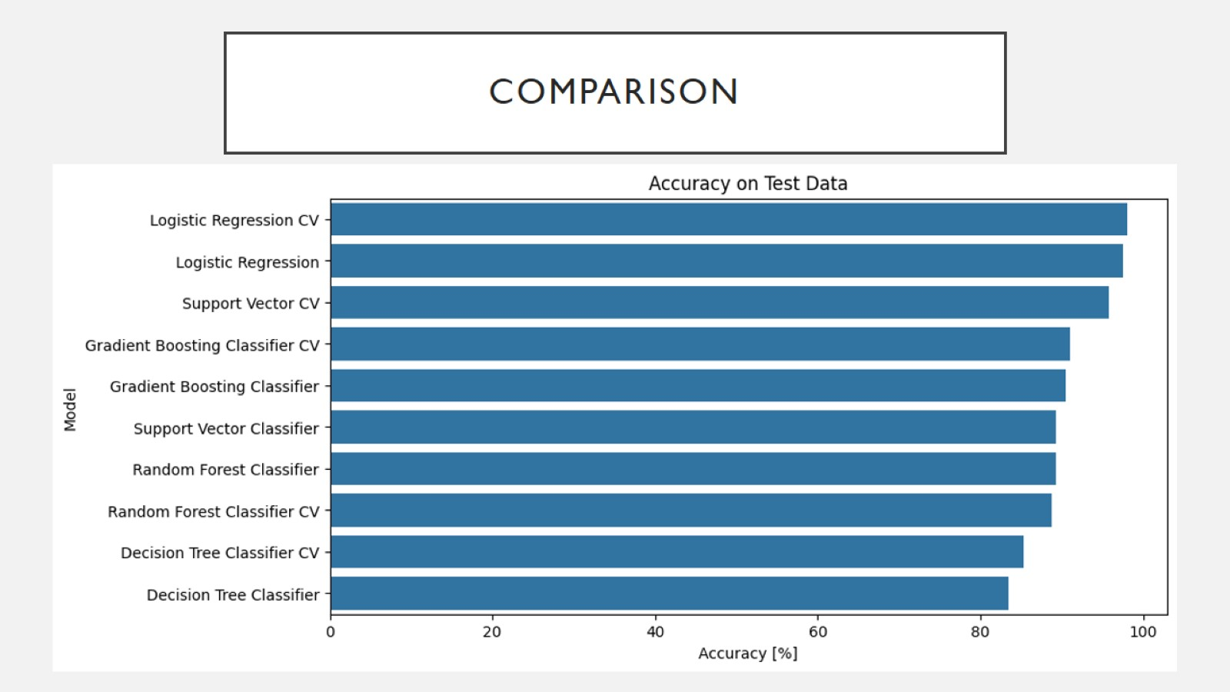
Comparison

Slide 40
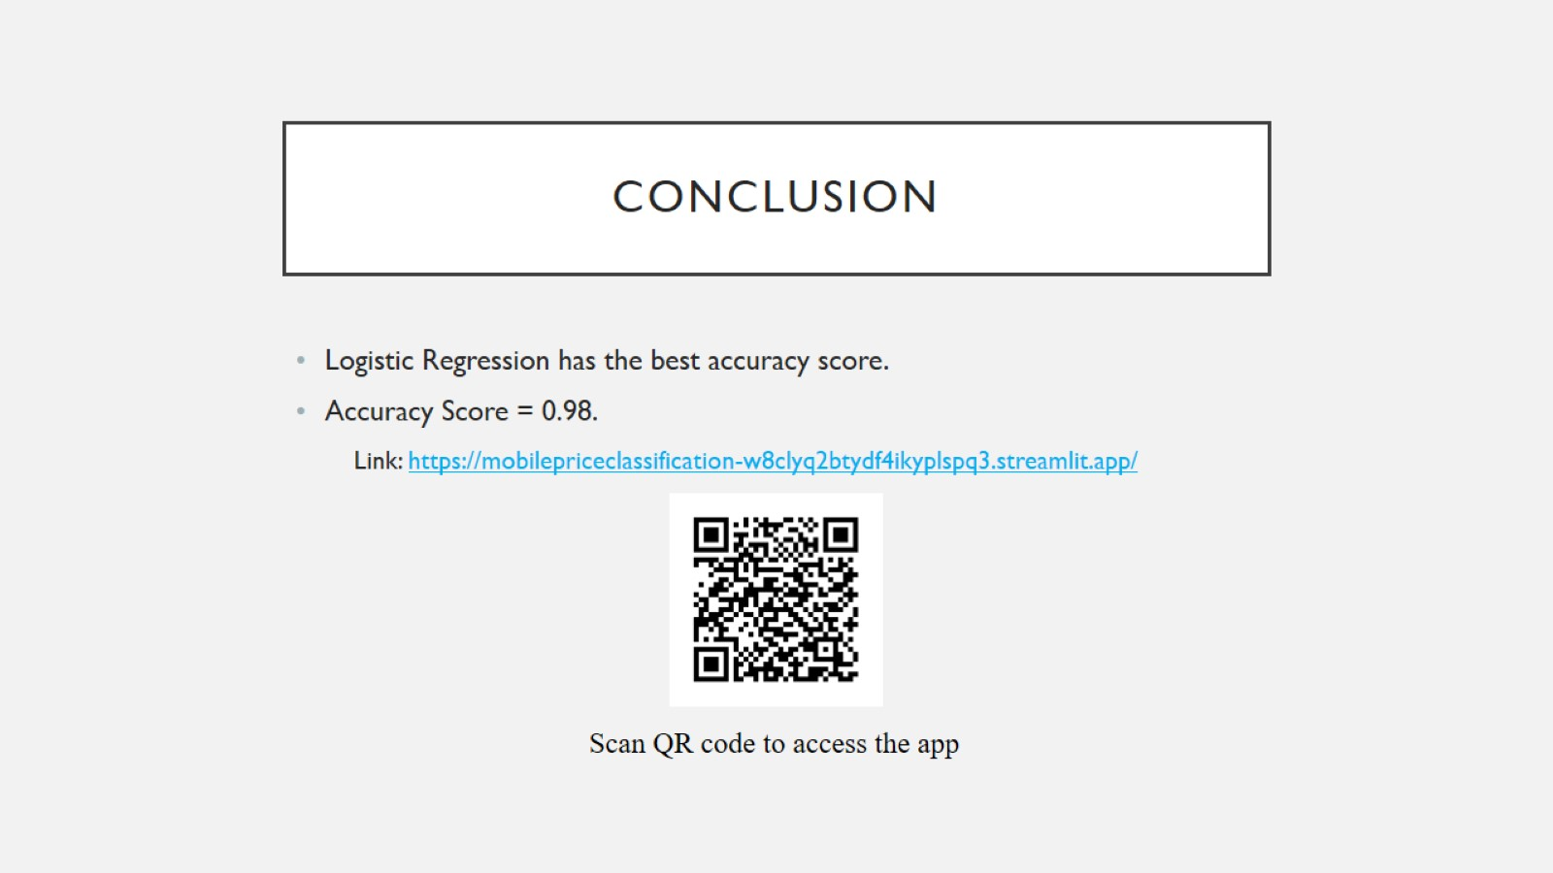
Conclusion

