Slide 1


Flight Complexity Analysis and Prediction
A data-driven framework to evaluate and predict flight complexity using operational, passenger, and baggage factors — enabling smarter, delay-free airline operations.
Team Jupyter
Tushar Bhardwaj (ECE) (12215060)
Ankit Meena (ECE) (12215059
National Institute of Technology Kurukshetra (NIT KKR)

Slide 2
Content
Problem Statement
Objectives
Data Description
Solution
Flight Level Data
Passenger Level Data
Bag Level Data
Combined Data
Insights
Recommendations
Advantage
Optimizations

Slide 3
Problem Statement
Frontline teams at United Airlines work hard to ensure that every flight departs safely and on time.
However, not all flights are equally easy to manage — some are more complex due to:
Short ground turnaround time,
A large number of passengers or baggage, and
Special service needs from certain customers.
Currently, this complexity is identified manually based on team experience and local knowledge.
This makes the process inconsistent, hard to scale, and limits the ability to plan resources proactively.
Hence, the challenge is to build a data-driven system that can automatically measure and predict how difficult each flight is to handle — called the Flight Difficulty (or Complexity) Score.

Slide 4
Objectives
To create a framework that:
Calculates a Flight Complexity Score for each flight using flight, passenger, and baggage data.
Finds the main factors that make some flights more complex than others.
Helps operations teams plan better and allocate resources efficiently before problems arise.

Slide 5
DATA DESCRIPTION
Airports Data: Details about airports and minimum turnaround requirements.
Flight Level Data: Flight schedules, delays, and ground time metrics.
Bag Level Data: Number and type of bags — Origin, Transfer, and Hot Transfer.
PNR Flight Level Data: Passenger-level data such as total passengers, children, and special categories.
PNR Remark Level Data: Remarks or special service indicators linked to passenger experience.

Slide 6
Solution
1️⃣ Data Integration:
Combined multiple datasets — flight, passenger, and baggage — to create a unified view of each flight’s operational profile.
2️⃣ Feature Identification:
Analyzed key parameters like ground time, bag type, transfer ratio, and passenger load to find which factors truly impact flight difficulty.
3️⃣ Scoring Framework:
Designed a Flight Complexity Score based on weighted contribution of three aspects:
Delay (45%)
Passenger (35%)
Baggage (20%)
4️⃣ Classification:
Ranked flights daily and categorized them as Easy, Medium, or Difficult, enabling teams to focus resources proactively.
5️⃣ Insights & Recommendations:
Highlighted flights and destinations that consistently show higher complexity, supporting better planning and decision-making.

Slide 7
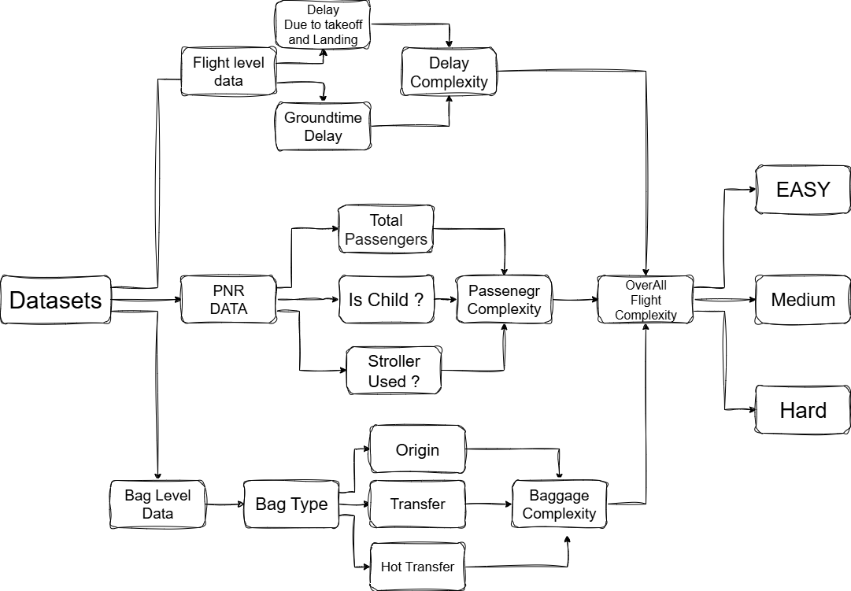

Slide 8
FLIGHT LEVEL DATA
Link to Dataset

Slide 9
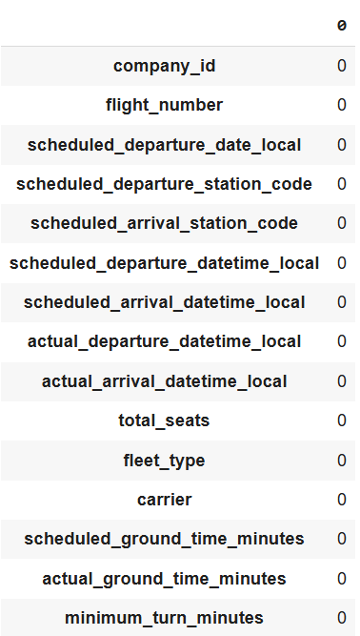


No Missing Value In flight Level dataset

Slide 10
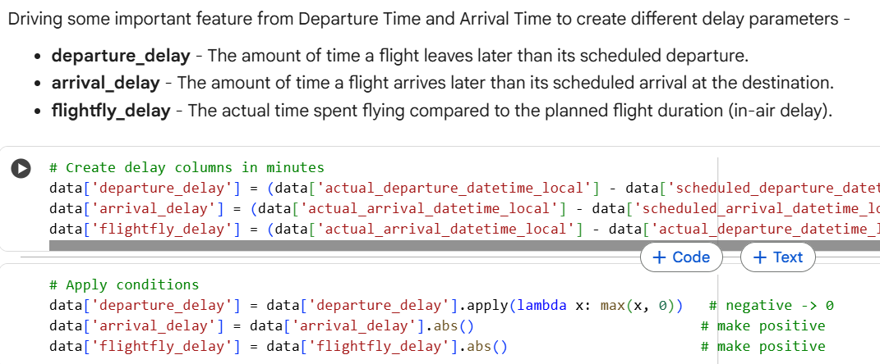
Deriving the new delay Features

Slide 11
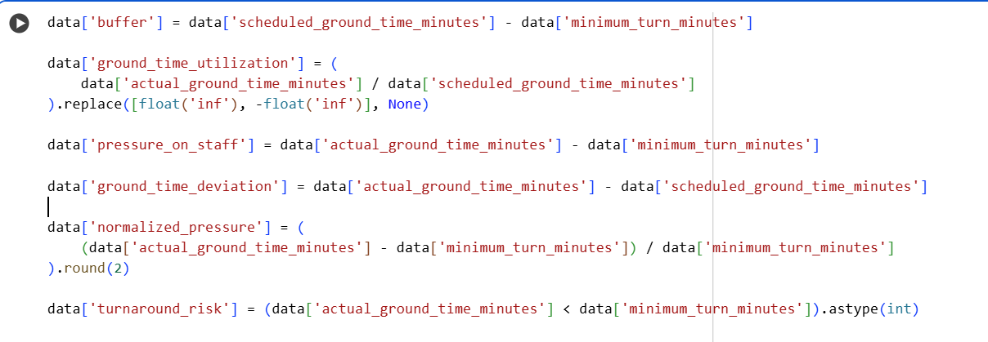
Deriving the ratios due to Groundtime

Slide 12
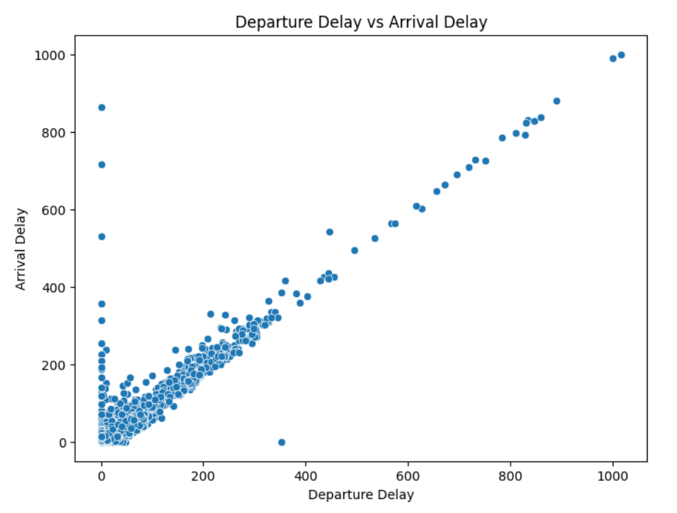
Visualization of departure Delay v/s Arrival Delay
Departure delay and Arrival Delay has Linear relationship
Conclusion –
Departing late will leads to
Arriving late

Slide 13
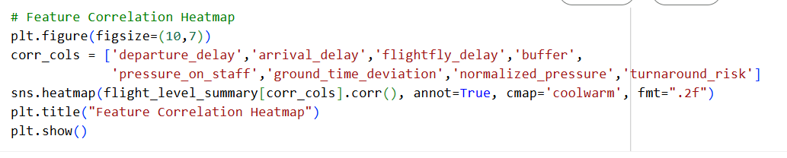
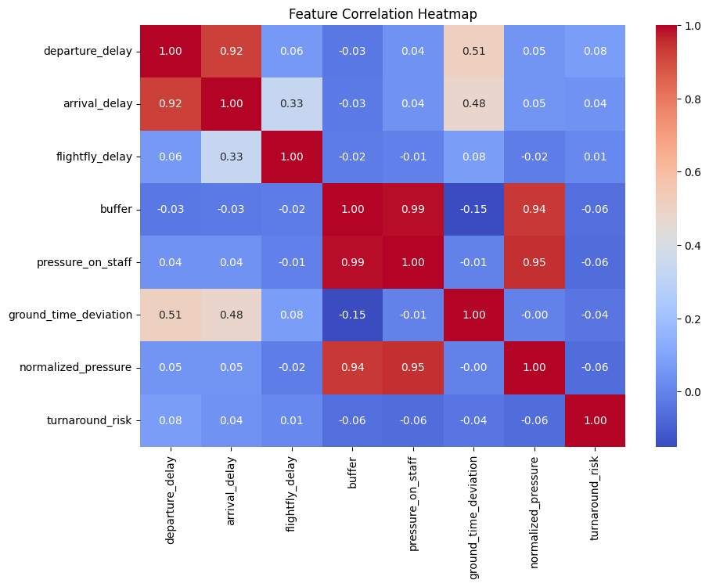
How each groundtime features are correlated with others

Slide 14
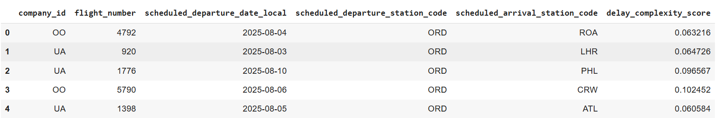
Delay Complexities Table

Slide 15
Passengers Level Data
Link to Dataset

Slide 16
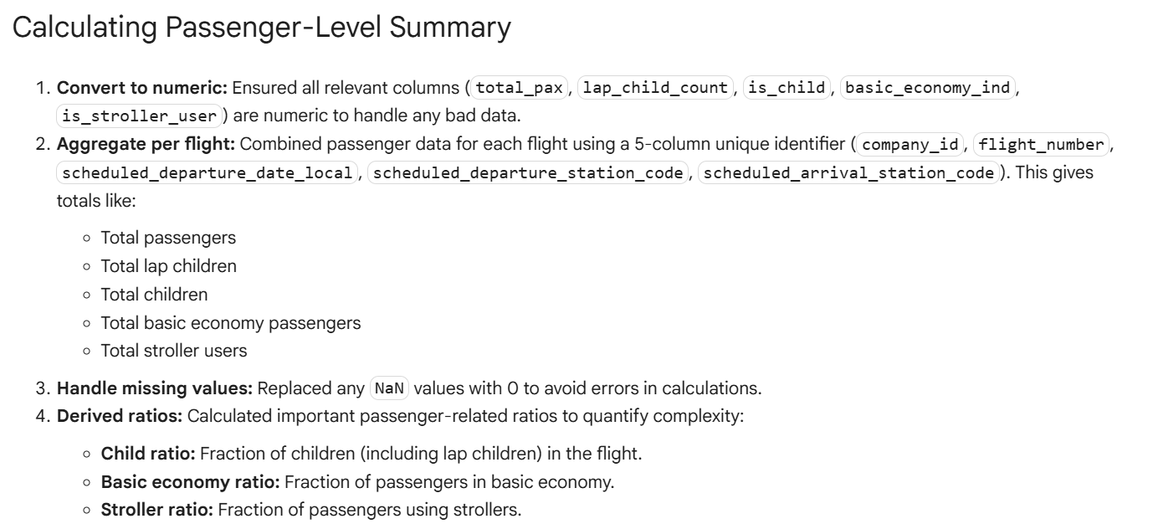

Slide 17
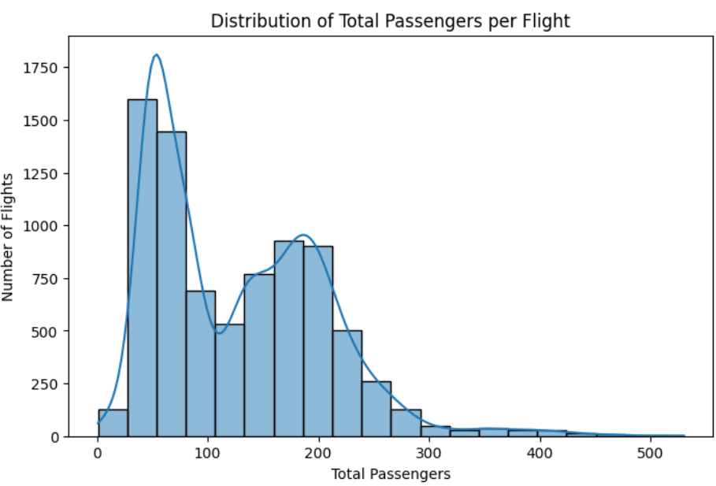
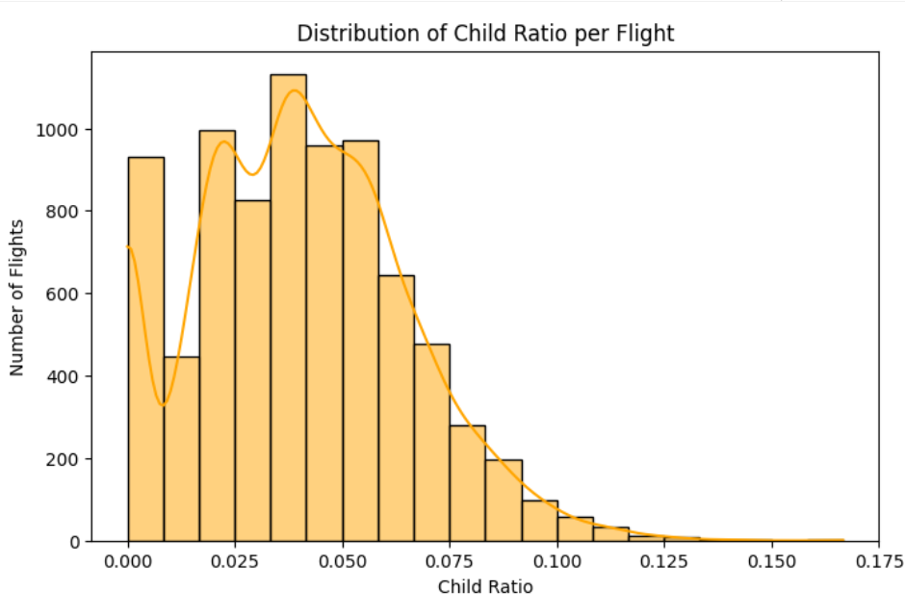
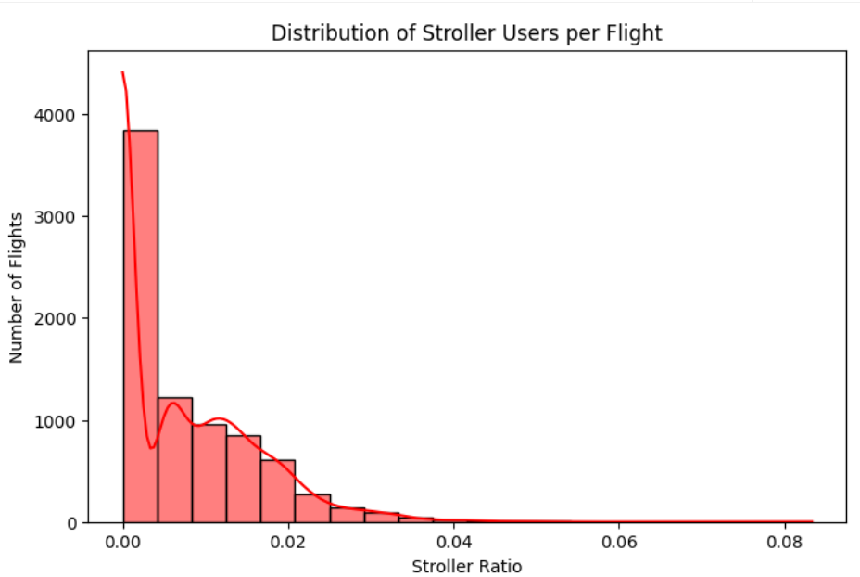
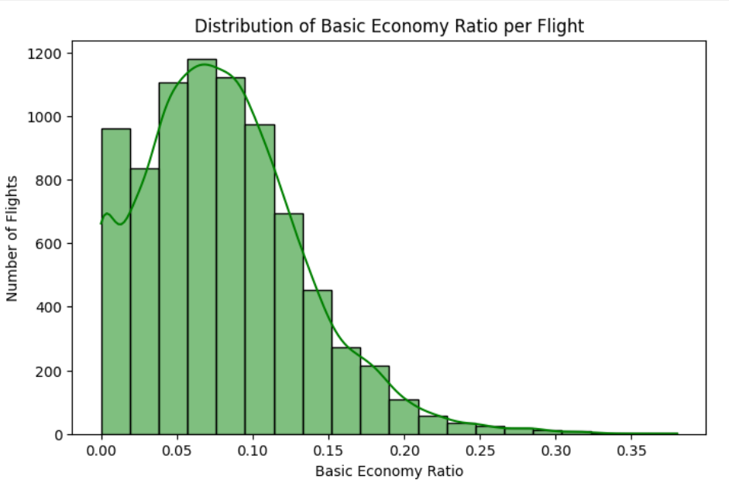
Distributions of Passengers Level Data

Slide 18
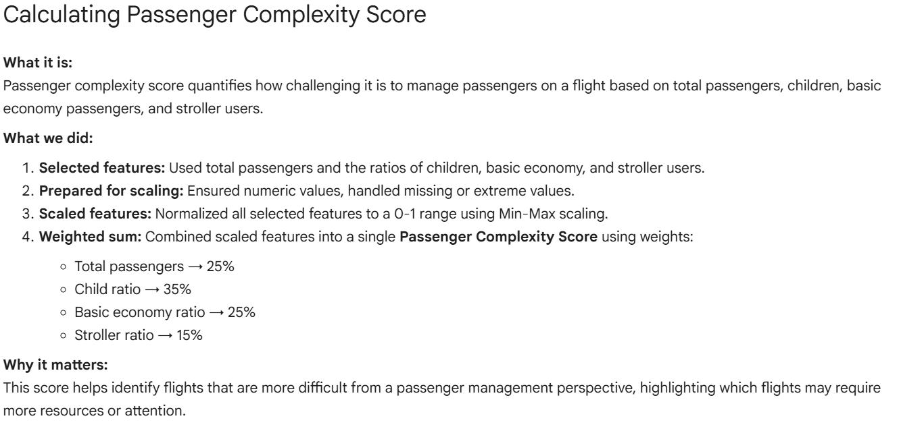

Slide 19
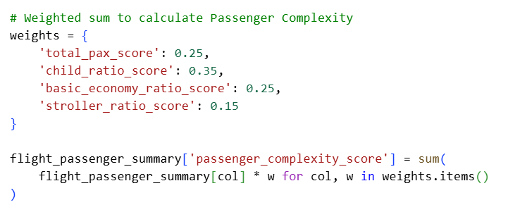
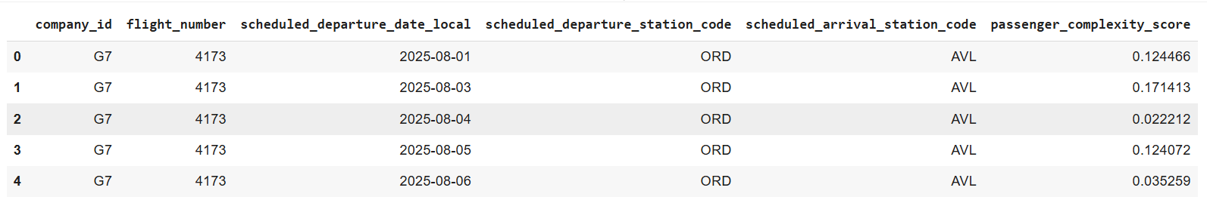
Passenegr complexity Calculation and final output table

Slide 20
Bag Level Data
Link to Dataset

Slide 21
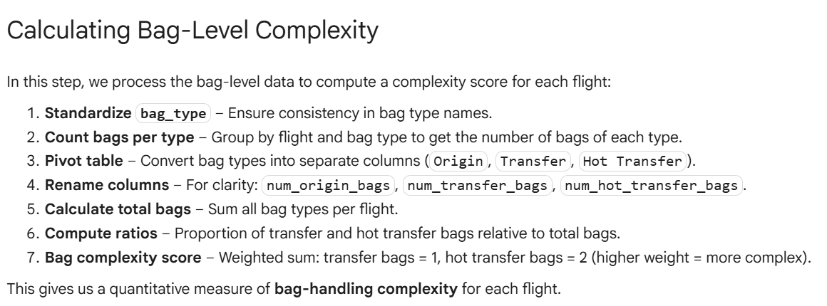

Slide 22
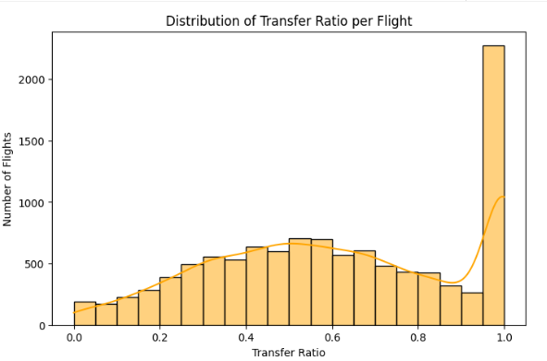
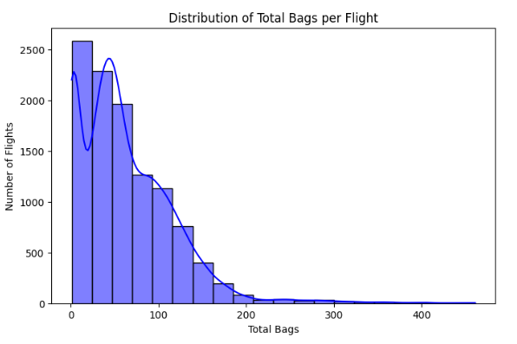
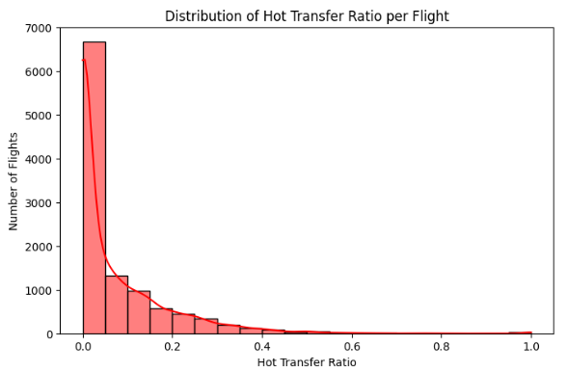
Distributions of Different bag type per total Bags

Slide 23
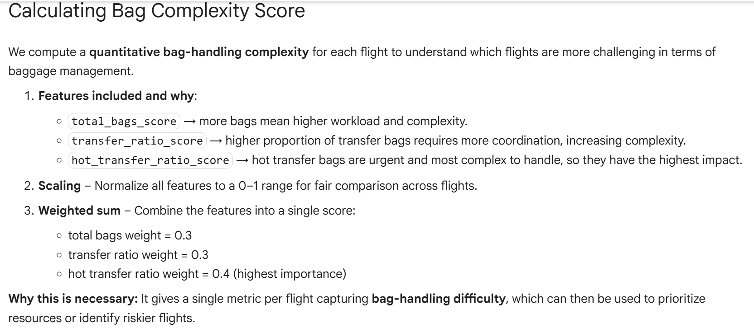

Slide 24
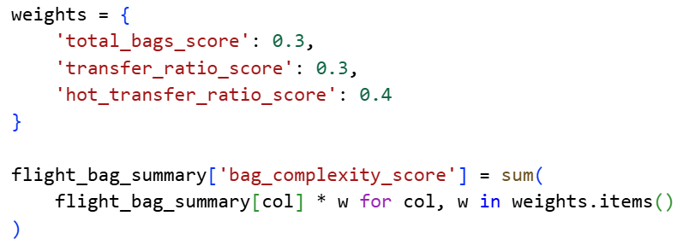
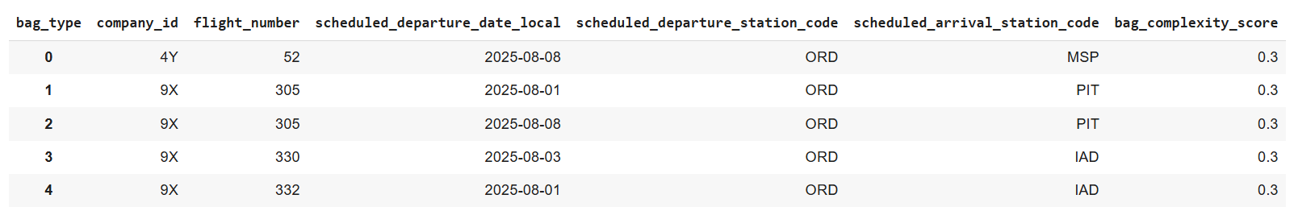
Baggage complexity Calculation and final output table

Slide 25
Final Dataset – combined with all
Important Features and Complexities
Link to Dataset

Slide 26
Flight Complexity Integration
We combined three key aspects — delay, passenger, and baggage — into one overall complexity score to identify the most challenging flights.
What we did:
Merged flight, passenger, and bag datasets using 5 common keys and filled missing values to ensure complete data for each flight.
Why we did it:
Each dataset highlights a unique challenge — delay (operational), passenger (load & service), and baggage (handling difficulty).
Merging them gives a complete picture of flight difficulty.
How we calculated:
Assigned weights to each component:
  Delay → 45%
  Passenger → 35%
  Baggage → 20%
  The combined score (overall_flight_complexity) helps rank and analyse flights by difficulty.

Slide 27
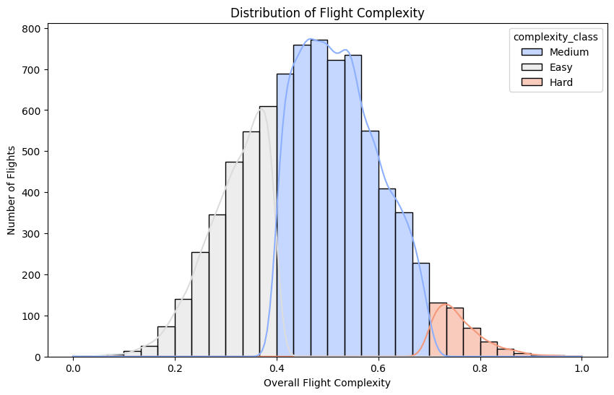
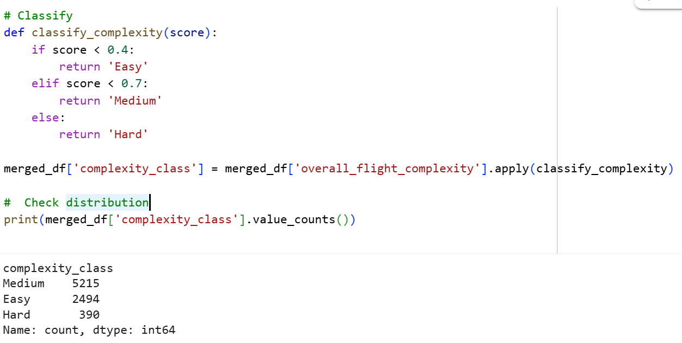
Classification of Complexities and Distribution

Slide 28
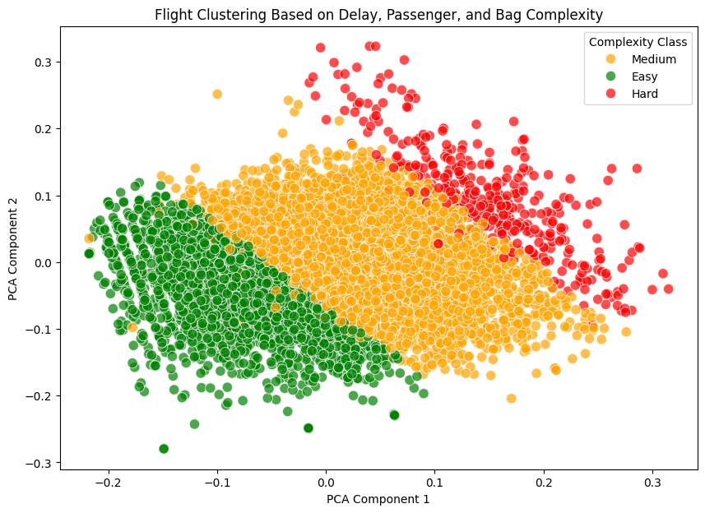
Clustering of different flights based on different complexities
All Hard, Medium, Easy Flights are being Clustered together
Note – for the visualization purpose here complexities are being reduced and converted into pca1 and pca2

Slide 29
Insights

Slide 30
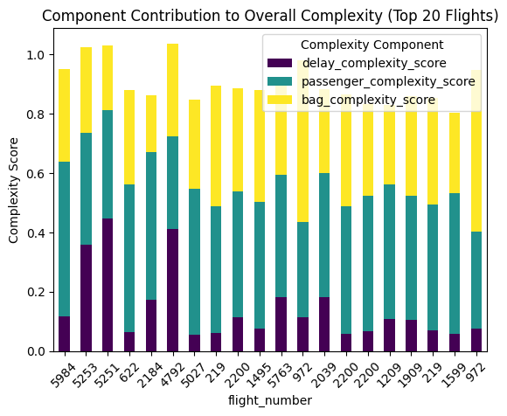
Component most Dominating

Slide 31
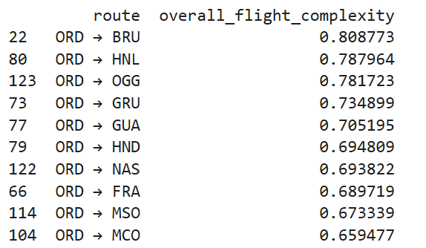
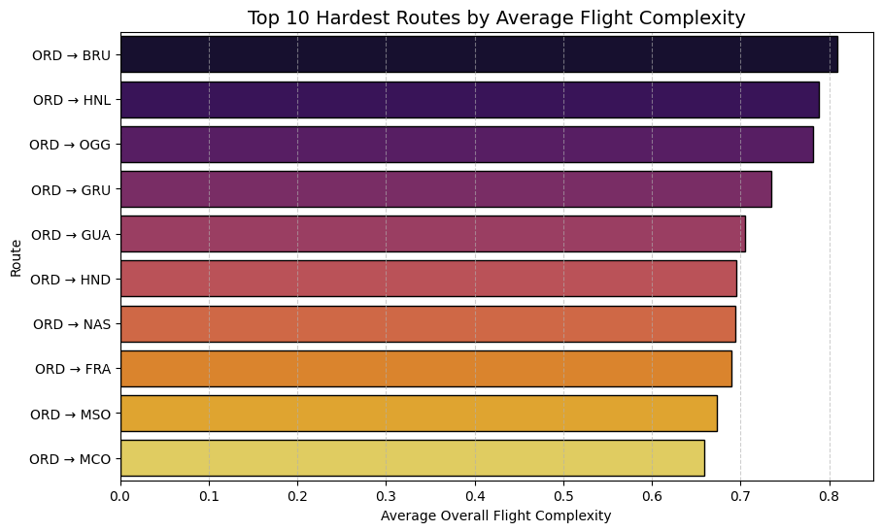
Top 10 Hardest Routes
Airlines company has to put extra effort on these routes in order to minimize there overall Complexity

Slide 32
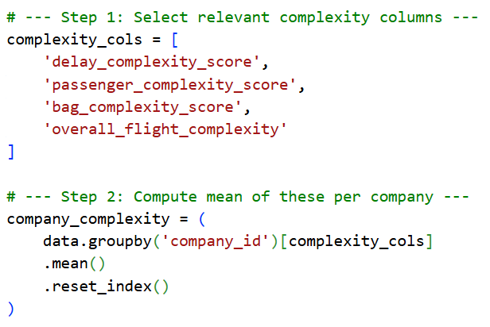
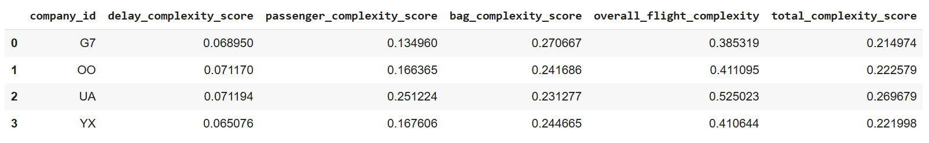
Individual Complexity score of different company

Slide 33
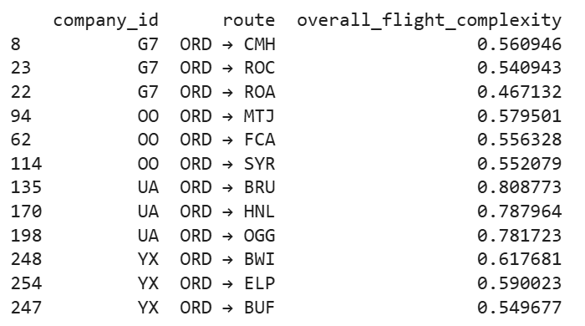
Top 3 Hardest Routes for each Airline Company

Slide 34
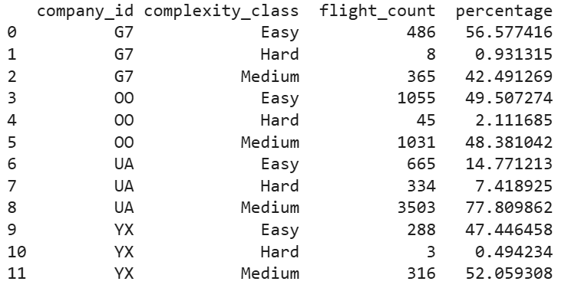
Percentage of each company flight into categories according to overall complexity

Slide 35
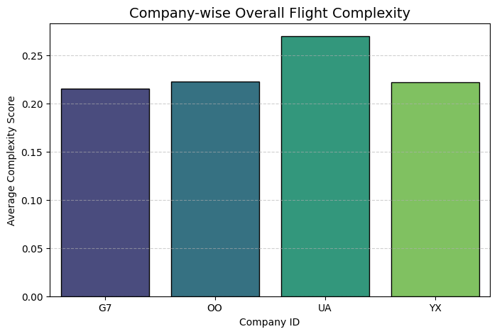
Company-wise Overall Flight Complexities

Slide 36
Recommendations

Slide 37
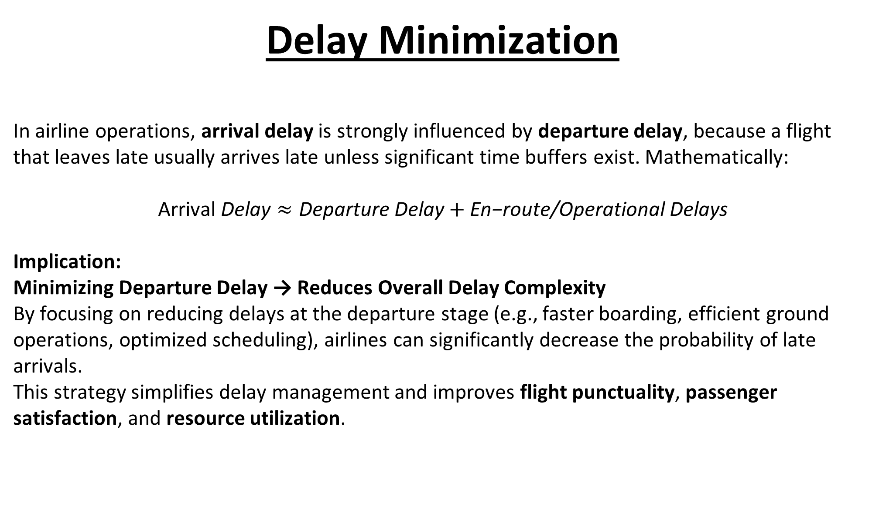
Delay Minimization
In airline operations, arrival delay is strongly influenced by departure delay, because a flight that leaves late usually arrives late unless significant time buffers exist. Mathematically:
$$\text{Arrival} \text{Delay}≈\text{Departure} \text{Delay}+\text{En}\text{−}\text{route}\text{/}\text{Operational} \text{Delays}$$
Implication:
Minimizing Departure Delay → Reduces Overall Delay Complexity
By focusing on reducing delays at the departure stage (e.g., faster boarding, efficient ground operations, optimized scheduling), airlines can significantly decrease the probability of late arrivals.
This strategy simplifies delay management and improves flight punctuality, passenger satisfaction, and resource utilization.

Slide 38
Increasing Buffer time
In airline operations, buffer time is the extra time scheduled beyond the minimum required for ground handling, boarding, and taxiing.
Key Idea:
Adding a few extra minutes as buffer can reduce the operational pressure on staff and resources.
This helps accommodate minor delays (e.g., late passengers, slow baggage handling, or weather disruptions) without impacting the scheduled departure and arrival times.
Effectively, it reduces the probability of cascading delays and improves overall flight punctuality and reliability.

Slide 39
Handling of Child Passengers
Children traveling as passengers often introduce additional operational complexity for a flight. Managing their needs—such as safety, comfort, seating arrangements, and boarding assistance—requires extra attention from cabin staff.
Key Points:
Ensuring child passengers are properly seated and accompanied can increase turnaround time and workload for staff.
Special services (e.g., unaccompanied minors) require additional checks and monitoring, which can affect overall scheduling.
Impact:
Direct impact on departure and arrival times: Handling child passengers can slightly increase boarding or ground time, contributing to overall flight delay complexity.

Slide 40
Efficient Baggage Handling
Objective: Reduce operational complexity and delays caused by baggage processing.
Origin Bags: Standard handling; minimal impact on flight schedules.
Transfer Bags: Require careful sorting between connecting flights; moderate delay impact.
Hot Transfer Bags: Tight connections demand urgent handling; high impact on departure and arrival times.
Actionable Steps:
Prioritize hot transfer baggage to avoid cascading delays.
Automate sorting and tracking where possible.
Allocate sufficient staff during peak transfer periods.
Impact: Streamlined baggage handling reduces turnaround time, minimizes delay complexity, and improves overall flight punctuality.

Slide 41
Advantages of the Flight Delay Complexity Model
1️⃣ Proactive Delay Management
Predicts critical factors contributing to delays, enabling airlines to take preventive actions.
2️⃣ Improved Operational Efficiency
Optimizes departure, boarding, and baggage handling processes, reducing turnaround time.
3️⃣ Passenger Satisfaction Enhancement
Efficient handling of special cases (children, transfers) reduces arrival delays and improves passenger experience.
4️⃣ Data-Driven Decision Making
Provides actionable insights on high-impact areas, supporting smarter scheduling and resource allocation.
5️⃣ Scalable & Flexible
Easily extendable to include additional complexities in the future (e.g., weather delays, crew availability, maintenance issues).

Slide 42
Future Optimizations for Flight Delay Complexity Model
1️⃣ Weather Integration
Include real-time weather data to predict and mitigate weather-related delays.
2️⃣ Airplane Model & Capacity
Factor in aircraft type, seating capacity, and turnaround characteristics for more accurate delay predictions.
3️⃣ Special Services Handling
Include passengers needing extra assistance (wheelchairs, unaccompanied minors) to refine boarding and ground time estimates.
4️⃣ Emergency & Irregular Operations
Account for emergency landings, medical diversions, or unscheduled maintenance for robust delay modelling.
5️⃣ Baggage & Crew Scheduling
Integrate baggage priority (hot transfers) and crew availability to optimize operations further.
6️⃣ Airport Traffic & Slot Constraints
Include runway congestion, taxiway bottlenecks, and slot availability for a more holistic complexity score.
Impact:
These enhancements make the model more realistic, predictive, and scalable, helping airlines optimize operations and minimize delays proactively.

Slide 43
Thank You

