Slide 1
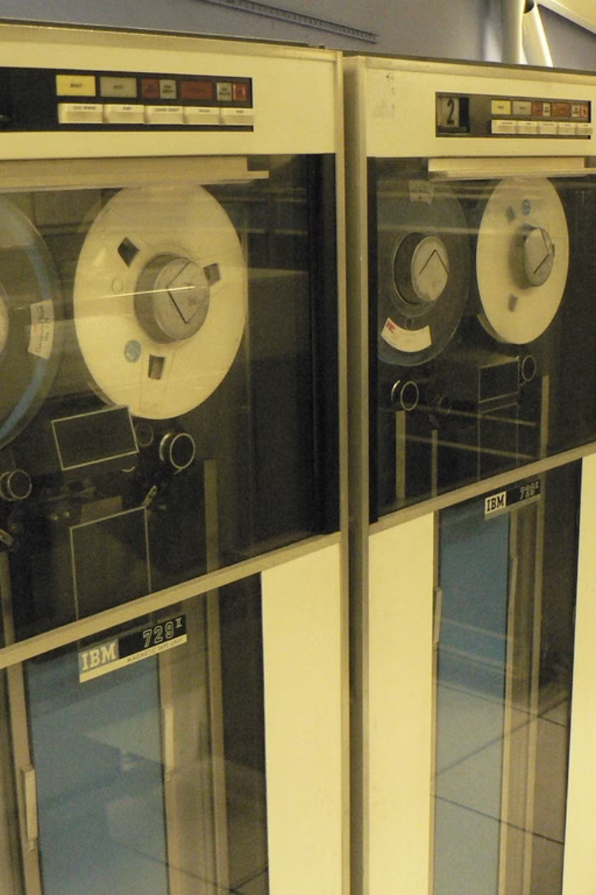
Introduction to Turing Machine
A Turing machine is a theoretical model of computation that was proposed by Alan Turing in 1936. It is a simple yet powerful model that can be used to simulate any algorithm. It consists of a tape, a head, and a set of states. The head can read and write symbols on the tape, and the machine can change its state based on the current symbol and its current state. Turing machines are used to understand the fundamental limits of computation. They are also used in the design of real-world computing devices, such as computers. This presentation aims to introduce you to the Turing machine, exploring its purpose, structure, operation, and applications.

Slide 2
Why We Need Turing Machine
Universality
Understanding Limits
A Turing Machine can be designed to compute any algorithm, making it a universal model of computation. This universality is a key concept in computer science, allowing us to understand the fundamental limitations of computation.
Turing Machines help us define the limits of what can be computed. Some problems are undecidable, meaning that no Turing Machine can solve them. This understanding is crucial for designing efficient algorithms and understanding the complexity of computational problems.

Slide 3

How it is Better Than PDA and FA
1
Memory
2
Bidirectional Movement
3
Complex Operations
Turing machines have unlimited memory, represented by the tape. This allows them to store and process information beyond the limitations of finite automata (FA) and pushdown automata (PDA), which have finite memory.
The Turing machine's head can move both left and right on the tape, enabling it to access information in both directions. This makes them more powerful than FA and PDA, which are typically restricted to unidirectional movement.
Turing machines can perform more complex operations than FA and PDA. They can manipulate the contents of the tape, allowing them to implement algorithms that require iterative computations and memory modifications.

Slide 4
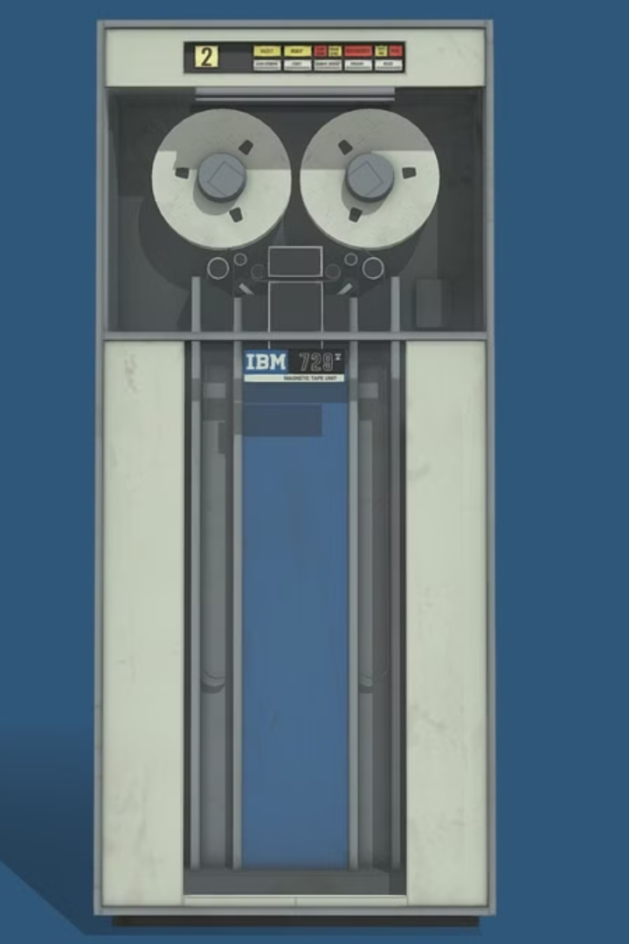



General Structure of Turing Machine
Tape
Head
The tape is a long strip of cells, each of which can hold a single symbol from a finite alphabet.
The head can read and write symbols on the tape. It can also move left or right along the tape.
Control Unit
The control unit is the “brain” of the Turing machine. It contains a finite set of states and a set of transition rules. It determines the next state and the next action based on the current state and the symbol read by the head.

Slide 5

Definition with 7 Tuple
A Turing machine is formally defined as a 7-tuple:
M = (Q, Σ, Γ, δ, q0, B, F)
Where:
* Q is a finite set of states.
* Σ is a finite set of input symbols (the input alphabet).
* Γ is a finite set of tape symbols (the tape alphabet).
* δ is the transition function, which maps a state and a tape symbol to a new state, a new tape symbol, and a direction (left or right).
* q0 is the initial state.
* B is the blank symbol.
* F is a set of final states.

Slide 6
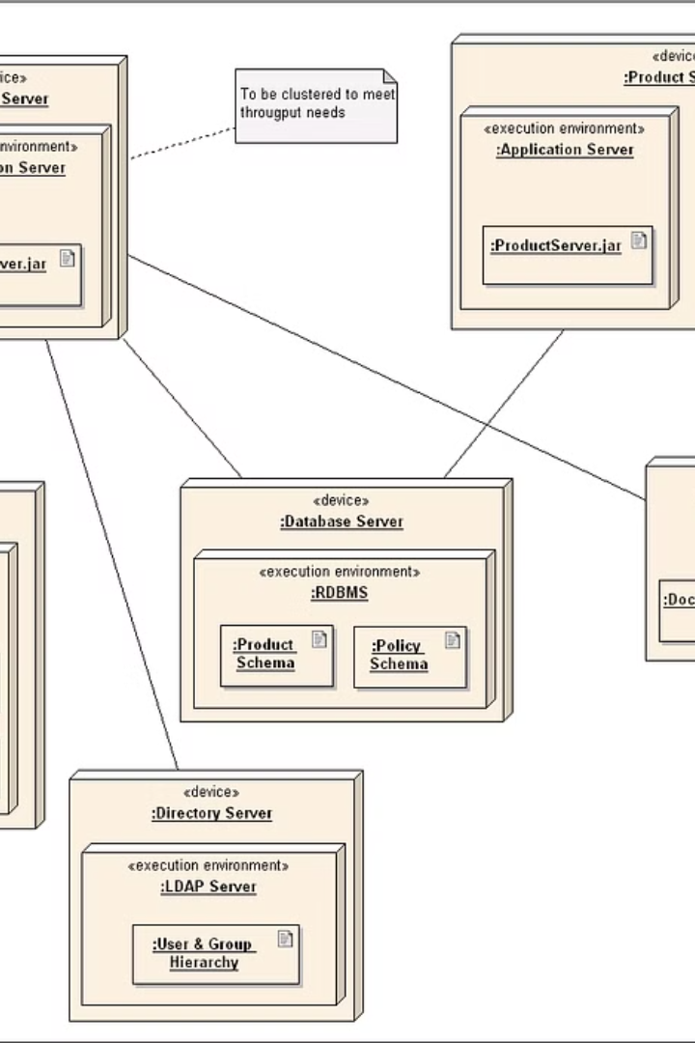


Turing Machine States and Transitions
States
A Turing Machine has a finite set of states, each representing a different configuration or stage of the computation. It transitions between these states based on the input and the current state.
Transitions
The transitions are defined by the transition function (δ). This function maps a state and a tape symbol to a new state, a new tape symbol, and a direction (left or right). It essentially determines the next step of the computation based on the current situation.

Slide 7




Design and Give an Example
Example: Binary Addition
1
Design
2
We can design a Turing machine to perform binary addition. The tape will contain two binary numbers separated by a blank symbol. The machine will read the two numbers, add them together, and write the result on the tape.
States
3
The machine will have several states to handle different cases, such as reading the input, adding the digits, carrying over the sum, and writing the result.
Transitions
4
The transition function will define the actions for each state, including moving the head, writing a symbol, and changing the state.

Slide 8
Applications and Limitations
Applications
Turing machines are the theoretical foundation of computer science. They are used to model the behavior of real-world computers and understand the limits of computation. They have applications in algorithm design, complexity analysis, and theoretical computer science.
1
Limitations
While Turing machines are powerful, they have limitations. For example, the Halting Problem is undecidable, meaning that there is no Turing machine that can determine whether any given Turing machine will halt for a given input. This shows that there are inherent limitations to what computers can achieve.
2

