Slide 1


A Java Swing Text-Based Adventure Game​
Dungeon Quest Game
Presented by
FAHIMA AFRIN ANUVA
MD TUSHAR KHAN
MD MINHAZ AHMED ROHAN

Slide 2

Overview
Objectives of the Project
- Why Java Swing?
How it will run?

Slide 3
Overview of the code
  The code represents a text-based adventure game built using Java Swing for the graphical user interface (GUI). The game involves the player navigating through different scenarios, making choices, and interacting with the environment. The player's actions determine the flow of the game, with consequences such as combat, talking to NPCs, and finding items like weapons. The game is a turn-based adventure where the player can explore different locations, engage in battles, and make decisions that affect the outcome.

Slide 4




Key Features
Engaging
text-based
Exception Handling
Object-Oriented Programming (OOP)
Graphical User Interface (GUI)

Slide 5
Objectives of the Projects
  Create an Interactive Adventure Game: Players experience a choice-based narrative involving exploration, combat, and decision-making.
  Implement a GUI: Uses Java Swing (e.g., JFrame, JPanel, JButton) to display game text, player choices, health, and inventory.
  Introduce RPG Mechanics: Features combat, health management, and inventory (e.g., acquiring weapons like a long sword).
  Demonstrate OOP Principles: Encapsulation, inheritance, polymorphism, and abstraction for game logic and structure.
  Handle Exceptions: Ensures smooth gameplay by catching and managing unexpected errors.
  Enable Multiple Endings: Player choices lead to different outcomes, enhancing replayability.

Slide 6
Game Output
Win/loss Conditions
Health Management System
Text-Based Adventure
Dynamic Gameplay
Single Player Experience

Slide 7
Object Oriented Programming
Polymorphism
Inheritance
Encapsulation
Abstract

Slide 8
Object Oriented Programming
  Encapsulation: Data and methods are bundled together within the Game class. Private variables like playerHP and monsterHP are accessed and modified through public methods, ensuring controlled access.
  Abstraction: The complex game logic (combat, movement, etc.) is hidden behind methods like townGate(), attackGuard(), and fight(). The player only interacts with high-level game actions, not the internal details.
  Inheritance: The code doesn't explicitly use inheritance in the traditional sense (e.g., extending classes), but you could add new types of characters or actions by creating subclasses of Game or other entities, inheriting common properties and behaviors.
  Polymorphism: The ChoiceHandler class demonstrates polymorphism, as it handles different actions (e.g., townGate(), talkGuard(), attackGuard()) based on the position and user input. The same method (actionPerformed()) behaves differently based on context

Slide 9
How exception handling is used in the code: Try-Catch Blocks: TitleScreenHandler and ChoiceHandler classes use try-catch blocks to handle any unexpected errors that might occur during the execution of their respective event-handling logic. For instance, in the TitleScreenHandler class, when the start button is pressed, the game screen is created inside a try block. If an error occurs, it is caught in the catch block, and an error message is printed.
Exception Handling
Prevent Crashes: This ensures that if something goes wrong (like a null pointer or array out-of-bounds exception), the game will not terminate unexpectedly. Error Logging: The error message and stack trace are printed, making it easier to debug and fix the issue.

Slide 10
Graphical User Interface
  Main Window: Uses JFrame to create the main game window (window).
  Components: JPanel to organize elements like title, buttons, and player stats. JButton for user choices (e.g., "Start", "Choice 1"). JLabel for displaying game title, player stats, and other text. JTextArea for dynamic game text (narrative, dialogue).
  Layout: Uses null layout for custom positioning of components (setBounds()). GridLayout for arranging choice buttons in a grid.
  Interactivity: ActionListener handles button clicks, updating the game state based on user input. Dynamic updates of text and labels as the game progresses (mainTextArea.setText()).
  Appearance: Custom fonts and colors are used for aesthetic purposes (e.g., titleFont, Color.red).
  Display Game Information: Present the game's narrative, player stats (HP, weapon), and choices in an interactive and visually appealing way.
  Facilitate User Interaction: Allow players to make decisions (e.g., via buttons) that influence the story progression and game state.
  Support Dynamic Updates: Update the game display in real-time based on player actions (e.g., changing health points, displaying new scenarios).

Slide 11
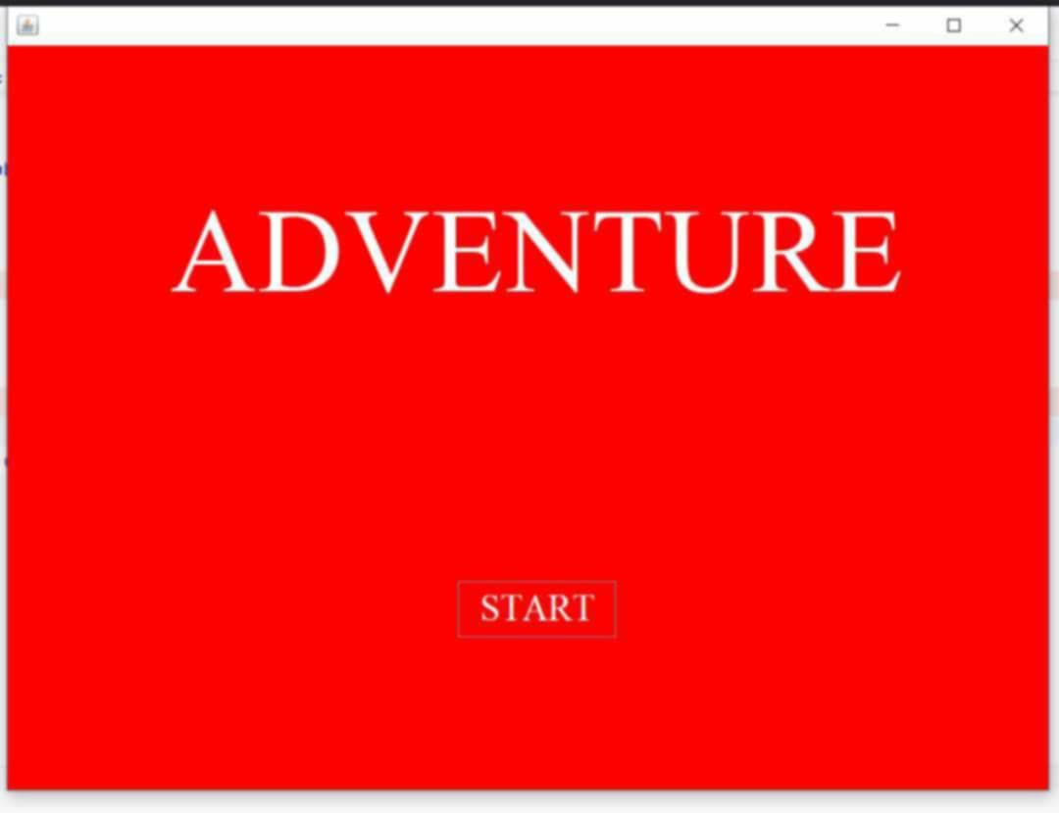
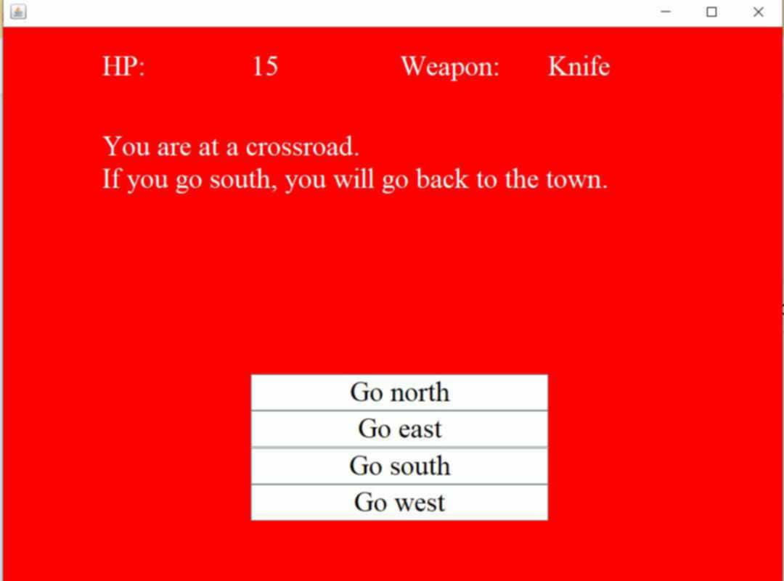


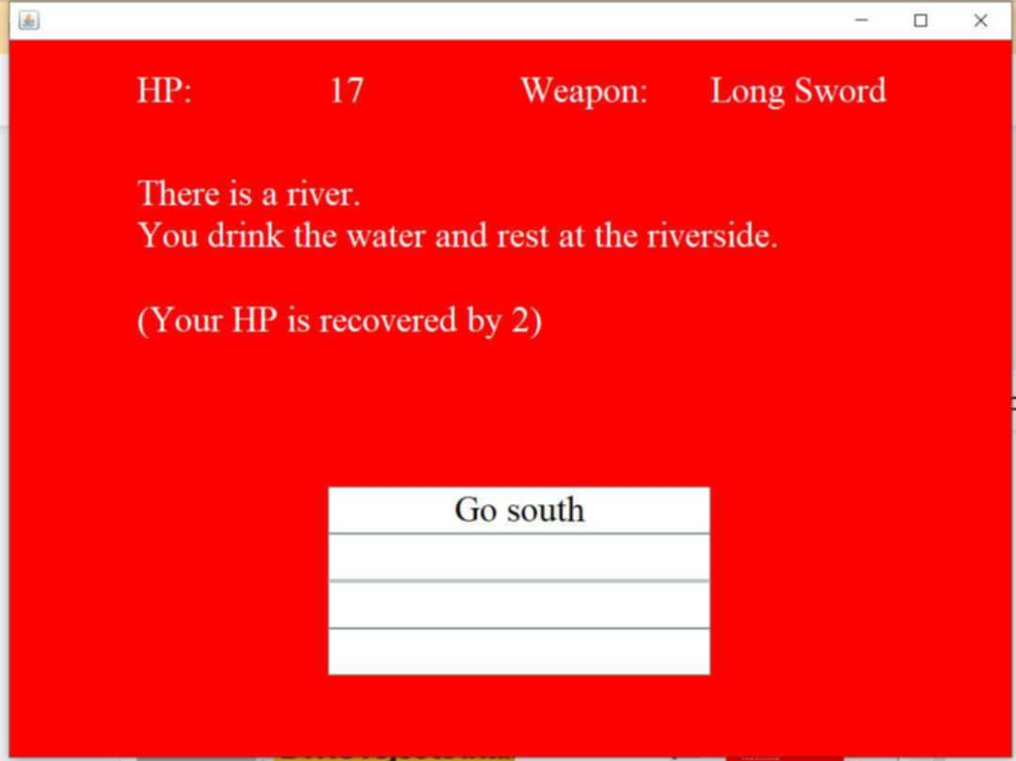
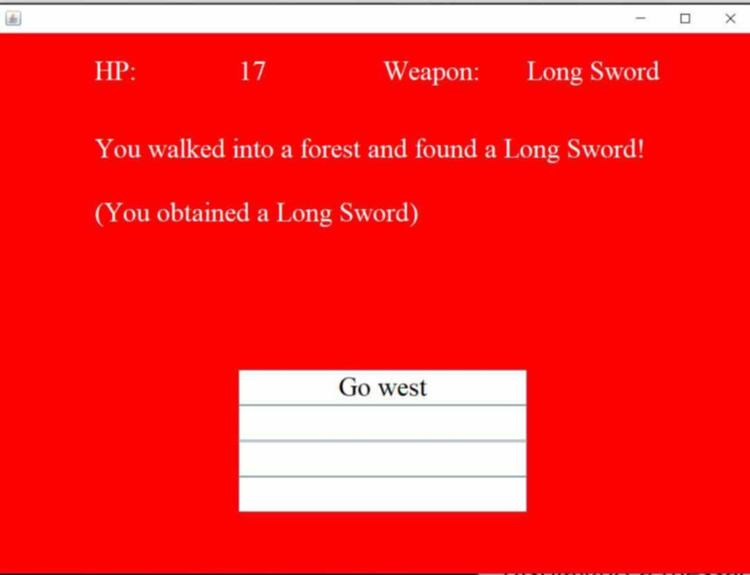

Slide 12
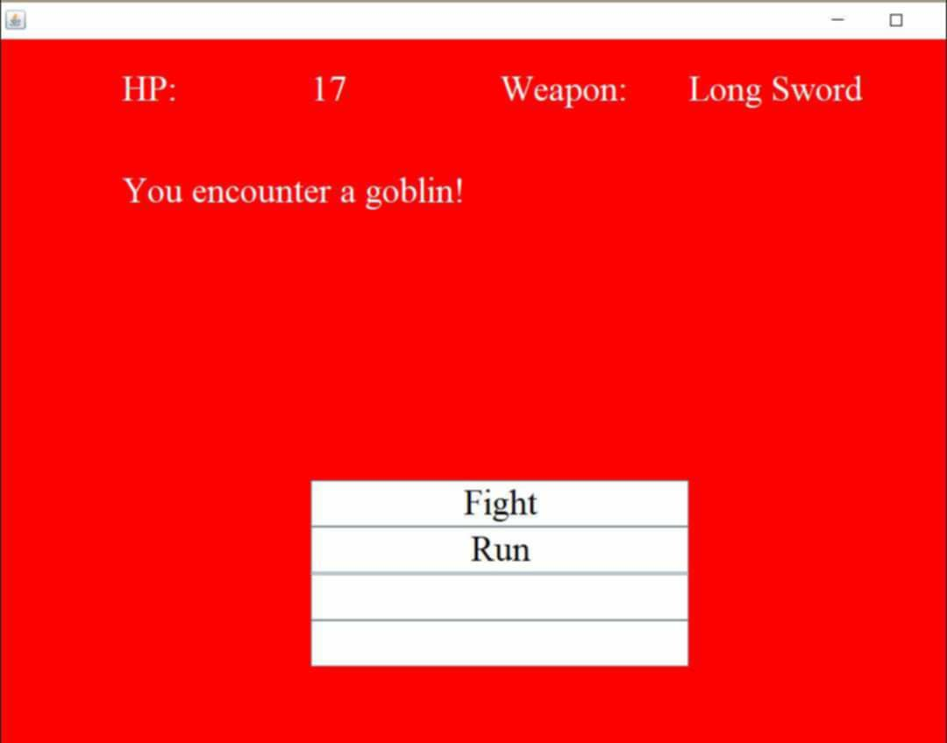
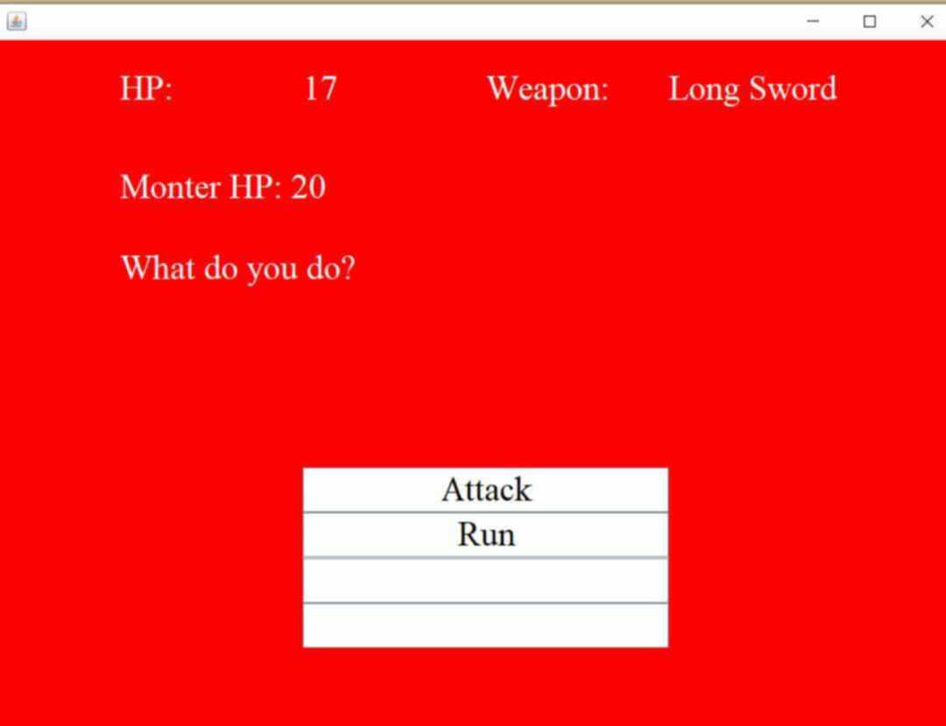
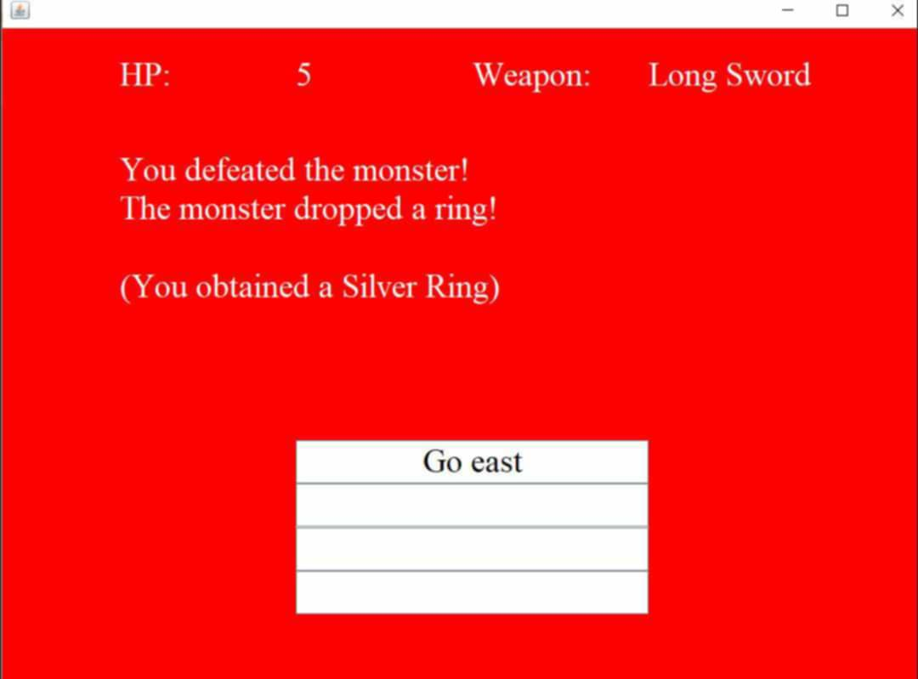

Slide 13
Conclusion
This code creates a simple but functional text-based adventure game using Java Swing. It provides a graphical interface for users to interact with, displaying text and options based on the player's decisions. The game incorporates core programming concepts like OOP, exception handling, and GUI design. The key features revolve around player choices, combat mechanics, and story progression, creating an engaging interactive experience.

Slide 14


Slide 15

Any Queries?

