Slide 1

Maps show us where we are.
But only in two dimensions.
MAPS
Notes:
Maps… show us where we are… but only in two dimensions…

Slide 2
WHAT ABOUT HEIGHT?

Slide 3
Altitude does matter.

Slide 4
Atmosphere changes

Slide 5

Atmosphere changes

Slide 6
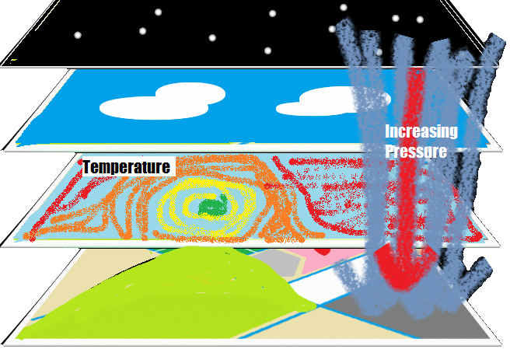
So do temperature and pressure

Slide 7
And It matters a lot for…
Travellers
Scientists
Notes:
Travellers and scientists

Slide 8
Data not found!!
But this data is not available easily for everyone…
Notes:
But this data is not available easily for everyone…

Slide 9
Not anymore ☺

Slide 10
Presenting

Slide 11
dLimiter
Break the Barriers

Slide 12
An app that…
Is a 3D map
Shows altitude
Tracks you

Slide 14


Slide 15
Along with…
Pressure
Temperature
Weather
Wind velocity

Slide 16
And suggest…
Suitable crops to farmers
Required equipment to tourists

Slide 17
With…
Detailed information about a region for research.

Slide 18

Thank you for watching!
By:
B72 Krushn Dayshmookh
Notes:
Add our pic here.

