Slide 1
fertility advisor
Your friendly farm manager
Made with <3 and code at GHRCE

Slide 2

Features

Slide 3

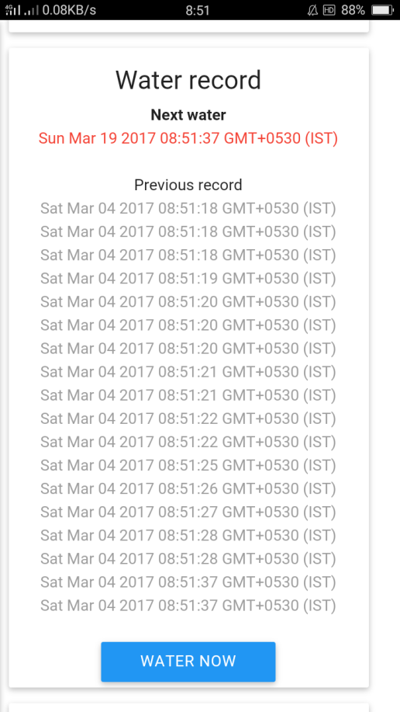
Water now!!
Water your crops,
Maintain water record
and get reminder for next watering time.
All from a single unified interface!

Slide 4
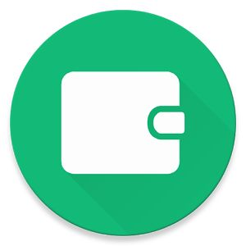
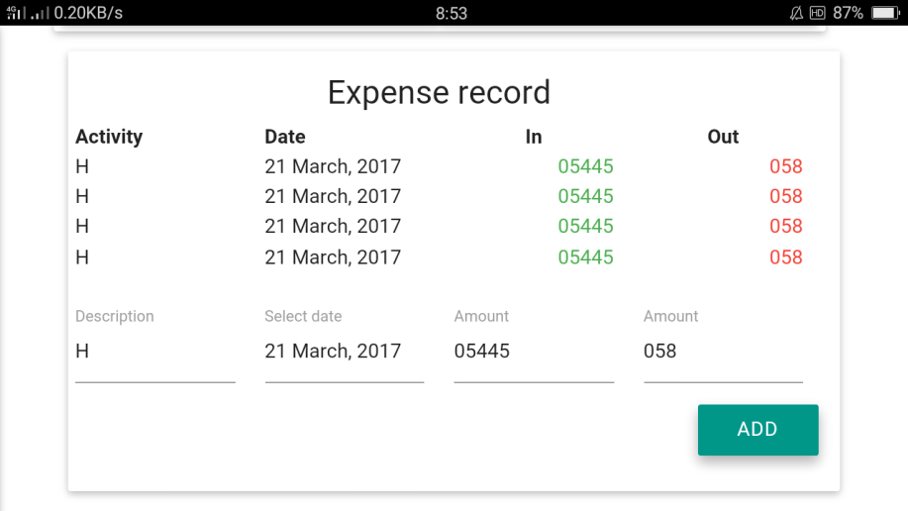
Manage expenses
Keep track of expenses on the farm with this nifty tool.
Also includes an inbuilt store to spend money.

Slide 5

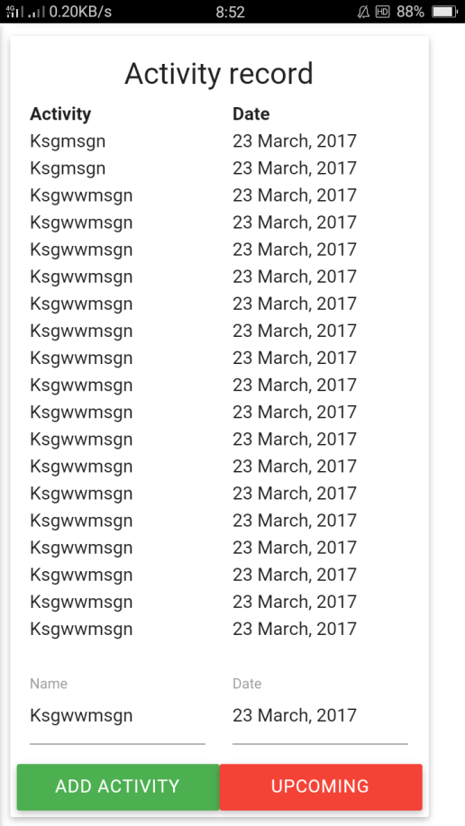
Organizer
Also lists and tracks all the activities like tilling, ploughing and sowing.
Also get suggestions and reminders for upcoming

Slide 6

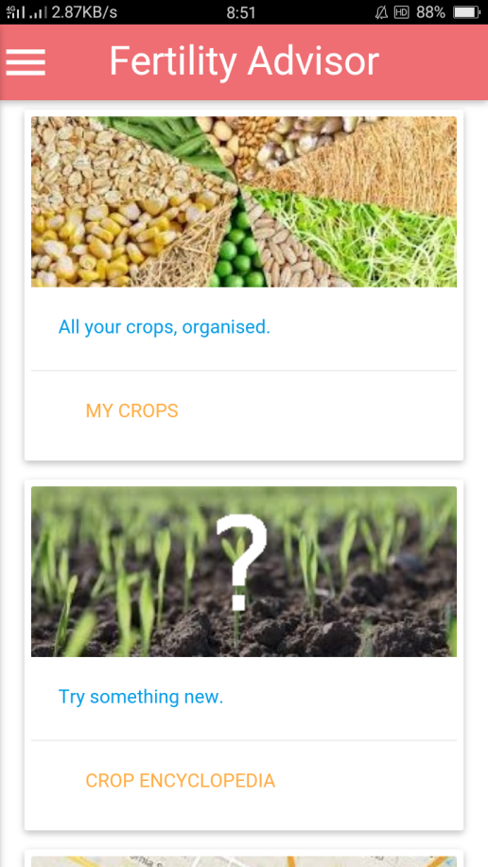
Dashboard
A single unified interface for all your daily activities.

Slide 7

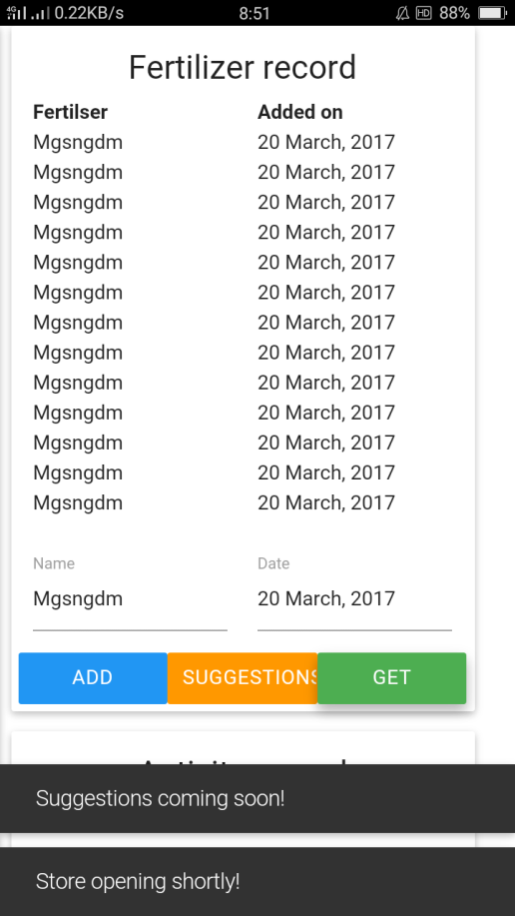
Store
Get fertilizers and equipment with real-time suggestions and manage inventory from one single app.

Slide 8

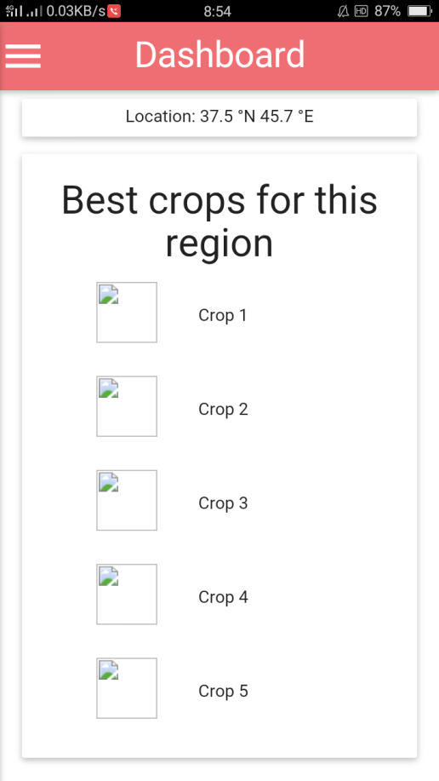
Crop suggestions
Based on geography of your location, this tool can suggest best crops for maximum profit

Slide 9

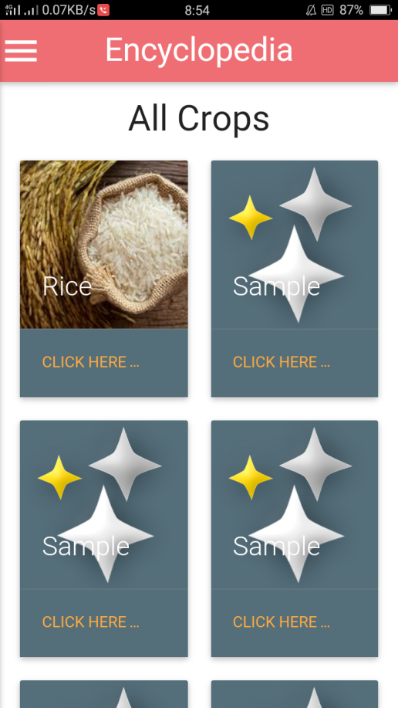
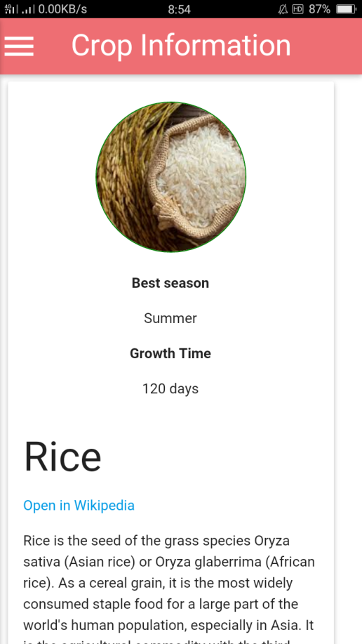
Crop Encyclopedia
Get all the information about your plant with an in-built off-line encyclopedia powered by Wikipedia.

Slide 10

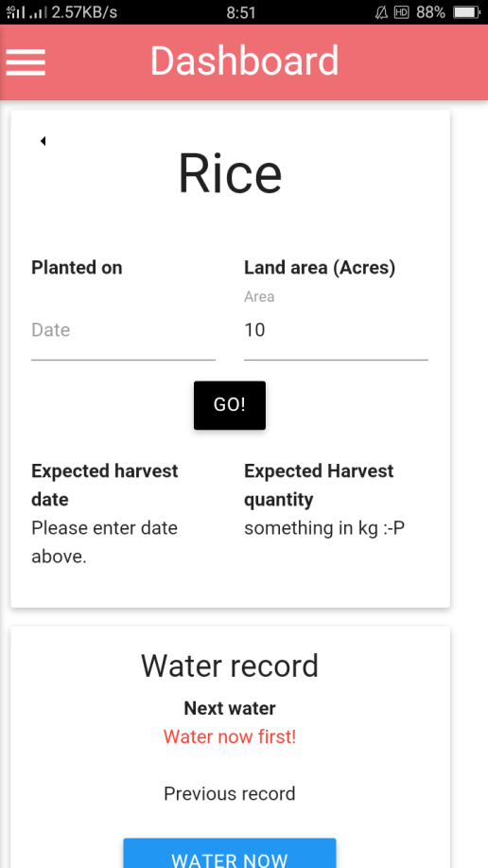
Timer
Our unique timer would notify you when its time to sow and when to harvest.
Add-on: also shows expected harvest quanitity.

Slide 11

Krushn Dayshmookh
G. h. raisoni College of engineering
Made by

Slide 12


