Slide 1

Outlines
Introduction
Recurrence and different methods to solve recurrence
Multiplying large Integers Problem
Problem Solving using divide and conquer algorithm
Binary Search
Max-Min problem,
Sorting (Merge Sort, Quick Sort)
Matrix Multiplication
Exponential.
Department of Computer Engineering
Unit no: 3
Unit title: Divide and Conquer
Subject name and code: Design and Analysis of Algorithms
(01CE0503)
Prof. Aastha Masrani

Slide 2
Introduction
Recursive in structure.
A typical Divide and Conquer algorithm solves a problem using following three steps.
1.Divide: Break the given problem into subproblems of same type. 2. Conquer: Recursively solve these subproblems 3. Combine: Appropriately combine the answers

Slide 3
Recurrence and different methods to solve recurrence
Recurrence equation:
Equation that defines a sequence recursively.
T(n) = T(n-1) + n, n>0 -------(1 (recurrence relation))
T(0) = 0 --------(2 (initial condition))
3 methods to solve recurrence equation.

Slide 4
Recurrence equation
Recurrence equation
Substitution method
Forward substitution
Backward substitution
Master’s method
Recurrence tree method

Slide 5
Substitution method
1 forward substitution
Use initial conditional in initial term, use this value to find next term.
Recurrence relation
T(n) = T(n-1) + n Initial condition T(0)=0
Sol.: T(n) = T(n-1) + n -----(1)
If n=1
T(1) = T(0)+1
= 0+1
T(1) = 1 ----(2)

Slide 6
Substitution method
If n=2
T(2) = T(1)+2
= 1+2
T(2) = 3 ----(3)
If n=3
T(3) = T(2)+3
= 3+3
T(3) = 6 ----(4)
By observing,
T(n) = n(n+1)/2
= n²+n/2
= O(n²)
It is difficult to find pattern so generally not used.

Slide 7
Backward substitution method
2. Backward substitution
T(n) = T(n-1) + n -----(1)
If n=n-1
T(n-1) = T(n-1-1)+(n-1)
= T(n-2) + (n-1) ----(2)
Put eq^{n}(2) in eq^{n} (1)
T(n) = T(n-2) + (n-1)+ n ------(3)
let n=n-2
T(n-2) = T(n-1-2)+(n-2)
= T(n-3) + (n-2) ----(4)

Slide 8
Backward substitution method
Put eq^{n}(4) in eq^{n} (3)
T(n) = T(n-3) + (n-2) + (n-1)+ n ------(3)
|
|
T(n) = T(n-k) + (n-k+1) + (n-k+2)+------+ n
Let k=n then,
T(n) = T(n-n) + (n-n+1) + (n-n+2)+------+ n
T(n) = T(0) +1+2+3+------+ n
T(n) = 0 +1+2+3+------+ n
T(n) = n(n+1)/2
= n²+n/2
= O(n²)

Slide 9

Master’s Method
T(n) = a T($\frac{n}{b}$ ) + f(n) where n>= d and d is constant(ε > 0)
(time for divide and conquer)
size of each
subproblem

Slide 10
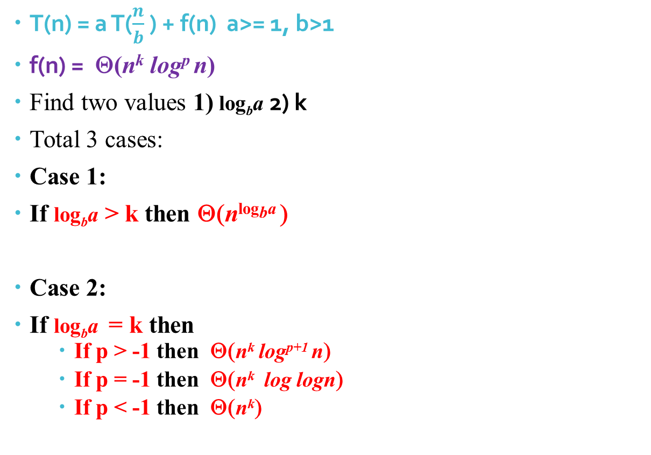
Master’s Method
T(n) = a T($\frac{n}{b}$ ) + f(n) a>= 1, b>1
f(n) = Θ(n^{k} log^{p} n)
Find two values 1) log_{b}a 2) k
Total 3 cases:
Case 1:
If log_{b}a > k then Θ(n^{logba} )
Case 2:
If log_{b}a = k then
If p > -1 then Θ(n^{k} log^{p+1} n)
If p = -1 then Θ(n^{k} log logn)
If p < -1 then Θ(n^{k})

Slide 11
Master’s Method
Case 3:
If log_{b}a < k then
If p >= 0 then Θ(n^{k} log^{p} n)
If p < 0 then Ο (n^{k})
Ex1 . T(n) = 9T(n/3) + n
a = 9, b = 3, f (n) = θ(n¹log⁰n ), k =1 , p=0
log_{b}a = 2
CASE 1: log_{b}a > k
T(n) = Θ(n²).

Slide 12
Master’s Method
Ex2 . T(n) = 2T(n/3) + 1
a = 2, b = 3 , f (n) = θ( n⁰log⁰n ), k =0 , p=0 and p >-1
log_{b}a = log₃ 2 = n⁰ = 1
CASE 2: log_{b}a = k ,
If p > -1 then Θ(n^{k} log^{p+1} n)
∴ T(n) = Θ(logn).
Ex 3 T(n) = 4T(n/2) + n³
a = 4, b = 2 ,f (n) = θ(n³log⁰n ), k=3, p=0
log_{b}a = 2
CASE 3: log_{b}a < k
If p >= 0 then Θ(n^{k} log^{p} n)
T(n) = Θ(n³).

Slide 13
Recursion tree method
T(n) = 4 T(n/2) + n³
Where n³ = root node
T(n/2) = size of sub-problem
4 = number of sub-problem
Step 1: find cost of each level
Step 2: find depth of tree
Step 3: find number of leaves
There are total 3 cases to solve examples. But case 1 and case 2 are solved by above 3 steps.
Case 1: cost of root node is maximum
Case 2: cost of leaf node is maximum.
Case 3: cost of each level is same.

Slide 14
Recursion tree method
Case 3: cost of each level is same.
Step 1: find cost of each level
Step 2: find depth of tree
Step 3: find level of tree
Step 4: total cost = cost of each level * number of level

Slide 15
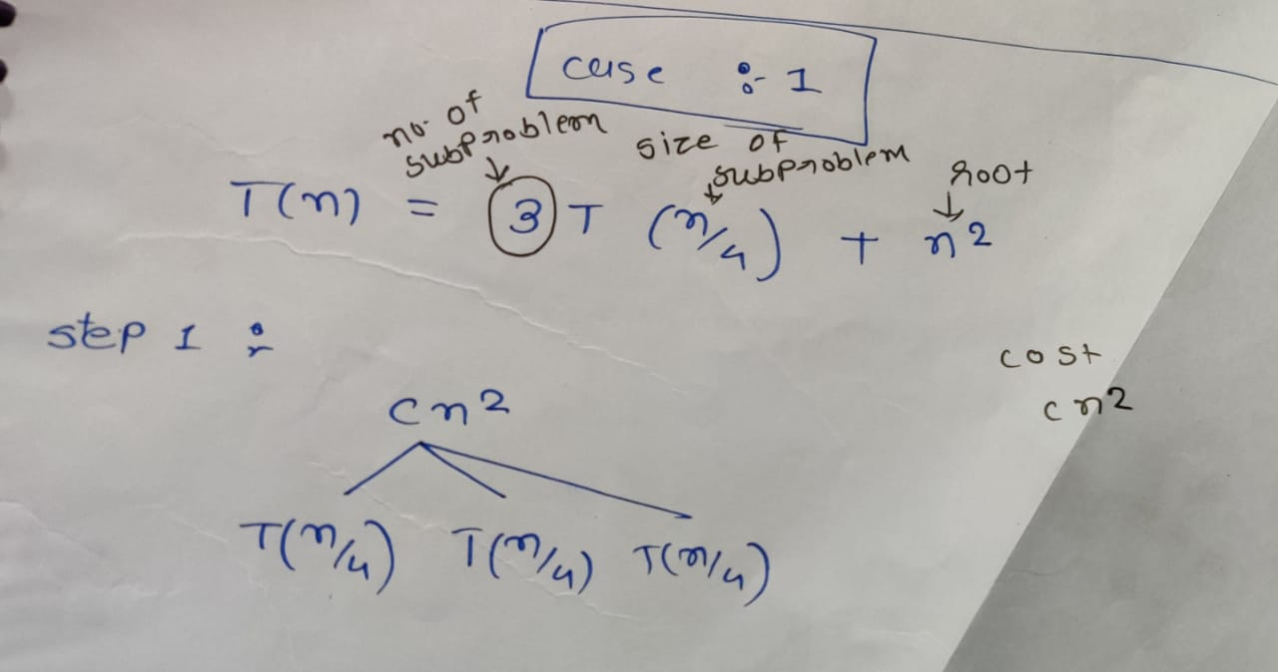
CASE 1: recursion tree

Slide 16
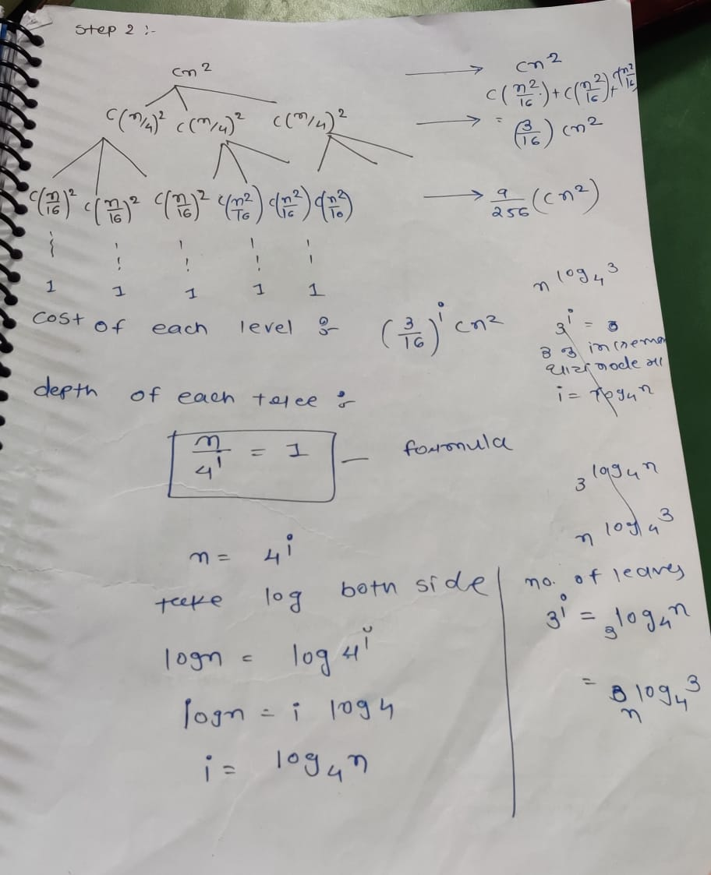
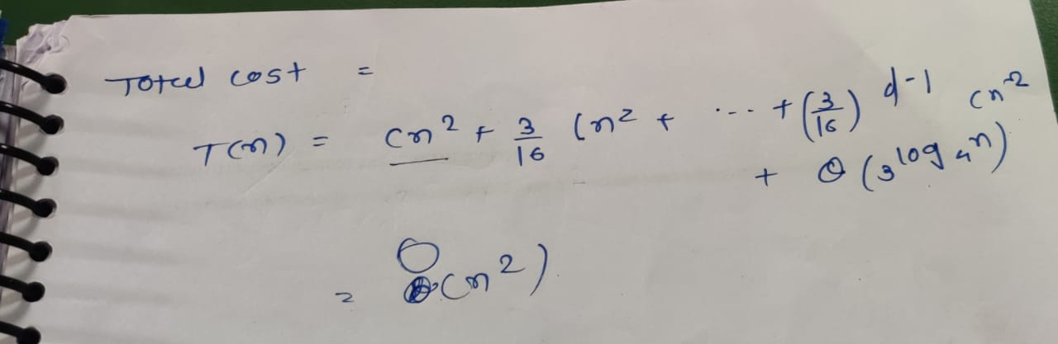

Slide 17
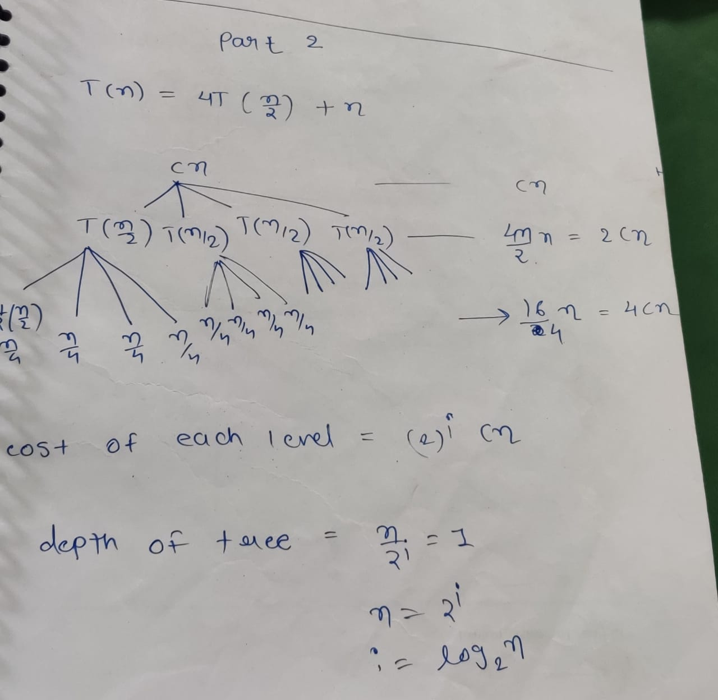
CASE 2: recursion tree

Slide 18
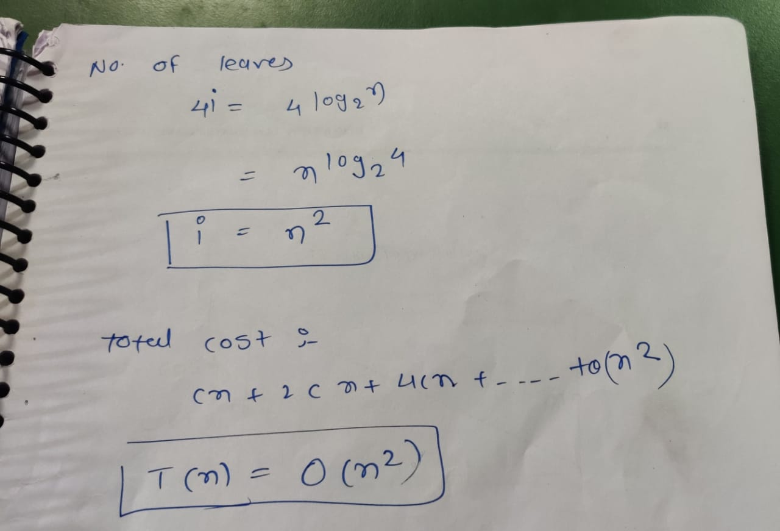

Slide 19
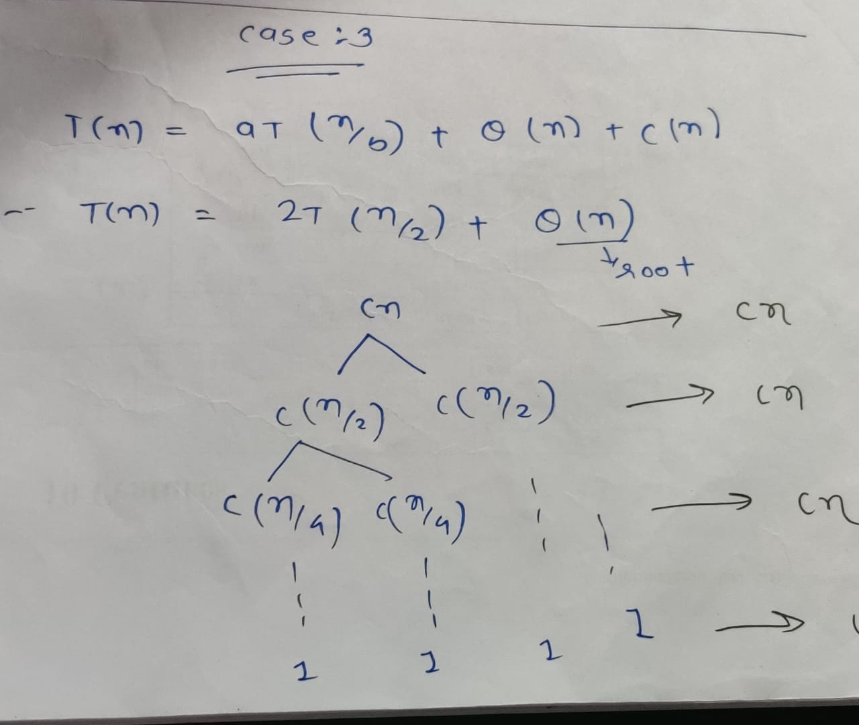
CASE 3: recursion tree

Slide 20
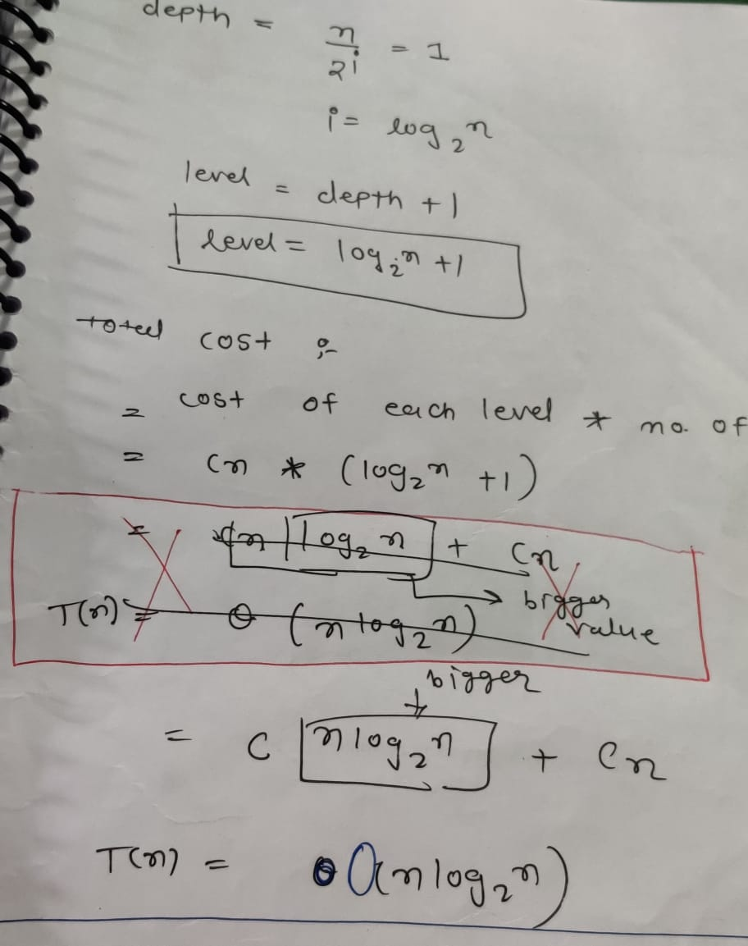

Slide 21
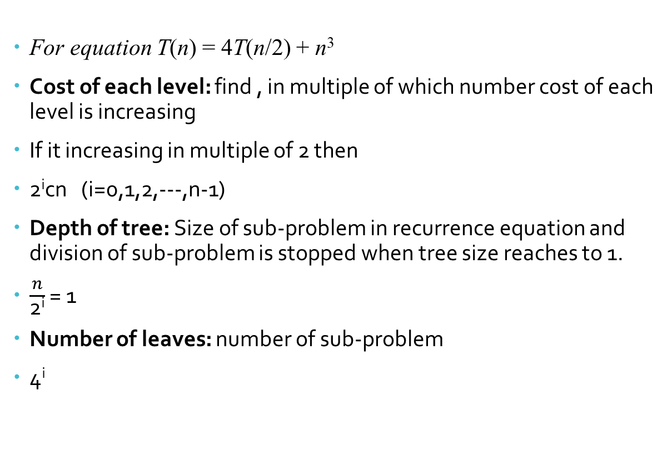
How to find
For equation T(n) = 4T(n/2) + n³
Cost of each level: find , in multiple of which number cost of each level is increasing
If it increasing in multiple of 2 then
2^{i}cn (i=0,1,2,---,n-1)
Depth of tree: Size of sub-problem in recurrence equation and division of sub-problem is stopped when tree size reaches to 1.
$\frac{n}{\text{2}\text{i}}$ = 1
Number of leaves: number of sub-problem
4^{i}

Slide 22
Multiplying large integers problem
X = 1234
Y= 2345
Divide integer into 2 portion X = a b
where a= 12, b = 34 ( X= 1234)
Y = c d
Where c= 23, d = 45 ( Y= 2345)
X Y = (a * 10^{n/2} + b ) (c * 10^{n/2} + d )
= ac * 10^{n} + (a*d * 10^{n/2})+ (b*c * 10^{n/2})+ bd
= ac * 10^{n} + (ad+ bc) 10^{n/2} + bd
The above procedure still needs four multiplications; ac,ad,bc and bd

Slide 23
Multiplying large integers problem
The key observation is that there is no need to compute both ad and bc; all we really need is the sum of these two terms.
So there is one algorithm which takes only 3 multiplication.
begin
u= (a+b)(c+d)
v=a*c
w=b*d
z= v* 10^{n} + (u-v-w) * 10^{n/2} + w
end

Slide 24
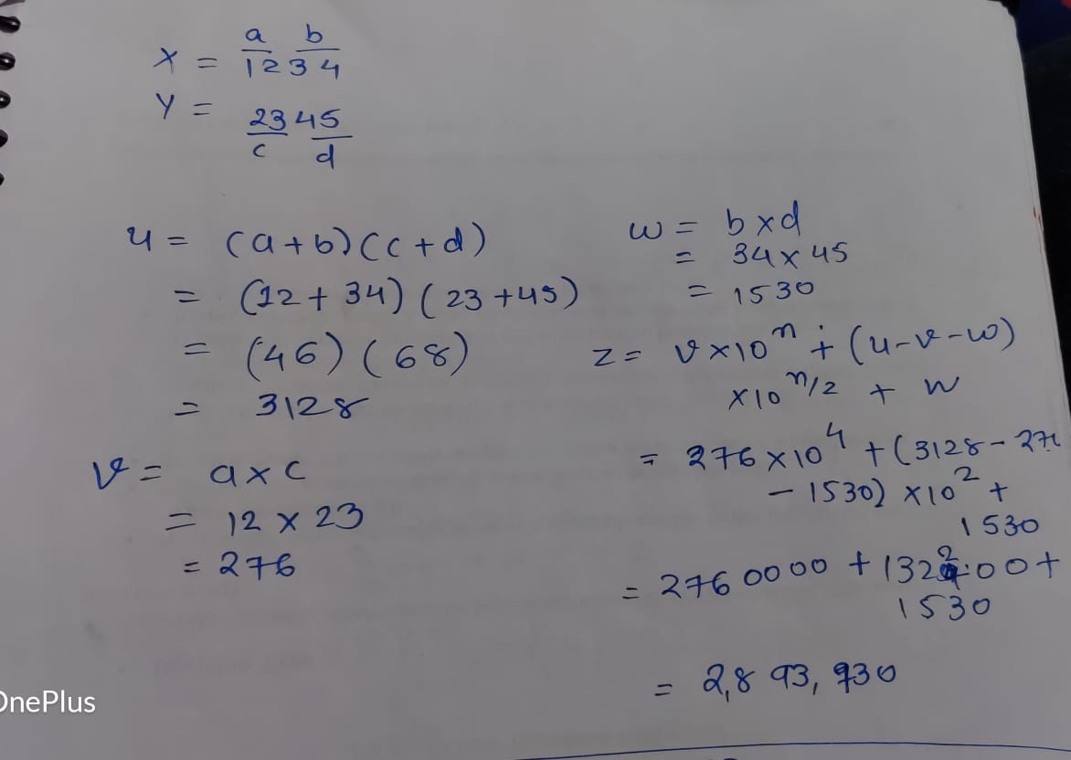

Slide 25
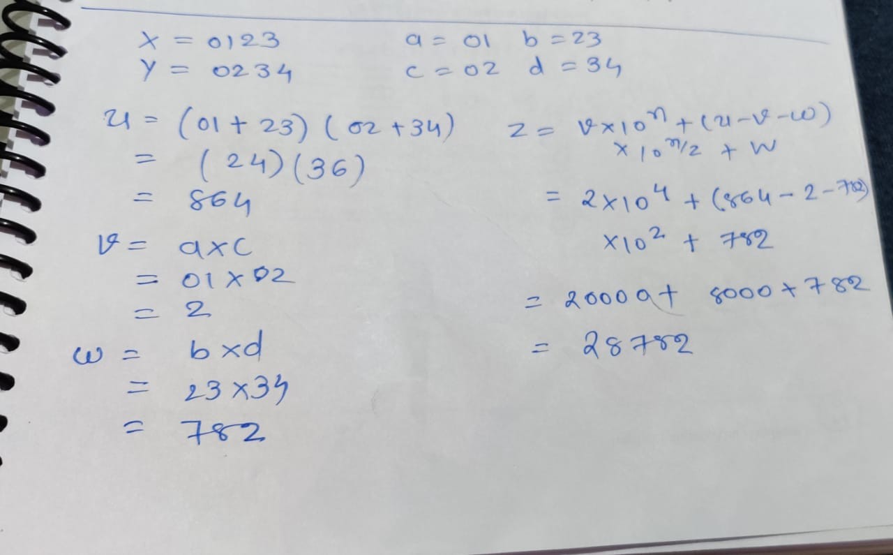

Slide 26
Time complexity
begin
u= (a+b)(c+d)
v=a*c
w=b*d
z= v* 10^{n} + (u-v-w) * 10^{n/2} + w
End
Divide 1 digit into 2 parts so size of sub problem is n/2
So our recurrence equation is
T(n) = 3 T(n/2) + k1 n ------- eq^{n} (1)
divide part-
Total 3 multiplication –
number of sub-problem is 3
Shifting, addition, subtraction– conquer part

Slide 27
Time complexity
Solve this equation by backward substitution
n=n/2 in eqn 1
T(n/2) = 3T(n/4) + k1 n/2 ------(2)
Put eqn(2) in eq(1)
T(n) = 3(3T(n/4) + k1 n/2 ) + k1 n
= 3²T(n/4) + k1n (3/2) + k1 n -------(3)
Put n=n/4 in eqn (1)
T(n/4) = 3T(n/8) + k1 n/4 ------(4)
Put eqn(4) in eq(3)
= 3³T(n/2³) + k1n (3/2)² + k1 n(3/2)+ k1n -------(5)
‘
‘ (upto k we have to find)
= 3^{k}T(n/2^{k}) + k1n [(3/2)² + (3/2)+ 1]
Put n=2^{k}
= 3^{k}T(n/n) + k1n [(1 +(3/2)+ (3/2)² +----+ (3/2) ^{k-1} ]

Slide 28
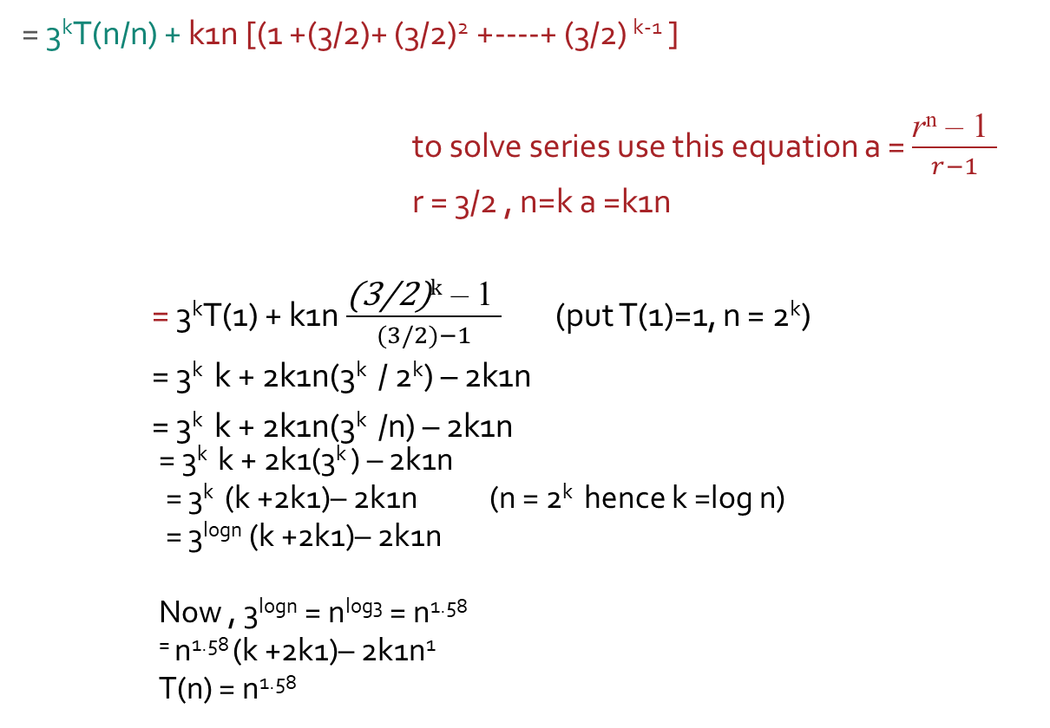
Time complexity
= 3^{k}T(n/n) + k1n [(1 +(3/2)+ (3/2)² +----+ (3/2) ^{k-1} ]
to solve series use this equation a = $\frac{\text{r}\text{n}\text{ – 1 }}{r−1}$
r = 3/2 , n=k a =k1n
= 3^{k}T(1) + k1n $\frac{\text{(3/2)}\text{k}\text{ – 1 }}{(3/2)−1}$ (put T(1)=1, n = 2^{k})
= 3^{k} k + 2k1n(3^{k} / 2^{k}) – 2k1n
= 3^{k} k + 2k1n(3^{k} /n) – 2k1n
= 3^{k} k + 2k1(3^{k} ) – 2k1n
= 3^{k} (k +2k1)– 2k1n (n = 2^{k} hence k =log n)
= 3^{logn} (k +2k1)– 2k1n
Now , 3^{logn} = n^{log3} = n^{1.58}
⁼ n^{1.58} (k +2k1)– 2k1n¹
T(n) = n^{1.58}

Slide 29
Max Min algorithm
Max_min(A, min, max, low, high)
{
if(low=high) then
max= min= A[low];
else if(low= high-1) then
{
if(A[low]<A[high]) then
{
max = A[high];
min = A[low];
}
else
{
max = A[low];
min = A[high];
}
}

Slide 30
Max Min algorithm
Else
{
mid = (low+high)/2;
Maxmin(low, mid, max, min);
Maxmin(mid+1, max1, min1, high);
if(max< max1) then max=max1;
if(min> min1) then min=min1;
}
}

Slide 31
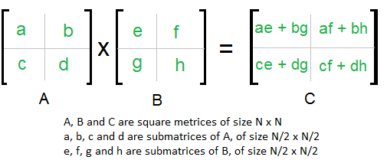
Matrix multiplication
In the above method, we do 8 multiplications for matrices of size N/2 x N/2 and 4 additions. Addition of two matrices takes O(N²) time.
The idea of Strassen’s method is to reduce the number of recursive calls to 7. Strassen’s method is similar to above simple divide and conquer method in the sense that this method also divide matrices to sub-matrices of size N/2 x N/2 as shown in the above diagram, but in Strassen’s method, the four sub-matrices of result are calculated using following formulae.

Slide 32
Addition and Subtraction of two matrices takes O(N²) time. So time complexity can be written as
T(n) = 7T(n/2) + O(n²)
From Master's Theorem, time complexity of above method is O(n^{Log7}) which is approximately O(n^{2.8074})

Slide 33
Merge sort
Mergesort(A[0,--,n-1], low, high)
If(low< high) then
{
mid = (low+high)/2
mergesort(A, low, mid)
mergesort(A, mid+1, high)
combine(A , low, mid, high)
}
Combine(A[0,---,n-1], low, mid, high)
{
k = low #new temp array
i =low #for left sub list
j= mid+1 #for right sub list

Slide 34
While(i<= mid AND j <= high)do
{
if(A[i]= A[j]) then
{
temp[k] = A[i]
i= i+1
k = k+1
}
else
{
temp[k] = A[j]
j= j+1
k = k+1
}
}

Slide 35
While(i<= mid) do
{
temp[k] = A[i]
i= i+1
k = k+1
}
While(j<= high) do
{
temp[k] = A[j]
j= j+1
k = k+1
}
}
When there is only one element left in left sub tree or right tree

Slide 36
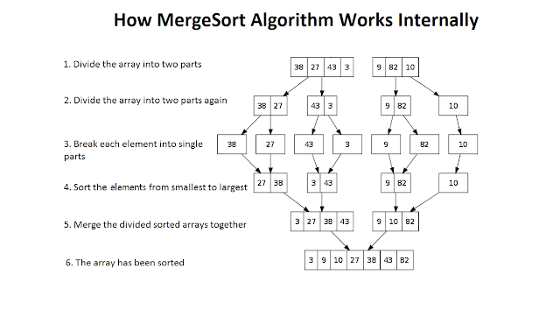
Example of merge sort

Slide 37
Quick sort Algortihm
Quicksort(A[0,--,n-1], low, high)
If(low< high) then
{
m = partition(A[ low….high]) quicksort(A [ low….m-1]))
quicksort(A [ m+1….high]))
}

Slide 38
Quick sort Algortihm
Partition(A[ low….high])
Pivot = A[low]
i= low
J= high
While(i<= j)do
{
while(A[i]<= pivot)do
i= i+1
while(A[j>= pivot)do
j= j+1
if (i<= j) then
swap(A[i], A[j])
}
Swap(A[low], A[j]) # (if j<i)
Return j

Slide 39
Quick sort Algortihm
First of all we take first element and place it at its proper place. We call this element Pivot element.
Note: We can take any element as Pivot element but for convenience the first element is taken as Pivot.
There are two condition to place Pivot at its proper place.
All the elements to the left of Pivot element should be smaller than
All the elements to the right of Pivot element should be greater than
Now we are having two sub part:
Quick sort Left sub tree
Quick sort right sub tree

Slide 40
Time complexity of quick sort and merge sort
T (n) = 2T(n/2)+ n
a=2, b= 2 f(n)= n¹ log⁰p
^{logba} = ^{log22} = 1 k=1 p=0
case : 2
T(n) = θ(n logn)

Slide 41
Exponential
Let a and n be two integers.
We wish to compute x = a^{n}.
If n is small, the obvious algorithm is:
Function expoSeq(a, n) {
r ← a
for i ← 1 to n-1 do r ← a*r
return r
}
T(n) = O(n)

Slide 42
Divide and conquer method
With divide and conquer:
a^{n} = return a if n = 1
return (a^{n/2})² if n is even
return a * a^{n-1} otherwise
a²⁹ = a * a²⁸ = a * (a¹⁴)² …….
Which involves only three multiplications and four squaring instead of the 28 multiplication.
a²⁹ = a * a²⁸
= a * (a¹⁴)²
= a * ((a⁷)²)²
= a * (a * (a⁶)²)²
= a * (a * ((a³)²)²)²
= a * (a * ((a * a²)²)²)²
Which involves only three multiplications and four squaring instead of the 28 multiplication

Slide 43
PSEUDOCODE
Function expdc(a,n)
{
if n = 1 then
return a
if n is even then
return (expdc(a^{n/2})² )
else
return( a * expdc(a^{n-1}))
}
T(n) = O(log n)

