Slide 1
Problem Statement Title:
Team Name:
Personalized Product Recommendations
UrbanIQ

Slide 2

Team members details
Team Name
Institute Name/Names | Manipal University Jaipur National Institute of Technology Delhi
Team Members > | 1(Leader) | 2 | 3
Name | PRIYANSHI VYAS | TUSHAR AGARWAL | -
Batch | 2024 | 2024
UrbanIQ

Slide 3
Deliverables/Expectations for Level 2 (Idea + Code Submission)
Idea Submission:
Objective: Develop a system capable of generating personalized product recommendations using collaborative filtering techniques and matrix factorization algorithms like SVD and KNN.
Target Users: Online shoppers, e-commerce platforms.
Impact: Increase conversion rates, enhance user engagement, provide tailored shopping experiences.
Code Submission:
Languages & Libraries: Python, Surprise Library (for recommendation algorithms), Pandas (for data manipulation).
Code Structure: Organized into distinct modules for data loading (data_loader.py), model training and evaluation (model.py), main orchestration (main.py), and web interface (app.py).
Deployment Considerations: Designed for scalability, extensibility, and integration with existing e-commerce platforms.

Slide 4
Glossary
SVD (Singular Value Decomposition): A matrix factorization technique used in recommendation systems to capture latent factors.
KNN (K-Nearest Neighbors): Algorithms used for collaborative filtering, including variations like KNNBasic, KNNWithMeans, and KNNWithZScore.
RMSE (Root Mean Square Error): A standard measure for quantifying the difference between predicted and actual ratings.
P0, P1, P2 (Priority Levels): Classification of use cases or features by importance or impact, with P0 being the highest priority.
API (Application Programming Interface): A set of rules and protocols for building and interacting with software applications.

Slide 5
Use-cases
P0: Personalized Product Recommendations:
Description: Provide users with personalized product suggestions based on past behavior, preferences, and interactions.
Impact: Enhance user engagement, increase conversion rates, improve customer satisfaction.
Implementation Details: Utilize collaborative filtering techniques, including SVD and KNN algorithms, and integrate with product catalogs.
P1: Integration with E-commerce Platforms:
Description: Seamlessly integrate the recommendation system with existing e-commerce platforms.
Impact: Enable e-commerce platforms to leverage personalized recommendations without significant changes to their existing systems.
Implementation Details: Design APIs for easy integration, ensure compatibility with different product catalog structures.
P2: Analytics and Insights:
Description: Gather and analyze data on user interactions, recommendation effectiveness, and popular products.
Impact: Provide insights to businesses on user behavior, product trends, and recommendation performance.
Implementation Details: Implement tracking and analytics, provide dashboards and reports.

Slide 6
Solution statement/ Proposed approach
Problem Breakdown:
Data Preprocessing:
Objective: Prepare data for modeling by cleaning, transforming, and handling missing values.
Approach: Utilize Pandas for data manipulation, clean and cap ratings, convert data into Surprise format.
Model Training:
Objective: Train recommendation algorithms on preprocessed data.
Approach: Implement and tune SVD and KNN algorithms using the Surprise library, perform hyperparameter tuning, save trained models.
Evaluation:
Objective: Assess the accuracy and relevance of recommendations.
Approach: Utilize metrics like RMSE, precision, and recall, evaluate models on validation sets, compare performance.
Overall Solution:
Description: A modular and scalable recommendation system capable of providing personalized product suggestions, integrating with e-commerce platforms, and gathering insights.

Slide 7
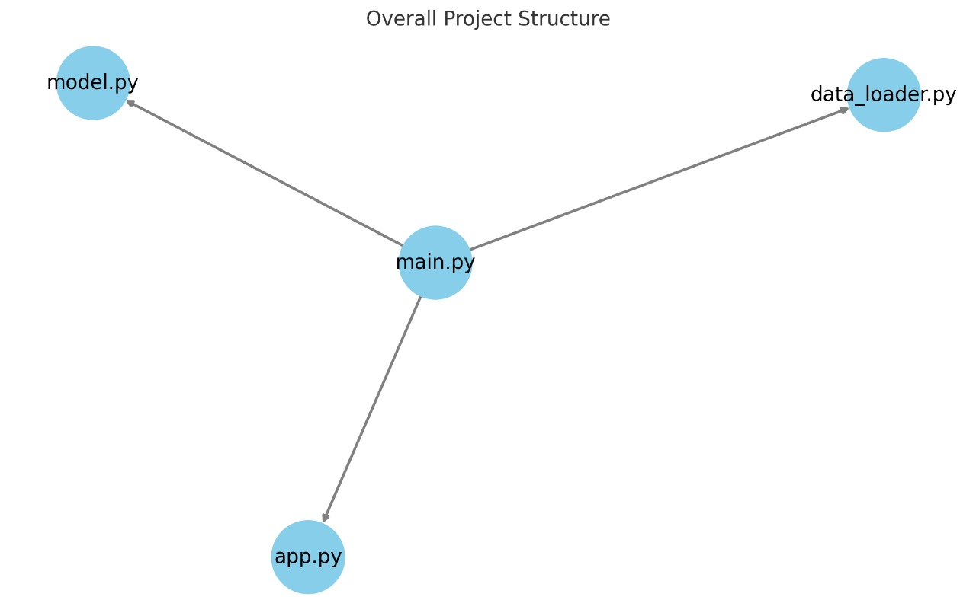

Slide 8
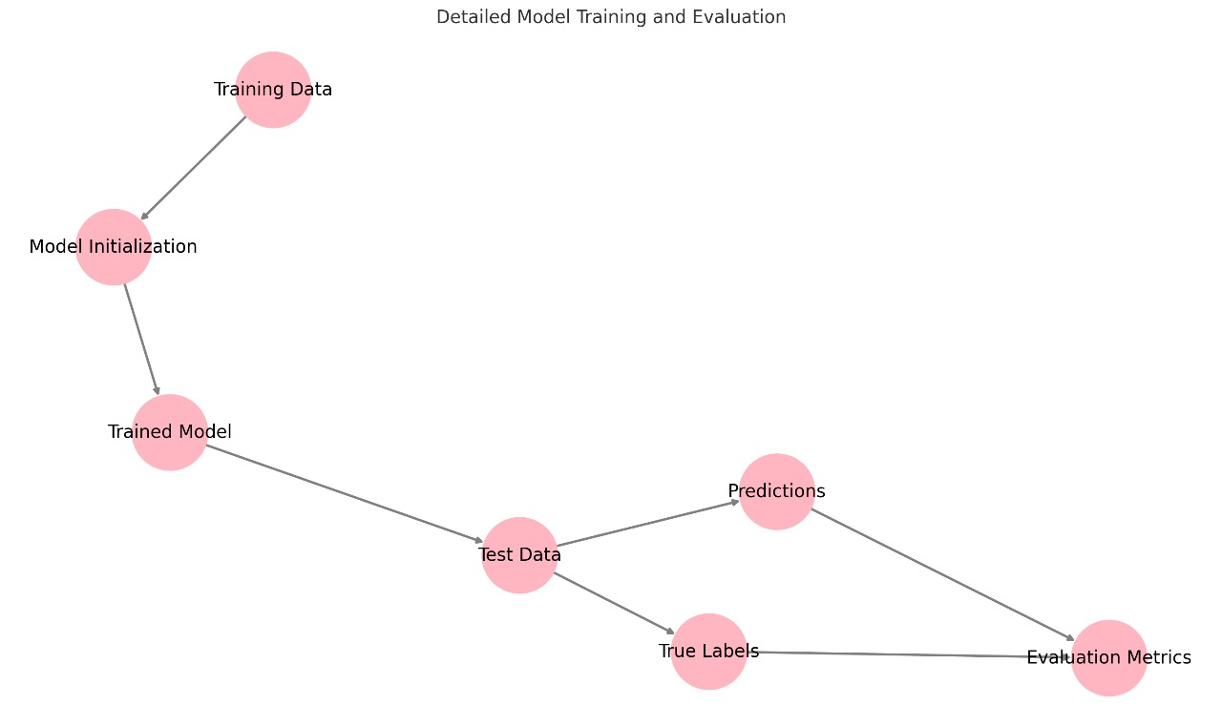

Slide 9
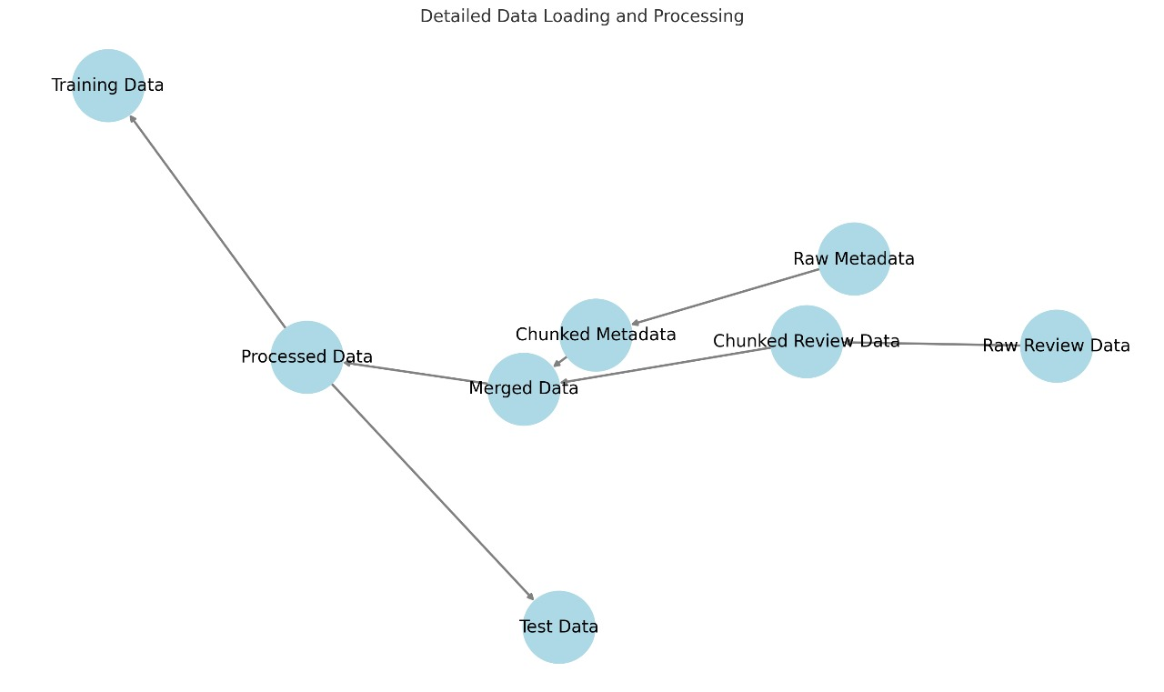

Slide 10
Limitations
Cold Start Problem:
Description: Difficulty in providing recommendations for new users or products without prior data.
Impact: May lead to generic or irrelevant recommendations for new users.
Potential Mitigations: Utilize content-based filtering or hybrid approaches.
Dependence on Explicit Ratings:
Description: The system relies on explicit user ratings, which may limit coverage if users don’t rate products.
Impact: Reduced ability to provide personalized recommendations without sufficient rating data.
Potential Mitigations: Incorporate implicit feedback like clicks, views, purchase history.
Scalability Challenges:
Description: Potential challenges in handling extremely large datasets or rapidly scaling to accommodate more users and products.
Impact: May affect performance, response times, or accuracy.
Potential Mitigations: Utilize distributed computing, optimize algorithms for efficiency.

Slide 11
Future Scope
Hybrid Recommendation Models:
Description: Combining content-based and collaborative filtering to provide more nuanced recommendations.
Potential Impact: Improved accuracy, ability to handle cold start problems, more personalized recommendations.
Deep Learning Integration:
Description: Explore neural network-based models for capturing complex patterns and relationships in data.
Potential Impact: Enhanced prediction accuracy, ability to model complex user behavior.
Real-time Recommendations:
Description: Implement real-time updates and recommendations based on user interactions and behavior as they browse the platform.
Potential Impact: More dynamic and responsive recommendations, immediate adaptation to user preferences.

Slide 12
Conclusion
The project successfully implemented a personalized recommendation system that met the requirements of Flipkart GRiD 5.0 coding challenge. By leveraging various algorithms, careful preprocessing, and tuning, the system is capable of providing relevant and accurate product recommendations.

Slide 13
Thank You

