Slide 1
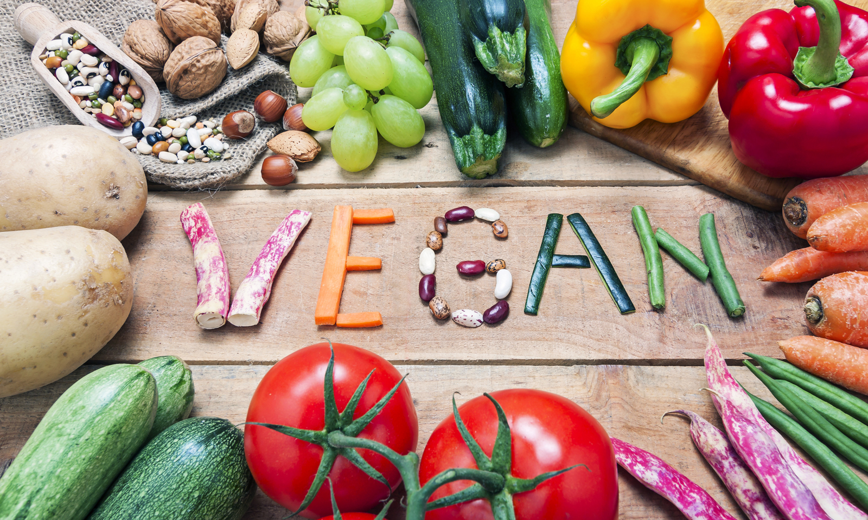
IS Vegan Life Good For Health?
-- Mahmudur Rahman Tushar

Slide 2
Thesis Statements
In my opinion, A Vegan or Vegetarian life is good for health due to some reasons.
Lose Excess Weight.
Protect Against Certain Cancers.
Lower Risk of Heart Disease.

Slide 3
First of All
Lose Excess Weight
Lower body mass indexes (BMI)
More effective for weight loss
Be fit & healthy

Slide 4
Secondly
Protect Against Certain Cancers
Cancers can be prevented by factors within your control, including diet.
Reduce the risk of prostate, breast and colon cancers.
Reduce your risk of colorectal cancer by about 9–18%.

Slide 5
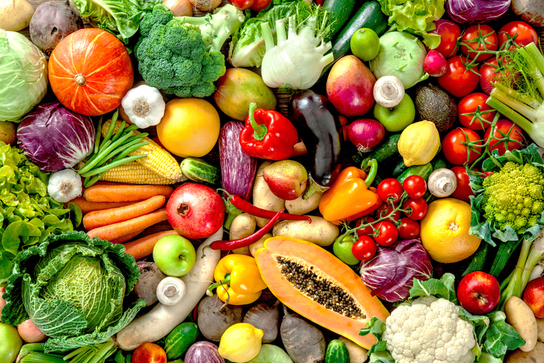
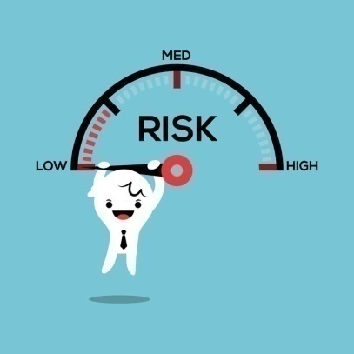
Lower Risk of Heart Disease
Thirdly
Benefit from up to a 75% lower risk of developing high blood pressure
Vegans may also have up to a 42% lower risk of dying from heart disease

Slide 6
Conclusion
Vegan diets may provide an array of health benefits.
For the most part, the exact reasons why these benefits occur are not fully known.
That said, until further research emerges, it can only benefit you to increase the amount of nutrient-rich, whole plant foods in your diet.

Slide 7
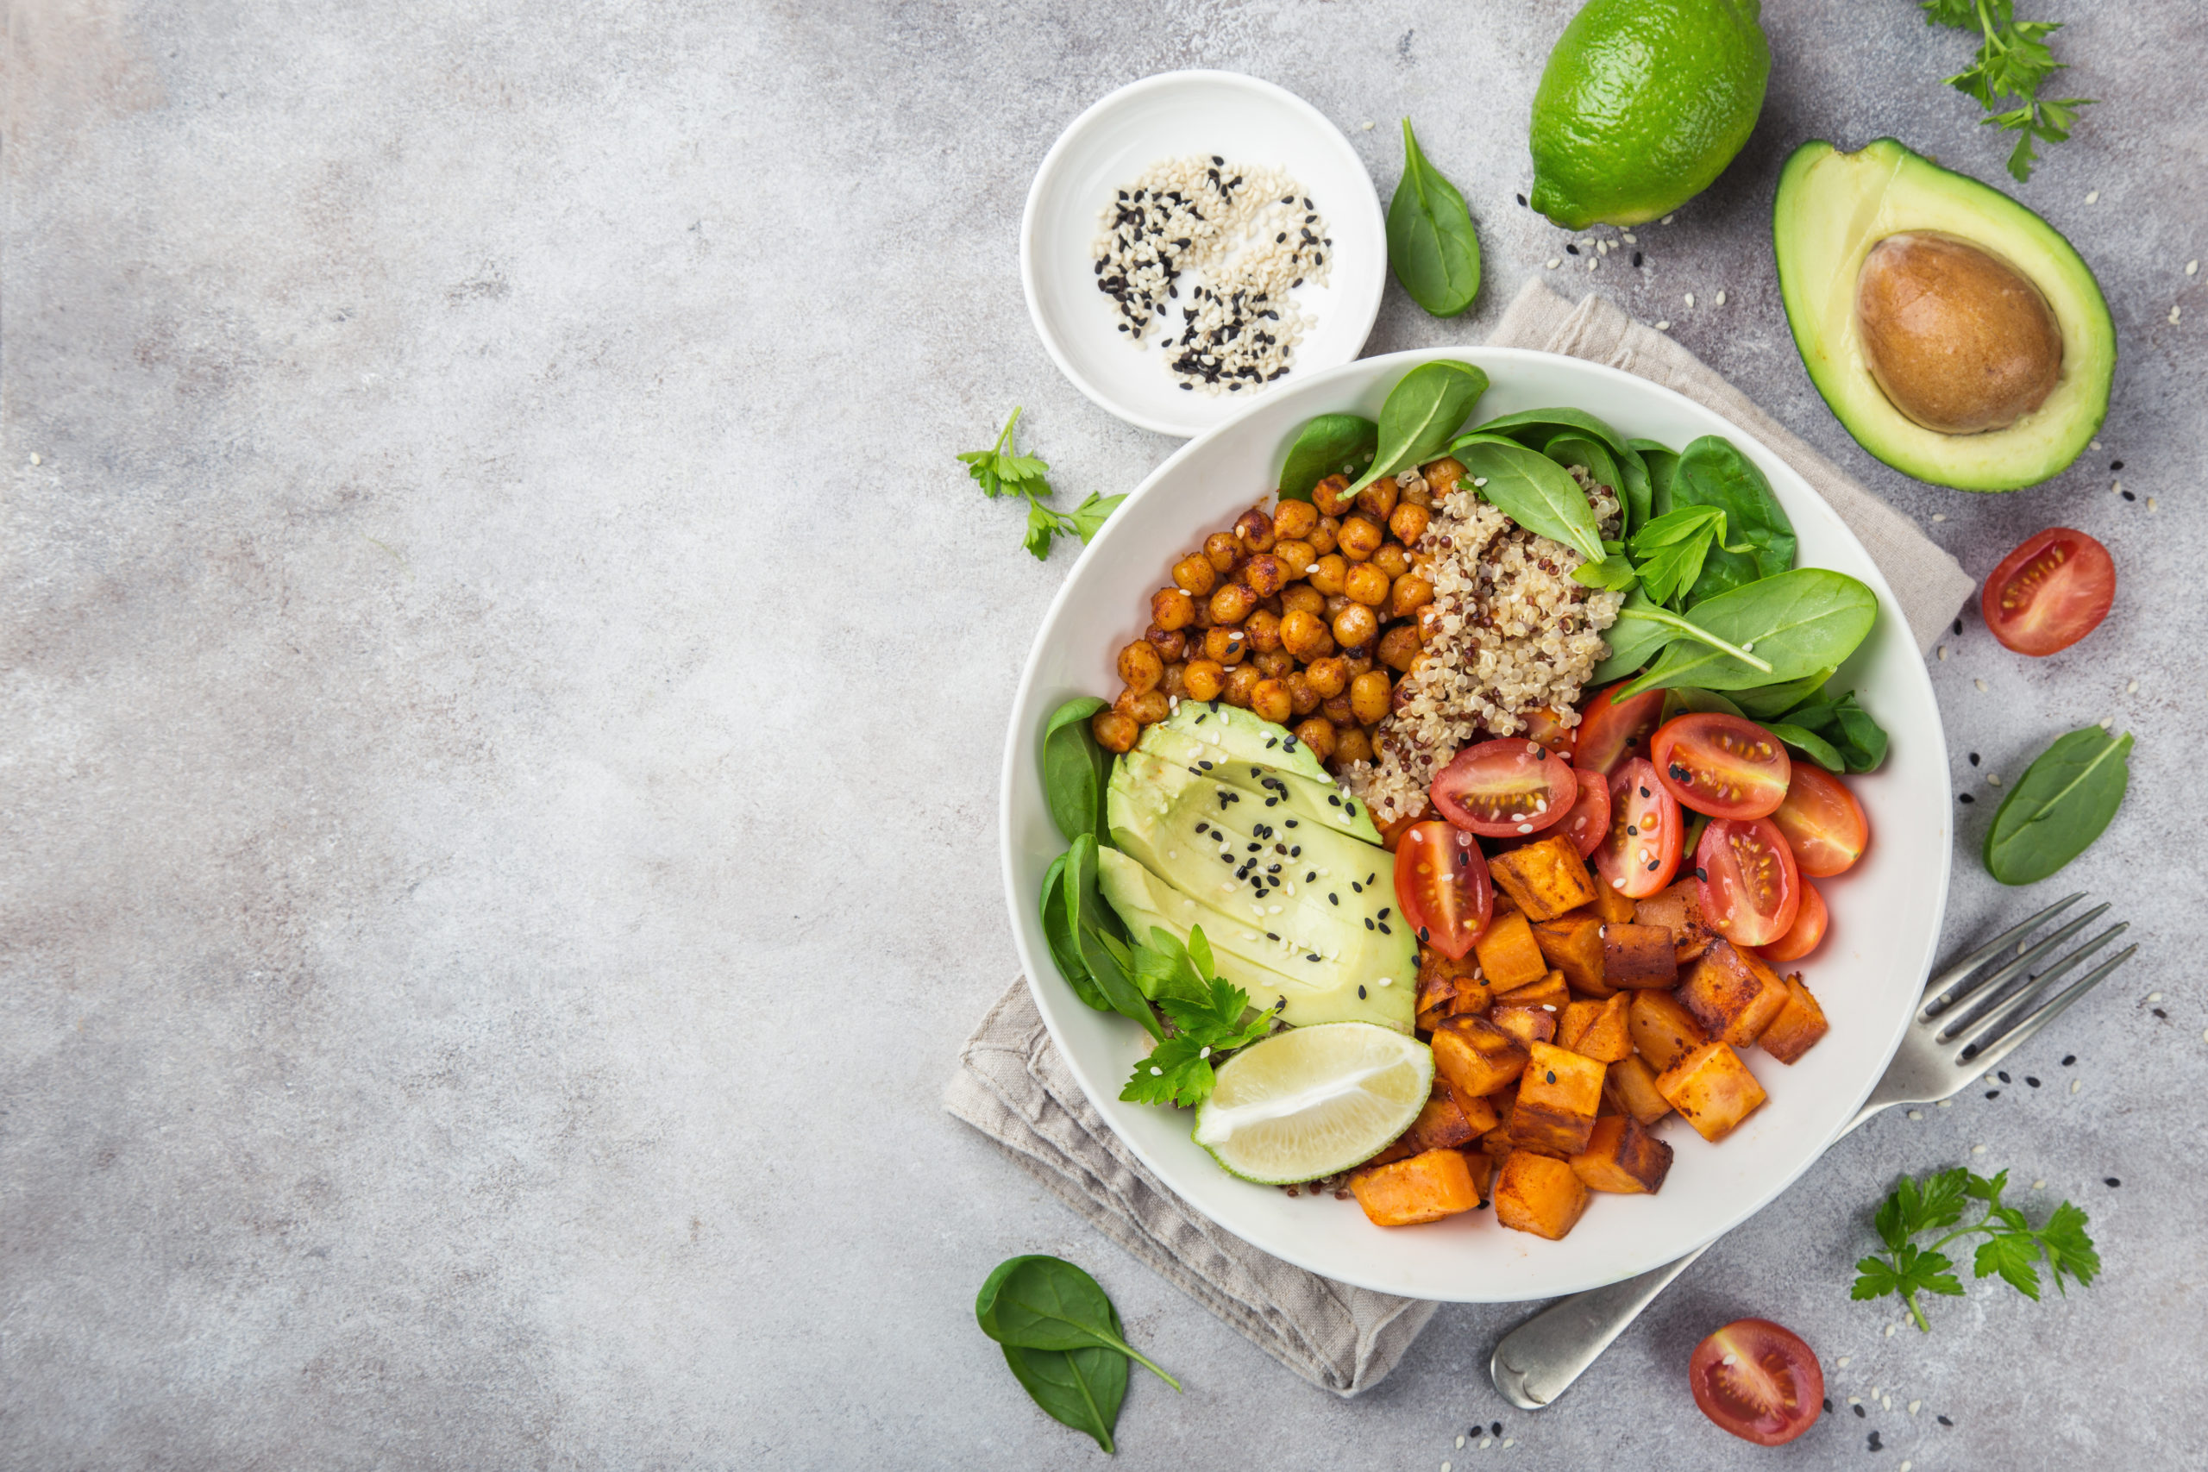
Thank You
Thank You
Insert the Sub Title of
Your Presentation

