Slide 1
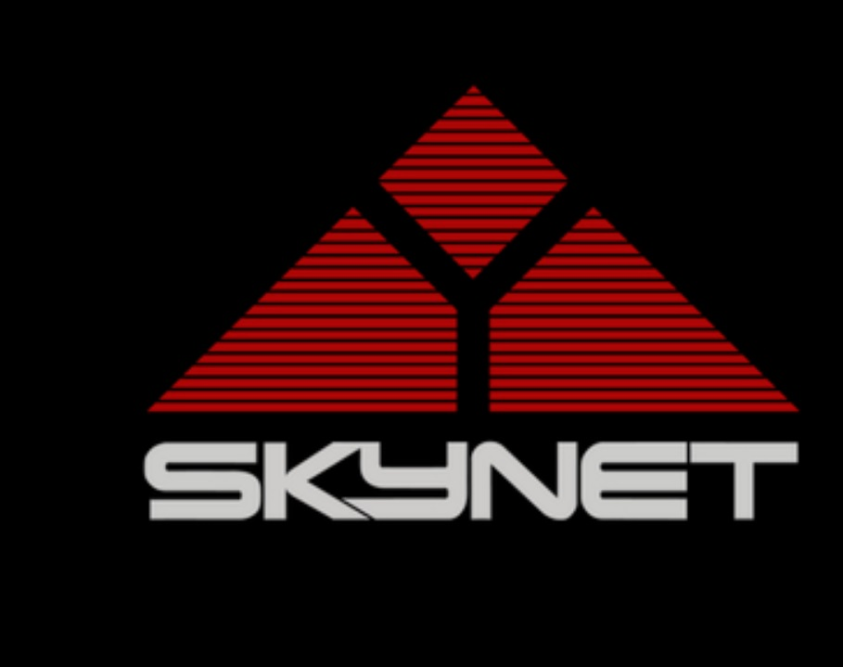
Car Brands Detection System based on YoLo
Team:
Ernani Fantinatti
Maria Castro
Rudransh Sharma
Tushar Bothra

Slide 2
Explanation
This is a brand-new project and idea that will leverage the car insurance industry with an astonishing idea, that is: A project aims detect passing cars models or brands on an avenue or to use Raspberry PI plus a Raspberry Pi 3 model B connected with a Raspberry Pi V2 camera in order to upload the images to a premade model of YoLo v3 or v4 and detect objects, such as cars, in our case. Counting the brands as the cars passes, we may be able to account it generating statistics, metrics that could be useful to car insurance project.

Slide 3
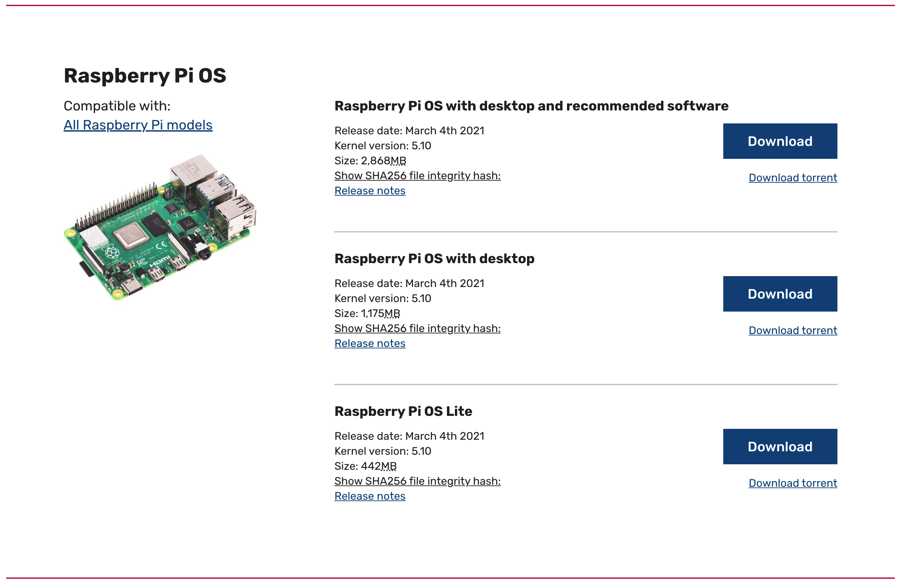
Choosing Raspbian Image

Slide 4
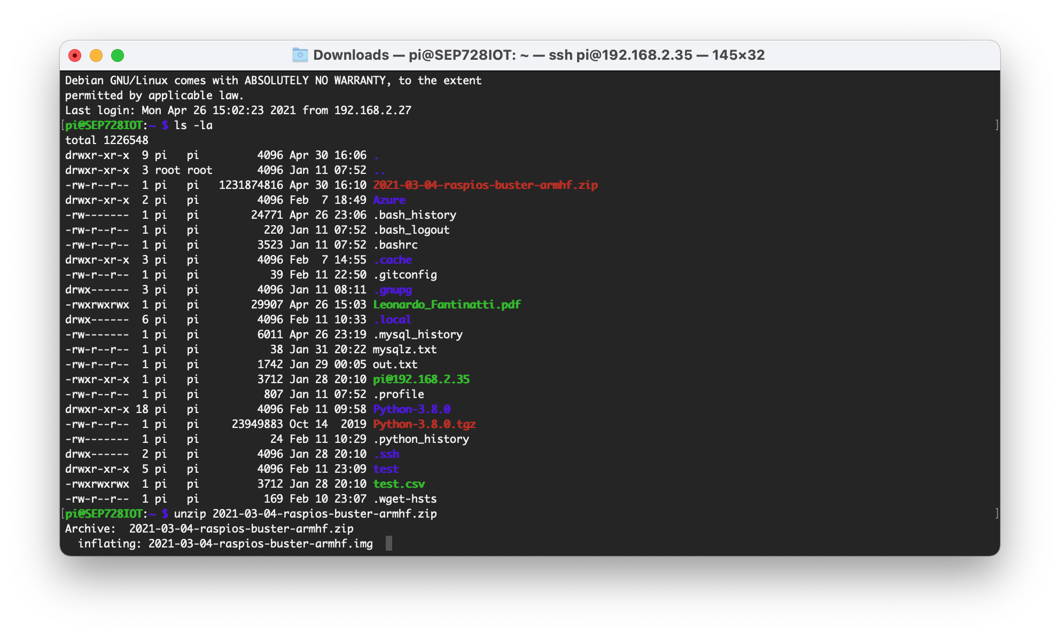
Uncompressing Raspbian Image

Slide 5
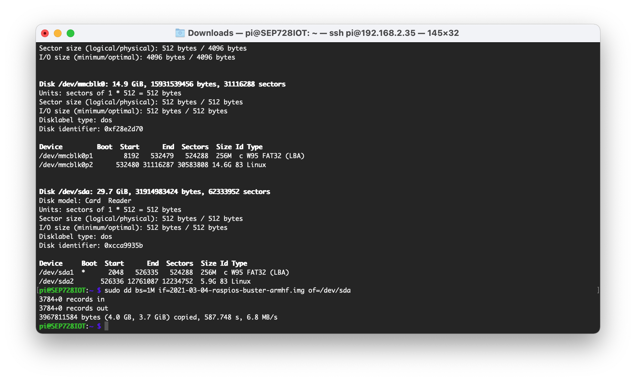
Installing Raspbian Image onto SD card

Slide 6
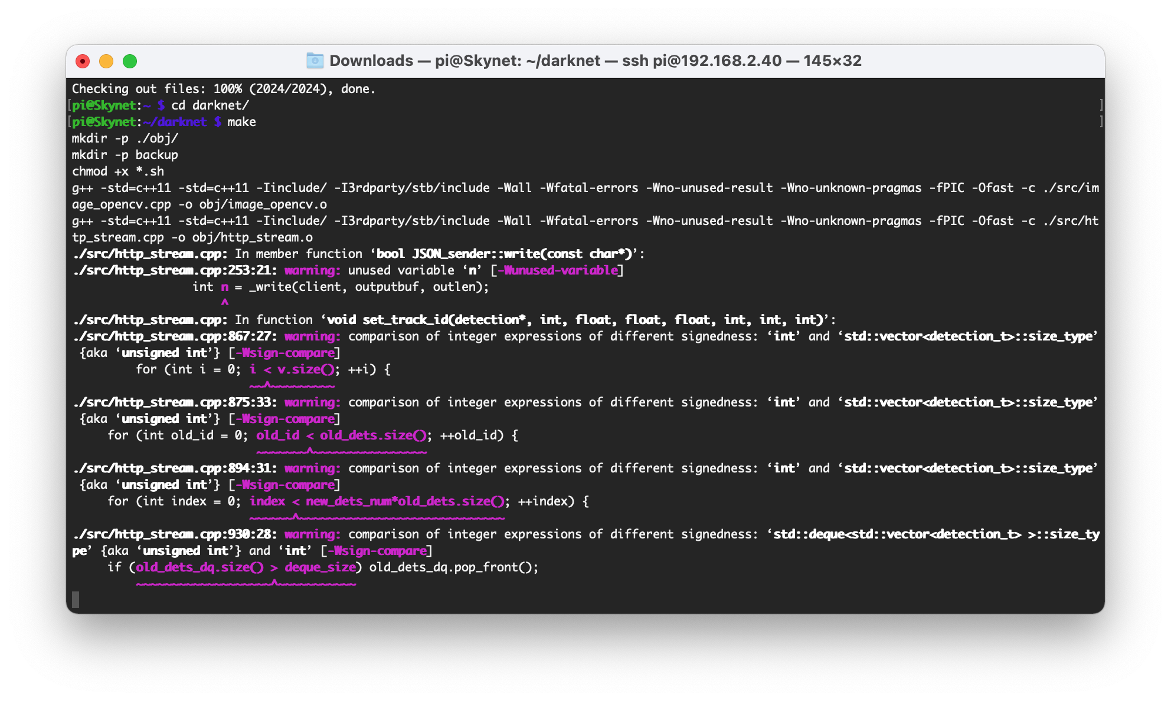
Compiling a pretrained model

Slide 7
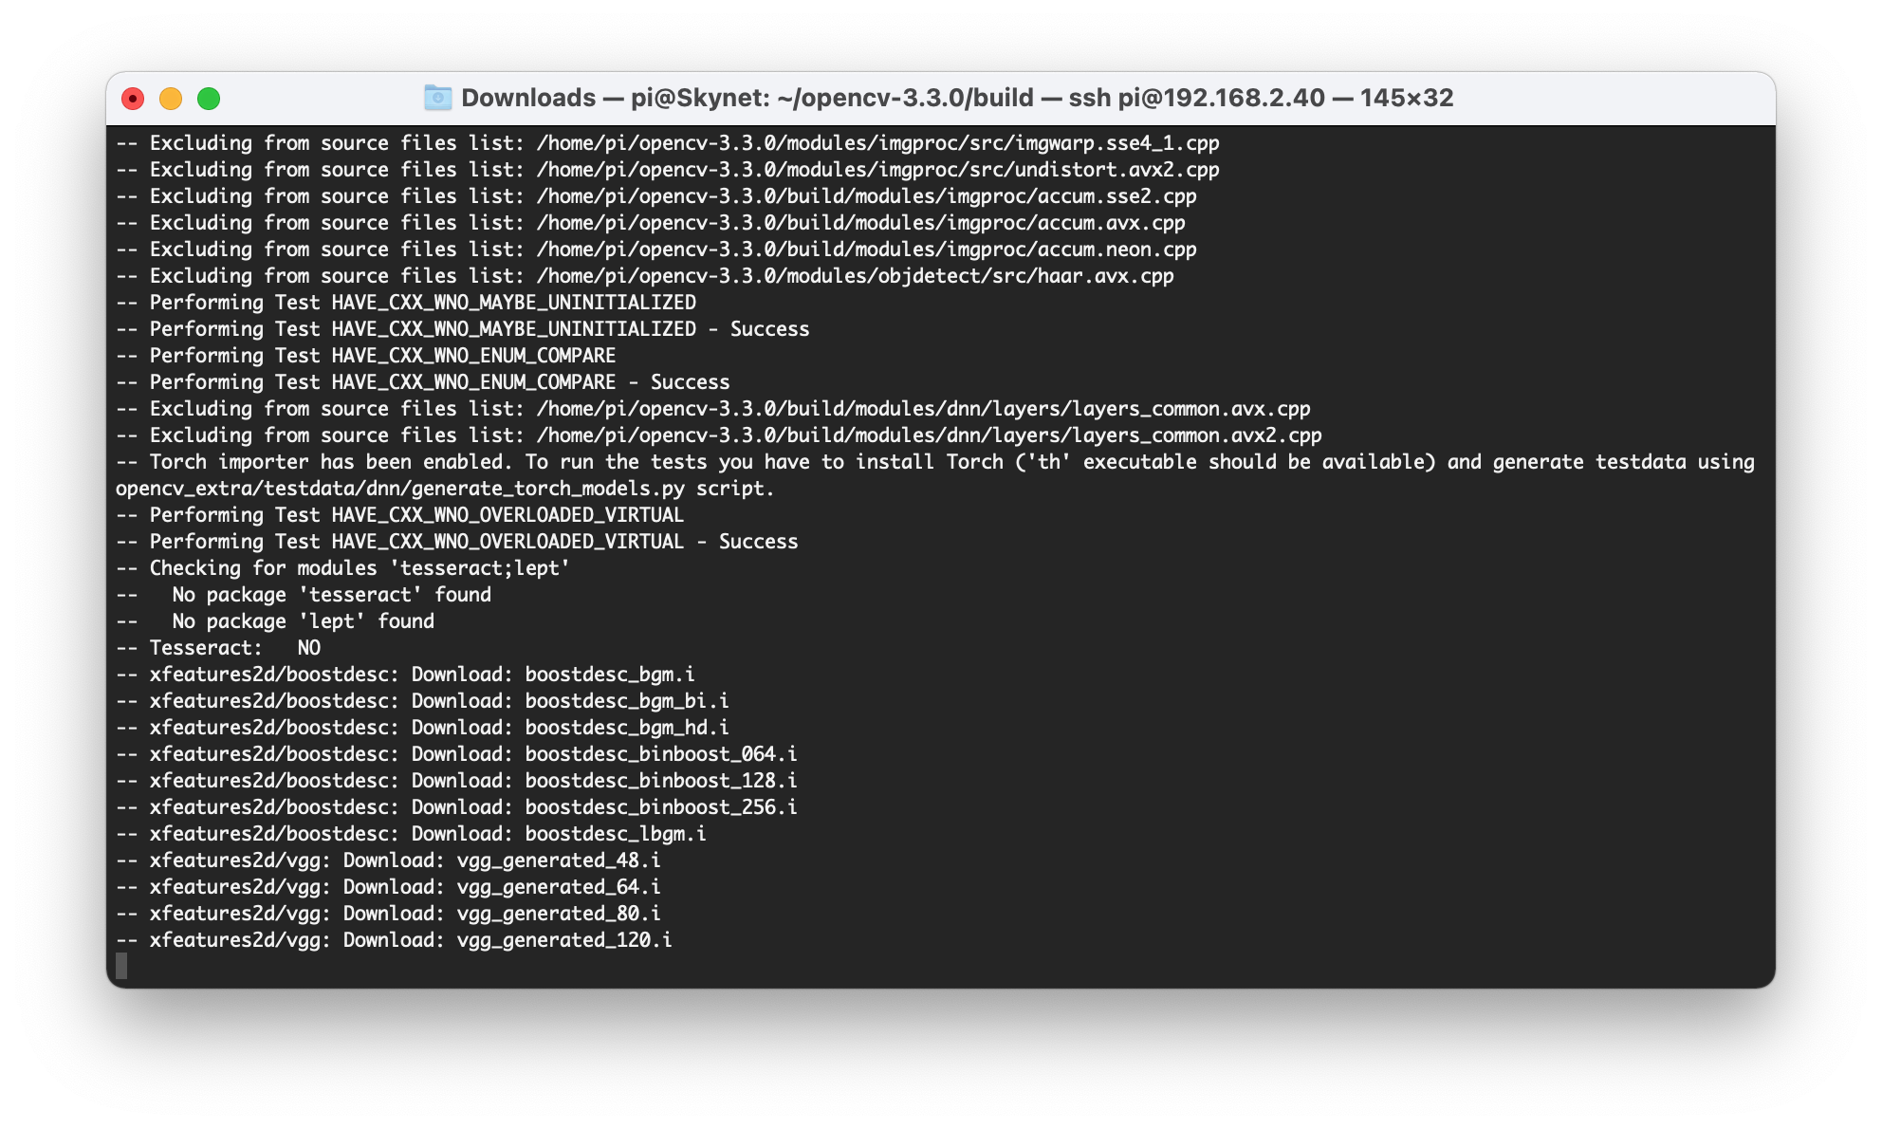
Compiling a OpenCV

Slide 8
UI
UI was created separately on Windows 10 with the latest version of Flutter (https://flutter.dev/).
Plan was to provide an interface to better display statistics and findings of the scans/pictures.
Another planned feature was to allow the download of these as well.
Home page was meant to show a view of a camera and detect objects from there so they can be processed/coordinated with OpenCV and model.

Slide 9
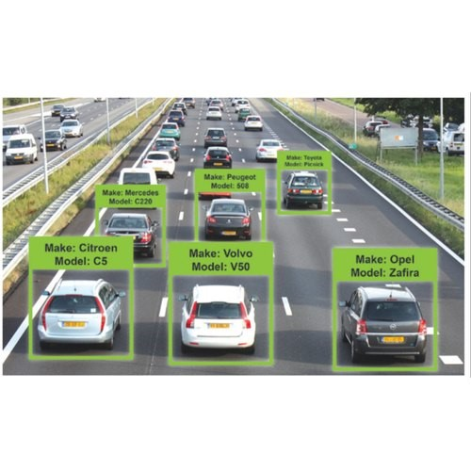
Car Brand detection

Slide 10
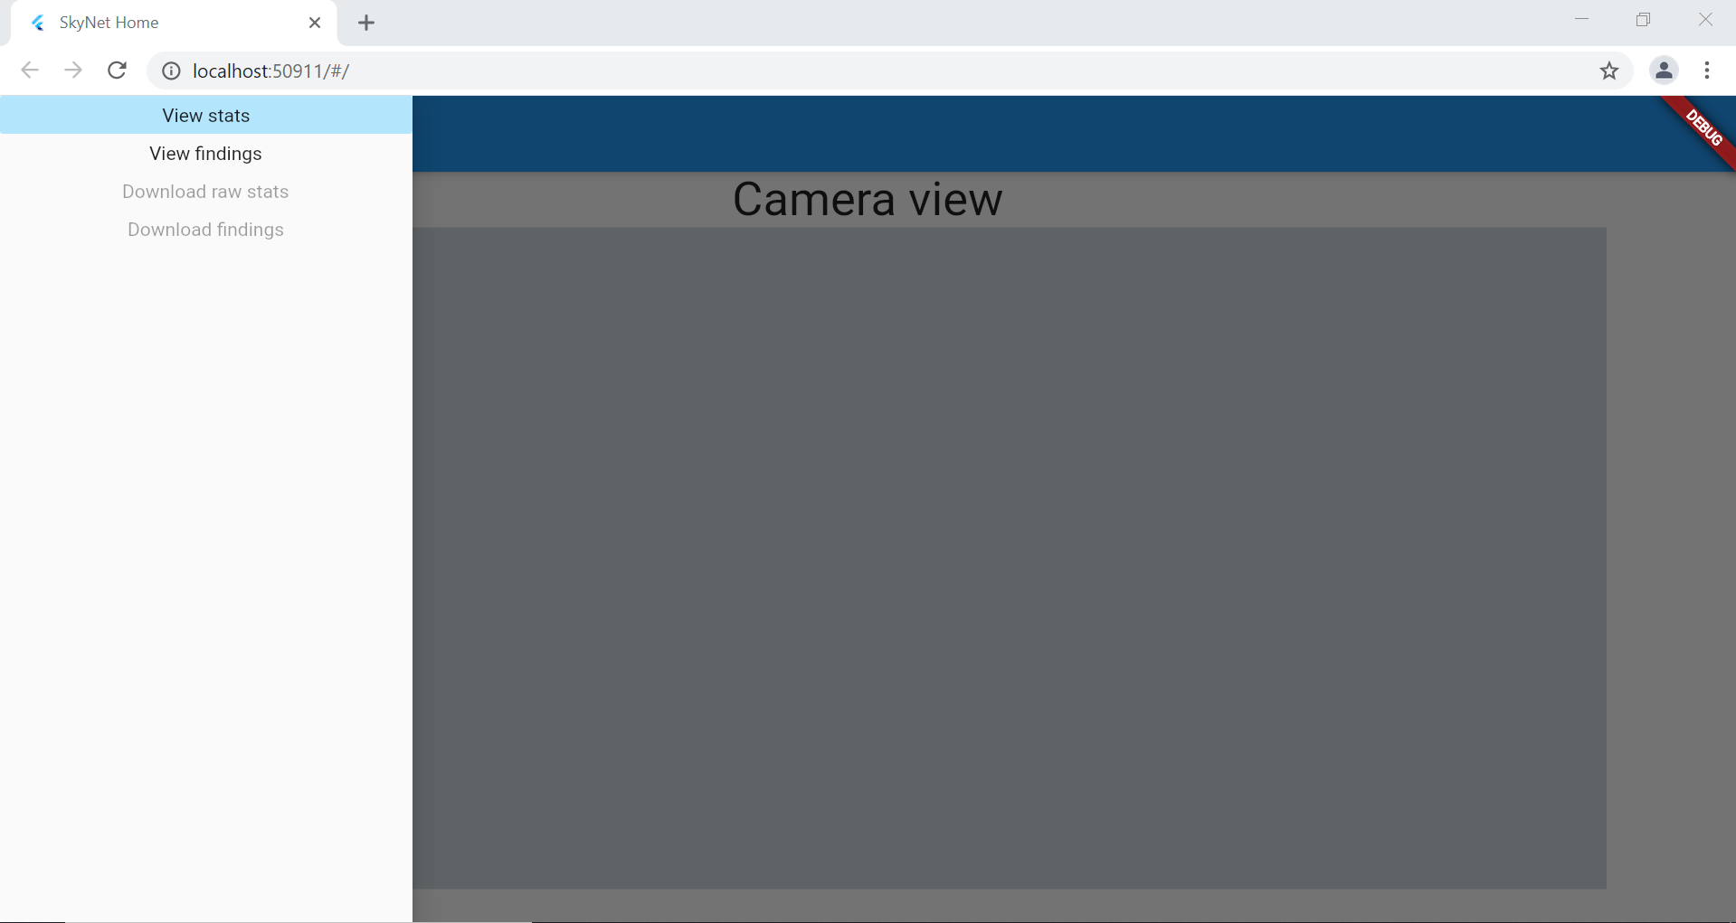
Flutter Webpage

