Slide 1


Dept. of Industrial IoT | SVPCET, Nagpur | 2025-26
SMART INDUSTRIAL
AIR QUALITY &
LEAKAGE GUARD
IoT-Based Gas Detection & Alert System using ESP32 + MQ2 + MQ135
Submitted By:
Yug Ramteke (25109002)
Tushar Agashe (25109006)
Vaibhav Ghode (25109004)
Parth Janai (25109007)
Guide: Prof. Tushar Aneyrao
HOD: Dr. M. Shriraghavan

Slide 2
Abstract & Introduction
Abstract
MQ2 + MQ135
Industrial environments face severe risks from hazardous gas leakages such as LPG, methane, CO and smoke. This project presents a Smart Industrial Air Quality and Leakage Guard using ESP32, MQ2 and MQ135 sensors. The system continuously monitors gas concentration, displays real-time values on a 16×2 LCD and triggers a buzzer alarm when levels exceed safe thresholds. Using ESP32's Wi-Fi, the system can send Telegram alerts and report data remotely, making it a cost-effective, reliable solution for industrial safety.
Dual Sensors
ESP32
Microcontroller (WiFi/BT)
16×2 LCD
Real-Time Display
Buzzer + Telegram
Alert Mechanisms

Slide 3
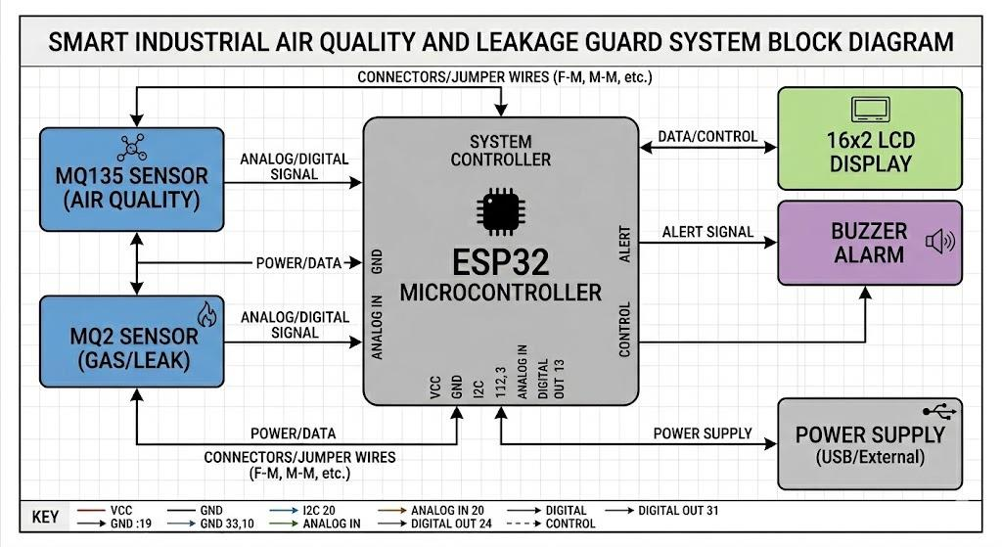
System Architecture & Block Diagram
System Architecture
INPUT UNIT
MQ2 detects LPG, methane, hydrogen & smoke. MQ135 monitors NH3, NOx, benzene & CO2 — providing continuous analog signals to ESP32.
PROCESSING UNIT
ESP32 (dual-core 32-bit MCU) reads ADC values, converts to PPM and compares with preset safe threshold limits every second.
OUTPUT UNIT
Power → ESP32 ← MQ2 (Gas/Leak) + MQ135 (Air Quality) → LCD Display + Buzzer Alarm + Telegram Alert
16×2 LCD displays live gas values & status. Buzzer triggers on threshold breach. Telegram alert sent via Wi-Fi for remote notification.

Slide 4
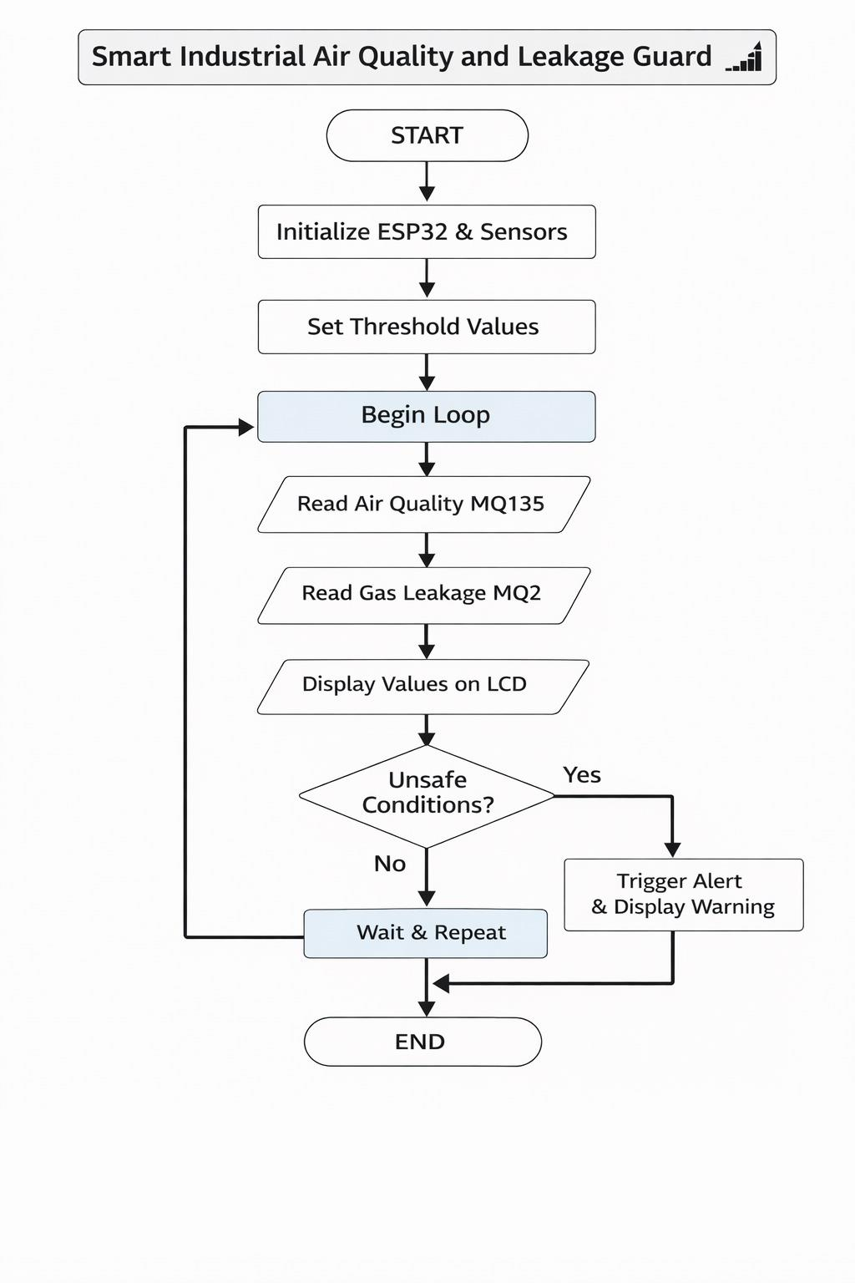
Flowchart & Algorithm
Step-by-Step Algorithm
01
Initialize
ESP32 boots up → initializes MQ2, MQ135 sensors and 16×2 LCD display.
02
Set Thresholds
Define safe PPM limits: MQ2 threshold = 100, MQ135 threshold = 50000.
03
Read Sensors
Continuously read analog ADC values from both sensors every 1 second.
04
Display Values
Show MQ2 and MQ135 live readings on LCD Row 1 & Row 2 respectively.
05
Check Conditions
Compare values vs thresholds. If exceeded → trigger buzzer + LED alert.
06
Send Alert
ESP32 sends Telegram message with gas values & status every 10 seconds.

Slide 5
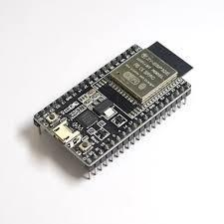
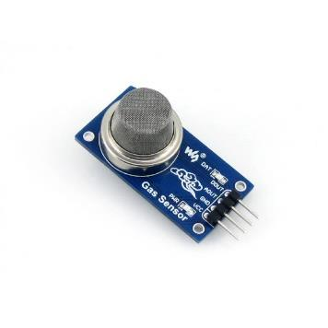
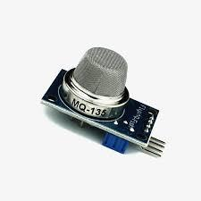
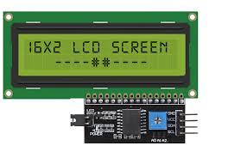
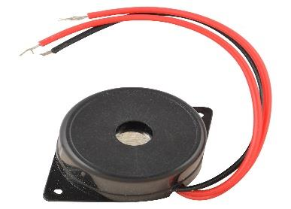
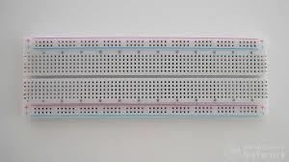
Hardware Components
ESP32
MQ2 Sensor
Dual-core MCU with WiFi & BT. Main processing unit.
Detects LPG, smoke, methane, hydrogen, alcohol.
MQ135 Sensor
16×2 LCD Display
Detects NH3, NOx, benzene, CO2 — overall AQI.
Shows real-time gas values and SAFE/DANGER status.
Buzzer
Breadboard + PCB
Active piezo buzzer — instant alert on gas detection.
0-size PCB for compact final industrial deployment.

Slide 6
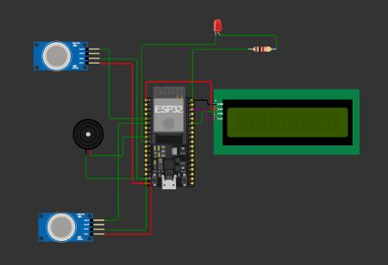
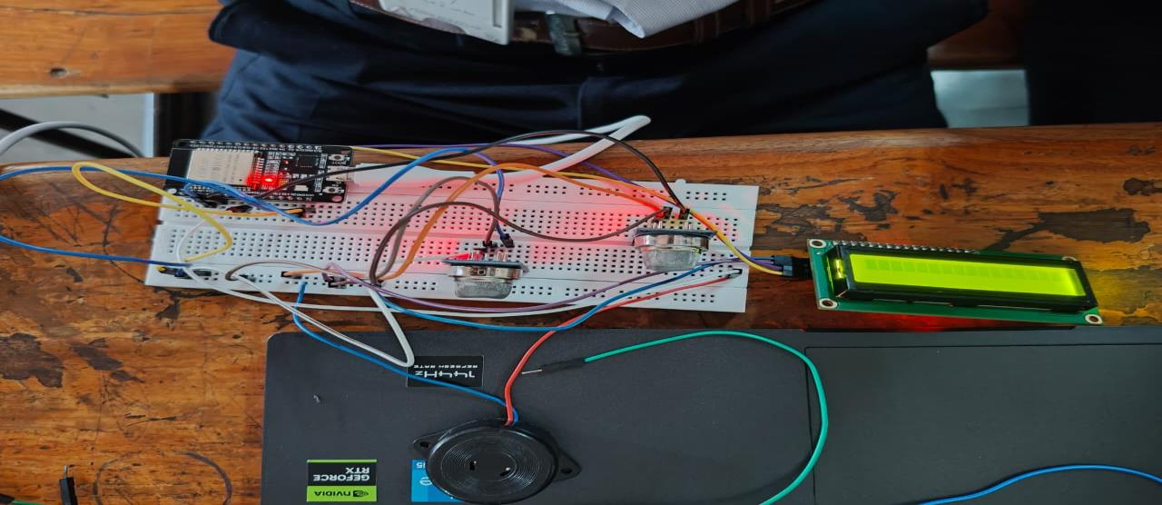
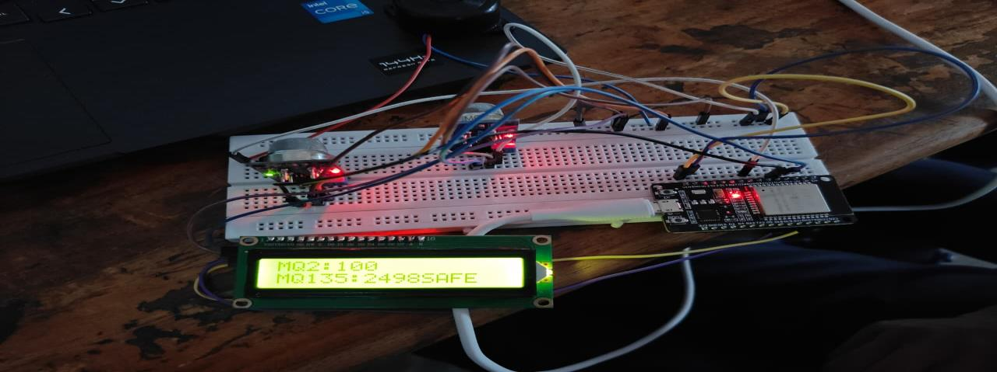
Circuit Diagram & Project Output
Circuit Diagram (Simulation)
Actual Hardware Testing
LCD Output (MQ2:100 / MQ135:2498 SAFE)
Key Observations
MQ2 responded instantly to smoke/LPG exposure
LCD showed real-time PPM values without lag
Buzzer triggered within <1 sec of threshold breach
System ran continuously and stably for full test

Slide 7






Applications
Chemical Industries
Hospitals & Labs
Monitor toxic & flammable gas levels in chemical plants, oil refineries, and petroleum units.
Detect anesthetic gas leaks, ETO sterilization gas, and maintain safe air quality in labs.
Mining Operations
Gas Pipelines / LPG
Alert miners to methane and CO accumulation in underground tunnels and shafts.
Early leak detection in LPG/CNG distribution networks and domestic storage areas.
Smart Buildings
Food & Cold Storage
Indoor AQI monitoring in offices, schools and public spaces (CO2, VOCs, smoke).
Detect ammonia refrigerant leaks in cold storage units and food manufacturing plants.

Slide 8


Advantages & Disadvantages
ADVANTAGES
DISADVANTAGES
✓
Real-time 24×7 continuous gas monitoring without manual effort
✗
MQ sensors drift over time and need periodic recalibration
✓
Low-cost MQ sensors + 0-size PCB — affordable for SMEs
✗
Cross-sensitivity may cause false alarms with similar gases
✓
Dual-sensor coverage: wide range of hazardous gases detected
✗
Readings affected by temperature/humidity variations
✓
Instant buzzer + Telegram alert for quick emergency response
✗
No built-in battery backup during power failures
✓
ESP32 WiFi enables cloud integration and remote monitoring
✗
MQ sensors require 20–30 sec warm-up before stable readings
✓
Simple, low-maintenance, reliable long-term operation
✗
Remote monitoring needs separate app/cloud configuration

Slide 9


Project Scope & Future Scope
Current Project Scope
Future Scope
Local air quality monitoring with MQ2 & MQ135 sensors 24×7
Real-time display on 16×2 LCD with SAFE / ALERT status
Instant buzzer alert when gas levels exceed safe thresholds
Telegram bot notification via ESP32 WiFi every 10 seconds
Compact 0-size PCB design for industrial deployment
Suitable for labs, workshops, factories, and LPG stores
AI/ML Prediction
Predict gas leakages from historical trends before they occur.
Edge Computing
Local AI on ESP32 for instant decisions even during WiFi loss.
Auto Gas Shutoff
Interface solenoid valve to automatically stop gas on detection.
Drone Patrol
Mount sensors on autonomous drones to find leaks in large plants.
Mobile App
Real-time dashboard with historical graphs and push notifications.
Multi-Gas Sensors
Add H2S, SO2, O3 sensors for comprehensive industrial coverage.

Slide 10
Conclusion
The Smart Industrial Air Quality and Leakage Guard successfully delivers a reliable, cost-effective, and automated gas detection solution for industrial safety.
Using ESP32 + MQ2 + MQ135, the system provides real-time air quality monitoring with immediate visual (LCD) and audio (buzzer) alerts, plus remote Telegram notifications via Wi-Fi.
The project demonstrates that affordable sensor technology can serve as a robust safety guard, minimizing human error and serving as a foundational model for Industry 4.0 safety protocols.
THANK YOU
Presented By:
Yug Ramteke (25109002)
Vaibhav Ghode (25109004)
Tushar Agashe (25109006)
Parth Janai (25109007)
ESP32 MCU + WiFi
MQ2 + MQ135 Sensors
16×2 LCD Display
Buzzer + Telegram Alert
Guide: Prof. Tushar Aneyrao
Dept. of Industrial IoT, SVPCET Nagpur

