Slide 1

CHITKARA UNIVERSITY INSTITUTE OF ENGINEERING & TECHNOLOGY
Department of Computer Science & Engineering
Minor Project Presentation
Project Title: Part My Bills
Group Name- Team Flix
Presented by:
1. Suraj Dhawan (2010993588-G6)
2. Tushar Arora (2010993594-G6)
3. Himanshi (2010991884-G6)
4. Rahul Grover (2010990569-G2)

Slide 2
Contents
Introduction
The story
Technology And Services
Key Features
Project Snapshots
References
<number>

Slide 3
Introduction
PartMyBills is a service that allows you to easily settle expenses with a group of people.
With PartMyBills you can manage a list with your shared expenses. Easily enter your expenses and check the group balance. Settle the list and we calculate exactly who has to pay what to whom!
<number>

Slide 4
The Story
As we go to lunch, dinners and get togethers with our friends and family we realized that sharing costs within a group was a massive pain. One person had to volunteer to make notes that somehow made sense of everything. But there was no way of sharing the workload, and the resulting sheet was so complex that understanding it was almost as hard as creating it.
We searched in vain for a painless online solution. One that was simple and worked without fuss or registration. Finally, we got together, drank beer and stroked our chins and set out to to make splitting costs as easy as humanly possible.
The result is PartMyBills. We made it in our spare time and some of us even taught themselves to code along the way. We will be overwhelmed when people will begin to use our little project.
I'm sure it'll be a hugely enjoyable journey.
<number>

Slide 5
Technologies & Services
PartMyBills could not have been made without the following technologies and services:
HTML
CSS
JS
Sessional storage
<number>

Slide 6
Key Feature
User can add infinite number of members
Result accuracy
Session storage
User friendly
<number>

Slide 7
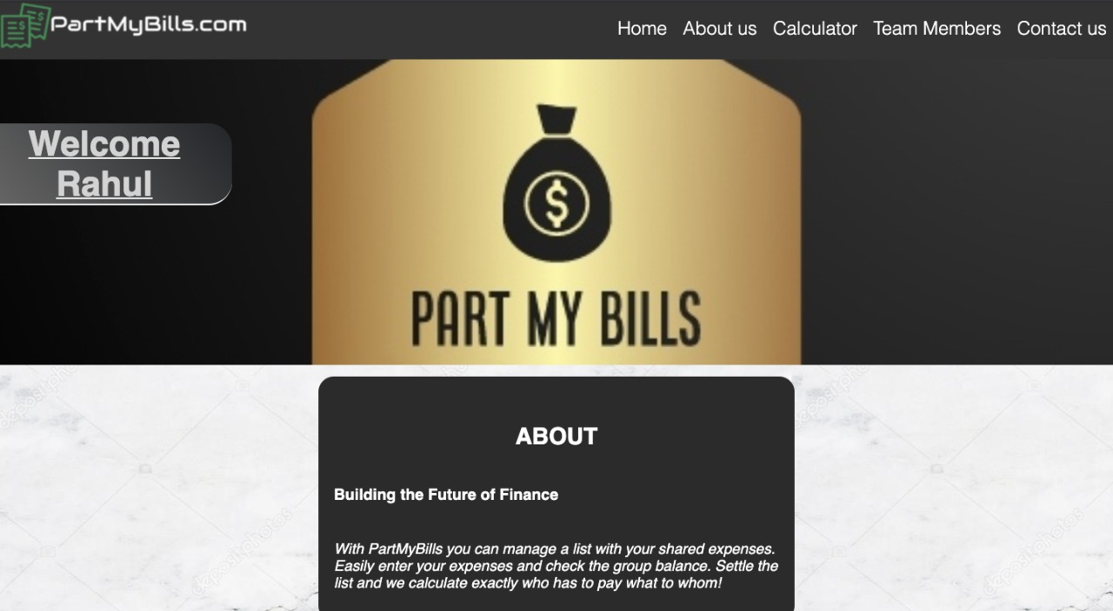
Project Snapshots
<number>

Slide 8
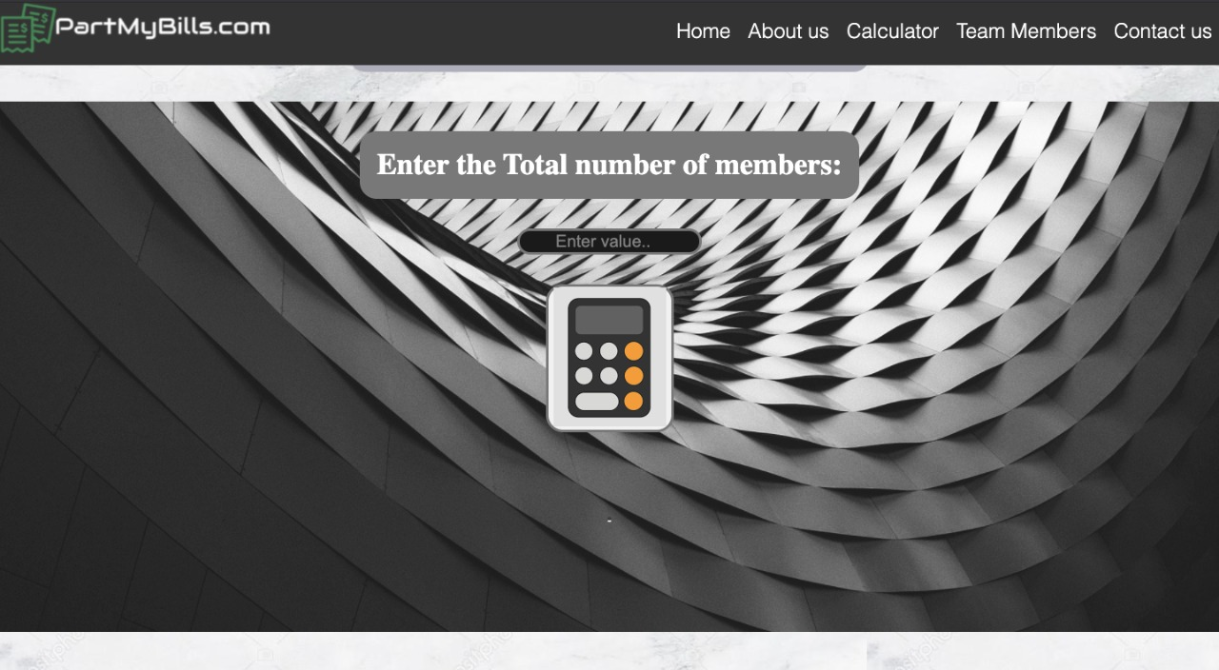
Project Snapshots
<number>

Slide 9
References
W3Schools
GeeksForGeeks
Github
RGBcolours
FontAwesome
<number>

Slide 10
Thank You
<number>

