Slide 1
Welcome To My Presentation
Notes:
We designed this template so that each member of the project team has a set of slides with its own theme. Members, here’s how you add a new slide to just your set:
Mark where you want to add the slide: Select an existing one in the Thumbnails pane, click the New Slide button, then choose a layout. The new slide gets the same theme as the other slides in your set.
Careful! Don’t annoy your fellow presenters by accidentally changing their themes. That can happen if you choose a different theme from the Design tab, which changes all of the slides in the presentation to that look.

Slide 2
My Presentation Topics is Counter & Register
Presented By
Tushar Sarkar
Student ID : 18CSE35
Second Year Second Semester
Department of CSE, BSMRSTU.

Slide 3
Content
What is Counter?
Counter Classification
The use of Counter
What is Register?
Parallel load Register
Shift Right Register
Shift Left Register
The Uses of Register

Slide 4
What is Counter?
A Counter is a device which stores (and sometimes displays) the number of times a particular event or process has occurred, often in relationship to a clock signal.
Counters are used in digital electronics for counting purpose, they can count specific event happening in the circuit.
For example,
in UP counter a counter increases count for every rising edge of clock. Not only counting, a counter can follow the certain sequence based on our design like any random sequence 0,1,3,2… .

Slide 5
Counter Classification
Counters are broadly divided into two categories
Asynchronous counter
Synchronous counter

Slide 6
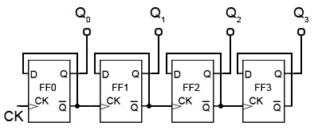
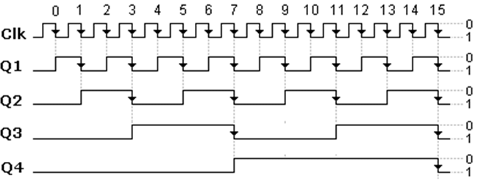
Asynchronous Counter
In asynchronous counter we don’t use universal clock, only first flip flop is driven by main clock and the clock input of rest of the following flip flop is driven by output of previous flip flops. We can understand it by following diagram-
Asynchronous Counter
Asynchronous Counter Diagram

Slide 7
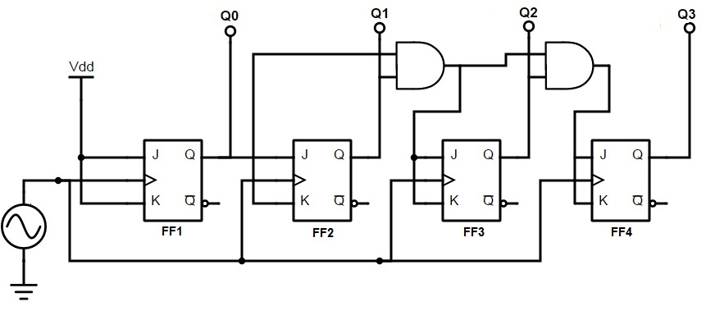
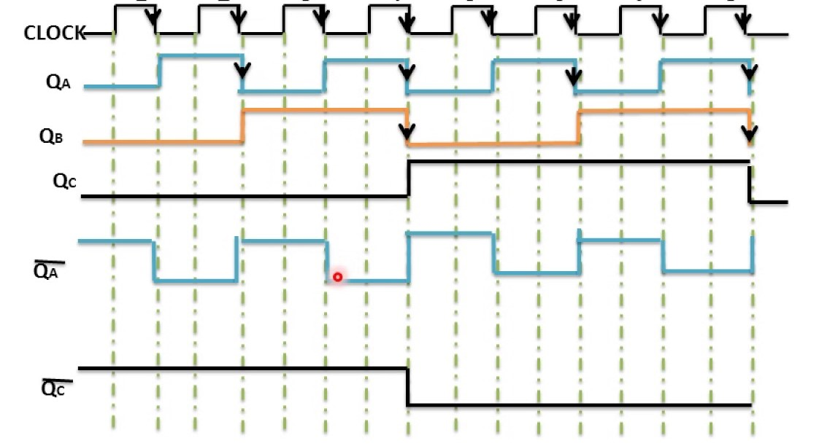
Synchronous Counter
Unlike the asynchronous counter, synchronous counter has one global clock which drives each flip flop so output changes in parallel.
The one advantage of synchronous counter over asynchronous counter is, it can operate on higher frequency than asynchronous counter as it does not have cumulative delay because of same clock is given to each flip flop.
Synchronous Counter
Synchronous Counter Diagram

Slide 8
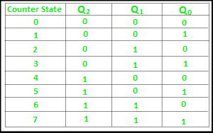
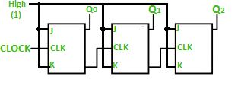
Ripple Counter
It is an asynchronous counter.
Different flip-flops are used with a different clock pulse.
All the flip-flops are used in toggle mode.
Only one flip-flop is applied with an external clock pulse and another flip-flop clock is obtained from the output of the previous flip-flop.
The flip-flop applied with external clock pulse act as LSB (Least Significant Bit) in the counting sequence.

Slide 9
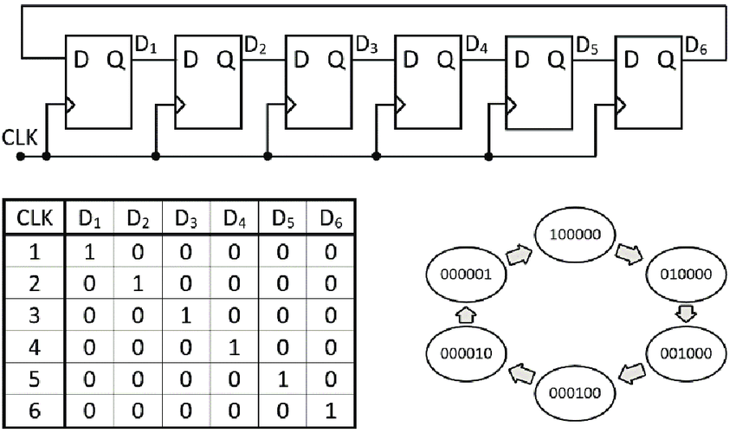
Ring Counter
Ring counter is a typical application of Shift resister. Ring counter is almost same as the shift counter.
The only change is that the output of the last flip-flop is connected to the input of the first flip-flop in case of ring counter but in case of shift resister it is taken as output.
Except this all the other things are same.
Johnson Counter

Slide 10
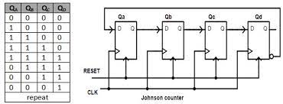
Johnson Counter
The Johnson counter is similar to the Ring counter.
The only difference between the Johnson counter and the ring counter is that the outcome of the last flip flop is passed to the first flip flop as an input.
But in Johnson counter, the inverted outcome Q' of the last flip flop is passed as an input.
The remaining work of the Johnson counter is the same as a ring counter. The Johnson counter is also referred to as the Creeping counter.

Slide 11
The Uses of Counter
In the conversions from Analog to Digital, these counters are used.
In the applications of Timers for example Washings machines where we set the time. These counters are used.
With the help of these counters, a ‘Digital Triangular Wave Generator’ can be designed.
In the application of ‘Digital Clock’ counters are used.
A practical example of these devices is seen in malls, stadiums, or auditoriums. In the above situations to keep the data on the number of persons. This can be made possible or it will become simple because of these counters.

Slide 12
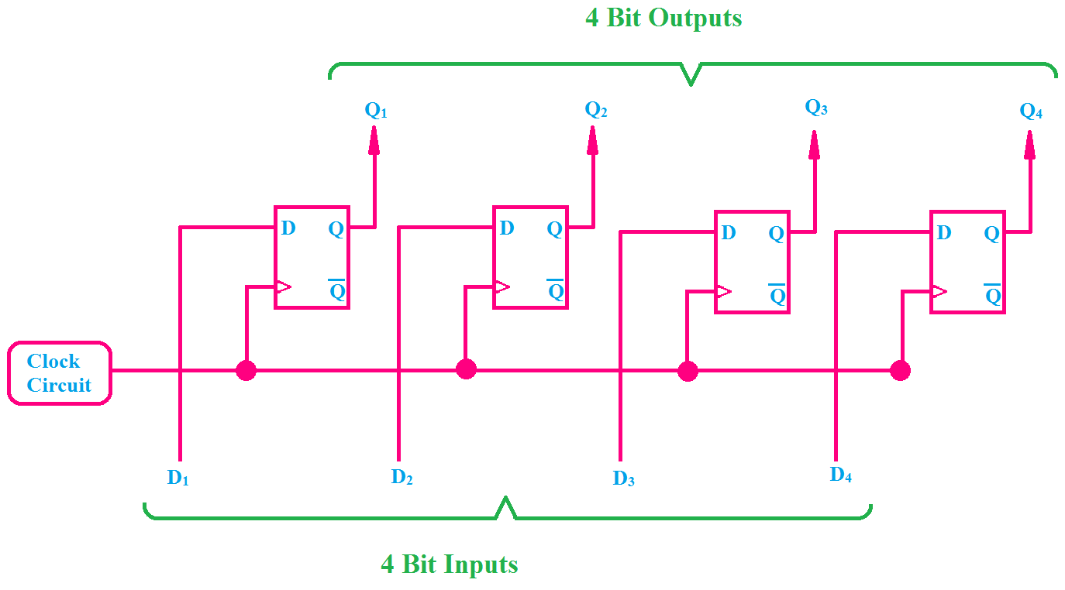
What is Register?
The main application of register is storing data in digital form. They also can hold data and address. The registers are also used to make digital memory chips like ROM Chips, Flash Memory etc. Cache memory in CPU is also made by registers.

Slide 13
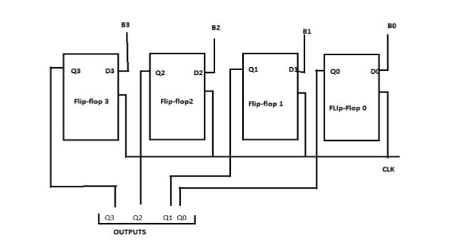
Parallel Load Register

Slide 14
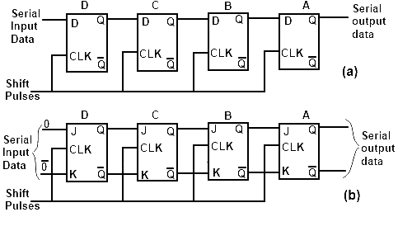
Shift Right Register

Slide 15
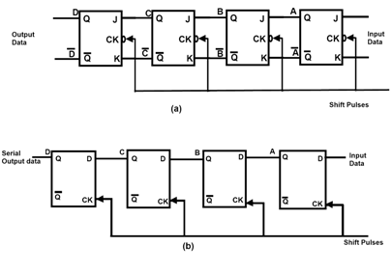
Shift Left Register

Slide 16
The Uses of Register
The main application of register is storing data in digital form.
They also can hold data and address.
The registers are also used to make digital memory chips like ROM Chips, Flash Memory etc.
Cache memory in CPU is also made by registers.

Slide 17
Thank You

