Slide 1
Welcome To My Presentation
Notes:
We designed this template so that each member of the project team has a set of slides with its own theme. Members, here’s how you add a new slide to just your set:
Mark where you want to add the slide: Select an existing one in the Thumbnails pane, click the New Slide button, then choose a layout. The new slide gets the same theme as the other slides in your set.
Careful! Don’t annoy your fellow presenters by accidentally changing their themes. That can happen if you choose a different theme from the Design tab, which changes all of the slides in the presentation to that look.

Slide 2

My Presentation Topics is “FA for the language of all those strings containing a1 as a substring”
Presented By
Tushar Sarkar
Student ID : 18CSE035
Second Year Second Semester
Department of CSE, BSMRSTU.

Slide 3
Content
What is FA?
What is DFA?
Solve using DFA
How to use an DFA?
Problem Solve
Five Tuple
Application of FA

Slide 4
What is FA?
Finite automata(FA) are used to recognize patterns. It takes the string of symbol as input and changes its state accordingly. When the desired symbol is found, then the transition occurs.
We can solve this given question by using DFA or NFA. Here we use DFA to solve this problem.

Slide 5
What is DFA?
DFA refers to Deterministic Finite Automata. Deterministic refers to the uniqueness of the computation. The finite automata are called finite automata if the machine is read an input string one symbol at a time.
In DFA, there is only one path for specific input from the current state to the next state.
DFA does not accept the null move, i.e., the DFA cannot change state without any input character.
DFA can contain multiple final states. It is used in Lexical Analysis in Compiler.

Slide 6


Solve using DFA
A DFA is defined by the 5-tuple:
{Q, ∑ , $q_{0}$ ,F, δ }
Here,
Q: finite set of states
∑: finite set of the input symbol
$q_{0}$: initial state
F: final state
δ: Transition function

Slide 7
How to use an DFA?
Input: a word w in ∑*
Question: Is w acceptable by the DFA?
Steps:
Start at the “start state” q₀
For every input symbol in the sequence w do
If after all symbols in w are consumed, the current state is one of the accepting states (F) then accept w;
Otherwise, reject w.
Compute the next state from the current state, given the current input symbol in w and the transition function

Slide 8
Problem Solve
Question :
Solve :
Input Alphabet, ∑ ={ a, 1}
Language, L ={a1, a11, 11a1, 111a1a1a1a, a1aa1,1a1a1a11a11a, ………..}
FA for the language of all those strings containing a1 as a substring.
1
a
a,1
A
a
B
1
C
Transition Diagram

Slide 9
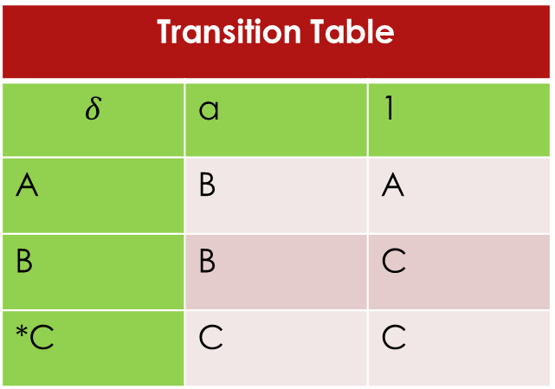

Problem Solve
A finite set of states, Q = {$A,B,C$}
A finite set of input symbols, $\sum{=\{a,1\}}$
Start state ,$q_{0}$ = A
Set of accepting states, F = {C$\}$
Five Tuple :
Transition Table
$$δ$$ | a | 1
A | B | A
B | B | C
*C | C | C
Symbol
States

Slide 10
Application of FA
For the designing of lexical analysis of a compiler.
For recognizing the pattern using regular expressions.
For the designing of the combination and sequential circuits using Mealy and Moore Machines.

Slide 11
Thank You

