Slide 1
Welcome To My Presentation
Notes:
We designed this template so that each member of the project team has a set of slides with its own theme. Members, here’s how you add a new slide to just your set:
Mark where you want to add the slide: Select an existing one in the Thumbnails pane, click the New Slide button, then choose a layout. The new slide gets the same theme as the other slides in your set.
Careful! Don’t annoy your fellow presenters by accidentally changing their themes. That can happen if you choose a different theme from the Design tab, which changes all of the slides in the presentation to that look.

Slide 2

My Presentation Topics is “DFA for the language of all those strings starting and ending with same letters”
Presented By
Tushar Sarkar
Student ID : 18CSE035
Second Year Second Semester
Department of CSE, BSMRSTU.

Slide 3
Content
Symbol, Alphabet
Strings, Languages
What is DFA?
Formal Definition of DFA
How to use an DFA?
Problem Solve
Final Result
Application of DFA

Slide 4
Symbol, Alphabet
Symbol :
Alphabet
Symbol is the basic building block of Theory of computation.
Example :
a, b, c, d, ……, z
0, 1, 2, 3, 4, 5, …, 9
letter, digits, etc.
An alphabet is a finite, non-empty set of symbols which denote by ∑ (sigma). Examples :
Binary: ∑ = {0,1}
All lower case letters: ∑ = {a,b,c,..z}.
Alphanumeric: ∑ = {a-z, A-Z, 0-9}

Slide 5
Strings, Languages
Strings :
Languages :
A string or word is a finite sequence of symbols chosen from ∑
Length of a string w, denoted by “|w|”, is equal to the number of (non- ε) characters in the string.
Example: w=0001,1010,101010.
Languages is the collections of strings which can be finite and infinite.
Examples:
Let L be the language of all strings consisting of n 0’s followed by n 1’s: L = {ε, 01, 0011, 000111,…}
Let L be the language of all strings of with equal number of 0’s and 1’s:
L = {ε, 01, 10, 0011, 1100, 0101, 1010, 1001,…}
L is a said to be a language over alphabet ∑, only if L ⊆ ∑*
this is because ∑* is the set of all strings (of all possible length including 0) over the given alphabet ∑

Slide 6
What is DFA?
DFA refers to Deterministic Finite Automata. Deterministic refers to the uniqueness of the computation. The finite automata are called finite automata if the machine is read an input string one symbol at a time.
In DFA, there is only one path for specific input from the current state to the next state.
DFA does not accept the null move, i.e., the DFA cannot change state without any input character.
DFA can contain multiple final states. It is used in Lexical Analysis in Compiler.

Slide 7


Formal Definition of DFA
A DFA is defined by the 5-tuple:
{Q, ∑ , $q_{0}$ ,F, δ }
Here,
Q: finite set of states
∑: finite set of the input symbol
$q_{0}$: initial state
F: final state
δ: Transition function

Slide 8
How to use an DFA?
Input: a word w in ∑*
Question: Is w acceptable by the DFA?
Steps:
Start at the “start state” q₀
For every input symbol in the sequence w do
If after all symbols in w are consumed, the current state is one of the accepting states (F) then accept w;
Otherwise, reject w.
Compute the next state from the current state, given the current input symbol in w and the transition function

Slide 9

Problem Solve
Question :
Solve :
DFA for the language of all those strings starting and ending with same letters
A finite set of states, Q = {$q_{0}$, $q_{1}$, $q_{2}$, $q_{3}$, $q_{4}$}
A finite set of input symbols, $\sum{=\{a,b\}}$
Start state = $q_{0}$
Set of accepting states, F = {$q_{2}$, $q_{4}\}$
So Language, L={$∈$, a, b, aa, bb, aba, bab,……}

Slide 10

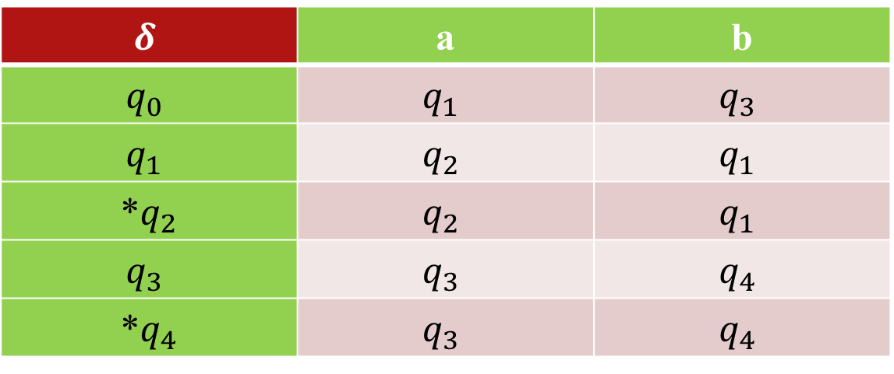




Problem Solve
a
b
a
Start
$$q_{0}$$
a
$$q_{1}$$
$$q_{2}$$
b
b
Transition Table
a
$$q_{3}$$
Symbol
$$δ$$ | a | b
$$q_{0}$$ | $$q_{1}$$ | $$q_{3}$$
$$q_{1}$$ | $$q_{2}$$ | $$q_{1}$$
*$q_{2}$ | $$q_{2}$$ | $$q_{1}$$
$$q_{3}$$ | $$q_{3}$$ | $$q_{4}$$
*$q_{4}$ | $$q_{3}$$ | $$q_{4}$$
b
a
b
$$q_{4}$$
Status

Slide 11

Final Result
So the DFA “Five-tuple” notion is
A = ({$q_{0}$, $q_{1}$, $q_{2}$, $q_{3}$, $q_{4}$}, {a, b}, $δ$, $q_{0}$, {$q_{2}$, $q_{4}$})

Slide 12
Application of DFA
DFA uses include protocol analysis, text parsing, video game character behavior, security analysis, CPU control units, natural language processing, and speech recognition.

Slide 13
Thank You

