Slide 1
Welcome To My Presentation

Slide 2
My Presentation Topic is Digital IC Terminology, IC Data Sheet
Presented By
Tushar Sarkar
Student ID : 18CSE035
Second Year Second Semester
Department of CSE, BSMRSTU.

Slide 3
What is IC?
An integrated circuit (IC) is a small semiconductor-based electronic device consisting of fabricated transistors, resistors and capacitors.
An integrated circuit is also known as a chip or microchip.

Slide 4
Propagation Delay
Propagation delay is the time required to change the output after application of input.
It’s basically have two types:
1.High to Low (tPHL)
2.Low to High(tPLH)

Slide 5
Propagation delay diagram
Input
50%
Output
50%
tPHL
tPLH
Avg prop. Delay=
tPHL + tPHL
2

Slide 6
Fan IN
The number of inputs of a gate that it can handle impairing it’s normal operation.
Fan in =1
Fan in =2
Fan in =4

Slide 7
Fan Out
Fan out is no of output signals a gate can drive without degrading it’s output voltage level.
To others I/O

Slide 8
Voltage Parameters
I/P voltage
O/P voltage
Vcc(Supply)
Vcc(Supply)
Logic 1
Logic 1
VIH(min)
V0H(min)
undefined
undefined
VIL(max)
VOL(max)
Logic 0
Logic 0
t
t
Input voltage parameter
Output voltage parameter

Slide 9
VIL= Low level I/P voltage
VIH=High level I/P voltage
VOH =High Level O/P voltage
VOL= Low level O/P voltage
High
Low
Low
High
VOL
VIL
VOH
VIH

Slide 10
Current Parameters
IIL = Low level I/P current
IIH =High level I/P current
IOH =High Level O/P current
IOL= Low level O/P current
High
Low
Low
High
IOL
IIL
IOH
IIH

Slide 11
IC Data Sheet
Notes:
We designed this template so that each member of the project team has a set of slides with its own theme. Members, here’s how you add a new slide to just your set:
Mark where you want to add the slide: Select an existing one in the Thumbnails pane, click the New Slide button, then choose a layout. The new slide gets the same theme as the other slides in your set.
Careful! Don’t annoy your fellow presenters by accidentally changing their themes. That can happen if you choose a different theme from the Design tab, which changes all of the slides in the presentation to that look.

Slide 12
Types of IC
IC categorize are following three ways:
Based on Technology
Scale of Integration
Scale of Integration
TTL
SSI
Through Hole Technology
CMOS
MSI
DIP
LSI
Surface mount technology
VLSI

Slide 13
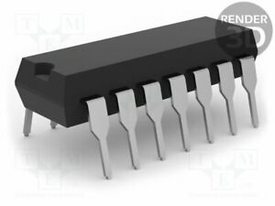
Through Hole Technology(THT)
THT components have pins that are inserted into holes drilled in the PCB and soldered on the reverse side of the board.

Slide 14
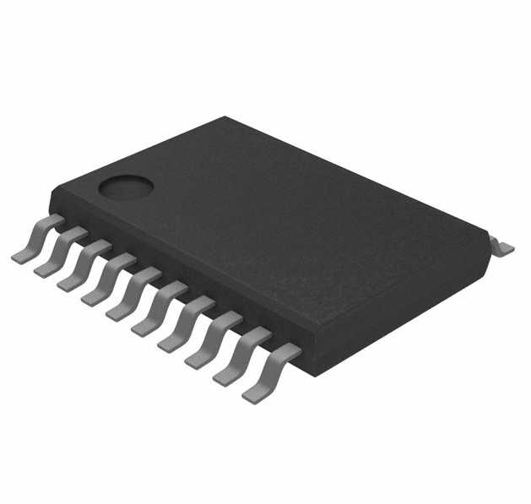
Surface Mount Technology
SMT components are mounted on the surface of the PCB, so no holes need to be drilled.

Slide 15
TTL logic sub families
TTL series | Infix | Example | Comments
Standard TTL | none | 7404 ,7400 | Original TTL series. Slowest & use lots of power.
Low power | L | 74L00, 74L04 | Consume less power than standard
Schottky | S | 74S04,74S00 | Optimized for speed consume lots of power.
Low power Schottky | LS | 74LS01, 74LS02 | Faster & lower power consume than L & LS.
Advanced Schottky | AS | 74AS08 | Very fast ,use lots of power.
Advanced Low Power Schottky | ALS | 74ALS86 | Very good speed power ratio. Quit popular number of this family.

Slide 16
Manufacture Datasheets
A manufacturer datasheet for a logic gate contains the following information:
General Description
Connection (pin-out) Diagram
Function Table
Operating Conditions
Electrical Characteristics
Switching Characteristics
Physical Dimensions

Slide 17
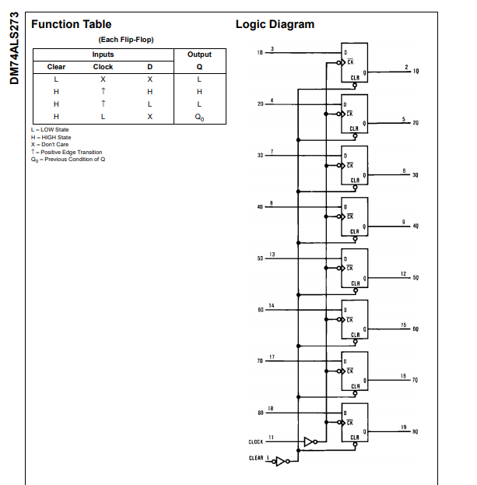
Function Table:

Slide 18
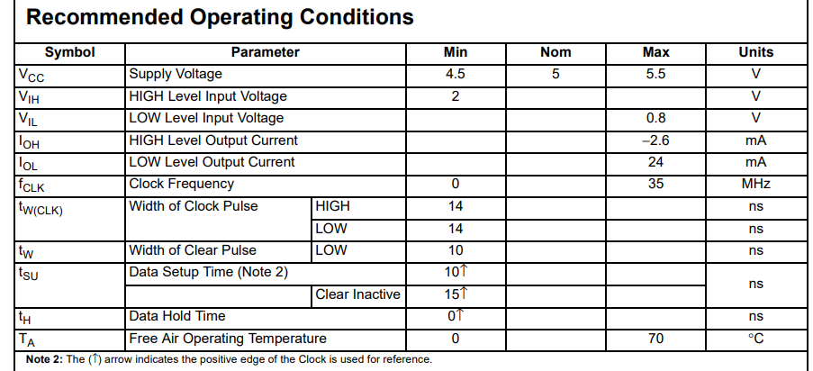
Operating Conditions:

Slide 19
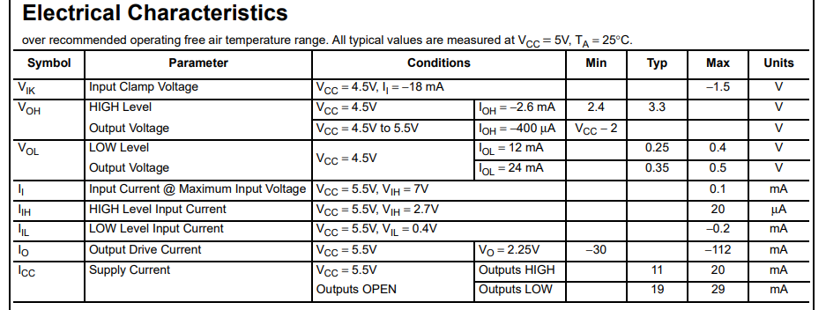
Electrical Characteristics

Slide 20
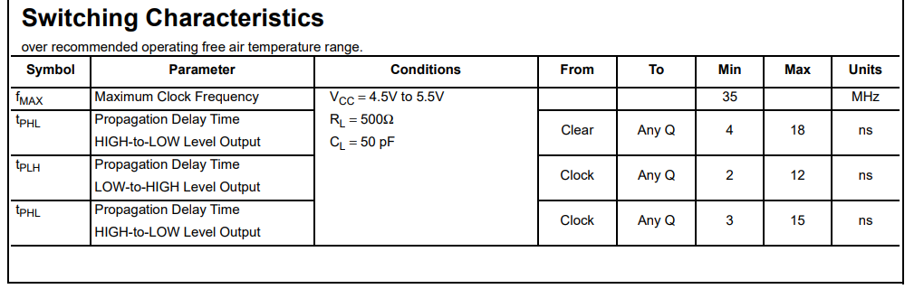
Switching Characteristics

Slide 21
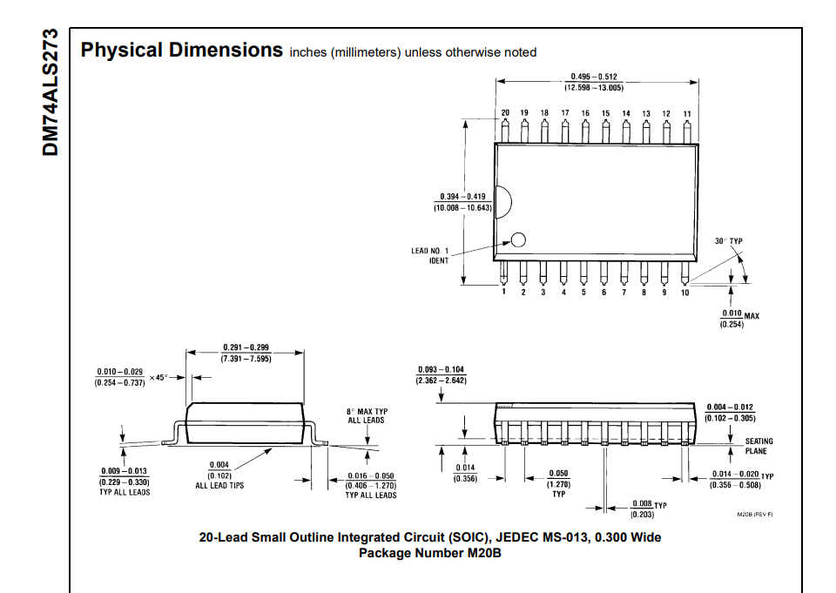
Physical Dimensions

Slide 22
Thank You!

