Slide 1
Welcome To My Presentation

Slide 2
My Presentation Topic is Encoder, Decoder, Mux & Demux
Presented By
Tushar Sarkar
Student ID : 18CSE035
Second Year Second Semester
Department of CSE, BSMRSTU.

Slide 3
Outline
Encoder
Encoder Circuit & Truth Table
Decoder
Decoder Circuit & Truth Table
Multiplexer (MUX)
Multiplexer (MUX) Circuit & Truth Table
Demultiplexer (DEMUX)
Demultiplexer (DEMUX) Circuit & Truth Table
Practical use of Encoder, Decoder, MUX and DEMUX

Slide 4

Encoder
An Encoder is a combinational circuit that performs the reverse operation of Decoder .
It has maximum of $2^{n}$ input lines and 'n' output lines, hence it encodes the information from $2^{n}$ inputs into an n-bit code.
It will produce a binary code equivalent to the input, which is active High.

Slide 5
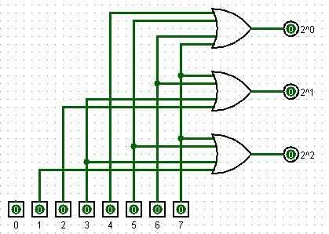
Encoder Circuit and Truth Table.
INPUT | OUTPUT
D0 | D1 | D2 | D3 | D4 | D5 | D6 | D7 | Y2 | Y1 | Y0
1 | 0 | 0 | 0 | 0 | 0 | 0 | 0 | 0 | 0 | 0
X | 1 | 0 | 0 | 0 | 0 | 0 | 0 | 0 | 0 | 1
X | X | 1 | 0 | 0 | 0 | 0 | 0 | 0 | 1 | 0
X | X | X | 1 | 0 | 0 | 0 | 0 | 0 | 1 | 1
X | X | X | X | 1 | 0 | 0 | 0 | 1 | 0 | 0
X | X | X | X | X | 1 | 0 | 0 | 1 | 0 | 1
X | X | X | X | X | 0 | 1 | 0 | 1 | 1 | 0
X | X | X | X | X | X | X | 1 | 1 | 1 | 1

Slide 6
Decoder
Decoder is a combinational circuit that has ‘n’ input lines and maximum of 2n output lines.
One of these outputs will be active High based on the combination of inputs present, when the decoder is enabled.
That means decoder detects a particular code.
The outputs of the decoder are nothing but the min terms of ‘n’ input variables lines, when it is enabled.

Slide 7
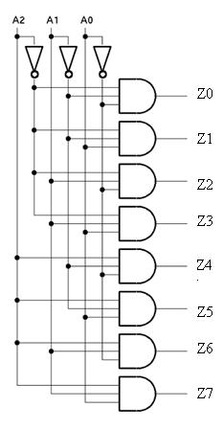
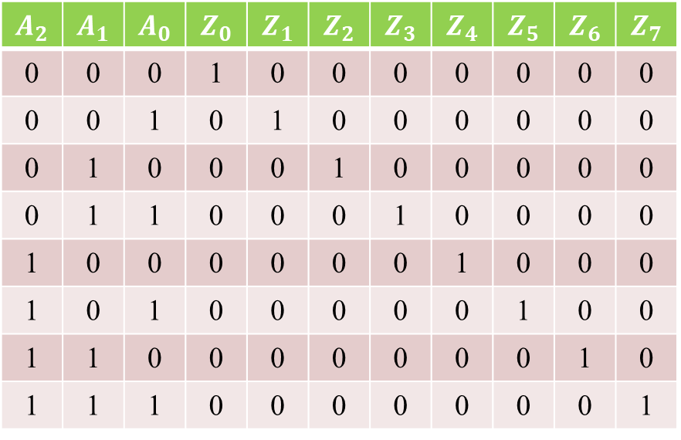
Decoder circuit and truth table
INPUT | OUTPUT
$$A_{2}$$ | $$A_{1}$$ | $$A_{0}$$ | $$Z_{0}$$ | $$Z_{1}$$ | $$Z_{2}$$ | $$Z_{3}$$ | $$Z_{4}$$ | $$Z_{5}$$ | $$Z_{6}$$ | $$Z_{7}$$
0 | 0 | 0 | 1 | 0 | 0 | 0 | 0 | 0 | 0 | 0
0 | 0 | 1 | 0 | 1 | 0 | 0 | 0 | 0 | 0 | 0
0 | 1 | 0 | 0 | 0 | 1 | 0 | 0 | 0 | 0 | 0
0 | 1 | 1 | 0 | 0 | 0 | 1 | 0 | 0 | 0 | 0
1 | 0 | 0 | 0 | 0 | 0 | 0 | 1 | 0 | 0 | 0
1 | 0 | 1 | 0 | 0 | 0 | 0 | 0 | 1 | 0 | 0
1 | 1 | 0 | 0 | 0 | 0 | 0 | 0 | 0 | 1 | 0
1 | 1 | 1 | 0 | 0 | 0 | 0 | 0 | 0 | 0 | 1

Slide 8
Practical Use of Encoder & Decoder
Encoder :
Decoder :
Encoders are used in devices that need to operate in high speed and with high accuracy.
The method of controlling the motor rotation by detecting the motor rotation speed and rotation angle using an encoder is called feedback control (closed loop method).
A digital decoder converts a set of digital signals into corresponding decimal code.
A decoder is also a most commonly used circuit in prior to the use of encoder.
The encoded data is decoded for user interface in most of the output devices like monitors, calculator displays, printers, etc.

Slide 9
Multiplexer (MUX).
In electronics, a multiplexer (or mux; spelled sometimes as multiplexor), also known as a data selector, is a device that selects between several analog or digital input signals and forwards the selected input to a single output line.
The multiplexer or MUX is a digital switch, also called as data selector.
It is a Combinational Logic Circuit with more than one input line, one output line and more than one select line.
Accepts the binary information from several input lines or sources and depending on the set of select lines, a particular input line is routed onto a single output line.

Slide 10
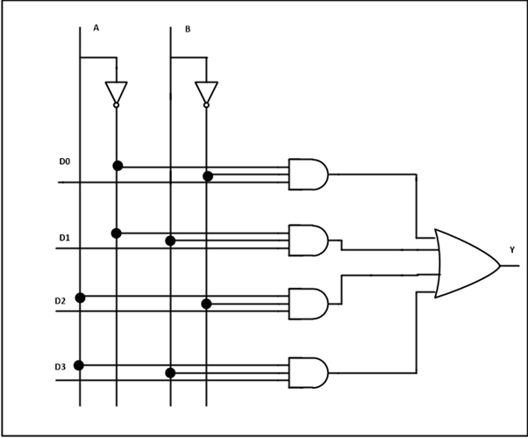
Multiplexer (MUX) Circuit and Truth Table
A | B | Y
0 | 0 | D0
0 | 1 | D1
1 | 0 | D2
1 | 1 | D3

Slide 11
Demultiplexer (DEMUX)
De-Multiplexer is a combinational circuit that performs the reverse operation of Multiplexer. It has single input, ‘n’ selection lines and maximum of 2^{n} outputs.
The input will be connected to one of these outputs based on the values of selection lines.

Slide 12
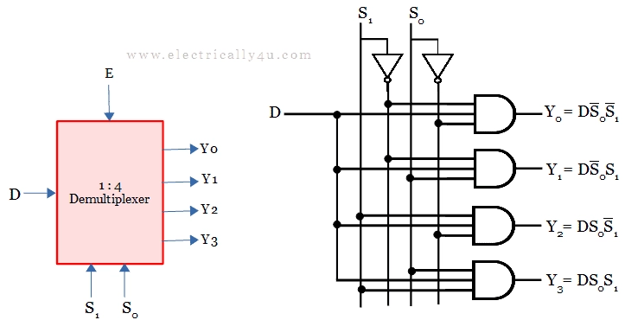
Demultiplexer(DEMUX) Circuit & Truth Table.
S1 | S0 | Y0 | Y1 | Y2 | Y3
0 | 0 | D | 0 | 0 | 0
0 | 1 | 0 | D | 0 | 0
1 | 0 | 0 | 0 | D | 0
1 | 1 | 0 | 0 | 0 | D

Slide 13
Practical Use of MUX and DEMUX
MUX:
DEMUX:
Multiplexer allow the process of transmitting different type of data such as audio, video at the same time using a single transmission line.
Telephone Network – In telephone network, multiple audio signals are integrated on a single line for transmission with the help of multiplexers.
Demultiplexer are also used for reconstruction of parallel data and ALU circuits. Communication System – Communication system use multiplexer to carry multiple data like audio, video and other form of data using a single line for transmission.
This process make the transmission easier.

Slide 14
Thank You!

