Slide 1
Welcome To My Presentation
Notes:
We designed this template so that each member of the project team has a set of slides with its own theme. Members, here’s how you add a new slide to just your set:
Mark where you want to add the slide: Select an existing one in the Thumbnails pane, click the New Slide button, then choose a layout. The new slide gets the same theme as the other slides in your set.
Careful! Don’t annoy your fellow presenters by accidentally changing their themes. That can happen if you choose a different theme from the Design tab, which changes all of the slides in the presentation to that look.

Slide 2
My Presentation Topics is Flip Flops & The Practical use Cases
Presented By
Tushar Sarkar
Student ID : 18CSE035
Second Year Second Semester
Department of CSE, BSMRSTU.

Slide 3
Content
What is Flip flop?
Types Of Flip Flop
SR Flip Flop
D Flip Flop
JK Flip Flop
T Flip Flop
The Practical Uses of Flip Flop

Slide 4
What is Flip Flop?
A flip flop is an electronic circuit with two stable states that can be used to store binary data, bit 1 or bit 0.
The stored data can be changed by applying varying inputs.
The designing of the flip flop circuit can be done by using logic gates such as two NAND and NOR gates.
Each flip flop consists of two inputs and two outputs, namely set and reset, Q and Q’.
This kind of flip flop is stated to as an SR flip flop.

Slide 5
Types of Flip Flop
Flip flop circuits are classified into four types based on its use,
Namley-
SR-Flip Flop
D Flip Flop
JK Flip Flop
T Flip Flop

Slide 6
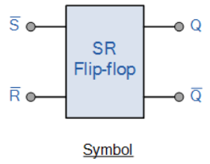
SR Flip Flop
The SR-flip flop is built with two AND gates and a basic NOR flip flop.
The o/ps of the two AND gates remain at 0 as long as the CLK pulse is 0, irrespective of the S and R i/p values.
When the CLK pulse is 1, information from the S and R inputs permits through the basic FF.
When S=R=1, the clock pulse occurrence roots both the o/ps go to 0.
When the CLK pulse is detached, the state of the FF is unstated.

Slide 7
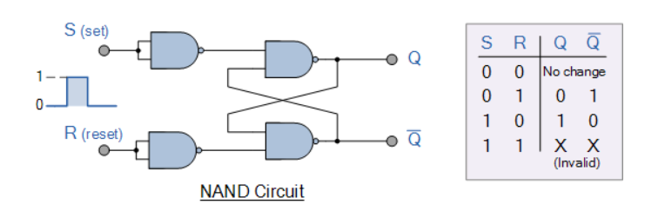
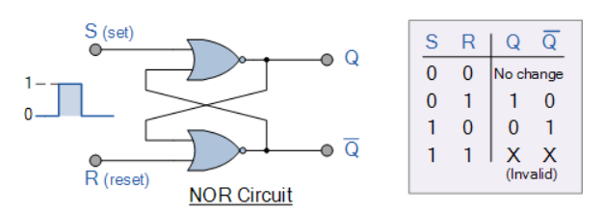
SR Flip Flop
NAND Gate SR Flip-flop :
NOR Gate SR Flip-flop

Slide 8
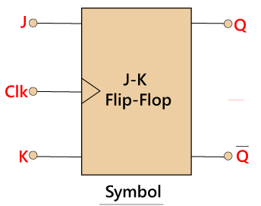
JK Flip Flop
A JK-FF is a simplification of the SR-flip flop. The inputs of the J and K flip flops behave like the inputs S & R.
When input 1 is applied to both the inputs J and K, then the FF switches to its complement state. The designing of the JK FF can be done in such a way that the o/p Q is ANDed with P and.
This procedure is made so that the FF is cleared during a CLK pulse only if the output was previously 1. In the same way, the output is ANDed with J & CP so that the FF is cleared during a CLK pulse only is Q’ was previously 1.

Slide 9
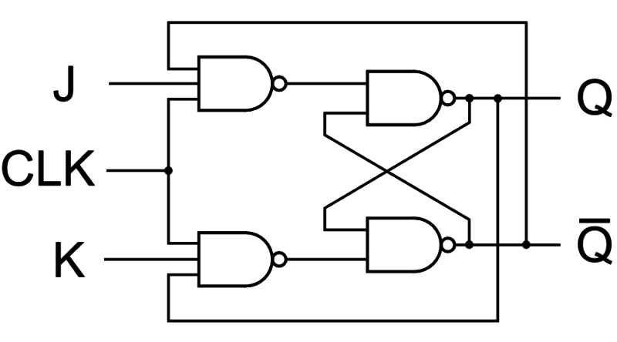
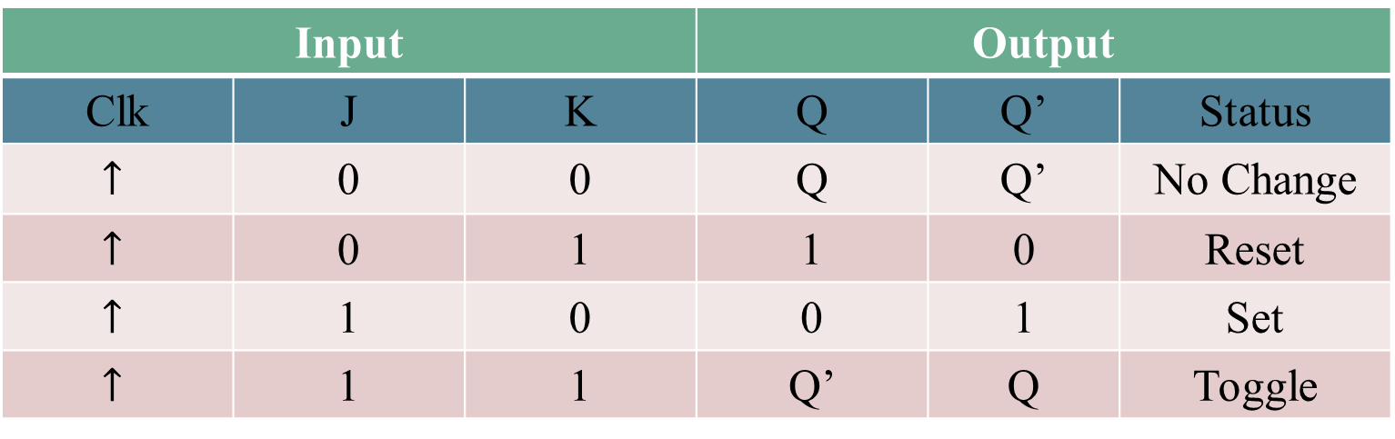
JK Flip Flop
JK flip Flop Logic Diagram:
Truth Table for JK Flip Flop :
Input |  |  | Output
Clk | J | K | Q | Q’ | Status
$$↑$$ | 0 | 0 | Q | Q’ | No Change
$$↑$$ | 0 | 1 | 1 | 0 | Reset
$$↑$$ | 1 | 0 | 0 | 1 | Set
$$↑$$ | 1 | 1 | Q’ | Q | Toggle

Slide 10
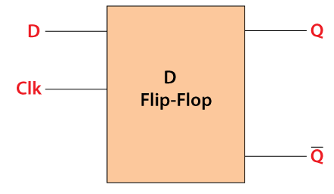
D Flip Flop
D Flip Flop also known as Data Filp Flop
The D-input is sampled throughout the existence of a CLK pulse.
If it is 1, then the FF is switched to the set state.
If it is 0, then the FF switches to a clear state.
The D flip flop will act as a storage element for a single binary digit (Bit)

Slide 11
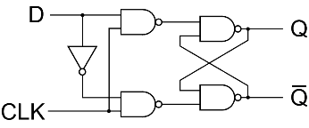
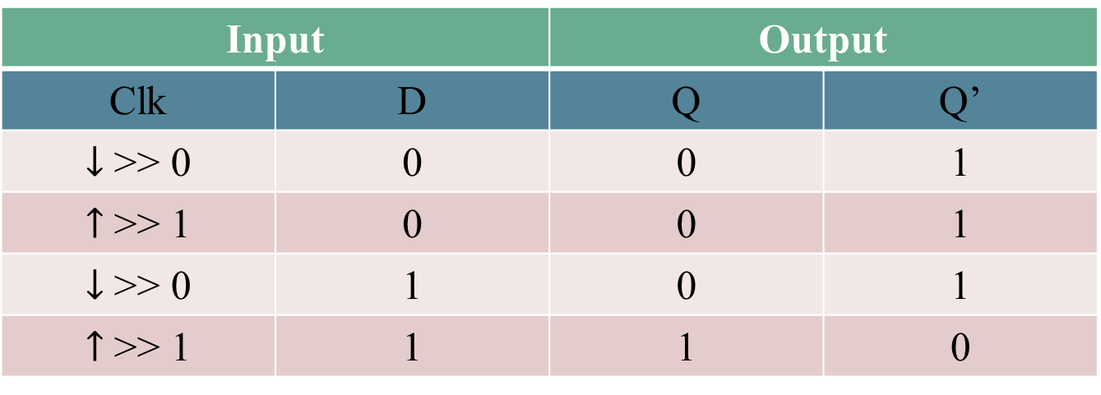
D Flip Flop
Input |  | Output
Clk | D | Q | Q’
$↓$ >> 0 | 0 | 0 | 1
$↑$ >> 1 | 0 | 0 | 1
$↓$ >> 0 | 1 | 0 | 1
$↑$ >> 1 | 1 | 1 | 0

Slide 12
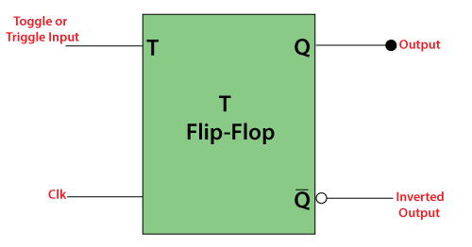
T Flip Flop
The T-flip flop or toggle flip flop is a single i/p version of the JK-flip flop.
The working of this FF is as follows: When the input of the T is ‘0’ such that the ‘T’ will make the next state that is similar to the current state.
That means when the input of the T-FF is 0 then the present state and the next state will be 0.
However, if the i/p of the T is 1 then the present state is inverse to the next state. That means, when T=1, then the present state =0 and next state =1).

Slide 13
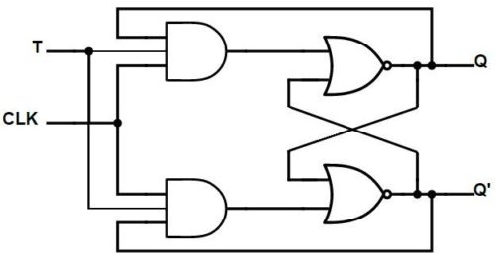
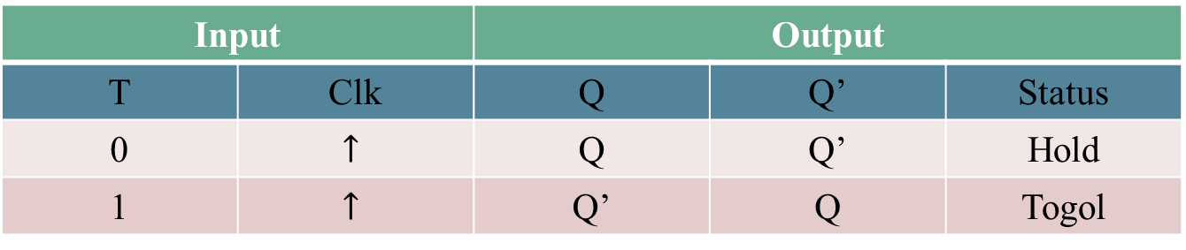
T Flip Flop
T flip Flop Logic Diagram:
Truth Table for T Flip Flop :
Input |  | Output
T | Clk | Q | Q’ | Status
0 | $$↑$$ | Q | Q’ | Hold
1 | $$↑$$ | Q’ | Q | Togol

Slide 14
The Practical Uses of Flip Flop
Counters-
Asynchronous counter
Modulo – n – counter
Synchronous counter
2 – Bit synchronous counter
Applications of Counters
Registers.
Frequency Division.
Data Transfer.

Slide 15
Thank You

