Slide 1
Hello Everyone Course Code : CSE201 Course Title : Data Structure
Course Teacher:
Md. Jamal Uddin
Assistant Professor
Department of CSE,BSMRSTU,
Gopalganj-8100.
Presented By:
Tushar Sarkar
Student ID: 18CSE035
Department of CSE,BSMRSTU,
Gopalganj-8100.

Slide 2
Linear Search

Slide 3
Outline
Introduction to Search
What is Linear Search?
Pseudo Code
Example of Linear Search
Code in C++
Complexity
Advantages & Disadvantages
Conclusion

Slide 4
Introduction to Search
The Definition of a Search is the process of looking for something or someone.
Searching is the process of finding a given value position in a list of values.
It decides whether a search key is present in the data or not.
It is the algorithmic process of finding a particular item in a collection of items.
It can be done on internal data structure or on external data structure.

Slide 5
What is Linear Search?
Linear search is a very simple search algorithm.
In this type of search, a sequential search is made over all items one by one.
Every item is checked and if a match is found then that particular item is returned, otherwise the search continues till the end of the data collection.

Slide 6
Pseudo Code
Start from the leftmost element of arr[] and one by one compare x with each element of arr[]
If x matches with an element, return the index.
If x doesn’t match with any of elements, return -1.

Slide 7
Example of Linear Search
When int x=20,int arr[10];
Index :
Value :
Explain:
First of all check leftmost index and it is 0,value is 10 but not equal to x
Then check index 1,here value is 50 but not matches x
Then check index 2,3,4,5 and value is respectively 30,70,80 & 60 but not equal to x
Finally check index 6,value is 20 and equal to x. So return index 6.
0 | 1 | 2 | 3 | 4 | 5 | 6 | 7 | 8
10 | 50 | 30 | 70 | 80 | 60 | 20 | 90 | 40

Slide 8
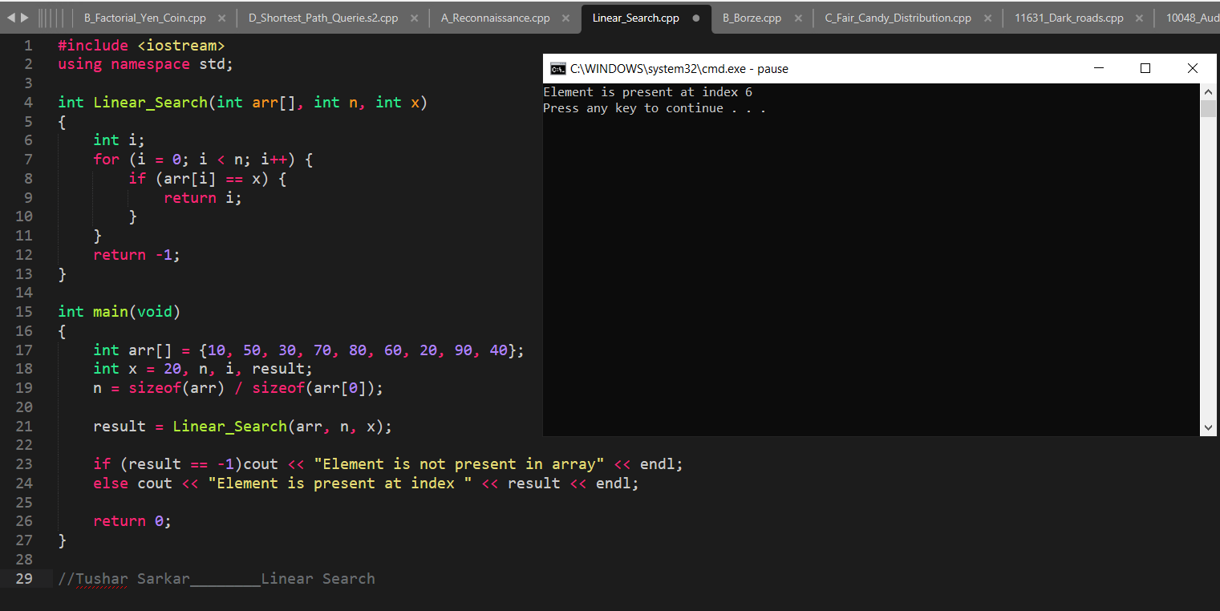
Code in C++
.

Slide 9
Complexity
Best Case :
The element being searched may be found at the first position.
In this case, the search terminates in success with just one comparison.
Thus in best case, linear search algorithm takes O(1) operations.
Worst Case :
The element being searched may be present at the last position or not present in the array at all.
In the former case, the search terminates in success with n comparisons.
In the later case, the search terminates in failure with n comparisons.
Thus in worst case, linear search algorithm takes O(n) operations.

Slide 10
Advantages & Disadvantages
Advantages :
Will perform fast searches of small to medium lists. With today's powerful computers, small to medium arrays can be searched relatively quickly.
The list does not need to sorted. ...
Not affected by insertions and deletions.
Disadvantages :
Linear Search is very slow for large lists.
As the number of elements in the array/list increases the time complexity also increases.

Slide 11
Conclusion
The sequential search, also known as the linear search, are the most basic search algorithms and are often the first search method learned in introductory computer science courses.
The basic strategy is straightforward.
Every element in the data set is examined in the order presented until the value being searched for is found.
If the value being searched for doesn't exist, a flag value is returned (such as -1 for an array or NULL for a linked list).

Slide 12
Thank You

