Slide 1
Hello Everyone Course Code : CSE201 Course Title : Data Structure
Course Teacher:
Md. Jamal Uddin
Assistant Professor
Department of CSE,BSMRSTU,
Gopalganj-8100.
Presented By:
Tushar Sarkar
Student ID: 18CSE035
Department of CSE,BSMRSTU,
Gopalganj-8100.

Slide 2
Linked List

Slide 3
Outline
Introduction
Insertion Description
Deletion Description
Basic Node Implementation
Complexity
Conclusion

Slide 4
Introduction
Definitions
What is link list?
Nodes and pointers
Single Linked Lists
Double Linked Lists
Circular Lists

Slide 5
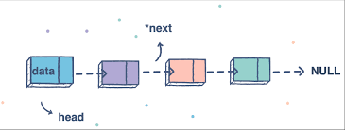
What is link list?
Link list is the linear collection of data elements called nodes, where the linear order is given by means of pointers.
Example:

Slide 6

Nodes and pointers
A node is called a self-referential object, since it contains a pointer to a variable that refers to a variable of the same type. For example, a struct Node that contains an int data field and a pointer to another node can be defined as follows.

Slide 7
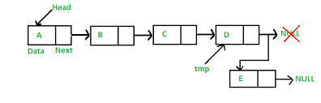
Single linked lists
A linked list is a linear data structure, in which the elements are not stored at contiguous memory locations. The elements in a linked list are linked using pointers as shown in the below image:

Slide 8
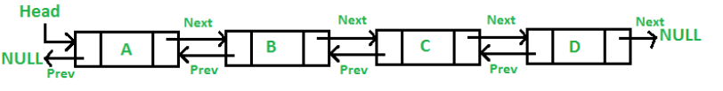
Double Linked Lists
A Doubly Linked List (DLL) contains an extra pointer, typically called previous pointer, together with next pointer and data which are there in singly linked list.

Slide 9
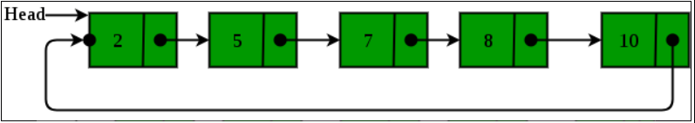
Circular Lists
Circular linked list is a linked list where all nodes are connected to form a circle. There is no NULL at the end. A circular linked list can be a singly circular linked list or doubly circular linked list.

Slide 10
Insertion Description
Insertion at the top of the list
Insertion at the end of the list
Insertion in the middle of the list

Slide 11
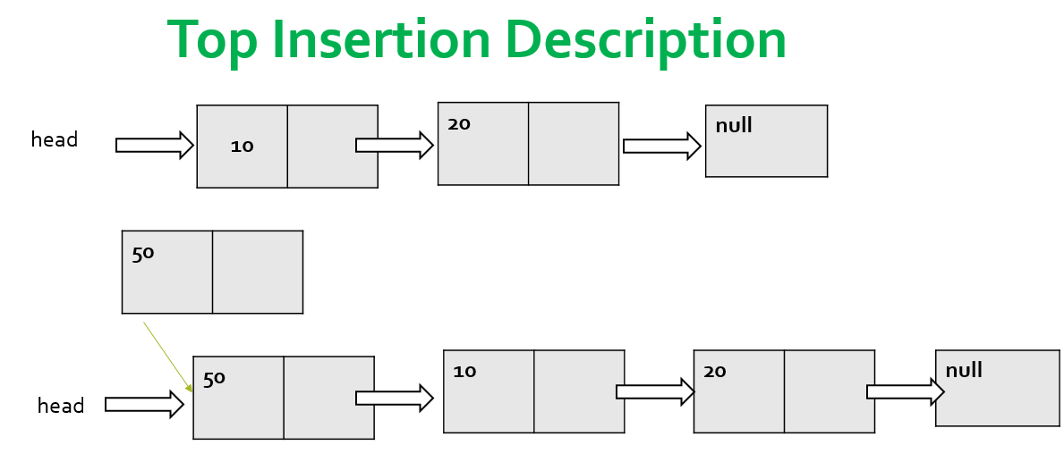
Insertion at the top
Steps:
Create a Node
Set the node data Values
Connect the pointers

Slide 12
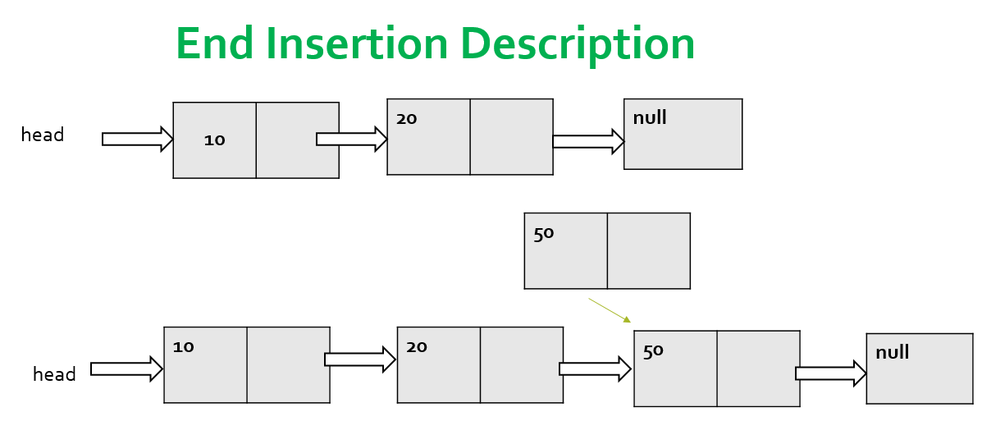
Insertion at the end
Steps:
Create a Node
Set the node data Values
Connect the pointers

Slide 13
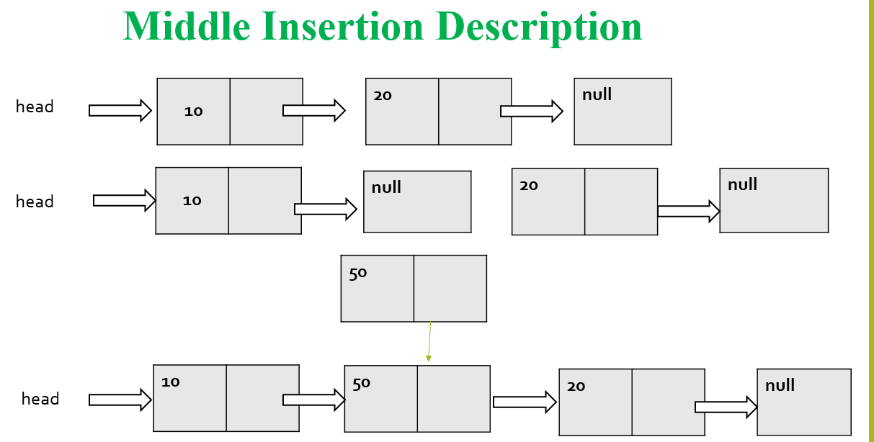
Insertion in the middle
Steps:
Create a Node
Set the node data Values
Break pointer connection
Re-connect the pointers

Slide 14
Deletion Description
Deleting from the top of the list
Deleting from the end of the list
Deleting from the middle of the list

Slide 15
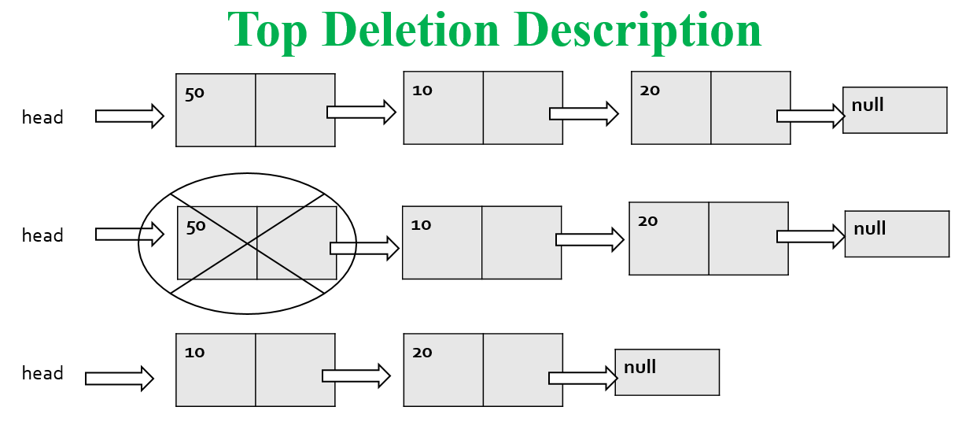
Deleting from the top
Steps:
Break the pointer connection
Re-connect the nodes
Delete the node

Slide 16
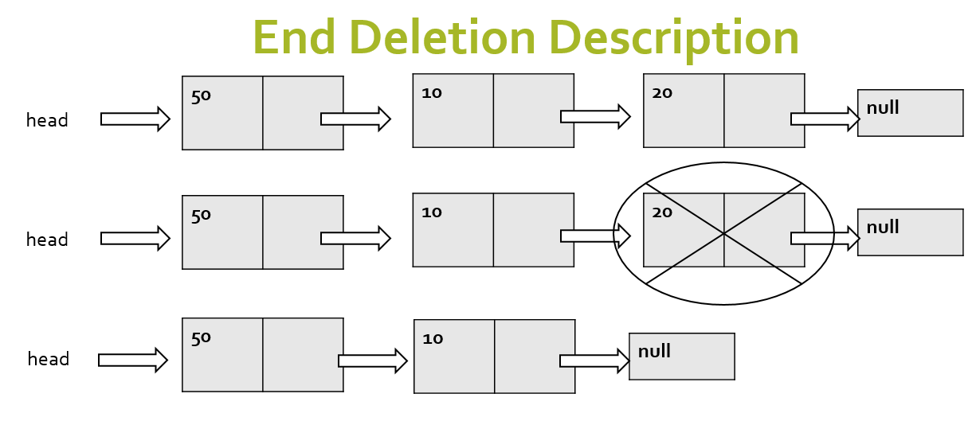
Deleting from the end
Steps:
Break the pointer connection
Set previous node pointer to NULL
Delete the node

Slide 17
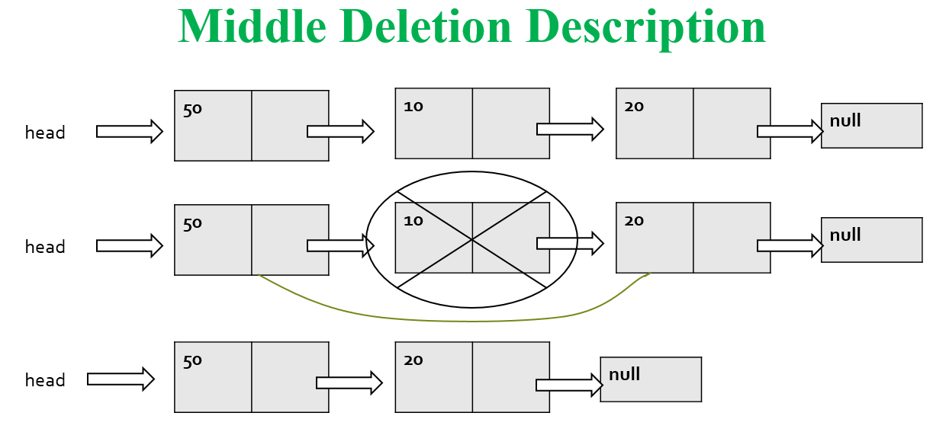
Deleting from the Middle
Steps:
Set previous Node pointer to next node
Break Node pointer connection
Delete the node

Slide 18

Basic Node Implementation

Slide 19
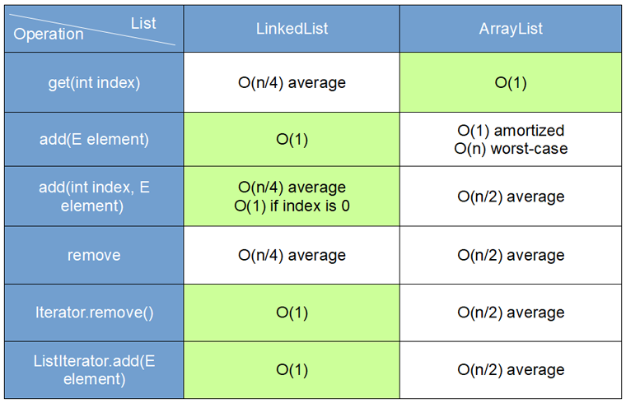
Complexity

Slide 20
Conclusion
Linked list is similar to an array that it contains data that is best organized in a list fashion
Its dynamic structure make it expandable or shrinkable execution.
This dynamic quality make it appealing to use in certain situations where the static nature of arrays will be wasteful

Slide 21
Thank You

