Slide 1
Welcome To My Presentation
Notes:
We designed this template so that each member of the project team has a set of slides with its own theme. Members, here’s how you add a new slide to just your set:
Mark where you want to add the slide: Select an existing one in the Thumbnails pane, click the New Slide button, then choose a layout. The new slide gets the same theme as the other slides in your set.
Careful! Don’t annoy your fellow presenters by accidentally changing their themes. That can happen if you choose a different theme from the Design tab, which changes all of the slides in the presentation to that look.

Slide 2
My Presentation Topics is Heap Sort
Presented By
Tushar Sarkar
Student ID : 18CSE35
Second Year Second Semester
Department of CSE, BSMRSTU.

Slide 3
Content
Heap Sort?
What is Heap?
Max/Min Heap.
Procedure on Heap.
Example of Heap Sort.
Pseudo Code
Complexity

Slide 4
Heap Sort
Heap Sort is a popular and efficient sorting algorithm in computer programming.
Learning how to write the heap sort algorithm requires knowledge of two types of data structures - arrays and trees.
Heap sort works by visualizing the elements of the array as a special kind of complete binary tree called a heap.

Slide 5
What is Heap?
A Heap is a special Tree-based data structure in which the tree is a complete binary tree.
Generally, Heaps can be of two types:
1.Max Heap
2.Min Heap

Slide 6
Max Heap
Root node must be greater than those child node.
Store data in ascending order
8
5
7
4
6
1

Slide 7
Min Heap
Root node must be lower than child node.
Store data in descending order
5
8
9
12
15
17
14

Slide 8
Procedures on Heap
Following procedures are apply on heap-
1. Heapify
2. Build Heap
3. Heap Sort

Slide 9
Heapify
Starting from a complete binary tree, we can modify it to become a Max-Heap by running a function called heapify on all the non-leaf elements of the heap.
2
2
7
Parent is now the largest
7
4
7
4
2
4
Child is greater than the parent

Slide 10
Build Heap
To build a max-heap from any tree, we can thus start heapifying each sub-tree from the bottom up and end up with a max-heap after the function is applied to all the elements including the root element.
Buildheap(A){ heapsize[A] ← length[A] for i ← length[A]/2 //down to 1 do Heapify(A, i)
}

Slide 11
Heap Sort Algorithm
The heap sort algorithm starts by using procedure BUILD-HEAP to build a heap on the input array A[1 . . n]. Since the maximum element of the array stored at the root A[1], it can be put into its correct final position by exchanging it with A[n] (the last element in A).
Heapsort(A){ Buildheap(A) for i ← length[A] //down to 2 do swap A[1] ←→ A[i] heapsize[A] ← heapsize[A] - 1 Heapify(A, 1) }

Slide 12
Example of Heap Sort
12
16
1
4
7
19
Array of A
Take Out Biggest
12
16
Move the last element
to the root
1
4
7
Sorted:
19

Slide 13
Example of Heap Sort
7
12
16
1
4
7
Swap
Array of A
12
16
Heapify
1
4
Sorted:
19

Slide 14
Example of Heap Sort
12
7
1
4
16
Array of A
Take Out Biggest
12
7
Move the last element
to the root
1
4
Sorted:
16
19

Slide 15
Example of Heap Sort
4
12
7
1
4
Array of A
Swap
12
7
Heapify
1
Sorted:
16
19

Slide 16
Example of Heap Sort
4
7
1
12
Take Out Biggest
Array of A
4
7
Move the last element
to the root
1
Sorted:
12
16
19

Slide 17
Example of Heap Sort
1
4
7
1
Array of A
Swap
4
7
Heapify
Sorted:
12
16
19

Slide 18
Example of Heap Sort
4
1
7
Take Out Biggest
Array of A
Move the last element
to the root
4
1
Sorted:
7
12
16
19

Slide 19
Example of Heap Sort
1
4
1
Array of A
Swap
4
Heapify
Sorted:
7
12
16
19

Slide 20
Example of Heap Sort
1
4
Take Out Biggest
Array of A
Move the last element
to the root
1
Sorted:
4
7
12
16
19

Slide 21
Example of Heap Sort
A
19
12
16
1
4
7
Given Array
1
Take Out Biggest
Sorted:
1
4
7
12
16
19

Slide 22
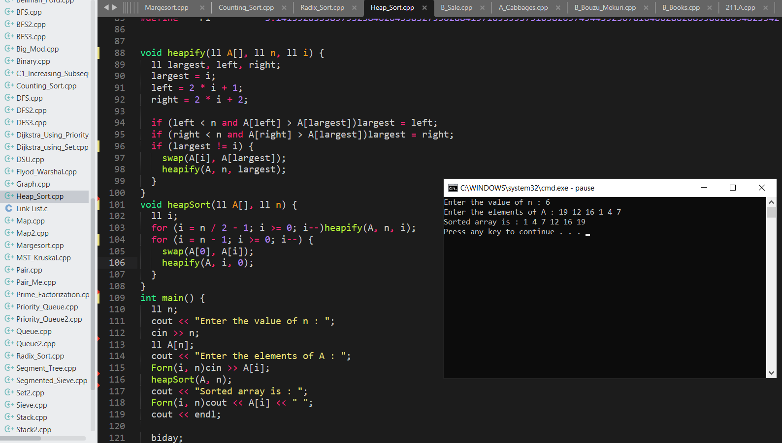
Pseudo Code

Slide 23
Complexity
Best Case | Worst Case | Average Case
O(n*logn) | O(n*logn) | O(n*logn)

Slide 24
Thank You

