Slide 1
Welcome To My Presentation

Slide 2
My Presentation Topic is Merge Sort
Presented By
Tushar Sarkar
Student ID : 18CSE35
Second Year Second Semester
Department of CSE, BSMRSTU.

Slide 3
Content
Introduction
Divide and Conquer Strategy
Divide, Conquer & Combine
Merge Sort Algorithm
Example Explain
Pseudocode
Time Complexity
Conclusion

Slide 4
Introduction
Merge Sort is one of the most popular sorting algorithms that is based on the principle of Divide and Conquer Algorithm.
Here, a problem is divided into multiple sub-problems.
Each sub-problem is solved individually.
Finally, sub-problems are combined to form the final solution.

Slide 5
Divide and Conquer Strategy
Using the Divide and Conquer technique, we divide a problem into sub-problems.
When the solution to each sub-problem is ready, we 'combine' the results from the sub-problems to solve the main problem.
Suppose we had to sort an array .
A sub-problem would be to sort a sub-section of this array starting at index and ending at index , denoted as .
A
p
r
A[p…r]

Slide 6
Divide, Conquer & Combine
Divide
Conquer
Combine
If q is the half-way point between p and r, then we can split the subarray A[p..r] into two arrays A[p..q] and A[q+1, r].
In the conquer step, we try to sort both the subarrays A[p..q] and A[q+1, r].
If we haven't yet reached the base case, we again divide both these subarrays and try to sort them.
When the conquer step reaches the base step and we get two sorted subarrays A[p..q] and A[q+1, r] for array A[p..r], we combine the results by creating a sorted array A[p..r] from two sorted subarrays A[p..q] and A[q+1, r].

Slide 7
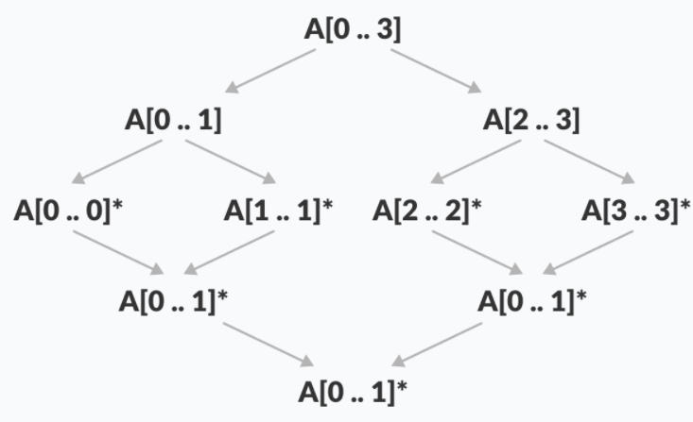
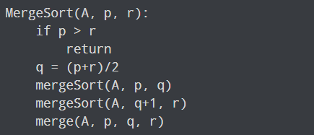
Merge Sort Algorithm
The MergeSort function repeatedly divides the array into two halves until we reach a stage where we try to perform MergeSort on a subarray of size 1 i.e. p == r.
After that, the merge function comes into play and combines the sorted arrays into larger arrays until the whole array is merged.
To sort an entire array, we need to call MergeSort(A, 0, length(A)-1)
As shown in the image, the merge sort algorithm recursively divides the array into halves until we reach the base case of array with 1 element. After that, the merge function picks up the sorted sub-arrays and merges them to gradually sort the entire array.

Slide 8
Example
Suppose an array is A. Starting index p & ending index r. Then denoted array is A[p..r].
Let p = 0, r = 6
A
This is an unsorted array.
So sorted this array—
A
0 | 1 | 2 | 3 | 4 | 5 | 6
38 | 27 | 43 | 3 | 9 | 82 | 10
0 | 1 | 2 | 3 | 4 | 5 | 6
3 | 9 | 10 | 27 | 38 | 43 | 82

Slide 9
Example Explain(Divide)
0 | 1 | 2 | 3 | 4 | 5 | 6
38 | 27 | 43 | 3 | 9 | 82 | 10
0 | 1 | 2 | 3
38 | 27 | 43 | 3
4 | 5 | 6
9 | 82 | 10
0 | 1
38 | 27
2 | 3
43 | 3
4 | 5
9 | 82
6
10
0
38
1
27
2
43
3
3
4
9
5
82

Slide 10
Example Explain(Conquer & Combine)
0
38
1
27
2
43
3
3
4
9
5
82
6
10
0 | 1
27 | 38
2 | 3
3 | 43
4 | 5
9 | 82
0 | 1 | 2 | 3
3 | 27 | 38 | 43
4 | 5 | 6
9 | 10 | 82
0 | 1 | 2 | 3 | 4 | 5 | 6
3 | 9 | 10 | 27 | 38 | 43 | 82

Slide 11
Example(Divide, Conquer & Combine)
0 | 1 | 2 | 3 | 4 | 5 | 6
38 | 27 | 43 | 3 | 9 | 82 | 10
0 | 1 | 2 | 3
38 | 27 | 43 | 3
4 | 5 | 6
9 | 82 | 10
0 | 1
38 | 27
2 | 3
43 | 3
4 | 5
9 | 82
6
10
0
38
1
27
2
43
3
3
4
9
5
82
0 | 1
27 | 38
2 | 3
3 | 43
4 | 5
9 | 82
0 | 1 | 2 | 3
3 | 27 | 38 | 43
4 | 5 | 6
9 | 10 | 82
0 | 1 | 2 | 3 | 4 | 5 | 6
3 | 9 | 10 | 27 | 38 | 43 | 82

Slide 12
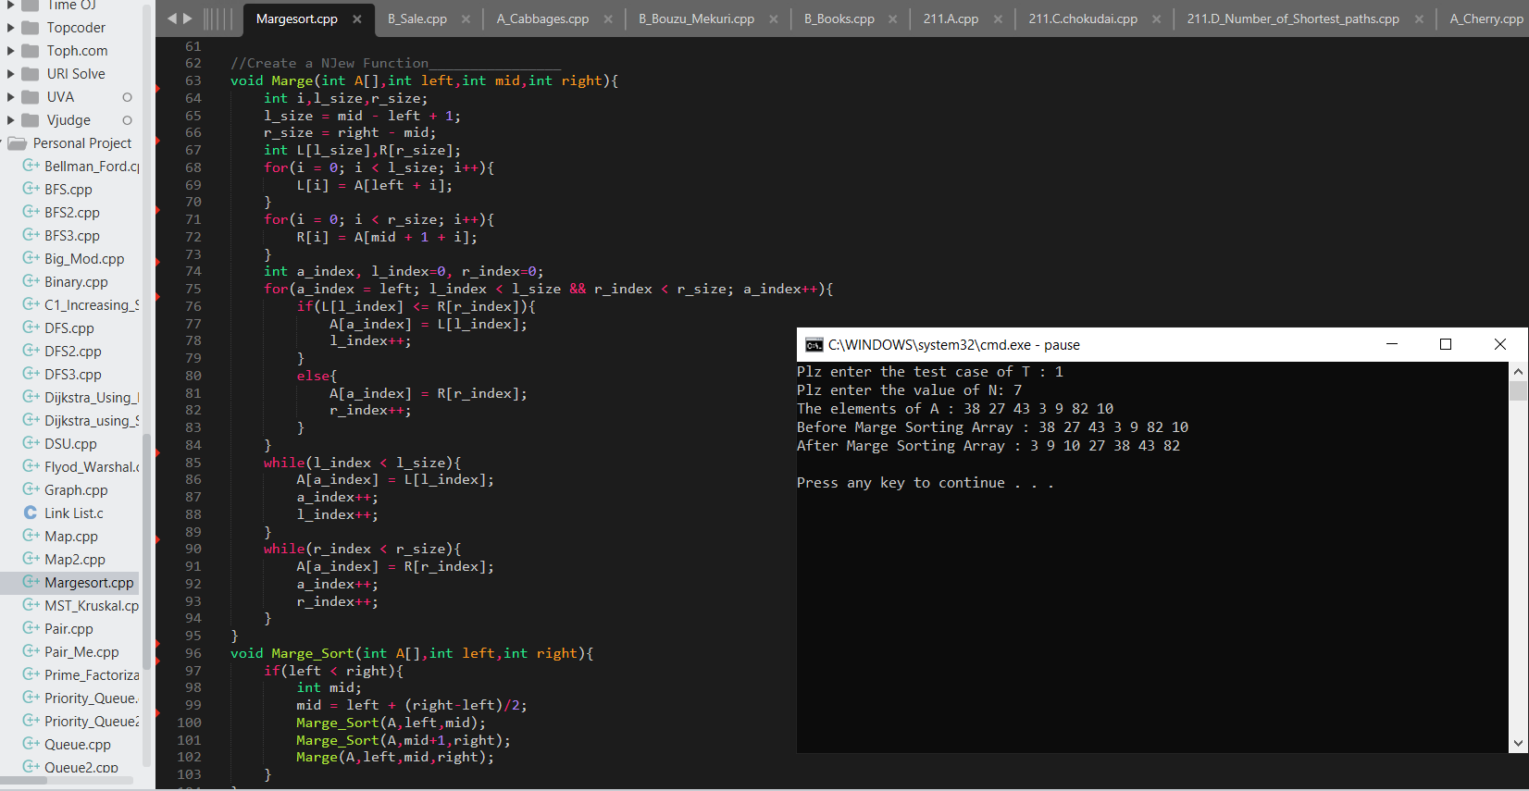
Pseudocode

Slide 13
Time Complexity
We denote with n the number of elements.
Since we repeatedly divide the (sub)arrays into two equally sized parts, if we double the number of elements n, we only need one additional step of divisions d.
if n=4 then d=2
if n=8 then d=3
On each merge stage, we have to merge a total of n elements (on the first stage n × 1, on the second stage n/2 × 2, on the third stage n/4 × 4, etc.
The merge process does not contain any nested loops, so it is executed with linear complexity: If the array size is doubled, the merge time doubles, too. The total effort is, therefore, the same at all merge levels.
So we have n elements times log₂ n division and merge stages.
Therefore: The time complexity of Merge Sort is: O(n log n)

Slide 14
Conclusion
Merge sort is an interesting algorithm and forms a great case-study to understand data structures and algorithms.
In order to develop strong foundations in computer science, you are advised to thoroughly understand various sorting algorithms that will help you pick up the basics.
Merge sort uses a divide-and-conquer method recursively sorts the elements of a list while Bubble, Insertion and Selection have a quadratic time complexity that limit its use to small number of elements.
Merge sort uses divide-and-conquer to speed up the sorting.

Slide 15
Thank You

