Slide 1
Welcome To My Presentation

Slide 2
My Presentation Topic is Quick Sort
Presented By:
Tushar Sarkar
Student ID: 18CSE035
Department of CSE,BSMRSTU,
Gopalganj-8100.

Slide 3
Outline
Introduction to Sort
What is Quick Sort?
Algorithm Explain
Example of Quick Sort
Pseudo Code
Complexity
Advantages & Disadvantages
Conclusion

Slide 4
Introduction to Sort
Sorting is one of the most basic functions applied to data.
Sorting is a technique that is implemented to arrange the data in a specific order.
It means arranging the data in a particular fashion, which can be increasing or decreasing.
Sorting is required to ensure that the data which we use is in a particular order so that we can easily retrieve the required piece of information from the pile of data.
If the data is unkempt and unsorted, when we want a particular piece of information, then we will have to search it one by one every time to retrieve the data.

Slide 5
What is Quick Sort?
Quick sort is a highly efficient sorting algorithm and is based on partitioning of array of data into smaller arrays.
A large array is partitioned into two arrays one of which holds values smaller than the specified value, say pivot, based on which the partition is made and another array holds values greater than the pivot value.
Quicksort partitions an array and then calls itself recursively twice to sort the two resulting subarrays.

Slide 6
Algorithm Explain
Step 1 − Choose the highest index value has pivot
Step 2 − Take two variables to point left and right of the list excluding pivot
Step 3 − left points to the low index
Step 4 − right points to the high
Step 5 − while value at left is less than pivot move right
Step 6 − while value at right is greater than pivot move left
Step 7 − if both step 5 and step 6 does not match swap left and right
Step 8 − if left ≥ right, the point where they met is new pivot

Slide 7
Example of Quick Sort
If primary array is :
Sorting By Ascending Order :
Sorting By descending Order :
3 | 2 | 5 | 4
2 | 3 | 4 | 5
5 | 4 | 3 | 2

Slide 8
Example Explain
Step 1:
pivot=3, right=4
pivot < right, right shift
Step 2:
pivot=3, right=5
pivot < right, right shift
Step 3:
pivot=3, right=2
pivot > right, swap(pivot,right)
Pivot
3 | 2 | 5 | 4
Left
Right
Pivot
3 | 2 | 5 | 4
Left
Right
Pivot
3 | 2 | 5 | 4
Left
Right

Slide 9
Example Explain
Step 4:
pivot=3, left=2
pivot > left, left shift
Step 5:
pivot=left=right=3
So 3 is sorted
Step 6:
pivot=left=right=2
So 2 is fixed
Pivot
2 | 3 | 5 | 4
Left
Right
Pivot
2 | 3 | 5 | 4
Left
Right
Pivot
2 | 3 | 5 | 4
Left
Right

Slide 10
Example Explain
Step 7:
pivot=5, right=4
pivot > right, swap(pivot,right)
Step 8:
pivot=5, left=4
pivot > left, left shift
Step 9:
pivot=left=right=5
So 5 is sorted
Pivot
2 | 3 | 5 | 4
Left
Right
Pivot
2 | 3 | 4 | 5
Left
Right
Pivot
2 | 3 | 4 | 5
Left
Right

Slide 11
Example Explain
Step 10:
pivot=left=right=4
So 4 is sorted
Step 11:
Array is sorted
Pivot
2 | 3 | 4 | 5
Left
Right
2 | 3 | 4 | 5

Slide 12
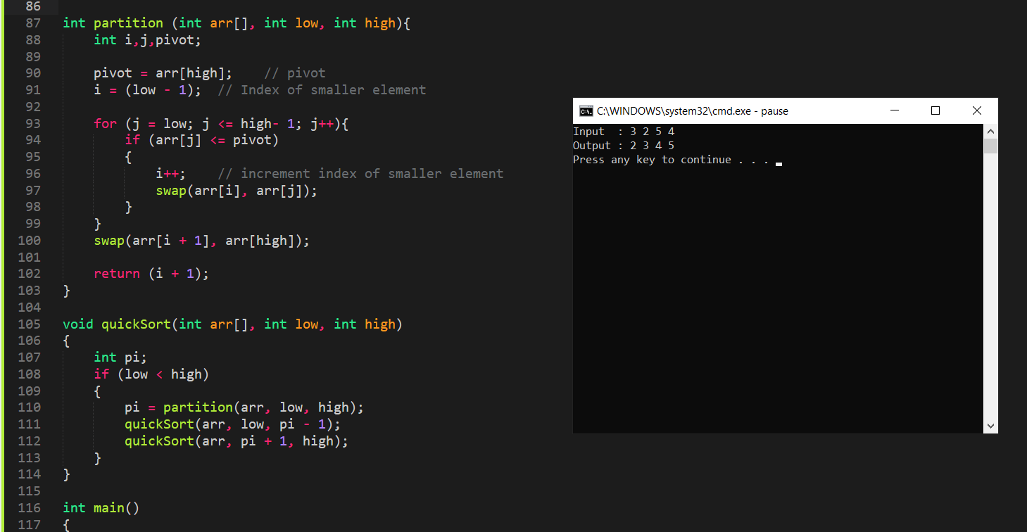
Pseudo Code
.

Slide 13
Complexity
Best case :
The best-case occurs the algorithm is conducted in such a way that always the median element is selected as the pivot and thus reduces the complexity.
The following time is taken for the best case.
T(n)=2T(n/2)+n;
The solution of the above recurrence is O(nlogn).
It can be solved using Master Theorem.
So the best case of this algorithm is nlogn where n is the size the array.

Slide 14
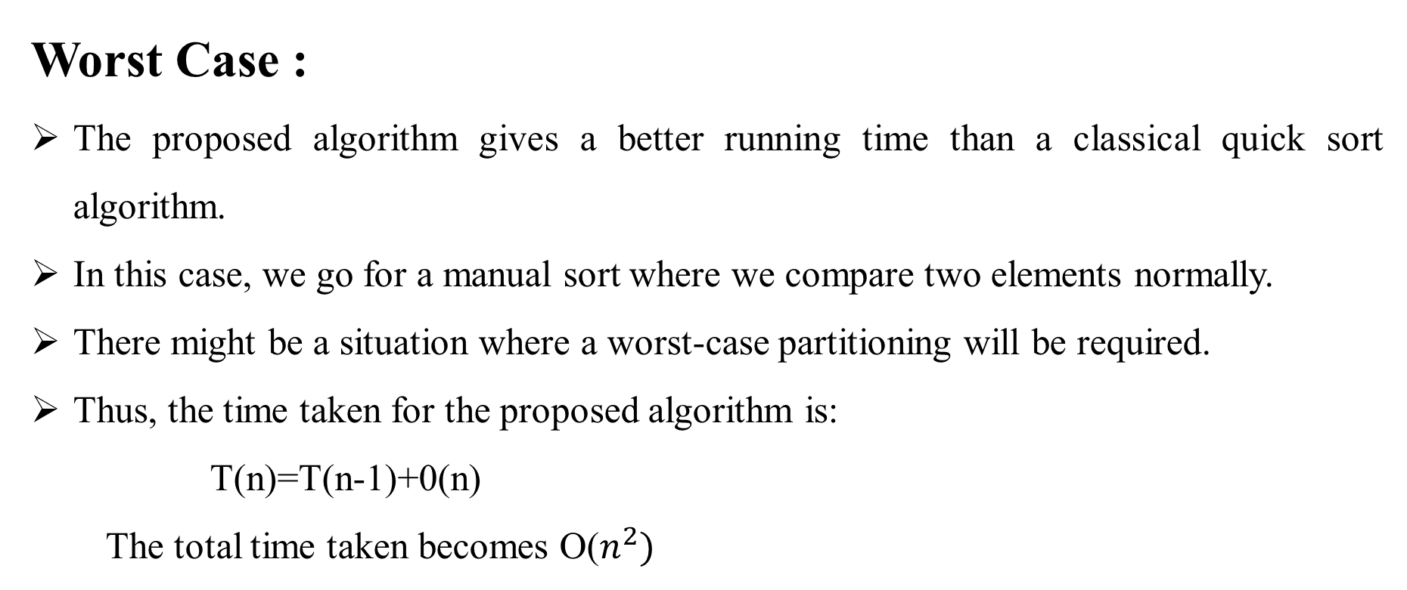
Complexity
Worst Case :
The proposed algorithm gives a better running time than a classical quick sort algorithm.
In this case, we go for a manual sort where we compare two elements normally.
There might be a situation where a worst-case partitioning will be required.
Thus, the time taken for the proposed algorithm is:
T(n)=T(n-1)+0(n)
The total time taken becomes O($n^{2})$

Slide 15
Advantages of Quick Sort
It is in-place since it uses only a small auxiliary stack.
It requires only n (log n) time to sort n items.
It has an extremely short inner loop.
This algorithm has been subjected to a thorough mathematical analysis, a very precise statement can be made about performance issues.

Slide 16
Disadvantages of Quick Sort
It is recursive. Especially, if recursion is not available, the implementation is extremely complicated.
It requires quadratic (i.e., n2) time in the worst-case.
It is fragile, i.e. a simple mistake in the implementation can go unnoticed and cause it to perform badly.

Slide 17
Conclusion
Quicksort turns out to be the fastest sorting algorithm in practice.
It has a time complexity of Θ( n log( n )) on the average.
However, in the (very rare) worst case quicksort is as slow as Bubblesort, namely in Θ( n ²).

Slide 18
Thank You

