Slide 1

Welcome to My Industrial Attachment Presentation
Gain Solutions
6th floor, Hazi Kujrat Ali Mollah Super Market,
Mirpur 12,
Dhaka, Bangladesh.

Slide 2
Presented By:
Tushar Sarkar
ID: 18CSE035
Bangabandhu Sheikh Mujibur Rahman Science & Technology University, Gopalganj
Department of Computer Science and Engineering

Slide 3
Special Thanks to:
Ashish Sarkar
Node JS Developer,
Gain Solutions

Slide 4
Training On
“Web Development and Working Environment of a Web Development Company”

Slide 5
Services
Develop web application using Laravel framework
Develop WordPress plugins for complete web solutions
Software development

Slide 6
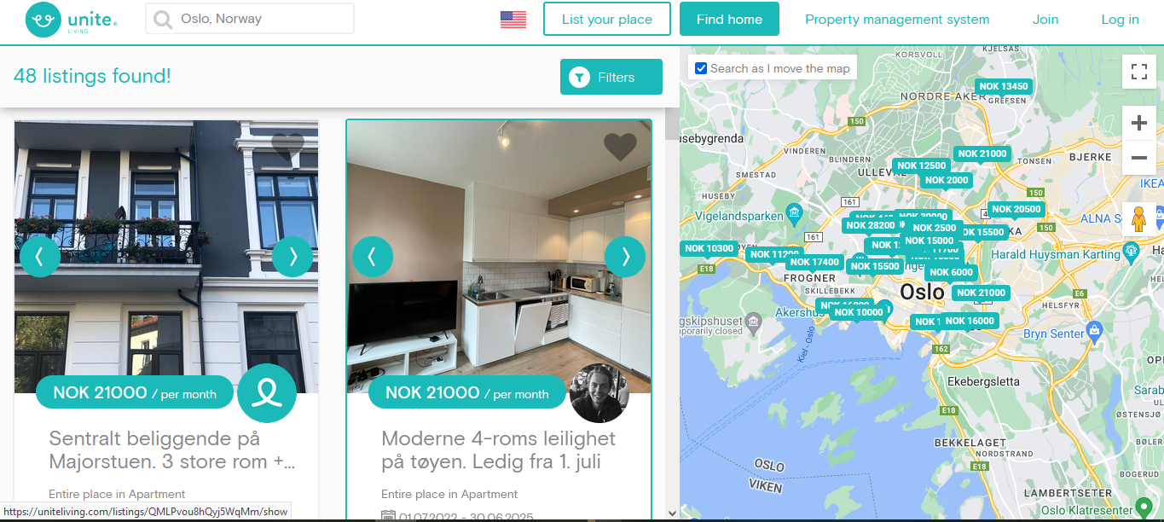
Running Project…
Unite living
Developed with:
  Front-end: React JS
  Back-end: Node.js
  Database: MongoDB
  API: GraphQL

Slide 7
What we have learn:
How a company get an order
How they distribute their work
How to deal with a problem during development
Risk analysis
Software delivery process
Software testing
Payment method of an employee

Slide 8
How to get an order???
Unite living
  A client of Norway
  Website for rent a house
Themeforest, Codecanyon, Fiverr, Upwork

Slide 9
Work Distribution
Project Manager
Team Lead
Developer
SQA Engineer
Client Review

Slide 10
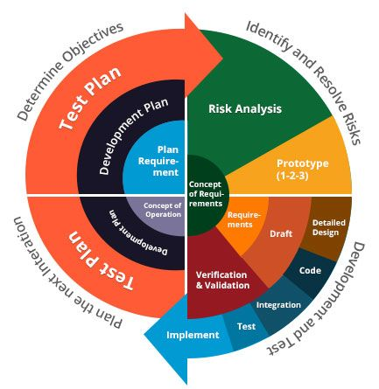
Process Model

Slide 11


Risk Analysis & Problem Handling
Discuss with team leaders
Choose the best approach

Slide 12
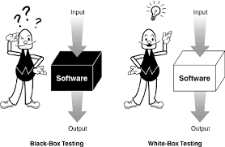
Testing Method
In Gain Solutions:
  White box testing is done by developer
  Black box testing is done by SQA Engineer
    Manual Testing
    Automated Testing: Cypress

Slide 13


Payment
Client
Gain Solutions
Developers

Slide 14
Thanks to All

