Slide 1
Student Management System
Submitted By:
Tushar Sarkar
Student ID: 18CSE035
Department of CSE, BSMRSTU
Gopalganj-8100.
Supervised By:
Md. Monowar Hossain
Assistant Professor
Department of CSE, BSMRSTU
Gopalganj-8100.

Slide 2
OUTLINE
Introduction
Objective
Project Category
Tools and Platform
Features and Result
Implementation
Future scope of the program
Conclusions

Slide 3

Introduction
Student Management System can handle all the detail about a student. The details include college details, Students personal details, Academic details etc.
The student management system is an automated version of manual Student Management System.

Slide 4
Objective
Student Management System is a management information system for education establishments to manage student data.
It provide capabilities for registering students in courses, admitting students, tracking student attendance and submitting students documents and fee payment online.
Ensure data integrity, privacy and security in an open-access environment.

Slide 5
Project Category
It is a desktop based application.
Unlike traditional applications, It is accessible anytime, anywhere, via a PC with an Internet connection.
It need lower requirements on the end user system and simplified architecture.

Slide 6



Tools and Platform
For saving the data of students we have used mysql database.
The entire application on the execute on the XAMPP server.
To access the application we can any type of pc using jdk any type of ide.

Slide 7

Features of Application
New User
Login
Student
Course
Add Course
Searching
Add Student
Student Manage
Edit
Add
Remove

Slide 8
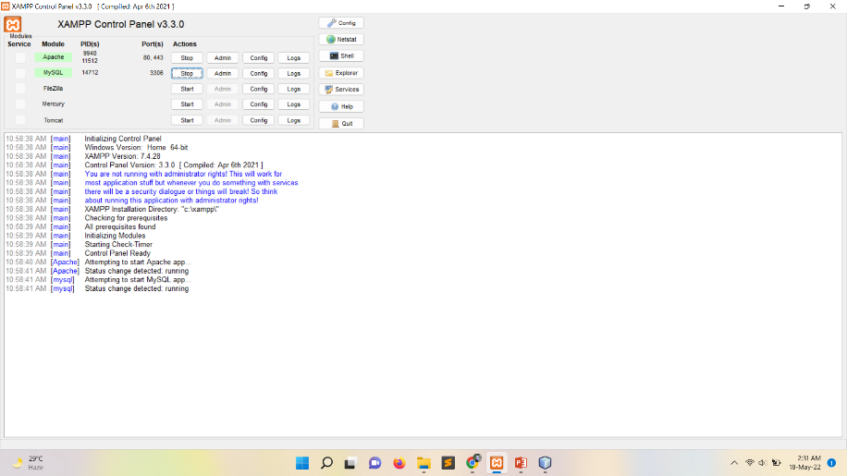
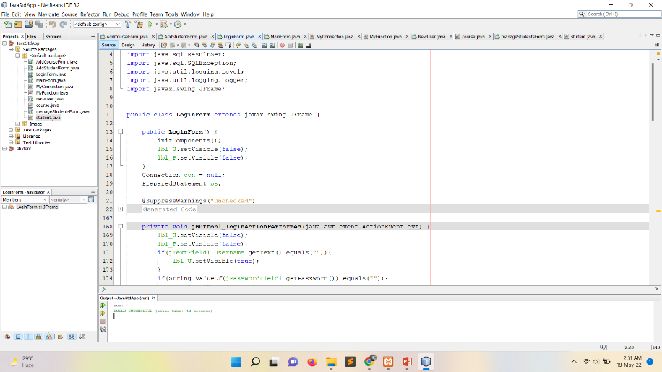
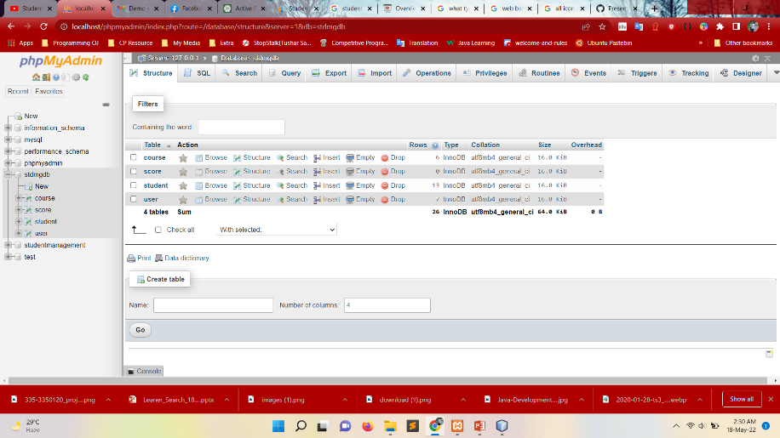
Implementation
XAMPP
Source Code
mysql

Slide 9
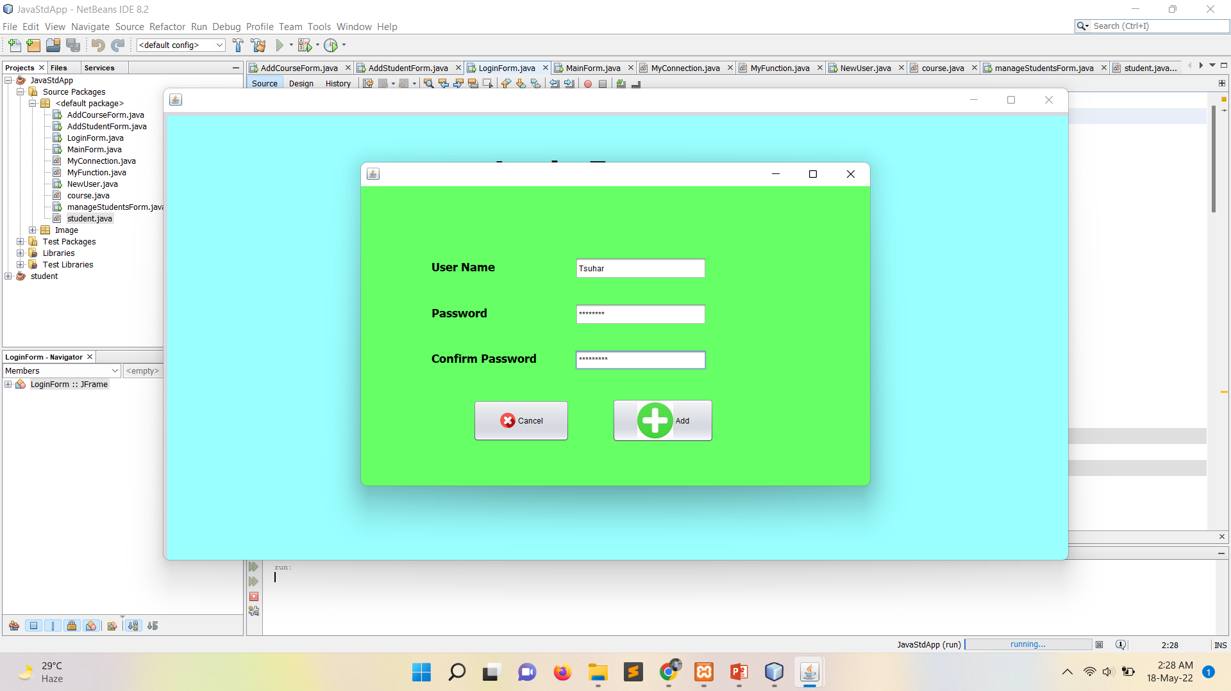
New User

Slide 10
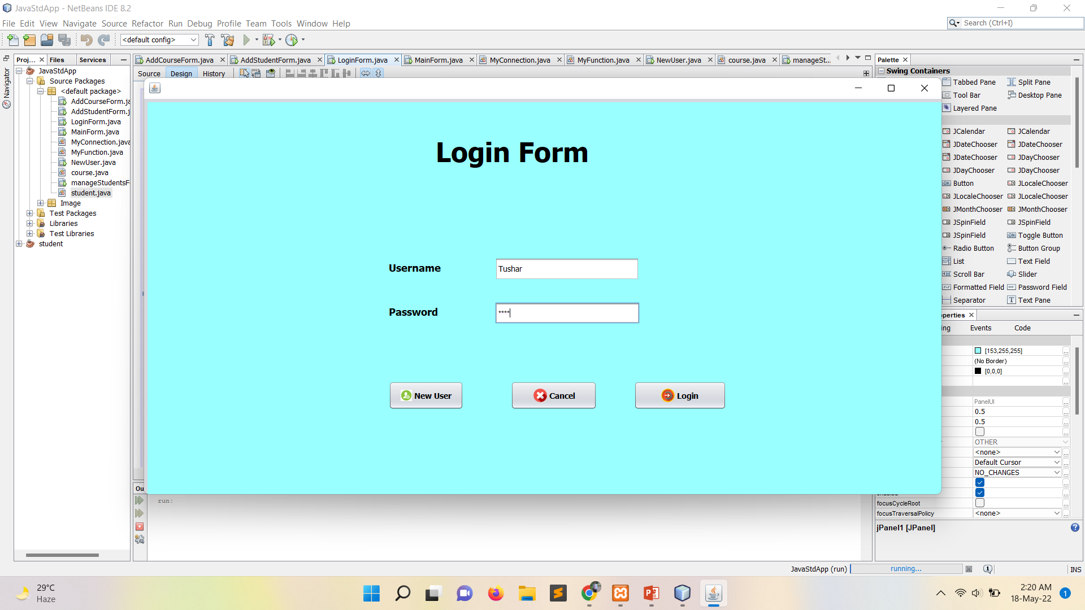
Login

Slide 11
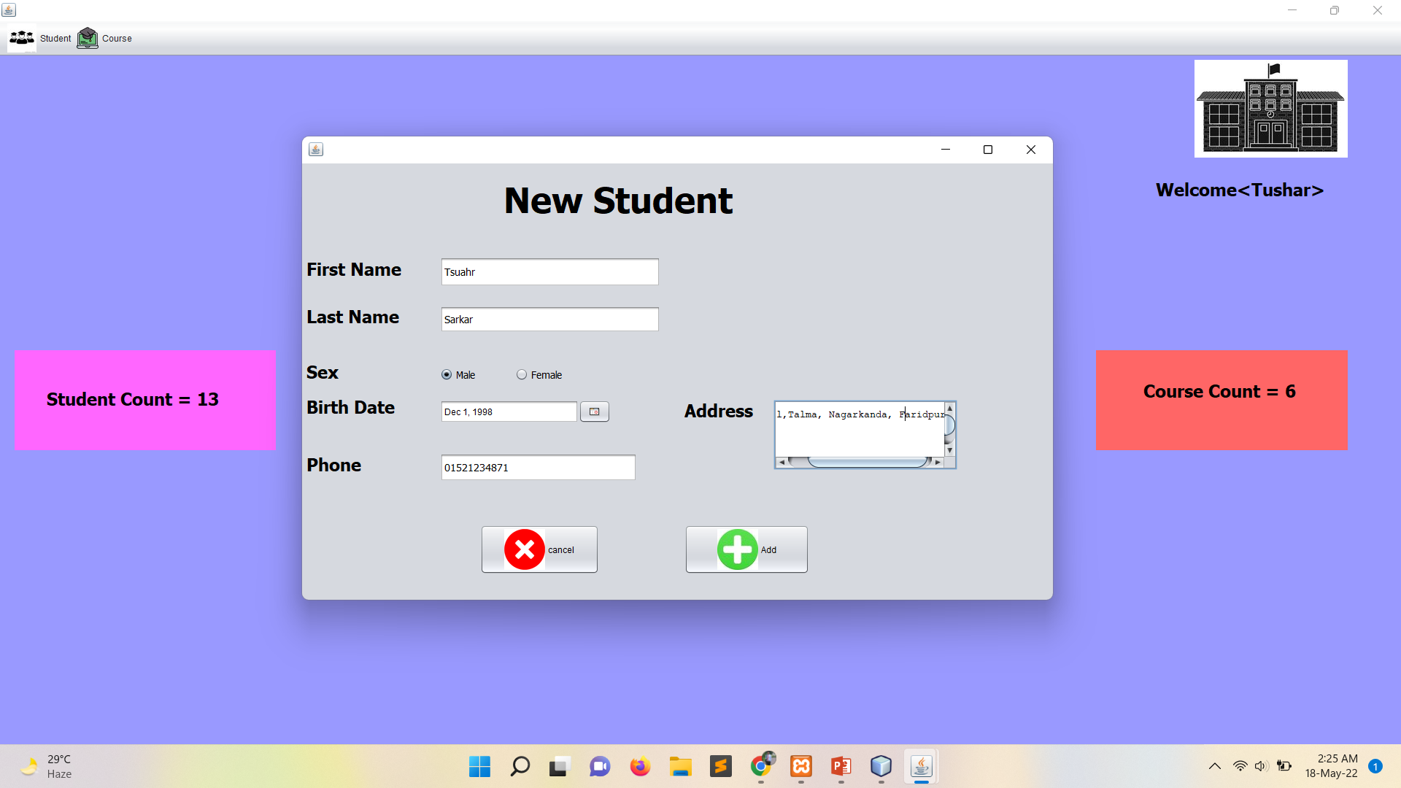
Registration Form

Slide 12
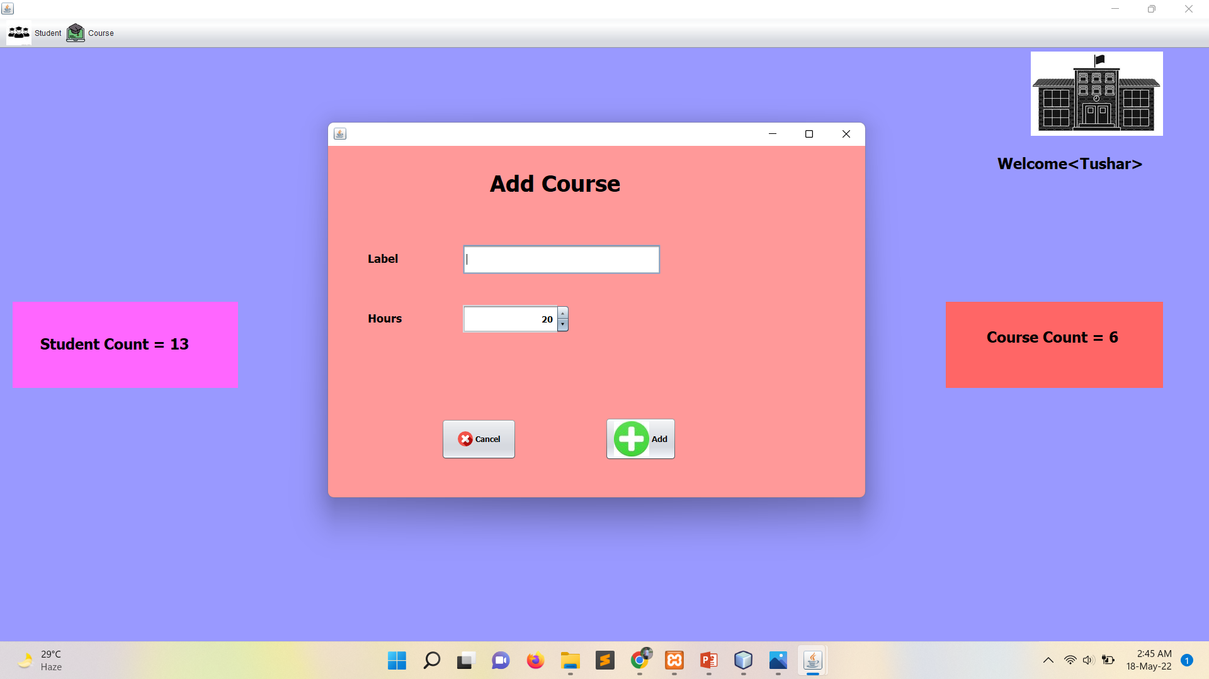
Add Course

Slide 13
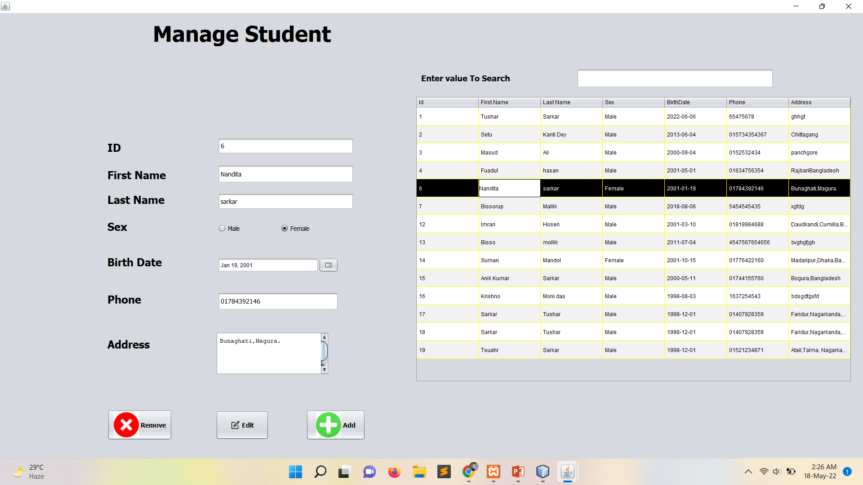
Manage Student

Slide 14
Future scope of the program
In the future student can also be able to upload or download notes.
We will see the entire system more interactive and also be able to give statistics data.
We can run the entire system in any operating system and also we have an android application of this entire system.

Slide 15
Conclusions
Best of Bread vs. Integrated Product Suite Approach will need to be taken.
Student Management Systems provide effective mechanisms for higher education institutions to manage students and faculty and their interaction with each other and external systems.

Slide 16
Thanks For Your Attention

