Slide 1

Detection of Autism Spectrum Disorder using EEG Signal
Submitted By:
Tushar Sarkar
ID: 18CSE035
Session: 2018-19
Department of CSE, BSMRSTU
Supervised By:
Md. Ferdous
Lecturer
Department of CSE, BSMRSTU

Slide 2
CONTENTS
Introduction
Literature Review
Motivation
Objectives
Methodology
Data Set
Results Comparison
Future Works
Conclusion
References
Detection of Autism Spectrum Disorder using EEG Signal

Slide 3
Introduction
Background
Introduce Autism Spectrum Disorder (ASD) as a neurodevelopmental condition characterized by repetitive behaviors and social communication challenges.
Relevance
Discuss the potential of Electroencephalography (EEG) signals in diagnosing ASD due to their ability to capture brain activity.
Scope
State that the thesis focuses on employing Higuchi Fractal Dimension (HFD) to analyze EEG signals for ASD detection.
Significance
Analyze EEG signals could offer a more accurate and easier way to detect ASD, benefiting doctors and patients alike.
Detection of Autism Spectrum Disorder using EEG Signal

Slide 4
Literature Review
[1] Detection of Autism Spectrum Disorder by feature extraction of EEG signals and machine learning classifiers
Achievements:
Successfully used a combination of advanced features like AR coefficients, Shannon entropy, and DFT estimates to improve ASD classification accuracy.
The k-NN algorithm demonstrated the highest accuracy, sensitivity, specificity, and accuracy among all the classifiers used.
Drawbacks:
No single feature was sufficient for accurate ASD classification.
The effectiveness of the classification was limited by the small sample size, which may impact the generalizability of the results.
[2] An EEG based Channel Optimized Classification Approach for Autism Spectrum Disorder
Achievements:
Accurately detects autism spectrum disorder (ASD) in most cases, even with fewer data channels, making detection efficient and user-friendly.
Using easy-to-apply techniques provides a cost-effective solution suitable for routine clinical settings.
Drawbacks:
Tested on a limited group of participants, leading to potentially less reliable results for a larger or different population.
Relies on selecting the right features from the data, which may limit applicability in different situations or with other data types.
2024
Detection of Autism Spectrum Disorder using EEG Signal

Slide 5
Motivation
Early and accurate ASD detection improves intervention and treatment.
Higuchi's fractal dimension (HFD) EEG signal analysis offers a promising diagnostic method.
Fractal analysis enhances understanding of brain activity and supports effective diagnostics.
Research aims to make ASD detection more accessible and efficient.
Innovative approaches such as HFD may lead to better support and outcomes for individuals with ASD.

Slide 6

Objective
Apply algorithms to measure fractal dimensions in EEG data.
Evaluate Higuchi’s Fractal Dimension (HFD) for its sensitivity to brain activity in ASD detection.
Compare HFD values between ASD patients and healthy subjects to identify detection thresholds.
Analyze the relationship between HFD values and ASD symptoms.
Contribute to improving ASD diagnostic tools through advanced signal processing techniques.

Slide 7
Methodology
Establish Correlation
Based on Max, Min and
Average HFD Values
Data Set
Data
Preprocessing
Calculation HFD Values
Patient Data
Model Selection
ASD Analysis
Based on
Correlation
Training and Testing
Prediction and Accuracy
Detection of Autism Spectrum Disorder using EEG Signal

Slide 8
Data set
Dataset Description:
The dataset contains raw EEG recordings collected from subjects during resting-state sessions with their eyes closed.
Each recording captures brain activity over time across multiple channels.
Source of the Dataset:
The EEG data was collected from Shaheed Shaikh Abu-Naser Specialized Hospital during a clinical study on autism spectrum disorder.
Size and Structure:
The dataset includes EEG recordings from 7 ASD subjects and 9 Control subjects, each with 8 channels.
The recordings span some minutes, sampled at a frequency of 256 Hz, resulting in more data points per channel.

Slide 9
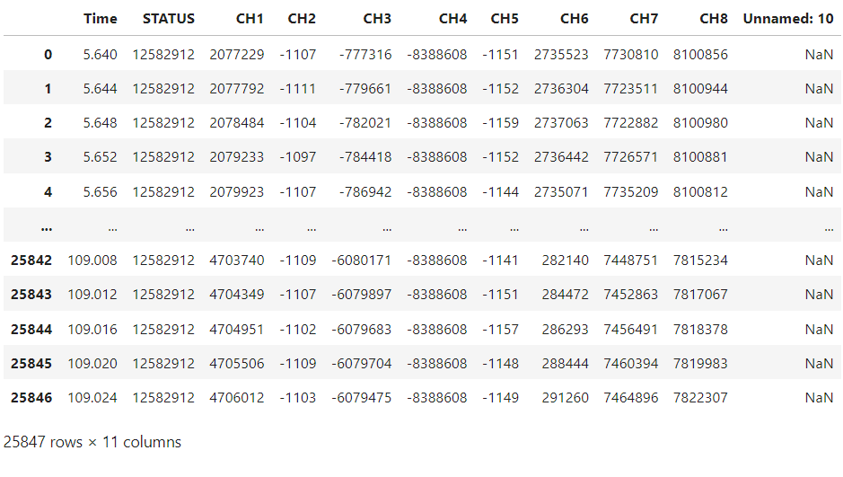
Data Set
Sample data

Slide 10
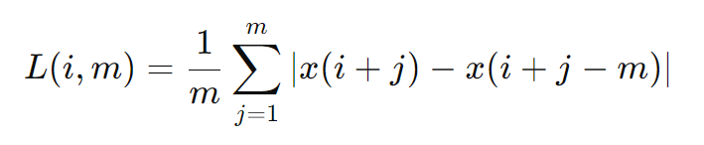
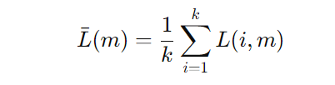
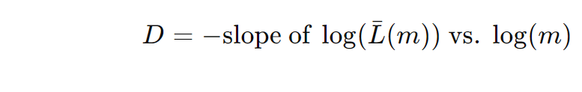
Higuchi Fractal Dimension (HFD) Algorithm
Prepare Data: Use the time series data x(t).
Segment Time Series: Divide the data into segments of length m. Compute the number of segments k for each m.
Calculate Segment Lengths: For each segment i, compute its length L(i, m) using ,
Average Segment Lengths: Compute the average length Lˉ(m) for each segment length m,
Repeat for Different Lengths: Perform the above calculations for multiple segment lengths m.
Estimate Fractal Dimension: Plot log⁡(Lˉ(m)) versus log⁡(m) and find the slope D of the line. The slope is the Higuchi Fractal Dimension D,

Slide 11
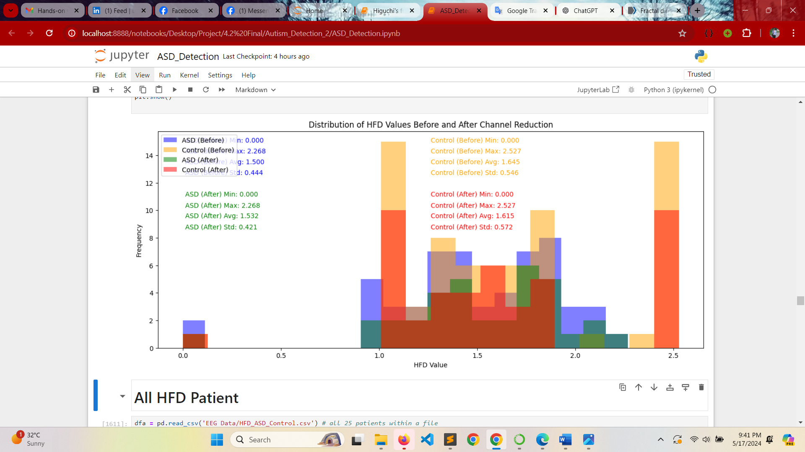
HFD MIN, MAX, AVG & STD for Kmax(2,256)
Detection of Autism Spectrum Disorder using EEG Signal

Slide 12
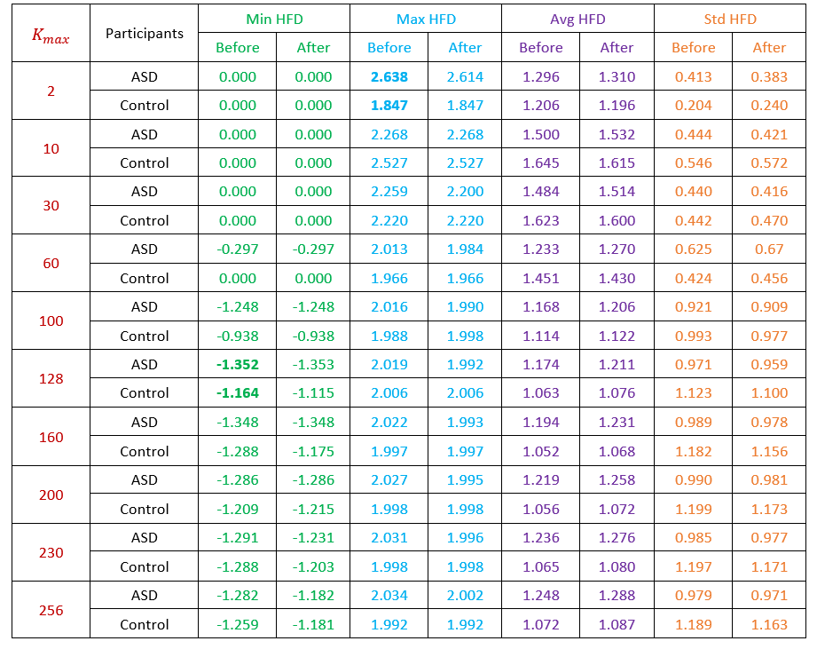
HFD MIN, MAX, AVG & STD for Kmax(2,256)

Slide 13
Results Comparison
Here, kmax=128, minimum HFD of ASD value is -1.352.
On the other hand, for the same kmax minimum HFD values in the case of Control subject is -1.164 that means MIN_ASD_HFD <= MIN_Control_HFD.
Thus, a minimum HFD lower than -1.4 may consider for ASD detection.
Here, kmax=2 maximum HFD of ASD value is 2.638.
On the other hand, for the same kmax maximum HFD values in the case of control subjects are 1.847 that means MAX_ASD_HFD >= MAX_Control_HFD.
Thus, a maximum HFD higher than 2.5 may consider as ASD.
And finally we can say that if the HFD minimum value of EEG signal of a person is less than -1.4 and if the maximum value is more than 2.5 then we can call him a patient with ASD.
Detection of Autism Spectrum Disorder using EEG Signal

Slide 14
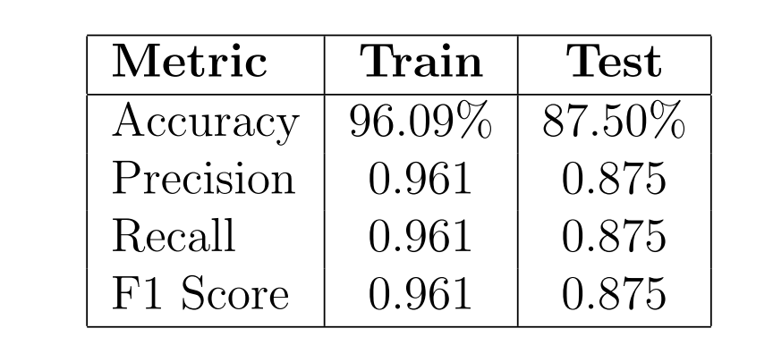
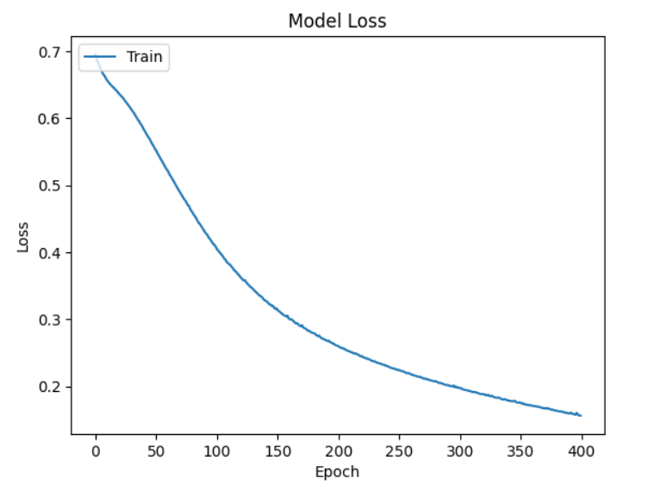
Model Select, training & Testing
Model: Long Short-Term Memory (LSTM) Neural Network

Slide 15
Future Work
Increase sample size for better validity and generalizability.
Utilize additional fractal dimensions and EEG features to improve detection accuracy.
Develop a real-time monitoring system for early ASD diagnosis.
Combine EEG data with other diagnostic tools for a comprehensive view.
Apply advanced algorithms and data processing for enhanced detection.
Compare other fractal dimensions with HFD to assess their effectiveness.

Slide 16
Conclusion
Higuchi’s Fractal Dimension (HFD) is effective in analyzing EEG data for detecting Autism Spectrum Disorder (ASD).
HFD values show clear differences in brain activity between individuals with and without ASD.
HFD successfully differentiates between ASD and non-ASD individuals.
The method provides a non-invasive and objective approach for early ASD detection.
This contributes to more accurate diagnostics and potentially better treatment options for ASD.

Slide 17
REFERENCES
[1] Mohi ud Din Q, Jayanthy AK. Detection of autism spectrum disorder by feature extraction of eeg signals and machine learning classifiers. Biomedical Engineering: Applications, Basis and Communications. 2023 Feb 10;35(01):2250046.
[2] Zhao J, Song J, Li X, Kang J. A study on EEG feature extraction and classification in autistic children based on singular spectrum analysis method. Brain and behavior. 2020 Dec;10(12):e01721.

Slide 18
THANK YOU

