Slide 1
END POINT SOFTWARE OR APPLICATION MANAGEMENT PORTAL
Project Guide : Mrs. A.R. Joshi Group No: 201
Group members:
Tushar Dahibhate B120234243
Sushant Dharmadhikari B120234259
Krish Gambhir B120234272 Sponsor:
Shruti Kothari B120234321 Persistent Systems Ltd.

Slide 2
Introduction
Endpoint Software/Application management portal will work as a platform to manage software and applications on any endpoint. It will be used to automate the process of software installation.
It will reduce the manual efforts required during installationofasoftwaresuchas-extraction,installation,post-conﬁgurations,etc. and will also be time saving. The goals and objective of this project are:
Goal:
To install softwares and applications on any endpoint.
Install multiple softwares on a single endpoint in parallel.
Install a single software on multiple endpoints in parallel.

Slide 3
Need
The conventional method of software installation comes with a lot of overheads .
It is also difficult for a person with less technical knowledge to find correctly the software of his interest and perform the subsequent steps that follow.
Hence to overcome these overheads this project automates the process of software installation and is thus faster.

Slide 4
Objective and Problem Statement
OBJECTIVE:
This project will work as Software as a Service platform(SaaS) to manage softwares and applications on any endpoint.
Develop a solution which will work as a SaaS platform to provide softwares on any endpoint accessible.

Slide 5
Scope
Endpoint Software/Application Management Portal will work as a platform to manage software and applications on any endpoint.
It will be used to automate the process of software installation. It will reduce the manual efforts required during installation of a software such as- extraction, installation, post-conﬁgurations, etc. and will also be time saving.
Using this portal we can deploy web applications by installing and packaging all the dependencies inside an isolated container. Endpoint Software/Application Management Portal,being a web based tool, availability of internet is a must.

Slide 6
Literature Study
Rest API:
Representational State Transfer Application Program Interface.
Chef:
An automation platform that configures and manages the infrastructure.
Docker:
An open-source project that automates the deployment of applications inside software containers.

Slide 7
Functional and Non-Functional Requirements
FUNCTIONAL:
To accept the software details and end point details from user.
To check if the software exists in repository
If available run the recipes at back end
If not ,get the credentials from the user and create the recipe and store it in the repository.
Installation of the software or application by running the recipes and improve the speed.
NON-FUNCTIONAL:
Parallel installation of software’s on multiple endpoints.
Parallel installation of multiple software's on a single endpoint.

Slide 8
Hardware and Software Requirements
Chef tool.
Docker tool.
Linux OS.
Chef Server
Nodes/Endpoints
Dual core processor with 2GB RAM and Internet Connection.

Slide 9
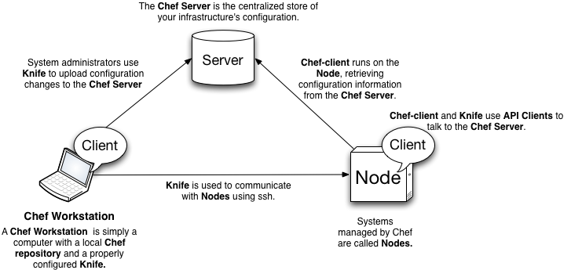
Chef Workflow

Slide 10
Docker Implementation
Docker-engine will get installed on the endpoint.
User will select the OS and the required development environment.
User will provide the path of the executable (.java, .c , .cpp) file which he/she wants to execute.
According to the environment selected, required image will be built.
The image will then be run inside a container.

Slide 11
UI Screens
Dockers(Application Deployment)
Chef(Software installation)

Slide 12
UML Diagrams
Architecture Diagram
Activity Diagram
Use case Diagram 1
Use case Diagram 2
Deployment Diagram

Slide 13
Testing
Acceptance testing
Unit testing
Chef Module
Docker Module

Slide 14
References
www.wikipedia.org
www.youtube.com
www.Learn.chef.io
Steven c. MarkeyREST in the cloud www.ibm.com
docs.docker.com
www.digitalocean.com/community/tags/docker?type=tutorials
blog.ﬂux7.com/blogs/docker/docker-tutorial-series-part-1-an-introduction

Slide 15
THANK YOU!!

Slide 16
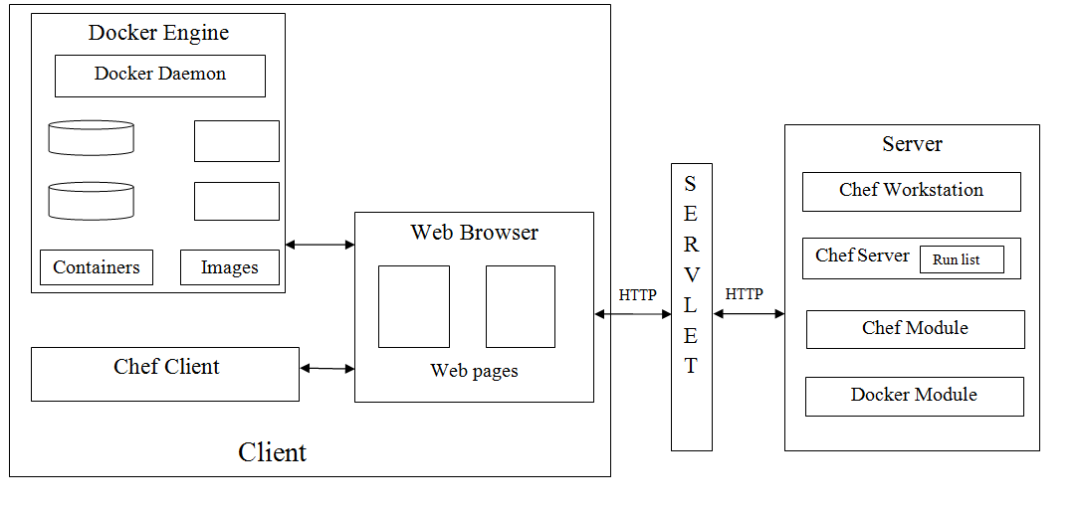
Architecture Diagram
Return→

Slide 17
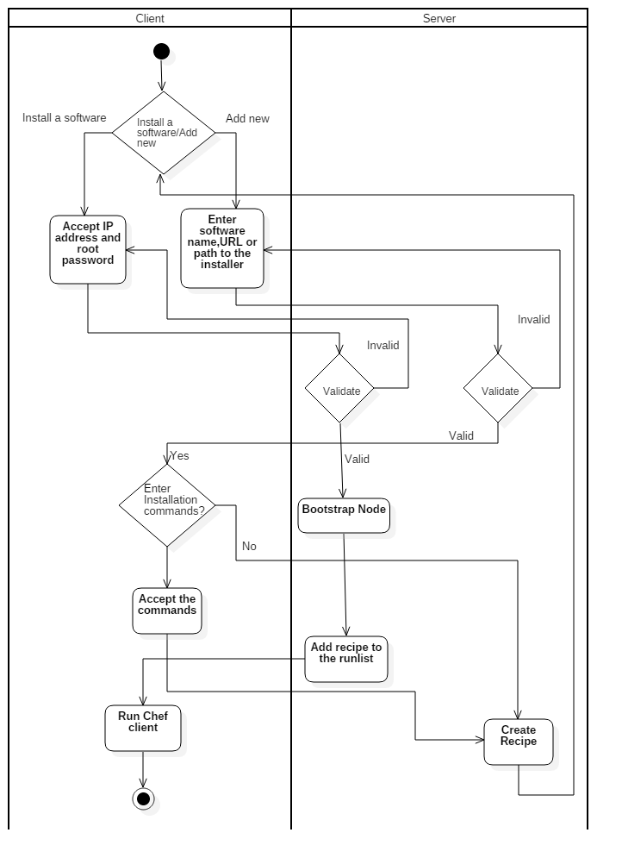
Activity Diagram
Return→

Slide 18
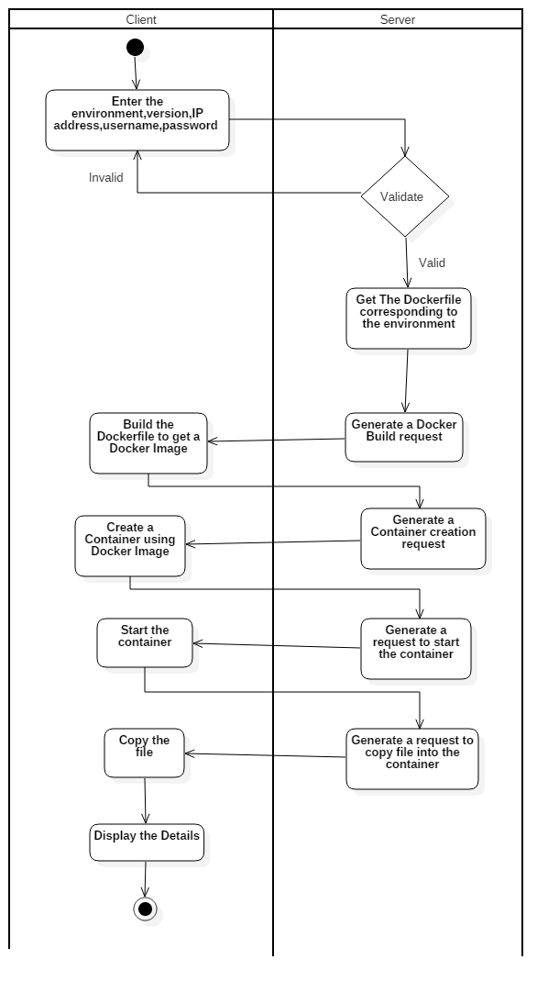
Activity Diagram
Return→

Slide 19
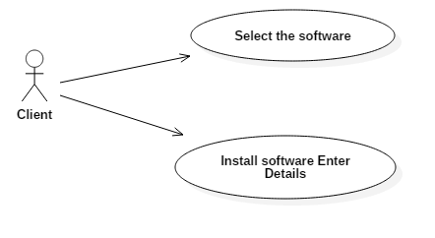
Use case Diagram Chef
Return→

Slide 20
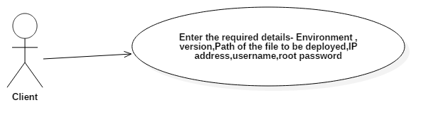
Use case Diagram Docker
Return→

Slide 21
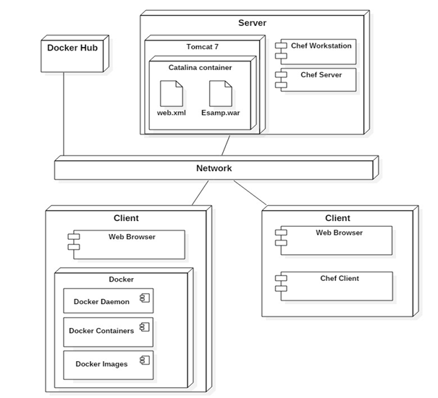
Deployment Diagram
Return→

Slide 22
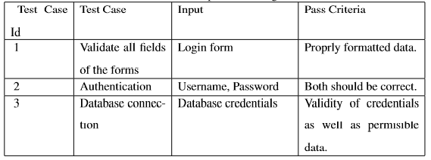
Return→

Slide 23
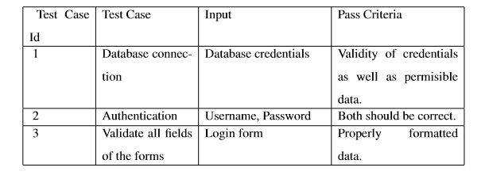
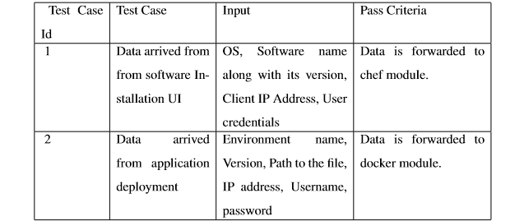
GUI Testing
Communication Module
Return→

Slide 24
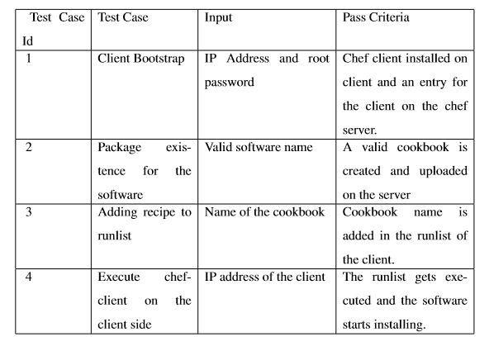
Return→

Slide 25
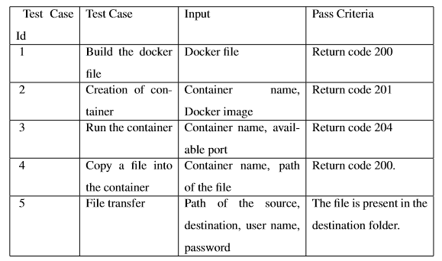
Return→

Slide 26
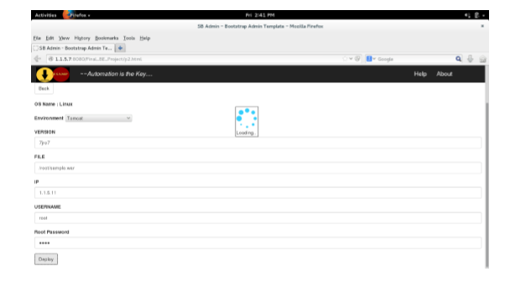
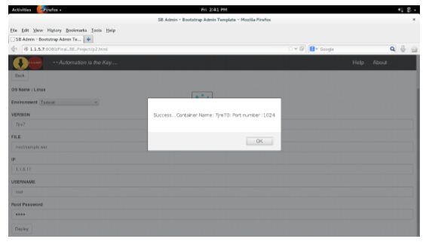
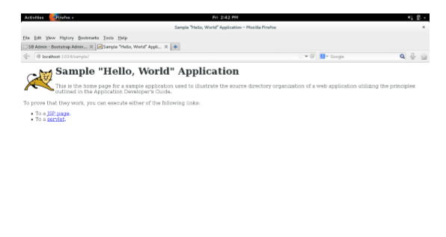
Input Form
Return→
Output page

Slide 27
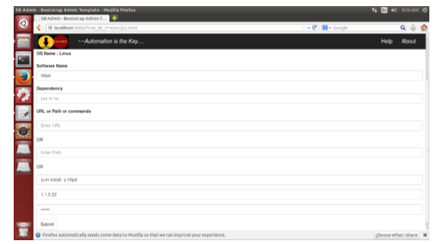
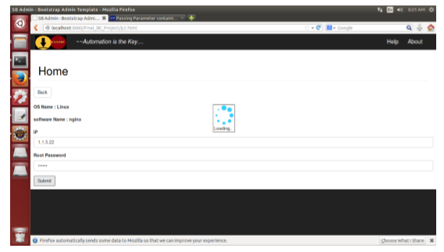
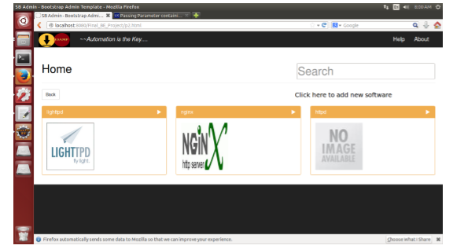
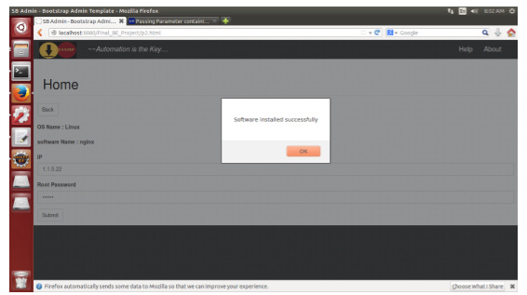
Adding new software
Client Details
Software List
Installed software
Return→

