Slide 1
Impact of COVID-19 on JSE/ALSI Market Volatility
Statistical analysis of absolute daily returns across Pre-COVID, COVID Shock and Recovery periods
Computational Finance Project
Indian Institute of Technology (Indian School of Mines), Dhanbad
Tushar Mukesh Gupta
Admission / Registration No.: 25MB0108
MBA (Business Analytics) | 2026

Slide 2
Executive Summary
What the statistical analysis shows
TOTAL OBSERVATIONS
ANALYTICAL OBSERVATIONS
ANOVA
KRUSKAL–WALLIS
501
252
F = 57.96
χ² = 23.634
02 Jan 2019–31 Dec 2020 dataset range*
Across three defined periods
p < 0.001
p = 0.0001
Absolute daily returns were substantially higher during the COVID Shock period (mean = 3.9949%) than Pre-COVID (0.9104%) and Recovery (1.0200%).
Shapiro–Wilk testing rejects normality for Pre-COVID and Recovery, while the COVID Shock sample does not reject normality (p = 0.28888).
The robust variance test and Bartlett’s test both indicate significant differences in group variances (p < 0.001).
The Kruskal–Wallis test confirms a statistically significant difference across the three periods.
Pairwise Wilcoxon tests show significant differences for Pre-COVID vs COVID Shock and COVID Shock vs Recovery, but not for Pre-COVID vs Recovery.
*The Stata date summary covers 02 Jan 2019 to 31 Dec 2020; 249 observations fall outside the three analytical period labels.
Computational Finance Project | IIT (ISM) Dhanbad
2
Notes:
Emphasize the central finding: COVID Shock is the clear statistical and descriptive outlier, while Recovery moves back toward Pre-COVID.

Slide 3
Research Objective & Hypotheses
From market disruption to statistical inference
PRIMARY OBJECTIVE
Statistical hypotheses
Assess whether volatility changed
Compare absolute daily returns across three COVID-related periods
H₀: The distributions / mean absolute daily returns are equal across the three periods.
Research questions
H₁: At least one period differs from the others.
Did the magnitude of daily market movements differ across the three periods?
Was the COVID Shock period associated with materially higher absolute returns?
Did volatility return to a level statistically comparable with Pre-COVID conditions during Recovery?
Pairwise H₀: Each specified pair has the same distribution of absolute daily returns.
For the three pairwise tests, Bonferroni-adjusted α = 0.05/3 = 0.01667.
Computational Finance Project | IIT (ISM) Dhanbad
3
Notes:
Explain that the main question is whether the magnitude of market movements differs across the three defined periods. H0 states equality; H1 states at least one difference.

Slide 4
Data & Study Design
JSE/ALSI daily market observations and analytical segmentation
DATASET
DATE RANGE
RETURN SERIES
ANALYSIS SAMPLE
501 rows
02 Jan 2019
500 valid
252
Final Stata dataset
to 31 Dec 2020
1 expected first return missing
45 + 19 + 188
Core variables
Period allocation
`date_stata` — Stata-formatted trading date
`close` — closing market level used for return calculation
`daily_return` — percentage daily return
`abs_daily_return` — absolute daily return used as the volatility proxy
`period` — Pre-COVID, COVID Shock and Recovery classification
Period | N | Share of full dataset
Pre-COVID | 45 | 8.98%
COVID Shock | 19 | 3.79%
Recovery | 188 | 37.52%
Outside defined periods | 249 | 49.70%
Analytical total | 252 | 50.30%
Computational Finance Project | IIT (ISM) Dhanbad
4
Notes:
Clarify that 501 observations are in the full dataset, but only 252 have one of the three analytical period labels.

Slide 5
Analytical Framework
Why both parametric and non-parametric inference was retained
1
Data validation
2
Return construction
3
Descriptive analysis
Dates, missing values, duplicates
Daily % return and absolute return
N, mean, SD, min, max
4
Assumption testing
5
Inference
6
Pairwise analysis
Shapiro–Wilk + variance tests
ANOVA + Kruskal–Wallis
Wilcoxon rank-sum + Bonferroni
Method choice: ANOVA is reported as the classical mean-comparison test, while Kruskal–Wallis and Wilcoxon provide assumption-robust non-parametric evidence. Welch ANOVA was not used.
Return construction: Daily return = [(Closeₜ − Closeₜ₋₁) / Closeₜ₋₁] × 100; volatility proxy = |Daily return|.
Computational Finance Project | IIT (ISM) Dhanbad
5
Notes:
Explain why both ANOVA and non-parametric methods are reported. Normality and equal variance assumptions are not uniformly satisfied. Welch ANOVA was intentionally not used.

Slide 6
Descriptive Statistics
Absolute daily return (%) by analytical period
Period | N | Mean | SD | Min | Max
Pre-COVID | 45 | 0.9104 | 1.0140 | 0.0451 | 4.5031
COVID Shock | 19 | 3.9949 | 2.9500 | 0.0180 | 9.7213
Recovery | 188 | 1.0200 | 0.8584 | 0.0038 | 3.8802
Total | 252 | 1.2247 | 1.4083 | 0.0038 | 9.7213
Key descriptive insight
COVID Shock has the highest mean absolute daily return (3.9949%) and the highest standard deviation (2.9500%).
Recovery mean (1.0200%) is close to Pre-COVID (0.9104%), while dispersion is lower in Recovery (0.8584% vs 1.0140%).
Computational Finance Project | IIT (ISM) Dhanbad
6
Notes:
Focus on the mean and standard deviation contrast: COVID Shock is much higher and more dispersed.

Slide 7
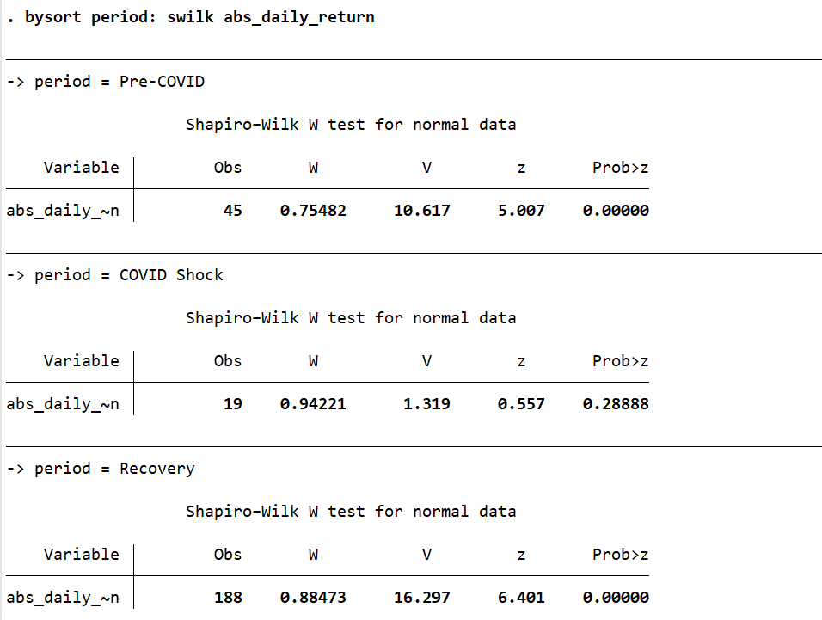
Normality Assessment
Shapiro–Wilk test and Stata Q–Q evidence
Period | N | W | p-value | Decision
Pre-COVID | 45 | 0.75482 | <0.001 | Reject H₀
COVID Shock | 19 | 0.94221 | 0.28888 | Fail to reject H₀
Recovery | 188 | 0.88473 | <0.001 | Reject H₀
Interpretation
Normality is rejected for Pre-COVID and Recovery.
COVID Shock does not show significant evidence against normality at the 5% level.
Because normality is not satisfied across all groups, non-parametric confirmation is important.
Stata output: Shapiro–Wilk W tests by period
Computational Finance Project | IIT (ISM) Dhanbad
7
Notes:
Explain Shapiro–Wilk decisions using p-values. Two groups reject normality; COVID Shock does not.

Slide 8
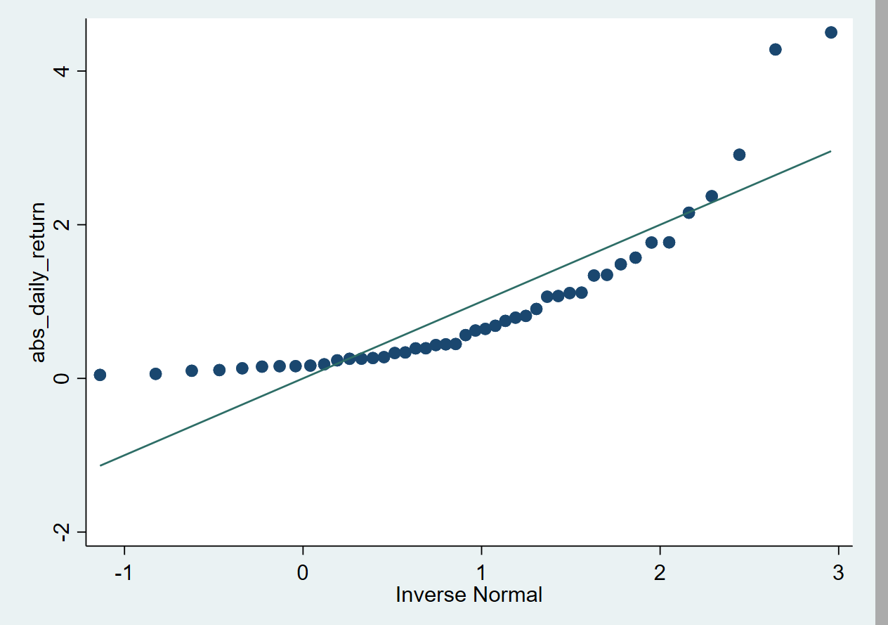
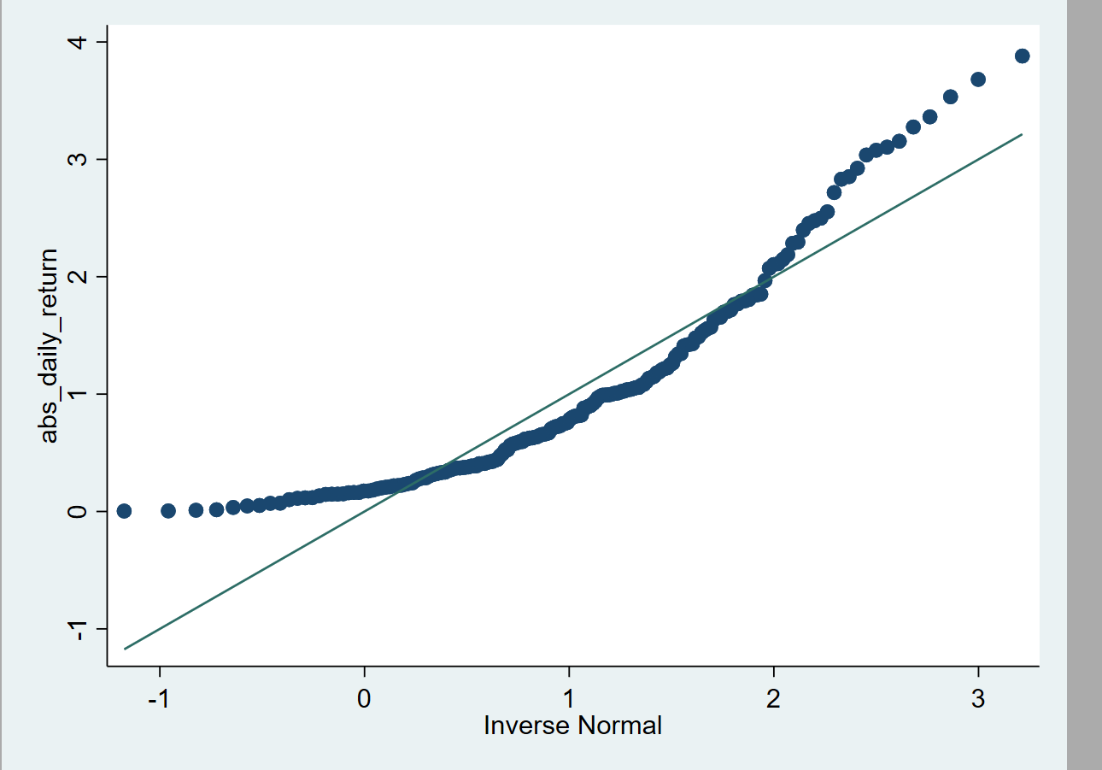
Normality: Q–Q Plots
Graphical assessment supports the formal test results
Stata Q–Q plot shown from the submitted analysis output; visible curvature and upper-tail departures are consistent with non-normality.
Stata Q–Q plot shown from the submitted analysis output; pronounced upper-tail departure is visible.
Computational Finance Project | IIT (ISM) Dhanbad
8
Notes:
Use the plots as visual evidence. Highlight departures from the reference line, especially in the tails.

Slide 9
Equality of Variances
Robust variance testing before interpreting group differences
ROBUST W50 TEST
BARTLETT TEST
DECISION
W50 = 56.7504
χ²(2) = 93.0253
Reject H₀
F(2,249), p < 0.001
p < 0.001
Variances are not equal
What the result means
Group dispersion from descriptive statistics
The equal-variance assumption is not supported across the three periods.
COVID Shock shows much greater dispersion than the other periods.
This strengthens the case for reporting non-parametric evidence alongside the classical ANOVA.
Period | Mean | SD | Variance (approx.)
Pre-COVID | 0.9104 | 1.0140 | 1.0283
COVID Shock | 3.9949 | 2.9500 | 8.7026
Recovery | 1.0200 | 0.8584 | 0.7369
Computational Finance Project | IIT (ISM) Dhanbad
9
Notes:
Explain that robust variance testing and Bartlett both reject equal variances.

Slide 10
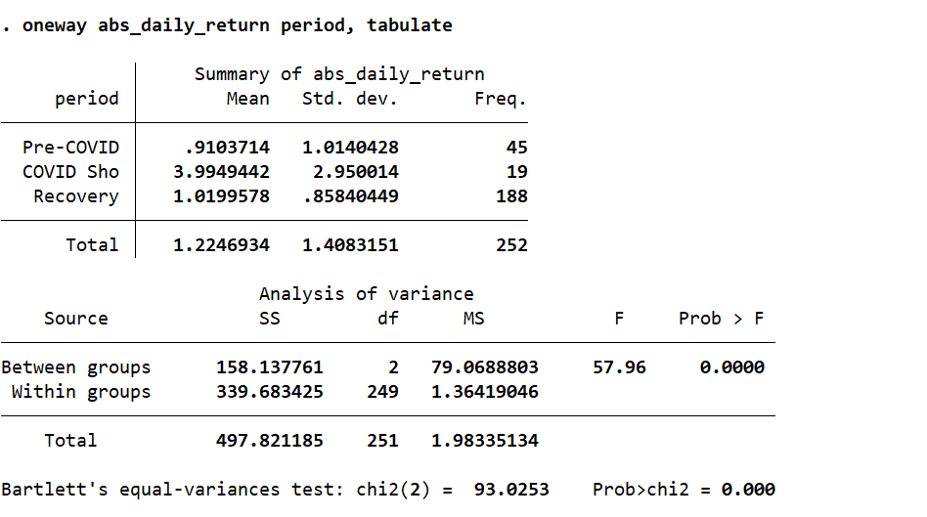
One-Way ANOVA
Classical comparison of mean absolute daily returns
ANOVA RESULT
F(2,249) = 57.96
p < 0.001
DECISION
Reject H₀
Mean absolute returns differ
Interpretation
The three group means are not all equal.
The strongest descriptive shift is the elevated COVID Shock mean.
Stata output retained as an evidence snapshot; the presentation table above is used for readability.
Computational Finance Project | IIT (ISM) Dhanbad
10
Notes:
State ANOVA result and its limitation: it detects mean differences but should not be interpreted alone because assumptions are violated.

Slide 11
Kruskal–Wallis Test
Non-parametric confirmation of differences across all three periods
TEST STATISTIC
P-VALUE
DECISION
χ²(2) = 23.634
0.0001
Reject H₀
Tie-adjusted result is identical
Statistically significant
At least one period differs
Rank-sum evidence
Why this matters
Period | N | Rank sum
Pre-COVID | 45 | 4,813.00
COVID Shock | 19 | 3,828.00
Recovery | 188 | 23,237.00
The result does not rely on normality or equal-variance assumptions.
It confirms that the distribution/rank location of absolute daily returns differs across the three periods.
This independently supports the central conclusion from ANOVA.
Computational Finance Project | IIT (ISM) Dhanbad
11
Notes:
Kruskal–Wallis provides non-parametric confirmation that the distributions/ranks differ across periods.

Slide 12
Pairwise Wilcoxon Rank-Sum Tests
Identifying which period comparisons drive the overall difference
Comparison | z | p-value | At α*=0.01667 | Decision
Pre-COVID vs COVID Shock | −4.254 | <0.001 | Significant | Reject H₀
COVID Shock vs Recovery | +4.561 | <0.001 | Significant | Reject H₀
Pre-COVID vs Recovery | −1.453 | 0.1463 | Not significant | Fail to reject H₀
Interpretation
Multiple-comparison control
COVID Shock is significantly different from both Pre-COVID and Recovery.
Pre-COVID and Recovery are statistically comparable in the pairwise rank-sum test.
This pattern is consistent with a temporary shock followed by normalization.
Three pairwise tests were conducted. The Bonferroni-adjusted threshold was set at α* = 0.01667. The two COVID Shock comparisons remain significant; Pre-COVID vs Recovery does not.
Note: Stata’s default two-sided p-values are reported for the rank-sum tests.
Computational Finance Project | IIT (ISM) Dhanbad
12
Notes:
Explain Bonferroni alpha = 0.01667 and the three pairwise decisions.

Slide 13
Integrated Findings
Putting descriptive, parametric and non-parametric evidence together
The evidence points to a pronounced, statistically significant increase in market-movement magnitude during the COVID Shock period, followed by substantial normalization during Recovery.
MAGNITUDE
ASSUMPTIONS
INFERENCE
COVID Shock mean absolute return = 3.9949%, versus 0.9104% Pre-COVID and 1.0200% Recovery.
Normality is not satisfied in two groups and variances are significantly unequal; therefore assumption-robust evidence is important.
ANOVA and Kruskal–Wallis both reject equality across periods; pairwise tests isolate the COVID Shock differences.
Overall analytical message
The COVID Shock period is the clear outlier in the analysis. Recovery is not statistically different from Pre-COVID in the pairwise Wilcoxon test, suggesting a return toward the pre-shock distribution of absolute daily returns.
Computational Finance Project | IIT (ISM) Dhanbad
13
Notes:
Bring all evidence together: temporary shock, significant COVID Shock differences, and Recovery close to Pre-COVID.

Slide 14
Conclusion
Answering the research questions
COVID Shock is associated with a markedly higher magnitude of daily market movements, reflected in the highest mean and dispersion of absolute daily returns.
The difference across periods is statistically significant under both classical ANOVA and the non-parametric Kruskal–Wallis framework.
Pairwise Wilcoxon tests confirm significant differences between COVID Shock and each of the other periods.
The Pre-COVID vs Recovery comparison is not statistically significant (p = 0.1463), indicating no evidence of a persistent difference between these two periods under the selected non-parametric test.
The results therefore support a temporary COVID-related disruption followed by substantial recovery toward pre-COVID conditions.
Final conclusion: The JSE/ALSI market exhibited a clear volatility shock during the COVID Shock period, while Recovery moved back toward the Pre-COVID level.
Computational Finance Project | IIT (ISM) Dhanbad
14
Notes:
State the final conclusion clearly and avoid causal overclaiming.

Slide 15
Limitations & Methodological Notes
Important qualifications for interpretation
The analysis uses absolute daily return as a proxy for the magnitude of market movements; it is not a direct estimate of implied or realized volatility.
The three analytical periods are defined classifications within the dataset; 249 of the 501 observations fall outside those period labels and are not used in the inferential comparison.
The COVID Shock group contains only 19 observations, so its normality assessment has limited power and should be interpreted alongside graphical and non-parametric evidence.
The unequal-variance and non-normality findings mean the ANOVA result should be interpreted together with the Kruskal–Wallis and Wilcoxon results rather than in isolation.
The analysis establishes statistical association across periods; it does not by itself identify every causal mechanism behind market movements.
Computational Finance Project | IIT (ISM) Dhanbad
15
Notes:
Acknowledge proxy, sample-size and period-definition limitations.

Slide 16
Submission & Reproducibility Files
Final Stata artifacts used for the analysis
FINAL DATA FILE
FINAL LOG FILE
JSE_ALSI_COVID_FINAL_ANALYSIS.dta
JSE_ALSI_COVID_FINAL_ANALYSIS.smcl
Final Stata dataset with analytical variables
Final closed SMCL log containing the analysis
Key variables in the final dataset
Key analyses in the final SMCL log
date_stata
daily_return
abs_daily_return
period
Descriptive statistics
Shapiro–Wilk normality
Robust variance test
ANOVA, Kruskal–Wallis and Wilcoxon tests
Computational Finance Project | IIT (ISM) Dhanbad
16
Notes:
Point to the reproducibility files submitted with the presentation.

Slide 17
Thank You
Tushar Mukesh Gupta | 25MB0108
MBA (Business Analytics) | IIT (ISM) Dhanbad

