Slide 1
Assignment 2: Image Filtering & Edge Detection
7 Output Images

Slide 2
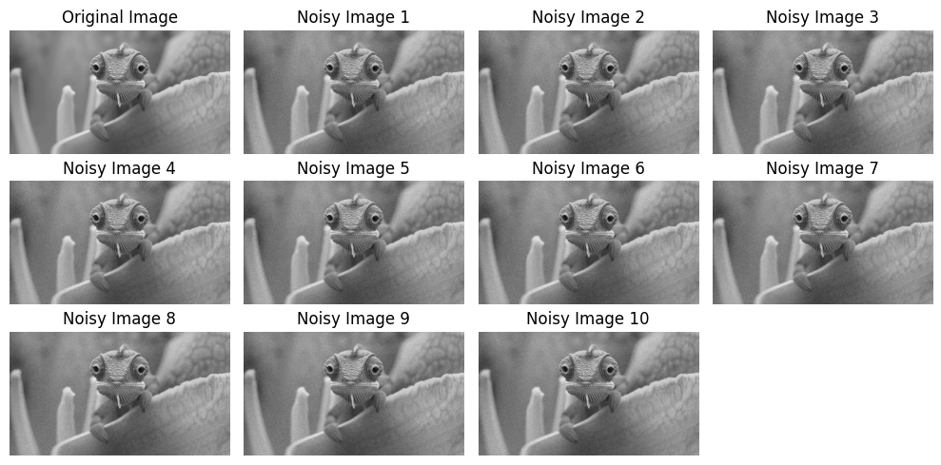

Slide 3


Slide 4
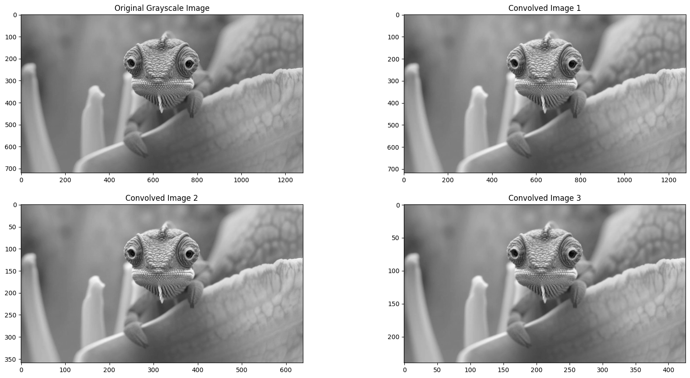

Slide 5


Slide 6
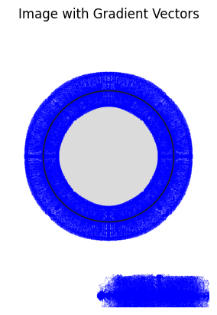

Slide 7
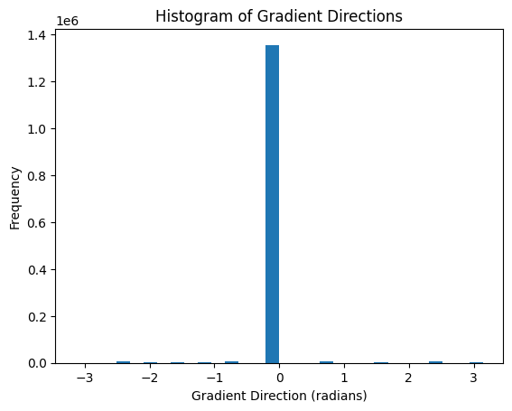

Slide 8


