Slide 1
Assignment 3: Robust Estimation & CNN Classification
5 Output Images

Slide 2
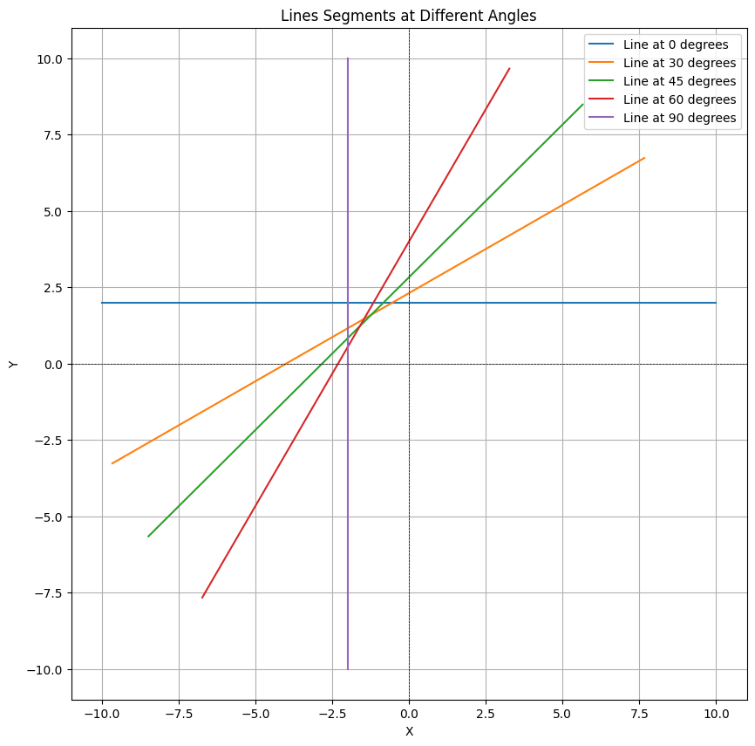

Slide 3
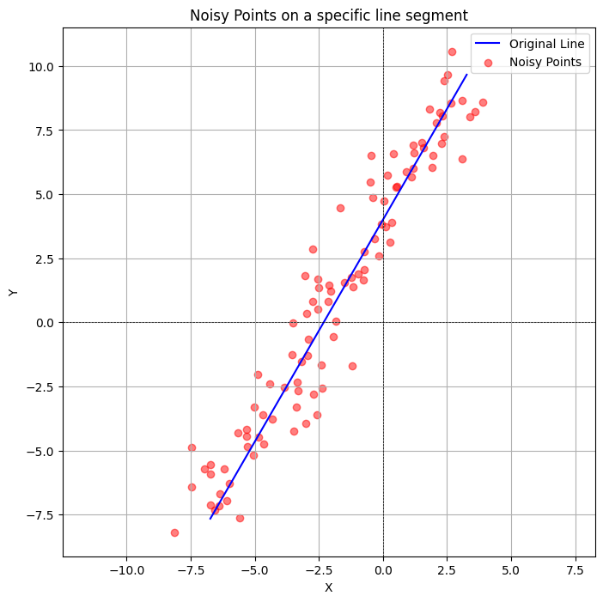

Slide 4
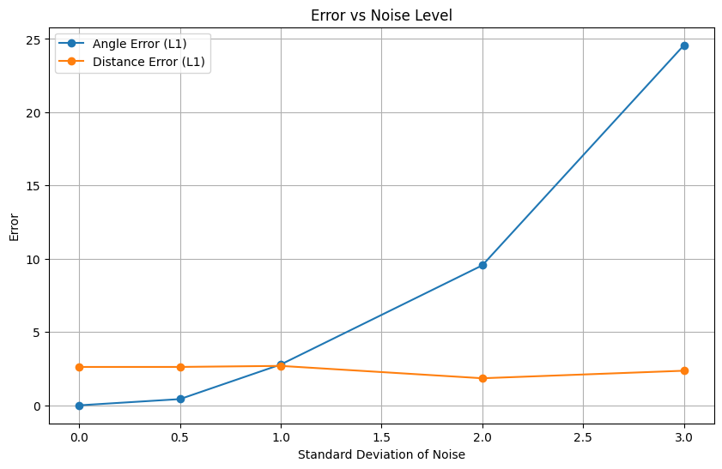

Slide 5
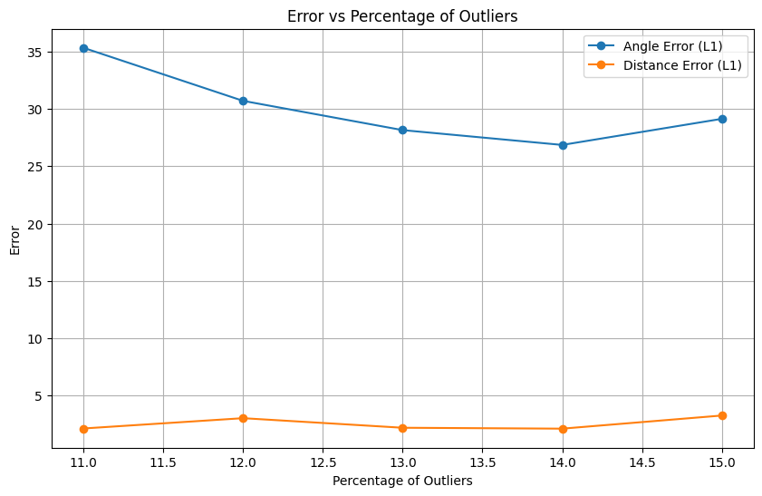

Slide 6
