Slide 1
Assignment 5: Vision Transformers
4 Output Images

Slide 2


Slide 3


Slide 4
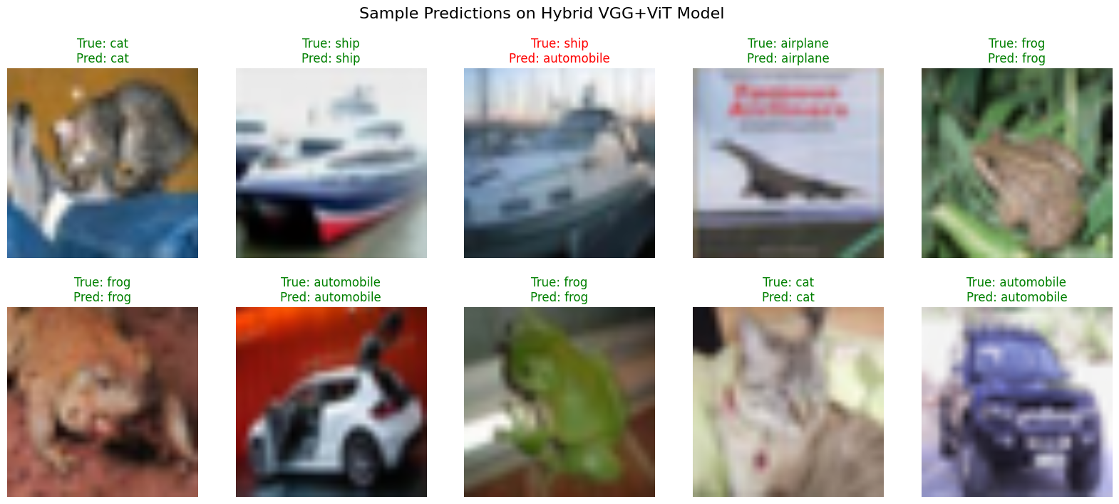

Slide 5
