Slide 1

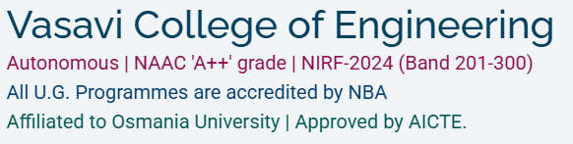


CAPSTONE PROJECT 2025- MECHANICAL ENGINEERING DEPT.
BATCH 12- KANAMALURI SAI VENKAT TUSHAR
SHYAM SUNDAR BEZAWADA &
MOHSIN ALI KHAN
An Initiative by The Government of India
LOCAL INDUSTRY COLLABORATOR
PROJECT TITLE - ERP-Integrated Manufacturing & Supply Chain Control Tower
INTRODUCTION
INDUSTRY COLLABORATOR BACKGROUND-Situated in Hyderabad , India ; Renuka Precision systems (RPS)
is a high-precision machining company serving industrial equipment, automotive, and heavy machinery sectors worldwide.
The organization operates CNC turning, milling, grinding, and inspection processes while managing inventory, procurement, supplier performance, and production planning.
Increasing operational complexity highlighted the need for an integrated decision-support platform capable of improving visibility and supporting data-driven decision-making across the manufacturing value chain.
PROBLEM STATEMENT:
- Supplier lead-time variability and sourcing risks
- Excess Inventory and Working Capital Utilization
- Procurement inefficiencies and limited spend visibility
- Production scheduling and capacity constraints
- Disconnected operational information systems
Objective: Create a centralized platform integrating inventory, procurement, supplier, and production data into a unified decision-support framework.

Slide 2
CONTROL TOWER
MODULES
INCORPORATION TO RPSs’ ENVIRONMENT
DEFINITION
DATA
COLLECTION
Collect inventory,
supplier, procurement
and production data
Material Master data and Inventory records.
Calculate EOQ,
Safety Stock and
Reorder Point.
Inventory planning for steel stock , tooling and consumables
Enables real-time monitoring of supply chain efficiency, procurement performance, inventory health, and manufacturing utilization.
INVENTORY OPTIMIZATION
EXECUTIVE DASHBOARD
SUPPLIER
ANALYTICS
Evaluate supplier
performance through
lead time, quality,
and delivery metrics.
Supplier monitoring for SKF, Sandvik , THK and Tata Steel
PROCUREMENT
ANALYTICS
Analyze spend,
procurement KPIs
and supplier risk.
Spend Analysis. Supplier Dashboard and Sourcing Visibility
PRODUCTION
PLANNING
Support production
scheduling and
capacity planning.
Manufacturing and planning across CNC Turning , Milling and Inspection
Notes:
EXECUTIVE DASHBOARD

Slide 3
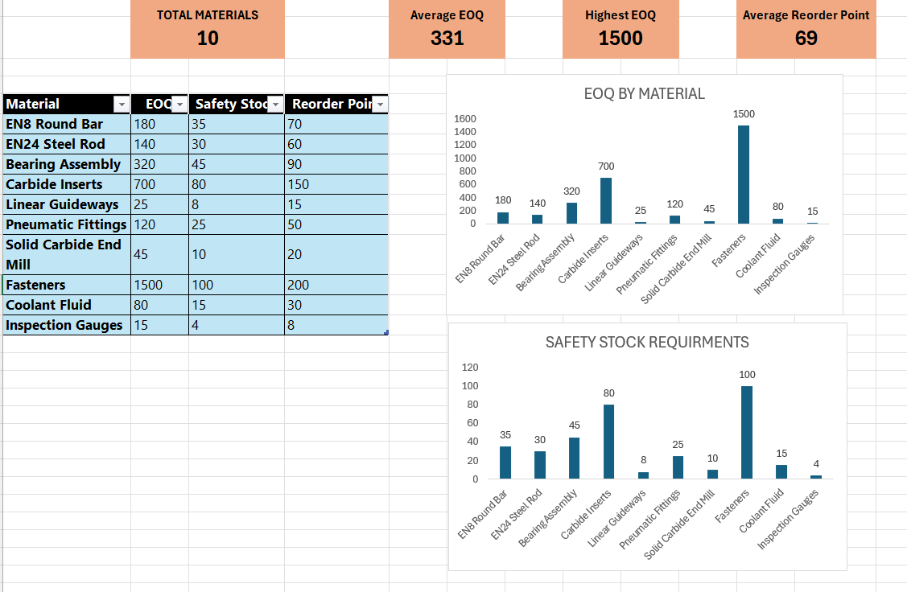
METHEDOLOGY
The framework combines inventory optimization, supplier analytics, procurement monitoring, and production planning to transform fragmented operational data into actionable insights.
Using EOQ analysis, safety stock calculations, supplier performance evaluation, and capacity planning the system supports operational and strategic decision-making.
The results are consolidated into a centralized Executive Dashboard that enables real-time monitoring of inventory health, procurement efficiency, supplier reliability, and production performance.
KPI CARDS
EOQ CHART
INVENTORY TABLE
SAFETY STOCK CHART
SAMPLE of Executive Optimization Dashboard

Slide 4
RESULTS: Reflection on Design Objectives
✓ Reduced inventory carrying-cost exposure through optimized EOQ and safety-stock policies
✓ Improved supplier-performance visibility, helping minimize production disruptions and associated revenue losses
✓ Enabled procurement-spend monitoring and sourcing optimization opportunities
✓ Improved alignment between material availability and production schedules
✓ Created a decision-support framework capable of improving profitability through better operational and supply-chain decisions
DISCUSSIONS
The project demonstrates how manufacturing organizations can use integrated operational data to support inventory, procurement, supplier, and production decisions. Rather than optimizing individual functions independently, the framework adopts a systems approach where operational improvements across the value chain contribute to improved efficiency, reduced costs, and stronger business performance.

Slide 5
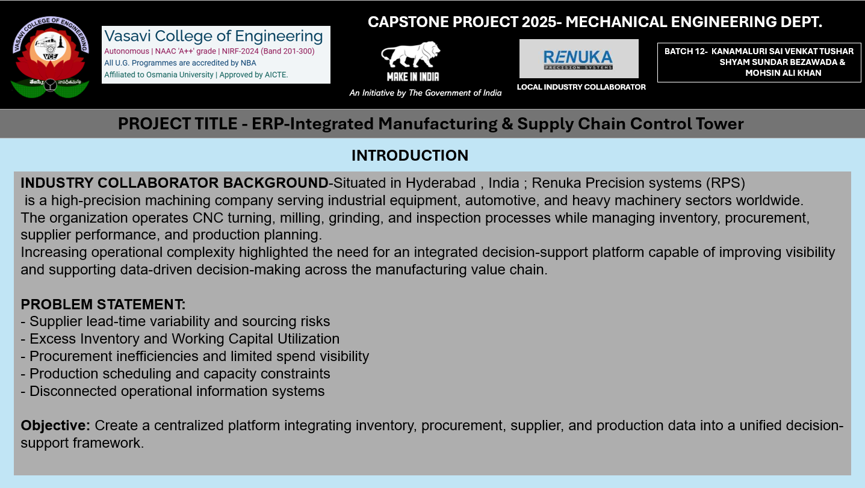
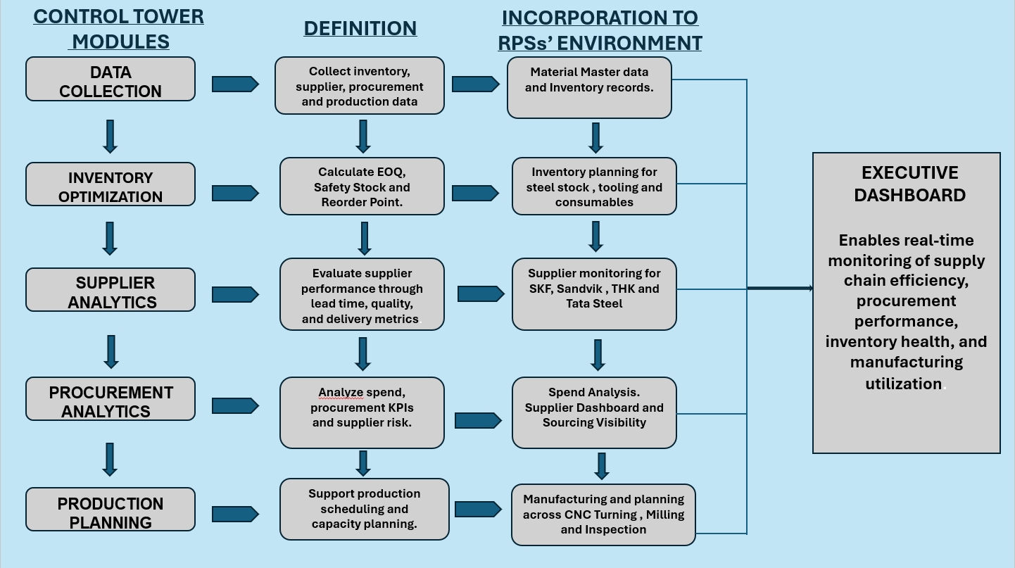
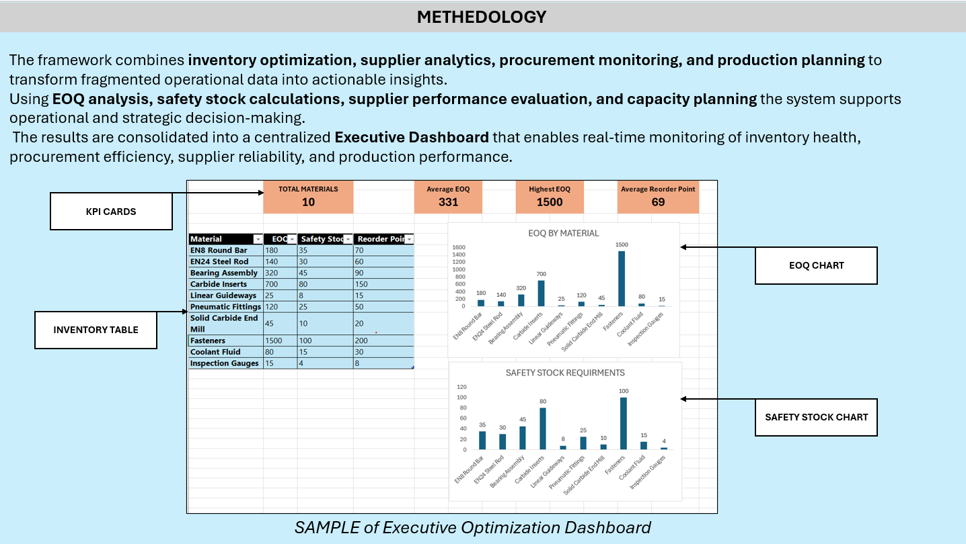
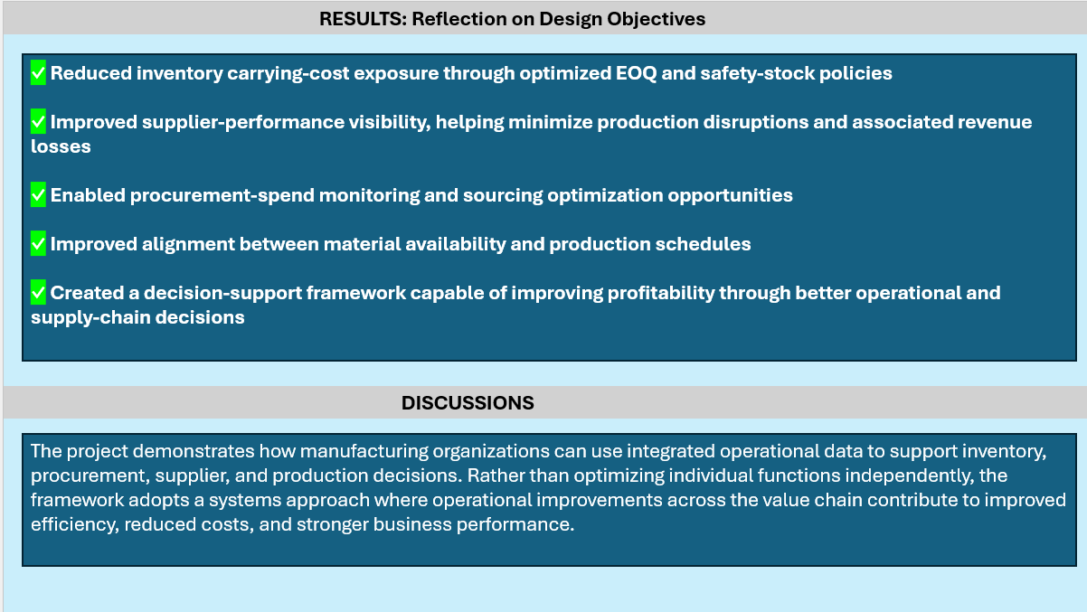
1
2
3
4

