Slide 1
Course pathway Learning Agent
IBM AICTE PROJECT
Presented By:
Student name : Tushar Kumar
College Name & Department : Sikkim Manipal University (M.C.A)

Slide 2
OUTLINE
Problem Statement
Technology used
Wow factor
End users
Result
Conclusion
Git-hub Link
Future scope
IBM Certifications

Slide 3
Problem Statement
Problem Statement 12- Students often struggle to identify the right learning path that aligns with their interest and long-term goals. The vast availability of online courses can be overwhelming and most lack personalized guidance based on individual skills or levels or preferences.
Proposed Solution: LearnMate is an Agentic AI coach built using IBM Watsonx and Agent Lab. It interacts with students, understands their- Interest area (e.g., Frontend, UI/UX, Cybersecurity, etc.), Current Skill level and Preferred Learning style. And dynamically generates a personalized course roadmap that adapts overtime, helping students reach their goal in a guided and structured way.

Slide 4
Technology used
IBM Cloud Lite Services
IBM Cloud Watsonx AI Studio
IBM Cloud Watsonx AI Runtime
IBM Cloud Agent Lab
IBM Granite Foundation Model (granite-3-3-8b-instruct)

Slide 5
IBM cloud services used
IBM Cloud Watsonx AI Studio
IBM Cloud Watsonx AI runtime
IBM Cloud Agent Lab
IBM Granite foundation model

Slide 6
Wow factors
This Agent behaves as an intelligent AI Learning coach that dynamically generates course roadmaps based on student instructions. By leveraging Granite Foundation Models, LearnMate delivers structured, weekly learning plans that are customized for Interest area, Skill level and Learning style.
LearnMate was created without writing code using IBM’s Agent Lab to engineer and test prompts with real-time LLM outputs.
Built on IBM Cloud Lite, the solutions can easily scale into web apps or chatbots for universities, coaching centers or edtech platforms.

Slide 7
End users
Students & Learners
School, College and self-taught students seeking guided learning paths in fields like Web Development, Cybersecurity, UI/UX, AI/ML, etc.
Especially useful for beginners confused about where and how to start.
Educational Institutions
Schools, colleges, coaching centers and training providers can use this as AI assistant for Personalized academic advising, Course planning assistant and Curriculum alignment.
Carrer Changers & Professionals
Working professionals exploring career transitions or upskilling will benefit from personalized roadmaps suited to their prior knowledge and goals.

Slide 8
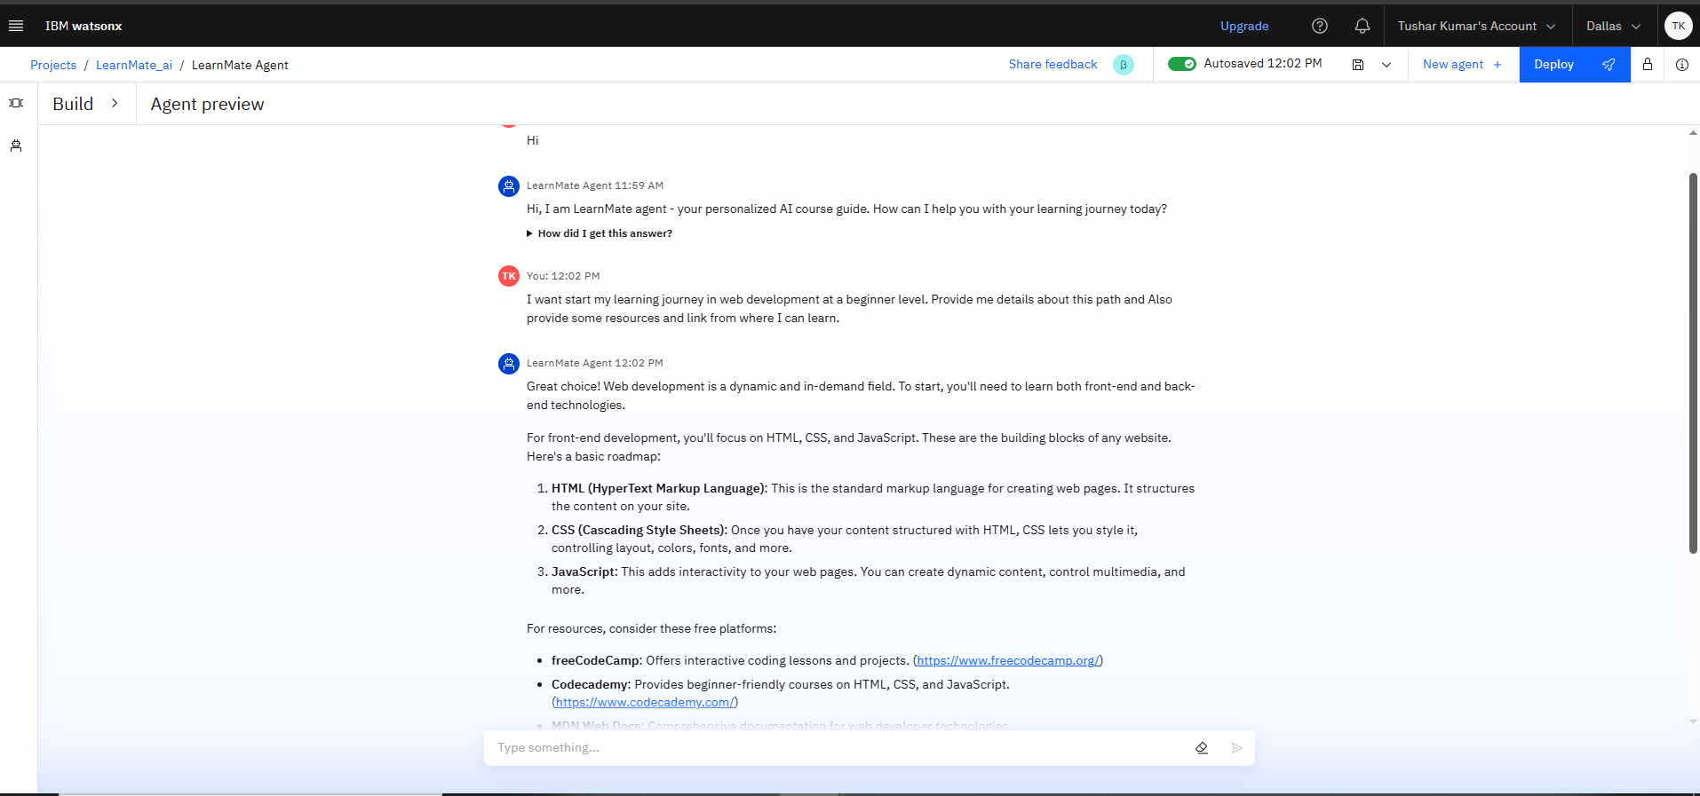
Results
Tested Output:

Slide 9
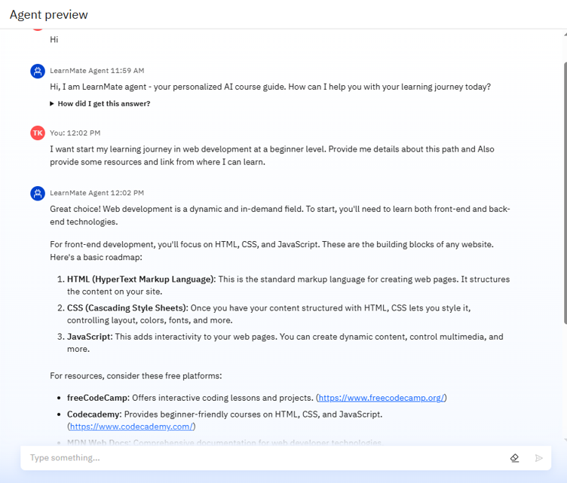
Results
Accurately identifies the user’s goal and current level (e.g., Beginner in Web Development).
Recommends Foundation Technologies like HTML, CSS, and JavaScript.
Suggest beginner-friendly online platforms.
Responds in clear, friendly and human-like manner using Granite model.

Slide 10
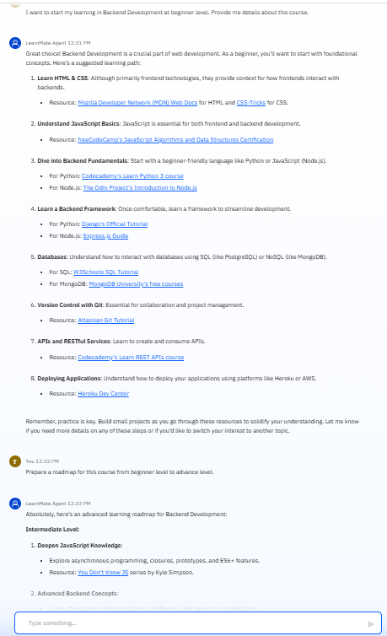
Results
Adapts to different user paths and dynamically generate tailored suggestion.
Break down complex topics into beginner-understandable modules.
Offers clear step-by-step guidance for getting started in chosen learning domain.
Includes clickable external links for direct access to curated learning resources.

Slide 11
Conclusion
This Agent generates personalized course roadmaps, adapting dynamically to student inputs and progress.
It streamlines academic planning by automating skill assessment, interest matching and curriculum design.
AI Agents like “LearnMate” enhance learning outcomes, engagement and efficiency in student-centered education.

Slide 12
GitHub Link
GitHub Repository – LearnMate AI-agent
Repository URL – https://github.com/TusharKcode/IBM-Internship-Project

Slide 13
Future scope
Multi-Language Support
Extended support for regional languages like Hindi, etc. to make learning accessible to a broader audience.
Domain Expansion
Include pathways for other domains such as Cloud Computing, Data Science, DevOps, etc., as well as with emerging technologies.
Dynamic Progress Tracking
Integrate feedback systems for tracking learner progress and re-tuning AI suggestions accordingly.
Documentation Integration
Auto recommended official documentation, tutorials and GitHub repositories alongside each week’s plan- helping learners not only know what to learn, but how to learn it with the resources.

Slide 14
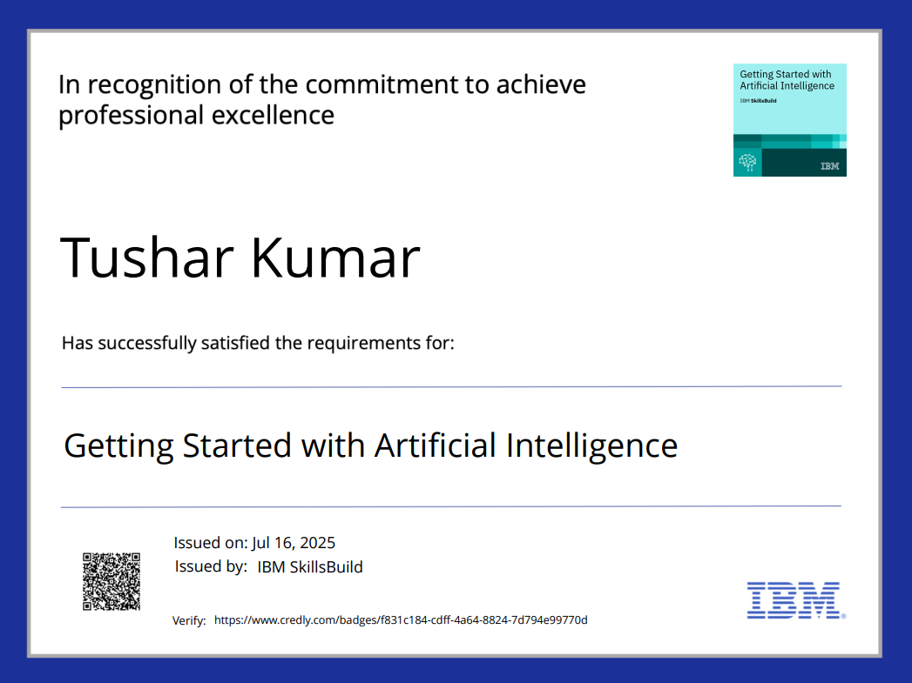
IBM Certifications

Slide 15
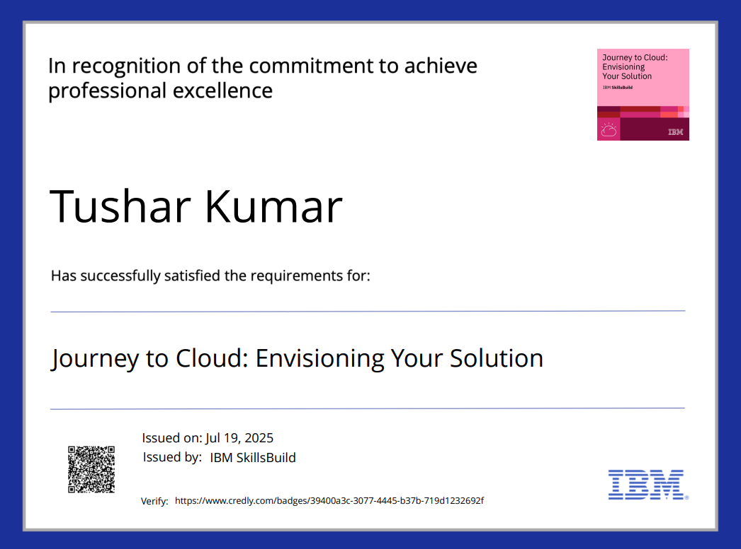
IBM Certifications

Slide 16
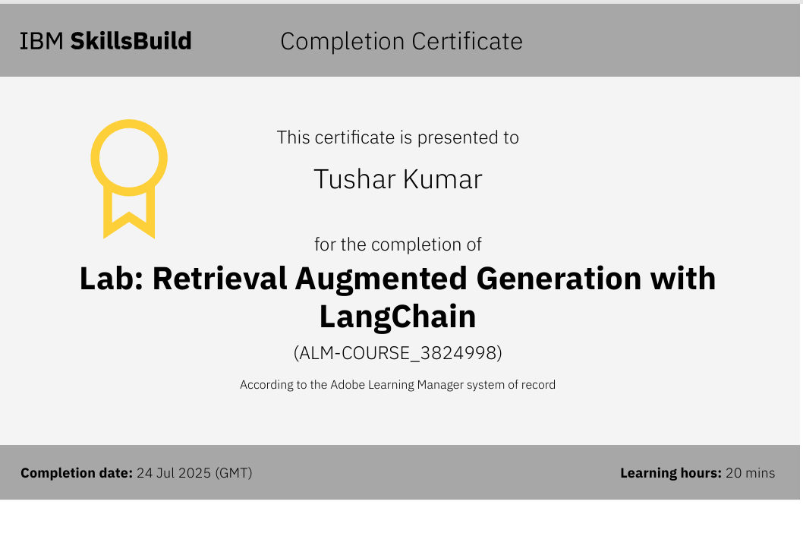
IBM Certifications

Slide 17
THANK YOU

