Slide 1

Ways of Working (WoW 2.0)
Phase - 1

Slide 2
How to access WoW
How to reset my password (coming soon)
How to view tasks/tickets assigned to me
How to update status and time spent against a task
How to update status and time spent against a ticket
How to create an unplanned task
How to create an unplanned ticket
How to request for leave (coming soon)
How to view my work calendar (coming soon)
Contents

Slide 3
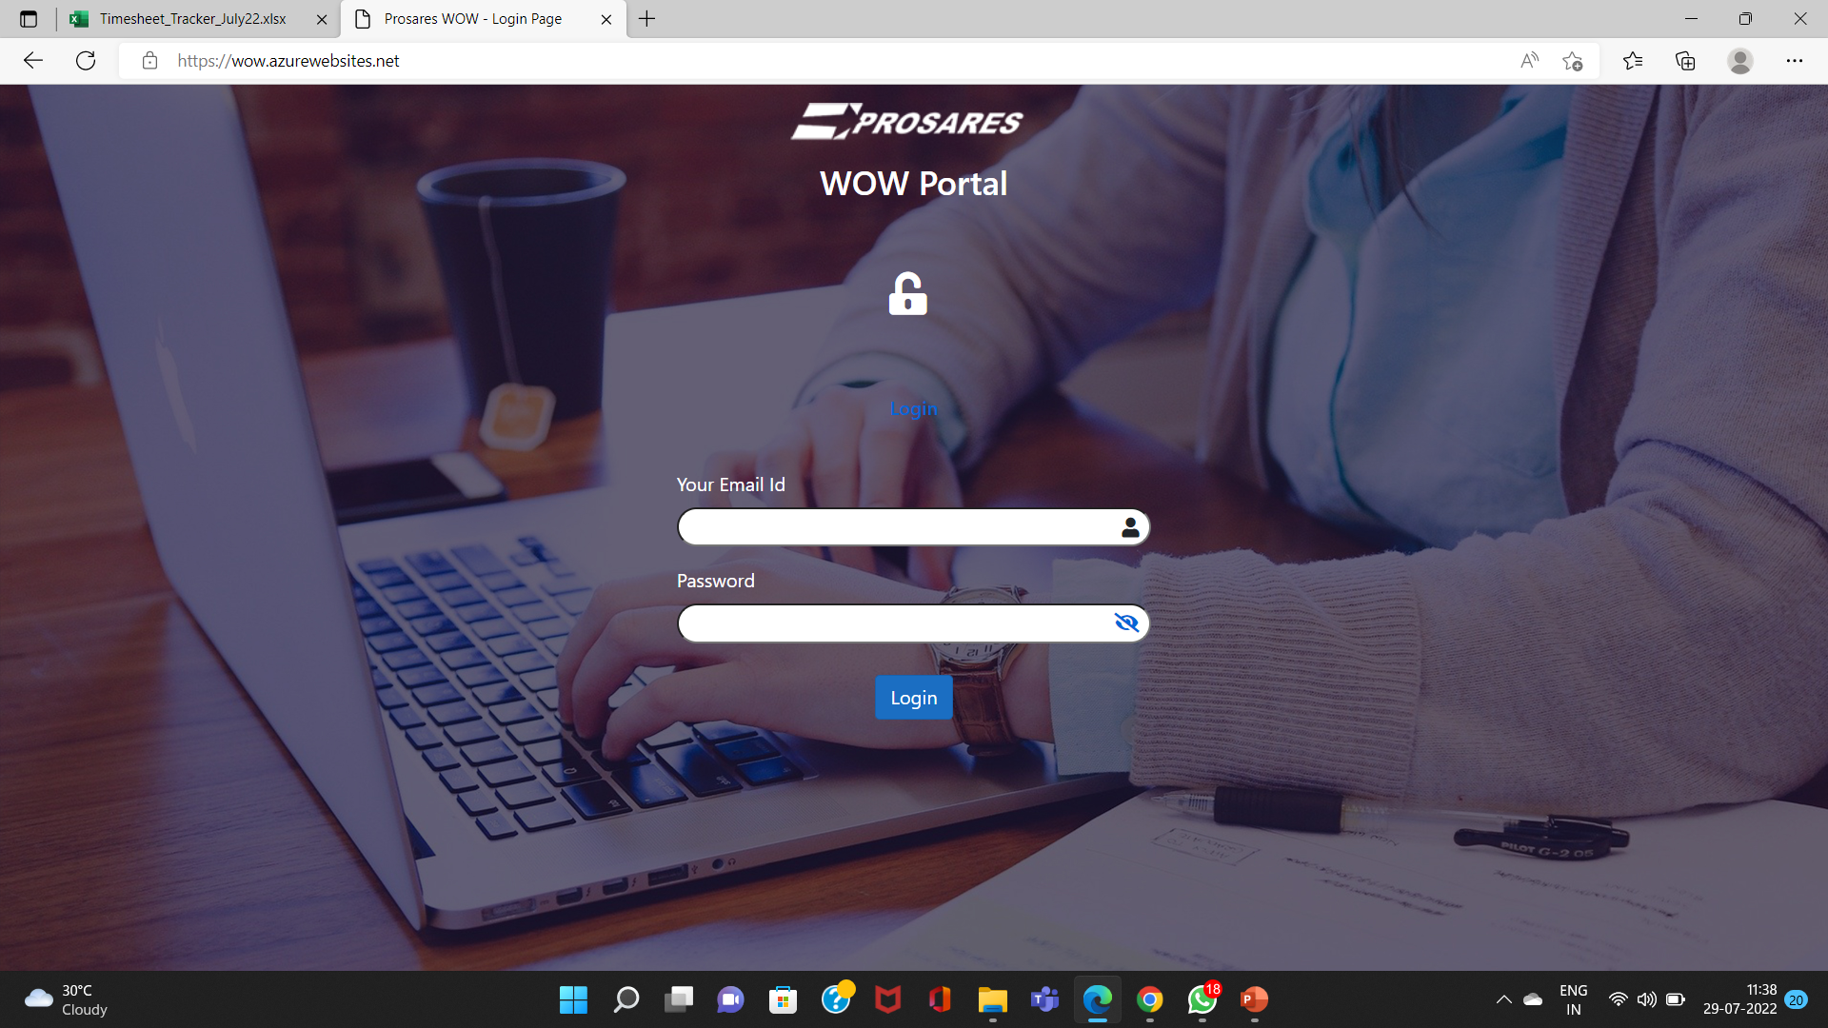
1. How to Access WoW
1.1 Access URL https://wow.azurewebsites.net/
1.2 Type the login ID assigned to you
1.3 Type the password provided to you
(Soon, you will be able to set your own password. The functionality will be released shortly.)

Slide 4
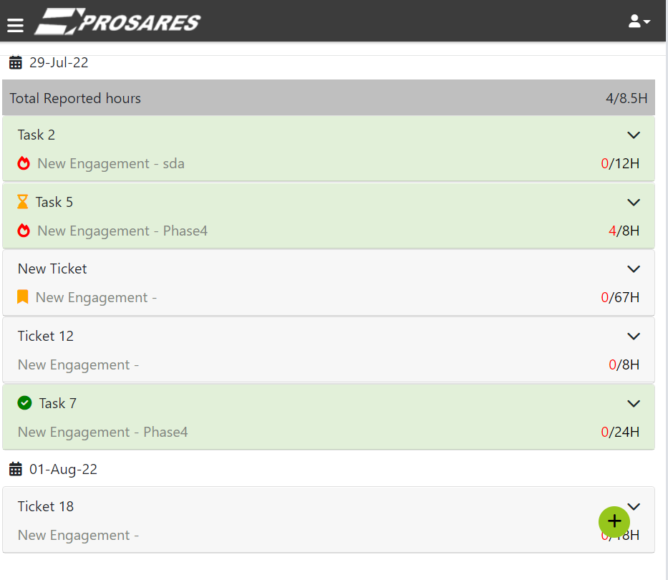
2. How to view my tasks / tickets
2.1 The landing page presents all the tasks / tickets assigned to you.
2.2 Current day (today’s) panel displays
a) Overdue - tasks/tickets for which the due date is elapsed
b) Due today – tasks/tickets to be completed today
c) In progress – tasks/tickets in progress
2.3 Subsequent panels will display tasks/tickets to be started on that respective day

Slide 5
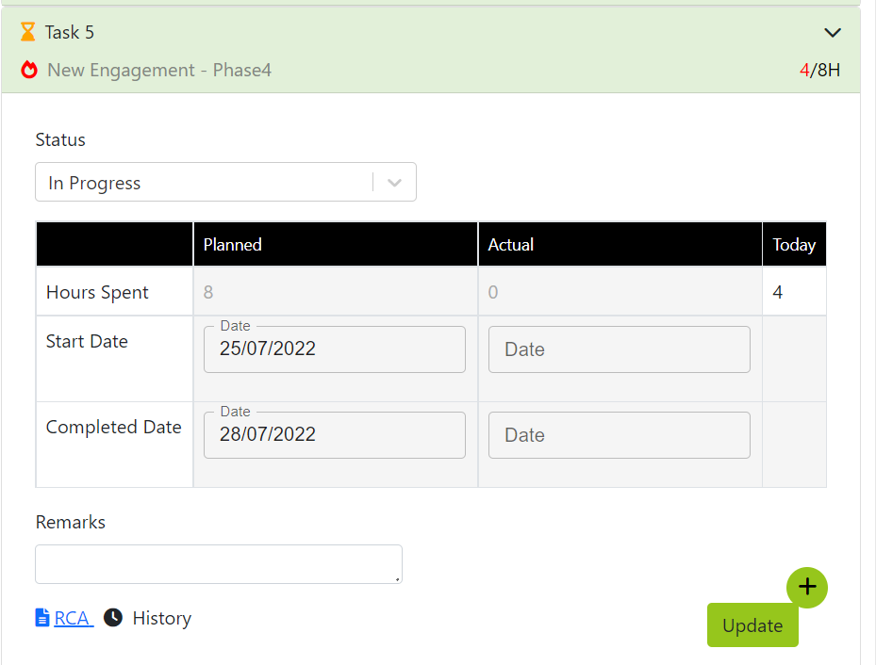
3. How to update status and time spent against a task
3.1 Click to expand the task tile you wish to update
3.2 Update status of the task (if there is a change)
3.3 Enter time spent on the task TODAY (in hours)
3.4 If needed, you may enter remarks against the task
3.5 Click on “Update” to save.
Note: You will be able to edit/update the status and time spent multiple times during the day. However, you will not be able to update previous days’ tasks.

Slide 6
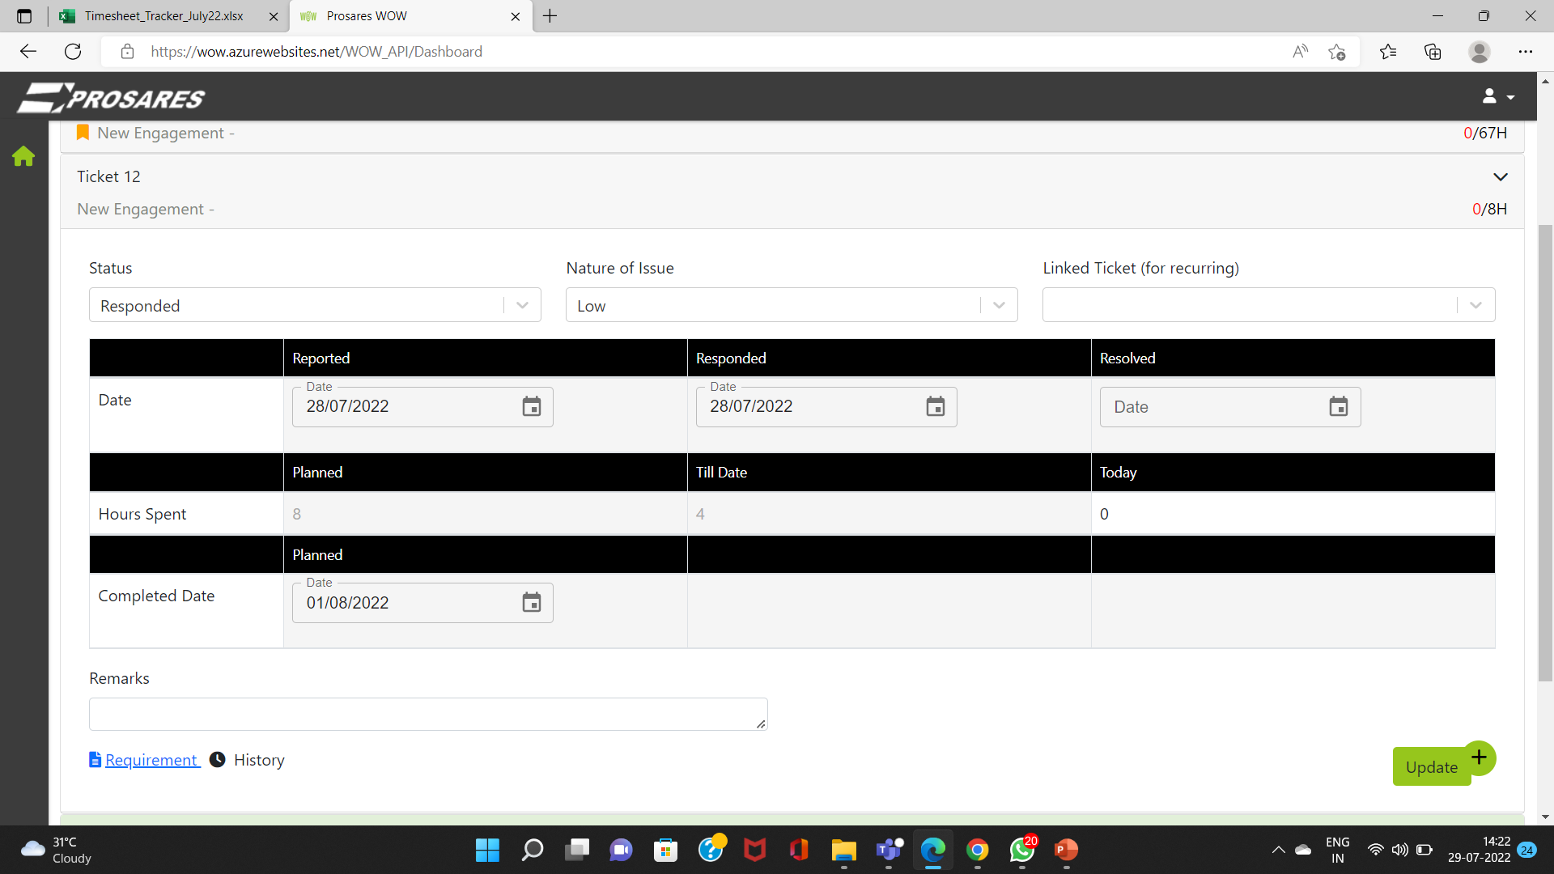
4. How to update status and time spent against a ticket
4.1 Click to expand the ticket tile you wish to update
4.2 Update status of the ticket (if there is a change)
4.3 Update nature of issue (if there is a change)
4.4 Update the time spent on the ticket TODAY
4.5 If needed, you may enter remarks against the task
4.6 Click on “Update” to save.
Note: You will be able to edit/update the status and time spent multiple times during the day. However, you will not be able to update previous days’ tasks.

Slide 7
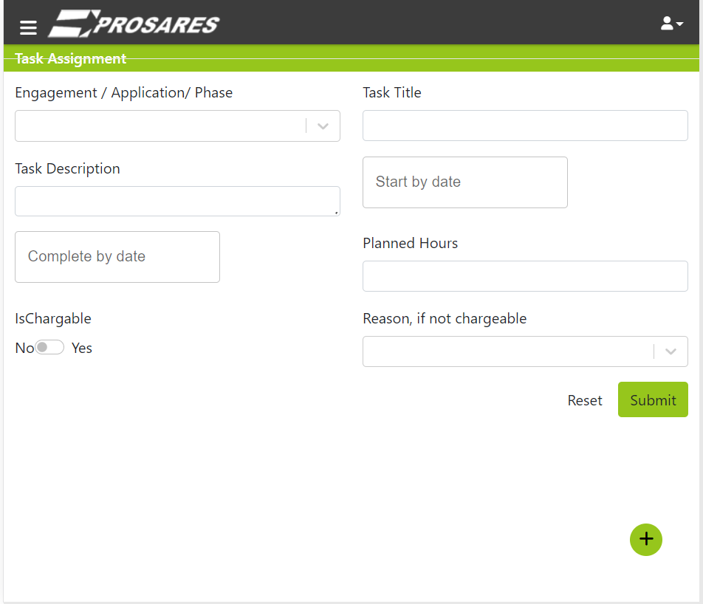
5. How to create an unplanned task
Note: Unplanned task is to created only under exceptional situations.
5.1 Select Engagement
5.1 Enter title of the task
5.2 Enter description of the task
5.3 Assign the task to self
5.4 Enter Start date and Due Date
5.5 Enter planned hours
5.6 Specify whether the task is chargeable, and select reason if it is not chargeable
5.7 Click Submit to save the task

Slide 8
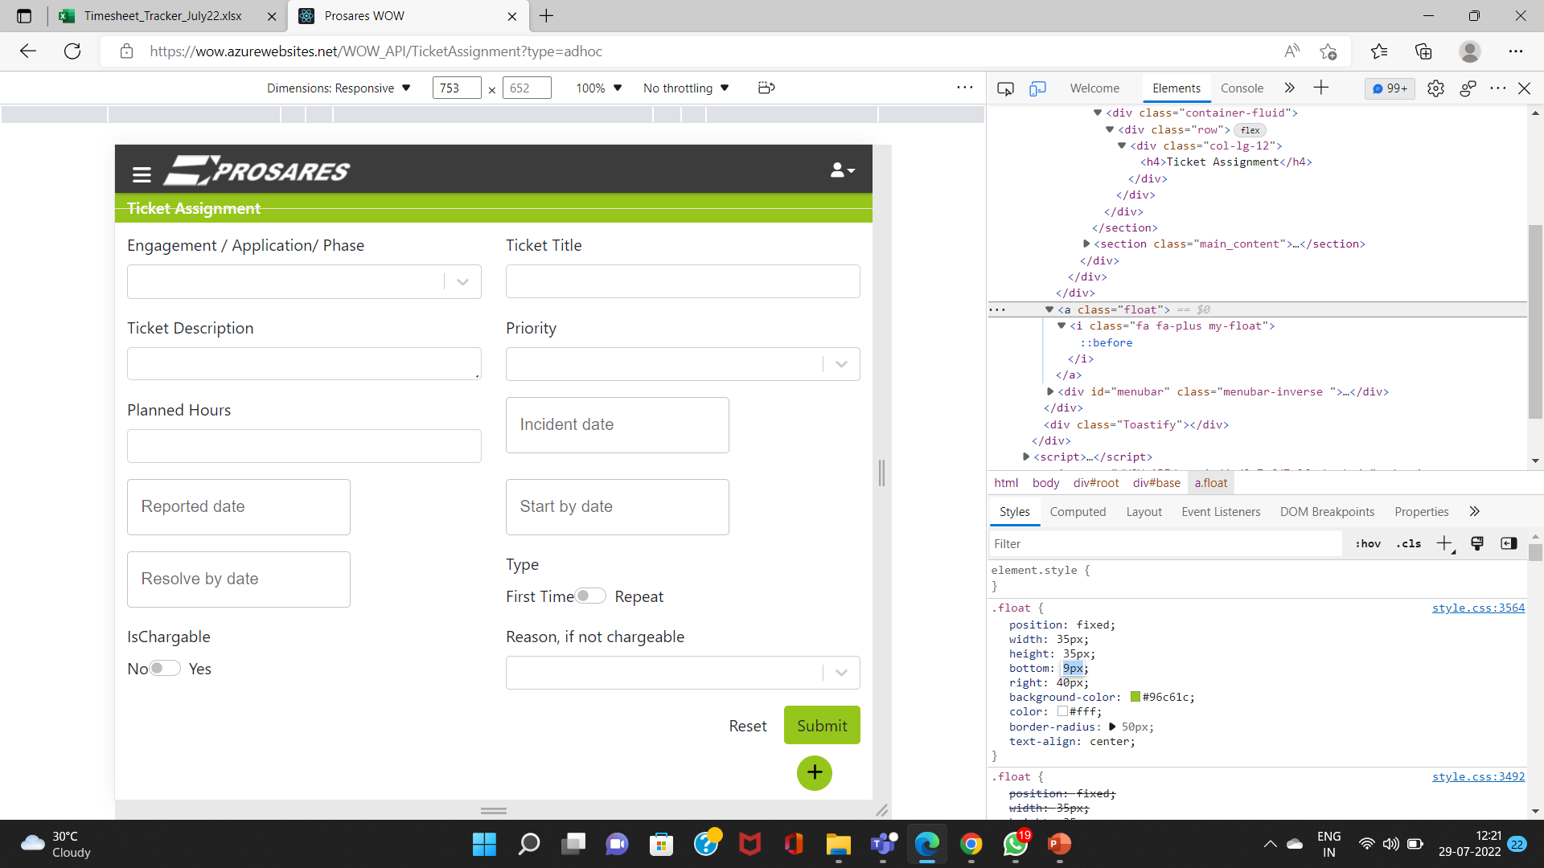
6. How to create an unplanned ticket
6.1 Enter the engagement
6.2 Enter the title of the ticket
6.3 Enter description of the task
6.4 Assign the ticket to self
6.5 Select priority and enter planned hours
6.6 Enter Incident date, Reported Date, Planned Start and Resolution Date
6.7 Specify whether the ticket is fresh or repeated
6.8 Specify whether the ticket is chargeable, and select the reason if it is not chargeable
6.9 Click Submit to save the ticket

