Slide 1

Detection of Fraudulent Job Listings
Course number: CS 5593 – Online Sections 995-999
Course name: Data Mining
Semester, year: Fall, 2024
Group Members: Group 3
Sreeja Reddy Muchantula
Sanjana Reddy Ella
Tushar Jayendra Mhatre

Slide 2

Outline
Introduction
Related Work
Proposed Work and results
a. Dataset
b. Data preprocessing
c. SMOTE
d. Methodology
e. System Architecture
f. User Manual
g. Results
4. Conclusion and Future work
5. Application Demo

Slide 3
Introduction
The rise of online job postings made it much easier for job seekers to find and apply jobs, but at the same time it is important to determine if a job is legitimate before applying to it.
Detecting Fraudulent postings manually is inefficient, so using an application with machine learning techniques automates the process.
The Fraudulent Job Posting Detection Portal is helpful for a user in finding out whether a job posted online is fraudulent or legitimate.
This application combines preprocessing techniques such as TF-IDF vectorization for text attributes, feature selection methods and employs five different classification models which are Logistic Regression, Decision Tree, Random Forest, XGBoost, Support Vector Machine (SVM) to evaluate and predict the legitimacy of the posting.

Slide 4
Related Work
Recent studies on fraudulent job detection have applied various machine learning and deep learning models.
One approach used Logistic Regression, KNN, Random Forest, and Bi-LSTM. But it only focused on textual features and did not develop an application
In another case, Naive Bayes, Multi-Layer Perceptron, KNN, and Decision Trees were used. While an application was built, it lacked proper feature engineering, and the evaluation metrics were insufficient.
All of the above cases have one or more limitations. So now our aim is to address these gaps.

Slide 5

Proposed Work
Now in this project our aim is to focus on a broad range of features, classification models, use multiple evaluation metrics to accurately predict, choose a best performing model and finally develop a web application.

Slide 6
Dataset
The “Fake Job Postings” dataset from Kaggle was used for this project.
It contains around 17,880 job postings with features like Job title, Company name, Job description, Location, Salary information, Job type and Company information.
The 1 indicates a fraudulent job post and 0 indicates a legitimate one.
The dataset is divided into training and testing subsets after preprocessing ensuring that the proportions of fraudulent and legitimate postings remain consistent in both subsets.
The URL of the dataset:
https://www.kaggle.com/code/deepeshbhatnagar/fakejobpostingprediction/input? select=fake_job_postings.csv

Slide 7
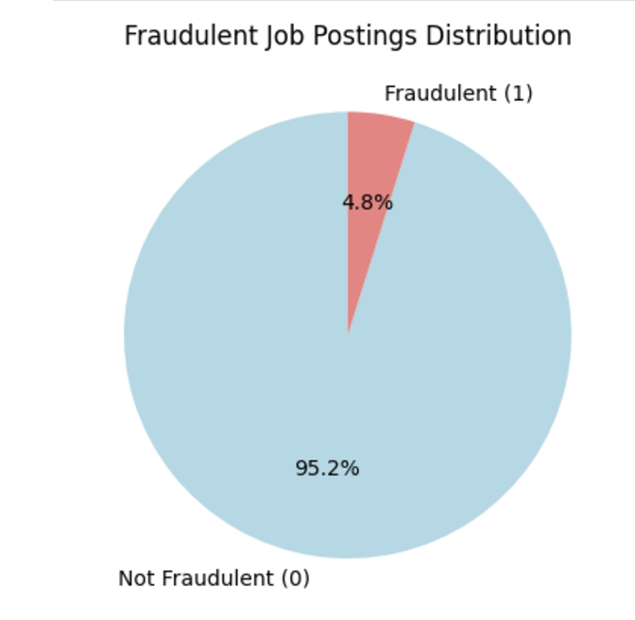
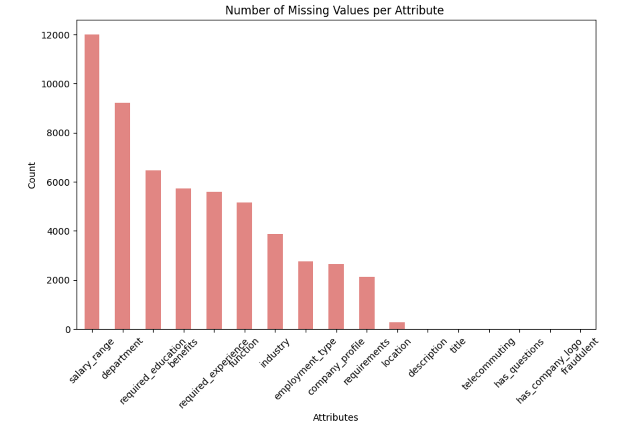
Exploratory Data Analysis
Data has a high class imbalance and also a very high number of missing values.

Slide 8
Data Preprocessing
Step 1: Dropping the “ID” column.
The job_ID column serves as a unique identifier and does not provide any meaningful insights for the machine learning algorithm.
Removing it helps in focusing on features that contribute to model learning.
Outcome: A dataset with one column dropped (17 columns)

Slide 9
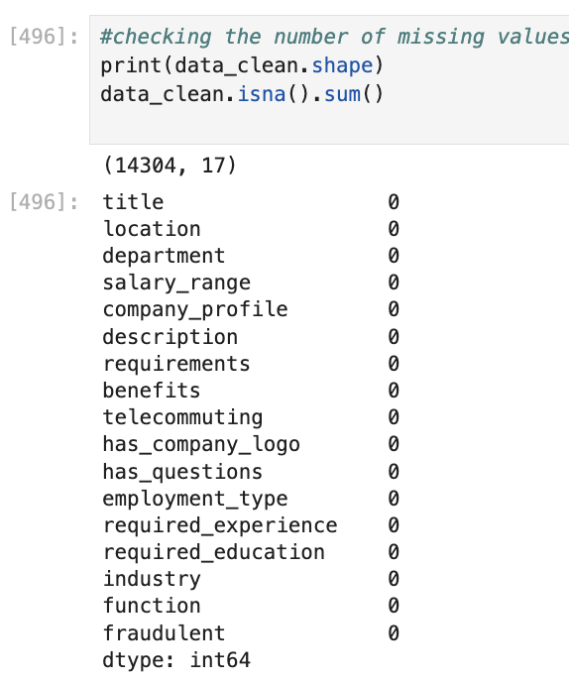
Data Preprocessing
Step 2: Imputing Missing Values
Missing values are very high in a lot of attributes.
Instead of dropping attributes with many missing values, replace missing data with keywords ‘Unknown’.
Missing values can indicate fraudulent posts and should be preserved.
Outcome: A complete dataset with no missing values.

Slide 10
Data Preprocessing
Step 3: Vectorization of Text Attributes
Many attributes are text-based, which cannot be directly used by machine learning models like logistic regression.
Solution: Use TF-IDF (Term Frequency-Inverse Document Frequency) to convert text attributes into numerical vectors.
How it Works:
Breaks text into words.
Removes common stopwords (like “the”, “and”).
Assigns importance scores to words based on frequency and rarity.
Outcome: Text data is now ready for model training.

Slide 11
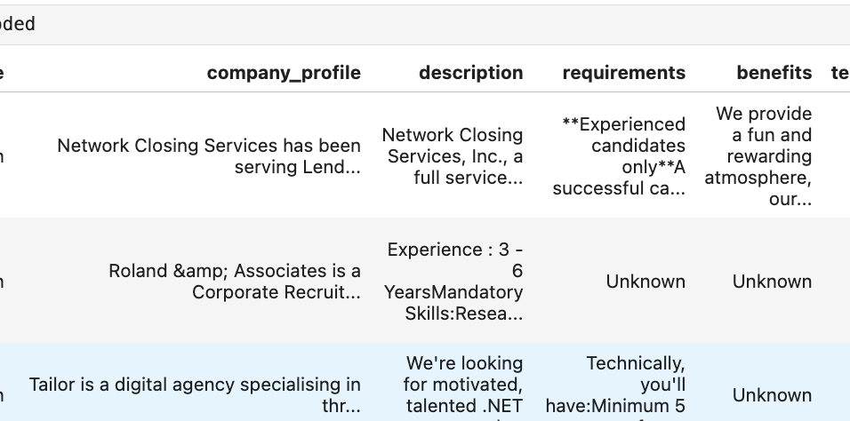
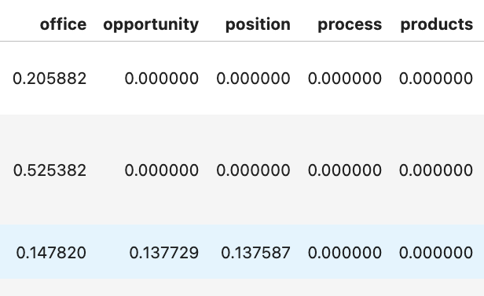
Conversion of textual columns to vectorized columns:

Slide 12
Data Preprocessing
EDA: Identifying and Excluding Common Words
Common words across both fraudulent and non-fraudulent postings do not add value for classification.
Identify and exclude frequently occurring words from the vectorization step.
How it Works:
Count word frequency in both fraudulent and non-fraudulent cases.
Exclude irrelevant words using a custom stopword list.

Slide 13
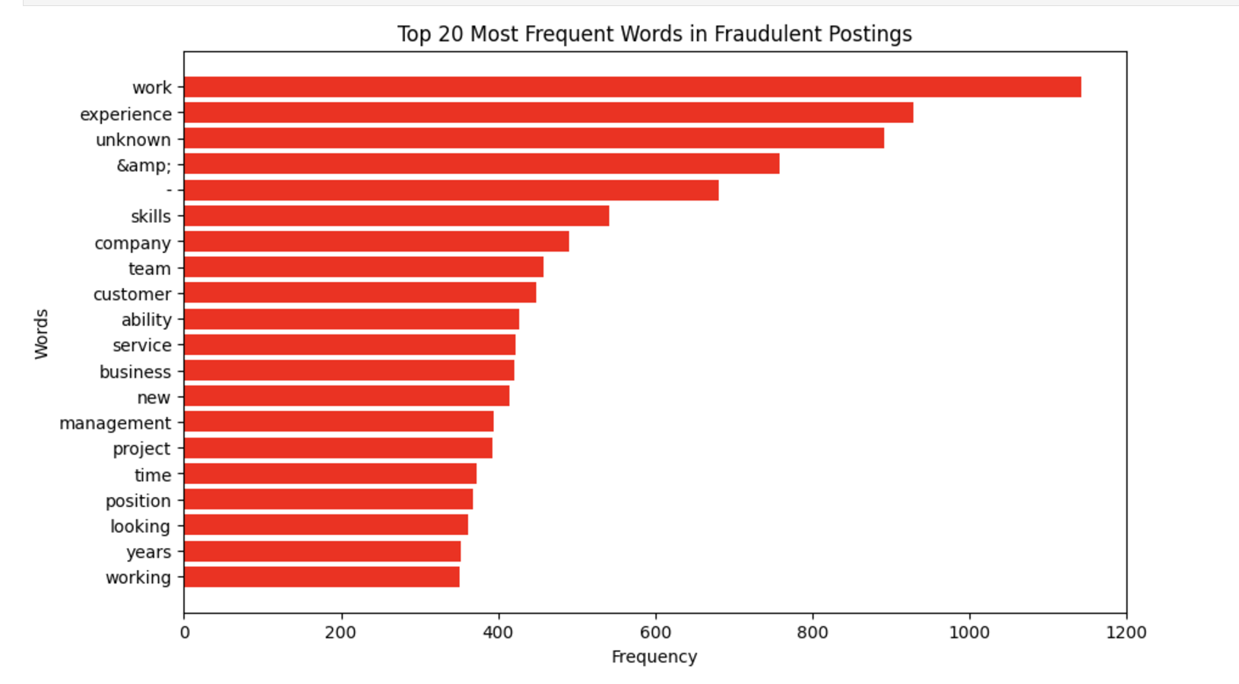
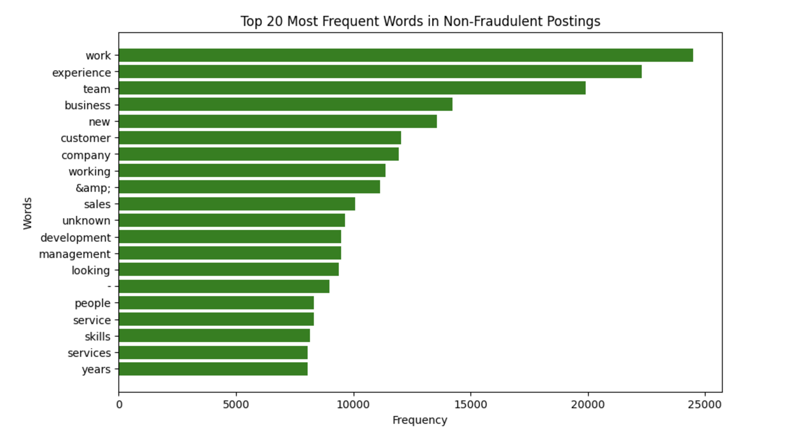

Slide 14
Data Preprocessing
Step 4: Factor Collapsing of Highly Cardinal Attributes
Categorical features with many possible values (e.g., job title, location) can increase model complexity and overfitting.
Collapse rare categories into a single “other” label to reduce cardinality.
How it Works:
Retain top N frequent categories. we kept N=9
Replace all other categories with "other".
Compressing the attribute to just 10 unique values
Outcome: Dataframe where each attribute has 10 or less than 10 Categories

Slide 15
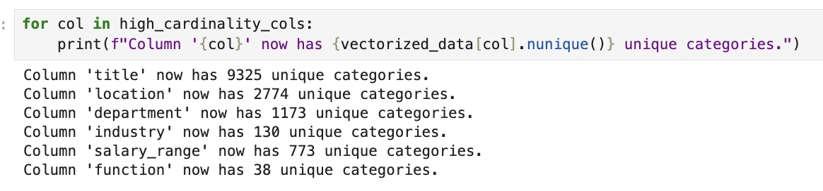
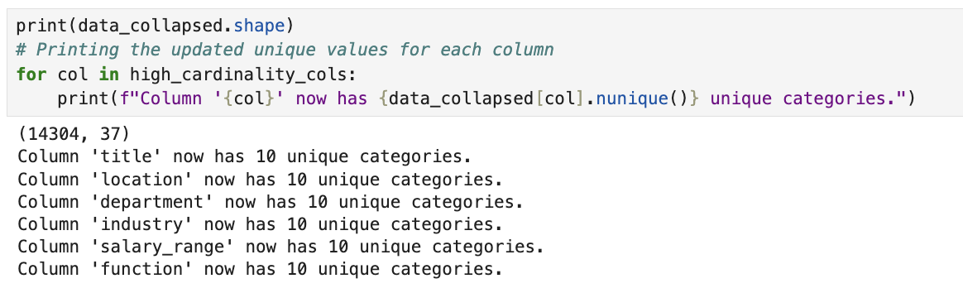
After:

Slide 16
Data Preprocessing
Step 5: One-Hot Encoding
Machine learning algorithms require numerical input, but categorical data is often in text form.
Use one-hot encoding to convert categorical variables into binary (0/1) columns.
How it Works:
Create a binary vector for each category.
Each row will have a 1 in the corresponding column for its category and 0 for others.
Outcome: Categorical features are now in a machine-readable format.

Slide 17
Data Preprocessing
Step 6: Feature selection
After One hot encoding, our dataset had 107 features.
We trained the dataset using 3 different models:
Xgboost
Decision Tree
Random Forest

Slide 18
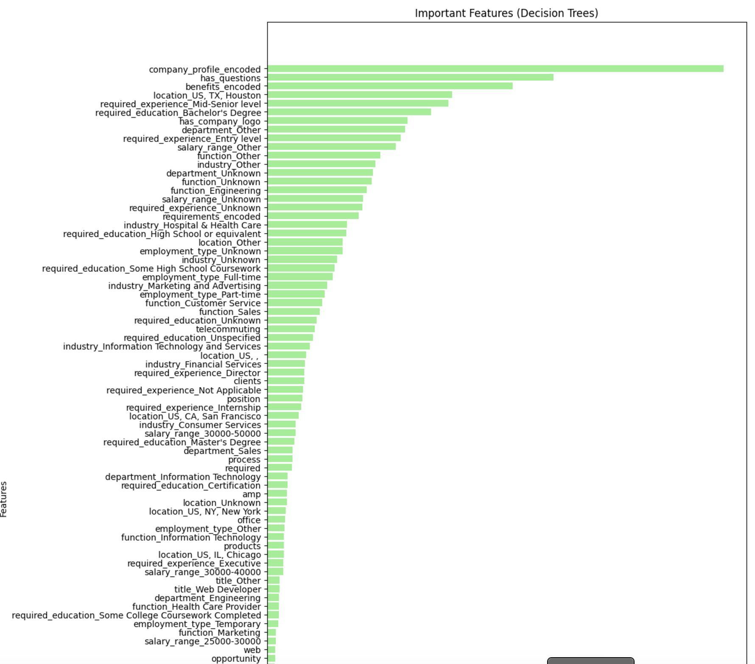
Feature Selection
Decision Tree model: Features are ranked based on Gini importance.
Bar plot showing the top features with the highest importance scores according to the Decision Tree model.
X-axis: Features
(sorted by importance)
Y-axis: Importance score
(higher = more important)

Slide 19
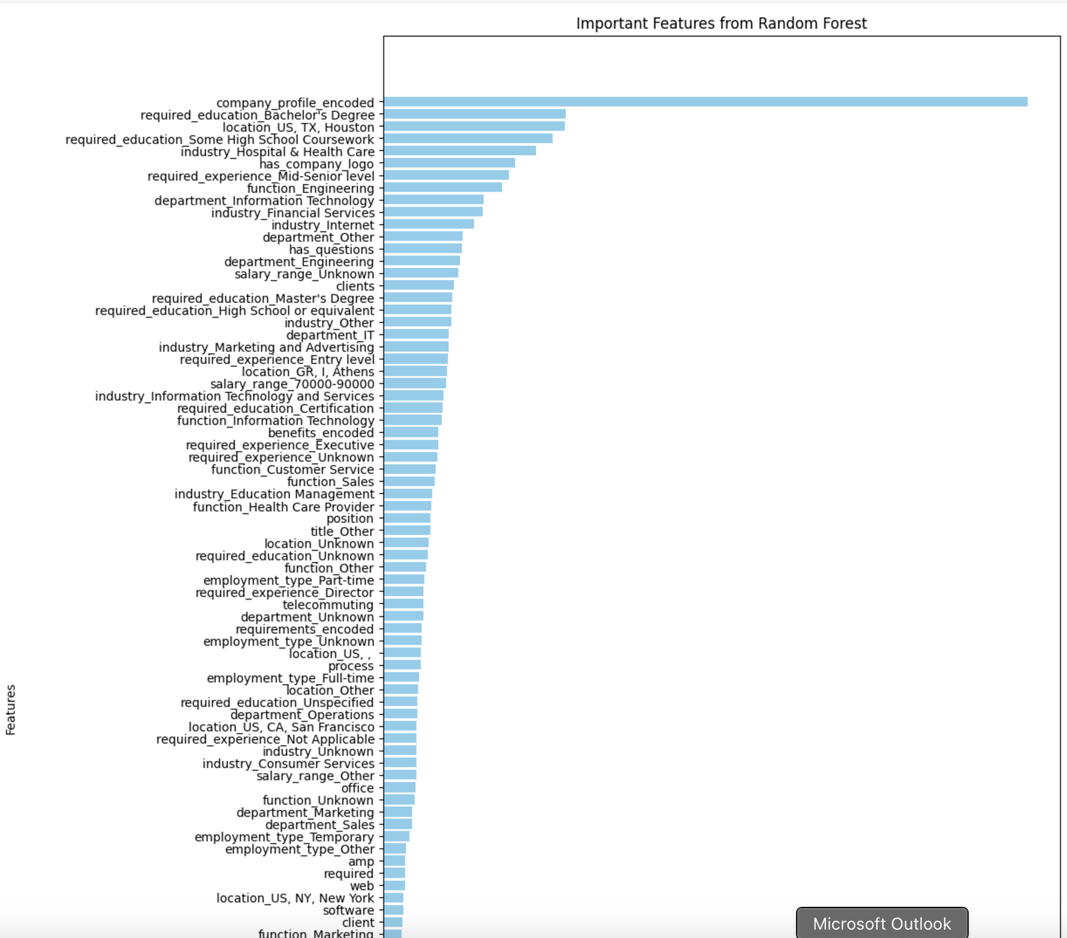
Feature Selection
Random Forest model: Features are ranked based on average Gini importance across all trees in the forest.
Bar plot showing the top features with the highest importance scores according to the Decision Tree model.
X-axis: Features
(sorted by importance)
Y-axis: Importance score
(higher = more important)

Slide 20
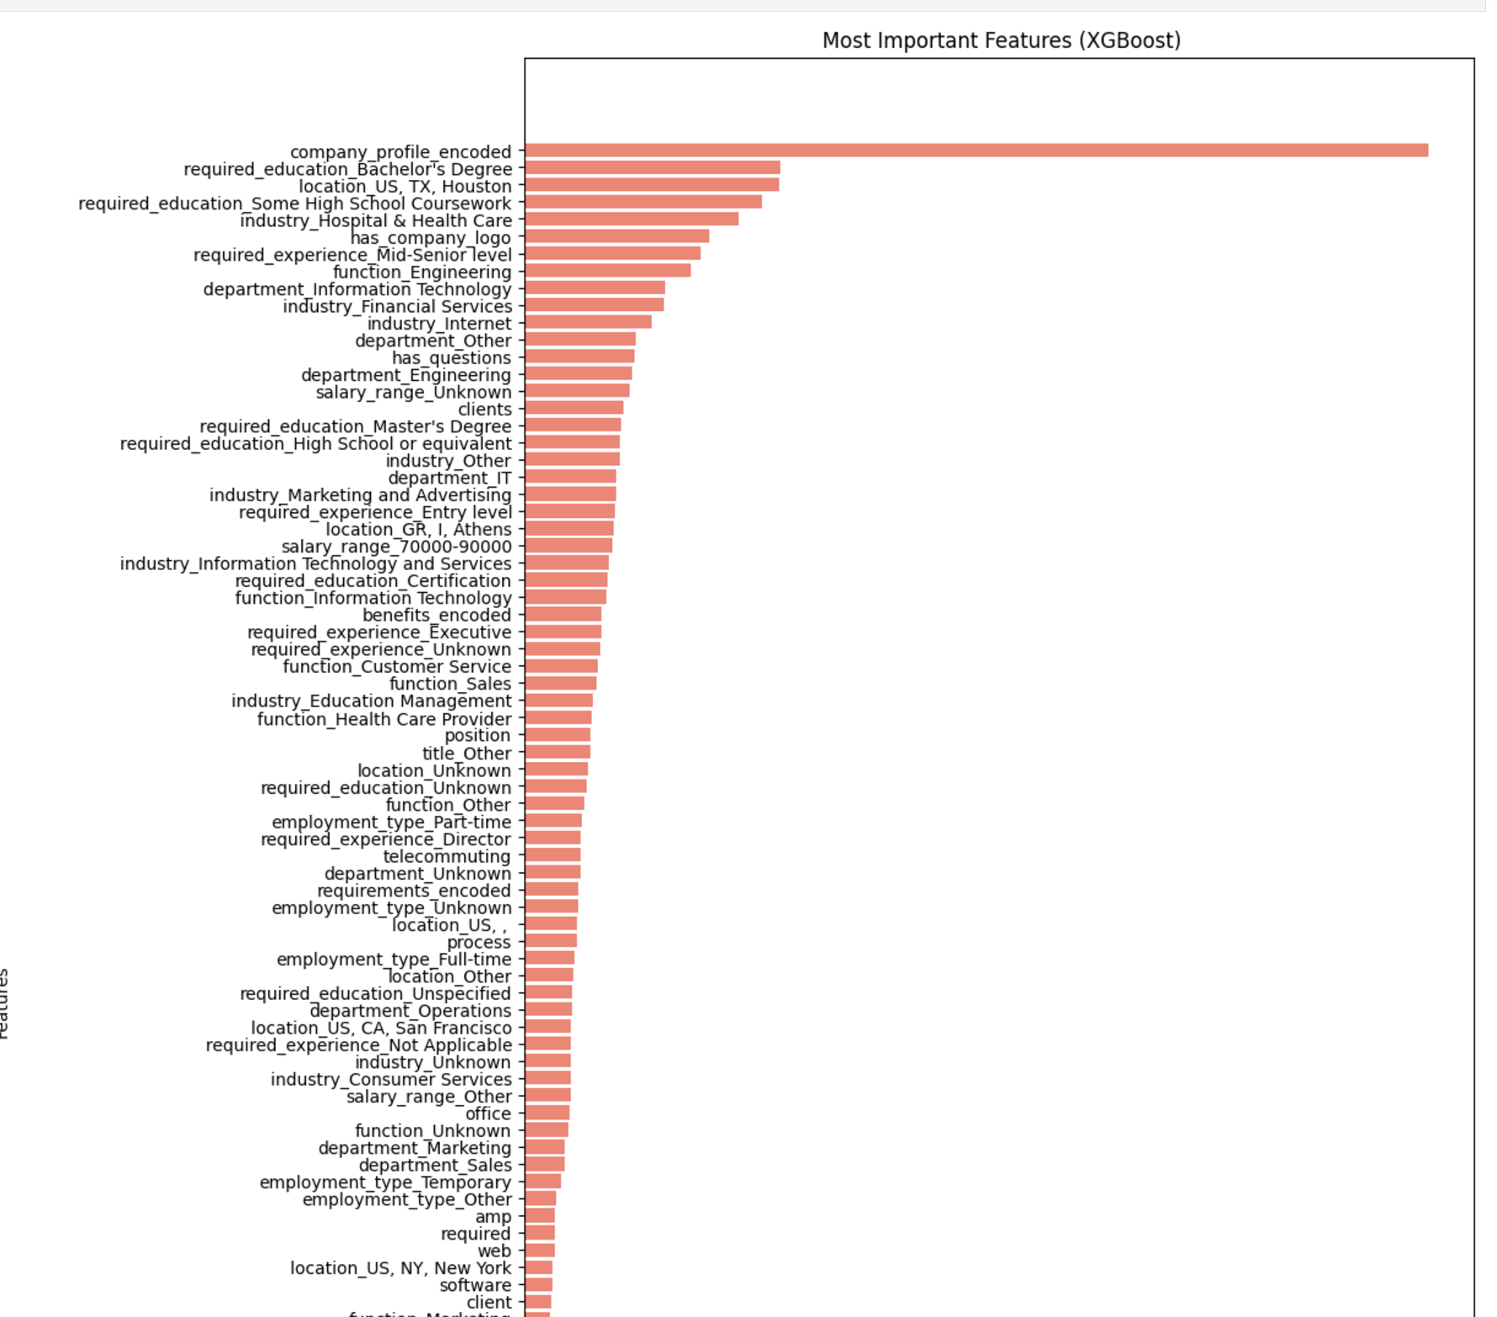
Feature Selection
Xgboost model: Features are ranked based on the number of splits and information gain they provide in classification.
Bar plot showing the top features with the highest importance scores according to the Decision Tree model.
X-axis: Features
(sorted by importance)
Y-axis: Importance score
(higher = more important)

Slide 21
Feature Selection
Results:
Distribution of the Feature importance score: 0-0.6
Threshold: Set at 0.0015 for all models.
Features with importance scores below 0.0015 in all three models were eliminated.
Over 48 features were eliminated.
58 unique features remain for the final model.
These are a mix of:
Binary features from one-hot encoding
Numerical vectorized features for keyword

Slide 22
Creating Preprocessing Pipeline
Compiling Preprocessing Steps into a Python Pipeline
After completing the individual preprocessing steps, we created a unified machine learning preprocessing pipeline to ensure consistency and efficiency during model training and deployment.
The pipeline as saved as a .pkl file
The file can be reused in application to transform the user input given by user

Slide 23
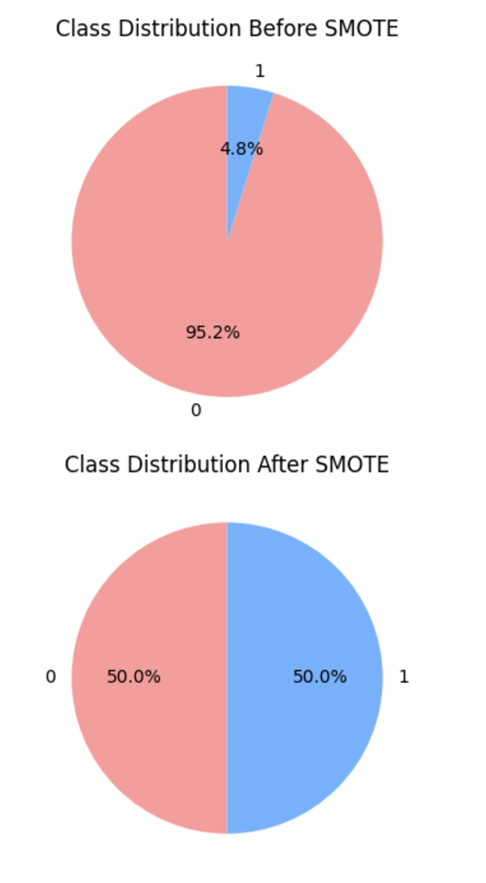
SMOTE (Synthetic Minority Over-sampling Technique)
Imbalanced classes could bias the model toward the majority class.
SMOTE generates synthetic data points for the minority class, which in this case is fraudulent postings.
Performed after preprocessing and before model training as SMOTE works best with numerical features.
Number of samples before SMOTE:
{0: 13611, 1: 693}
Number of samples after SMOTE:
{0: 13611, 1: 13611}

Slide 24
Methodology
Split data into 80% training and 20% testing using Stratified K-fold sampling.
Apply the preprocessing pipeline to both training and testing data.
Train models using Grid Search CV, sweeping through hyperparameters with 10-fold cross-validation.
Select the best model from Grid Search based on cross-validation performance.
Test the best model on testing data, splitting the test set into 5 folds.
Performance Evaluation:
Extract and calculate performance metrics.
Perform statistical analysis (ANOVA and T-tests) on results across 5 folds.

Slide 25
Methodology
Model Selection
The classification models selected are:
Logistic Regression
Decision Trees
XGBoost
Random Forest
Support Vector Machine

Slide 26

Model Selection
Logistic Regression:
Linear classification model used for binary classification tasks.
Works by estimating the probability that a given input belongs to a particular class using the sigmoid function.
Logistic function outputs a value between 0 and 1.
If the probability exceeds a set threshold the instance is classified as fraudulent.

Slide 27
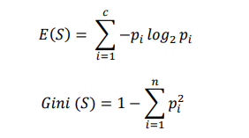
Model Selection
Decision Trees:
Splits the data based on feature values to make decisions.
The tree is built by recursively selecting the feature that maximizes information gain or Gini impurity.
The model can split these features to make predictions.

Slide 28
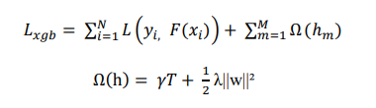
Model Selection
XGBoost:
Builds a series of decision trees in a sequential manner.
Each tree attempts to correct the errors made by the previous tree and the loss function is used to control the complexity of the tree.
XGBoost performs well in situations where there is a high degree of nonlinearity, as it iteratively builds trees that reduce residual errors.

Slide 29
Model Selection
Random Forest:
Combines multiple Decision Trees to make predictions.
Helps to mitigate overfitting.
Can handle both numerical and categorical features.
Each tree in the forest is trained on a random subset of features and instances, reducing the likelihood of overfitting compared to a single decision tree.
Automatically computes feature importance.
Support Vector Machine:
Finds the hyperplane to separate the classes in a high dimensional space.
Can find the optimal decision boundary between classes helpful to detect fraudulent jobs when there are complex relationships between features.

Slide 30
Model training:
Results obtained after testing logistic regression on testing data:
Best Hyperparameters:
C=100, max_iter=100000, random_state=42, solver=‘saga’
Fold | Accuracy | Precision | Recall | F1 Score | Specificity | AUC
Fold 1 | 0.8380 | 0.2086 | 0.8286 | 0.3333 | 0.8385 | 0.8782
Fold 2 | 0.8252 | 0.1773 | 0.7353 | 0.2857 | 0.8297 | 0.8670
Fold 3 | 0.8476 | 0.2137 | 0.8235 | 0.3394 | 0.8488 | 0.8886
Fold 4 | 0.8462 | 0.2093 | 0.7714 | 0.3293 | 0.8500 | 0.8601
Fold 5 | 0.8476 | 0.2109 | 0.7714 | 0.3313 | 0.8515 | 0.8517

Slide 31
Model Training:
Results obtained after testing Decision tree on testing data:
Best Hyperparameters: ‘criterion’: ‘entropy’, ‘max_depth’: 20, ‘min_samples_leaf’: 10, ‘min_samples_split’: 2
Fold | Accuracy | Precision | Recall | F1 Score | Specificity | AUC
Fold 1 | 0.9148 | 0.3243 | 0.6857 | 0.4404 | 0.9266 | 0.89
Fold 2 | 0.9245 | 0.3571 | 0.7353 | 0.4808 | 0.9339 | 0.9203
Fold 3 | 0.9399 | 0.4308 | 0.8235 | 0.5657 | 0.9457 | 0.9315
Fold 4 | 0.9301 | 0.3913 | 0.7714 | 0.5192 | 0.9382 | 0.893
Fold 5 | 0.9413 | 0.4493 | 0.8857 | 0.5962 | 0.9441 | 0.9343

Slide 32
Model Training:
Results obtained after testing Xgboost on testing data: Best Hyperparameters: n_estimators=200,eval_metric=’logloss’,max_depth=30,learning_rate=0.1
Fold | Accuracy | Precision | Recall | F1 Score | Specificity | AUC
Fold 1 | 0.9497 | 0.4902 | 0.7143 | 0.5814 | 0.9618 | 0.9297
Fold 2 | 0.9371 | 0.4035 | 0.6765 | 0.5055 | 0.9501 | 0.9444
Fold 3 | 0.9538 | 0.5098 | 0.7647 | 0.6118 | 0.9633 | 0.9663
Fold 4 | 0.9497 | 0.4906 | 0.7429 | 0.5909 | 0.9603 | 0.9434
Fold 5 | 0.9497 | 0.4909 | 0.7714 | 0.6 | 0.9588 | 0.9658

Slide 33
Model Training:
Results obtained after testing SVM on testing data:
Best Hyperparameters:max_depth=20, random_state=42,n_estimators=200
Fold | Accuracy | Precision | Recall | F1 Score | Specificity | AUC
Fold 1 | 0.8087 | 0.1852 | 0.8571 | 0.3046 | 0.8062 | 0.8687
Fold 2 | 0.8126 | 0.1753 | 0.7941 | 0.2872 | 0.8135 | 0.8769
Fold 3 | 0.8448 | 0.2148 | 0.8529 | 0.3432 | 0.8443 | 0.899
Fold 4 | 0.8182 | 0.1812 | 0.7714 | 0.2935 | 0.8206 | 0.8649
Fold 5 | 0.821 | 0.1837 | 0.7714 | 0.2967 | 0.8235 | 0.8522

Slide 34
Model Training:
Results obtained after testing Random Forest on testing data:
Best Hyperparameters:C=0.1, kernel='linear', probability=True, random_state=42
Fold | Accuracy | Precision | Recall | F1 Score | Specificity | AUC
Fold 1 | 0.9385 | 0.4237 | 0.7143 | 0.5319 | 0.9501 | 0.9245
Fold 2 | 0.9413 | 0.431 | 0.7353 | 0.5435 | 0.9515 | 0.9437
Fold 3 | 0.9441 | 0.4516 | 0.8235 | 0.5833 | 0.9501 | 0.9735
Fold 4 | 0.9385 | 0.4286 | 0.7714 | 0.551 | 0.9471 | 0.9479
Fold 5 | 0.9538 | 0.5161 | 0.9143 | 0.6598 | 0.9559 | 0.9791

Slide 35
STATISTICAL ANALYSIS OF MODEL RESULTS
Results of Annova tests for all 6 metrics across all models.
Metric | F-Statistic | P-Value
AUC | 24.036 | 2.13E-07
Recall | 1.14 | 0.3662
F1 Score | 48.928 | 4.73E-10
Accuracy | 186.571 | 1.58E-15
Precision | 74.039 | 1.06E-11
Specificity | 267.305 | 4.71E-17

Slide 36
Comparison | t-statistic | p-value
XGBoost vs Logistic | 8.09 | 0.0013
XGBoost vs Decision Tree | 8.21 | 0.0012
XGBoost vs Random Forest | -1.19 | 0.298
XGBoost vs SVM | 8.21 | 0.0012
Comparison | t-statistic | p-value
XGBoost vs Logistic | 26.65 | 1.18E-05
XGBoost vs Decision Tree | 2.42 | 0.0726
XGBoost vs Random Forest | 0.18 | 0.865
XGBoost vs SVM | 18.1 | 5.48E-05
T-tests for AUC of XGBoost against all other models
T-tests for F1 of XGBoost against all other models

Slide 37
Comparison | t-statistic | p-value
XGBoost vs Logistic | 52.56 | 7.84E-07
XGBoost vs Decision Tree | 3.88 | 0.0179
XGBoost vs Random Forest | 1.3 | 0.264
XGBoost vs SVM | 24.26 | 1.71E-05
Comparison | t-statistic | p-value
XGBoost vs Logistic | 11.39 | 0.000249
XGBoost vs Decision Tree | 2.86 | 0.0278
XGBoost vs Random Forest | -0.36 | 0.724
XGBoost vs SVM | 10.63 | 0.000497
T-tests for Specificity of XGBoost against all other models
T-tests for Accuracy of XGBoost against all other models

Slide 38
Comparison | t-statistic | p-value
XGBoost vs Logistic | 22.63 | 2.26E-05
XGBoost vs Decision Tree | 3.84 | 0.0185
XGBoost vs Random Forest | 1.23 | 0.221
XGBoost vs SVM | 11.76 | 4.68E-05
Comparison | t-statistic | p-value
Random Forest vs Logistic | 6.52 | 0.0029
Random Forest vs Decision Tree | 7.56 | 0.0016
Random Forest vs SVM | 6.66 | 0.0026
T-tests for Precision of XGBoost against all other models
T-tests for AUC of Random Forest against all other models

Slide 39
Comparison | t-statistic | p-value
Random Forest vs Logistic | 11.36 | 0.00034
Random Forest vs Decision Tree | 4.11 | 0.0148
Random Forest vs SVM | 11.11 | 0.00037
Comparison | t-statistic | p-value
Random Forest vs Logistic | 24.74 | 1.59E-05
Random Forest vs Decision Tree | 3.89 | 0.0177
Random Forest vs SVM | 20.05 | 3.65E-05
T-tests for F1 of Random Forest against all other models
T-tests for Accuracy of Random Forest all other models

Slide 40
Comparison | t-statistic | p-value
Random Forest vs Logistic | 15.13 | 0.00011
Random Forest vs Decision Tree | 4.3 | 0.0126
Random Forest vs SVM | 14.65 | 0.00013
Comparison | t-statistic | p-value
Random Forest vs Logistic | 24.61 | 1.62E-05
Random Forest vs Decision Tree | 3.95 | 0.0168
Random Forest vs SVM | 19.69 | 3.93E-05
T-tests for Precision of Random Forest against all other models
T-tests for Specificity of Random Forest against all other models

Slide 41
System Architecture
The Languages used for this application are :
Python: Used for backend development, for model design, training, feature analysis and development.
JavaScript / HTML: Used to design and build the GUI of the application.
Flask: It is a webframe used for developing APIs and establishing connection with front end.

Slide 42
User Manual
For a user to run the application, the user need to have basic software like VS code, Python and libraries like scikit-learn, pandas, numpy, which can be installed using pip.
After the necessary software and libraries are installed, the user can then run the application locally by executing the command python app.py in the terminal or command prompt.
The flask server will be hosted on http://127.0.0.1:5000

Slide 43
Results
Xgboost and Random Forest were the best-performing models based on the statistical analysis.
Both the models were implemented from scratch and then saved as a .pkl file in order to be integrated with application in backend.
Both models were tested on unseen user input data and gave accurate results.

Slide 44
Conclusion and Future Work
Conclusion:
The web application successfully identifies fake job listings using machine learning and text analytics.
It offers a simple, user-friendly interface with immediate results for users.
Future Scope:
Reinforcement Learning: Can be Implement to allow the model to improve gradually after each prediction iteration.
Integration of Large Language Models (LLMs): LLMs can provide a much better and enhanced interpretation of textual features in job postings, providing deeper insights.

Slide 45
APPLICATION DEMO

Slide 46

THANK YOU

