Slide 1

Healthcare Final Project
- Tushar Jayendra Mhatre
- Rami Reddy Yekkanti

Slide 2
Project Overview
Title: “Predicting Hospital Length of Stay Using Machine Learning”
Project Context: Our project uses machine learning to predict patients' length of stay at the hospital, which can help hospitals with the following:
Resource Management
Improve Patient’s Care

Slide 3
Dataset and Details
Dataset Source: “The dataset comes from the Multiparameter Intelligent Monitoring in Intensive Care (MIMIC-III) database, which contains comprehensive patient information”
The dataset includes a wide array of features related to treatment data for intensive care patients, such as:
Demographics
Lab Results
Treatments
Our target variable is the Length of Stay (LOS) group number, which categorizes patients into different stay durations.

Slide 4
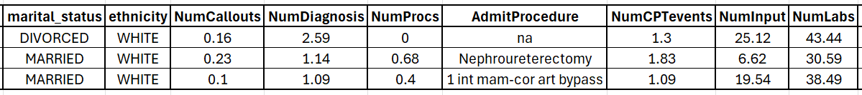
Sample Data

Slide 5
Project Plan
Data Preprocessing
Data Splitting Strategy
Feature Importance Analysis
Model Building
Model Comparison

Slide 6
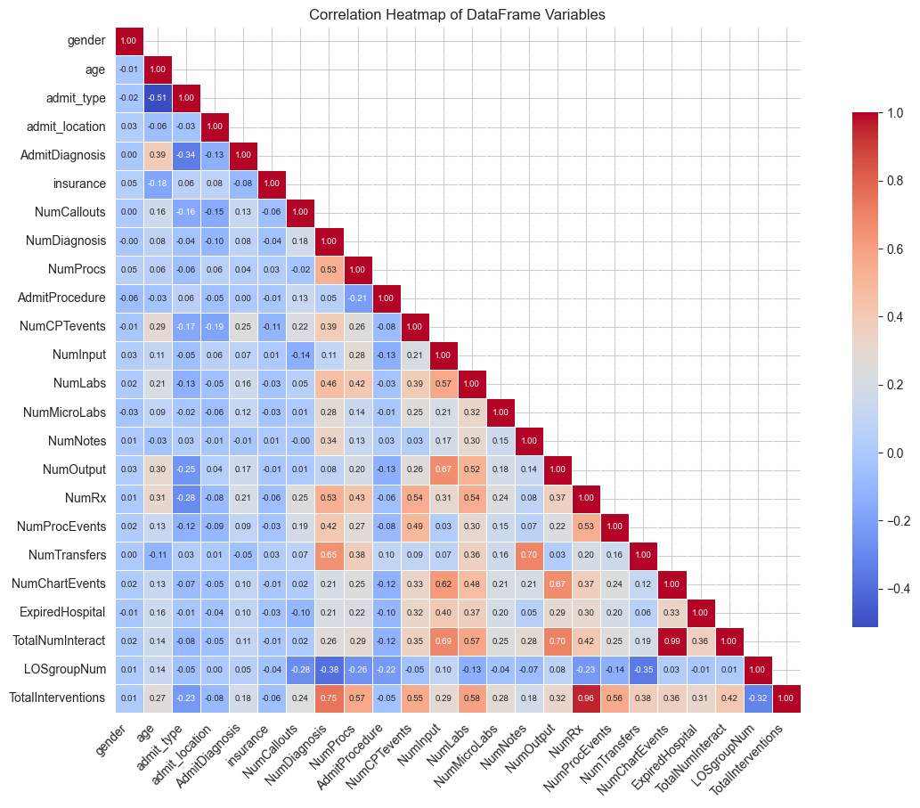
Heatmap

Slide 7
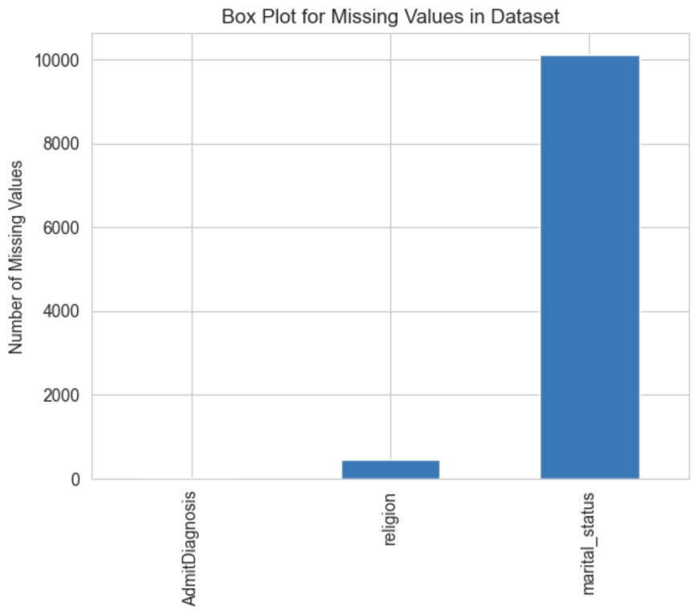
Bar Plot for Missing Values

Slide 8
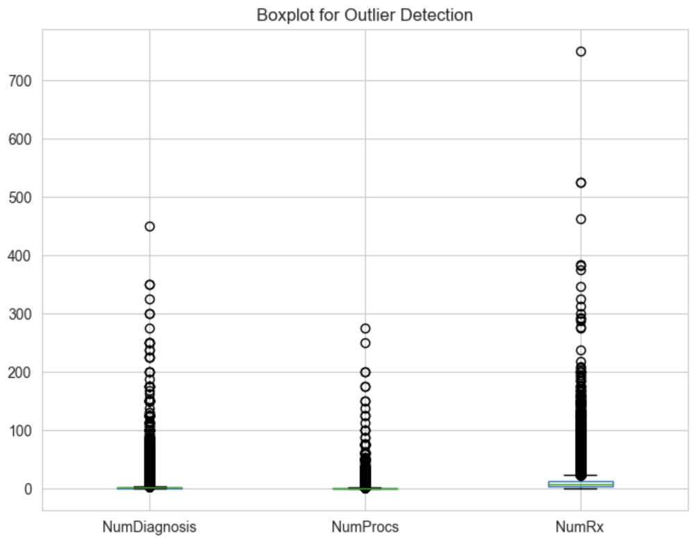
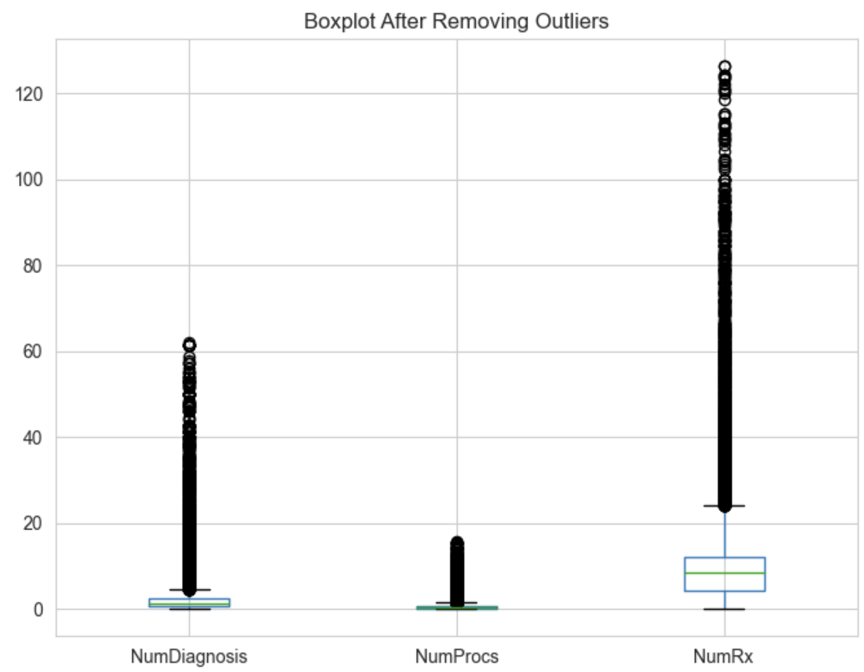
Outlier Detection
After Removing Outliers

Slide 9
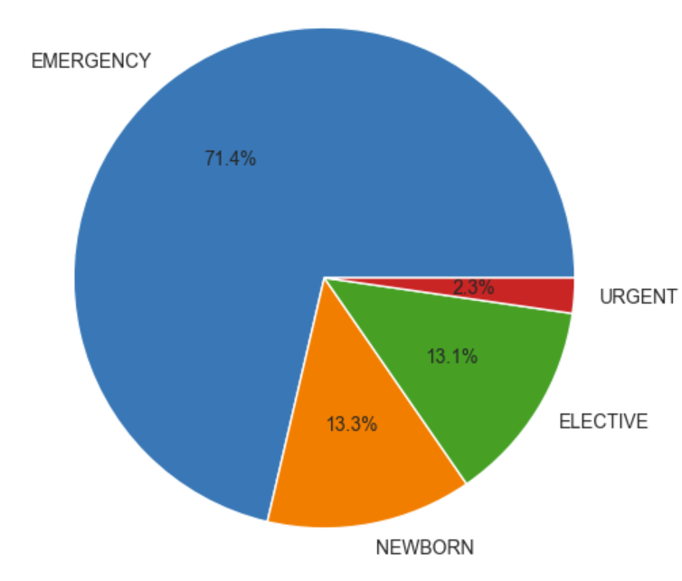
Pie Chart of Admission Types

Slide 10
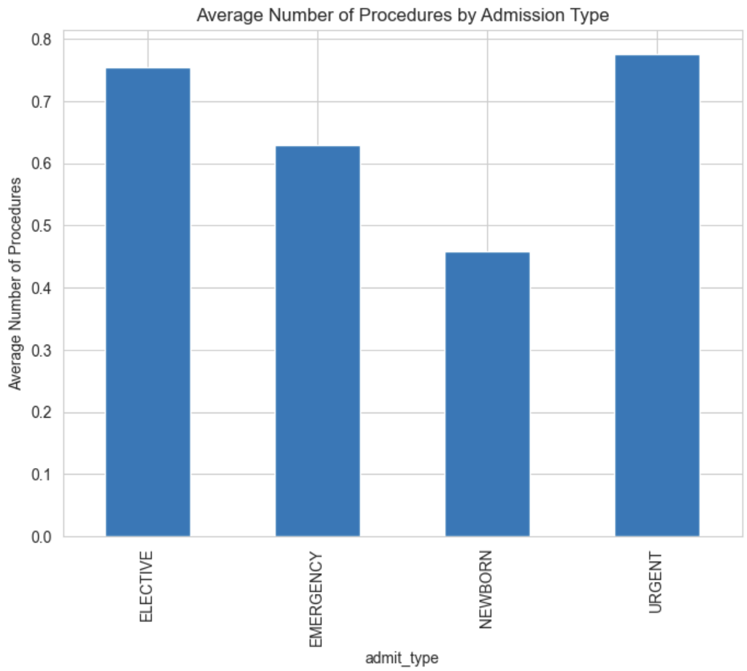
Average Number of Procedures by Admission Type

Slide 11
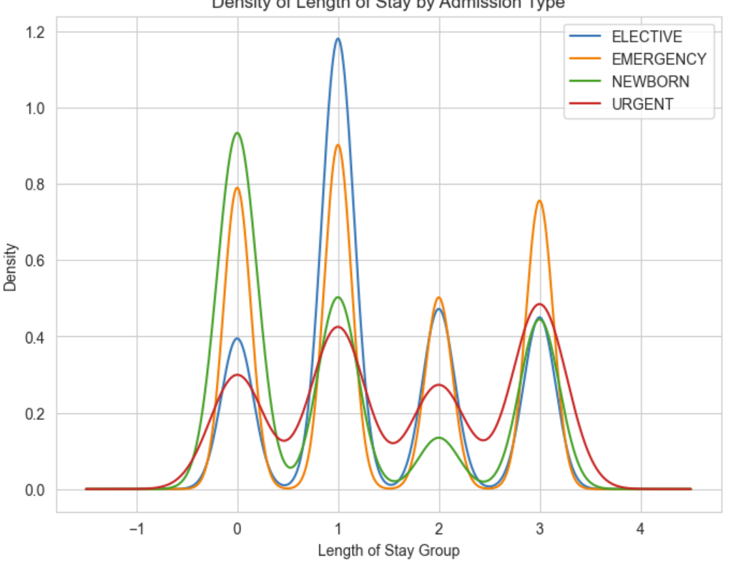
Kernel Density Estimate

Slide 12
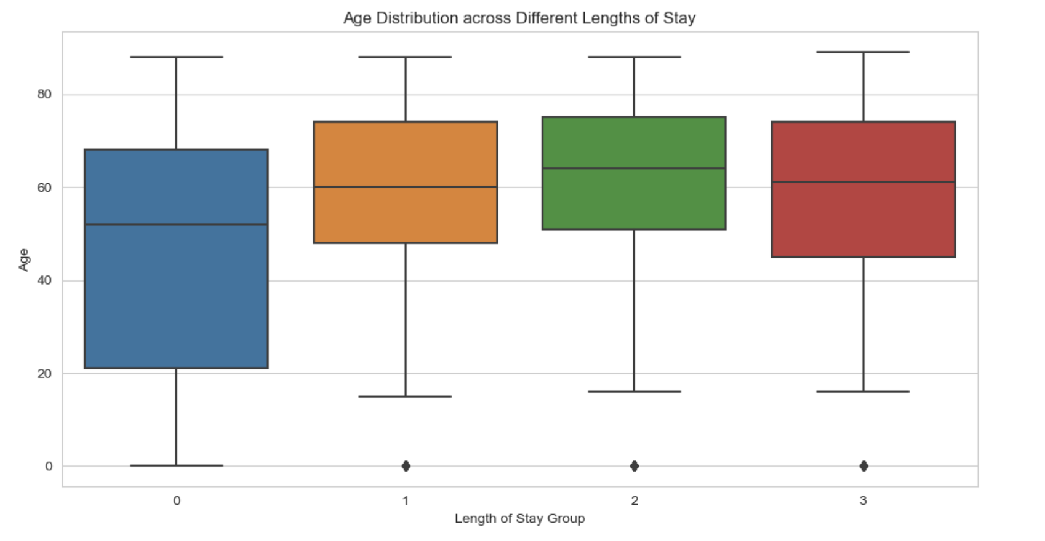
Age Distribution across Different Lengths of Stay

Slide 13
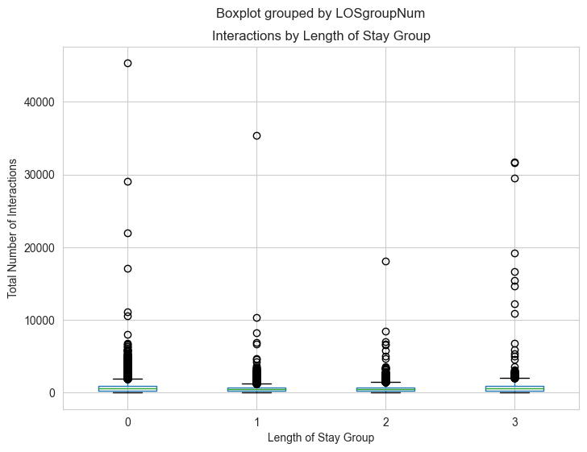
Boxplot Total Number of Interactions vs Length of Stay Groups

Slide 14
Building Models
Cleaning the Data
Feature Selection
Model Selection
Model Comparison

Slide 15
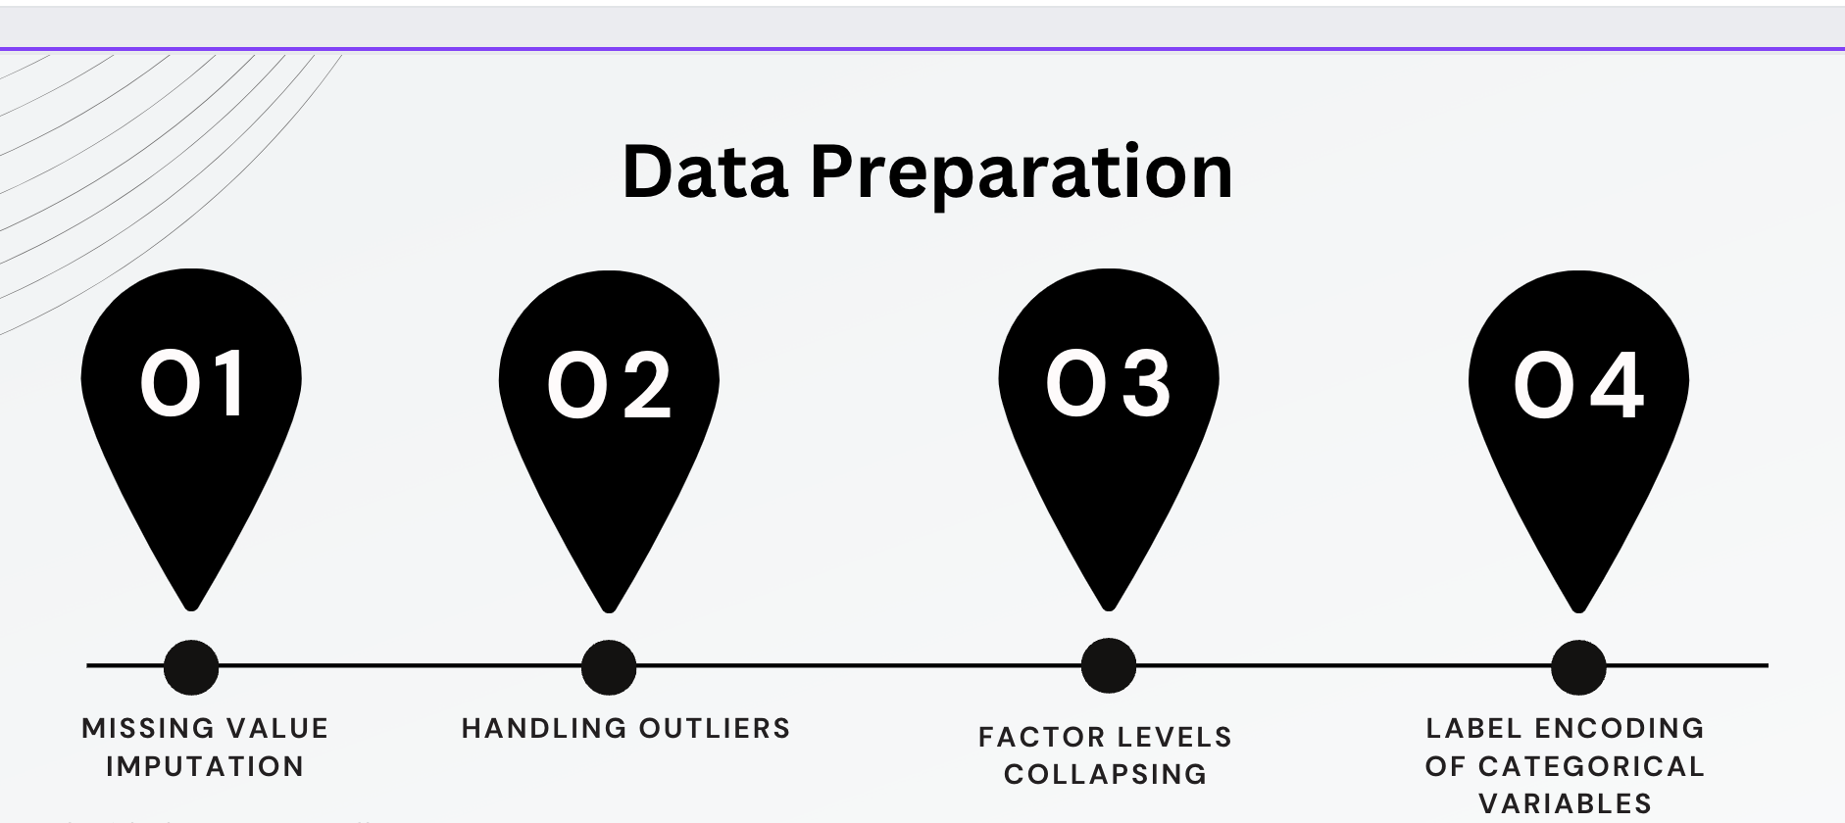
Steps for Data cleaning and preprocessing

Slide 16
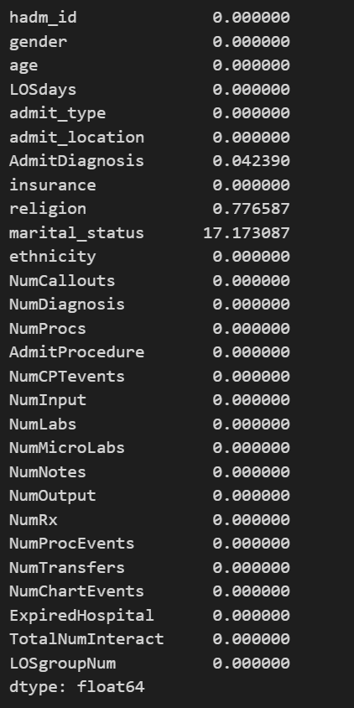
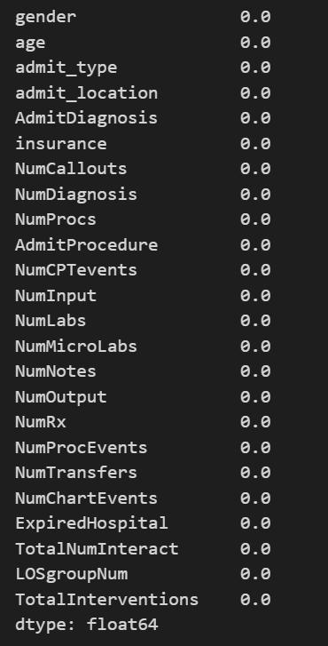
Columns with Missing Values are Removed

Slide 17
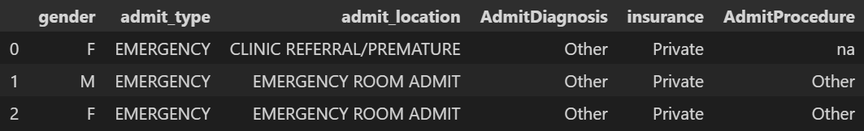
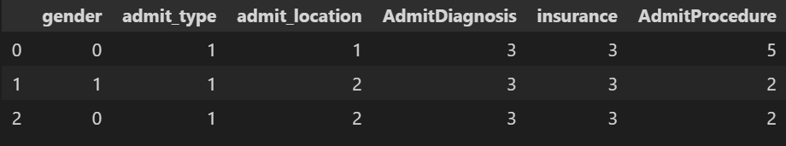
Label encoding for categorical columns

Slide 18
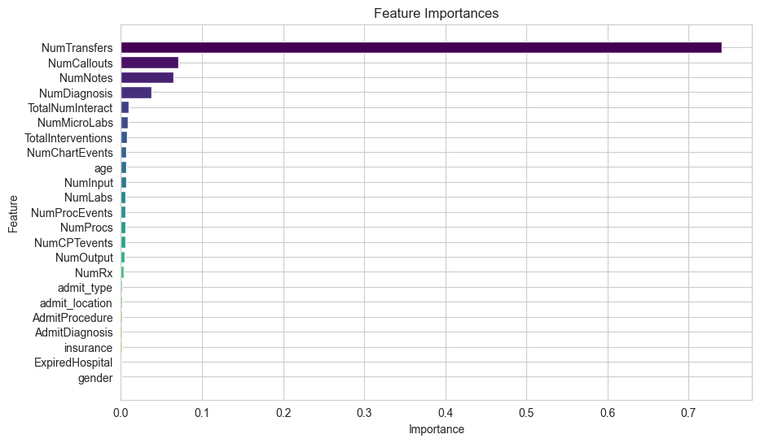
Feature Importance

Slide 19
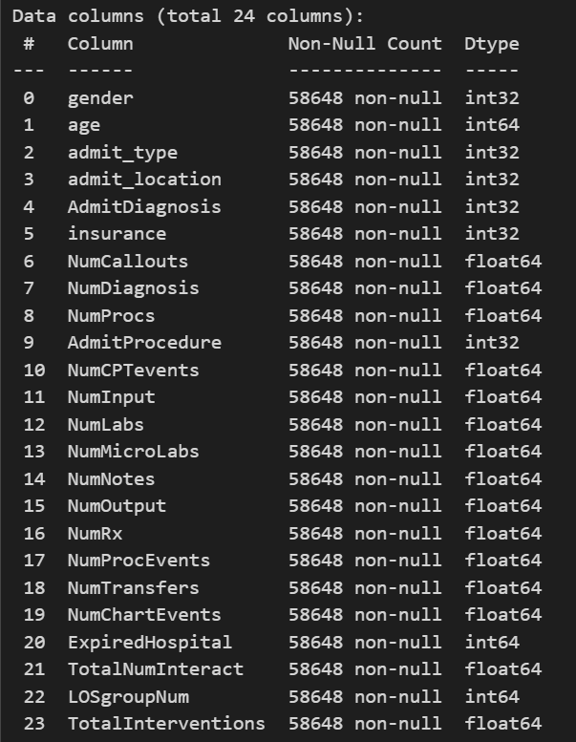
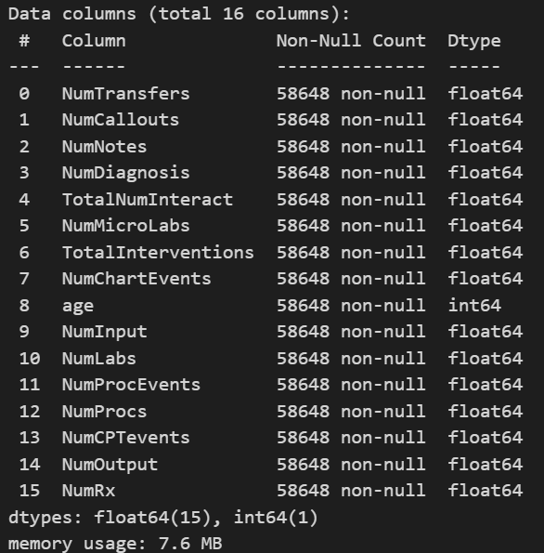
Data Summary after Feature Selection

Slide 20
Models Utilized
XGBoost
Random Forest
Decision Tree
KNN
SVM

Slide 21
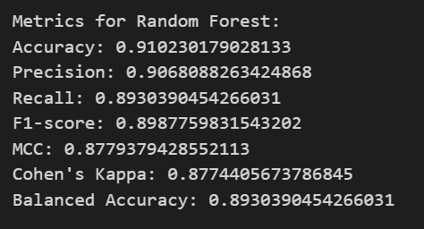
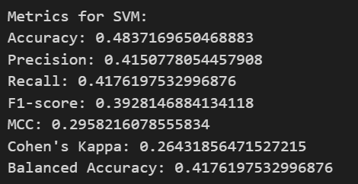
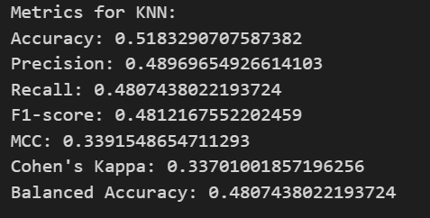
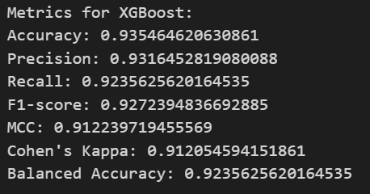
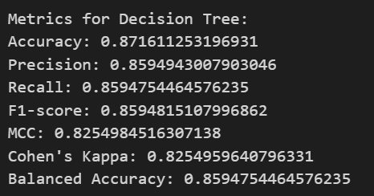
Results

Slide 22
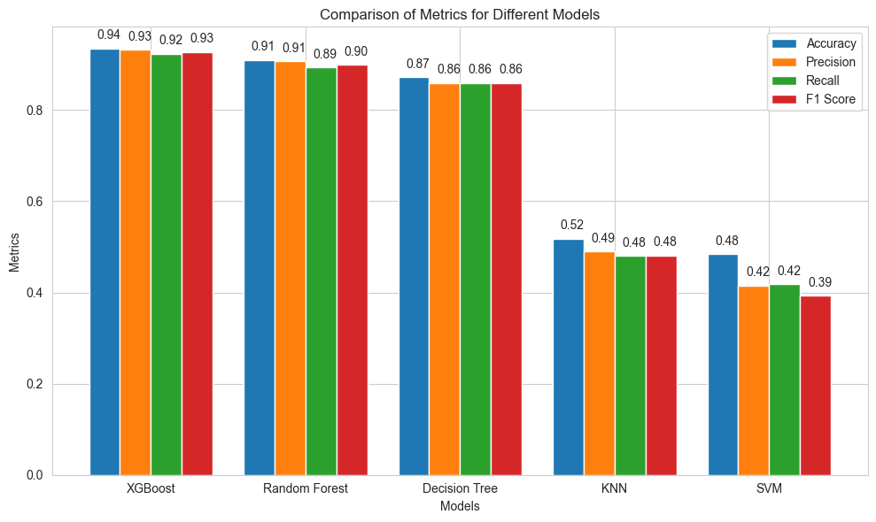
Models Comparison

Slide 23
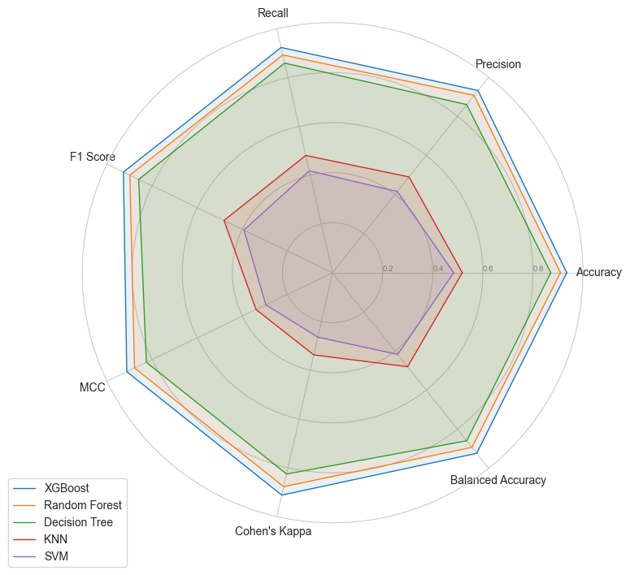
Radar Chart

Slide 24
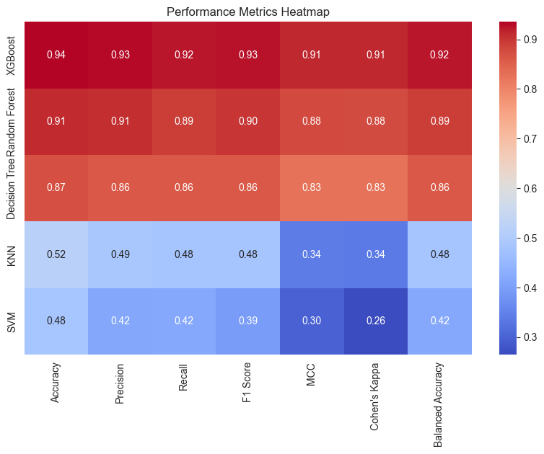
Performance Metrics Heatmap

Slide 25
Future Work and Interpretation
A feedback loop can be implemented where the model's predictions are continually compared against actual outcomes.
As"NumTransfers" is a critical feature, hospitals might reconsider their internal transfer policies to streamline patient movement.
Anticipate and plan for bed availability in real-time, reducing waiting times for patients needing transfer, which can directly reduce LoS

Slide 26
Thank You

