Slide 1
Introduction

Slide 2
Evolution of Computers
Computers have led to a third revolution for civilization, with the information revolution taking its place alongside the agricultural and the industrial revolutions.
T e computer revolution continues. Each time the cost of computing improves by another factor of 10, the opportunities for computers multiply. Applications that were economically infeasible suddenly become practical.

Slide 3
Evolution
Personal computers (PCs) are possibly the best known form of computing, which readers of this book have likely used extensively. Personal computers emphasize delivery of good performance to single users at low cost and usually execute third-party software.
Servers are the modern form of what were once much larger computers, and are usually accessed only via a network. Servers are oriented to carrying large workloads, which may consist of either single complex or handling many small jobs.

Slide 4
Evolution
At the other extreme are supercomputers, which at the present consist of tens of thousands of processors and many terabytes of memory, and cost tens to hundreds of millions of dollars.
Embedded computers are the largest class of computers and span the widest range of applications and performance. Embedded computers include the microprocessors found in your car, the computers in a television set, and the networks of processors that control a modern airplane or cargo ship

Slide 5
Welcome to the PostPC Era
Replacing PC is the personal mobile device (PMD). PMDs are battery operated with wireless connectivity to the Internet and typically cost hundreds of dollars, and, like PCs, users can download software (“apps”) to run on them. Unlike PCs, they no longer have a keyboard and mouse, and are more likely to rely on a touch-sensitive screen or even speech input.
Taking over from the traditional server is Cloud Computing, which relies upon giant datacenters that are now known as Warehouse Scale Computers (WSCs). Indeed, Sof ware as a Service (SaaS) deployed via the cloud is revolutionizing the sofware industry just as PMDs and WSCs are revolutionizing the hardware industry.

Slide 6
Ideas for Computer Architecture
Moore’s Law: w. It states that integrated circuit resources double every 18–24 months. Moore’s Law resulted from a 1965 prediction of such growth in IC capacity made by Gordon Moore, one of the founders of Intel
Use Abstraction to Simplify Design: A major productivity technique for hardware and software is to use abstractions to represent the design at different levels of representation; lower-level details are hidden to offer a simpler model at higher levels. We’ll use the abstract painting icon to represent this second great idea.

Slide 7
Ideas for Computer Architecture
Make the Common Case Fast: Making the common case fast will tend to enhance performance better than optimizing the rare case. Ironically, the common case is often simpler than the rare case and hence is often easier to enhance.
Performance via Parallelism: Since the dawn of computing, computer architects have offered designs that get more performance by performing operations in parallel.
Performance via Prediction: In some cases it can be faster on average to guess and start working rather than wait until you know for sure, assuming that the mechanism to recover from a mis-prediction is not too expensive and your prediction is relatively accurate.

Slide 8
Ideas for Computer Architecture
Performance via Pipelining A particular pattern of parallelism is so prevalent in computer architecture that it merits its own name: pipelining.
Hierarchy of Memories: Programmers want memory to be fast, large, and cheap, as memory speed often shapes performance, capacity limits the size of problems that can be solved, and the cost of memory today is often the majority of computer cost.
Dependability via Redundancy: Computers not only need to be fast; they need to be dependable. Since any physical device can fail, we make systems dependable by including redundant components that can take over when a failure occurs and to help detect failures.

Slide 9
Your program
To go from a complex application to the simple instructions involves several layers of software that interpret or translate high-level operations into simple computer instructions, an example of the great idea of abstraction.
Layers of software are organized primarily in a hierarchical fashion, with applications being the outermost ring and a variety of systems software sitting between the hardware and applications software.

Slide 10
Operating System
There are many types of systems software, but two types of systems software are central to every computer system today: an operating system and a Language processing system. An operating system interfaces between a user’s program and the hardware and provides a variety of services and supervisory functions. Among the most important functions are:
Handling basic input and output operations
Allocating storage and memory
Providing for protected sharing of the computer among multiple applications using it simultaneously

Slide 11
Language Processing System
We have learnt that any computer system is made of hardware and software. The hardware understands a language, which humans cannot understand. So we write programs in high-level language, which is easier for us to understand and remember.
These programs are then fed into a series of tools and OS components to get the desired code that can be used by the machine. This is known as Language Processing System.

Slide 12
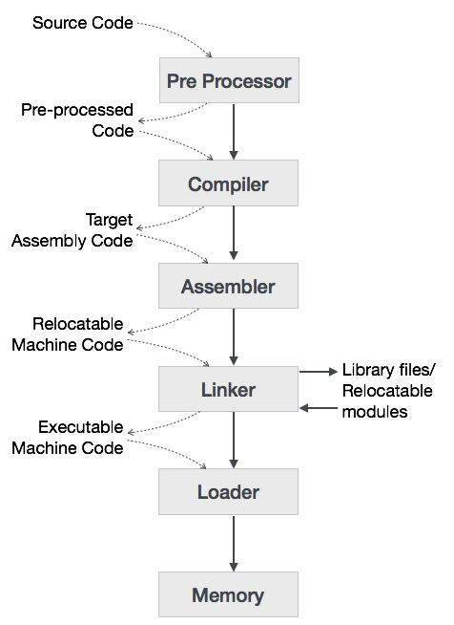

Slide 13
Language Processing System
The high-level language is converted into binary language in various phases. A compiler is a program that converts high-level language to assembly language. Similarly, an assembler is a program that converts the assembly language to machine-level language.
Let us first understand how a program, using C compiler, is executed on a host machine:
User writes a program in C language (high-level language).
The C compiler, compiles the program and translates it to assembly program (low-level language).
An assembler then translates the assembly program into machine code (object).
A linker tool is used to link all the parts of the program together for execution (executable machine code).
A loader loads all of them into memory and then the program is executed.

Slide 14
Language Processing System
A preprocessor, generally considered as a part of compiler, is a tool that produces input for compilers. It deals with macro-processing, augmentation, file inclusion, language extension, etc.
An interpreter, like a compiler, translates high-level language into low-level machine language. The difference lies in the way they read the source code or input. A compiler reads the whole source code at once, In contrast, an interpreter reads a statement from the input. If an error occurs, an interpreter stops execution and reports it, whereas a compiler reads the whole program even if it encounters several errors.
An assembler translates assembly language programs into machine code. The output of an assembler is called an object file, which contains a combination of machine instructions as well as the data required to place these instructions in memory.
Linker is a computer program that links and merges various object files together in order to make an executable file. All these files might have been compiled by separate assemblers. The major task of a linker is to search and locate referenced module/routines in a program and to determine the memory location where these codes will be loaded, making the program instruction to have absolute references.
Loader is a part of operating system and is responsible for loading executable files into memory and execute them. It calculates the size of a program (instructions and data) and creates memory space for it. It initializes various registers to initiate execution.

Slide 15
Performance
If you were running a program on two different desktop computers, you’d say that the faster one is the desktop computer that gets the job done first. If you were running a datacenter that had several servers running jobs submitted by many users, you’d say that the faster computer was the one that completed the most jobs during a day.
As an individual computer user, you are interested in reducing response time—the time between the start and completion of a task—also referred response time Also called execution time. The total time required for the computer to complete a task, including disk accesses, memory accesses, I/O activities, operating system overhead, CPU execution time, and so on.
Datacenter managers are often interested in increasing throughput or bandwidth—the total amount of work done in a given time. Hence, in most cases, we will need different performance metrics as well as different sets of applications to benchmark personal mobile devices, which are more focused on response time, versus servers, which are more focused on throughput.

Slide 16
Measuring Performance
Time is the measure of computer performance: the computer that performs the same amount of work in the least time is the fastest. Program execution time is measured in seconds per program. However, time can be defined in different ways, depending on what we count. The most straightforward definition of time is called wall clock time, response time, or elapsed time.
Computers are often shared, however, and a processor may work on several programs simultaneously. In such cases, the system may try to optimize throughput rather than attempt to minimize the elapsed time for one program. Hence, we often want to distinguish between the elapsed time and the time over which the processor is working on our behalf. CPU execution time or simply CPU time, which recognizes this distinction

Slide 17
CPU Time
CPU time can be further divided into the CPU time spent in the program, called user CPU time, and the CPU time spent in the operating system performing tasks on behalf of the program, called system CPU time.
Differentiating between system and user CPU time is dif cult to do accurately, because it is often hard to assign responsibility for operating system activities to one user program rather than another and because of the functionality differences among operating systems

Slide 18
Clock
Almost all computers are constructed using a clock that determines when events take place in the hardware. These discrete time intervals are called clock cycles (or ticks, clock ticks, clock periods, clocks, cycles).
Designers refer to the length of a clock period both as the time for a complete clock cycle (e.g., 250 picoseconds, or 250 ps) and as the clock rate (e.g., 4 gigahertz, or 4 GHz), which is the inverse of the clock period.

Slide 19
CPU Performance and Its Factors
Users and designers often examine performance using different metrics. If we could relate these different metrics, we could determine the effect of a design change on the performance as experienced by the user.
Since we are confining ourselves to CPU performance at this point, the bottom-line performance measure is CPU execution time. A simple formula relates the most basic metrics (clock cycles and clock cycle time) to CPU time:

Slide 20
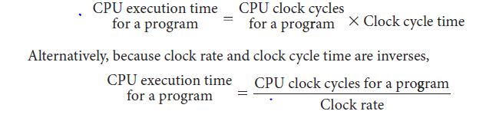
Clock Cycle
This formula makes it clear that the hardware designer can improve performance by reducing the number of clock cycles required for a program or the length of the clock cycle.

Slide 21

Performance
The performance equations above did not include any reference to the number of instructions needed for the program. However, since the compiler clearly generated instructions to execute, and the computer had to execute the instructions to run the program, the execution time must depend on the number of instructions in a program.

Slide 22
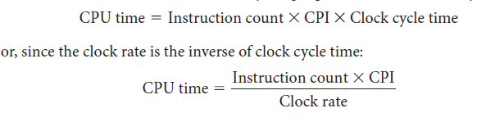
CPI
The term clock cycles per instruction, which is the average number of clock cycles each instruction takes to execute, is often abbreviated as CPI. Since different instructions may take different amounts of time depending on what they do, CPI is an average of all the instructions executed in the program

Slide 23
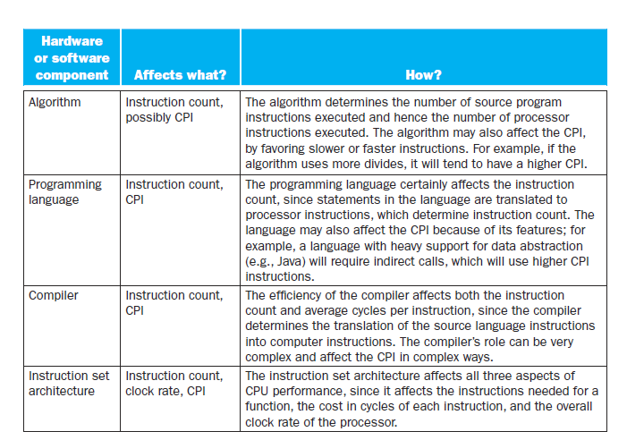

Slide 24
Fallacies and Pitfalls
Pitfall: Expecting the improvement of one aspect of a computer to increase overall performance by an amount proportional to the size of the improvement.
The great idea of making the common case fast has a demoralizing corollary that has plagued designers of both hardware and software. It reminds us that the opportunity for improvement is affected by how much time the event consumes.
A simple design problem illustrates it well. Suppose a program runs in 100 seconds on a computer, with multiply operations responsible for 80 seconds of this time. How much do I have to improve the speed of multiplication if I want my program to run five times faster?

Slide 25
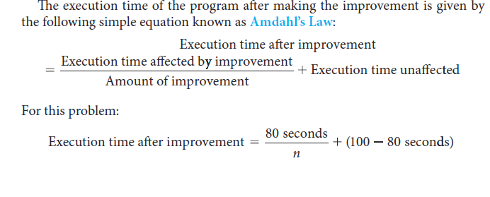
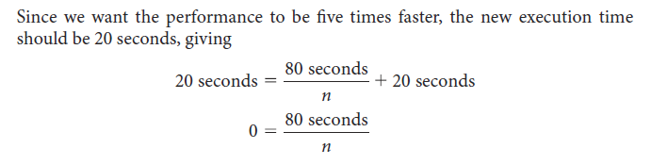
Fallacies and Pitfalls

Slide 26
Fallacies and Pitfalls
We can use Amdahl’s Law to estimate performance improvements when we know the time consumed for some function and its potential speedup.
Amdahl’s Law, together with the CPU performance equation, is a handy tool for evaluating potential enhancements. Amdahl’s Law will be explored in more detail in the exercises. Amdahl’s Law is also used to argue for practical limits to the number of parallel processors.

Slide 27
Fallacies and Pitfalls
Fallacy: Computers at low utilization use little power. Power efficiency matters at low utilizations because server workloads vary. Utilization of servers in Google’s warehouse scale computer, for example, is between 10% and 50% most of the time and at 100% less than 1% of the time.
Fallacy: Designing for performance and designing for energy efficiency are unrelated goals. Since energy is power over time, it is often the case that hardware or software optimizations that take less time save energy overall even if the optimization takes a bit more energy when it is used. One reason is that all of the rest of the computer is consuming energy while the program is running, so even if the optimized portion uses a little more energy, the reduced time can save the energy of the whole system.

Slide 28
Pitfalls and Fallacies
Pitfall: Using a subset of the performance equation as a performance metric. We have already warned about the danger of predicting performance based on simply one of clock rate, instruction count, or CPI. Another common mistake is to use only two of the three factors to compare performance.
Although using two of the three factors may be valid in a limited context, the concept is also easily misused. Indeed, nearly all proposed alternatives to the use of time as the performance metric have led eventually to misleading claims, distorted results, or incorrect interpretations

Slide 29
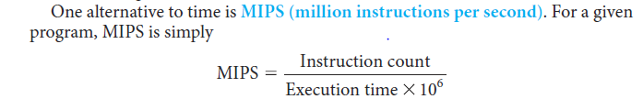
MIPS
Since MIPS is an instruction execution rate, MIPS specifies performance inversely to execution time; faster computers have a higher MIPS rating. The good news about MIPS is that it is easy to understand, and faster computers mean bigger MIPS, which matches intuition.

Slide 30
MIPS
There are three problems with using MIPS as a measure for comparing computers.
First, MIPS specifies the instruction execution rate but does not take into account the capabilities of the instructions. We cannot compare computers with different instruction sets using MIPS, since the instruction counts will certainly differ.
Second, MIPS varies between programs on the same computer; thus, a computer cannot have a single MIPS rating. For example, by substituting for execution time, we see the relationship between MIPS, clock rate, and CPI:

Slide 31

MIPS
Finally, and most importantly, if a new program executes more instructions but each instruction is faster, MIPS can vary independently from performance!

