Slide 1
Predicting best neighborhood to open a restaurant

Slide 2
In this project we will find the best neighbourhood in Pune to open a Fast Food Restaurant .
Work the data
Extracting the required data from Wikipedia url (names of neighborhoods of Pune ) and venues from Foursquare API
Fetch venues of all neighborhoods. On some selected venue categories where we assume number of people visiting will be large , arrange data in such a way that it represents count of venues of that category in that neighbourhood
Obtain score of each neighbourhood by multiplying each neighbourhood with the weights assigned to that select categories.
Get the data
Extract the insights

Slide 3
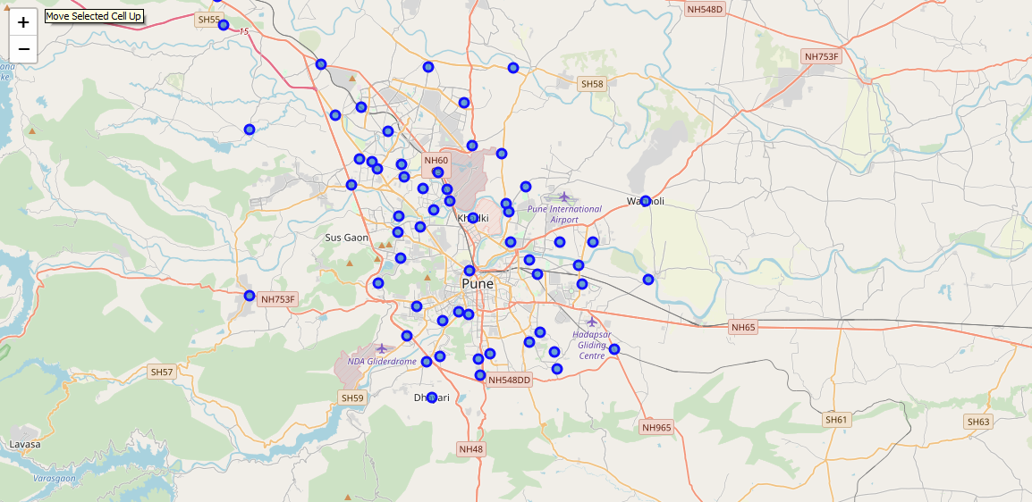
Initially , names of neighbourhoods of Pune are fetched from Wikipedia url . Then the coordinates of these neighborhoods are fetched from Open Street API . Then , we plot the coordinates of each neighborhood of Pune on Map .

Slide 4
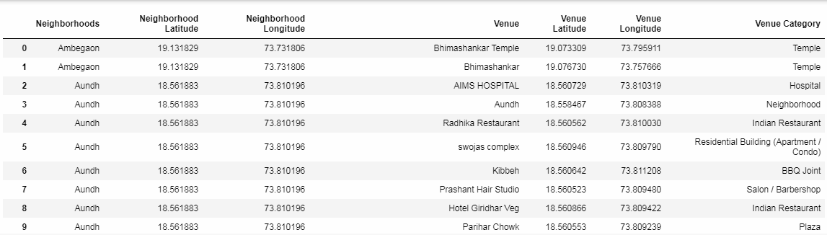
Using Foursquare.com , we will find proximity of various amenities from each neighborhood of Pune . The resulting dataframe will contain following columns – neighborhood name , neighborhood latitude and longitude , venue name ,venue latitude and longitude and venue category

Slide 5
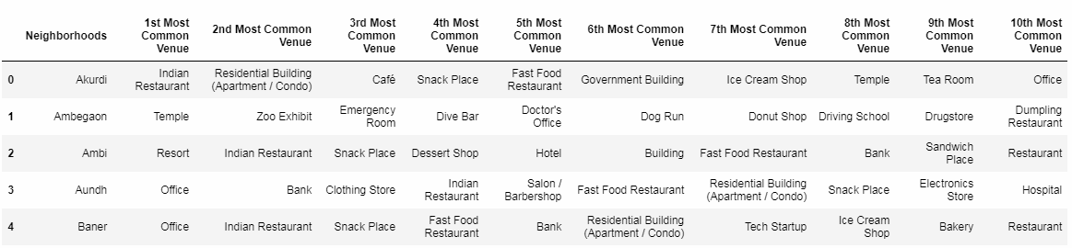
To know which category is the most common in each neighborhood , we will group by dataframe with neighborhood and convert each category in the column “Venue Category” from categorical to numerical, then take the mean for all the columns for each neighborhood . Then for each neighborhood , row is sorted in the descending order in order to get the most common venue .

Slide 6
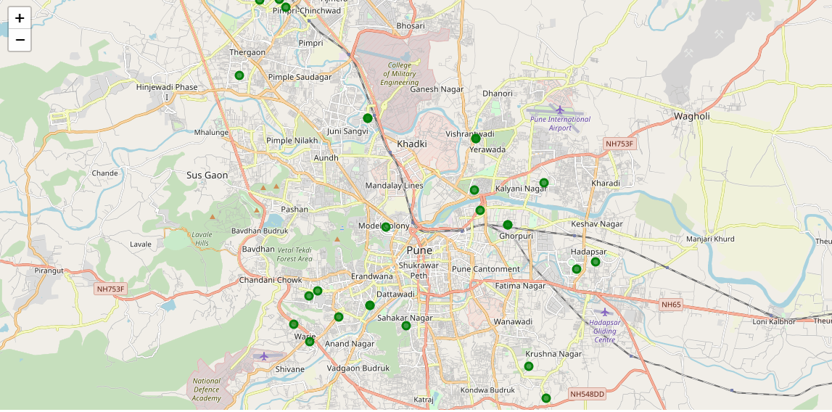
Using Foursquare.com , we will find proximity of all the high schools from all the neighborhood of Pune . On plotting all these locations , we get the below map

Slide 7
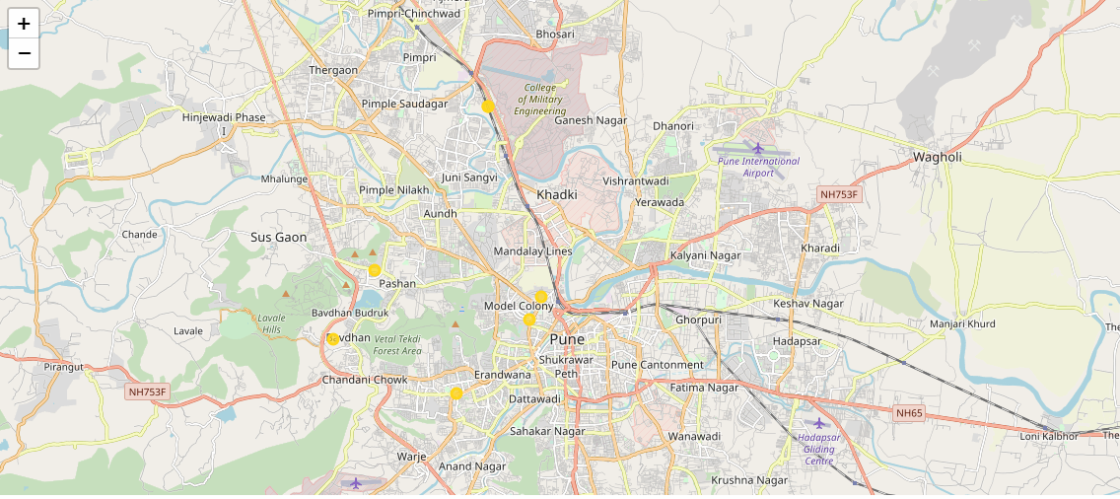
Using Foursquare.com , we will find proximity of all the universities from all the neighborhood of Pune . On plotting all these locations , we get the below map

Slide 8
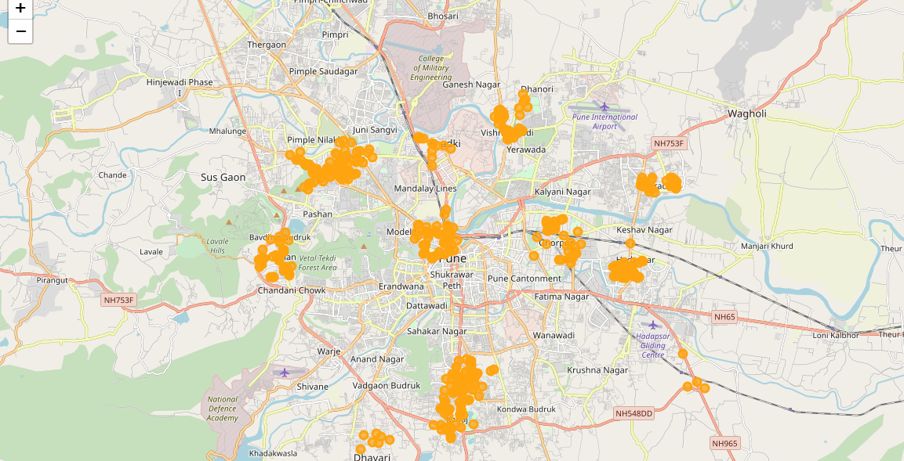
Using Foursquare.com , we will find proximity of all the offices from all the neighborhood of Pune . On plotting all these locations , we get the below map

Slide 9
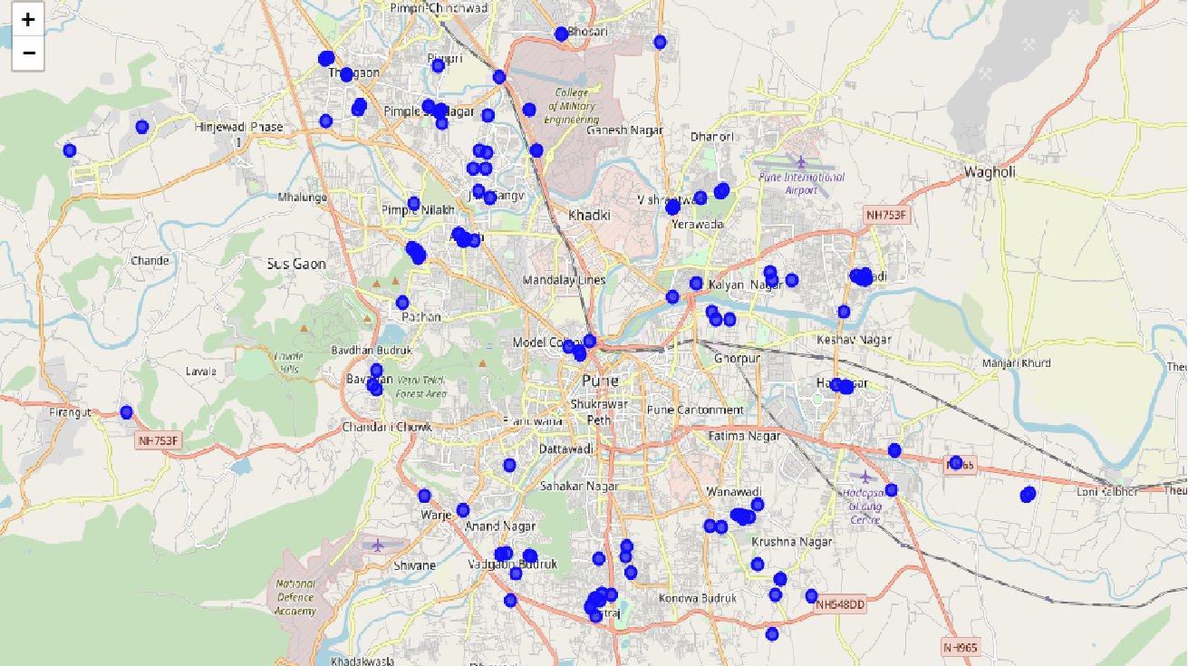
From the dataframe containing all the venues of Pune ,we fetch all the rows which has venue category as fast food restaurant. On plotting all these locations , we get the below map

Slide 10
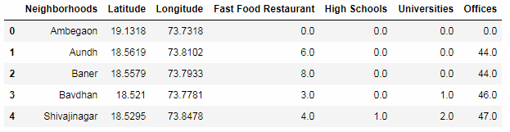
We write a function to add columns (the value of each element is the count of the category for that neighborhood ) of above dataframes into the original dataframe (dataframe which contains coordinates and names of neighborhoods . )

Slide 11
When we multiply these rows with their weights and sum each row , we get a score for each neighborhood. The weights are defined as below :
Schools have been weighted as 1 , since students are good customers.
Universities has been weighted as 1.5 , since college students are also good customers and have better spending ability as compared to school students.
Offices has been weighted as 2 , since employees are even better customers .

Slide 12
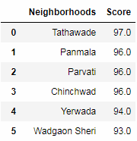
The neighborhood with the maximum score is our desired neighborhood for opening the Fast Food Restaurant for opening the Fast Food Restaurant - “Tathawade” with score of “97.0”
The second best option is “Panmala” with score of 96.0 .

Slide 13
Recommendations
Several more categories can be included for calculating the score of a neighborhood along with schools , universities and offices . For example , there are several more categories like temples, banks ,clothing stores , airports/stations where people generally are present in large numbers. If our restaurant is present is vicinity to all these categories in addition to the ones included before , the accuracy of business solution can increase.
The weights to these categories should be given as per their important and footfall of people around them who will be interested in going to a restaurant .
Client can be asked to merge more than one categories to open a restaurant . For example , if in a neighborhood , two top most categories are Indian Restaurants and Chinese Restaurant . Therefore if a restaurant is opened with both the specialties , there will be extra changes of success because more people can visit the restaurant .

