Slide 1

Veer Surendra Sai University Of Technology, Burla
Submitted To: Dr. DC Rao.
Group members:-
TUSHAR PANIGRAHI : 2102081004
SIMHADRI SANTOSH : 2102081013
SATYAM SIVAM PAL : 2102081021
ASUTOSH PATRO : 2102081024
RAMESH CH. MALLIK : 2203081002
SHailesh MisHra : 2102081011

Slide 2

ClayCode Compiler

Slide 3
Progress:
Week1: Initialized frontend development, completed lexical analysis.
Week2: Advanced to syntax analysis, focused on parser construction.
Week3: Shifted to semantic analysis, refined language semantics.
Week4: Progressed to intermediate code generation, pivotal stage achieved.
Week5: Preparing for backend implementation, finalizing compiler.

Slide 4
Compiler
A compiler is a software program that compiles program source code files into an executable program.
In simple terms, a compiler is a computer program that changes the language in which programs are written into instructions that a computer can use.
It is included as part of the integrated development environment IDE with most programming software packages.
The compiler takes source code files that are written in a high-level language, such as C, C++, or Java, and compiles the code into a low-level language, such as machine code or assembly code.
This code is created for a specific processor type, such as an Intel Pentium or PowerPC. The program can then be recognized by the processor and run from the operating system.

Slide 5
Phases of a compiler:
The compilation process is a sequence of various phases. Each phase takes input from its previous stage, has its own representation of the source program, and feeds its output to the next phase of the compiler. The phases are:-
Lexical Analysis
Syntax Analysis
Semantic Analysis
Intermediate Code Generation
Code Optimization
Code Generation

Slide 6
Features implemented in this project:
This project contains the implementation of the lexical analyzer phase of the C compiler. In our lexical analyzer we have implemented the following functionalities:-
Data Types: int, char data types with all its sub-types. Syntax : int a=3;
Comments: Single line and multiline comments
Keywords: char, else, for, if, int, long, return, short, signed, struct, unsigned, void, while, main
Identification of valid identifiers used in the language
Looping Constructs: It will support nested for and while loops.

Slide 7
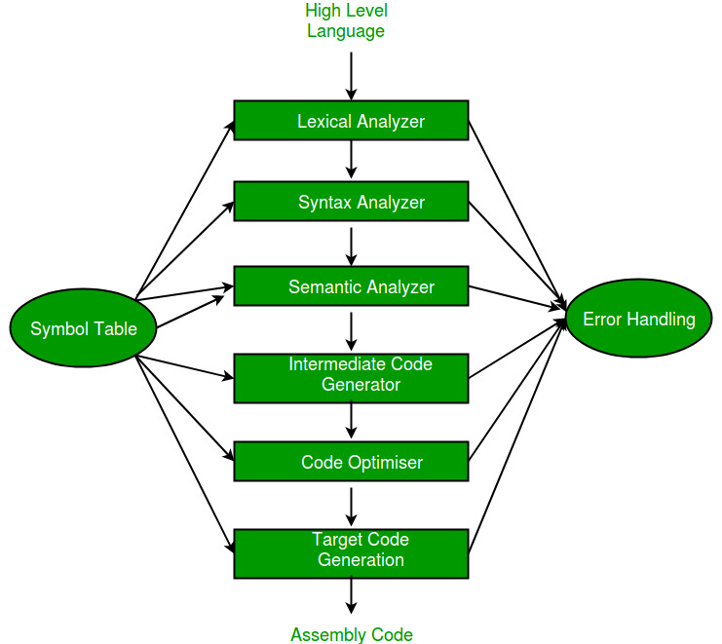

Slide 8
Introduction
Lexical Analysis :
Lexical Analysis is the first process of the compiler.
The input to a lexical analyzer is a high-level language program, such as a ’C’ program in the form of a sequence of characters.
The output is a sequence of tokens, which is passed to the parser for syntax analysis.
The blanks, tabs, newlines, and comments from the source program are removed.
It keeps track of line numbers and associates error messages from various parts of a compiler with line numbers.

Slide 9
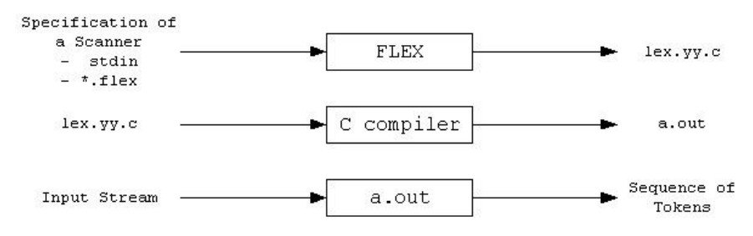
Flex Script
FLEX (Fast LEXical analyzer generator) is a tool for generating scanners. Instead of writing a scanner from scratch, we only need to identify the vocabulary of a particular language (e.g., C language), write a specification of patterns using regular expressions (e.g., DIGIT [0-9]), and FLEX constructs a scanner for us. FLEX workflow depicted as:

Slide 10
Implementation
The Regular Expressions for most of the features of C are fairly straightforward. However, a few features require a significant amount of thought, such as:
The Regex for Identifiers: The lexer must correctly recognize all valid identifiers in C, including the ones having one or more underscores.
{alpha}({alpha}|{digit}|{und})*
Where:-
alpha [A-Z, a-z]
digit [0-9]
und [ _ ]
space [ ]

Slide 11
Multiline comments should be supported
This has been supported by checking the occurence of ‘/*’ and ‘*/’ in the code. The statements between them has been excluded. Errors for unmatched and nested comments have also been displayed.
Literals
Different regular expressions have been implemented in the code to support all kinds of literals, i.e integers, floats, strings, etc. Float : ({digit}+)\.({digit}+)
Error Handling for Incomplete String
Open and close quote missing, both kind of errors have been handled in the rules written in the script.

Slide 12
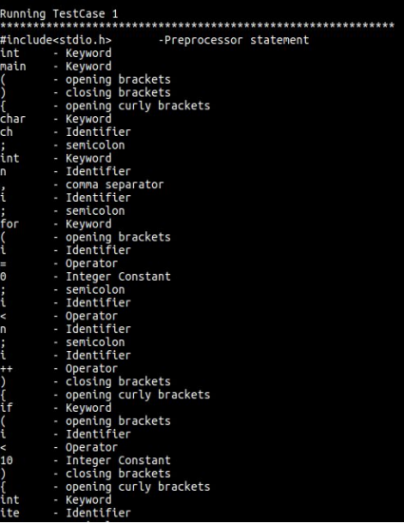
Output :

Slide 13
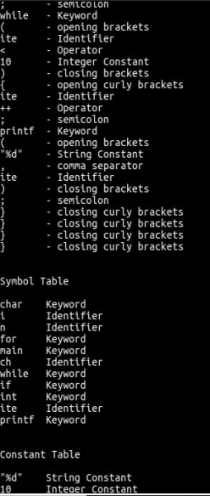

Slide 14
Syntax Analysis
This is Phase Two of the Compiler Designing Process
This phase involved the development of a Parser for C language which makes use of the C lexer to parse the given C input file.
The previous work was concentrated at developing a lexical analyzer(flex script) to generate a stream of tokens from the source code and populate the symbol table.

Slide 15
Introduction
Syntactic Analysis and Parser
The lexical analyzer (flex scripts) returns a stream of tokens, which populates the symbol table.
These tokens are then taken as input by the Parser.
Parser verifies that a string of token names can be generated by the grammar of the source language.
The Parser then reports any syntax errors in an intelligible manner and recovers from the commonly occurring errors to continue processing the remainder of the program.

Slide 16
The Parser recognizes the following types of errors:
Structural errors
Missing identifiers
Wrong keywords
Unbalanced parenthesis
Parser is that phase of compiler which takes token string as input and with the help of existing grammar, converts it into the corresponding parse tree.
Parser is also known as Syntax Analyzer.

Slide 17
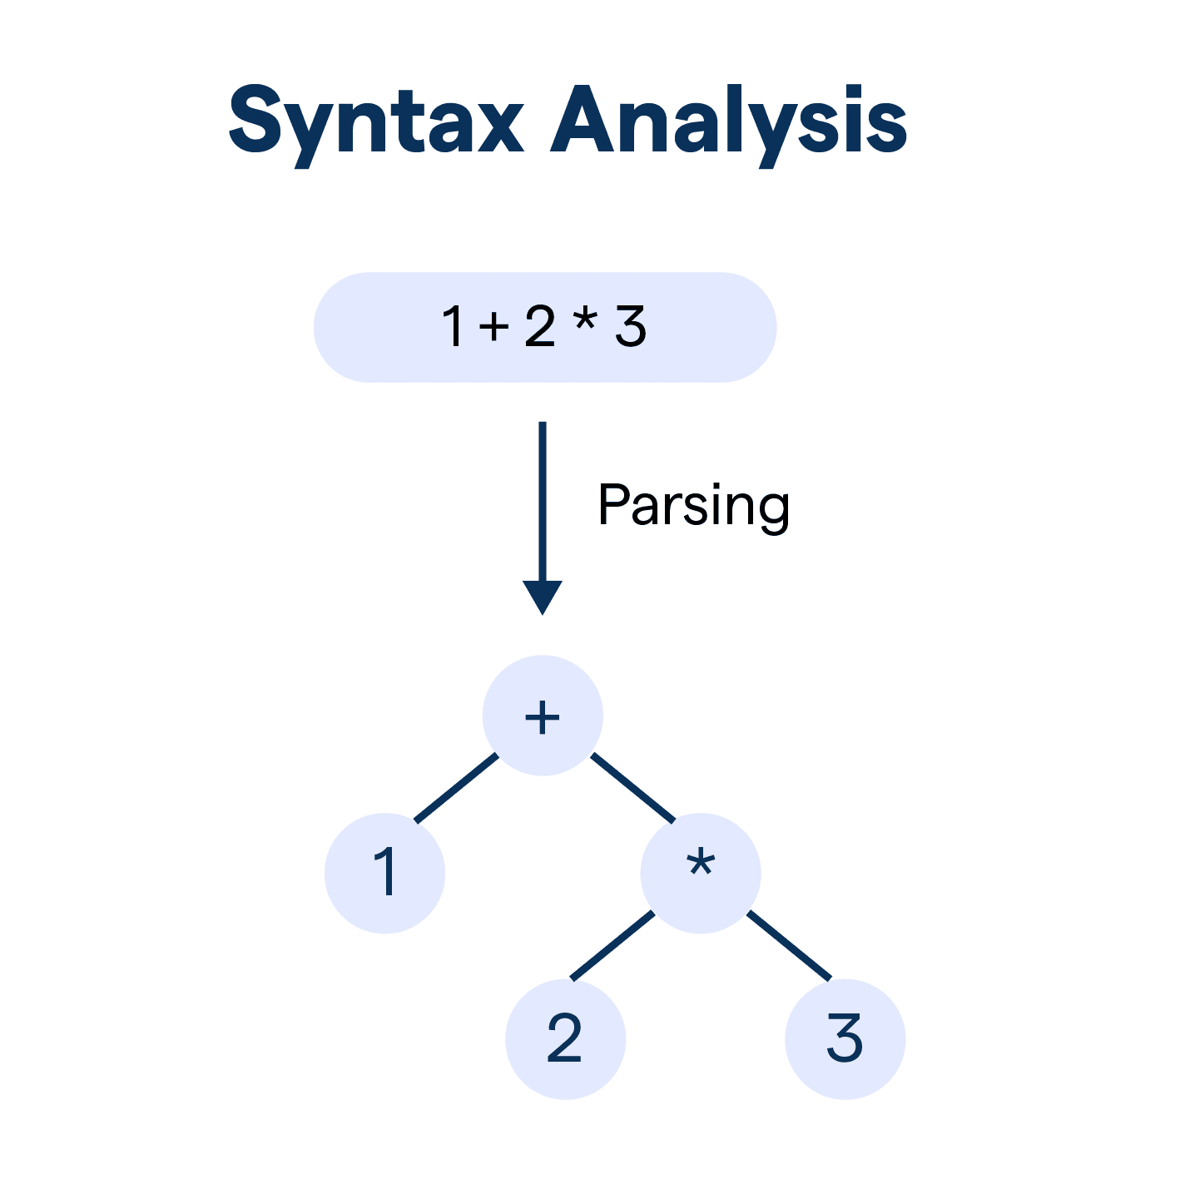

Slide 18
YACC Script
Yacc is written in a portable dialect of C, and the actions, and output subroutine, are in C as well. Moreover, many of the syntactic conventions of Yacc follow C.
Yacc provides a comprehensive tool for imposing structure on the input to a computer program. The Yacc user prepares a specification of the input process; this includes rules describing the input structure, code to be invoked when these rules are recognized, and a low-level routine to do the basic input.

Slide 19
C Program
This section describes the input C program which is fed to the yacc script for parsing. The workflow is explained as under:
Compile Yacc script by this command
$ yacc -d c_parser.y54
2. Compile the flex script using Flex tool
$ flex c_lexer.l
3. After compiling the lex file, a lex.yy.c file is generated. Also, y.tab.c and y.tab.h files are generated after compiling the yacc script.
4. The three files, lex.yy.c, y.tab.c and y.tab.h are compiled together with the options –ll and –ly
$ gcc -o compiler lex.yy.c y.tab.h y.tab.c -ll -ly
5. The executable file is generated, which on running parses the C file given as a command line input
$ ./compiler test.c
The script also has an option to take standard input instead of taking input from a file.

Slide 20
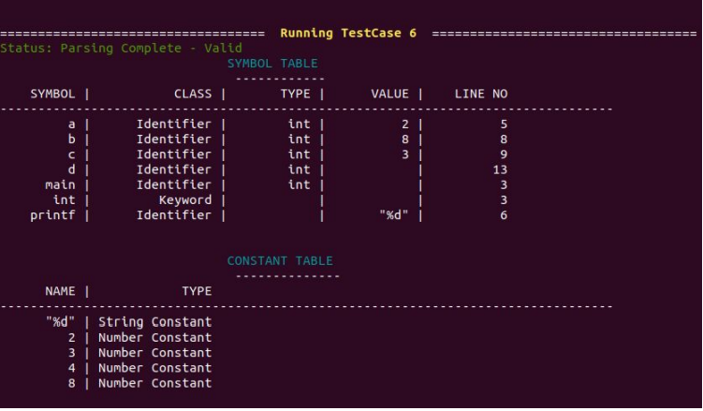
Output:

Slide 21
Semantic Analysis
Ensures program meaning and correctness beyond syntax.
Crucial for detecting and resolving semantic errors.
Type checking, scope resolution, semantic verification.
Integrated with syntactic analysis, symbol table management.
Identifies and reports semantic errors.
Handling complex constructs, ensuring compliance with language standards.

Slide 22
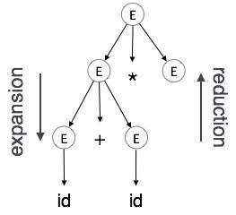
Example:

Slide 23
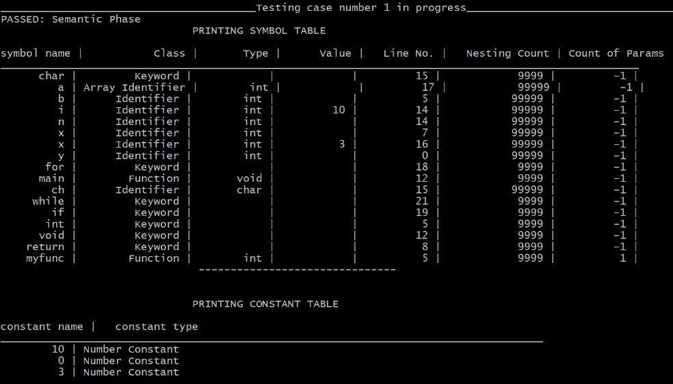
Output:

Slide 24
Intermediate Code Generation
Intermediate Code Generation phase is theglue between frontend and backend of thecompiler design stages. This means that,eventually, the program will have to beexpressed as machine code which can run onthe computer.
Many compilers use a medium level language as a stepping-stone betweenthe high-level language and the very low-levelmachine code. Such stepping-stone languagesare called intermediate code. It provides lowerabstraction from source level and maintainsome high level information

Slide 25
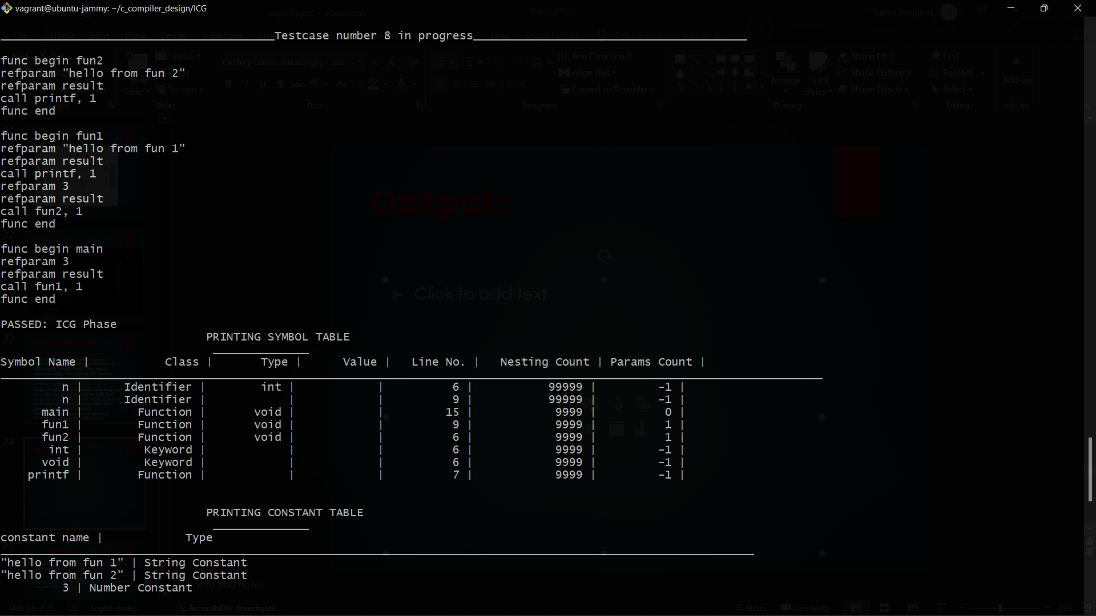
Output:

Slide 26
Future Directions and Conclusion:
Our next steps involve optimizing the compiler, enhancing efficiency, and exploring emerging trends in compiler design.
We are gearing up to tackle the backend implementation of the compiler, marking a crucial phase in completing its development cycle.

Slide 27
THANK YOU…

