Slide 1

Veer Surendra Sai University Of Technology, Burla
Submitted To: Dr. DC Rao.
Group members:-
TUSHAR PANIGRAHI : 2102081004
SIMHADRI SANTOSH : 2102081013
SATYAM SIVAM PAL : 2102081021
ASUTOSH PATRO : 2102081024
RAMESH CH. MALLIK : 2203081002
SHailesh MisHra : 2102081004

Slide 2

ClayCode Compiler

Slide 3
Compiler
A compiler is a software program that compiles program source code files into an executable program.
In simple terms, a compiler is a computer program that changes the language in which programs are written into instructions that a computer can use.
It is included as part of the integrated development environment IDE with most programming software packages.
The compiler takes source code files that are written in a high-level language, such as C, C++, or Java, and compiles the code into a low-level language, such as machine code or assembly code.
This code is created for a specific processor type, such as an Intel Pentium or PowerPC. The program can then be recognized by the processor and run from the operating system.

Slide 4
Phases of a compiler:
The compilation process is a sequence of various phases. Each phase takes input from its previous stage, has its own representation of the source program, and feeds its output to the next phase of the compiler. The phases are:-
Lexical Analysis
Syntax Analysis
Semantic Analysis
Intermediate Code Generation
Code Optimization
Code Generation

Slide 5
Features implemented in this project:
This project contains the implementation of the lexical analyzer phase of the C compiler. In our lexical analyzer we have implemented the following functionalities:-
Data Types: int, char data types with all its sub-types. Syntax : int a=3;
Comments: Single line and multiline comments
Keywords: char, else, for, if, int, long, return, short, signed, struct, unsigned, void, while, main
Identification of valid identifiers used in the language
Looping Constructs: It will support nested for and while loops.

Slide 6
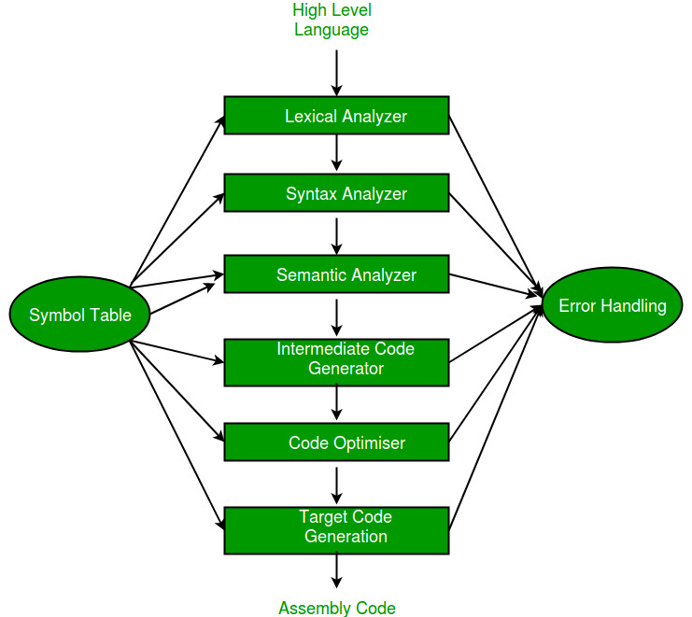

Slide 7
Introduction
Lexical Analysis :
Lexical Analysis is the first process of the compiler.
The input to a lexical analyzer is a high-level language program, such as a ’C’ program in the form of a sequence of characters.
The output is a sequence of tokens, which is passed to the parser for syntax analysis.
The blanks, tabs, newlines, and comments from the source program are removed.
It keeps track of line numbers and associates error messages from various parts of a compiler with line numbers.

Slide 8
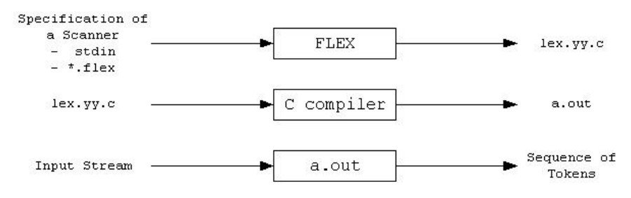
Flex Script
FLEX (Fast LEXical analyzer generator) is a tool for generating scanners. Instead of writing a scanner from scratch, we only need to identify the vocabulary of a particular language (e.g., C language), write a specification of patterns using regular expressions (e.g., DIGIT [0-9]), and FLEX constructs a scanner for us. FLEX workflow depicted as:

Slide 9
Implementation
The Regular Expressions for most of the features of C are fairly straightforward. However, a few features require a significant amount of thought, such as:
The Regex for Identifiers: The lexer must correctly recognize all valid identifiers in C, including the ones having one or more underscores.
{alpha}({alpha}|{digit}|{und})*
Where:-
alpha [A-Z, a-z]
digit [0-9]
und [ _ ]
space [ ]

Slide 10
Multiline comments should be supported
This has been supported by checking the occurence of ‘/*’ and ‘*/’ in the code. The statements between them has been excluded. Errors for unmatched and nested comments have also been displayed.
Literals
Different regular expressions have been implemented in the code to support all kinds of literals, i.e integers, floats, strings, etc. Float : ({digit}+)\.({digit}+)
Error Handling for Incomplete String
Open and close quote missing, both kind of errors have been handled in the rules written in the script.

Slide 11
Error Handling for Unmatched Comments
This has been handled by adding lookahead characters to operator regular expression. If there is an unmatched comment then it does not match with any of the patterns in the rule. Hence it goes to default state which in turn throws an error.
Error Handling for unclean integer constant
This has been handled by adding appropriate lookahead characters for integer constant. E.g. int a = 786rt, is rejected as the integer constant should never follow an alphabet.
User Defined Functions
User-defined functions are also supported. Parsing is done for return type, function name, parameters as well as opening and closing braces. {alpha}({alpha}|{digit}|{und})*\(({alpha}|{digit}|{und}|{space})*\)

Slide 12
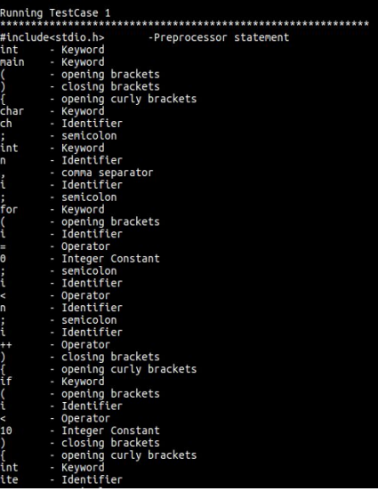
Output :

Slide 13
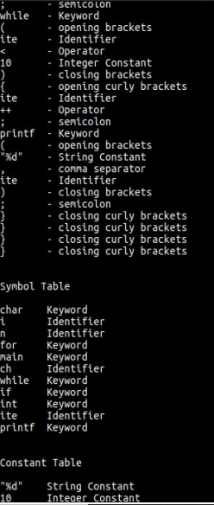

Slide 14
Syntax Analysis
This is Phase Two of the Compiler Designing Process
This phase involved the development of a Parser for C language which makes use of the C lexer to parse the given C input file.
The previous work was concentrated at developing a lexical analyzer(flex script) to generate a stream of tokens from the source code and populate the symbol table.

Slide 15
Introduction
Syntactic Analysis and Parser
The lexical analyzer (flex scripts) returns a stream of tokens, which populates the symbol table.
These tokens are then taken as input by the Parser.
Parser verifies that a string of token names can be generated by the grammar of the source language.
The Parser then reports any syntax errors in an intelligible manner and recovers from the commonly occurring errors to continue processing the remainder of the program.

Slide 16
The Parser recognizes the following types of errors:
Structural errors
Missing identifiers
Wrong keywords
Unbalanced parenthesis
Parser is that phase of compiler which takes token string as input and with the help of existing grammar, converts it into the corresponding parse tree.
Parser is also known as Syntax Analyzer.

Slide 17
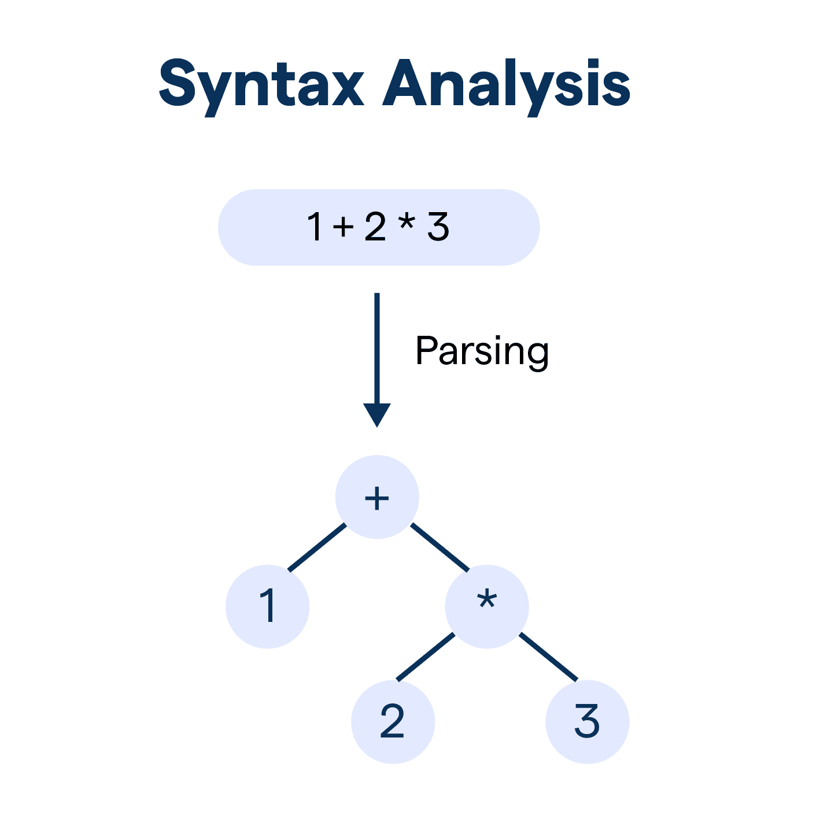

Slide 18
Parser is mainly classified into 2 categories :-
Top-down Parser
Bottom-up Parser.
Top-down Parser
Top-down Parser is the Parser, which generates parse for the given input string with the help of grammar productions by expanding the non-terminals i.e., it starts from the start symbol and ends on the terminals.
Bottom-up Parser
Bottom-up Parser is the Parser that generates the parse tree for the given input string with the help of grammar productions by compressing the non-terminals i.e., it starts from non-terminals and ends on the stat symbol. It uses the reverse of the rightmost derivation.

Slide 19
YACC Script
Yacc is written in a portable dialect of C, and the actions, and output subroutine, are in C as well. Moreover, many of the syntactic conventions of Yacc follow C.
Yacc provides a comprehensive tool for imposing structure on the input to a computer program. The Yacc user prepares a specification of the input process; this includes rules describing the input structure, code to be invoked when these rules are recognized, and a low-level routine to do the basic input.

Slide 20
C Program
This section describes the input C program which is fed to the yacc script for parsing. The workflow is explained as under:
Compile Yacc script by this command
$ yacc -d c_parser.y54
2. Compile the flex script using Flex tool
$ flex c_lexer.l
3. After compiling the lex file, a lex.yy.c file is generated. Also, y.tab.c and y.tab.h files are generated after compiling the yacc script.
4. The three files, lex.yy.c, y.tab.c and y.tab.h are compiled together with the options –ll and –ly
$ gcc -o compiler lex.yy.c y.tab.h y.tab.c -ll -ly
5. The executable file is generated, which on running parses the C file given as a command line input
$ ./compiler test.c
The script also has an option to take standard input instead of taking input from a file.

Slide 21
Rules Section
In this section production rules for the entire C language are written.
The rules are written in such a way that there is no left recursion and the grammar is also deterministic.
Non-deterministic grammar was converted to deterministic by applying left factoring.
This was done so that grammar is for LL(1) parser. This is so because all LL(1) grammar are LALR(1) according to the concepts.
The grammar productions does the syntax analysis of the source code. When a complete statement with proper syntax is matched by the parser.

Slide 22
Result
The Yacc Script was able to successfully parse all the tokens generated the flex script for C.
The type, value, and line of the declaration was returned as an output for all the identifiers and constants present in the program.
To handle the error messages the line number was returned along with the syntax error message.
Thus the following Yacc script is able to parse the tokens and generate error messages for the C program.

Slide 23
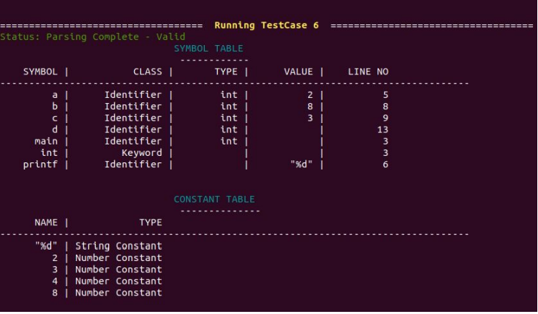
Output:

Slide 24
Semantic Analysis
Ensures program meaning and correctness beyond syntax.
Crucial for detecting and resolving semantic errors.
Type checking, scope resolution, semantic verification.
Integrated with syntactic analysis, symbol table management.
Identifies and reports semantic errors.
Handling complex constructs, ensuring compliance with language standards.

Slide 25
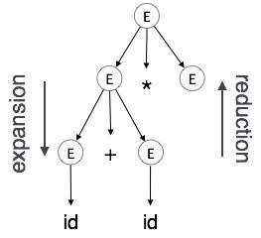
Example:

Slide 26
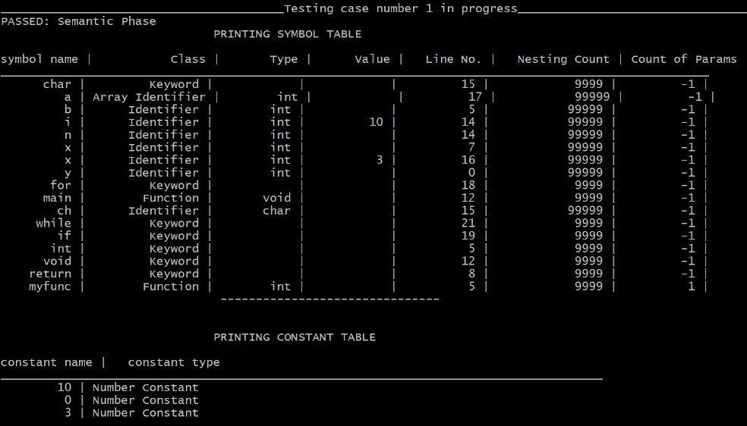
Output:

Slide 27
Future Directions and Conclusion:
Optimization, efficiency improvements, exploring emerging trends.
Semantic analysis vital for program correctness and compiler functionality.

Slide 28
THANK YOU…

