Slide 1
Project Name: Prediction for Credit Card Approval
By Mr. Tushar N. Pendhari
Data analyst

Slide 2
Steps in data science project :-
Problem statement
Data gathering
Exploratory data analysis
Feature engineering
Feature selection
Model training
Model evaluation

Slide 3
1. Problem statement
The primary objective of this project is to predict the approval or rejection of credit card applications.

Slide 4
2. Data gathering
Data is given in .csv format.
For training and testing purpose two separate files are given.
In pandas , we are merging both data frame, because we need to analyze whole data and also need to do EDA and feature engineering altogether .
Used ‘pd.append()’ function

Slide 5
3. Exploratory data analysis
First we are getting insight from categorical data.
Categorical variables from data :-
Gender
Has a car
Has a property
Employment status
Education level
Marital status
Dwelling
Job title

Slide 6
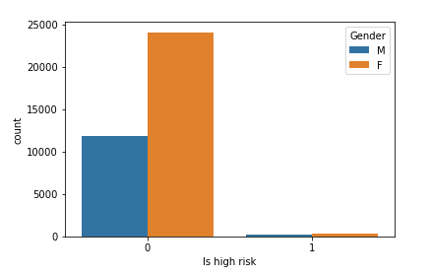
1. Gender
We plot count plot
Gender vs If high risk
Females are low risky applicants
So possibility for females to get credit card approved is more.

Slide 7
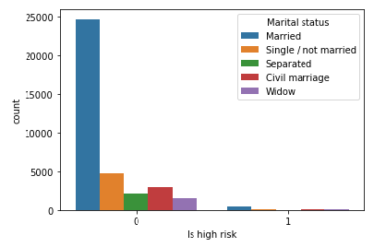
2. Marital status
Married applicants are low risky applicants.
They have higher possibility to get credit card approved.
Percentage of data available for married applicant is more than other applicants.
So data may be bias here.

Slide 8
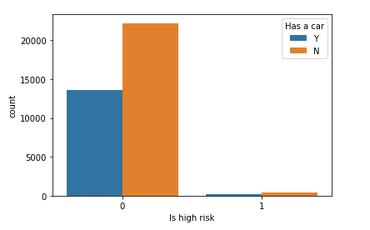
3. Has a car
Applicant with ‘no car’ has higher chances of credit card approved.
Though applicant with ‘a car’ is also have the a chance to get credit card approved.

Slide 9
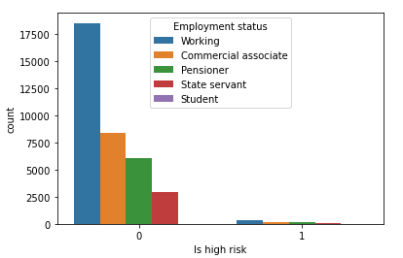
4. Employment status
Higher chances for ’working’ people to get credit card approved,
Followed by ‘commercial associate’, ‘pensioner’, ‘state servant.’
Not much records are available for students. So data may be bias here.

Slide 10
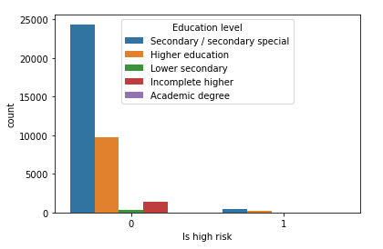
5. Education level
Secondary / secondary special :- 24777
Higher education :- 9864
Incomplete higher :- 1410
Lower secondary :- 374
Academic degree :- 32
More data is available for ‘secondary level education.’
We may say that data is imbalance here.

Slide 11
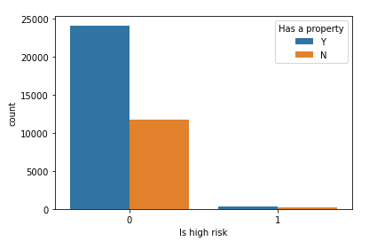
6. Has a property
Applicant with ‘property’ have more chances of getting credit card approved than applicant with ‘no property.’

Slide 12
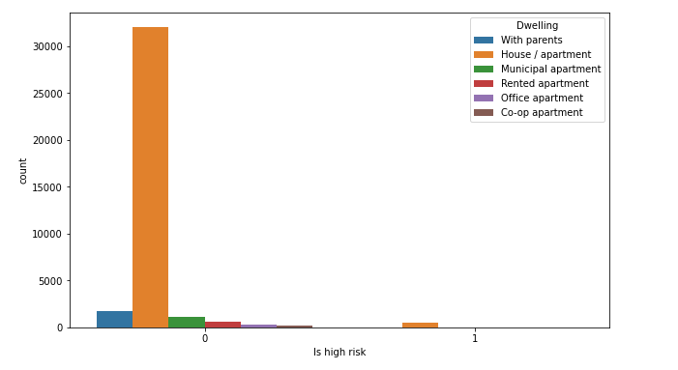
7. Dwelling
Too much data is available for ‘house/apartment’ holder.
Data might mislead here.

Slide 13
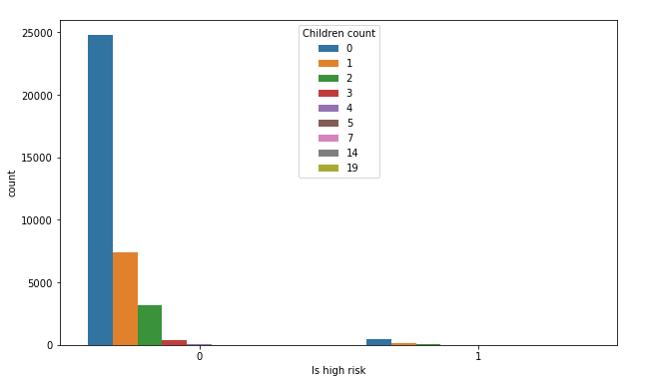
8. Children count
Applicant with ‘0’ children count has higher chances of getting credit card approved.
Also more data is available for applicant with ‘0’ children count.
Though this attribute looks like a numerical variable, but it is a categorical variable.

Slide 14
Conclusion from data analysis :-
From above all analysis, we can say that our data is imbalance.
Much more data is available for ‘low risky’ applicant that ‘risky’ applicant.
And that we can see in many attributes.
That hampers our accuracy.
So we need to balance the data to get good results.
That we can do after splitting the data.

Slide 15
4. Feature engineering
Here we are going to handle ‘missing values’, ‘outliers.’
Also changing attributes with ‘object’ data type with ‘integer’ data type.
Methods available for this :-
1. Label encoder.
2. One hot encoder.
3. We can also use ‘replace()’ function.

Slide 16
Using replace() function , we handled following attributes :-
Gender .
Has a car.
Has a property.
Employment status.
We did this, because above mention first three attributes contains binary categorical data, and the last one contains five unique values.
So it is easy to use for those attributes than contains such a low number of categorical data.

Slide 17
For following categorical variable, we used ‘Label encoding’ technique.
Education
Marital status
Dwelling
Job title
Here we use ‘Label encoder’, all above categories contains ordinal data, where categories are naturally in order.
We didn’t use ‘one hot encoding’ technique, because it creates additional columns in the data, that increases the complexity of the model.

Slide 18
Handling missing values :-
In our dataset, only one attribute contains missing values or null values i.e. ‘Job title.’
‘Job title’ is a categorical variable.
So it is better to replace null values with mode.
Mode :- ‘Laborers’ category

Slide 19
Handling outliers :-
Two methods :-
1. IQR(Interquartile range)
2. Z-score
We used IQR(Interquartile range) method.

Slide 20
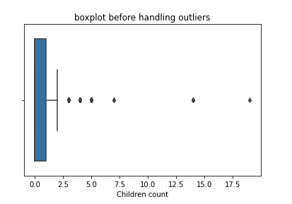
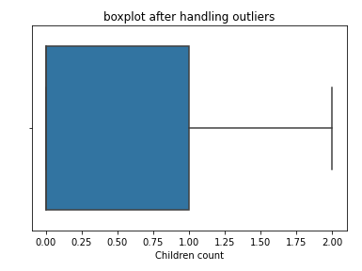
Children count :-
From boxplot we say that outliers are completely removed.
We used IQR (Interquartile range) method.
It’s a numerical discrete variable.
We used mode value to replace outliers.

Slide 21
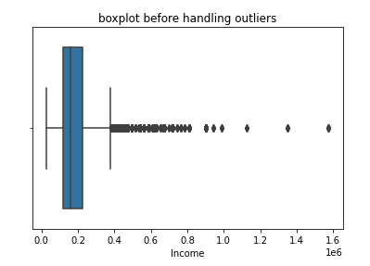
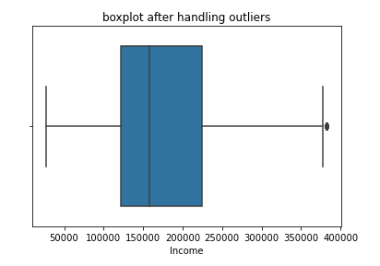
Income
It is a numerical variable, values are continuous in nature.
We replace outliers with median().
After handling it, many outliers are removed, but still some outliers are present.

Slide 22
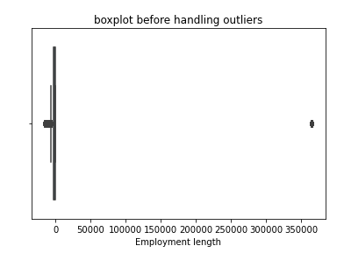
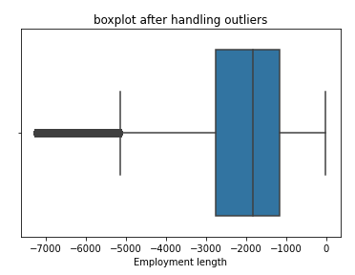
Employment length
It is continuous numerical variable.
Here also we used median().
Some outliers are still there.

Slide 23
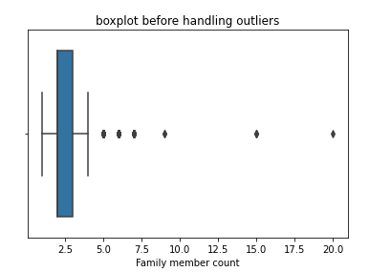
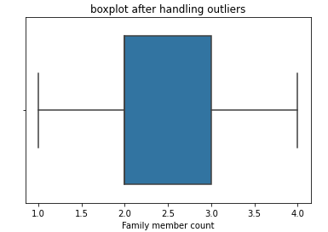
Family member count
It is numerical categorical variable.
So we replace outliers with model value.
We can see from boxplot, that outliers are completely removed.

Slide 24
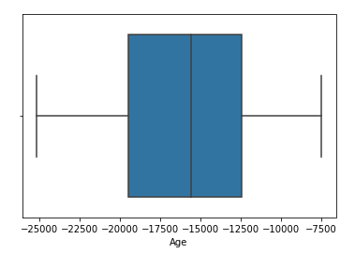
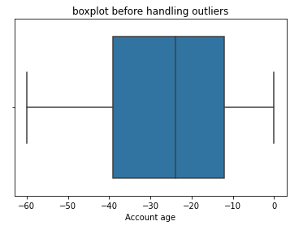
Age
Account age
Attribute ‘Age’ not contain any outlier.
Attribute ‘Account age’ not contain any outlier.

Slide 25
5. Feature selection
We are keeping all attributes to evaluate our model.
If the accuracy hampers, then will decide further.

Slide 26
6. Model training and Evaluation
Splitting data in ‘x’ and ‘y’.
Our target column ‘y’ is ‘Is high risk’.
Balancing the data :-
As we can see in data analysis, that our data is quite imbalance. To balance this data we used “SMOTE” technique.
We used oversampling for this.
We don’t use under-sampling, because in this we lost some important data, and it is not a good practice.
Then we do train_test_split.

Slide 27
Decision tree
Before hyper-parameter tuning :-
Testing accuracy :- 97.05
Training accuracy :- 99.94
After hyper-parameter tuning :-
min_samples_split': 2,
'min_samples_leaf': 3,
'max_depth': 9,
'criterion': 'gini'
Testing accuracy:- 82.46
Training accuracy:- 83.39
It increases the bias i.e. training error

Slide 28
Random forest :-
Before hyper-parameter tuning :-
Testing accuracy :- 98.74
Training accuracy :- 99.94
After hyper-parameter tuning :-
Best parameters :-
'n_estimators': 69, 'min_samples_split': 8,
'min_samples_leaf': 5,
'max_depth': 9,
'criterion': 'entropy‘
Testing accuracy :- 88.92
Training accuracy :- 89.39
It increase the bias i.e. training error.

Slide 29
Adaboost :-
Before hyper-parameter tuning :-
Testing accuracy :- 80.34
Training accuracy :- 81.30
After hyper-parameter tuning :-
Best parameter :-
'n_estimators': 77,
'learning_rate': 3
Testing accuracy :- 58.56
Training accuracy :- 62.35
It drastically increases the bias i.e. training error.

Slide 30
Conclusion :-
We have calculated accuracies for ‘Decision tree’, ‘Random forest’, and ‘Adaboost’ algorithm .
We can say that algorithm ‘Random forest’ is best suited for dataset and gives us best results.
After hyper-parameter tuning of all the models, we see that accuracy decreases and also increases the training error i.e. bias.
So we prefer the model without hyper-parameter tuning.

