Slide 1
Project Name: Sales Forecasting for Furniture Store
By Tushar N. Pendhari
Data Analyst

Slide 2
Steps in data science project :-
Problem statement
Data gathering
Exploratory data analysis
Feature engineering
Feature selection
Model training
Model evaluation

Slide 3
1. Problem statement
For a retail furniture store, predicting future sales is critical to avoiding inventory issues like overstocking or under-stocking.
So forecasting the sales of a furniture store to avoid above mention issues.

Slide 4
2. Data Gathering
Retail furniture store data is given.
It is in .csv format.
To read data in pandas , we used [encoding='latin-1‘]

Slide 5
3. Exploratory Data Analysis
We are trying to get some insights from data.
Some are categorical variables and some variables are continuous numerical variable.
Some variables contains dates which is in ‘object’ format, we need to convert it to ‘date-time’ format, then extracting important data from it.
Data doesn’t contains any null values.
We are dropping some variables which are not that much important for our prediction.

Slide 6
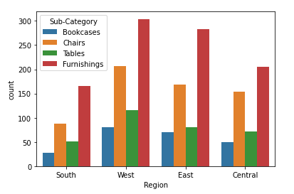
A. Data visualization
Region V/s Sub-category
Four region :- south, west, east, central.
Four sub category :- bookcases, chairs, tables, furnishings.
In all region, furnishing has more sales than other category.
In all region, lower sale is happen for bookcases.
Sale volume of sub-categories is different for different regions.
Among all region, west region has more sale volume in every sub-category.
Recommendation :-
Store need to focus on increasing sales in south and central region.
Also make a strategy to increase volume of sale for every sub-category item.

Slide 7
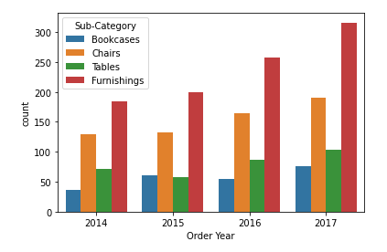
Order Year v/s sub-category
Volume of sale is increasing in every succeeded year.
‘Bookcase’ sale is much lower than other category followed by ‘Tables’.
Recommendation :-
Retail store needs to focus on increasing ‘Bookcase’ and ‘Table’ sales.

Slide 8
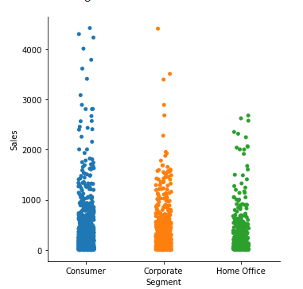
Segment v/s Sales :-
Volume of sales for ‘Home Office’ customer has lower than other two category.
Also sales above 3000 is much lower for all segment category.
Much sale is confined between 0 – 2000
Recommendation :-
Need to focus on increasing the share of ‘Home Office’ in sales.

Slide 9
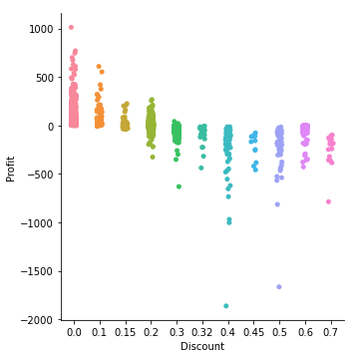
Discount v/s Profit :-
As discount increases, profit decreases.
Discount between 0 to 0.15, shows sale occurs at positive gain.
After 0.20 discount , profit margin shows negative trend.
Recommendation :-
Try to increase profit margin beyond 0.20 discount.

Slide 10
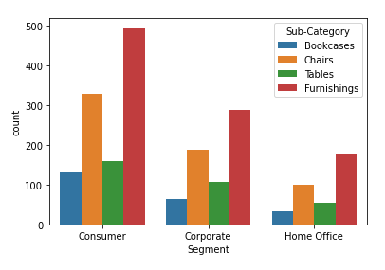
Segment v/s Sub-category :-
Every segment buys more furnishing items, followed by chairs, tables, bookcase.
For every segment, bookcase is lower sale item.
Recommendation :-
Try to increase customer base of ‘Home Office’ segment.
Also try to increase the sales of chairs, tables and bookcases.

Slide 11
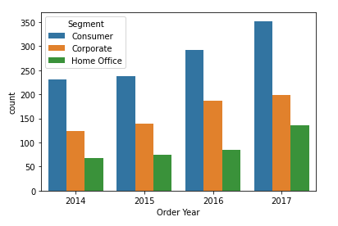
Order Year v/s Segment :-
For every succeeding year, share of customer in every segment is increased than that of previous year.
Customer base of ‘Home Office’ segment is much lower that other two segment.
Recommendation:-
Try to increase customer base in ‘Home Office’ segment and also in ‘corporate’ segment.

Slide 12
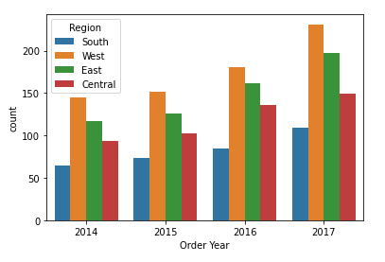
Order Year v/s Region :-
For every succeeding year, customer base is increased in all regions than the previous year.
‘West’ zone has strong customer base for retail store followed by ‘East’ zone.
‘South’ region has lower customer base than other regions.
Recommendation :-
Try to focus on increasing customer base from ‘South’ region.

Slide 13
4. Feature engineering
1. converting object data-type to date-time format :-
Some variables contains dates, but they are in ‘object’ data-type. So we need to convert it to ‘date-time’ data-type, and after that extracting information we need.
Order date
Ship date
We extract separate ‘Day’, ‘Month’ and ‘Year’ from above two mention variables.

Slide 14
2. Encoding :-
Converting ‘object’ data-type to ‘int’ data-type.
Used for categorical variable which has ‘object’ data type.
Label encoding :-
Used where variable contains ordinal data.
Ordinal data means information contains in a variable has following a specific order.
Variables :- ship mode, Region.
To avoid complexity of the model, we applied ‘label encoder’ on some other variables that doesn’t contains ordinal data. Because, if we apply ‘one hot encoding’ there, it increases number of columns in the data. That makes our model too complex.
Variables :- city, state, product name,

Slide 15
One hot encoding :-
Used where variable doesn’t contains ordinal data.
Some variables not contains ordinal data, but we didn’t used ‘one hot encoding’ there. Those variables contains lots of unique values. If we apply there , it increases model complexity.
Variable :- Sub-Category(used one hot encoder)
Variables :- city, state, product name(used label encoder)
Replace function :-
Used on some variables to convert ‘object’ data type into ‘int’ data-type.
Variables :- segment, category, country.

Slide 16
3. Handling outliers :-
IQR(Interquartile Range ) :-
Q1 = 25 percentile
Q2 = 75 percentile
IQR = Q3 – Q1
Lower_range = Q1 – 1.5(IQR)
Upper_range = Q3 + 1.5(IQR)
If value lower than lower_range or greater than upper_range, then the value is considered as a outlier.
Z_score method :-
Z_score =
(X – mean)/std. deviation
Threshold
If value of z_score is greater than specific threshold value, then it considered as a outlier.

Slide 17
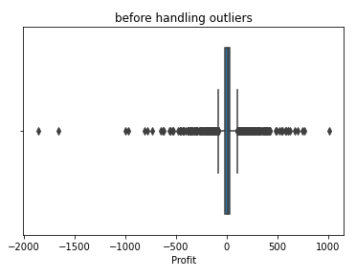
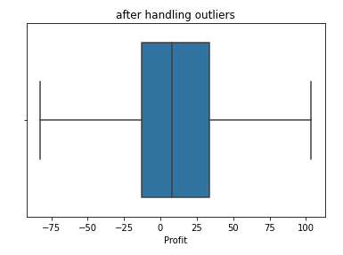
Profit :-
We used IQR method.
From boxplot we can see that, the range of an outliers is large.
25 percentile :- -12.849 75 percentile :- 33.7266 Lower Range :- -82.7123 Upper Range :- 103.589
First we impute outliers with median value, still outliers are present.
So capping outliers to upper and lower range , that completely removes outliers. We can see it from boxplot.

Slide 18
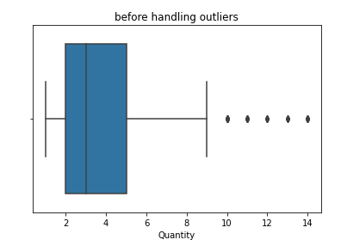
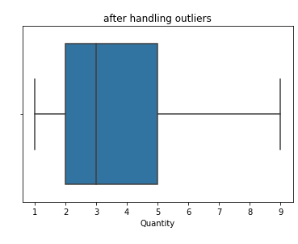
Quantity :-
It is a numerical discrete variable, so considering it as a numerical categorical variable.
Imputing outliers with mode.
25 percentile :- 2.0
75 percentile :- 5.0
lower range :- -2.5
upper range :- 9.5
Mode = 3
From boxplot, we see that outliers are completely removed.

Slide 19
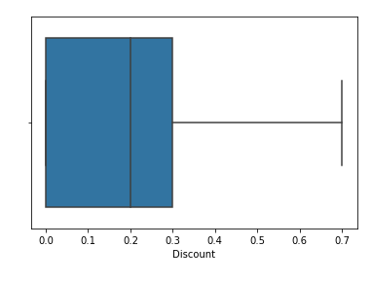
Discount :-
Variable ‘Discount’ not contain any outliers.

Slide 20
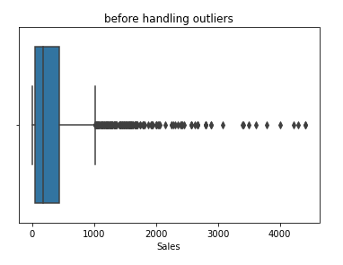
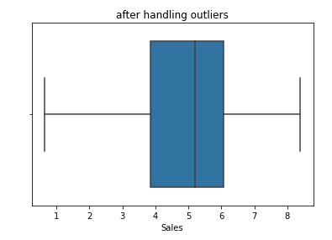
Sales :-
Checking outliers for target variable.
From boxplot, we say that outliers are present. And range of outliers is also large.
Here we are not trying to manipulate target variable data. Because with this, we may get good accuracy for training data but will not robust for unseen data and it will make errors.
So either we are using log transformation or removing extreme values from target variable.
We are using log transformation.
From second boxplot, we see that outliers are tackled completely using log transformation.

Slide 21
5. Feature selection
Methods :-
Filter method :-
Coefficient of correlation
Information gain method
Annova test
Missing value ratio
Chi-square test
Wrapper method :-
Forward selection
Backward selection
Embedded method :-
Regularization etc

Slide 22
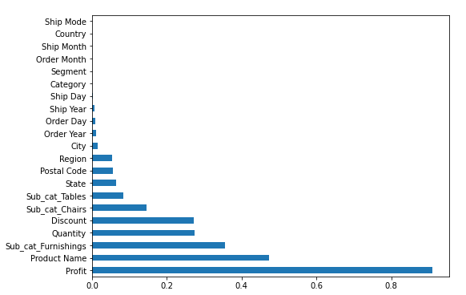
Information gain method :-
Library :- [ from sklearn.feature_selection import mutual_info_regression]
Based on the graph we keep those attributes that are important and drop those attribute which are not much of importance.
Here we are keeping all attributes.

Slide 23
6. Model training and evaluation
Random forest :-
Testing :- 89.44
Training :- 98.37
After hyper-parameter:-
Testing :- 88.41
Training :- 93.65
Adaboost :-
Testing :- 82.03
Training :- 83.28
After hyper-parameter:-
Testing :- 82.51
Training :- 84.22

